Slide 1
CONVOCATION
Academic Year 2021 - 2022

Slide 2
Welcome to the 2021-22 Academic Year!

Slide 3
Breakout Session
Check-in:
How are you showing up to this new academic year?
If you had two wishes for our college, what would they be?

Slide 4
Highlights 2020-21
Supporting Students Through the Pandemic:
Technology loaner program for students
Wi-Fi internet accessibility added to Parking Lots C and D
COVID-19 giving initiative raised over $11k
Tutoring support and embedded tutoring
SmartShop Workshops
The Market (free food distribution)

Slide 5
Highlights 2020-21
Supporting Students Through the Pandemic:
COVID-19 testing on-campus
COVID-19 Town Hall for students and families
COVID-19 vaccine distribution on-campus

Slide 6
Highlights 2020-21
Our Call to Action:
President’s Task Force
President’s Speaker Series
ConnectUp
BlacknessXEnglish
21st Century Policing Program, Community Voices Series
Black Cultural Resource Center

Slide 7
Highlights 2020-21
Institutional Priorities:
Educational Master Plan
Accreditation Kick-off
Guided Pathways – Year of Action
Academic & Career Pathways
Program Mapper
Career Coach
Persistence Project

Slide 8
Highlights 2020-21
New Programs and Course Offerings:
First Shop Iron workers Cohort Apprenticeship Program
Actors Conservatory
Certificate of Achievement in Artificial Intelligence
Red Hat Linux Administration Certification
Management Information Systems (MIS) Certification
Automotive Non-Credit Programs
Social Justice Students: LGBTQ Studies AA-T
Elementary Teacher Education AA-T

Slide 9
Highlights 2020-21
New Programs and Course Offerings:
Marketing Certificate
Customer Services Certificate and Small Business Management Certificate
LPC Honors Transfer Program Certified Inaugural Class of UCLA TAP Applicants
Campus Hill Winery offers First-Ever Wine Sale

Slide 10
Highlights 2020-21
College Events & Activities:
Romeo & Juliet Virtual Production
Honoring Women Veterans
Walk 2.2 for Vets
Baby Mine Virtual Choir
Vocal East Jazz Ensemble Performance
Black History Month: Honoring Leaders, Legends & Legacies
Literary Arts Festival

Slide 11
Highlights 2020-21
Honors & Awards:
LPC Named the 14th Best Community College in the Country; 5th Best Community College in California
42nd Edition of Havik and 15th Edition of Naked Magazine
Talk Hawks Soar at Asynchronous and Synchronous Tournaments
Talk Hawks Finish with Gold Medal at the RHI RHO PI National Championship Tournament

Slide 12
Highlights 2020-21
Facilities Projects:
2420 Lecture Hall Renovation/Replacement of Audio/Visual System
Mammoth Bones display on campus
LPC Architecture Barriers Project 1600 Building
Kinesiology Lab Project
Installation of Art on Campus Mural Project

Slide 13
Highlights 2020-21
Construction Begins for New Projects:
Academic Support and Faculty Building
Temporary Faculty Office Complex
AG SCI: Horticulture Project
Public Safety Complex/Advanced Manufacturing & Transportation Project
Emergency Call Station Project

Slide 14
Highlights 2020-21
Community Partnerships:
Tri-Valley Non-Profit Alliance MOU to establish the formal cross-marketing relationship and partnership certificate program
San Jose Evergreen Community College MOU to continue the formal working relationship with the Silicon Valley Career Pathways Consortium Partners
Ohlone Community College District and LPC’s Engineering Technology Learning Community Agreement
Federal Bureau of Prisons Contract Agreement to offer non-credit Business Certificate courses

Slide 15
Highlights 2020-21
Community Partnerships:
National University Agreement allowing LPC Pubic Safety students to apply their transfer requirements to National University
ISA and Courses with Livermore-Pleasanton Fire Department
LLNS (LLNL) Student Internship Agreement

Slide 16
Highlights 2020-21
Federal Stimulus Funds:
CARES Act Institutional Portion Grant ($4,547,129)
Emergency Financial Aid Grants to Students ($1,437,746)

Slide 17
Highlights 2020-21
Student Support:
Virtual Welcome Center
General Information
Library
Computer Center
Student Communication/Texting Tool in Canvas (Pronto)
LPC Parent & Families Information Night
Purchased 500 laptops for new students from Tri-Valley

Slide 18
Highlights 2020-21
Recognitions & Celebrations:
What’s Right at LPC
Ceremonies:
Virtual Commencement Ceremony for 2020 and 2021
Black Graduation Celebration
CDC Preschool Graduation
LPC Fire Academy Graduation

Slide 19
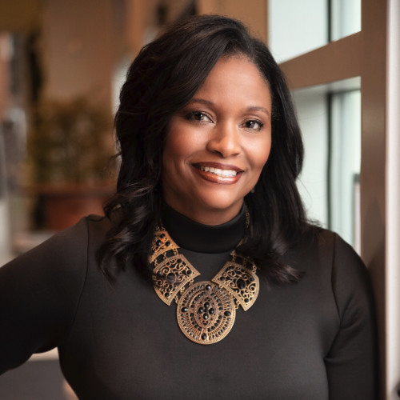
New Faces on Campus
Dr. Jeanne Wilson
Vice President of Student Services

Slide 20
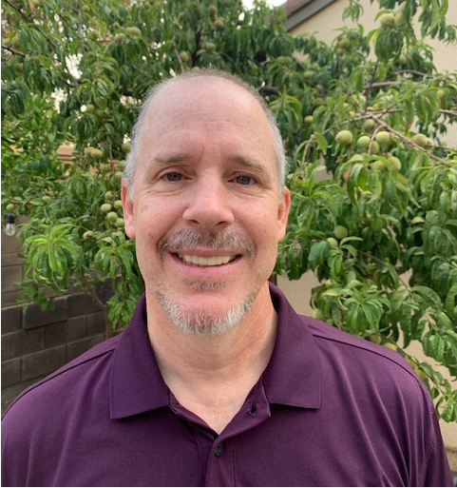
New Faces in Student Services
Christopher Crone
DSPS Director

Slide 21
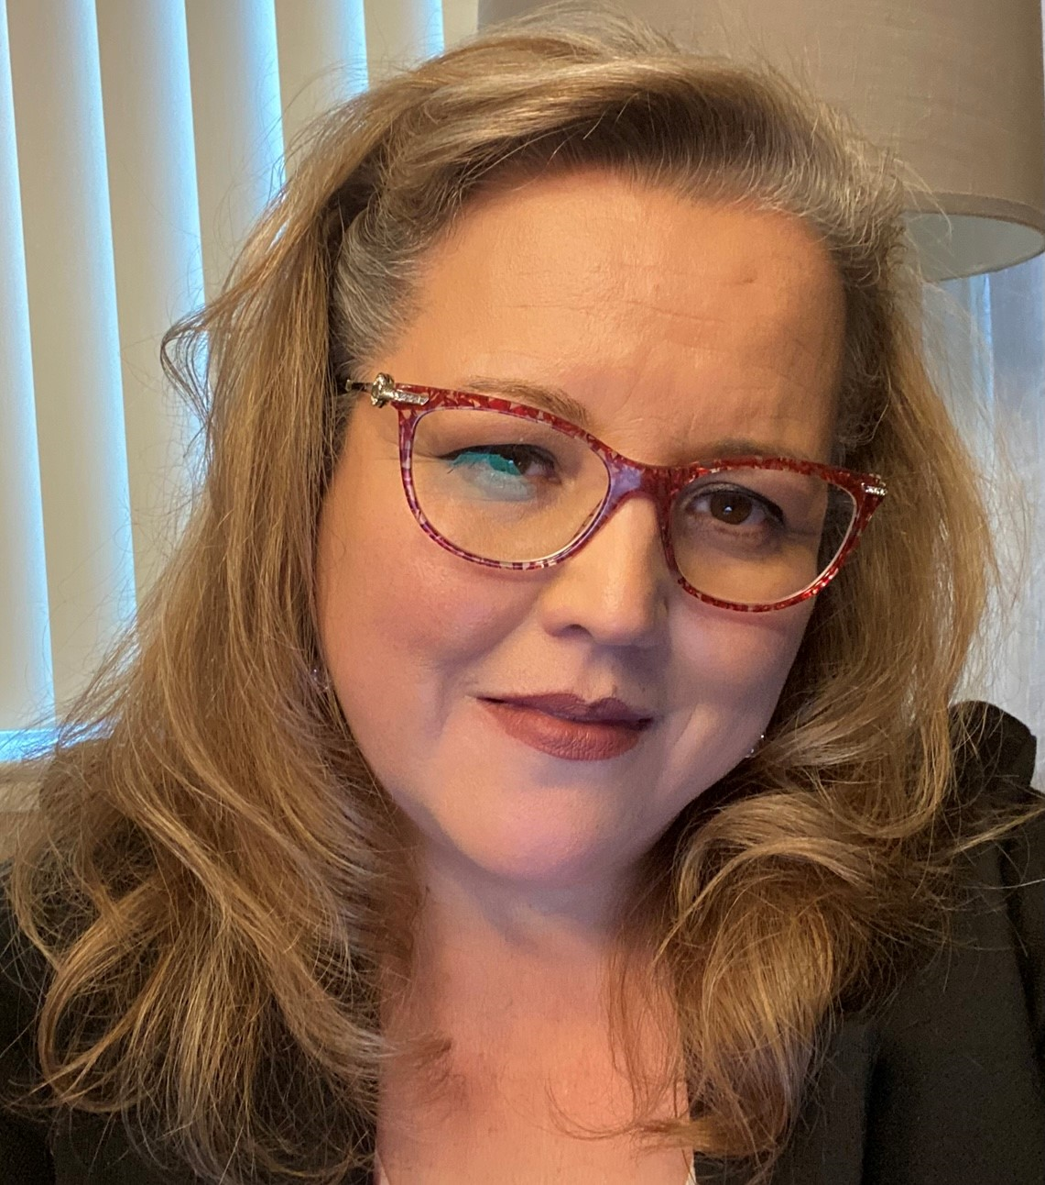
New Faces in Student Services
Nora Angel
Sr. Admin. Assistant
Counseling
LaShawn Raybon
Sr. Admin. Assistant
Enrollment Services

Slide 22
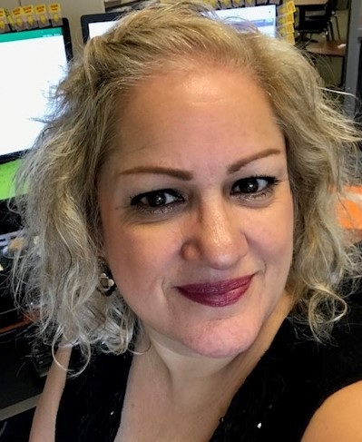
New Faces in Student Services
Yvette Nahinu
Executive Assistant
Vice President of Student Services

Slide 23
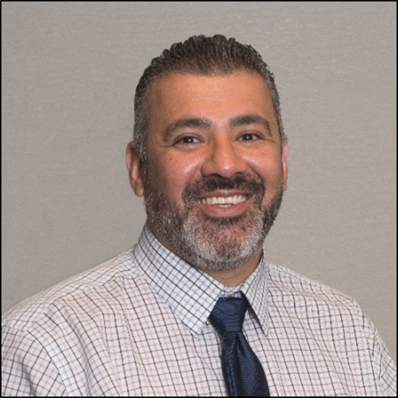
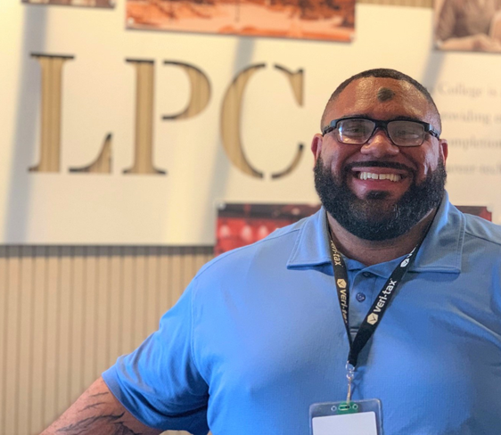
Promotions
Nalan Smith
Financial Aid Advisor II
Mike Alvarez
Assessment Specialist

Slide 24
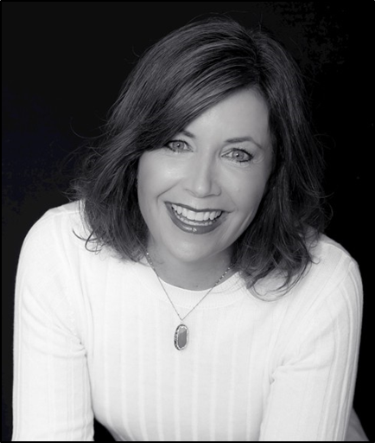
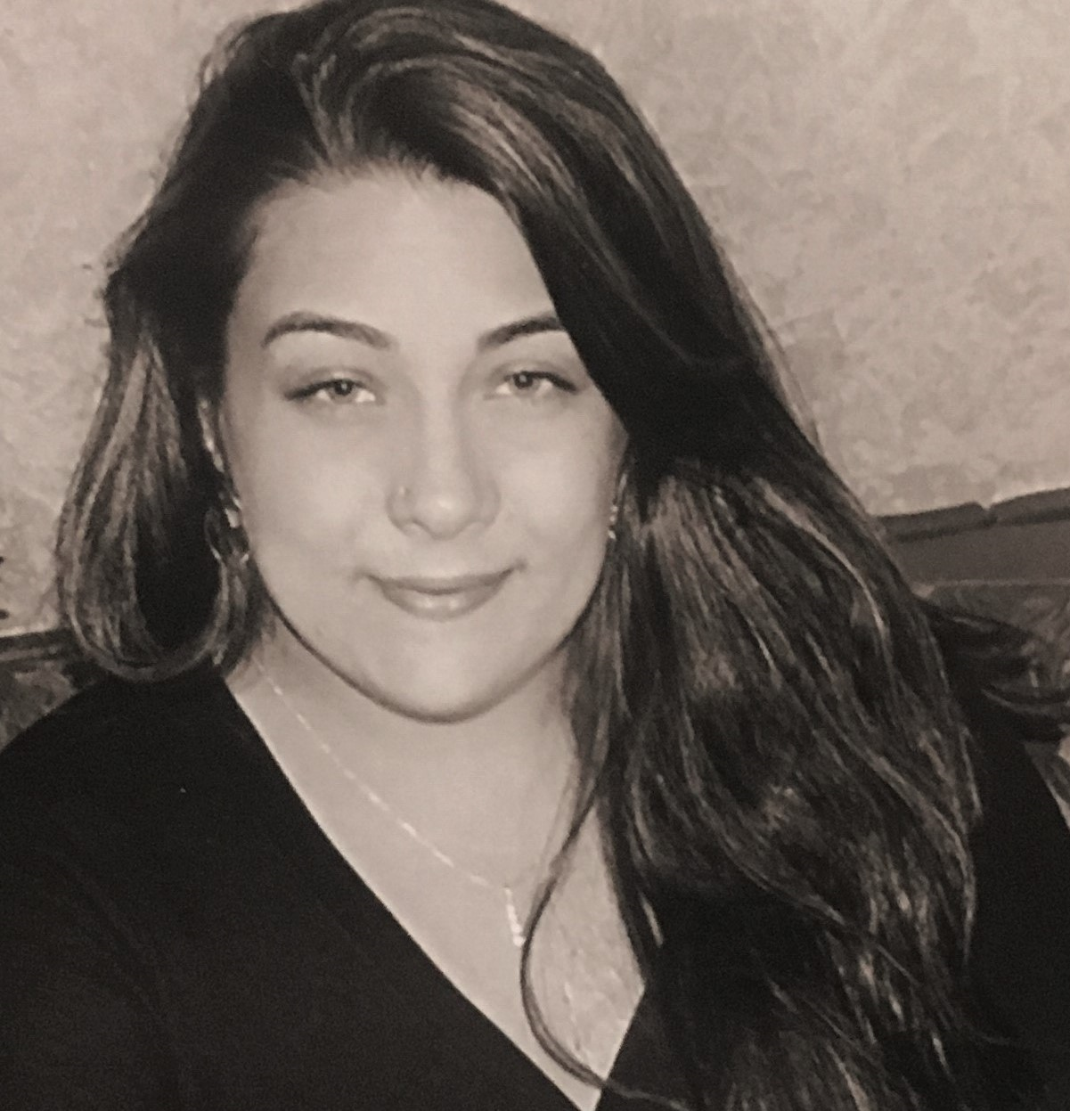
New Faces on Campus
Danielle Banuelos
Sr. Admin. Assistant
Academic Services

Slide 25
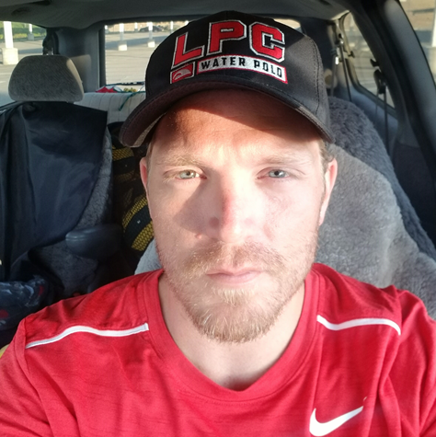
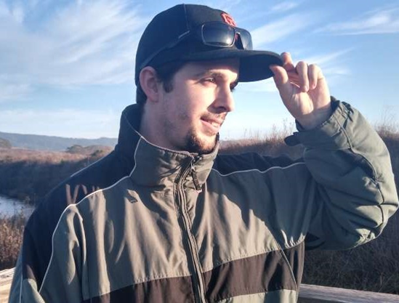
New Faces on Campus
Ryan Wheeler
Laboratory Technician
Biology & Chemistry
Nathan Brandon
Assistant Coach/Athletic Assistant

Slide 26
Promotions
Elizabeth McWhorter
Curriculum and Student Learning Outcome Specialist

Slide 27
Fall Enrollment
Dr. Thomas Orf

Slide 28
Enrollment Numbers
SUMMER 21 |  |  | FALL 21
FTES | 694.52 |  | FTES | 2551.35
Fill Rate | 79.23% |  | Fill Rate | 78.16%
# of Sec | 192 |  | # of Sec | 782
Down 9.32%
Down 12.74%
SUMMER 20 |  |  | FALL 20
FTES | 765.94 |  | FTES | 2923.87
Fill Rate | 91.13 |  | Fill Rate | 88.83%
# of Sec | 175 |  | # of Sec | 798
Fall ‘21 compared to Fall ’19: 17.82% Decline
Summer ‘21 compared to Summer ’19: 8.80% Increase

Slide 29
Enrollment Considerations
Review scheduling patterns to reduce class conflicts for Spring 2021
Target campus-wide productivity: 490 WSCH/FTEF
Consider class size and fill rates
Targeted outreach and in-reach efforts
Due to enrollment reductions at CSUs and other 4-year institutions, we may see an increase in enrollments in specific disciplines for Spring 2021

Slide 30
Rajinder Samra
Director, Research, Planning & Institutional Effectiveness

Slide 31
Student Senate Leaders 21-22
Kyle Johnson
President
Yasmeen Ibrahim
Director of Legislature
Lara Wiedemeier
Vice President
Amy Attia
Director of Events
Sara Kim
Student Trustee
Tyler Rivas
Inter-Club Council Chair

Slide 32
Classified Senate Leaders 21-22
Elizabeth McWhorter
Vice President Fundraising
Jean O’Neil Opipari
President
Daysi Valle Treasurer
Carmen Ortiz
Aubrie Ross
Ambassadors

Slide 33
Sarah Thompson
Academic Senate, President

Slide 34
Academic Senate Leaders 21-22
Sarah Thompson President
Collin Thormoto
Secretary
Tracey Coleman President Elect
Ashley Young
Treasurer
Craig Kutil
Vice President (Fall)

Slide 35
A Look Ahead to College Day (8:30 AM)
Welcome
State of the College – President Foster
A Call to Action (Accomplishments/Reflections) – President Foster
Guided Pathways: Student Success Teams
Break
Guided Pathways: Student Experiences
Lunch
Breakout Sessions

Slide 36
Thank you!
Looking forward to seeing you all tomorrow!

