Slide 1
California Community Colleges

Slide 2
Why National University
Veteran Founded in San Diego in 1971
We are now one of the largest private, nonprofit universities in California
Regionally accredited by WSCUC
Offers 100+ Associates, Bachelor’s, Master’s, & Certificate programs
Local support, global reach
30,000+ students annually
Average student is 32 years old
Over 150,000 alumni, and growing
One course per month
Flexible schedule
Onsite, Online, and Hybrid classes
Affordable and Accessible

Slide 3
CALIFORNIA COMMUNITY COLLEGE & NATIONAL UNIVERSITY
Highlights and High-Level Goals
Create and offer more than 24 Associate Degree for Transfer (ADT) pathways
Develop partnerships with community colleges and other public university systems
Effectively advance student success from point of entry to completion
Associate Degree for Transfer Scholarship
Transfer to Success Scholarship
CC Employee Scholarship
CC Employee Spouse & Dependents Scholarship

Slide 4
Great Choice for Working Professionals
Fully accredited, which means your classes and instructors meet high standards and your education is respected and transferable
Year-round enrollment allows you to begin your education whenever personal and work schedules allow
Four-week one-course-per-month format provides concentrated learning allowing students to focus on one subject at a time and complete a full course in a single month
Classes offered online or onsite with 20 locations in California

Slide 5
Offering 100+ degree programs
College of Letters and Sciences
College of Professional Studies
Department of Engineering & Computing
Department of Healthcare & Human Services
Department of Professional Studies
Department of Business & Management
Sanford College of Education

Slide 6
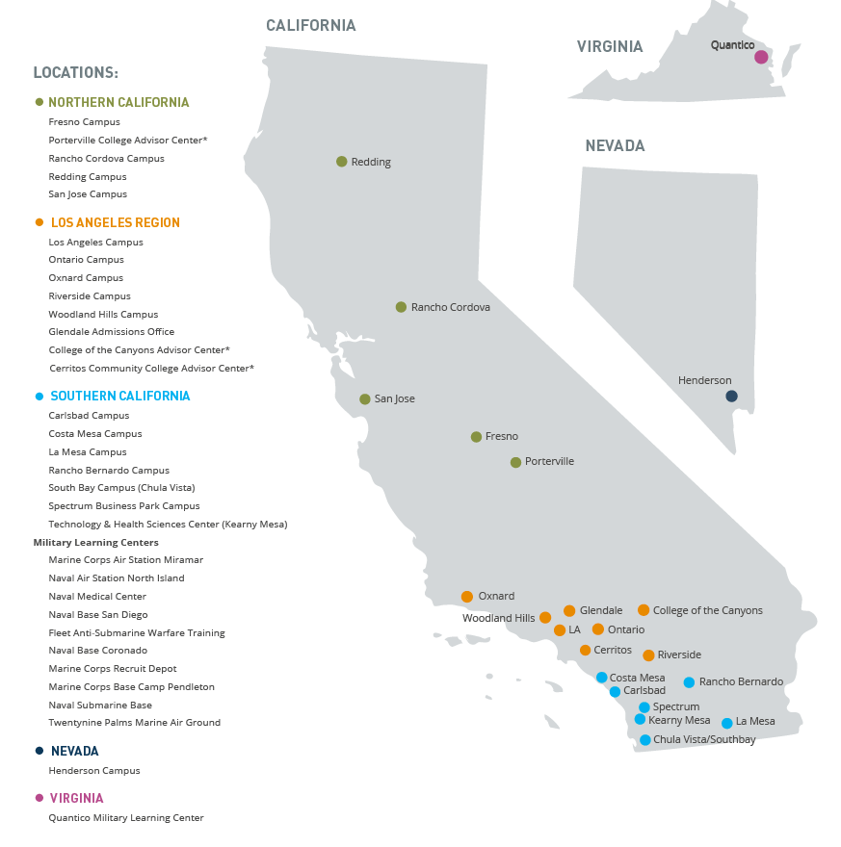
Accessibility
National University is committed to accessibility and features over 20 campus location across California and in Nevada, many of which feature student lounges, computer labs, and writing and math center.

Slide 7
How to get started
Contact a National University
Admissions Advisor:
(855) 355-6288
Email:
advisor@nu.edu

Slide 8
Admissions Process at NU
Complete the online application for admission
Meet with an Enrollment Advisor at your convenience campus
Submit official transcripts

Slide 9
THANK YOU
Notes:
All Team

