Slide 1
Facilities Modernization Program
Funded by Measure A
Project Report
August 26, 2019

Slide 2
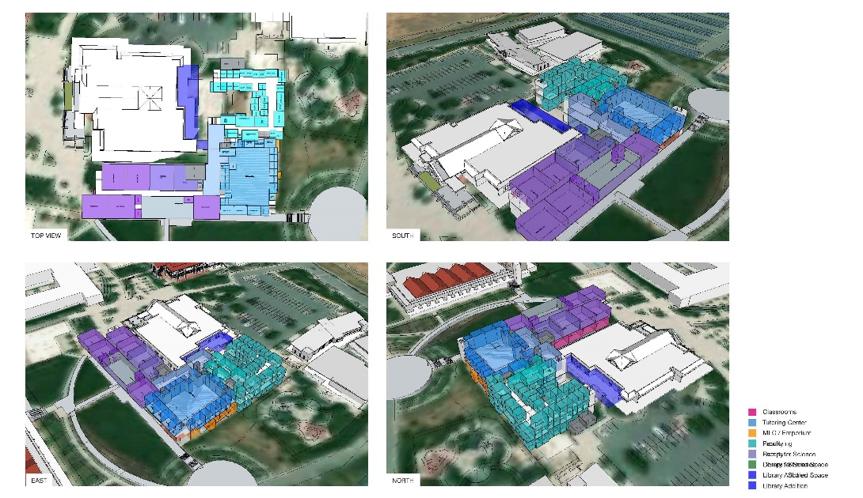
PROJECT PROGRESS REPORT
B2100 New Academic Support and
Office Building
LAS POSITAS COLLEGE
August 26, 2019
Project Team:
Architect: LPAS
Project / Construction Manager: Construction Services, Inc.
Contractor: TBD
Project Description:
The new Academic Support and Office building will be built in the location of existing buildings 2100 & 2200. The project consists of the following elements and programs: English Center incorporating classrooms, computer lab, tutoring and study areas. Math Center incorporating classrooms, labs and the Math X program. Computer Sciences Center including computer labs, networking, maker space and open labs with the expanded of library functions including reference desk, study areas, computer lab, expanded staff offices and library operational support spaces. Faculty Offices, Dean’s suite and support spaces will also be in the building.
Project Update:
Project Programming of the building was completed in May 2019. Schematic design is in progress. User Group meetings continue.
Programming: Completed
Schematic Design 09/2019
Design Development 10/2019
Construction Documents 05/2020
DSA Permit Approval: TBD
Construction Start TBD
Occupancy TBD

Slide 3
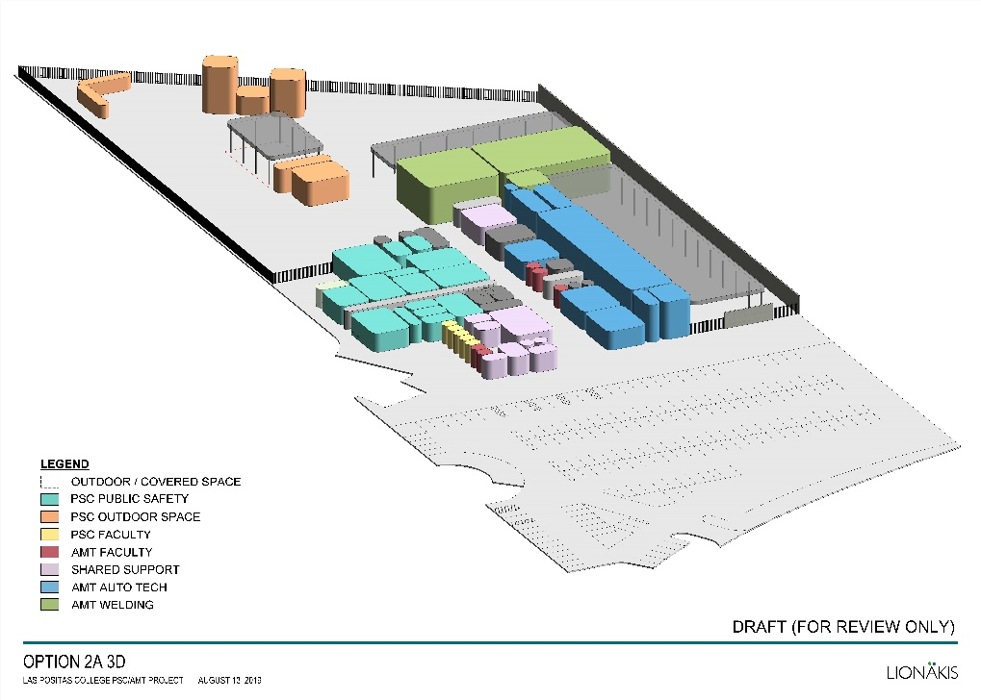
PROJECT PROGRESS REPORT
Public Safety Complex /
Advanced Manufacturing and Transportation
LAS POSITAS COLLEGE
August 26, 2019
Project Team:
Architect: Lionakis
Project / Construction Manager: Construction Services, Inc.
Contractor: TBD
Project Description:
The new Public Safety Complex (PSC) and Advanced Manufacturing and Transportation (AMT) building will be co-located to allow for shared linkages between the various programs, classrooms and event spaces. The building will be built near the existing sports fields in the northeastern portion of the upper campus. The PSC project consist of the following elements and programs: EMS Simulation Lab and Situation Rooms, and a new fire tower that includes a Class A burn area. The AMT project will include an automotive tech facility, welding lab, and classroom and lab spaces to provide training of advanced manufacturing processes. Faculty Offices, Dean’s suite and support spaces will also be included in the project.
Project Update:
Project Programming of the building was completed in July. Schematic Design is underway with User Group meetings continuing.
Programming: Completed
Schematic Design 09/2019
Design Development 10/2019
Construction Documents 06/2020
DSA Permit Approval: TBD
Construction Start TBD
Occupancy TBD

Slide 4
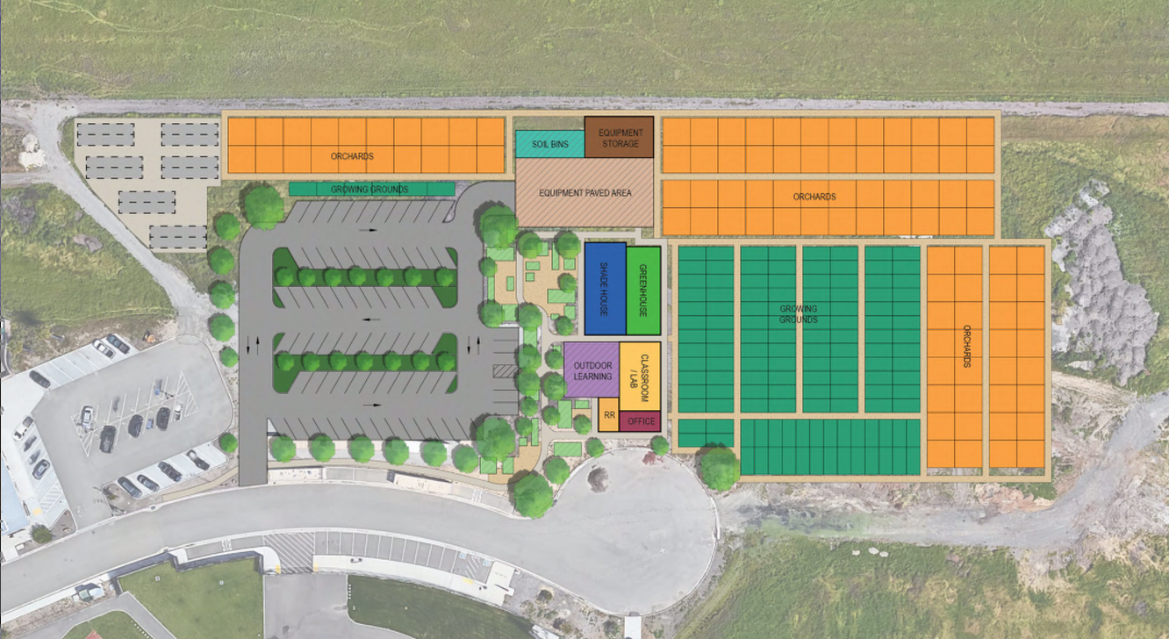
PROJECT PROGRESS REPORT
AG SCI: Horticulture Facility Project
LAS POSITAS COLLEGE
August 26, 2019
Project Team:
Bridging Architect: ATI Architects and Engineers
Construction Manager: Roebbelen (RCMS)
Contractor: TBD
Project Description: The New Horticulture Facility Building is a 2,900 SF facility which includes classroom/lab spaces, offices and a resource library. The project includes an extensive outdoor facility such as greenhouse, shade house, outdoor learning patio, equipment storage and as well as 40,000 SF orchards and 24,000 SF growing grounds. The facility will be located in the northeastern side of the upper campus.
Project Update:
Project Kick-off meeting occurred at the beginning of August 2019. Programming of the building has started, with weekly User Group meetings.
Programming 08/2019
Schematic Design 09/2019
Design Development 10/2019
Construction Documents 01/2020
Construction Start TBD
Occupancy TBD

Slide 5
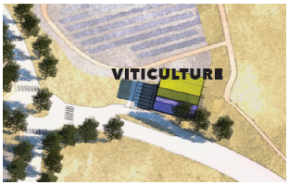
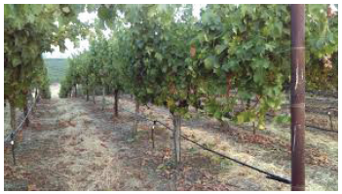
PROJECT PROGRESS REPORT
AG SCI: Viticulture Facility Project
LAS POSITAS COLLEGE
August 26, 2019
Project Team:
Bridging Architect: TBD
Construction Manager: Roebbelen (RCMS)
Contractor: TBD
Project Description: The New Viticulture Facility will replace the existing facilities currently located in/outside of Bldg. 800. The Viticulture Facility will be located at the main entrance to the campus off of Campus Hill Road. The New Facility will be developed at the higher elevation allowing for expansive views, user experience, and gravity assist production facilities. The New Facility will be approximately 6,700 SF will incorporate instructional classrooms, production teaching winery, barrel storage, outdoor patio, processing areas, hospitality and bottle storage.
Project Update:
Design Proposals received in August 2019. Interviews were held on Friday August 23, 2019. Anticipated Board Approval at the September 2019 Board Meeting.
Programming TBD
Schematic Design TBD
Design Development TBD
Construction Documents TBD
Construction Start TBD
Occupancy TBD

Slide 6
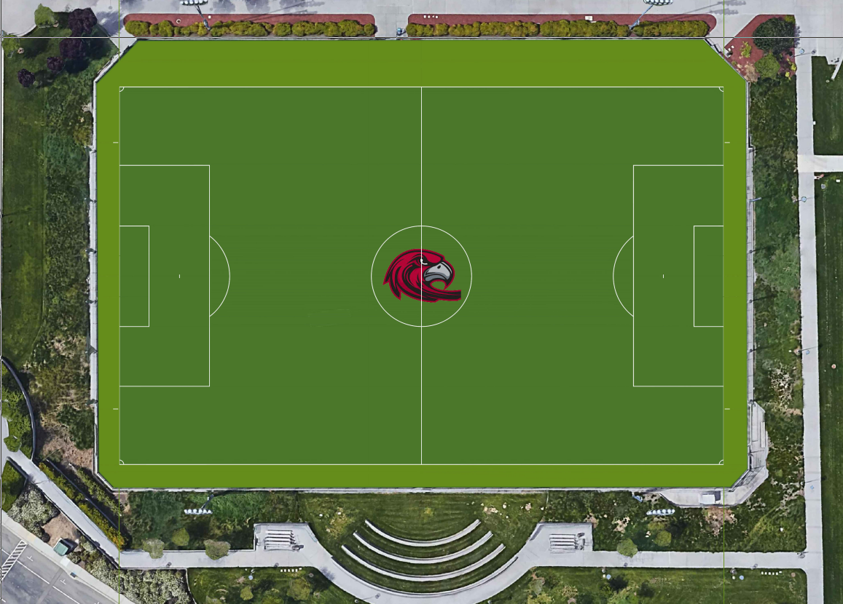
PROJECT PROGRESS REPORT
Synthetic Turf Replacement
LAS POSITAS COLLEGE
August 26, 2019
Project Team:
Bridging Architect: Verde Design, Inc.
Construction Manager: Roebbelen (RCMS)
Contractor: Valley Precision Grading, Inc.
Project Description: Installation of new synthetic turf at the existing synthetic turf soccer field. Project includes removal and disposal of the existing turf, shock/drain pad beneath the turf, and any base corrections needed. Provide new synthetic turf which includes NCAA/FIFA lines and school logo as well as new netting.
Project Update:
Pre-construction meeting occurred at the beginning of August. Weekly meetings in progress. Construction is expected to begin first week of September with completion at the end of October 2019
Pre-Construction Meeting 08/2019
Construction 09/2019
Final Completion 10/2019
Occupancy 11/2019

Slide 7
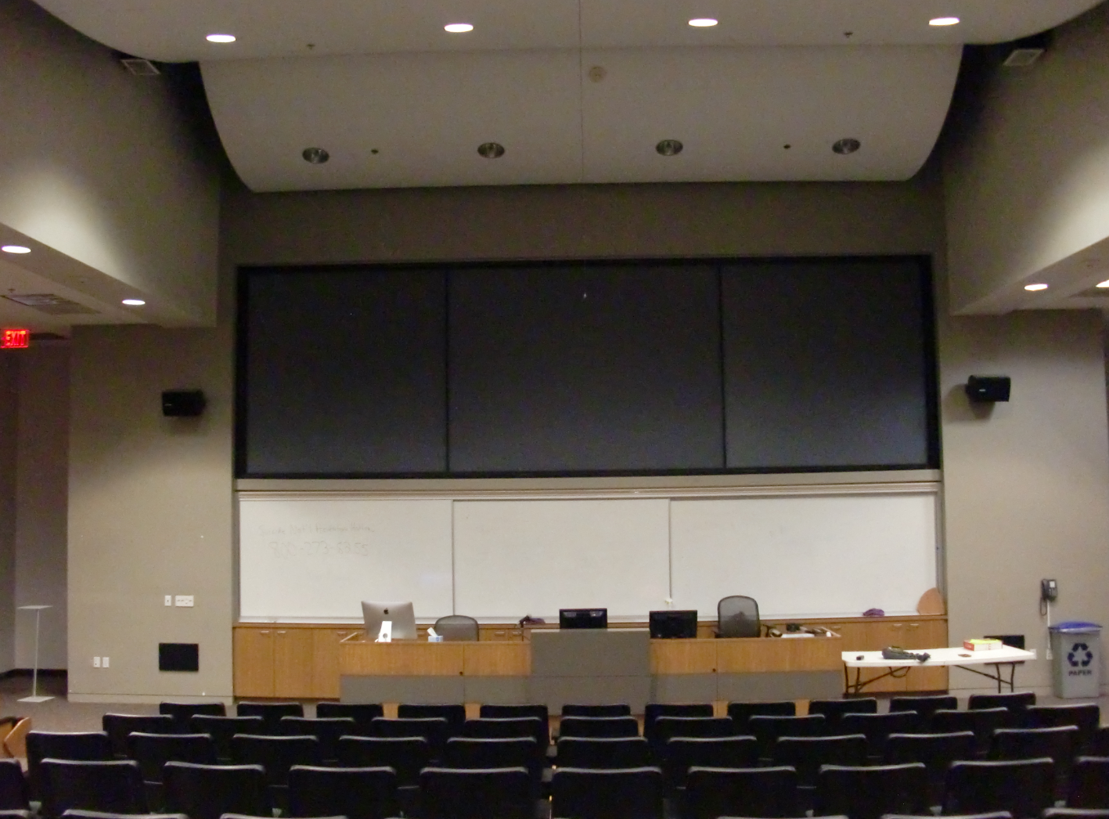
PROJECT PROGRESS REPORT
B2420 AV Wall Building 2400
LAS POSITAS COLLEGE
August 26, 2019
Project Team:
Architect: ATI Architects and Engineers
Construction Manager: Roebbelen (RCMS)
Contractor: TBD
Project Description:
The existing audio-visual system in Room B2420 is comprised of three projectors and a screen which includes AV controls at the lectern. The existing system will be replaced with LED flat panel system, movable lectern, upgraded speakers and cameras.
Project Update:
Project was Approved by DSA August 15, 2019. Bidding is in progress with 2 job walks taking place in early September. Contractor Bids due in October, with Board Approval November 2019.
Design Started 03/2019
DSA Approval 08/2019
Bids Due 10/2019
Construction Winter Break
Occupancy Spring Semester

Slide 8
PROJECT PROGRESS REPORT
M&O Small Projects
LAS POSITAS COLLEGE
August 26, 2019
Project Description | Point of Contact | Division | Location | Status
Bookstore and Welcome Center Signs |  |  | Bldg 1300 | Completed
803 Computer Lab Workstation Wiring and Electrical |  |  | B800 | Completed
Blinds for Student Services |  |  | Bldg 1600 | Completed
Office Reconfiguration A&R and EOPS | William Garcia | Student Services | Bldg 1600 | Completed
In Process
Upper Soccer Field Wind Screen | Amir Law | BHAWK | Track and Field Interior, 4ft fence | 6/18/19, PO# B190405 sent to Big Signs Inc 7/1/19, Received at District Office
Team Room Updates | James Giacomazzi | BHAWK | Bldg 2500 Locker Rooms | Demo completed; Lockers to arrive approx. week of Sept. 23, 2019
Meditation/Prayer Room | William Garcia | Student Services | Bldg 2400 2420A | Waiting on Signage
Lactation/Nursing Room | William Garcia | Student Services | Locations: Bldg 1600 1st/2nd floor; Bldg 1000 Bldgs 400,1700 | Locks installed; waiting on signage
White Board additions to rooms 1001, 1002,and 1060 | Jennie Graham | STEM | Rooms 1001, 1002, and 1060 | Product Received – Install to happen by M&O
Computer Studies Display Cases | Moh Daoud | STEM | 804, Welding/Auto Entrance | The cases are on campus and scheduled for installation by M&O
4135-37 & 4224 Faculty Office Window Coverings | Stuart McElderry | A&H | L4000 | Expected arrive date, 8/16/19 - M&O will coordinate installation
Office Reconfiguration, Student Life Office | William Garcia | Student Services | 1643
Parking Lot Striping | Sean Prather | Campus Safety | LPC Parking Lots | Completed

