Slide 1
Student Characteristics and Momentum Metrics of New First-Time College Students Who Want to Transfer and/or an Associate Degree
Presenter: Rajinder Samra
Director of Research, Planning, and Institutional Effectiveness
Spring 2019 Guided Pathways Retreat
January 10, 2019

Slide 2
New First-Time College Students
who want to Transfer and/or an Associate Degree:
Transfer with an associate degree
Transfer without an associate degree
Associate degree only

Slide 3
Handout
Answer Questions together: 1, 2a, 2b, 2c, 2d, and 2e

Slide 4
1. Each fall, about 9,300 students attend LPC.
How many are new first-time college students who would like to transfer and/or earn an associate degree?
Answer: Approximately 1,200

Slide 5
2. Of new first-time college students who would like to transfer and/or earn an associate degree:
What percentage identify as female?
Answer: 45%
What percentage are full-time (12 units or more)?
Answer: 60%
What is the top city of residence?
Answer: Tracy

Slide 6
2. Of new first-time college students who would like to transfer and/or earn an associate degree:
What percentage only want an associate degree (i.e., they do not want to transfer)?
Answer: 4%
Of the students who want to transfer, what percentage want to earn an associate degree prior to transferring?
Answer: 76%

Slide 7
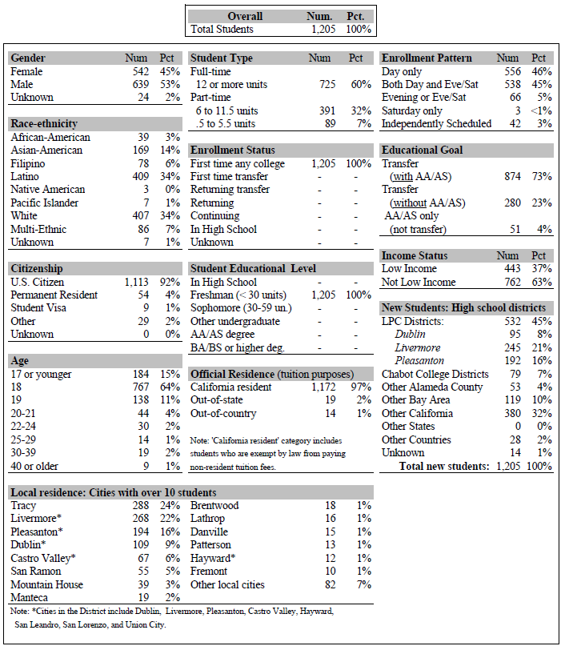
Las Positas College Student Characteristics
New First-time College Students with Goal of Transfer and/or Associate Degree

Slide 8
Handout
Answer Questions Together: 3, 4, 5, and 6

Slide 9
3. Of all new first-time transfer and/or associate degree-seeking students, what percentage successfully complete 15 units by the end of their first fall semester?
Answer: 12%
4. Of new first-time transfer and/or associate degree-seeking students who are full-time, what percentage successfully complete 15 units by the end of their first fall semester?
Answer: 20%

Slide 10
All Successful Units by First Fall Term Cohorts: Fall 2013 to Fall 2017

Slide 11
5. Of all new first-time transfer and/or associate degree-seeking students, what percentage successfully complete 30 units by the end of their first year?
Answer: 8%
6. Of new first-time transfer and/or associate degree-seeking students who are full-time, what percentage successfully complete 30 units by the end of their first year?
Answer: 19%

Slide 12
All Successful Units in First Year Cohorts: Fall 2013 to Fall 2017

Slide 13
Fall to Spring Persistence Cohorts: Fall 2013 to Fall 2017

Slide 14
Successful Completion of Degree/Transfer-Level English and/or Math Cohorts: Fall 2013 to Fall 2017

