Slide 1
CVC-OEI: Aligning Courses to the OEI Course Design Rubric
*California virtual campus-online education Initiative
Christina Lee, Victoria Austin, Maureen O’Herin

Slide 2
Agenda: · Introduction to the CVC-OEI · Main “Work” Areas of OEI Course Design Rubric · Expectations of OEI Rubric vs Your course · Resources · Next Steps Review your own DE course and identify areas to work on

Slide 3
What is the CVC-OEI?
Collaborative effort among all CA community colleges
Intended to allow students to complete educational goals more easily
Supports high quality online courses
Finish Faster Online!

Slide 4
What is Las Positas’s role?
May 2014 – 23 college pilot, not including us
May 2018 – 33 new colleges added
We commit to:
Align 20% of our DE sections to the OEI Course Design Rubric in two years (Fall 2020)
Creating a local POCR (peer online course review) process to align DE courses

Slide 5
What courses are eligible?
Fully online class
Taught at least one previous semester online at LPC or Chabot
Transfer eligible (IGETC or CSU) or CTE

Slide 6
Main “Work” Areas of OEI Course Design Rubric
Module/Unit Learning Objectives
Accessibility Issues(e.g,.videos, ppts, urls)
Interactions/Feedback (F2S, S2S, grading rubrics)
Linking assessments to match learning objectives
The OEI rubric is about delivery, not content

Slide 7
Expectations of OEI Rubric vs Your course
Benefits
Challenges
Takeaways
OEI MOU

Slide 8
Resources
Professional Development at LPC
OEI Resources for Instructors

Slide 9
Next Steps
Identify which course you would like to work on
Start working on it today (e.g., small tasks first)
A13 – Student Services
A14 – Tech Support
A7 – Use of Canvas Tools
A9 – Instruction for Learners

Slide 10
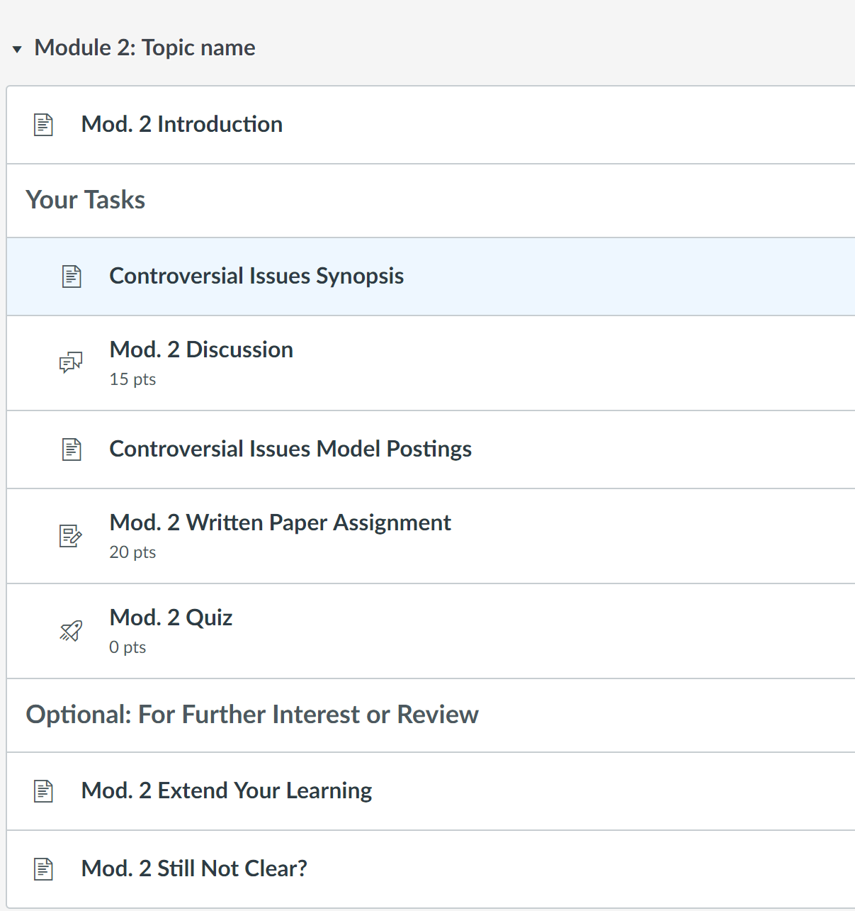
Scott’s Course Design Template (in Canvas)
Meets the standards in the Course Design Rubric
Contains sample content for you to edit

Slide 11
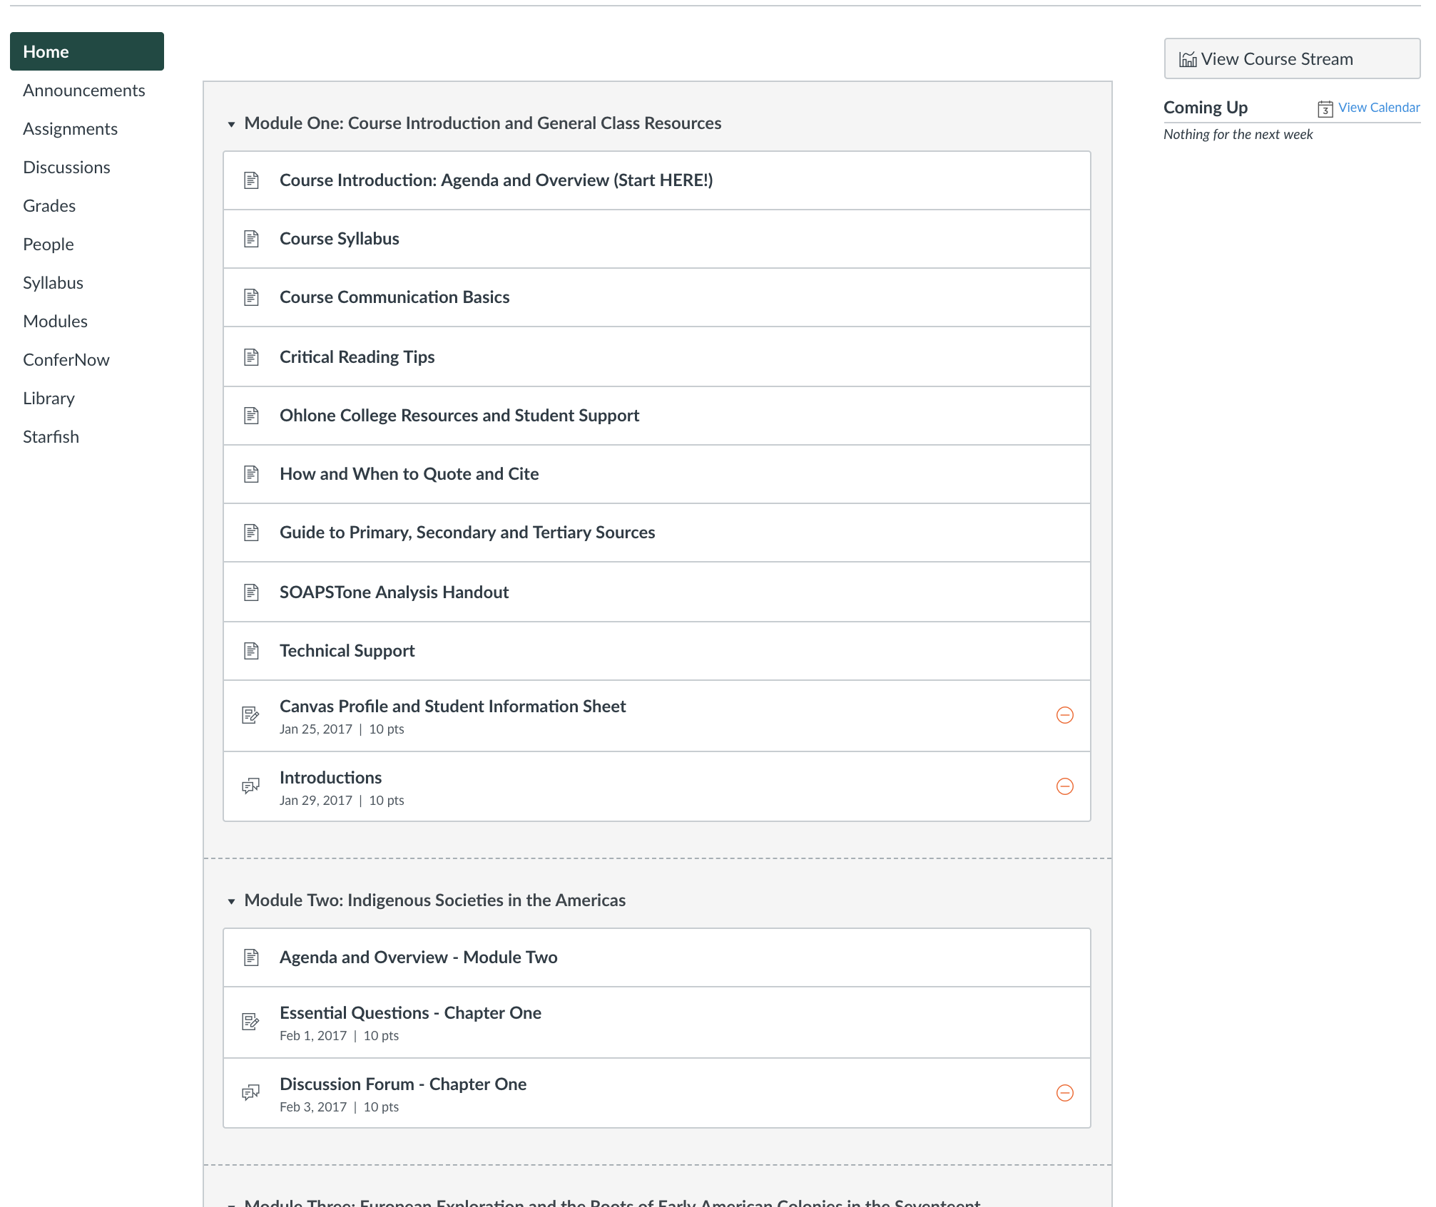
Example
From OEI Resources for instructors

Slide 12
Questions? Thank you!

