Slide 1
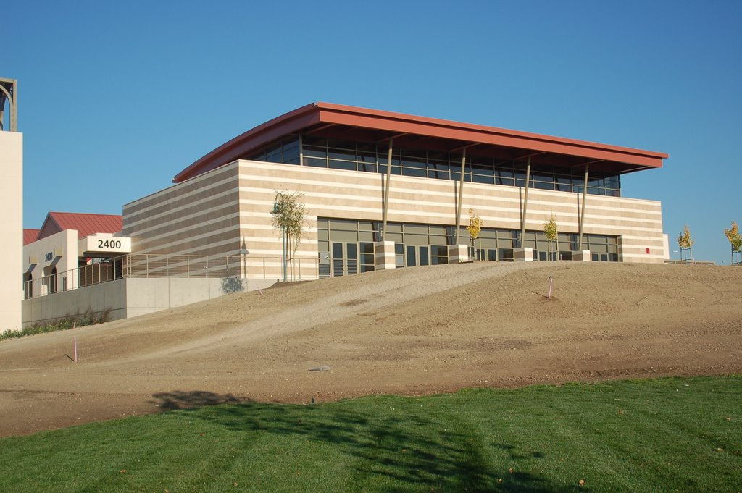
Everything You Need to Know to Secure a Full-Time Tenure-Track Faculty Position at a Community College
Presented by the Faculty & Staff of Las Positas College
Saturday, November 14, 2015 1:00 PM – 3:00 PM
Room 2420

Slide 2
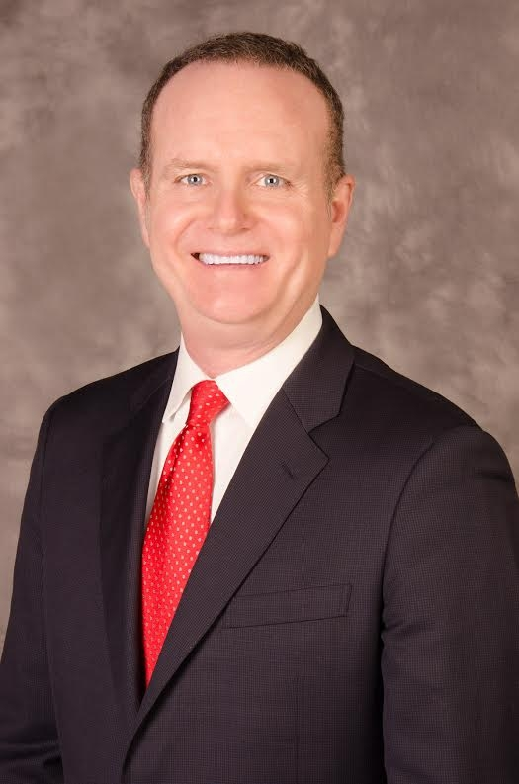
List of Presenters
Dr. Barry Russell (President)
Roanna Bennie (VP of Academic Services)
Don Miller (Dean of ALSS)
Howard Blumenfeld (Mathematics Faculty)
Rajeev Chopra (Business Faculty)
Heike Gecox (Counseling Faculty)
Barbara Morrissey (Dean of Student Services)
Richard Grow (Chemistry Faculty)
LaVaughn Hart (CIS Faculty & FA Representative)
Ernie Jones (Psychology Faculty)
Karin Spirn (English Faculty)
Marsha Vernoga (Nutrition Faculty)

Slide 3
Follow us in the Cloud
You can follow along with our presentation on your smartphone, tablet, or laptop by entering the following link on your browser:
http://1drv.ms/1Qp0W9K

Slide 4
Please Hold Your Questions
We will make time at the end of our presentation for a Q&A session.
Put one question on the 3x5 notecard that was provided to you at the entrance.
There will be a staffed table located in the main foyer dedicated to answering additional questions.
An “FAQ” page may be created and distributed to answer additional questions.

Slide 5
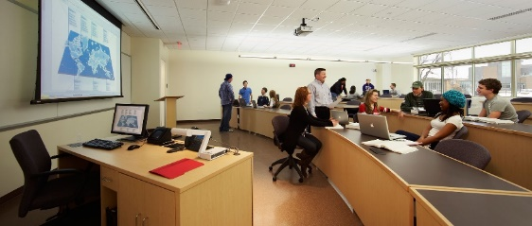
Full-Time Professional Responsibilities
Annual full-time teaching load is 30 units
Serve on committees
Coordinator duties
Professional development activities
Conduct Faculty Evaluations
Program Review & Student Learning Outcomes
Participation in Accreditation Process
Mentoring Opportunities

Slide 6
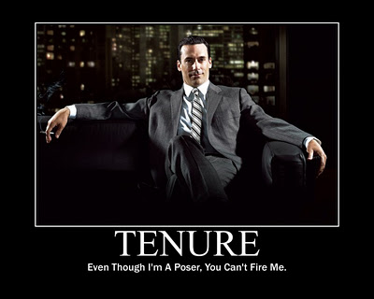
Full-Time Professional Responsibilities
Earning tenure is a four year comprehensive process
Must write annual professional review report to division dean
Evaluated at regular intervals during first four years
New Faculty Orientation during first year

Slide 7
Preparing Your Application
Be sure to prepare all materials well ahead of time. Submit early the day it is due.
Write clearly and concisely highlighting ALL points from the ad
Edit, rewrite, review, revise, spellcheck.
Know your audience (work in a brief sentence or two that lets them know you have researched their campus in detail).
Address all correspondence to the correct person/college.
Include information that directly refers to what they are seeking (avoid tangents).

Slide 8
Preparing Your Application
Equivalency
The use of equivalency in the Chabot-Las Positas Community College District specifies that an individual who is eligible for the applicant pool must have academic preparation at least equal to that for the required degree, or must have the degree, and/or experience equivalent to the required degree as determined by the District Equivalency Committee.

Slide 9
The Resume & Cover Letter
Your paperwork must explain how you meet all of the minimum and desirable qualifications for the position.
coverletter
resume
application
other requested materials (statement of qualifications, supplemental questions)
Do not assume the department knows anything about you.

Slide 10
What to Emphasize
Community college teaching experience
Other teaching experience
Courses you have taught
Variety of levels and topics
Training, knowledge and experience in your field
The ways you meet the minimum and desirable qualifications for the position
Collegial/discipline work such as curriculum development, SLO writing and assessment

Slide 11
What to Emphasize (Cont'd)
Experiences that show your ability to teach a diverse student body
Experiences that show your ability to work with students with learning disabilities and other struggling learners
Experience teaching with technology
Experience teaching in multiple modalities
(DE, Hybrid, Flipped, Lecture, Lab)

Slide 12
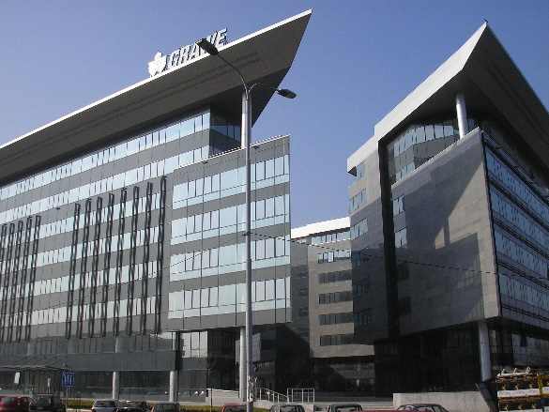
What to Emphasize (Cont'd)
Industry experience if you are applying for a career technical position
Professional experience that might be useful to the college (grant writing, event planning, budgeting/resource allocations)
Your familiarity with the college and
department to which you are applying

Slide 13
What Not to Emphasize
Academic scholarship and publications
Academic papers presented
The argument of your thesis or dissertation
Any job experience not related to the position you’re applying for
Anything that might sound negative or make the reader uncomfortable

Slide 14
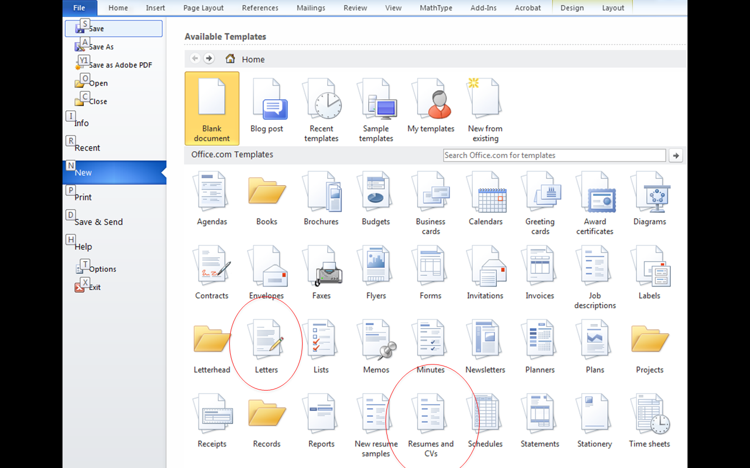

Slide 16
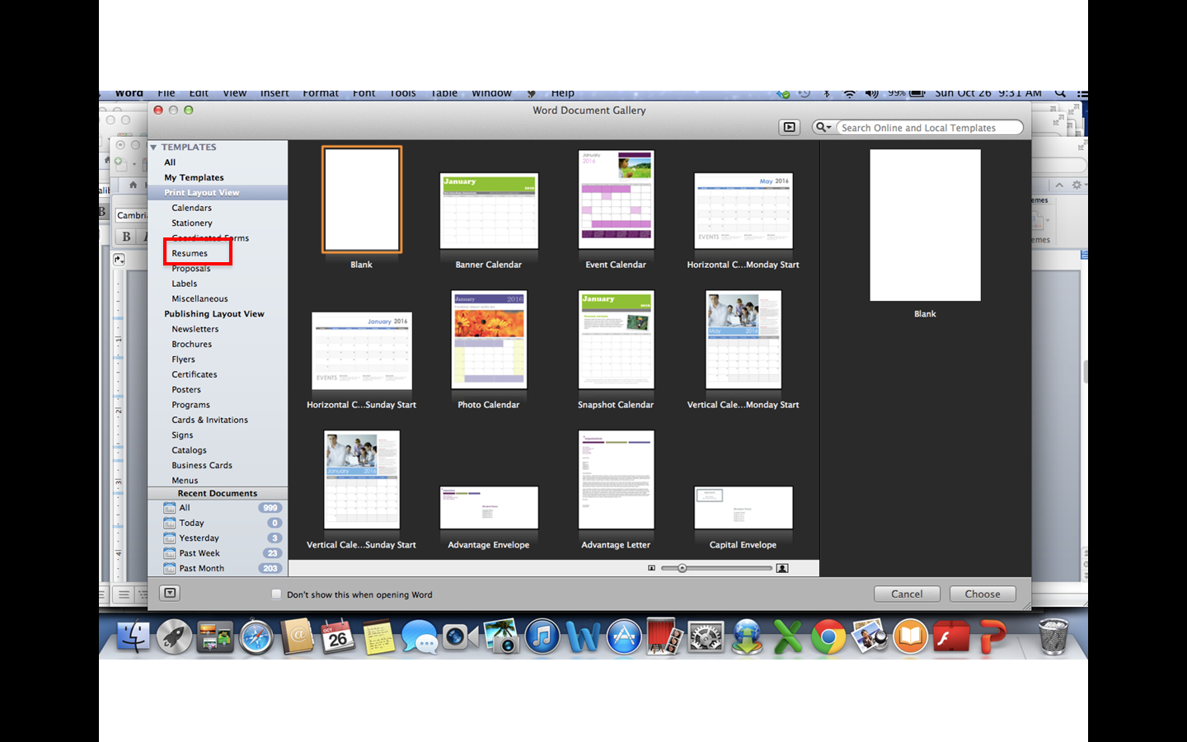

Slide 18
Resume (Or CV)
Courses you taught (not just numbers, but topics/levels)
Emphasize California Community College teaching
Include anything “above and beyond” your teaching; SLO work, writing curriculum, special projects for the department or college

Slide 19
Sample Resume Entry
2012-Present
Biology Instructor, Diablo Valley College
Courses taught:
Biology 101, Fundamentals of Biological Science (Spring 2012, 2013; Fall 2013, 2014; Summer 2013)
Biology 118, Fundamentals of Microbiology with Lab (Fall 2012; Spring 2013, 2014)
Biology 120, Introduction to Human Anatomy and Physiology (Fall 2013)
Duties: Prepare and deliver lectures, design lab assignments and teach laboratory courses, coordinate with lab technicians, hold one office hour per week, attend monthly department meetings, assess and record SLOs.

Slide 20
Cover Letters
NOT a regular business cover letter
Should specifically address how you meet all the minimum and desirable qualifications (unless the job announcement asked you to do this as a supplemental question/qualifications statement)
Can be up to three pages

Slide 21
Supplemental Questions
Some positions may have supplemental questions for you to answer.
Teaching philosophy and sample assignments should generally reflect that you are a positive, accessible, and encouraging.
Most departments value an interactive teaching style that allows students to work hands-on and collaborate in groups.

Slide 22
Use Positive Language
negative language
positive language
I had some initial problems working with this student population.
I was not offered any classes but Statistics, so my experience teaching at other levels is unfortunately limited.
I faced some initial challenges working with this student population.
While I have so far only had the chance to teach Statistics, I have a background in Calculus and attended department trainings on basic skills instruction and am excited to teach those courses when the opportunity arises.

Slide 23
The First Interview
Be early and give yourself a few minutes to relax before the interview is scheduled to start.
When you enter the room, there may be people on the committee that you work with regularly; they will probably act as if they have never met you before.
Committees may have more members than you expect. It isn't unusual for committees have 5-8 members.

Slide 24
The First Interview
Introductions
Follow the lead of the person that brought you into the room
There may not be time or space to shake everyone's hand; that's ok
Typically, the committee members will introduce themselves
Committee Composition
Faculty from the discipline and/or related disciplines
Dean/Area Administrator
Classified staff
Student(s)

Slide 25
The First Interview
The Questions
Will be written in advance of the interview, all candidates will be asked the same questions and will be based on job announcement.
A copy will likely be available on the table for you to refer to during the interview.
May be provided to you a few minutes before the interview but don't rely on that.

Slide 26
The First Interview
The Questions
Will focus on how you relate to students, your knowledge of the subject matter, and your understanding of the roles and responsibilities of a full-time faculty member in a community college.

Slide 27
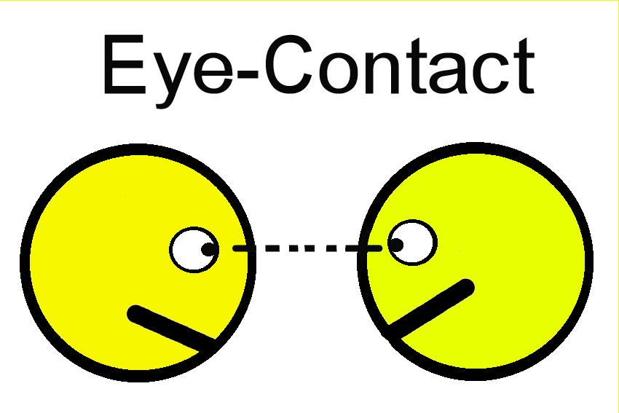
The First Interview
During the Interview
Be mindful of the time, yet answer thoroughly.
If you don't get to answer all the questions, you will lose points.
You may also lose points if you do not go into enough detail.
Make eye contact when possible
Committee members will be making notes so they may not be looking at you all the time.

Slide 28
The First Interview
During the Interview
Answer questions concisely and completely
If a question has multiple parts, make sure your answer covers the entire question.
It's OK to take a moment to compose your thoughts before answering a question.
Stay on topic.

Slide 29
The First Interview
During the Interview
Let the committee know you want to be part of their college
Use examples that show that you know about the programs/services at their college.

Slide 30
The First Interview
Typical Types of Questions
Subject matter
Scenarios
Professional experience

Slide 31
The First Interview
Closing the Interview
May be asked if you have any questions of the committee
Committee chair will probably explain the next steps
Always good to thank the committee for their time

Slide 32
A Teaching Demonstration on….
How to do a Teaching Demonstration

Slide 33
Objectives
After viewing this teaching demonstration, you will have the tools to:
Develop an engaging teaching demonstration based on your strengths
Differentiate between what should and should not be included
Organize your teaching demonstration concisely and effectively

Slide 34
Work in pairs…
Answer these questions:
What makes a GREAT teacher?
What strategies have you used to engage the adult learner and why?

Slide 35
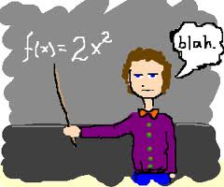
What makes a good teacher?

Slide 36
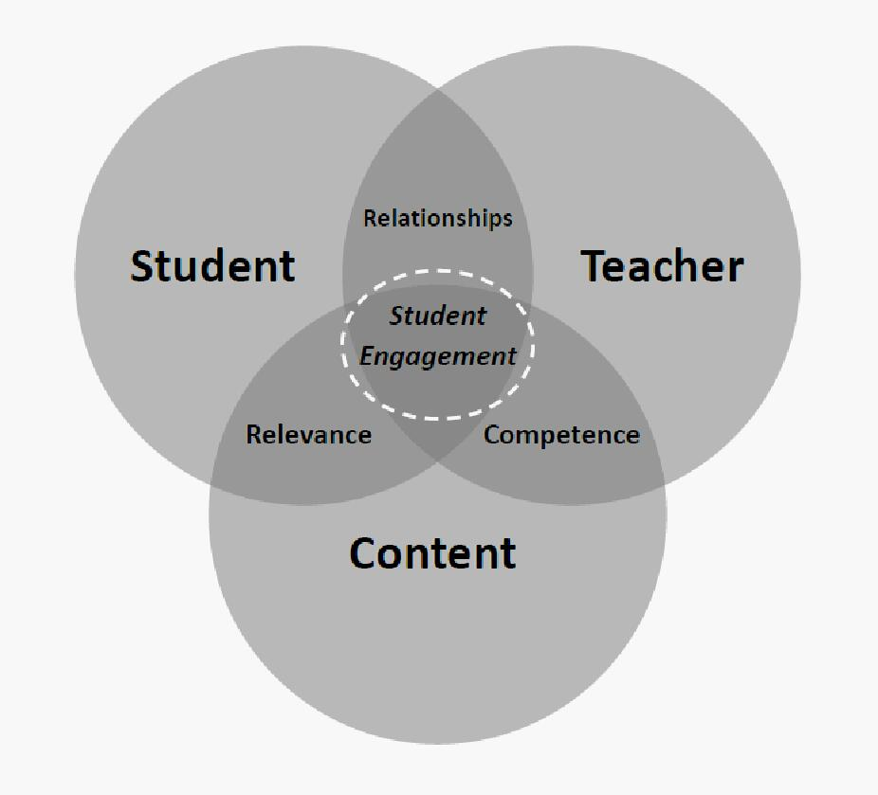
What strategies have you used to engage the adult learner and why?

Slide 37
What to focus on….
The topic?????
Focus on the HOW you are delivering the material
Focus on the LEARNER (engaging your committee)
Focus on HIGHLIGHTING your teaching capabilities

Slide 38
What to Do
Do….
Be creative!
Ask about available technology
Think of ways to engage your committee…
Visuals, handouts, short videos
Consider ALL learning styles
Highlight your best teaching practices
Practice with a timer!
Limit
The amount of information thrown at your committee
Sage on the stage
Research oriented vs. learner oriented

Slide 39
How to organize…
KISS (Keep it simple sweetheart)
Objectives (1-3)
Concise body addressing objectives
Use images, videos, example exercises, etc. to engage your committee
Wrap-up
Questions

Slide 40
Wrap-up
Relax
Focus on the learner
Keep it simple and concise
Practice
Let your great teaching skills shine through!

Slide 41
Questions??????
Answered during Q&A

Slide 42
Counseling Specific Information
Counseling is often college specific (read the job description)
- Academic
- Career
- Personal (connect & identify skills)
SSSP
-What is it?
- How does it affect counseling?
- This is how we serve our students

Slide 43
Counseling Specific Information
Transfer Information
- articulation -A.A.-T or A.D.-T.
Assist.org
-transfer assistance
Degree Works

Slide 44
Counseling Specific Information
Minimum Qualifications
Teaching Philosophy
- may be required to give a demonstration
Personal Philosophy

Slide 45
Counseling Specific Information
Sensitivity to Diversity & Experience
Case Scenarios
- How would you work with a particular student?
- What would you do?
Flexible, Multi-Tasking, Fast Paced

Slide 46
The Second Interview
What is the college mission, vision and values...and how do you fit in?
The process involves many variables like
What additional skills or tools do you bring to the campus?
Diversity
"Fit" in terms of the college and the department
Commitment to the community
Dress and Composure
Expect the Unexpected

Slide 47
Information about Recruitment Event
Breakout Room Assignments
Room 2480: Arts, Letters, and Social Sciences
Behavioral Sciences, Business and Athletics
Room 2470: STEM and Public Safety
Student Services

Slide 48
ALSS Arts, Letters and Social Sciences Don Miller, Ph.D., Dean donmiller@laspositascollege.edu | STEMPS Science, Technology, Engineering, Math & Public Safety Lisa Everett, Ed.D., Dean leverett@laspositascollege.edu | BSBA Behavioral Sciences, Business & Athletics Dyan Miller, Dean/Athletic Director drmiller@laspositascollege.edu | SS Student Services Barbara Morrissey, Dean bmorrissey@laspositascollege.edu
ANTR - Anthropology ASL - American Sign Language ENG - English ESL - English as a Second Language Foreign Languages *FREN - French *ITLN - Italian *SPAN - Spanish GEOG – Geography HIST – History Humanities *ARTS - Art *ARHS – Art History *HUMN - Humanities *PHIL - Philosophy *PHTO - Photography *RELS - Religious Studies *VCOM - Visual Communications INTD - Interior Design Learning Communities LIBR – Library Skills MSCM - Mass Communications *MSCM - Journalism *MSCM - TV/Radio Performing Arts *DANC - Dance *MUS - Music *SPCH - Speech/ Forensics *THEA – Theater POLI – Political Science SOC – Sociology WMST - Women’s Studies | AJ - Administration of Justice ANAT - Anatomy ASTR – Astronomy AUTO - Automotive BIO - Biology BOTN - Botany CHEM – Chemistry CIS – Computer Information Sys CNT- Computer Networking Tech CS – Computer Science ECOL - Ecology EMS - Emergency Medical Services ENGR – Engineering EVST – Environmental Studies EVSC - Environmental Sciences FST - Fire Service Technology GEOL - Geology HSCI – Health Sciences MATH - Mathematics MICR - Microbiology OSH - Occupational Safety & Health PARA - Paramedics Technology PHYS - Physics PHSI - Physiology WLDT – Welding Technology | BUSN – Business Child Development Center ECD – Early Childhood Dev. ECON - Economics HLTH – Health/Wellness Intercollegiate Athletics INTN - Internship KIN – Kinesiology (formerly Physical Educ) MKTG - Marketing NUTR – Nutrition PSYC – Psychology VWT - Viticulture/Winery Technology HORT – Horticulture WRKX – Work Experience | Counseling GNST-General Studies LRNS - Learning Skills TUTR – Tutoring PSCN – Psychology Counseling and Human Services Transfer Center Assessment CalWORKs DSPS EOPS & CARE Programs

Slide 49
LPC Full-Time Positions
LPC will soon recruit for the following positions:
Anthropology
Art
Biology
Computer Networking Technology
Counselor (3 positions)
Emergency Medical Services
English
Health
History
Horticulture/Viticulture
Humanities
Kinesiology – Head Men’s Soccer Coach
Math (2 positions)
Political Science
Psychology
Theater - with Technical Theater Emphasis

Slide 50
Informational Handout & Checklist
We have provided you with an online handout that summarizes important points covered in this presentation and a checklist for your use when completing applications.
http://1drv.ms/1NoUcbs

Slide 51
Participant Feedback
If you only came for the first event, we would appreciate if you could take a few minutes to provide us with feedback about the seminar.
If you are staying for the second event, please provide us with feedback about both events after you have attended the recruitment event.
The online survey can be found at
http://goo.gl/forms/aJ5WfGZQ3o

Slide 52
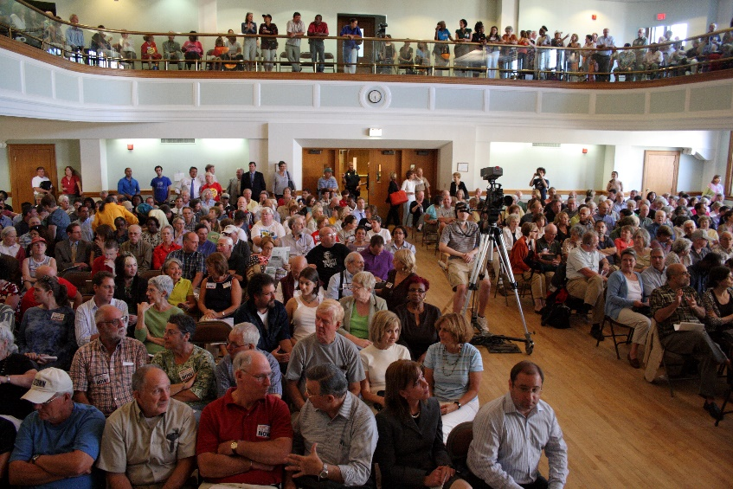
Q&A Session
Pass the 3x5 cards toward the aisles for collection.
Panel of experts will answer as many as possible.
FAQ page

Slide 53
Participant Feedback
If you only came for the first event, we would appreciate if you could take a few minutes to provide us with feedback about the seminar.
If you are staying for the second event, please provide us with feedback about both events after you have attended the recruitment event.
The online survey can be found at
http://goo.gl/forms/aJ5WfGZQ3o

Slide 54
Information about Recruitment Event
Breakout Room Assignments
Room 2480: ALSS and BSBA
Room 2470: STEMPS and Student Services

