Slide 1

Welcome & Announcements
Dr. Nan Ho
Vice President, Academic Services

Slide 2
Angelo Mercado, Student Government President
Welcome & Announcements
Student Government Update
New Colleagues on Campus
Nan Ho, Vice President, Academic Services
Nan Ho, Vice President, Academic Services
What’s Right at LPC
Nan Ho, Vice President, Academic Services
Enrollments by Modality
Rajinder S. Samra, Director of Research, Planning, and Institutional Effectiveness
Facilities Master Plan Update
Megan Gaunce & Melinda Nish, Cambridge West Partnership, LLC
LPC Foundation Update
Ken Cooper, Executive Director, LPC Foundation
Budget Update
Sean Brooks, Vice President, Business & Administrative Services
Artificial Intelligence & Academic Integrity Update
Catherine Suarez, Spanish Professor; Catherine Eagan, English Professor; and David Montelongo, Chemistry Professor
Academic Senate Update
Ashley Young, Academic Senate President

Slide 3
College Updates
Dr. Nan Ho
Vice President, Academic Services

Slide 4

College Updates
  CONGRATULATIONS COACH CUMBO
  300 CAREER WINS

Slide 5
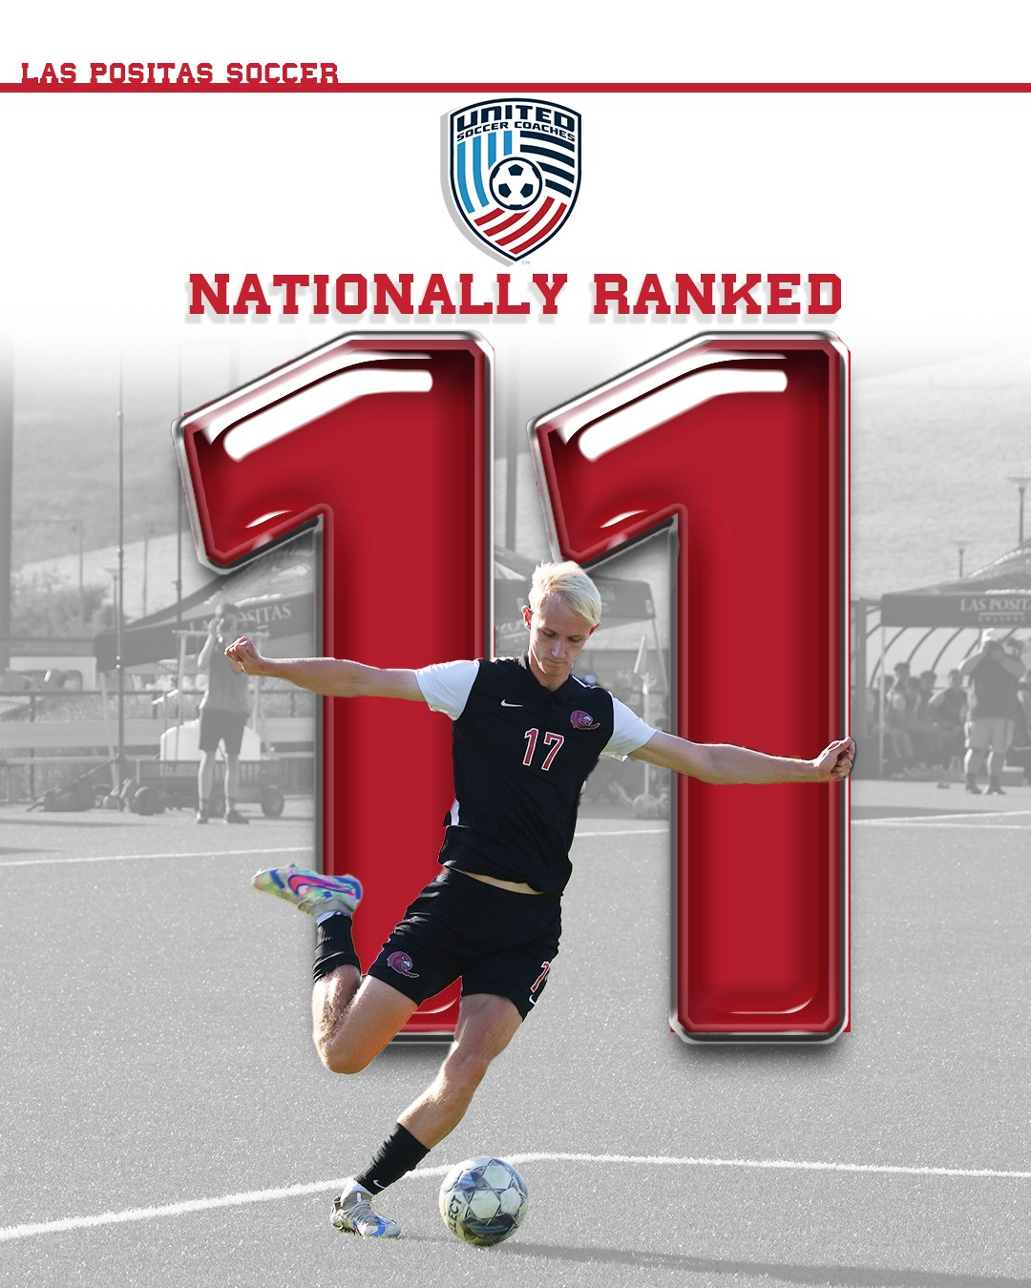
College Updates
LAS POSITAS MENS SOCCER
11th in California
11th in Nation

Slide 6
New Colleagues on Campus
Dr. Nan Ho
Vice President, Academic Services

Slide 7
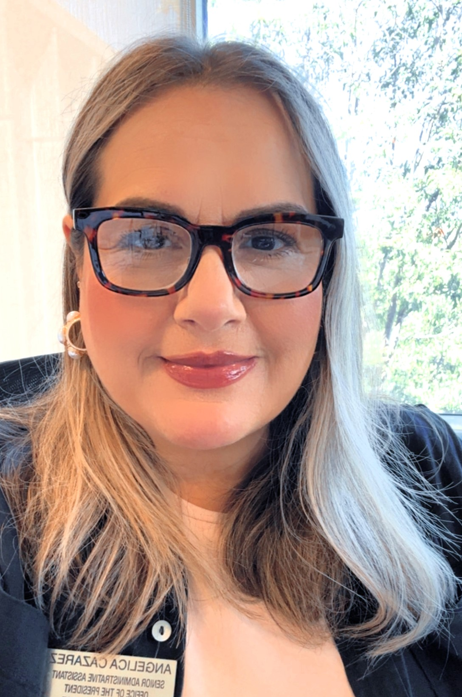
Angelica Cazarez
Executive Admin. Assistant
to the College President
Promotion

Slide 8

Elizabeth McWhorter
Program Coordinator
Early College Programs and Pathways
Promotion – Chabot College

Slide 9
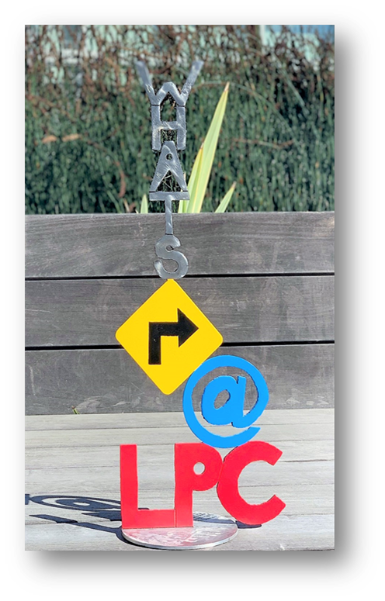
What’s Right at LPC?

Slide 10
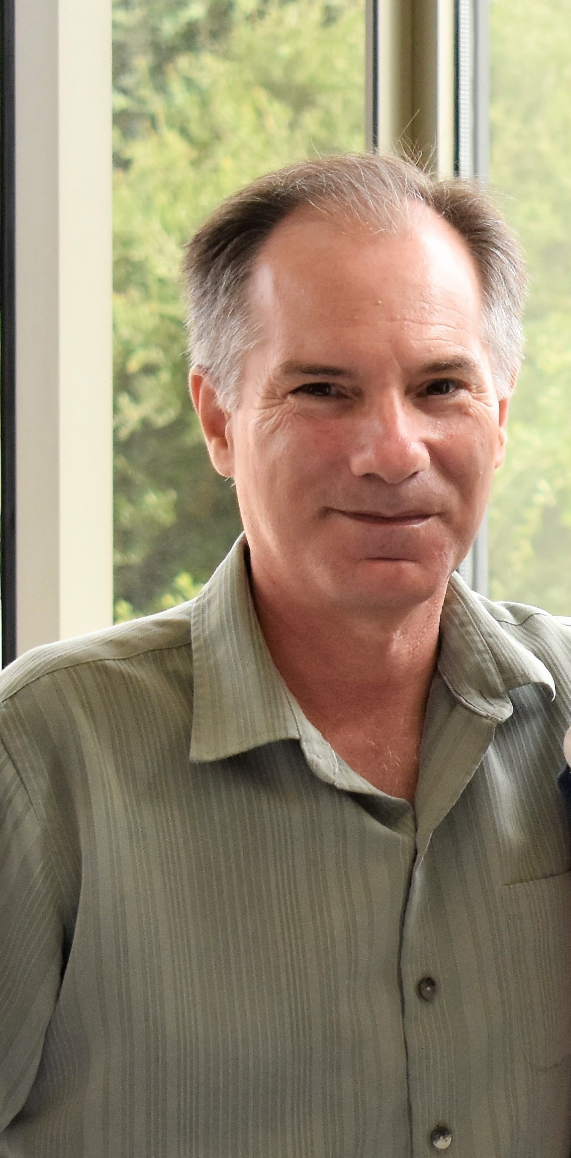
October 2024
Scott Vigallon
SAVE THE DATE:
For Scott Vigallon’s Retirement Celebration
Wednesday, October 30, 2024, 2:00 P.M. – 4:00 P.M. In the Cafeteria

Slide 11
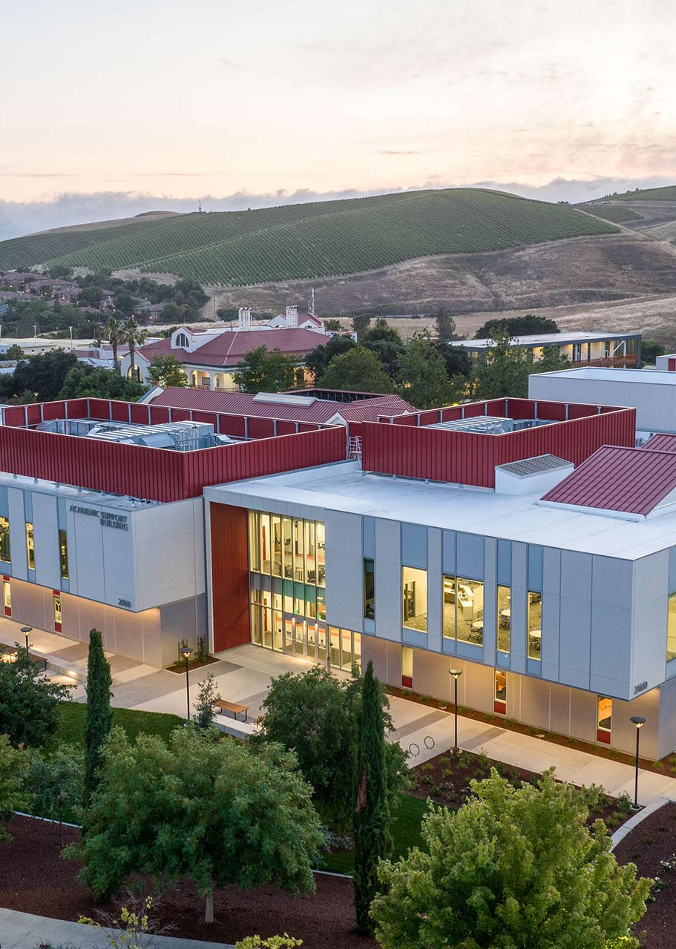

LPCSG
OCTOBER
TOWN MEETING
PRESENTATION
By Angelo Mercado
2024

Slide 12


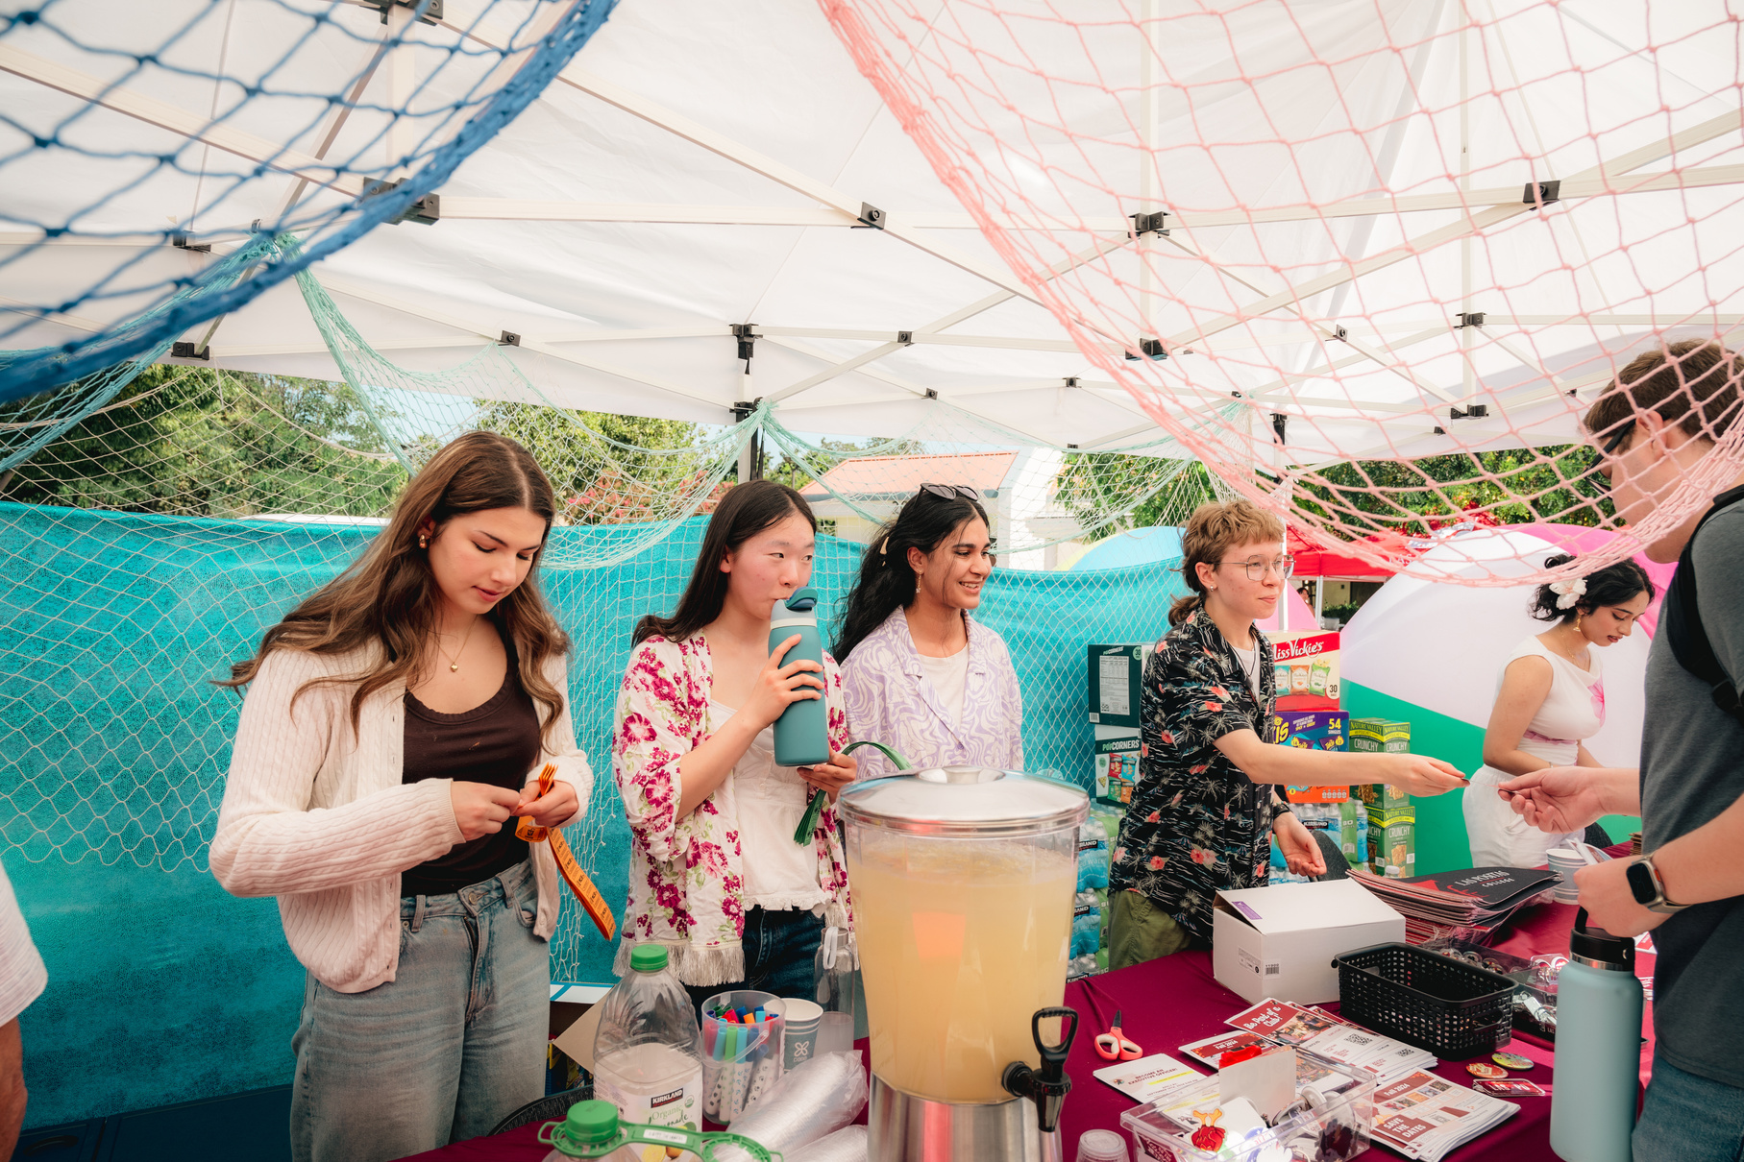
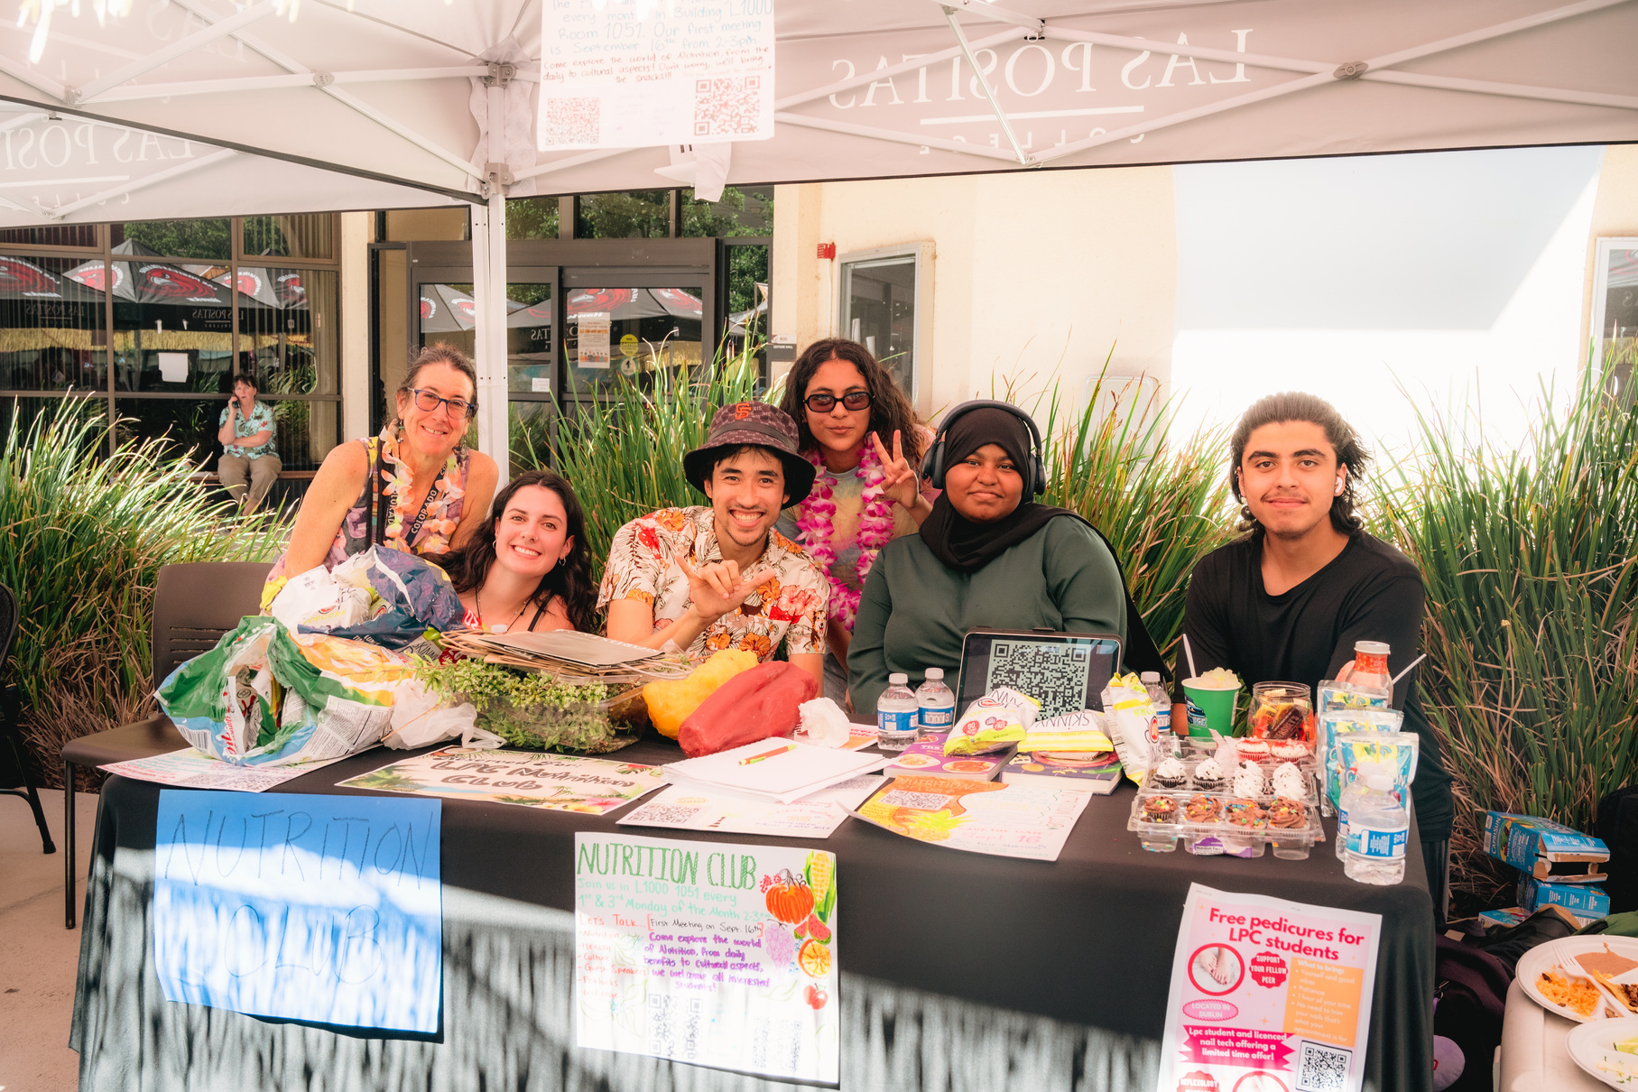
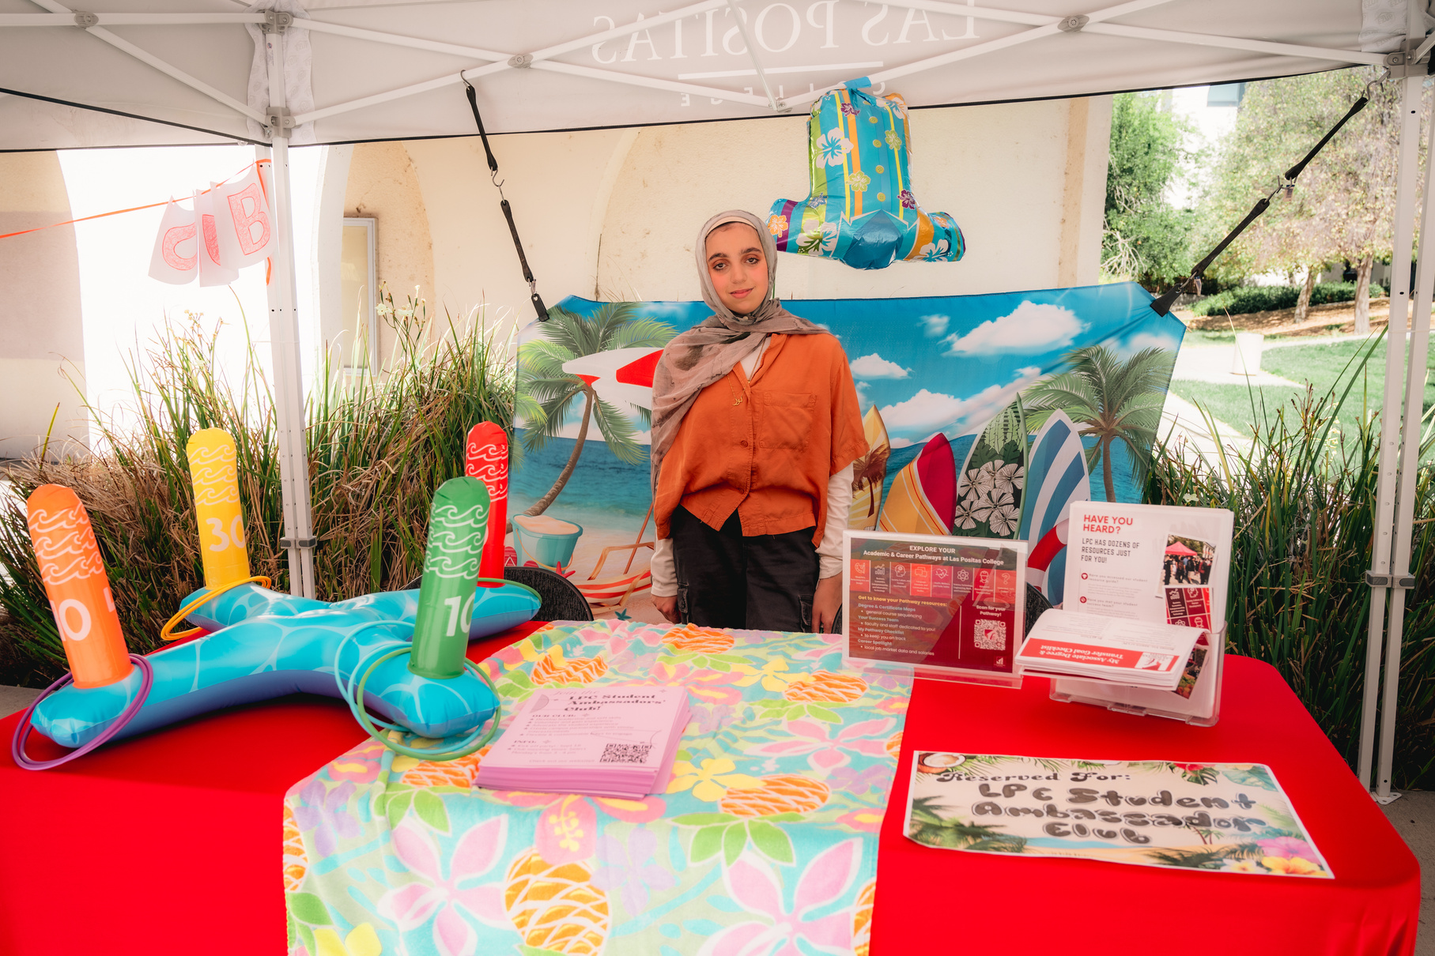
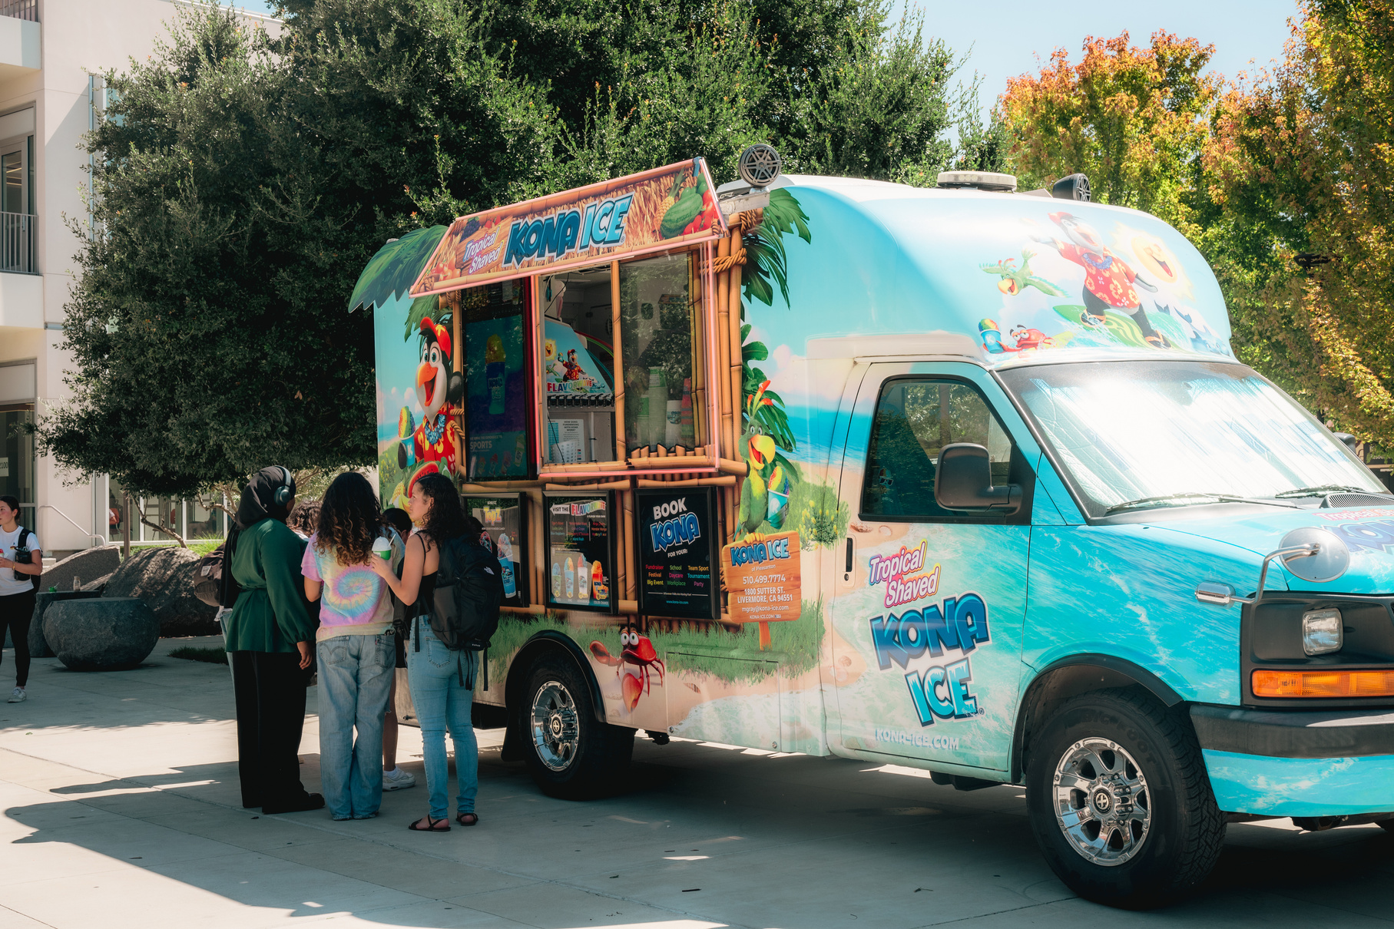


WELCOME BACK WEEK
OVER 550 PLATES SERVED

Slide 13


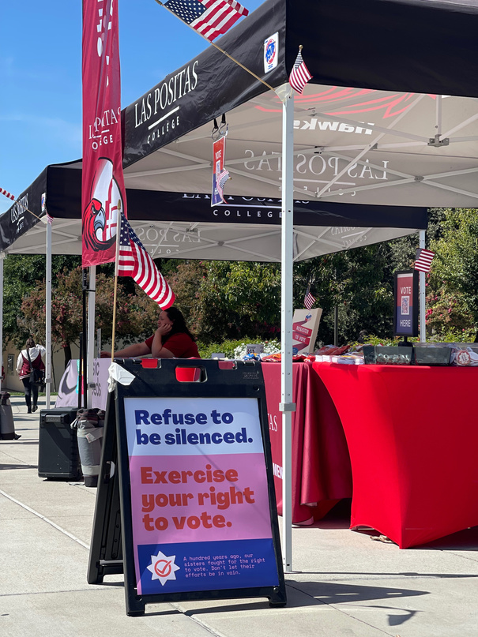
CONSTITUTION DAY / VOTER REGISTRATION
SEPTEMBER 17TH

Slide 14


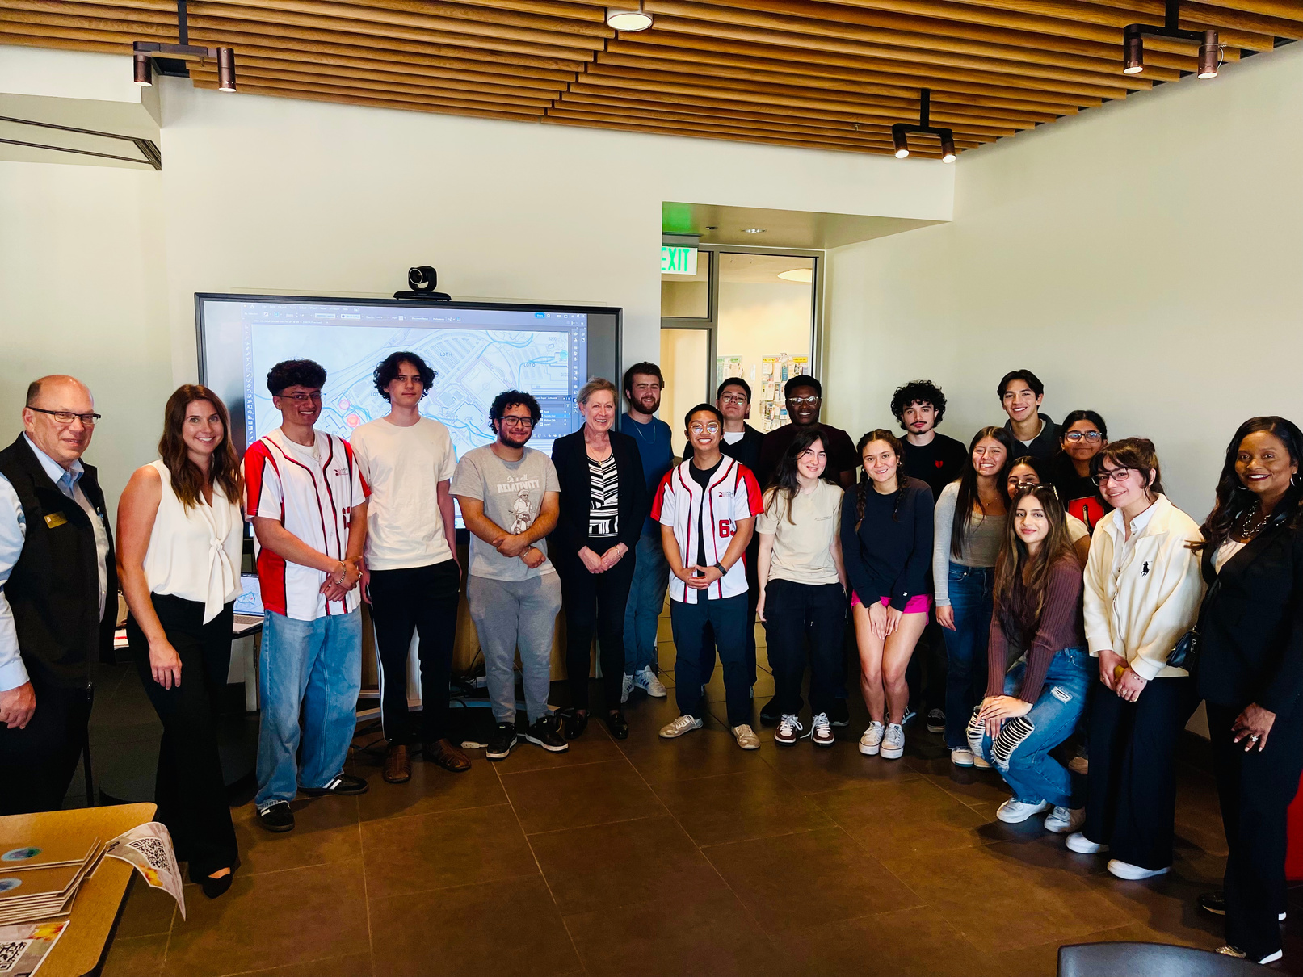
FACILITIES MASTER PLAN

Slide 15
NEW TO LPCSG
A RECORD HIGH - 19 INDIVIDUALS INTERESTED IN THE TWO VACANT POSITIONS
2024-2025

Slide 16
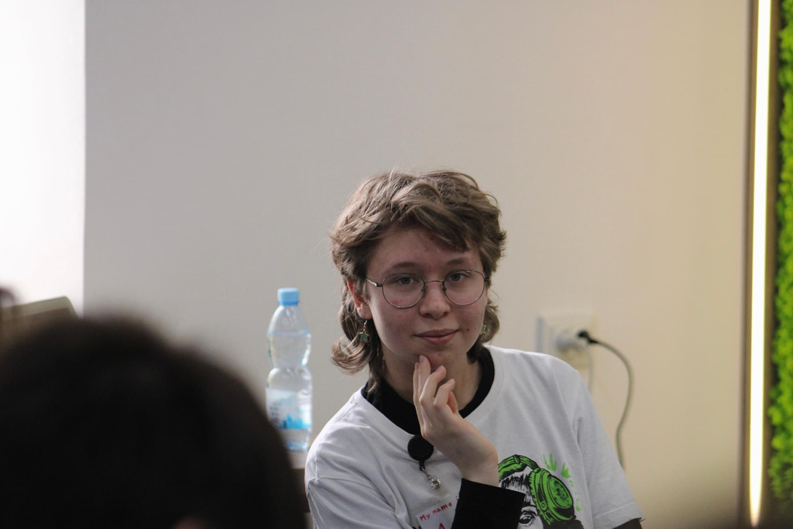
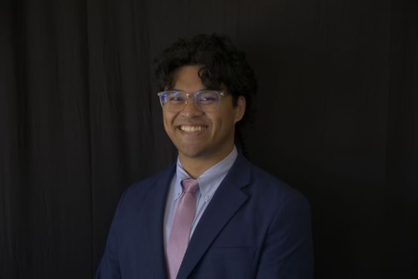
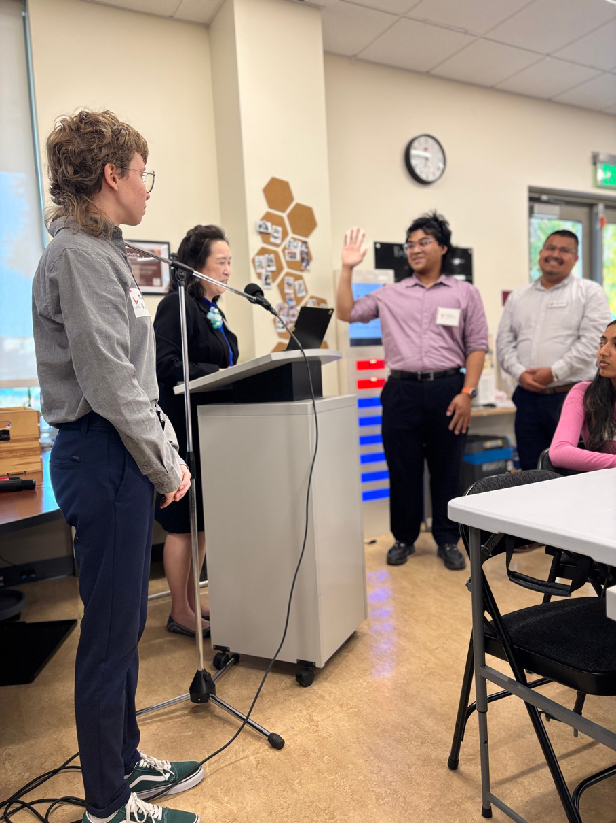
NEWLY LPCSG EXECUTIVE OFFICERS
MARIIA VOLOVA
DIRECTOR OF LEGISLATION
KEONI FEDERICO
DIRECTOR OF CLUB OUTREACH

Slide 17

LPCSG COHORT
We have appointed 7 more Senators
  8 Executive Officers
  16 Senators
  24 total officers of LPCSG

Slide 18
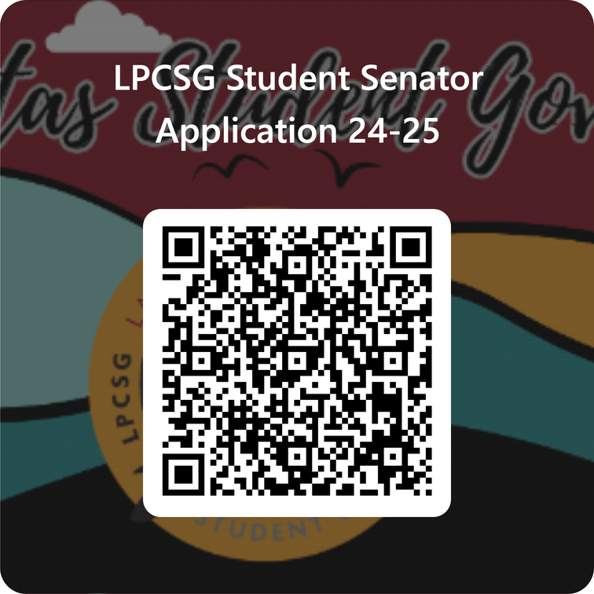
BECOME A SENATOR

Slide 19

LIBRARY CARD DRIVE
OCTOBER 16TH, 2024

Slide 20
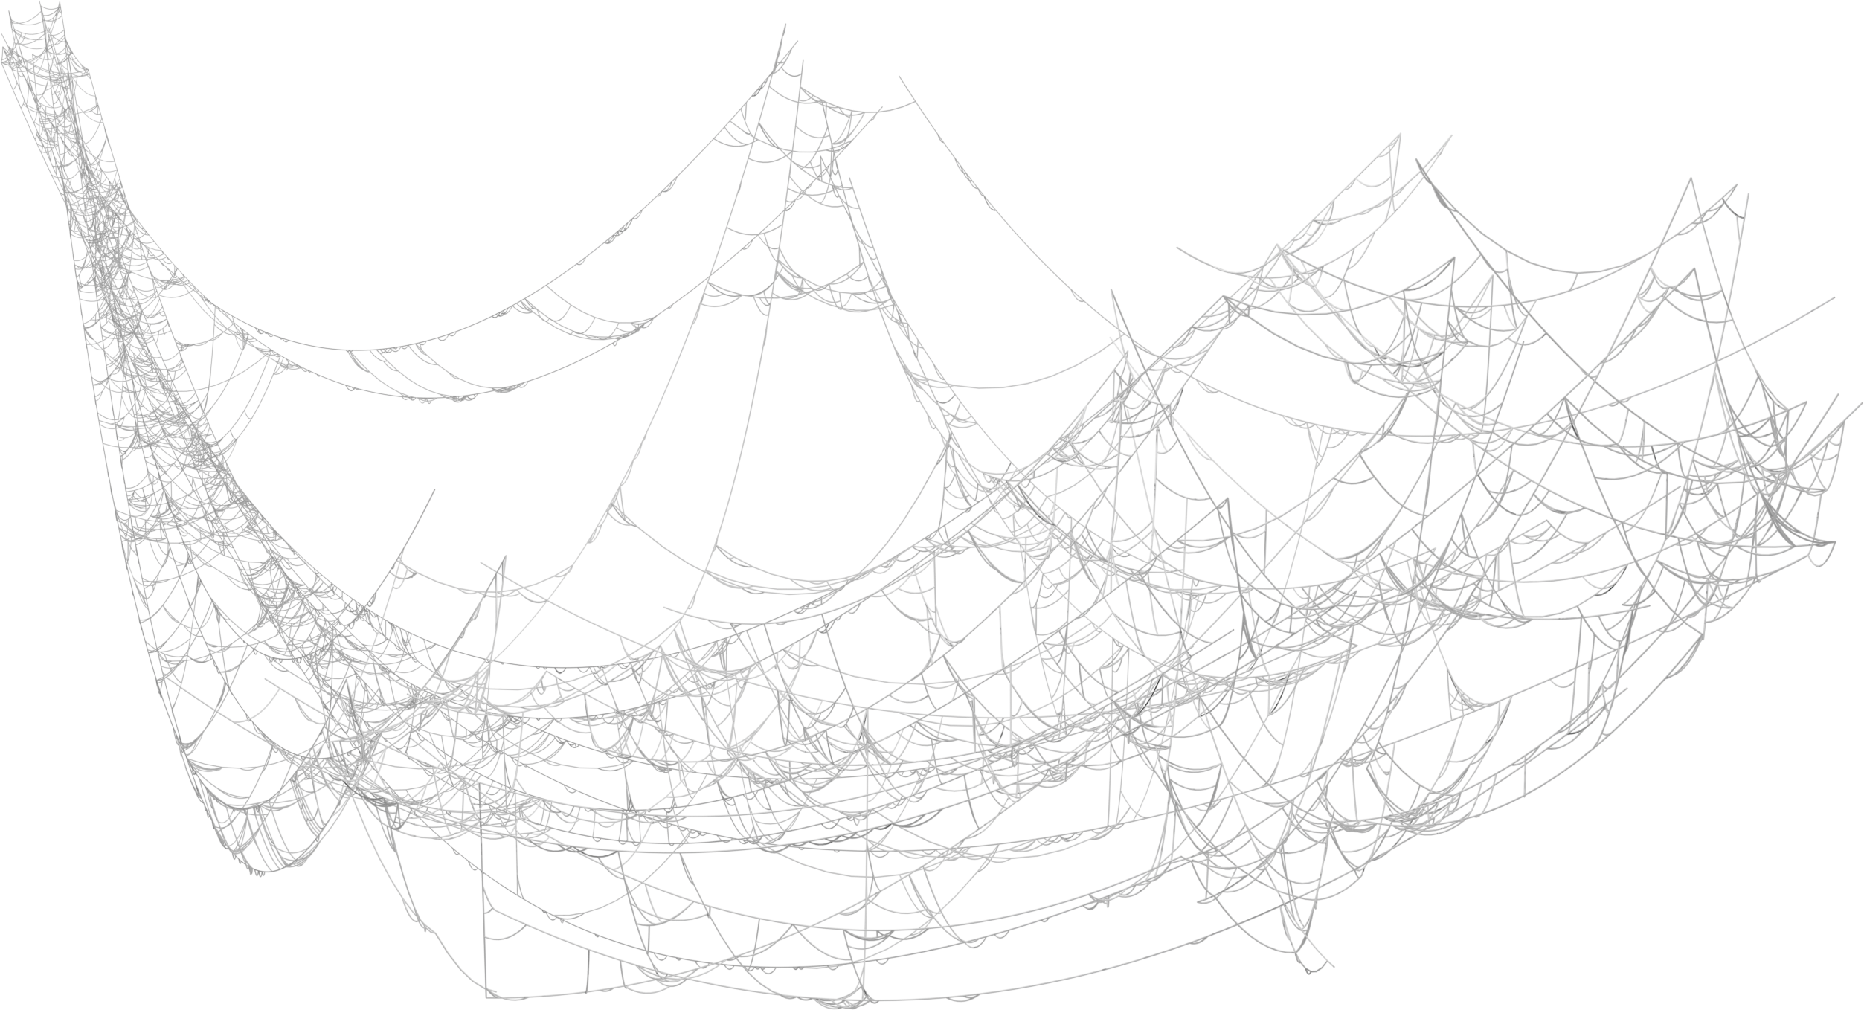














FALL CLUB & RESOURCE FAIR
JOIN US
IF YOU DARE
WED., OCTOBER 30TH, 2024

Slide 21

THE MARKET
EVERY 4TH TUESDAY OF THE MONTH
  September Market served 200 families
  October 22nd, 2024 at 11:00 AM
  Located at the Courtyard in front of building 1600
  Open to all!

Slide 22
LAS POSITAS COLLEGE STUDENT GOVERNMENT
THANK YOU

Slide 23



Slide 24
Academic Senate Update
Ashley Young
Academic Senate President

Slide 25
Academic Senate Update October 2024
Artificial Intelligence Honesty Policy
2 FLEX Day Sessions:
Workshop to write your own class policy and give input into our campus-wide policy
Panel of faculty, admin, and students to discuss policy and procedures if a student violates your policy

Slide 26
Common Course Numbering Phase I: 6 courses
ENGLC1000 Academic Reading and Writing
ENGLC1001 Critical Thinking and Writing
COMMC1000 Introduction to Public Speakin
STATC1000 Introduction to Statistics
POLSC1000 American Government and Pol
PSYCC1000 Introduction to Psychology
In Process of updating courses through our Curriculum Committee to comply with new state course requirements to be implemented next fall

Slide 27
Common Course Numbering Phase 2:
23 courses in 12 areas
English
History
Economics
Art History
Biology
Chemistry
Math
Astronomy
Anthropology
Communication Studies
Sociology
Child Development
Currently getting input from faculty across state via surveys and then smaller
12-person workgroups to create common descriptors for these courses

Slide 28
LPC Foundation Update
Ken Cooper
Executive Director, LPC Foundation

Slide 29


Slide 30
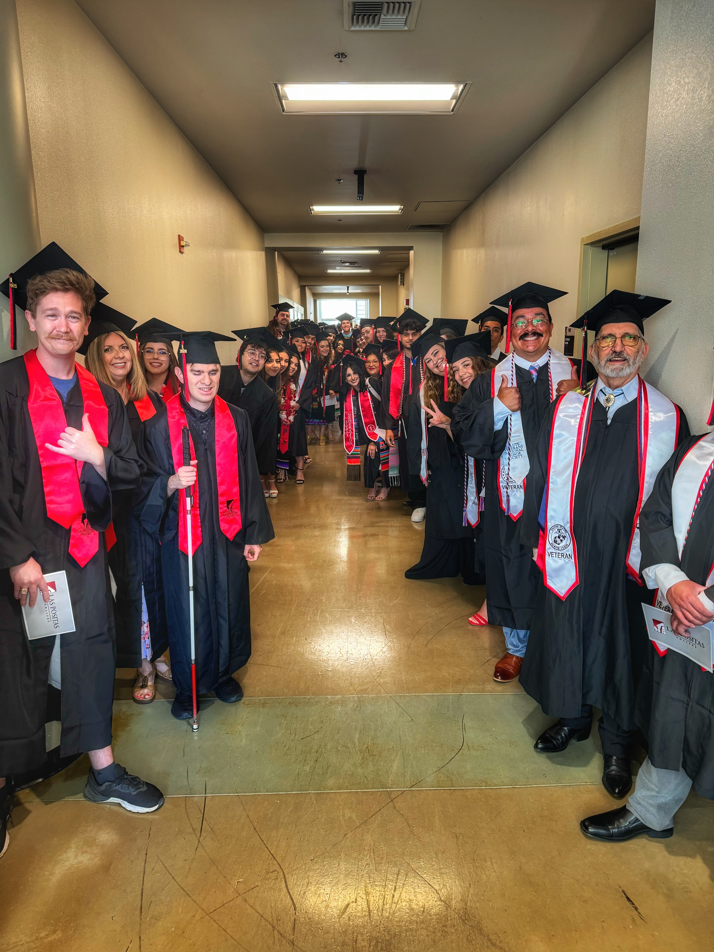
Thank You!
The Las Positas College Fund was launched in 2023
$89,500 raised through 315 gifts averaging $284 each
Unrestricted funds provide the most flexibility to address campus-based needs
2

Slide 31
When you give, we give back.
Areas supported through unrestricted giving:
Naked Magazine
Big Band Workshop & Performance
Literary Arts Festival
Aaron De La Cruz Presentation
Music Ensemble Performances
Automotive Technology Community Event
3

Slide 32

LPCF_Logo_Revision.png
The Opportunity
Las Positas College represents one of the best values in higher education and career training available today. With an excellent faculty & staff and unmatched, facilities, LPC plays a vital role in helping to prepare our students for the next steps in their educational and career journeys.
The Las Positas College Fund helps attract and award dollars that create truly exceptional educational experiences. Experiences that often go unmet by available state dollars and personal resources.

Slide 33

LPCF_Logo_Revision.png
The Opportunity
Make a contribution to the Las Positas College Fund
Sign up for monthly payroll deduction or give via credit card/digital wallet
Scan this code ☺

Slide 34
LPCF_Logo_Revision.png
Circle of Excellence
Circle of Excellence members are special friends and supporters of Las Positas College who are uniquely committed to student success. Circle of Excellence donors make a minimum $1,000 unrestricted gift to help the foundation respond to the campus‘ most critical unmet needs including; student scholarships, special campus program grants, vital student services and special projects. Circle of Excellence members play a vital role in cultivating the legacy of excellence at Las Positas College and supporting the college's mission, vision & values.

Slide 35

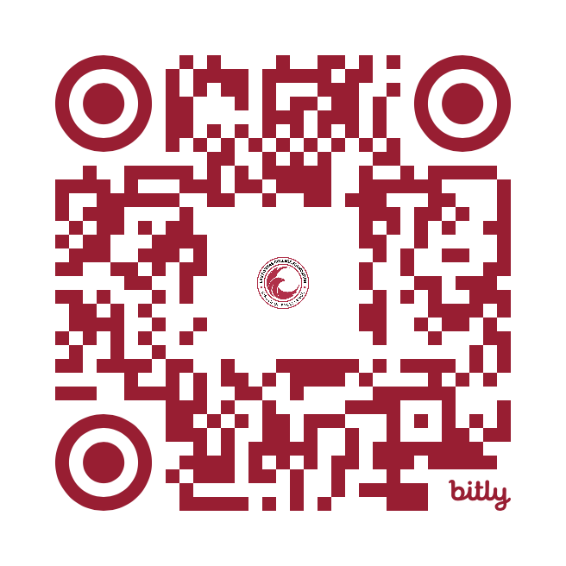
LPCF_Logo_Revision.png
Circle of Excellence

Slide 36
Budget Update
Sean Brooks
Vice President, Business & Administrative Services

Slide 38
Enrollments by Modality
Rajinder S. Samra
Director of Research, Planning, and Institutional Effectiveness

Slide 39
Enrollments by Modality
Fall 2019 vs. Fall 2024 (preliminary)
Presenter: Rajinder S. Samra
Director of Research, Planning, and Institutional Effectiveness
October 2, 2024
Town Meeting
Notes:
- There’s a lot of data that I could have covered.
- It takes a village to address transfer.
High leveraged.

Slide 40
Class Modalities
In Person Only: live, on campus meetings that take place physically, face-to-face.
Asynchronous online: All activities and work are done online at
any time of the day or night in Canvas.
Synchronous online: All class meetings occur live online on scheduled
days and times in Zoom.
Synchronous online and asynchronous online: Scheduled live, online meetings are
combined with online asynchronous activities.
Hybrid: Scheduled on-campus meetings are combined with online asynchronous activities.
HyFlex: Instruction is conducted on campus and online (synchronous and/or asynchronous).
Notes:
- Seeing it by demographics to see what is driving the decrease in numbers.
Going over the first data slide slowly so that we are on the same page
Using bubbles to show the relative size of populations

Slide 41
Enrollments (Seats Filled)
Notes:
- Seeing it by demographics to see what is driving the decrease in numbers.
Going over the first data slide slowly so that we are on the same page
Using bubbles to show the relative size of populations

Slide 43
Enrollments (seats filled) by Modality of Instruction
Fall 2019 vs. Fall 2024
N = 25,045
N = 24,259

Slide 44
Student Headcount
Notes:
- Seeing it by demographics to see what is driving the decrease in numbers.
Going over the first data slide slowly so that we are on the same page
Using bubbles to show the relative size of populations

Slide 46
Online Only Students
Notes:
- Seeing it by demographics to see what is driving the decrease in numbers.
Going over the first data slide slowly so that we are on the same page
Using bubbles to show the relative size of populations

Slide 47
N = 9,061
N = 8,365

Slide 48
N = 4,652
N =4,220
N = 4,224
N = 3,964
N = 185
N =181

Slide 49
N =
1,671
N =
1,945
N =
360
N =
376
N =
408
N =
388
N =
2,695
N =
2,402
N =
56
N =
31
N =
2,950
N =
2,405
N =
670
N =
663
N =
251
N =
155

Slide 50
N =
3,039
N =
3,698
N =
1,801
N =
1,373
N =
1,314
N =
890
N =
1,010
N =
711
N =
917
N =
734
N =
573
N =
555
N =
407
N =
404

Slide 51
N =
5,780
N =
5,308
N =
547
N =
607
N =
1,054
N =
1,099
N =
256
N =
226
N =
371
N =
350
N =
931
N =
657

Slide 52
Thanks for your time!
Notes:
- Seeing it by demographics to see what is driving the decrease in numbers.
Going over the first data slide slowly so that we are on the same page
Using bubbles to show the relative size of populations

Slide 53
Artificial Intelligence & Academic Integrity Update
Catherine Suarez, Spanish Professor;
Catherine Eagan, English Professor; and
David Montelongo, Chemistry Professor

Slide 54
Statewide Happenings
Resolution of the Board of Governors California Community Colleges Number 2024-17
Digital Center for Innovation, Transformation and Equity
Vision 2030’s Three Goals: Diversity, Equity, Inclusion, and Accessibility (DEIA)
Notes:
Catherine

Slide 55
On the Horizon
Flex Day sessions
  A panel discussion about how to approach AI used by students in our classrooms. The panel will include students, classified representatives, faculty, and deans.
  A workshop designed to learn how to write your own HUMANS-centered AI integrity statement. Do you want to use an Honor Code in you class? Consider what consequences you want to have for different AI situations with your students.
TLC workshops
CVC @ONE webinar series on AI in the online classroom begins later this month
CVC @ONE training in Spring 2025
Notes:
Catherine

Slide 56
Coming in Canvas
Instructor-generated discussion summaries
AI-generated search tool
Tools that plan lessons, generate questions, create discussion prompts, etc.
Language translation for Inbox and Discussions
Rubric generation
More AI tools are expected

Slide 57
Academic Honesty Policy Revisions

Slide 58
Academic Honesty Statement
Statement of College values
Greater inclusion of all students, not just those who earn “a high grade” or achieve “mastery”
New statement of commitment to student education on how to create original work/do their own work and avoid cheating and plagiarism
Statement of College’s response to academic dishonesty that moves away from “does not tolerate” language and toward student learning and integrity
Statement of penalties for academic dishonesty
Notes:
Katie/David

Slide 59
Statement of Affirmation by the Las Positas College Academic Senate on Academic Integrity
Proposed renaming of statement
Question of whether to repeat Academic Honesty Statement at the beginning
Added definition of skills and knowledge needed for original student work (needs input from STEM folk)
Caveat that student will sometimes develop skills and knowledge with the help of instructor, tutors, study groups, etc.
Acknowledgement that various technologies, resources, etc. will sometimes be used in creation of student work, but only with permission of instructor and in certain instructor-defined contexts
Notes:
Katie/David

Slide 60
Statement of Affirmation by the Las Positas College Academic Senate on Academic Integrity
End goal of this kind of original student learning and practice allowing the student to develop creative and innovative solutions to academic and real-world problems
In definitions of cheating and plagiarism, added mention of unauthorized use of online sources and artificial intelligence
Review of definitions of cheating and plagiarism to make sure that they are umbrella definitions that would apply to different types of assignments and assessments in different disciplines
Added note that various instructors and disciplines will use modeling, collaboration, and/or artificial intelligence to complement student work but that such use is only authorized by the instructor in specific settings
Added footnotes
Notes:
Katie/David

Slide 61
5 Minute
Wellness Break

Slide 62
Facilities Master Plan Update
Megan Gaunce & Melinda Nish
Cambridge West Partnership, LLC

Slide 63

LAS POSITAS
C O L L E G E
TOWN HALL
10.02.2024
Notes:
MG

Slide 64




INTRODUCTION: YOUR PLANNING TEAM
30
7
2B
600M
COMMUNITY
COLLEGES
EDUCATIONAL
CENTERS
DOLLARS
DOLLARS
DEVELOPING BUILDING/FACILITIES PROGRAMS
STATE FUNDING FOR CAPITAL CONSTRUCTION PROJECTS
EDUCATIONAL AND FACILITIES MASTER PLANS
Developed Facilities Master Plans to Support Successful Bond Programs
Institutional Support for Specialized Educational Projects
FACILITIES MASTER PLAN UPDATE
64
Notes:
GW

Slide 65
What is a Facilities Master Plan?
…An implementable, data driven, framework for development that supports and is tied to the mission of the College.
FACILITIES MASTER PLAN UPDATE
65
Notes:
GW

Slide 66

THE FOREST, NOT THE TREES
The intent of our discussions is the "forest, not the trees". We are looking for a discussion of what is important in the planning of the campus as a whole - facilities, infrastructure, open space, etc. We are looking for ideas beyond the detail of "I need a sink here" or "an outlet there", this is an opportunity to express what is important to you in the planning of your campus to support student success.
FACILITIES MASTER PLAN UPDATE
66

Slide 67
GOALS
Provide the optimal physical setting to support the academic mission of the college
Provide a blueprint for campus development and a resource for decision making
Campus Involvement
in the process
FACILITIES MASTER PLAN UPDATE
67
Notes:
GW

Slide 68




GUIDING PRINCIPLES | OBJECTIVES
IMPROVE EFFICIENCY /
UTILIZATION OF CAMPUS
Improve zoning/ space utilization
Maximize functional space
  Provide Hi-flex, resilient spaces
  Renovate facilities to meet evolving needs (21st century learning)
Evaluate non-functional space
BROADEN DEFINITION OF SUSTAINABILITY
Environmental + Community + Financial
SIMPLIFY IMPLEMENTATION
TO MAXIMIZE VALUE
Limit number of moves
Minimize need for swing space
ENHANCE STUDENT SUCCESS
Support Student access
  Physical access (Universal Access Principles)
  Services & Student life
Balance and support socialization and formal learning
Maintain student safety
FACILITIES MASTER PLAN UPDATE
68
Notes:
MG

Slide 69
PLANNING OUTCOMES
Space requirements addressed for the future
Frames future development and the continued evolution of the campus, including:
  Identification of specific building / facilities programs
  Placement / Identification of repurposed / renovated / replaced / new facilities
  Identification of enterprise / joint use opportunities
  Improvement of major campus systems
  Identification of needed site amenities
Identify cost and timeline for Master Plan implementation
FACILITIES MASTER PLAN UPDATE
69
Notes:
MG

Slide 70
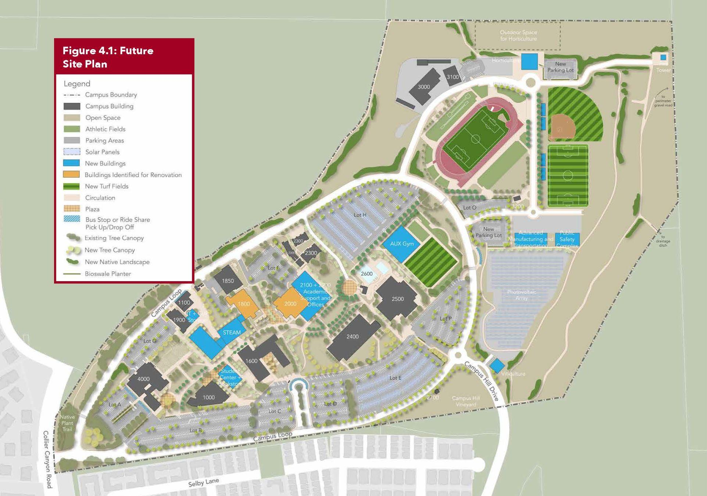


2019 FACILITIES MASTER PLAN
COMPLETED
Horticulture with Parking
Advanced Manufacturing & Transportation
Public Safety Complex
Academic Support & Offices
Viticulture
Building 2000 Renovation (Library)
IN DESIGN
STEAM & Building 1800 Renovation
REMAINING 2019 FMP PROJECTS
Student Center
AUX Gym & Fields
IT Storage
FACILITIES MASTER PLAN UPDATE
70

Slide 71
PROJECTED TIMELINE
Understanding of Existing Conditions
Broad Concepts /Planning Priorities
Data Assessment/
Site Tours
Interviews/
Survey
Draft Plan
Finalization
1
2
3
4
5
6
Spring 2024
Fall 2024
Spring 2025
FACILITIES MASTER PLAN UPDATE
71

Slide 72

UPCOMING ENGAGEMENT
10/2 Town Hall
10/9 Academic Senate
10/15 Executive Facilities Team
10/23 Student Government
10/28 Monthly Facilities & Sustainability
11/7 Classified Senate
11/19 Executive Facilities Team
11/21 College Council
11/25 Monthly Facilities & Sustainability
FACILITIES MASTER PLAN UPDATE
72

Slide 73

COLLEGE ENGAGEMENT INTERVIEWS
+ Student Government
25
Deans, Faculty, Staff
President & VPs
5
Participatory
Governance
Facilities & Sustainability
Executive Facilities
3
Campus Visits
SURVEY INCLUDES:
Faculty/Staff : 94
Students : 377
+ 1
Board
Workshop
FACILITIES MASTER PLAN UPDATE
Notes:
MG

Slide 74
FTES TRENDS
LAS POSITAS COLLEGE FTES
 | 2014-15 | 2015-16 | 2016-17 | 2017-18 | 2018-19 | 2019-20 | 2020-21 | 2021-22 | 2022-23 | 2023-24
Credit | 6,469 | 6,710 | 6,969 | 7,037 | 6,984 | 6,894 | 6,234 | 5,362 | 5,208 | 5,875
Non-Credit | - | - | - | - | - | 35 | 34 | 30 | 77 | 59
TOTAL | 6,469 | 6,710 | 6,969 | 7,037 | 6,984 | 6,929 | 6,268 | 5,392 | 5,285 | 5,934
Annual College FTES Median Decline is -0.7% : 2014/15 – 2022/23
LP FTES in 2017/18 was 7,037 (height of enrollment)
LP FTES in 2022/23 was 5,285 (decline of 1,752 FTES since 2017/18)
FACILITIES MASTER PLAN UPDATE
74

Slide 75

MODALITY SPLIT
60%
40%
IN PERSON
ONLINE
FACILITIES MASTER PLAN UPDATE
75

Slide 76


OUTCOMES: INTERVIEWS | SURVEYS
LABS
CLASSROOMS
Extremely strong usage for several disciplines and some opportunity for increased usage
  Currently several labs at/beyond capacity for Biology, Chemistry, Physiology, Anatomy
  STEAM building will allow for increased capacity for art and science lab spaces
Classroom capacity exists for continued restoration and growth
60/40 modality split – expected to remain & stabilize near this level
Strong multi-discipline use for general lecture classrooms
Well equipped lecture rooms, particularly in new buildings
FACILITIES MASTER PLAN UPDATE
76

Slide 77
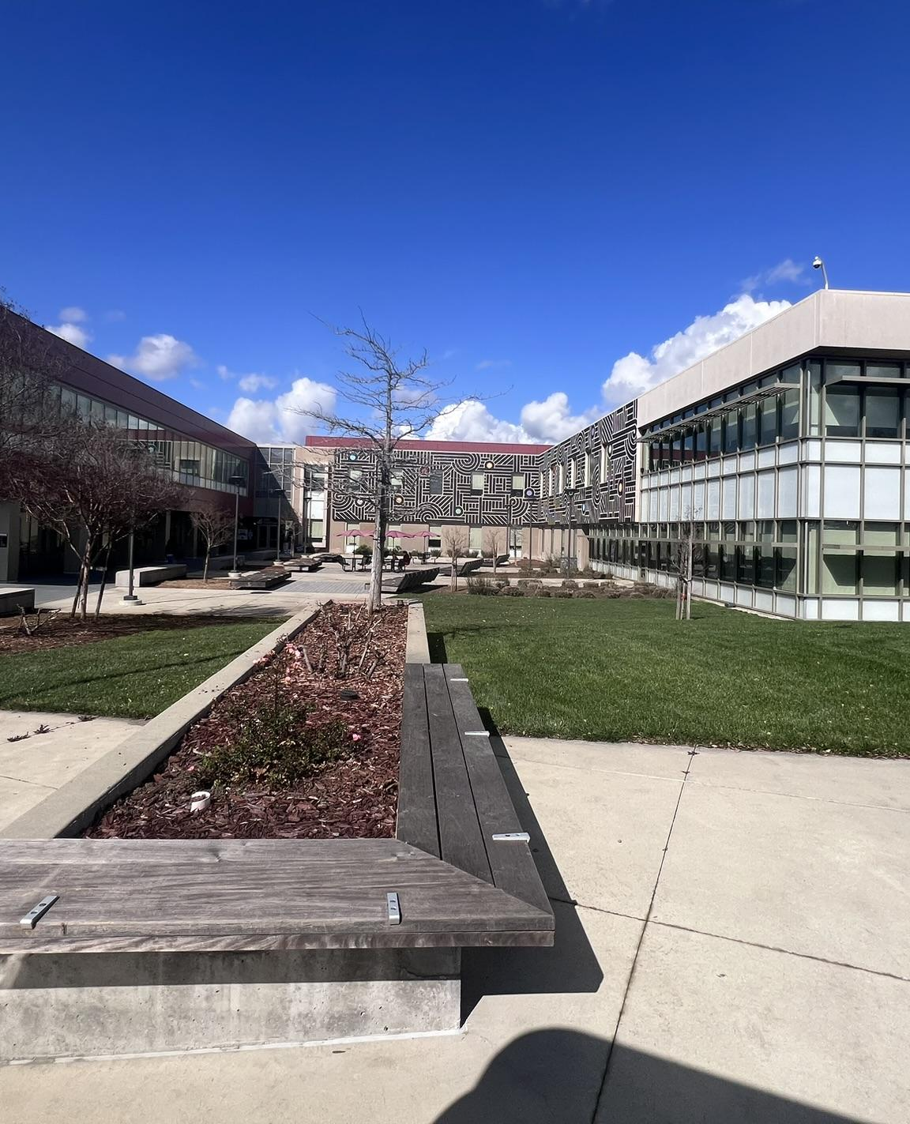
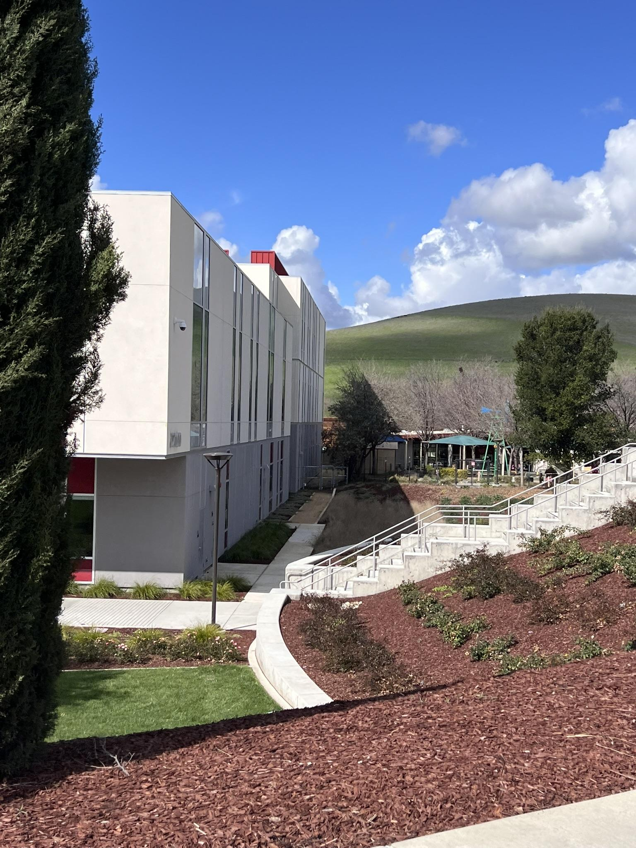
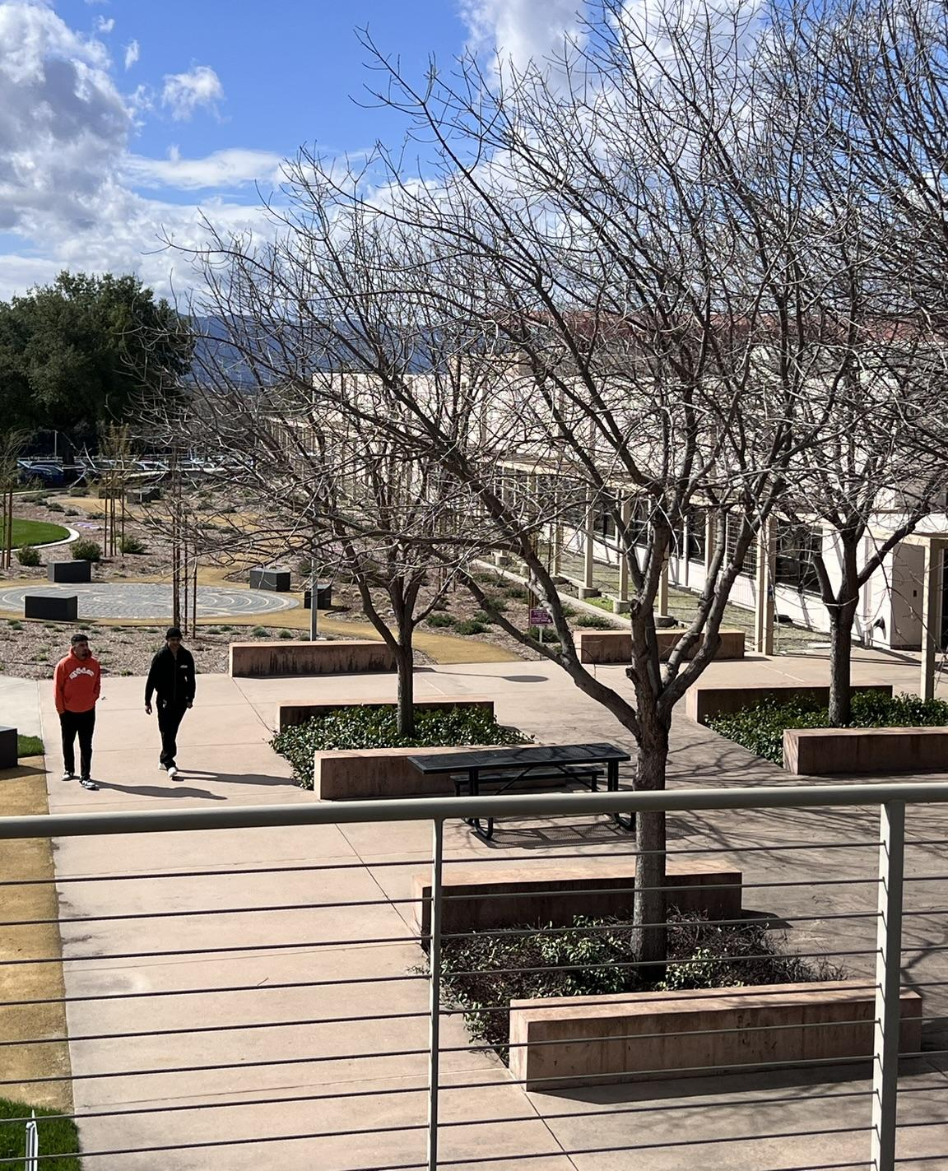
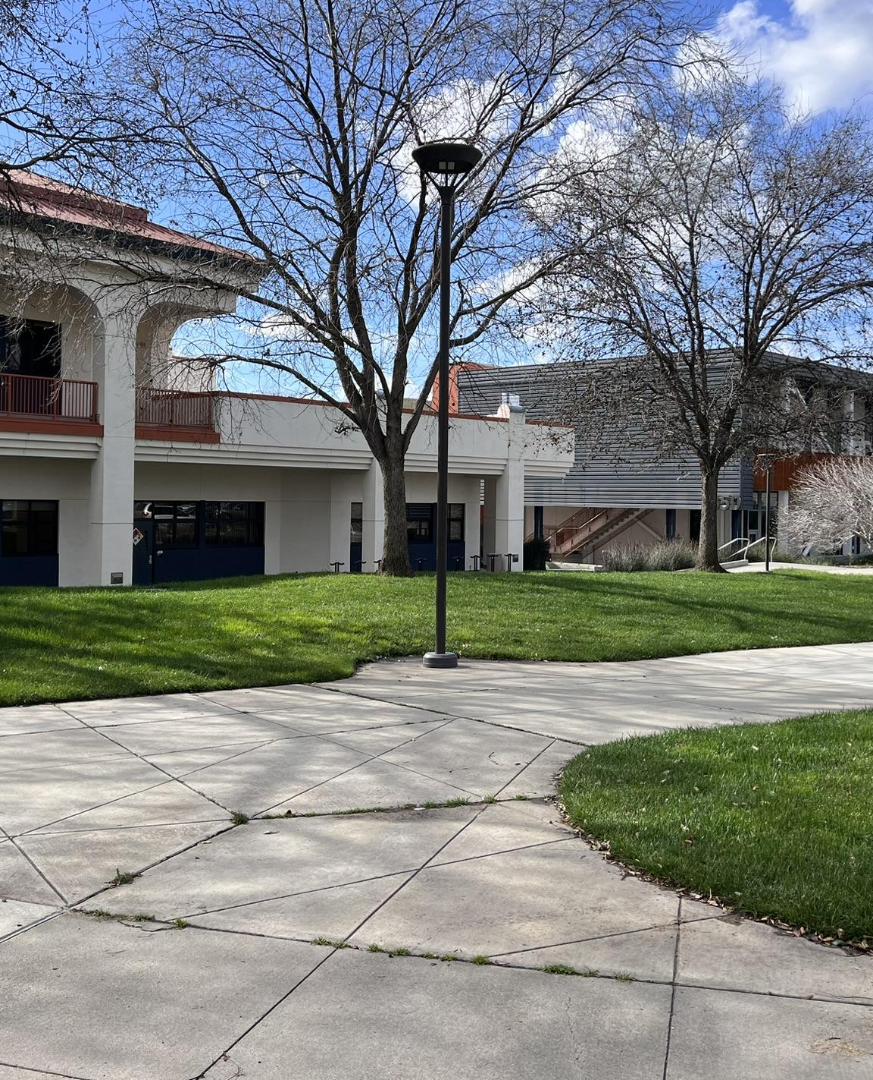
OUTCOMES: INTERVIEWS | SURVEYS
Younger campus, well maintained with recent significant improvements
FACILITIES MASTER PLAN UPDATE
77

Slide 78





OUTCOMES: INTERVIEWS | SURVEYS
Priority need for facilities is student centered spaces
STUDENT
GOVERNMENT
BASIC
NEEDS
STUDENT
HEALTH SERVICES
SPECIAL PROGRAMS/
EQUITY GROUPS
MEETING/
CONFERENCE/ EVENT SPACE
FACILITIES MASTER PLAN UPDATE
78

Slide 79





OUTCOMES: INTERVIEWS | SURVEYS
ATHLETICS
STUDENT HOUSING
COMMUNITY USAGE
WAYFINDING
BRANDING
FACILITIES MASTER PLAN UPDATE
79

Slide 80
2019 FACILITIES MASTER PLAN
COMPLETED
Horticulture with Parking
Advanced Manufacturing & Transportation
Public Safety Complex
Academic Support & Offices
Viticulture
Building 2000 Renovation (Library)
IN DESIGN
STEAM & Building 1800 Renovation
REMAINING 2019 FMP PROJECTS
Student Center
AUX Gym & Fields
IT Storage
FACILITIES MASTER PLAN UPDATE
80

Slide 81
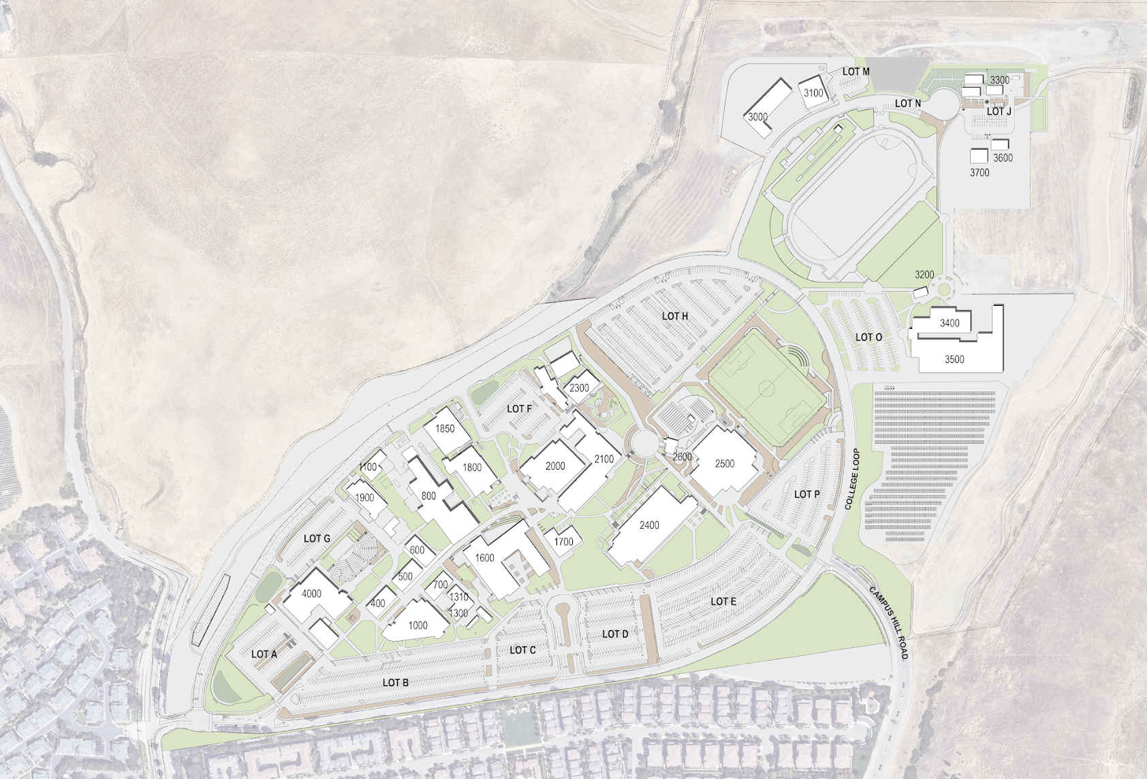








PLANNING CONCEPTS & STRATEGIES
FACILITIES
GATEWAYS/LANDSCAPE
UNIVERSAL ACCESS
MINOR RENOVATIONS
1. Student Center
2. Building 400 Renovation
3. Building 2400 Renovation
4. Student Housing
6
7
5. Auxiliary Gym
5
6. Athletic Fields
4
7. Events Plaza
12
11
8. Southwest Entry
5
9. Campus Entry / Connection
4
10. Campus Beautification
11. Lot O Expansion
3
10
2
12. Establish/Enhance Access
1
8
9
1600 + 4000
FACILITIES MASTER PLAN UPDATE
81

Slide 82
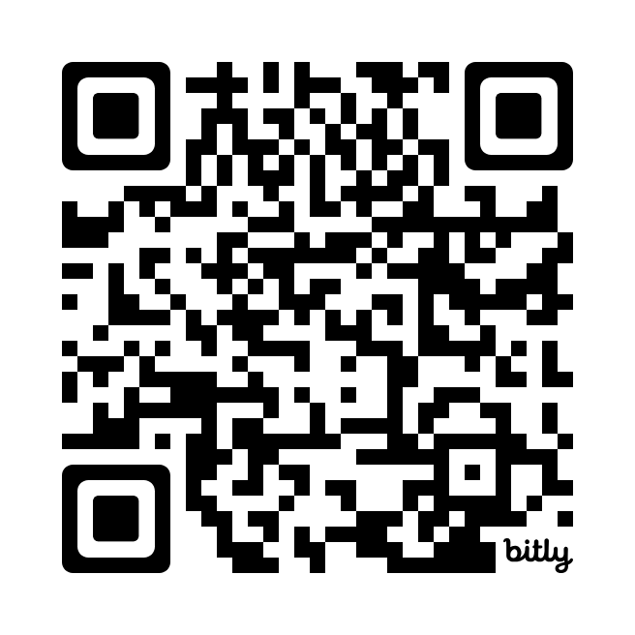
PROVIDE FEEDBACK
Notes:
MG

Slide 83
Thank You

