Slide 1
Town Meeting
ANNOUNCEMENTS
September 5, 2012

Slide 2
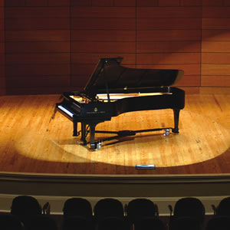
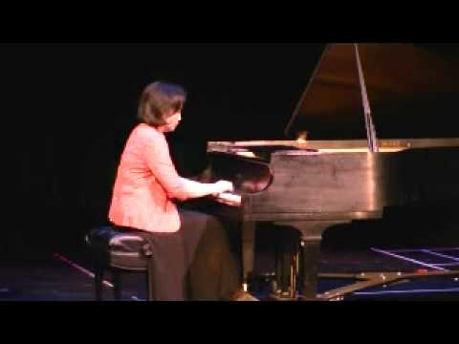
Faculty Showcase
Sept. 6
7:30 p.m.
Mertes Center for the Arts

Slide 3
Athletics
Women’s Soccer
Long Beach – Sept. 7
Men’s Soccer
Modesto– Sept. 6
Feather River – Sept. 8
Merritt – Sept. 11
Cross Country
@ Fresno – Sept. 8

Slide 4
Clinton Global Initiative Club
Tri-Valley Creeks to Bay Day Sat., September 15, 2012 9 a.m. to Noon
Register by Monday, September 10
www.trivalleycreeks.org
More Info:
Catherine Suarez
(925) 424-1212 or csuarez@laspositascollege.edu

Slide 5
ASLPC Club Rush
September 5 – 6 on the Campus Boulevard

Slide 6
Fall 2012 Staff TLC Workshops
Sign up for a Fall 2012 Teaching and Learning Center workshop and/or appointment by going to the Staff Development home page and clicking Workshops.
http://www.laspositascollege.edu/staffdevelopment/workshops.php

Slide 7
Student Transfer Opportunities
UC Berkeley
September 6
10:00 – 2:30
Appointment sign up available in Building 700!
CSU East Bay
September 10
9:30 - 2:30

Slide 8
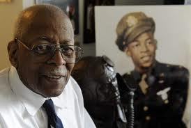
Lt. Col. Alexander Jefferson: Tuskegee Airman
Wednesday, October 3
12:30 PM
Main Stage Auditorium
Mertes Center for the Arts
More Info:
Teri Ann Bengevino
925.424.1287 TBengiveno@laspositascollege.edu

Slide 9
Reading and Writing Center
THE READING AND WRITING CENTER FALL OPENING
SEPTEMBER 10TH IN THE READING ROOM (2401)
STUDENTS GET 1-ON-1 TUTORING WITH AN ENGLISH INSTRUCTOR!
MONDAY THROUGH THURSDAY 10:30 - 2:30
TUESDAY AND WEDNESDAY 4:00 – 6:00
More info:
Richard Dry
rdry@laspositascollege.edu
www.laspositascollege.edu/ENG/writingcenter.php

Slide 10
Italian Film Festival
Italian Film Festival
OCTOBER 12th and 13th
More Info:
Teri Ann Bengevino
925.424.1287 TBengiveno@laspositascollege.edu

Slide 11
CARE Grants
CARE has provided $1500 in grants specifically for Las Positas College. These grants are intended to help faculty and staff fund projects to “improve services to the college”!
More info: http://www.care-news.org/grants/index.htm
Deadline for Application:
September 21, 2012

Slide 12
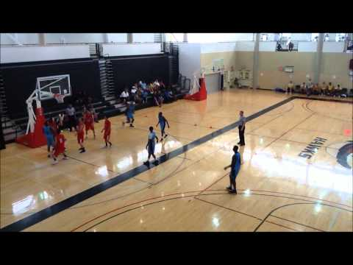
WELLNESS 101 STARTS SEPT. 14
Basketball and Badminton
LPC GYM
Fridays 12:30 – 1:30
All Faculty and Staff
Are
Welcome!
Sign up through Community Ed
More Info: Tom Dodge

Slide 13
Community Events
ValleyCare Educational Seminar
September 10, 2012 ~ 6:00 PM
Valley Care Medical Plaza
5725 W. Las Positas, Suite 220, Pleasanton
Dr. Kavitha Raj will discuss common lymphomas and leukemias as well as risk factors, diagnosis and treatment. FREE!
http://www.valleycare.com/educationseminars

Slide 14
Community Events
Bill Paskewitz featured show and
Article in www.110mag.com at:
http://www.myvirtualpaper.com/doc/110mag/110vp_sept.2012/2012083101/#76

Slide 15
Announcements Wanted
Send Town Meeting Announcements to
Sharon Gach by
Noon on the day before each Town Meeting
Send WEBSITE Announcements to
Sharon Gach (sgach@laspositascollege.edu) ANY TIME.
Use form at bottom of News and Events Column!
Send to Sharon Gach items for new pages on:
Student Achievements
http://www.laspositascollege.edu/news/STUDENTACHIEVEMENTPAGE.php
and
LPC Staff Excellence
http://www.laspositascollege.edu/news/STAFF-fACULTY-aDMIN-eXCELLENCE.PHP

Slide 16
September 5, 2012
For complete announcement details, please visit the Town Meeting page on the Intranet:
http://grapevine.laspositascollege.edu/administration/TownMeeting.php

