Slide 1

Welcome
Dr. Dyrell Foster, College President
LPCSG
Naomi Mangini, LPCSG President
What’s Right at LPC
Dr. Dyrell Foster, College President
Academic Senate Awards
Classified Senate Awards
Don Milanese Award
Break
Retirements
30-Years of Service Awards
20-Years of Service Awards
Various Presenters
Various Presenters
Various Presenters
Aubrie Ross, Classified Senate President
Dr. Dyrell Foster, College President
All Attendees
Ashley Young, Academic Senate President
5-Years of Service Awards
10-Years of Service Awards
Various Presenters
Dr. Dyrell Foster, College President
Tenured Faculty
Dr. Dyrell Foster, College President

Slide 2

36TH ANNUAL
COMMENCEMENT CEREMONY
SATURDAY, MAY 30, 2026 – 10:00 AM
LAS POSITAS COLLEGE
NEW LOCATION – OFF CAMPUS
Cornerstone Event Center
348 N Canyons Pkwy, Livermore
www.laspositascollege.edu/graduation

Slide 3
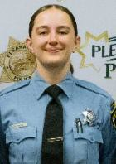
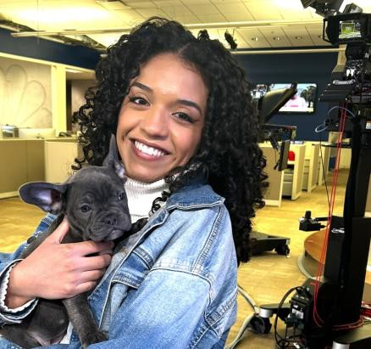
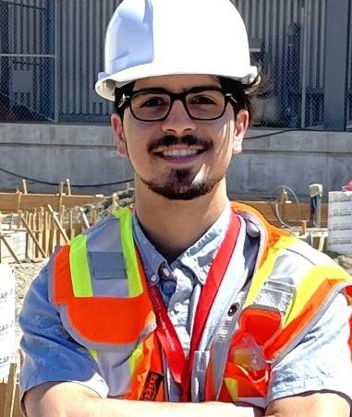

Got Work? Enroll in WRKX & Get College Credit!
If you have a job, internship, or steady volunteer work, get college credit by enrolling now in a Work Experience class: late-start, asynchronous, online, light weekly assignments, designed for students in all majors.
WRKX IS AN EASY WAY TO EARN UNITS!
“The class is great and everyone working and going to college should take it.”
BEFORE ENROLLING Visit the WRKX Page & FAQ Chart to Choose the Right Course and Section for You!

Slide 4


Slide 5


Slide 6


Slide 7


Slide 8
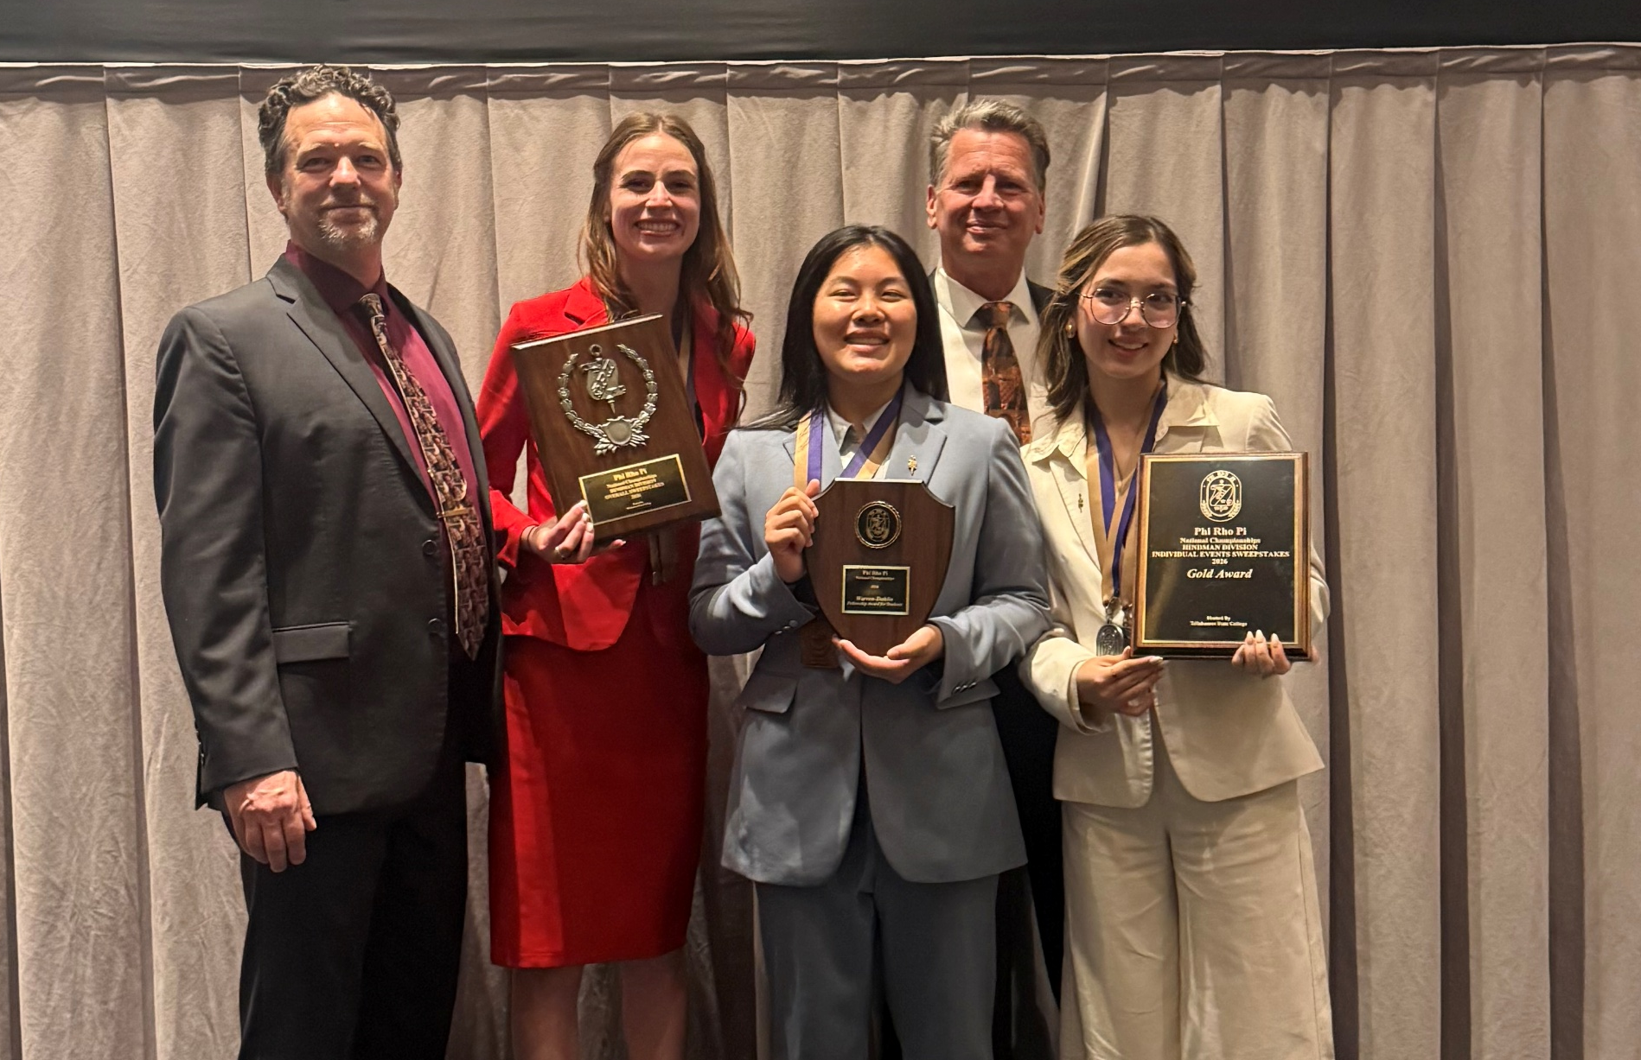
Talk Hawk are National Champions!
Team Gold – 3rd year in a row!

Slide 9
Swim & Dive 3C2A
State Championship Results
2 STATE CHAMPIONS:
Filuka Houborg won the women’s 1650 (mile) | School Record
Samantha Fehr won the women’s 100 breaststroke |School Record
This is the first time LPC has had two different state champions crowned in the same season – both setting school records.
Women’s Team – Finished 6th Overall
Men’s Team – Finished12th Overall – led by Nathanael Ridosko who broke two school records (200 and 500 freestyle)

Slide 10
Swim & Dive
Women’s - Season Summary
11 new team records
3 New Coast Conference records
12 All-American Performances (top 16 in the Country)
17 All-State Performances (top 16 in CA)
26 All-Conference Performances (top 3 in Conference)
Finished 6th in the State at 3C2A Championships in Costa Mesa out of 40 teams
2 State Champions – Both women went undefeated all season! Congratulations Filuka Houborg & Samantha Fehr
2026 Coast Conference Champions – 8th Title in the 14 year history of the program

Slide 11
Swim & Dive
Men’s - Season Summary
Finished 12th in the State at 3C2A Championships in Costa Mesa out of 40 teams
2nd Place in the Coast Conference – 7 Titles in the 14 year history of the program
2 new team records
7 All-American Performances (top 16 in the Country)
10 All-State Performances (top 16 in CA)
14 All-Conference Performances (top 3 in Conference)

Slide 12
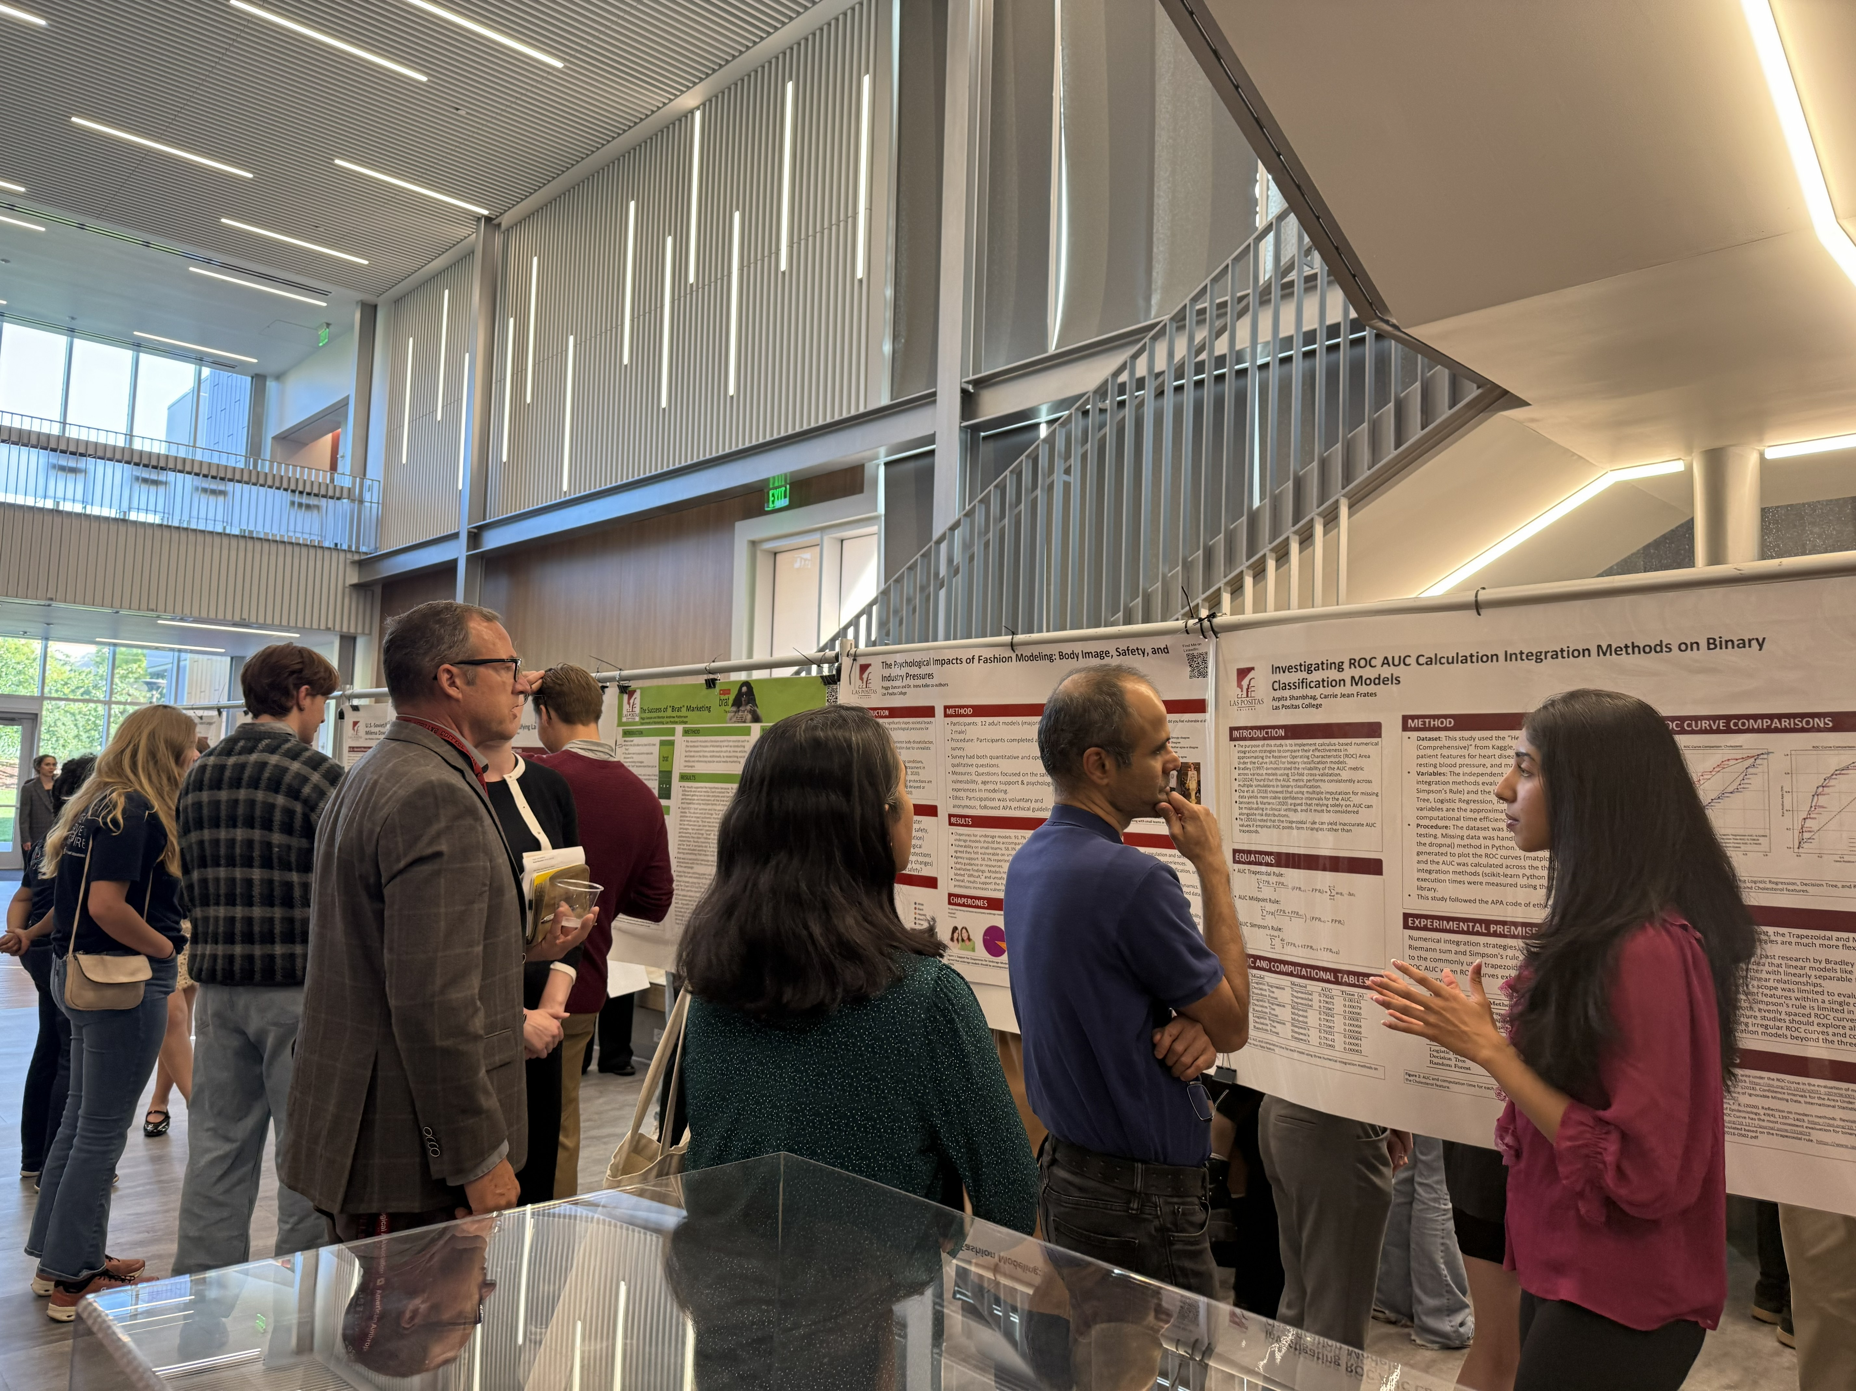
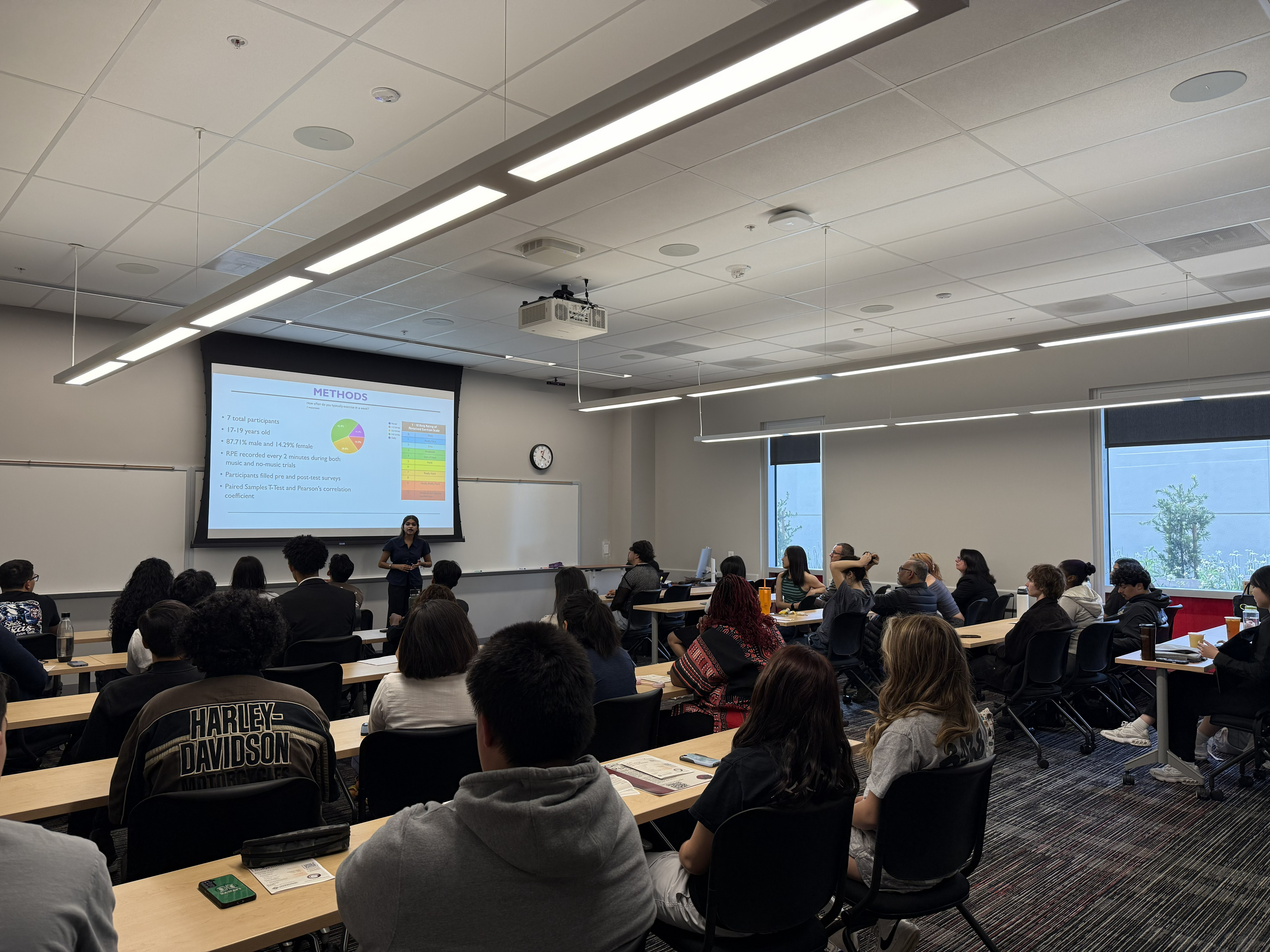
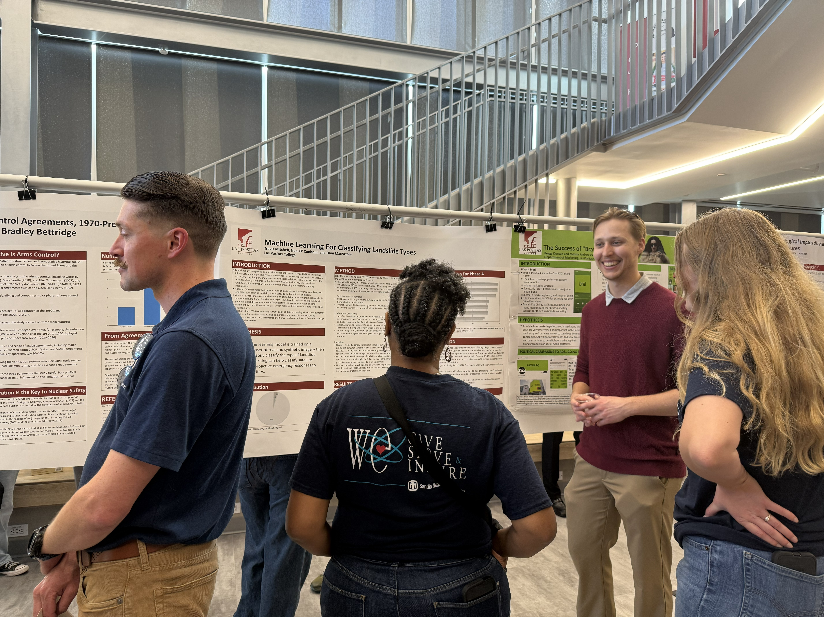
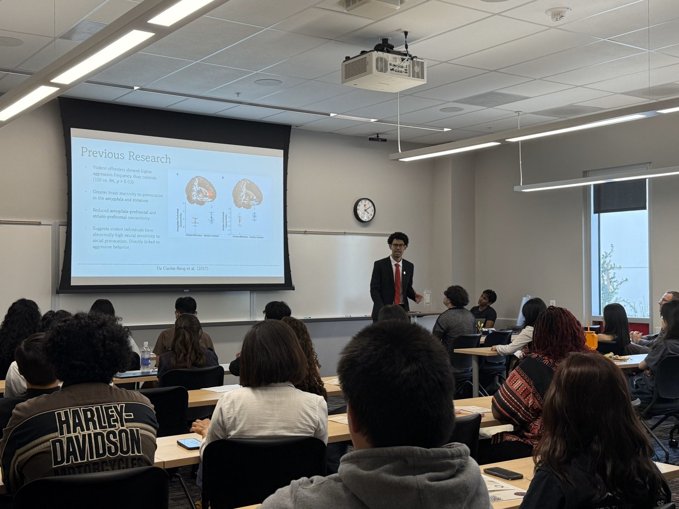
LPC Student Symposium
Spring 2026
22 posters & 24 live presentations
Special Thanks To: LPC Foundation, Honors Program Committee,
Honors Faculty, Jean O'Neil-Opipari, Carlos Hernandez, Chip Woerner.
1

Slide 13

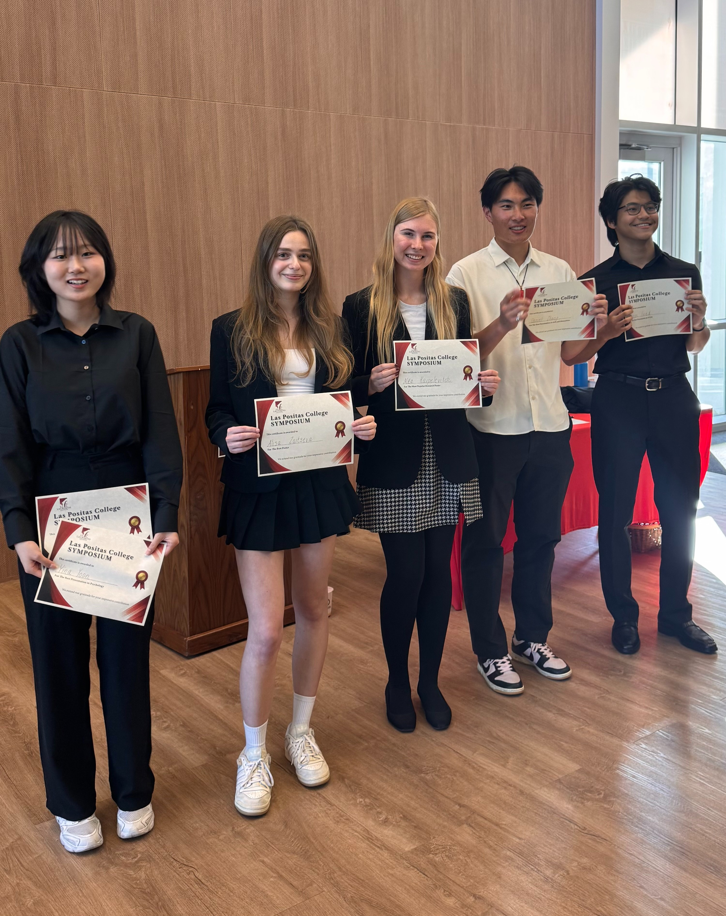
LPC Symposium Awards
​
Special Recognition: Jennifer Siders & Jean O'Neil-Opipari
Faculty Awards
Honors Research Mentor Award: Jeremiah Bodnar
Honors Innovation & Creative Leadership Award: John Rosen
Most Approachable & Committed Honors Faculty Award: Dan Cearley
Passion For Teaching in Honors Award: Alain Olivarrieta
Students Audience Awards
Most Popular Presentation: Yina Yoon
Most Popular Research Poster: Nika Karpelevitch
Students Awards (based on Faculty judges)
Best Poster: Alisa Zaitseva
Best Presentation in Media & Communications:
Mattea Guttierez
Best Presentation in Psychology: Yina Yoon
Best Presentation in STEM: Aaron Fried
Best Presentation in Arts & Humanities: Daniel Zhang
2

Slide 14
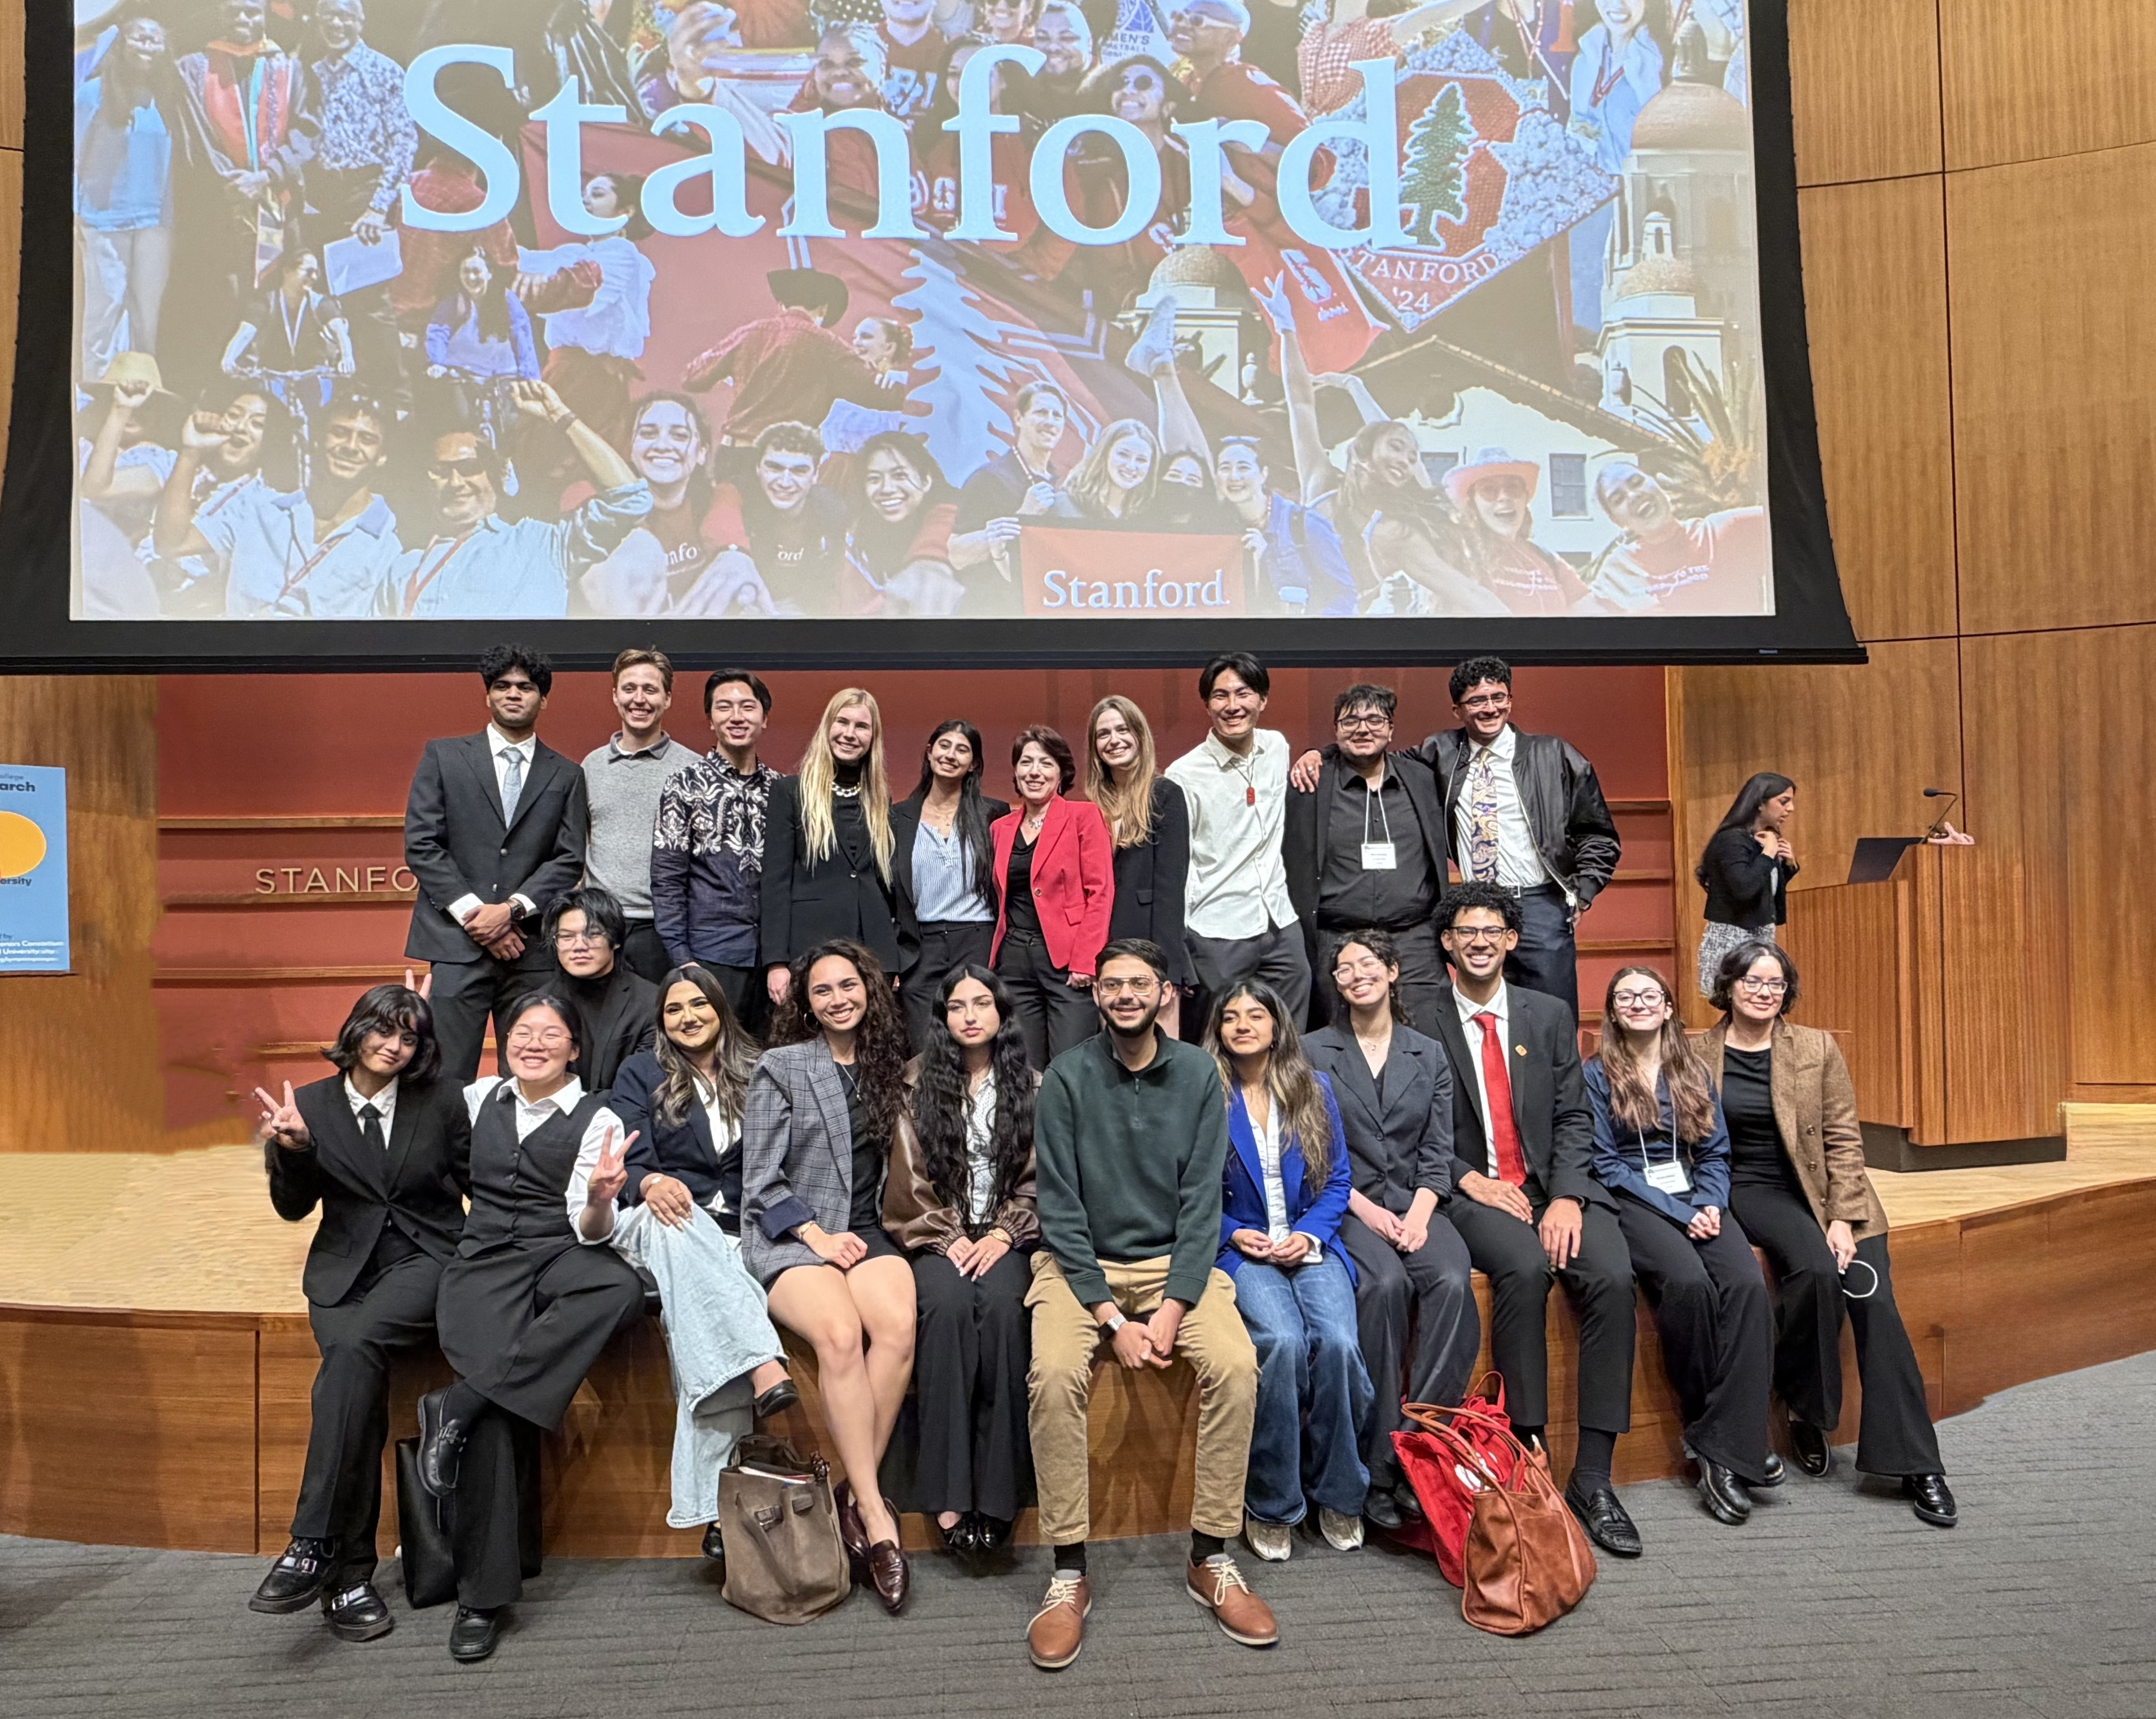
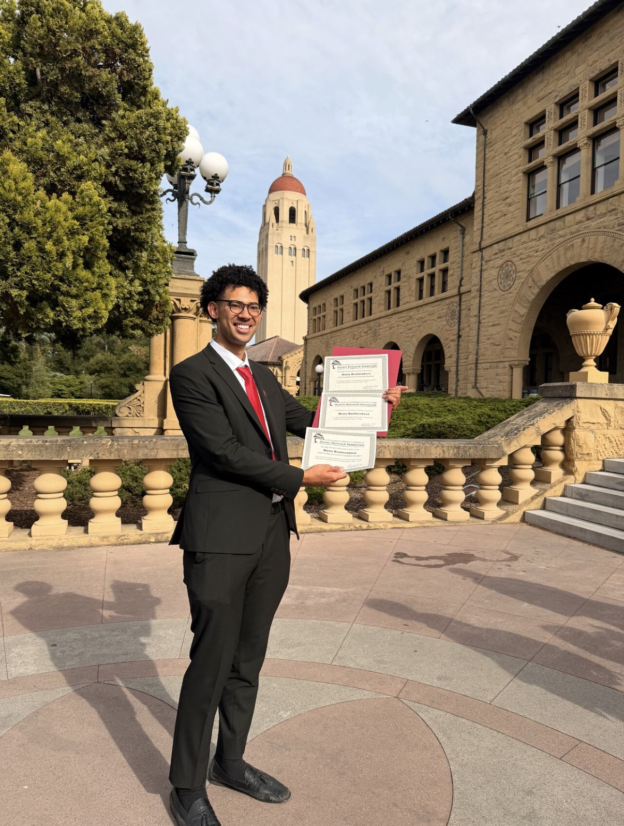
Bay Honors Symposium, Stanford
Spring 2026
21 students presented 19 projects, making LPC the most represented College in all of California
Manu Buatavatava was among 6 finalists, nominated for the Katherine BHC awards and the Hesslet.
Thank you to LPC Foundation, the faculty who joined, and especially the field trip drivers: Paul Sapford, Michael Ansell and Jennifer Siders.
3

Slide 15


Bay Honors Symposium, Stanford
Students Who Presented and their Faculty Mentors
Student | Mentor
Archisha Anshuman | Melissa Korber
Abigail Brandel | Michael Ansell
Crystal Zhu | Michael Ansell
Grant Yong | Soraya Renteria
Daniel Zhang | Soraya Renteria
Camryn Burke | Jeremiah Bodnar
Arya Ferozy | Jennifer Siders
Aaron Fried | Kai Blaisdell
Mattea Gutierrez | Akihiko Hirose
Nika Karpelevitch | Theresa Murray
Sidhant Parashar | Seth Lavender
Student | Mentor
Susana Andrea Ibanez Terrazas | Cindy Rosefield
Aparajita Kantak, Shyam Balasubramania,Chris Sun | Ted Lee
Suhaila Radwan | Marsha Vernoga
Maegha Ramanathan | Felipe Ponce
Rifa Sipai | Andrew Rush
Alisa Zaitseva | Kylara Martin
Manu Buatavatava | Irena Keller
Yina Yoon | Irena Keller
Thank you LPC Foundation for Making this Possible!
4

Slide 16
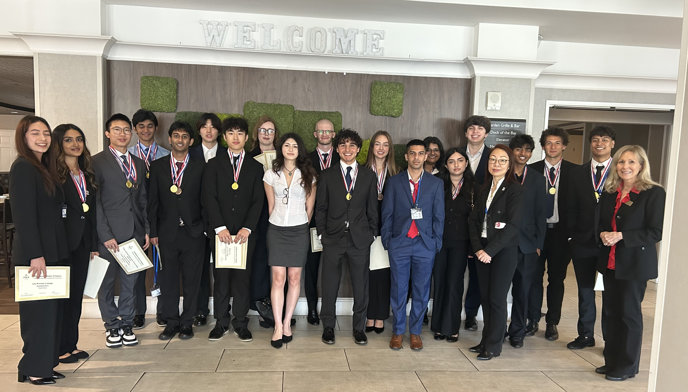
LPC Wins Third Place in State Business Conference Competitions

Slide 17


Slide 18
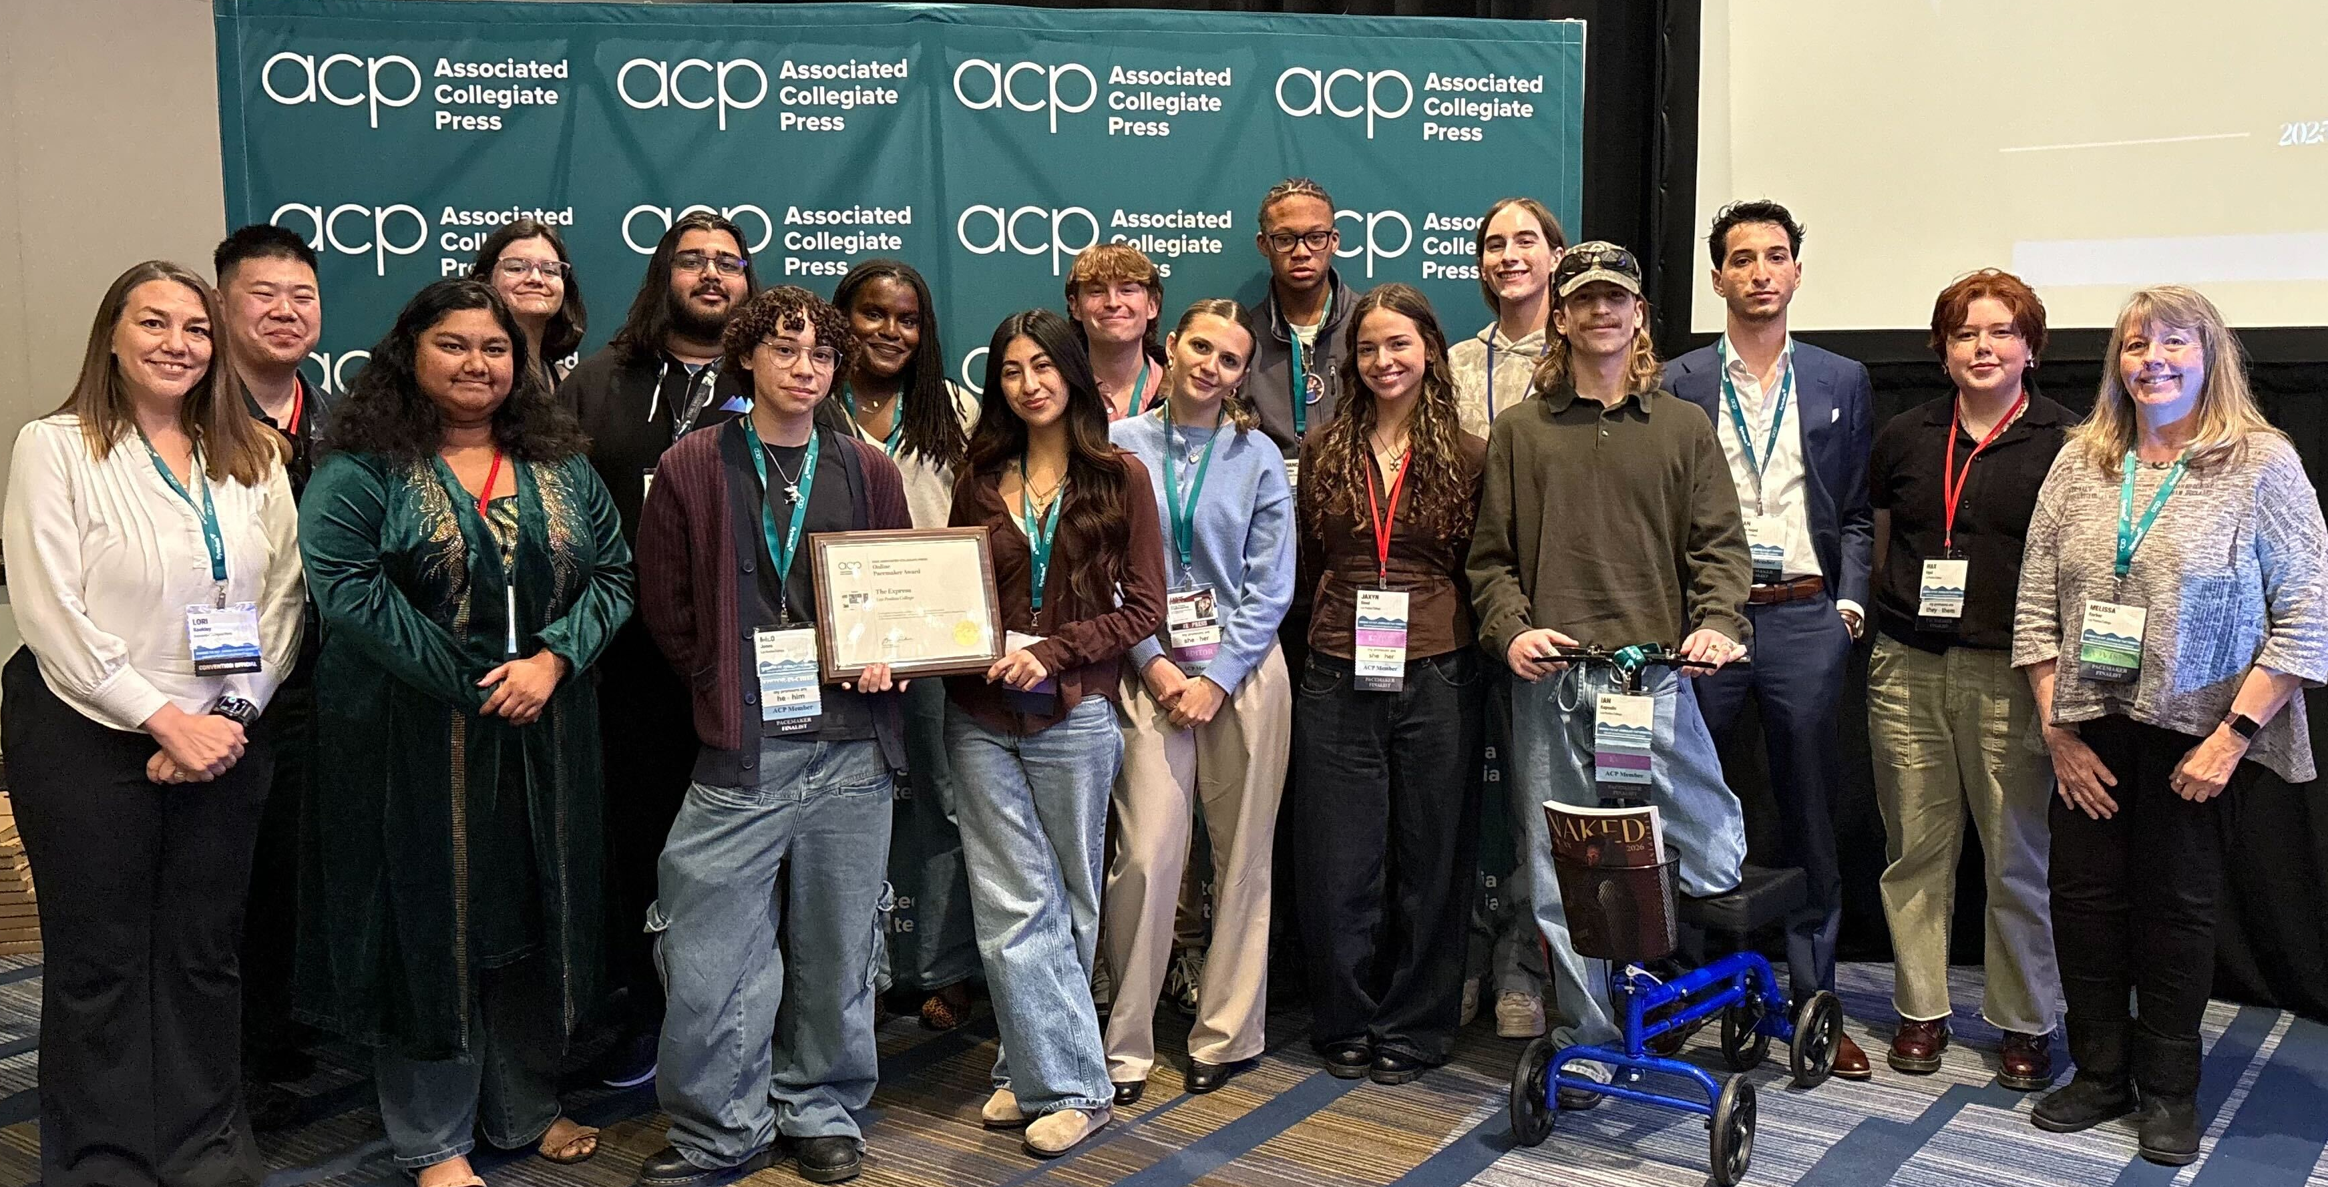
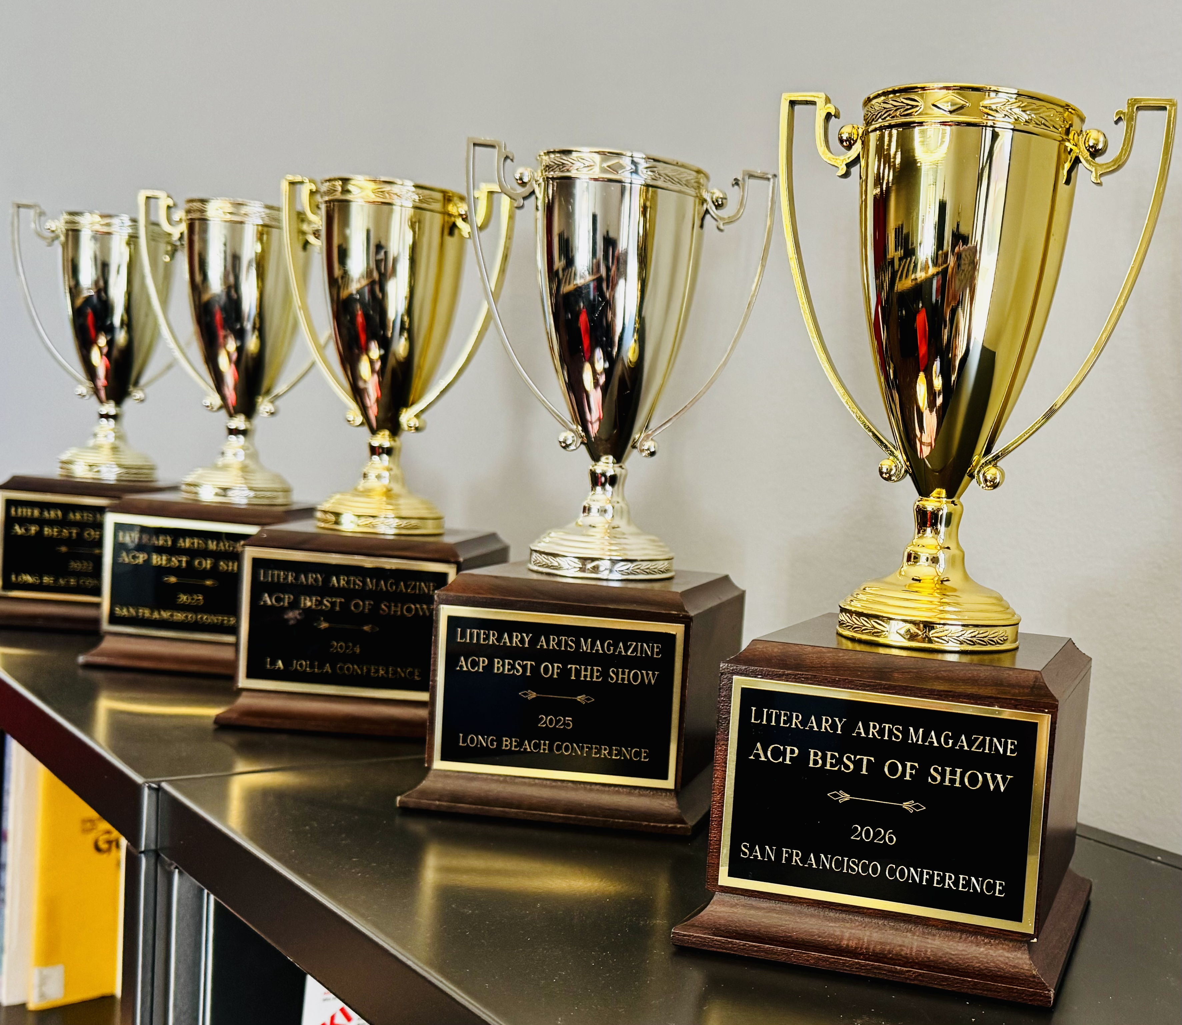

MEDIA STUDENTS EARN 36 AWARDS
AT NATIONAL CONFERENCE
Online Express Named National Pacemaker
Express Named State Pacesetter
Havik Named Best of Show for 5th Time

