Slide 1

Facilities Modernization Program
Funded by Measure A
Project Report
September 23, 2019

Slide 2
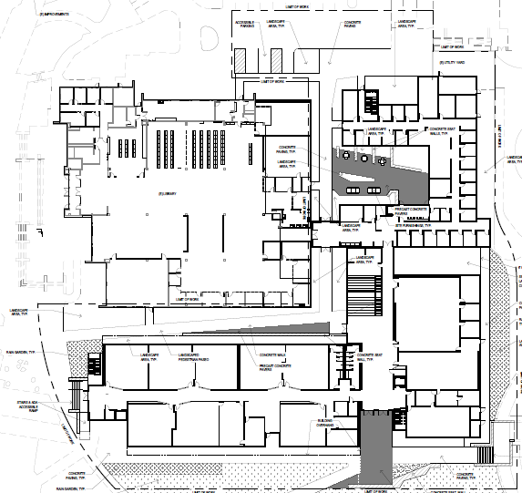
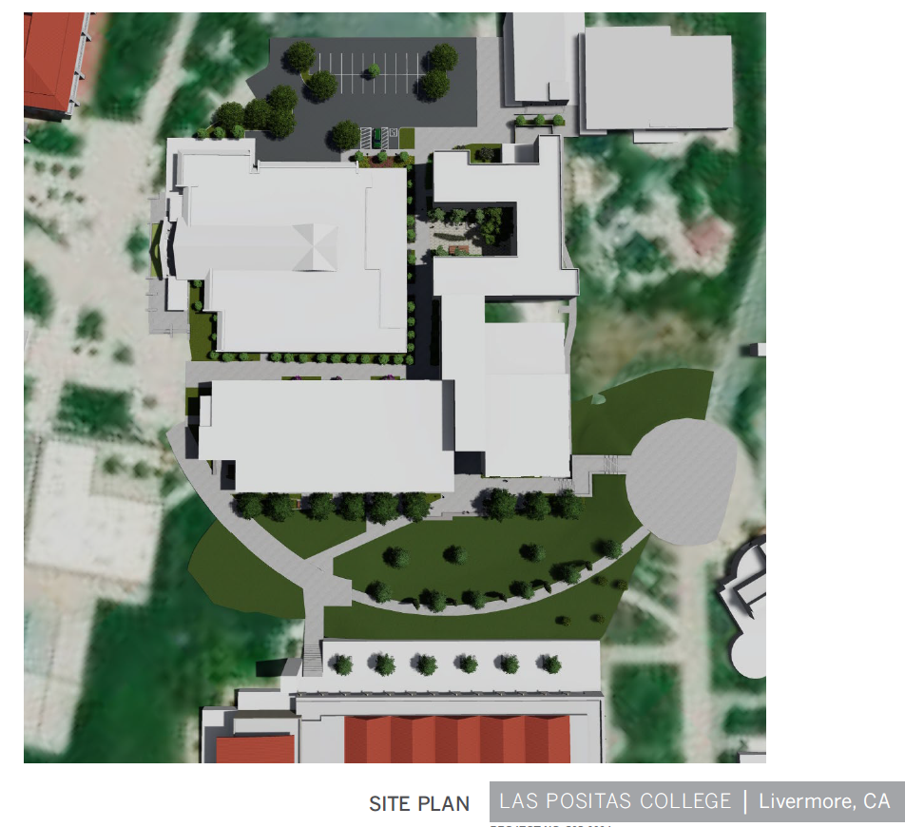
PROJECT PROGRESS REPORT
B2100 New Academic Support and
Office Building
LAS POSITAS COLLEGE
September 23, 2019
Project Team:
  Architect: LPAS
  Project / Construction Manager: Critical Solutions, Inc.
  Contractor: TBD
Project Description:
The new Academic Support and Office building will be built in the location of existing buildings 2100 & 2200. The project consists of the following elements and programs: English Center incorporating classrooms, computer lab, tutoring and study areas. Math Center incorporating classrooms, labs and the Math X program. Computer Sciences Center including computer labs, networking and open labs with the expansion of library functions including reference desk, study areas, classroom, expanded staff offices and library operational support spaces. Faculty Offices, Dean’s suite and support spaces will also be in the building.
Project Update:
Schematic Design Phase was completed in early September 2019. Design Development phase has kicked off with Use Group meetings taking place in late September 2019. Meetings with DSA and Livermore Fire have occurred in the last month.
Programming: Completed
  Schematic Design Completed
  Design Development 9/2019
  Construction Documents 05/2020
  DSA Permit Approval: TBD
  Construction Start TBD
  Occupancy TBD

Slide 3
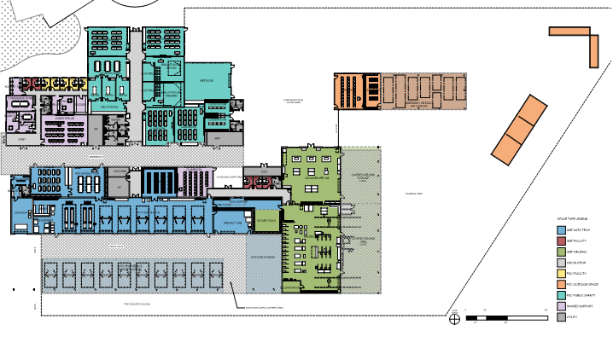
PROJECT PROGRESS REPORT
Public Safety Complex /
Advanced Manufacturing and Transportation
LAS POSITAS COLLEGE
September 23, 2019
Project Team:
  Architect: Lionakis
  Project / Construction Manager: Critical Solutions, Inc.
  Contractor: TBD
Project Description:
The new Public Safety Complex (PSC) and Advanced Manufacturing and Transportation (AMT) building will be co-located to allow for shared linkages between the various programs, classrooms and event spaces. The building will be built near the existing sports fields in the northeastern portion of the upper campus. The PSC/AMT project consist of the following programs: EMS Simulation lab, Situation rooms, Administration of Justice, a Fire Tower that includes a Class A burn area, an Automotive Tech facility, Welding lab, classrooms and lab spaces to provide training of advanced manufacturing processes. Dean’s suite, Faculty offices and support spaces.
Project Update:
Schematic Design (SD) is in progress, with User Groups meetings taking place through the end of September 2019 with cost estimates for SD design in progress. Teams goal is to move into the Design Development Phase in early October 2019.
Programming: Completed
  Schematic Design 09/2019
  Design Development 01/2020
  Construction Documents 07/2020
  DSA Permit Approval: TBD
  Construction Start TBD
  Occupancy TBD

Slide 4
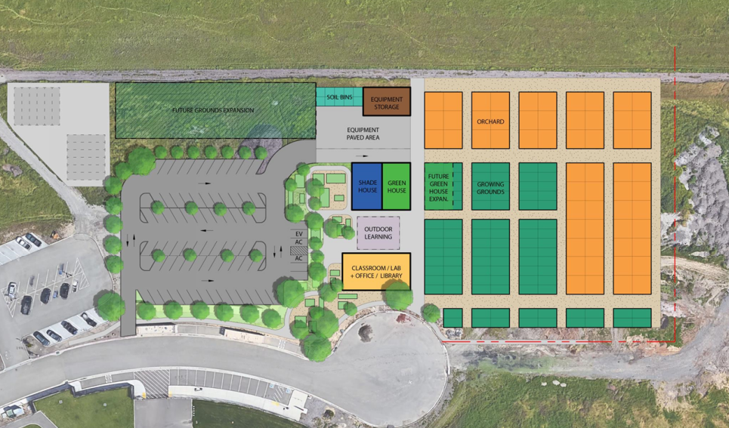
PROJECT PROGRESS REPORT
AG SCI: Horticulture Facility Project
LAS POSITAS COLLEGE
September 23, 2019
Project Team:
  Bridging Architect: ATI Architects and Engineers
  Construction Manager: Roebbelen (RCMS)
  Contractor: TBD
Project Description:
The New Horticulture Facility will have a 2,900 SF building which includes classroom/lab spaces, offices and a resource library. The project includes an extensive outdoor facility, which includes a greenhouse, shade house, outdoor learning patio, equipment storage and approximately 40,000 SF of orchards and 24,000 SF growing grounds. The facility will be located in the northeastern side of the upper campus.
Project Update:
Architectural Programming Phase in-progress, with several User Group meeting taking place to develop project programming needs. Design team has provided a preliminary sustainable checklist, and is currently working on conceptual estimate. Conceptual site and building layout is under review with the User Group in order to obtain approval for the next Design Phase.
  Programming 09/2019
  Schematic Design 10/2019
  Design Development 11/2019
  Construction Documents TBD
  Construction Start TBD
  Occupancy TBD

Slide 5
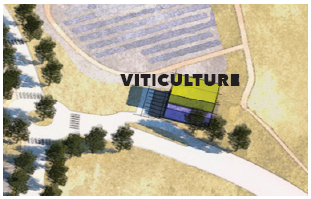
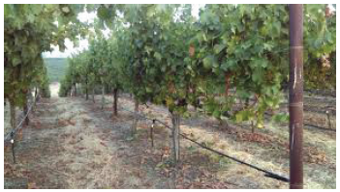
PROJECT PROGRESS REPORT
AG SCI: Viticulture Facility Project
LAS POSITAS COLLEGE
September 23, 2019
Project Team:
  Bridging Architect: tBP/Architecture, Inc.
  Construction Manager: Roebbelen (RCMS)
  Contractor: TBD
Project Description:
The New Viticulture Facility will replace the existing facilities currently located in/outside of Bldg. 800. The Viticulture Facility will be located at the main entrance to the campus off of Campus Hill Road. The New Facility will be developed at the higher elevation allowing for expansive views, user experience, and gravity assist production facilities. The New Facility will be approximately 6,700 SF will incorporate instructional classrooms, production teaching winery, barrel storage, outdoor patio, processing areas, hospitality and bottle storage. Work includes the connection for vehicles, equipment, and pedestrians from the campus to the new facility. The work includes modifications to the intersection of the Campus Hill Road and Campus Loop Road to improve circulation and traffic flow.
Project Update:
Design Proposals received in August 2019. Interviews were held on Friday August 23, 2019. The Board approved architects contract at the September 2019 Board Meeting. Contract negotiations are underway with a tentative project kick off meeting to take place in October 2019.
  Programming TBD
  Schematic Design TBD
  Design Development TBD
  Construction Documents TBD
  Construction Start TBD
  Occupancy TBD

Slide 6
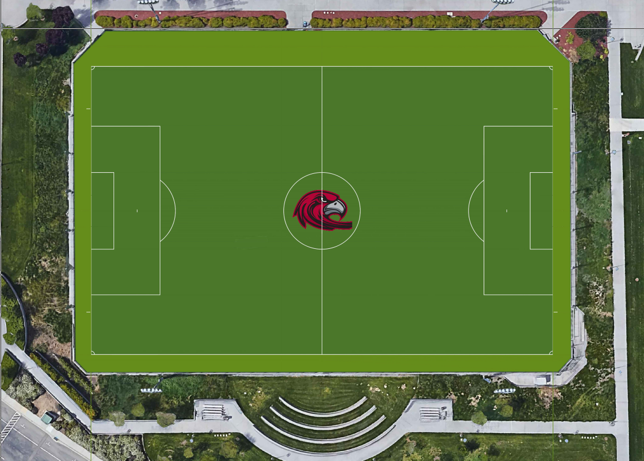
PROJECT PROGRESS REPORT
Synthetic Turf Replacement
LAS POSITAS COLLEGE
September 23, 2019
Project Team:
  Bridging Architect: Verde Design, Inc.
  Construction Manager: Roebbelen (RCMS)
  Contractor: Valley Precision Grading, Inc.
Project Description:
Installation of new synthetic turf at the existing synthetic turf soccer field. Project includes removal and disposal of the existing turf, shock/drain pad beneath the turf, and any base corrections needed. Provide new synthetic turf which includes NCAA/FIFA lines and school logo as well as new netting.
Project Update:
Demolition of existing field in-progress: synthetic turf and shock/drainage pads have been demolish and removed. Grading of the field is in progress. Upcoming will be the install of new liner, pad and turf.
Pre-Construction Meeting 08/2019
  Construction 09/2019
  Final Completion 10/2019
  Occupancy 11/2019

Slide 7
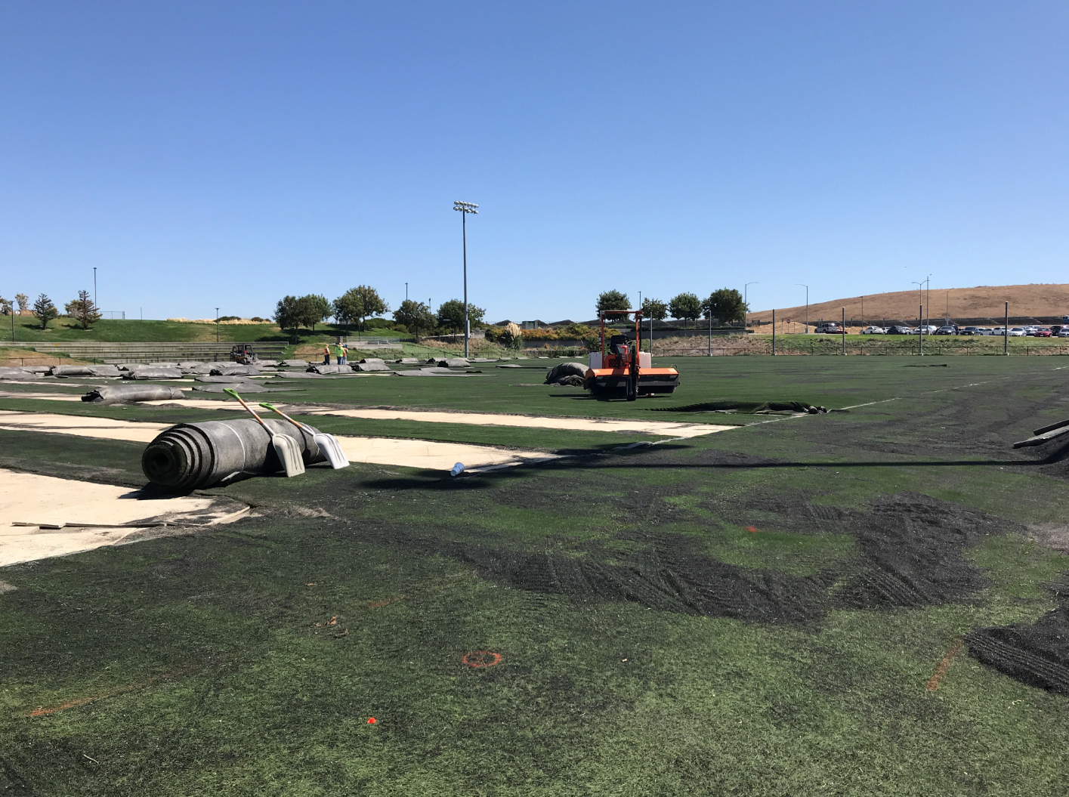
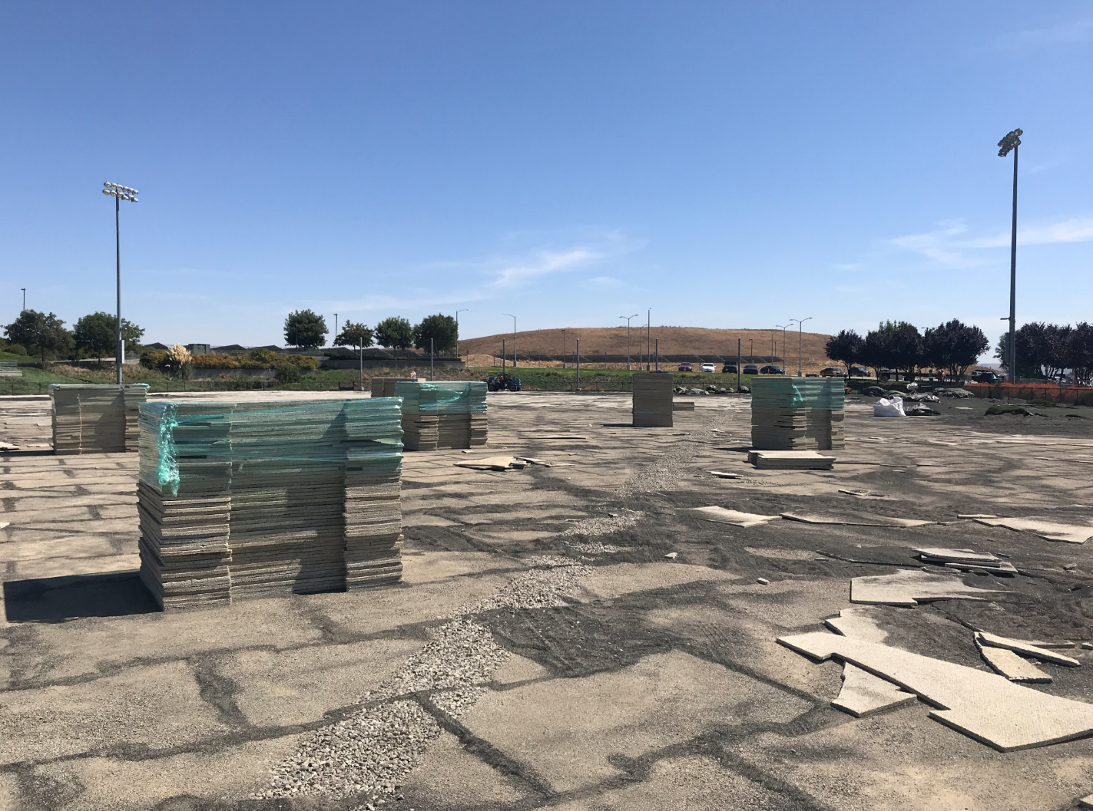
PROJECT PROGRESS REPORT
Synthetic Turf Replacement
LAS POSITAS COLLEGE
September 23, 2019
PROGRESS PHOTOS
Synthetic Turf Demolition
Shock/Drainage Pad Demolition

Slide 8
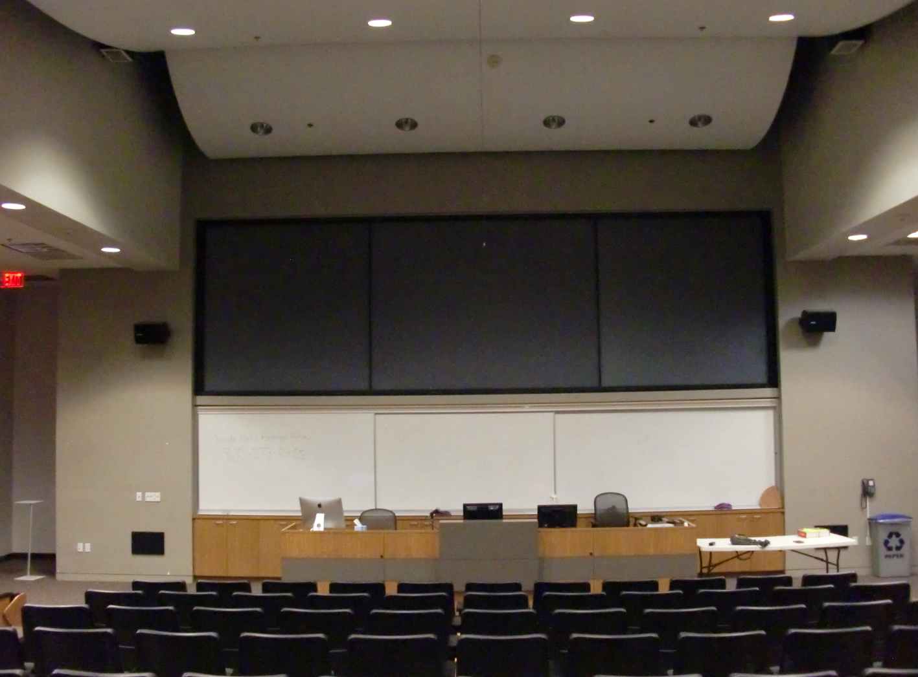
PROJECT PROGRESS REPORT
B2420 AV Wall Building 2400
LAS POSITAS COLLEGE
September 23, 2019
Project Team:
  Architect: ATI Architects and Engineers
  Construction Manager: Roebbelen (RCMS)
  Contractor: TBD
Project Description:
The existing audio-visual system in Room B2420 is comprised of three projectors and a screen which includes AV controls at the lectern. The existing system will be replaced with LED flat panel system, movable lectern, upgraded speakers and cameras.
Project Update:
Project is currently bidding, Pre-bid Conferences were conducted. Design Team is currently working on items for Addendum to be released this week, with bids due on 10/03/19.
Design Started 03/2019
  DSA Approval 08/2019
  Bids Due 10/2019
  Construction Winter Break
  Occupancy Spring Semester

Slide 9
PROJECT PROGRESS REPORT
M&O Small Projects
LAS POSITAS COLLEGE
September 23, 2019
Project Description | Point of Contact | Division | Location | Status
Bookstore and Welcome Center Signs |  |  | Bldg 1300 | Completed
803 Computer Lab Workstation Wiring and Electrical |  |  | B800 | Completed
Blinds for Student Services |  |  | Bldg 1600 | Completed
Office Reconfiguration | William Garcia | Student Services | Bldg 1600 | Completed
A&R and EOPS
Upper Soccer Field Wind Screen | Amir Law | BHAWK | Track and Field Interior, 4ft fence | Completed
Meditation/Prayer Room | William Garcia | Student Services | Bldg 2400 | Completed
 |  |  | 2420A
4135-37 & 4224 Faculty Office Window Coverings | Stuart McElderry | A&H | B4000 | Completed
Computer Studies Display Cases | Moh Daoud | STEM | 804, Welding/Auto Entrance | Complete
Parking Lot Striping | Sean Prather | Campus Safety | LPC Parking Lots | Completed
Team Room Updates | James Giacomazzi | BHAWK | Bldg 2500 Locker Rooms | Demo completed; Lockers arrived and installed on Sept. 23 & 24, 2019.
Lactation/Nursing Rooms | William Garcia | Student Services | Locations: Bldg 1600 1st/2nd floor; B1000, B400, B1700 | Locks being changed; signage completed; furniture being ordered
White Board additions to rooms 1001, 1002,and 1060 | Jennie Graham | STEM | Rooms 1001, 1002, and 1060 | In Progress
Office Reconfiguration, Student Life Office | William Garcia | Student Services | 1643 | PO issued, awaiting arrival of furniture
Campus Safety Furniture Update | Sean Prather | Campus Safety | B1700 Safety Office | Furniture approved and in process of ordering

