Slide 1
Las Positas College
Cassidy Medina, M.Ed., BCBA
Priti S Nagaraj, M.S. (ASR), BCBA, CCC-SLP
Clinicians, Trumpet Behavioral Health

Slide 2
Who We Are…
Trumpet Behavioral Health® specializes in the treatment of children and adults with autism, developmental delays, and other exceptional needs.
We provide our effective clinical services in homes, schools, communities, and intensive treatment centers.
Our team includes Board Certified Behavior Analyst® (BCBA®) and Board Certified Assistant Behavior Analyst® (BCaBA®) providers, as well as our trained therapists!
Trumpet Behavioral Health® is a privately held company with offices, services, and intensive treatment centers in 11 states

Slide 3
What We Do…
Our services are based in Applied Behavioral Analysis
Behavioral consultation, intensive behavioral intervention, education, and special training for parents, educators, and healthcare professionals.
Social Skills Acquisition and Social Skills Programs
Functional Behavior Assessments
Parent Education and Training

Slide 4
What We Already Know!
What we know about people with Autism
  Can someone share what they know?
What you are already doing and how it is working
  Can someone share something they do already?

Slide 5

Current Facts About Autism
Fastest-growing developmental disability in U.S.
5 times more common in males
  Centers for Disease Control (2012)

Slide 6
Individual Differences
Wide variety in symptoms and characteristics
  Range from mild to severe
  Complex interplay of diagnoses
Deficits may also vary based on age
Affects each individual differently and to varying degrees

Slide 7
Autism Diagnosis (CDC)
  Persistent deficits in social communication and social interaction across multiple contexts
  Restricted, repetitive patterns of behavior, interests, or activities, as manifested by at least two of the following
        Stereotyped or repetitive motor movements, use of objects, or speech
        Insistence on sameness, inflexible adherence to routines, or ritualized patterns of verbal or nonverbal behavior
        Highly restricted, fixated interests that are abnormal in intensity or focus
        Hyper- or hypo- activity to sensory input or unusual interest in sensory aspects of the environment

Slide 8
Autism Diagnosis (CDC)
  Symptoms must be present in the early developmental period
  Usually by 3, as early as 12 months
  Symptoms cause clinically significant impairment in social, occupational, or other important areas of current functioning
Autism “Spectrum” Disorder (ASD)
  Autistic Disorder
  Asperger’s Syndrome
  Pervasive Developmental Disorders (PDD-NOS)

Slide 9
Applied Behavioral Analysis (ABA)
Behavior analysis focuses on the principles that explain how learning takes place
ABA focuses on studying behavior and describing it in specific, observable and measurable terms
Analyzes and allows us to understand why behaviors occur and how we can predict them in the future in certain environments
A lot of what you do every day is based in the principles of ABA!

Slide 10
Working with those with Autism
  If those with Autism have difficulties with communication, poor social skills and restrictive or repetitive behaviors or interests, how can we as educators work more effectively with these students?
  What are some simple things we can remember to do? What are things we are doing that we can do more of?
  Today, we are going to look at ways to take the already great strategies you are using and how you can use them to work with students with Autism!

Slide 11
Maximizing Opportunities
General Strategies in Working with Students with ASD

Slide 12
Maximizing Opportunities By:
Creating a Positive Environment
Using Behavioral Momentum
Using the Premack Principle
Using Behavioral Skills Training (BST)
Using Reinforcement
Using Self-monitoring and Self-management

Slide 13
Maximizing Opportunities By:
Adapting Tasks, Activities and Language
Giving Effective Commands
Effectively Denying Requests
Always Following Through
Avoiding Power Struggles

Slide 14

Creating a
Positive Environment
Increase the GLPR
  “General Level of Positive Reinforcement”
Make yourself a reinforcer- pair yourself with access to preferred items and activities
Give choices as frequently as possible

Slide 15
Creating a
Positive Environment
Increase praise for appropriate behavior
    “I like the way you did _____”
Reduce corrective statements
    “No” is okay, but avoid excessive use of it
Use a 5 to 1 ratio of positives to correctives

Slide 16
Using Behavioral Momentum
Building up momentum to what you really want them to do, by tossing out easy, or “throw away” questions or directions, that they are super likely to do first

Slide 17
Using the Premack Principle
A.k.a. “Grandma’s Rule”
  “Eat your peas before you get dessert”
Give the student something to work towards
First/then board
  Visual support

Slide 18
Using Behavioral Skills Training
(BST)
A behavior based method for training a skill and you may be using these methods already!
Instructions, Modeling, Rehearsal and Feedback
Are you using BST already?

Slide 19
Using Behavioral Skills Training
(BST)
Are you using BST already?
Has been used to children and adults with ASD various skills, including social skills, safety skills and other functional skills
Has been used to train staff or professionals to teach these skills and many others as well too!

Slide 20
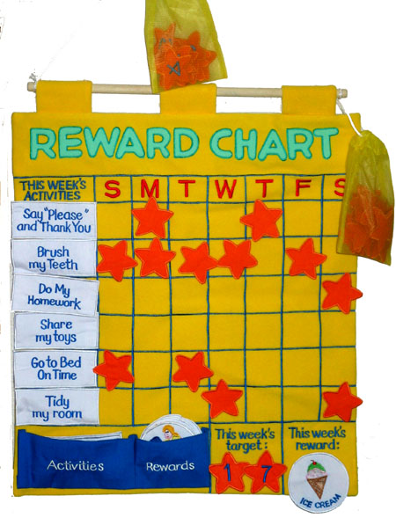
Using Reinforcement
“If you do not have good reinforcers or are not working to establish them, you might as well go home.”
Ron Leaf & John MacEachin
Autism Partnership
1999

Slide 21
Using Reinforcement
How we can increase the future likelihood of a desired behavior
Examples:
  Tangibles (e.g., candy, toy)
  Activities
  Praise
  Removal of “nagging”
  Getting out of an assignment

Slide 22
Common Arguments
Against Reinforcement
I’ve tried reinforcement, it doesn’t work.
He should do his homework because he’s supposed to.
She should want to get good grades.
It’s not fair to the other students to use rewards.
He’ll always expect something and he’ll never be intrinsically motivated.

Slide 23
The Facts
A study evaluating 96 different research articles, comparing extrinsically-rewarded subjects to non-rewarded subjects, suggests that when reinforcement was used the right way, not only did the positive and desired behavior increase, it produced an increase in intrinsic motivation (Cameron, Pierce, and Epling, 1994).

Slide 24
Developmental Changes & Reinforcement
And…the majority of school-aged children are not “intrinsically motivated” to do well in school.
Reinforcement can take many forms:
  Grades, allowance, teacher approval, fitting in with classmates, not getting in trouble, etc.
  Don’t forget that the other students are “earning” too!

Slide 25
Developmental Changes
And Reinforcement
Younger Older | Tangibles
 | Activities/ Privileges
 | Adult approval, peer approval
 | Good grades
 | Learning for the sake of learning, improving oneself
 | Doing the right thing, morality

Slide 26
In Defense of Reinforcement
Reinforcement works - if what you are doing is not working, you may not have a reinforcer
We all work under some contingencies
  Would we show up without a paycheck?
Sometimes we need to “Bridge the Gap”
Does not have to cost money
  Make preferred activities contingent
  Consider special jobs or privileges

Slide 27
Reinforcement Guidelines
Deliver immediately & pair with specific praise
If the behavior does not increase than it is not a reinforcer!
  Different people work for different things
Initially deliver frequently, then “thin” over time
  Intermittent reinforcement
  Ultimate goal: “natural contingencies”

Slide 28
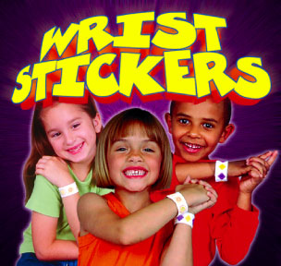
Finding Out What’s Reinforcing
OBSERVE
  What do they gravitate toward?
ASK
  The children or adults
  Parents/other teachers
EVALUATE
  Reinforcer survey
  Ask what they want!

Slide 29
Are you a “reinforcer” or an “enforcer”?

Slide 30
Make Yourself a Reinforcer
80% to 90% of interactions should be positive
Approach students just to “check in”, say hi, or praise
Give lots of choices
Provide frequent reinforcement

Slide 31
Using Self Monitoring/
Self Management
Teach them to become more aware of their behavior
Establish clear expectations/rules and set goals
  Use Self monitoring checklists
  Use Task analyses
Student will self-evaluate and self-reinforce

Slide 32

Modifying Tasks and Activities
Task interspersal
  Alternate between hard task, easy task, hard task, etc
Incorporate visual supports
  Write schedules on the board
  Provide a calendar of due dates
Modify the task altogether
Increase predictability in the classroom
Offering choices is a good thing, right?
    Teach what the “finished” product looks like

Slide 33
Using Appropriate Language
Avoid verbal overload!
Use specific objective language
For those with Autism, language is very tricky!
  Avoid using idioms or sarcasm
  Non verbal cues are very difficult
Check for understanding!

Slide 34
Giving Effective Instructions
Stand within arms reach
Use name, get eye contact
Be clear and concise
Avoid questions when there isn’t a choice
  (e.g., “Do you want…?”)
Use prompts to ensure follow through
  Don’t be a “broken record”

Slide 35
Effectively Denying Requests
Acknowledge
  “I know you want______________”
Inform when request may be obtained
AND/OR
Provide choices of what is available now
  “You can have ____ or _____” (i.e., Forced choice)
Avoid lengthy explanations/arguing

Slide 36
Always Following Through!
If you can’t follow through, then maybe you shouldn’t be asking!
  Make easy requests throughout day that student very likely to comply with
  Use easy, preferred warm-up tasks (e.g., behavioral momentum)
  No idle threats or promises
Get some form of compliance before moving on

Slide 37
Avoiding Power Struggles
Provide the student with choices prior to inappropriate behavior occurring
  “Would you rather do this or that first?”
Use visual aids, redirect but minimize use of words or arguing
  e.g., redirect back to behavioral contracts, list of rules, etc.
Don’t negotiate once student is non-compliant or inappropriate
  If it wasn’t a choice before, it isn’t a choice now
Notes:
Redirecting to visual/rules helps remove staff from power struggle, makes more “objective”
Minimize words: Also important not to “over ask” client to follow direction again & again. More directions = more opportunities to not comply. Better to make use of “let me know when ready….” and OCCASIONALLY repeat expectation

Slide 38
Problem Behaviors!!

Slide 39
Behavior is Functional
Environment impacts behavior, behavior impacts the environment
  Reciprocal, functional relationship
Behavior is purposeful
  Reinforced behaviors are repeated
  If a behavior is occurring, then it is working somehow for that individual

Slide 40
Identifying target behaviors
Identify behaviors of concern
Speak in specific, observable, measurable terms
Say exactly what the student does
Targeting the most impactful behaviors

Slide 41
Defining and Being Specific!
Not so good:
    Johnny is mean
    Johnny is disrespectful
    Johnny disrupts circle
Better:
    Johnny teases and calls others names
    Johnny says “No!” in raised voice
    Johnny makes noise during circle and calls out without raising his hand

Slide 42
Activity
Put the following into specific, observable, measureable terms:
  “Off-task”
  “Rowdy”
  “Rude”
  “Out of Control”
  “Aggressive”
  “Tantrum”

Slide 43
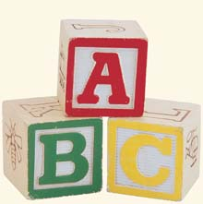
What Are The ABC’s?

Slide 44
What is an Antecedent?
What comes BEFORE the behavior
  Includes the “trigger”
  “WH” questions
    Who was there?
    When did it happen?
    Where did it happen?
    What specifically was happening?

Slide 45
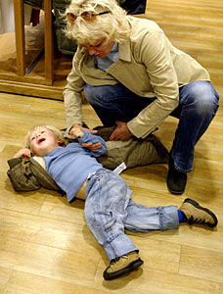
What is the Behavior?
What is the target behavior
    What did the child do?
Speak in specific, observable, measurable terms

Slide 46
What is the Consequence?
What happens immediately AFTER the behavior
  The result of the student’s behavior
    e.g., The work task was delayed, peers laughed
  Consequences can be “good” or “bad”

Slide 47
Why do we need the ABC’s?
The ABC’s give us a clue as to what the function or purpose of the behavior is.
With an understanding of the purpose, we can implement the most appropriate strategies for each student.
Without the function or purpose, our positive efforts may be useless.

Slide 48

Example 1

Slide 49
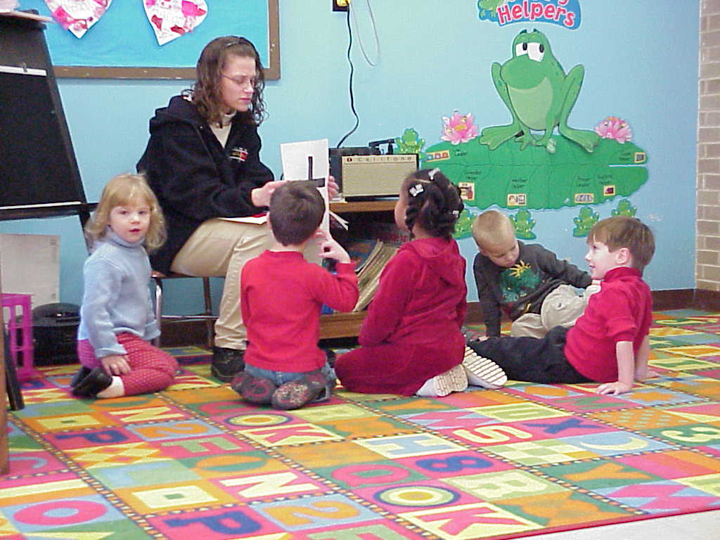
Example 2

Slide 50

Example 3

Slide 51

Taking Data on ABC’s
Record the ABC’s
Structured data sheets or “long-hand”
  See examples

Slide 55
Let’s Try It!
Identify the ABC’s

Slide 56
Example 1
You place work materials on the table in front of Billy. Billy picks them up and throws them across the room. You get up and pick up the materials, which takes a few minutes. This happens every day.
Antecedent________________
Behavior__________________
Consequence______________

Slide 57
Example 2
While the teacher is giving a lecture, Tina begins to talk on her phone. You immediately walk over, look at her, and say “put your phone away!” This scenario repeats itself several times.
Antecedent________________
Behavior__________________
Consequence______________

Slide 58
Analyze the ABC’s
Behavior is a function of its consequences
Consequences (good and bad) maintain behavior
  If a behavior is occurring, then it is somehow being reinforced
  Behavior that is reinforced (rewarded) is more likely to occur in the future

Slide 59
In other words…
Children or adults behave inappropriately because…
  They are not sure how else to get their needs met
  It has worked in the past
  It is easier than being appropriate

Slide 60
Analyzing the ABC’s
Review data
Look for patterns
Identify triggers
Identify maintaining consequences
  Antecedents and consequences tell us how & why a behavior is being reinforced

Slide 61
Identifying Function(s)/Purpose(s)
“Function” aka purpose = why a behavior occurs
4 possible functions
  Sensory/Automatic
  Escape
  Attention
  Tangible (Access to)
Can occur alone or in combination

Slide 62
“Attention”
Access to attention
  Can take many forms:
      Look at me
      Help me
      Reassurance
      Upsetting others
From adults or from peers
“Good” or “Bad” attention
  Does it matter to the child? Not always!

Slide 63

“Escape”
Temporarily delay, avoid, or permanently escape
Escape from:
  Instructions
  Tasks
  Situations
  People
  Change/novelty
  ANYTHING aversive to that person

Slide 64
“Access”
Access to preferred items or activities
  Food
  Trading cards
  Computer
To gain access
  When told “No”
To re-gain or maintain access
  When something is taken away or activity ends

Slide 65

“Sensory/Automatic”
Different than first three
  Not “socially mediated”
  Happens independently of the external environment
  “It feels good,” “Is enjoyable,” (increases stimulation) or it reduces stress (decreases stimulation)
  Engaging in the behavior itself is its own reinforcer
Examples:
  Masturbating
  Humming/singing
  “Stimming”
  Scratching an itch
  Activities that are “intrinsically motivating”

Slide 66
Functions of Behavior
Why are you attending this training?
  Getting paid (access)
  Avoid getting in trouble (escape)
  To get acknowledgement from your supervisor (attention)
  Enjoy learning new things (automatic)

Slide 67
Activity
Identify Possible Functions

Slide 68
Example 1
You place work materials on the desk in front of Billy. Billy picks them up and throws them across the room. You instruct Billy to pick up the materials. This happens every day.
  Possible function of Billy’s behavior?

Slide 69
Example 2
While the teacher is giving a lecture, Tina begins to talk on her phone. You immediately walk over, look at her, and say “put your phone away!” This scenario repeats itself several times.
  Possible function of Tina’s behavior?

Slide 70
Creating A Behavior Plan
Overview

Slide 71
Positive Behavioral Strategies
Designing individualized plans
Understanding relationships between behavior and environment
Collaborating with team members to develop interventions that are a “good fit” for the environment
Continually analyzing, re-evaluating and making changes when needed

Slide 72
Positive Strategies Include…
Preventative strategies
  For changing antecedents (or “triggers”) or problem behaviors
Instructional strategies
  For teaching new behaviors, so problem behaviors won’t happen
Reactive strategies
  For changing consequences for appropriate and problem behaviors

Slide 73
Using Preventative Strategies
Stopping it before it starts!

Slide 74
Preventative Strategies
Antecedent Management
  “An ounce of prevention”
  Initial investment saves time later
Critical for effective behavior management
Positive impact for all students
  But necessary for student with Autism

Slide 75
Preventative Strategies
Post schedules and establish routine
Incorporate visual cues
Review expectations prior to starting activity
Provide warnings about changes in advance
Remove “triggers” from the environment
Provide extra help during “high risk” situations

Slide 76
Preventative Examples
Change the layout of the environment
Give student preferential seating
Provide movement breaks
Add reinforcement systems
Modify interactions (e.g., calm demeanor)
Make yourself a reinforcer
  Increase positivity!
Increase reinforcement for appropriate behavior

Slide 77
Using Instructional Strategies
Teaching the Behaviors!!

Slide 78
Instructional Strategies
Increasing or teaching appropriate behaviors
  Our hope is that problem behaviors will disappear once appropriate behaviors are learned & reinforced
  Can be “replacement” or “adaptive” behaviors

Slide 79
Instructional Strategies
Ask yourself, “What should they be doing?”
Ask yourself, “Why aren’t they doing what they should be doing?”
  “Can’t do” → Skills training issue
  “Won’t do” → Motivational issue
May be crucial to teach and reinforce appropriate behaviors

Slide 80
Teaching Replacement
Behaviors
An appropriate behavior that is functionally equivalent to problem behavior
  i.e., it meets the same need
Typically referred to as “functional communication”
Replacement behaviors will only be effective if….
  The replacement behavior is EASIER than the problem behavior
  The replacement behavior is MORE EFFECTIVE (e.g., more rewarded) than the problem behavior.

Slide 81
When to Teach
Replacement Behavior
BEFORE the occurrence of problem behavior
Can be taught when you see signs of problem behavior coming (e.g. if they become fidgety before they leave their seat)
Can set up times or situations to practice replacement behaviors
If you teach AFTER problem behavior the two behaviors can become linked

Slide 82
Teaching Adaptive Behaviors
Behaviors that are not functionally equivalent to the problem behavior but will help child or adult adapt to environment
  Examples:
    Waiting
    Accepting “no”
    Following directions
    Learning frustration management

Slide 83
Using Reactive Strategies
The behavior already happened!!

Slide 84
Using Reactive Strategies
What to do when a desired or appropriate behavior occurs
Examples
  Acknowledgement; specific praise
  Points/rewards
  Make sure the behavior is effective!

Slide 85
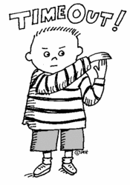
Reacting to Inappropriate Behavior

Slide 86
Reactive Strategies
What to do when a problem behavior occurs
Examples:
  Ignore
  Redirect
  Warning system
  Time out from reinforcement

Slide 87
What is Punishment?
Something happens after a behavior that decreases the future likelihood of a behavior
Examples:
    Raising voice
    Extra work
    Time-Out/Asked to leave class
    Losing privileges

Slide 88
Punishment Procedures
Lots of studies on punishment:
  Punishment can be effective in the short term
  Generally these effects do not last, especially once the punisher is not around
  Does not teach appropriate behavior
  Effects wear off so the ante has to be upped
  They may begin to associate punishment with the person who does the punishing
  May lead to “power struggle”
  If they wanted to leave class, it may backfire!

Slide 89
Reinforcement or Punishment:
Which should you use?
Focus on reinforcement of appropriate behavior combined with antecedent and instructional strategies.
In some cases, punishment is not an option (e.g., public school settings)

Slide 90
Summary
How to maximize learning opportunities with those with Autism
Look at some classroom strategies
How to assess behaviors of concern and look at their function or purpose
Look at preventative, instructional, and reactive strategies
Look for replacement behaviors (what they should be doing instead) and adaptive behaviors

Slide 91
Contact with Questions!
Please feel free to contact me with further questions!
Cassidy Medina
cmedina@tbh.com
925-596-3859

