Slide 1

Globalizing the Curriculum: Opening Our Students’ Minds to the World
Catherine Eagan, PhD
Patricia Stokke, EdD, PHR

Slide 2
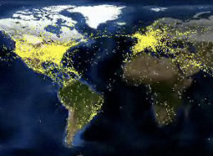
Globalization
  Whether at home or abroad, students are going to be encountering different cultures and cultural systems more than they ever have.
See world air traffic during a 24 hour period in 2010:
https://www.youtube.com/watch?v=yx7_yzypm5w&list=PLC70229043BEFD5F8
© 2014 Thunderbird School of Global Management, All rights reserved
Notes:
Tom Friedman
The World is Flat – popular business book
SIGNIFICANCE
Means more risk for the enterprise and the individual:
Organizations are expanding globally to give them an edge in global marketplace. No organization can survive without considering global implications – means new skills and abilities, roles for HR
In 1990 3000 MNCs, 2012 over 100,000 MNCs with over 57 trillion in assets ( *World Investment Report World Investment Forum, April 2012, under secretary Robert Hormats)
More people working cross culturally in more countries.

Slide 3
Globalization, cont.
They are also going to be asked to make decisions that will depend on being informed global citizens and recognizing our interconnectedness.
  Choosing qualified elected officials
  Buying local, GMO or not, fair trade or not
  Developing positions on policy issues from climate change to migration to global health
  Designing or supporting educational standards
  Supporting or founding charities

Slide 4
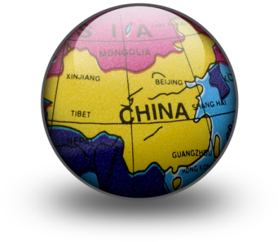
Agenda
Discuss the concept of a globalized curriculum and desirable outcomes: global perspective, global mindset
Introduce research regarding the need for global mindset & global leadership skills
Assess LPC’s institutional commitment and individual faculty commitment to these outcomes
Discuss ways of increasing our commitment
Notes:
It is essential for leaders and followers, and consequently business students to learn to navigate our increasingly complex global environment. Today we will:
a. Define and discuss the importance of a global perspective / global mindset and global leadership skills
b. Introduce research regarding the need for global mindset and global leadership skills
c. Assess LPC’s institutional commitment and individual faculty commitment to these outcomes
d. Discuss ways of increasing our commitment
We have three focus questions for you today, and we have additional slides after each question to guide the discussion if needed but that we may or may not get to. The most important thing that we’d like to get out of today is a discussion of ways we can increase our commitment, the last item. I do have slides of our core competencies on developing a global perspective for reference, but you will be invited to discuss these at future town meetings dedicated to revising them. Hopefully this discussion will encourage you to join me on the “Respect and Responsibility” team.

Slide 5

What & Why of a Global Perspective
Considerations:
Diverse communities
Diverse cultural systems
Diverse political & institutional systems
Time & geographic distance (2014, Thunderbird School of Global Management)
Required skills:
Ability to build trust
Ability to empathize with different standpoints
Work in diverse teams and communities
Accept new ways of thinking
Implications:
Conflict
Insensitivity to different perspectives at home and abroad
Damage to individual, organization, & nation reputations
Loss of relationships, careers, business revenue, and political missteps
Reduced sense of fulfillment, connectedness
  http://www.youtube.com/watch?v=uFpDvh2z5Tw
Notes:
Business considerations:
Diverse cultural systems
Diverse political and institutional systems
Time and geographic distance
Required skills for this new world we live in -
If don’t have these skills these are business consequences
Since we live in a global society and do business in a global marketplace, it is essential for students to learn to navigate the complex global environment. To develop global leadership skills, as well as develop a global perspective that enables success in business in a global environment.
. The learning of global competencies needs to be integrated into all courses, not just specific courses, although those are important too.

Slide 6
Focus Question #1
When you hear a phrase like “globalizing the curriculum” or “internationalizing the curriculum,” what does it mean to you? What would the benefit be to students?
(talk to your neighbor)

Slide 7
Definitions
Global perspective / global mindset:
“We would define global mindset as one that combines an openness to and awareness of diversity across cultures and markets with a propensity and ability to see common patterns across countries and markets” (Financial Times)
Cultural Intelligence (“CQ”): Theory suggesting individual’s understanding of his/her cultural background or behavior and that of others is key for effective communication.
Global Leaders:
  Individuals who possess a global mindset & who think, lead, & act from a global perspective (Kim, 1997).
Demands of Global leadership:
More complex, more issues dealing with ethical challenges, challenges & paradoxes, teams, change efforts all across cultures (Osland and Bird, 2006).
Notes:
“Global Mindset” is a set of attributes and characteristics that help [one] better influence individuals, groups, and organizations unlike themselves.” (Javidan, 2013)
Cultural intelligence – a management and organizational psychological theory suggesting that an individual's understanding of the impact of his or her cultural background on behavior is necessary for effective business
Global leaders /followers – not a position or rank – individuals who possess a global mindset and who think, lead, and act from a global perspective (Kim, 1997, as cited by Han, 2012).
Global leadership - nascent field much discourse over the definition – parable 6 blind men who went to see an elephant - What is global leadership?
Is it different than traditional leadership? Yes, because of degree of complexity involved in leading cross culturally and in a global environment. Different more complex issues in ethical challenges, dealing with challenges and paradoxes, teams, change efforts all across cultures (Osland and Bird, 2006).
Global leadership is a transformational experience that can produce new mental models. It requires a different way of thinking, a different mindset, a different perspective – a global mindset

Slide 8

Case Study: Global Mindset in Business
“Global mindset… [is a ] set of attributes that enable an individual to influence individuals, groups, and organizations from diverse social and cultural
institutional systems.”
(Javidan, Steers, and Hitt, 2007, pp. 2-3)
http://www.youtube.com/watch?v=LR093vZ3zUU
Notes:
“Global mindset… set of attributes that enable an individual to influence individuals, groups, & organizations from diverse social & cultural institutional systems” (Javidan, Steers, and Hitt, 2007, pp. 2–3)
Another way to describe global mindset –
Being comfortable with being uncomfortable in uncomfortable situations
Video clip global mindset http://www.youtube.com/watch?v=LR093vZ3zUU

Slide 9
Case Study: Global Perspective in English
Program SLO: Recognize, appreciate, and compare the similarities and differences between authors, characters, and self that stem from historical era and cultural tradition.
https://www.youtube.com/watch?v=7qY0DjIayMY

Slide 10
Focus Question #2
What are some good examples of how we are working to provide students with these tools, either individually or as a college?
(speed dating)

Slide 11
Creating Reflective Learning Experiences
Some of you already do these, for example,
whether as part of a class project or for extra
credit:
Create a framework for reflection.
Construct an experience that gives students an opportunity to reflect & make meaning:
Suggestions:
  Visit a part of town or a different city you’ve never been
  Go to a restaurant of a different culture
  Attend a religious service different from your faith
  Assign students work in diverse teams
  Assign virtual team projects
Notes:
Reflective Practices – develop construct an experience that gives students an opportunity to reflect, make meaning that creates a framework for reflection
Framework for reflection means creating activities and experiences such as:
Assignment to visit a part of town never been to before,
Go to a restaurant of a different culture,
Attend a religious meeting of a different faith than yours
Sit with and get to know fellow students different from oneself
Assign students to diverse teams
Sit on a different side of the room

Slide 12
Focus Question #3
What more could we do, individually and as a college, to more consistently provide students with these tools across the curriculum?
(journaling)

Slide 13

Sample Ideas:
Put together a team to win grant money from Stanford’s EPIC initiative: https://sgs.stanford.edu/programs-centers/community-engagement/community-college-engagement/2015-16-epic-projects
Work with CEMC and deans so that courses with global focus are offered more consistently, are marketed better, and don’t get cancelled.
Create Global Studies major.
Look at data to see if students’ classes
are getting them this competency.
Engage students in effort (clubs, intl.
students, etc.)

Slide 14
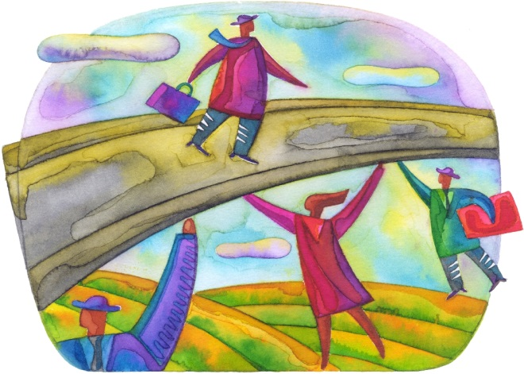
Thank you!
Let’s develop Global Citizens who foster relationships & engage in collaboration across cultures to build bridges for success in education, careers, and life.

Slide 15

Selected Bibliography
Downie, R. & Useem, R.H. (2012). Writing Out of Limbo. Newcastle, UK: Cambridge Scholars Publishing.
Gupta, A., & Govindarajan, V. (2002). Cultivating a global mindset. Academy of Management Executive, 16(1), 116-126.
http://etec.ctlt.ubc.ca/510wiki/File:Reflective-practice.gif -
Javidan, M., Steers, R. M., & Hitt, M. A. (2007). The global mindset. Advances in International Management, 19. UK: Emerald Group Publishing Limited.
Javidan, M. & Walker, J. (2013). Developing Your Global Mindset. Edina, MN: Beaver’s Pond Press.
Mendenhall, M.E., Osland, J.S., Bird, A., Oddou, G. R., Maznevski, M. (2008). Global Leadership. New York, NY: Routledge.
Morrison, T. & Conaway, W.A. (2006). Kiss, Bow, or Shake Hands, 2e. Avon, MA: Adams Media.
“Reflective Practice” CD ROM, 2007, http://www.education.vic.gov.au/childhood/professionals/support/Pages/collaborativeact.aspx
Rhinesmith, S.H. (1993). A Manager's Guide to Globalization. Homewood, IL: Business One Irwin.
Notes:
http://etec.ctlt.ubc.ca/510wiki/File:Reflective-practice.gif

Slide 16
Core Competencies (ISLO’s)
4.4 Communities (local to global)
a. Assume personal responsibility for being informed, ethical and active citizens of their community, the nation, and the world
b. Act with an informed awareness of contemporary issues and their historical contexts
c. Exercise civic responsibility
d. Are cognizant of balancing human needs with the limitations of world resources
e. Recognize the impact of human activity (political, economic, social, technological) on local and global environments
Notes:
We have commitments agreed upon through shared governance that commit us to providing an education that is cognizant of global perspectives: Core Competencies, or ISLOs, and Educational Master Plan.

Slide 17
Core Competencies (ISLO’s)
4.5 Diversity
a. Recognize the commonality of human experiences across cultures
b. Recognize the human tendency to gravitate towards people and customs that are familiar
c. Recognize the influence of cultural perspectives on human thought and behavior
d. Accept the rights of others to have different cultural beliefs and behaviors
e. Work with diverse people including those with different physical abilities, linguistic, cultural, religious, lifestyle, national, and political backgrounds.

