Slide 1
SLOs and SAOs: What Are They?
Information in this presentation comes from the Fundamentals of Assessment conference led by Dr. Amy Driscoll and sponsored by ACCJC, and from the LPC Student Learning Outcomes Handbook.

Slide 2
What is an SLO/SAO?
According to the Academic Senate for California Community College’s SLO Terminology Glossary, “Student learning outcomes (SLOs) are the specific observable or measurable results that are expected subsequent to a learning experience. These outcomes may involve knowledge (cognitive), skills (behavioral), or attitudes (affective) that provide evidence that learning has occurred as a result of a specified course, program activity, or process. An SLO refers to an overarching outcome for a course, program, degree or certificate, or student services area (such as the library). SLOs describe a student’s ability to synthesize many discreet skills using higher level thinking skills and to produce something that asks them to apply what they’ve learned. SLOs usually encompass a gathering together of smaller discrete objectives through analysis, evaluation and synthesis into more sophisticated skills and abilities.”

Slide 3
Most courses have two to six SLOs
Student service areas should have at least one SAO (Student Area Outcome).

Slide 4
What is an objective?
According to the same glossary, objectives “are small steps that lead toward a goal, for instance the discrete course content that faculty cover within a discipline. Objectives are usually more numerous and create a framework for the overarching student learning outcomes which address synthesizing, evaluating and analyzing many of the objectives.”

Slide 5
Most courses have several measurable objectives

Slide 6
An example
CSLO for English 4: Upon completion of English 4, students will be able to identify and evaluate implied arguments in college-level literary texts.
Some measurable objectives that lead to the CSLO:
Identify unstated premises and hidden assumptions which arise from the social, historical, moral, cultural, psychological, or aesthetic perspectives and contexts.
Explain, analyze, and apply a literary argument and related critical evaluation using logical patterns of reasoning, such as induction and deduction.
Identify logical and literary fallacies in fiction
Distinguish between fact, inference, and judgment, recognizing that many reasonable inferences can be derived from the same facts

Slide 7
A easier way to think about outcomes
An outcome clarifies what students come out of the course, program, institution, or service with. Students are often able to produce or do something as a result.
What do you want students to be able to do when they leave the course or student service? How will they apply what they’ve learned?

Slide 8
Bigger picture: How SLOs and SAOs fit in the assessment cycle
Develop or modify SLOs [or SAOs]
Develop, modify, or review a curriculum, course, program, or service
Design and measure student learning as a result of the curriculum, course, or program [or service].
Determine refinements based on outcomes data
Collect, discuss, and analyze data.
Source: ASCCC SLO Terminology Glossary

Slide 9
An example
Full-time and part-time faculty agree to assess following PSYC 1 SLO:
•Demonstrate fundamental knowledge and comprehension of the major concepts, theoretical perspectives, historical trends, and empirical findings in psychology.
Within next 3 years…
Next semester, faculty have a one-hour department meeting to discuss assessment results.
•Many faculty find that students are struggling to understand the section on the brain. The faculty collaborate to create a new unit on the brain.
Individual faculty select what type of assessment will best capture the SLO (comprehensive final exam or smaller unit quizzes).
By the end of the semester the assessment data are entered into eLumen.

Slide 10
Sources of outcomes
Institutional mission and values
National and international priorities
Disciplinary associations
Bloom’s Taxonomy
Faculty interest, commitments, and expertise
Employer feedback
Alumni feedback
Student feedback
Accreditation requirements

Slide 11
Learning outcomes are not...
Descriptions of learning activities
Descriptions of curriculum content
Descriptions of a course or program
Descriptions of the learning environment

Slide 12
The SLO Committee recommends...
SLOs broad in scope, focusing on areas of knowledge, skills, or attitudes that are central to the course or program
SLOs be measurable and use verbs from Bloom’s Taxonomy that show higher level thinking (examples on next slide)
2-6 SLOs per course or program

Slide 13
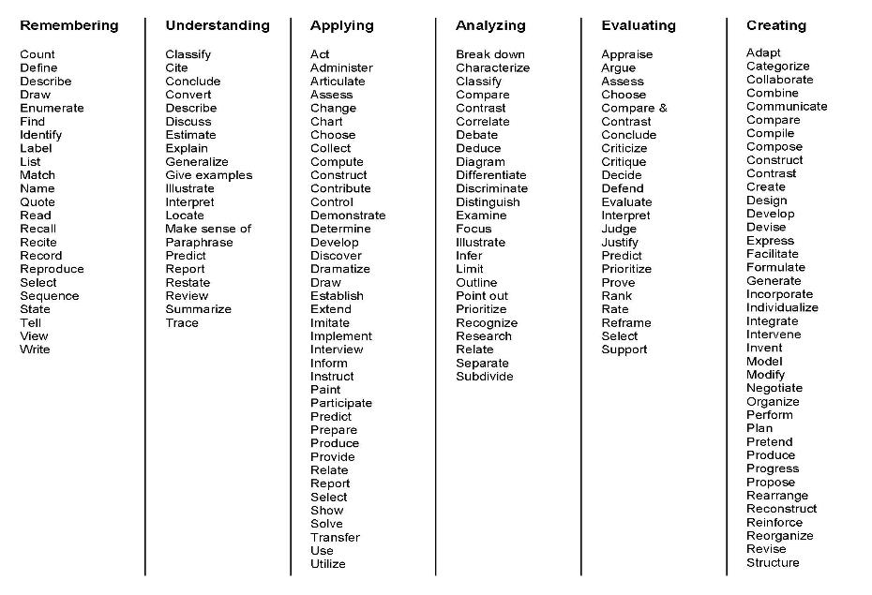
Low level
High level

Slide 14
Examining SLOs and SAOs
Are the verbs specific, observable, measurable, open to description and common understandings?
Does the outcome describe one outcome rather than several at a time?
Is it clear? Will students understand it?
Does it allow for a “diverse array of methods” of assessment?* (American Association for Higher Education’s 9 Principles of Good Practice for Assessing Student Learning)
                *exceptions may apply

Slide 15
An example of how ISLOs, PSLOs, and CSLOs might be linked.
ISLO: Students access, evaluate, and use information from technology sources.
PSLO: Students access, evaluate, and use culinary information from technology sources.
CSLO: Students access culinary information from multiple technology sources.
CSLO: Students evaluate culinary information from multiple technology sources.
CSLO: Students use culinary information from multiple technology sources.

Slide 16
Outcome or not?
Students analyze situations to solve management problems
Students practice writing to convince a future employer
Students apply organizational skills to management situations

Slide 17
Outcome or not?
Students analyze situations to solve management problems
Students practice writing to convince a future employer
Students apply organizational skills to management situations

Slide 18
Outcome or not?
Students learn about the history of technology
Students appreciate the role of technology in economics
Students describe ethical considerations for technology
Students practice using technology to solve problems

Slide 19
Outcome or not?
Students learn about the history of technology
Students appreciate the role of technology in economics (yes, though debatable)
Students describe ethical considerations for technology
Students practice using technology to solve problems

Slide 20
Outcome or not?
Students work on writing skills for improvement
Students experience different purposes of writing
Students write compelling communication for varied purposes
Students compare their early writing with later writing

Slide 21
Outcome or not?
Students work on writing skills for improvement
Students experience different purposes of writing
Students write compelling communication for varied purposes
Students compare their early writing with later writing

Slide 22
Outcome or not?
Students identify and analyze community issues
Students serve in community agencies to become aware of community needs
Students reflect on community experiences to determine insights for citizenship
Students describe self as citizen and evaluate readiness for role

Slide 23
Outcome or not?
Students identify and analyze community issues
Students serve in community agencies to become aware of community needs
Students reflect on community experiences to determine insights for citizenship
Students describe self as citizen and evaluate readiness for role

Slide 24
Outcome or not?
Students describe steps of problem solving
Students practice solving problems to have greater skill and understanding
Students solve problems with consideration of multiple perspectives

Slide 25
Outcome or not?
Students describe steps of problem solving
Students practice solving problems to have greater skill and understanding
Students solve problems with consideration of multiple perspectives

Slide 26
What’s my role?
Become familiar with the course SLOs for the courses you teach, or the SAOs for your student service.
Be sure you’re assessing how your students are meeting those outcomes at least once during the semester.
Depending on your discipline’s SLO process, or your service’s SAO process, enter data and reflections in eLumen for all or some of those assessments (often at the end of the semester).

Slide 27
What’s my role?
Participate in discipline, division, and institutional discussions about student learning (including SLO/SAO results)
Our current recommendation is disciplines discuss a course or SLO at least every three years, and as a part of this discussion, analyze the data that has been entered in eLumen since the course or SLO was last discussed.

Slide 28
What’s my role?
In your discipline or student service, encourage ongoing review and development of the SLOs/SAOs themselves
  Does a new SLO/SAO need to be added to the course or service? (e.g., Isn’t it important for a student taking any section of this course to be able to do X upon completion of the course?)
  Does a current SLO or SAO need revised?
  Are there any current SLOs or SAOs that aren’t really outcomes?

