Slide 1
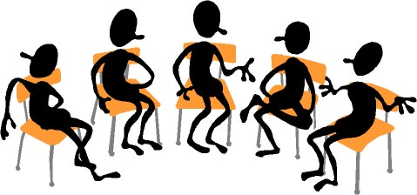

Working Together: Grading Theories and Practices
FLEX Day – October 24, 2017
1:00 PM – 2:50 PM
Room 2470
Organized by Howard Blumenfeld, Sheena Turner-August, Steve Chiolis, Marty Nash, Marsha Vernoga, and Elizabeth Owens

Slide 2
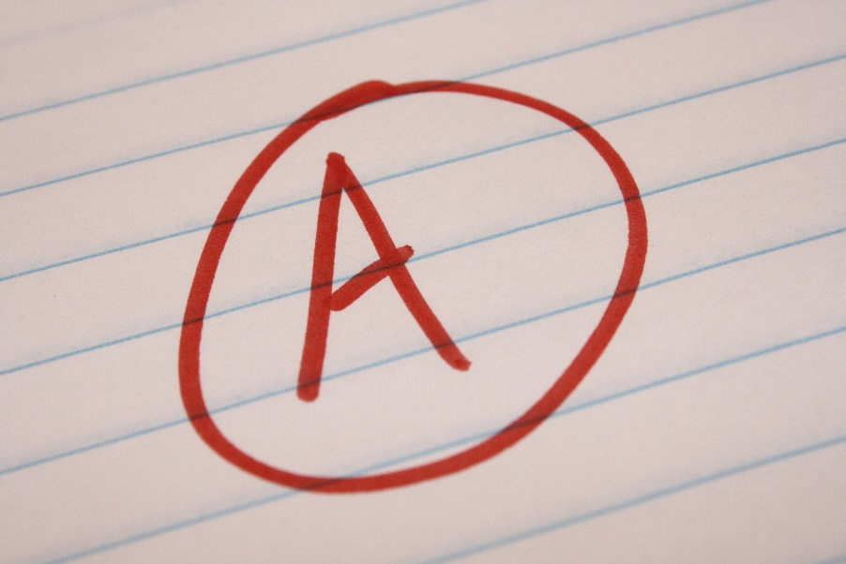




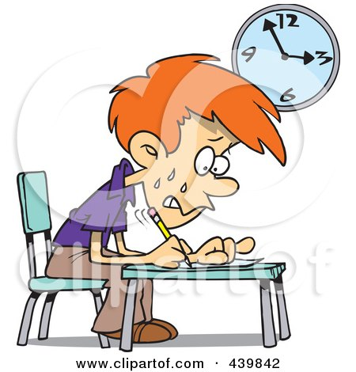

Slide 3
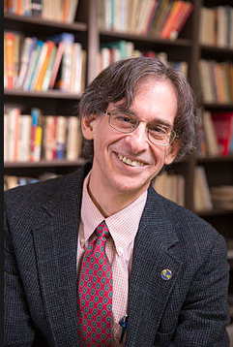
The Case Against Grades
Alfie Kohn is an American author and lecturer in the areas of education, parenting, and human behavior. The following is a quote from his article The Case Against Grades:
“I remember the first time that a grading rubric was attached to a piece of my writing…Suddenly all the joy was taken away. I was writing for a grade – I was no longer exploring for me. I want to get that back. Will I ever get that back?” –Claire, a student

Slide 4
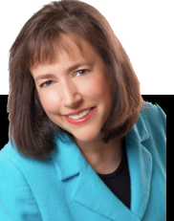
De-Grading Education
Elizabeth Wissner-Gross is an author and educational strategist based in New York. She has helped many high school and college students to discover their passions and get into the right college or university to further their studies.

Slide 5
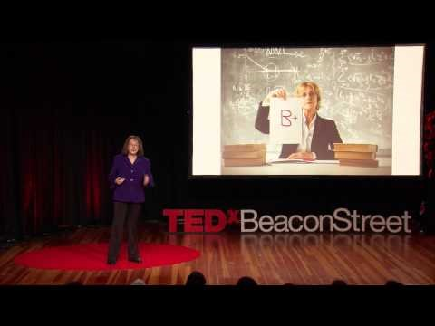
De-Grading Education

Slide 6
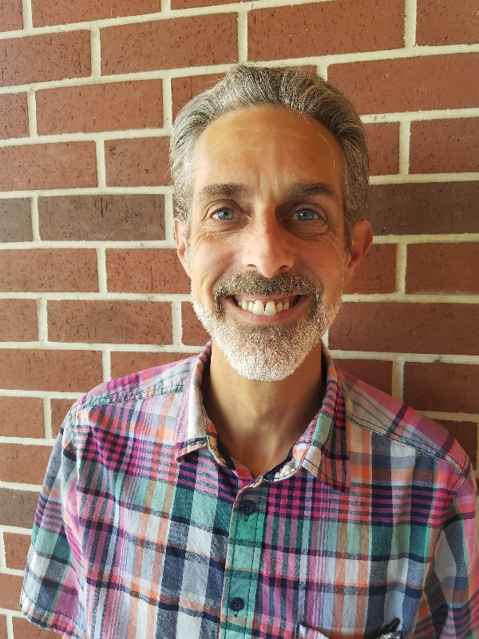
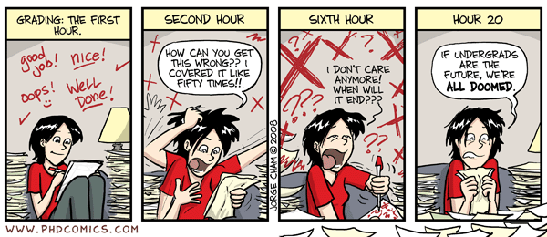
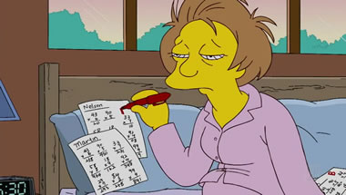
Mutable Marks & Sometimes Miserable Markers
—Steve Chiolis
“C” Is for “Conditioned”: Changing Scales & Descriptions
“W” Is for “Workload” and “Wearniness” and “Withdrawal”
“Q&A” is for “Questioning & Answering” and “Quantifying and Advocating”

Slide 7
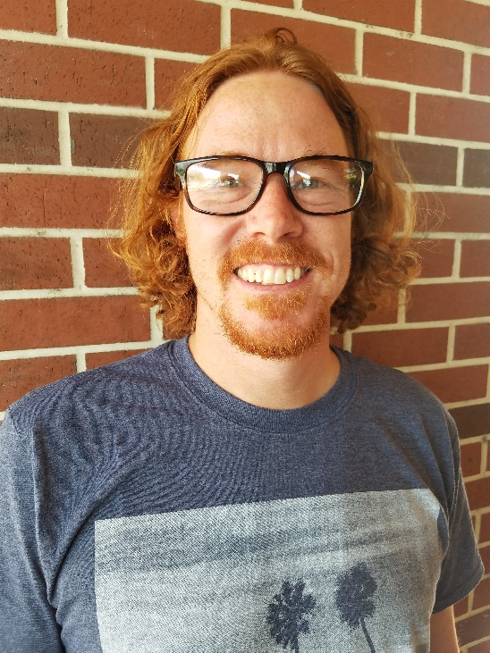
What Are Grades Really For? (Marty Nash)
Evaluate the process or the product? Both?
What motivates students to learn? I hope it's not points.
What to make of failure. The student who plays it safe or the student who takes risks?
Is this a social justice issue?

Slide 8
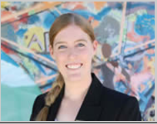
The Purpose of Feedback (Elizabeth Owens)
Types of feedback
Returning sufficient, timely feedback
Comments for student benefit versus comments in defense of a grade

Slide 9
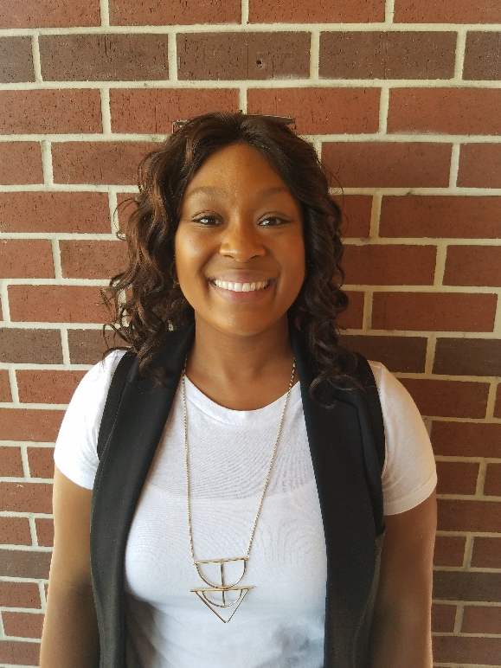
“I Didn’t Expect You to Be Black”(Sheena August-Turner)
What is the impact of Diversity on the grading process?
  Age, gender, ethnicity, sexual orientation, language, immigration status
What authority looks like
Are we discussing the intersection of Power and Diversity related to the grading process?
Notes:
Diversity Paper for Psyc 1 Example

Slide 10

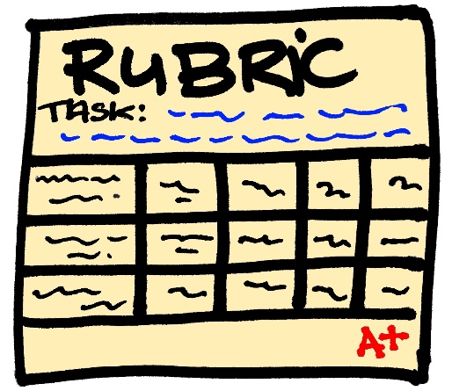
Small Group Breakout Sessions
Group breakout session facilitators:
  Marty Nash & Steve Chiolis
  Marsha Vernoga & Elizabeth Owens
  Howard Blumenfeld & Sheena August-Turner

Slide 11

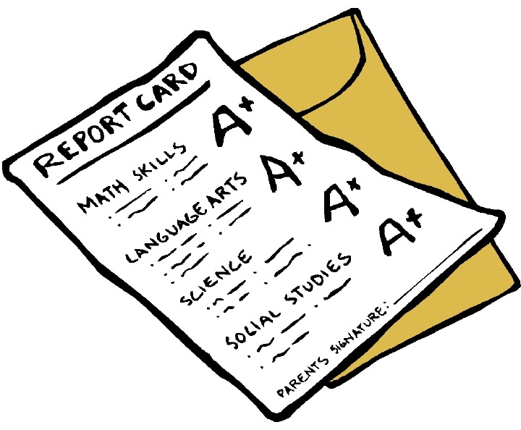
Questions to answer in groups
  Are you teaching the way you want to or the way you need to?
  What is the role of mercy in grading?
  How do you encourage students to derive a sense of genuine motivation and personal value from your classes?
Notes:
Old question - The impact of diversity factors related to assigning grades is an area often not explored. Has this come up in your classroom? If so, please share on your experiences and how you worked to resolve the intersection of the two.
Old question - Have you ever had a dilemma while assigning a grade (e.g., a student on the borderline)? What did you do?

Slide 12

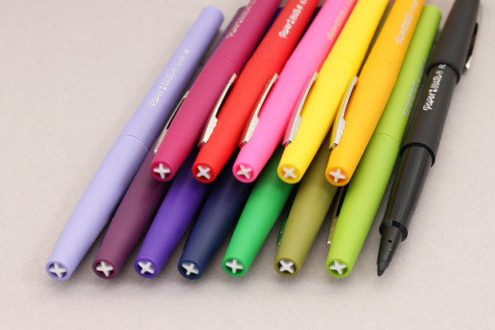
Reflections
  Briefly summarize highlights of small group discussions.

Slide 13

Where do we go from here?
Follow-up Conversations on Monday, November 6 in Room 2410 (From 3:30 PM to 5:30 PM) and Wednesday, November 8 in Room 2410(From 2:30 PM – 4:30 PM)
The Teaching Institute
Other Workshops
Hand out surveys

