Slide 1
Data Security
Las Positas College Flex Day

Slide 2
Starting Point #1:
What do we mean by IT Security?

Slide 3
IT Security tries to achieve three things

Slide 4
IT Security tries to achieve three things
Maintain Confidentiality

Slide 5
IT Security tries to achieve three things
Confidentiality
Maintain Data Integrity

Slide 6
IT Security tries to achieve three things
Integrity
Confidentiality
Maintain Availability

Slide 7
IT Security tries to do three things
Availability
Integrity
Confidentiality
C. I. A.

Slide 8
Today’s Focus -
Confidentiality

Slide 9
Starting Point #2:
What Is Personally Identifiable Information?

Slide 10
Personally Identifiable Information (PII) Is…
More than just SSN
Varies by state
A combination of data elements…

Slide 11
What Is Personally Identifiable Information?
An individual’s first name or first initial and last name in combination with any one or more of the following data elements, when either the name or the data elements are not encrypted:
(A) Social security number.
(B) Driver’s license number or California identification card number.
(C) Account number or credit or debit card number, in combination with any required security code, access code, or password that would permit access to an individual’s financial account.
(D) Medical information.
(E) Health insurance information.
(F) Information or data collected through the use or operation of an automated license plate recognition system, as defined in Section 1798.90.5.
(2) A user name or email address, in combination with a password or security question and answer that would permit access to an online account.
(i) (1) For purposes of this section, “personal information” does not include publicly available information that is lawfully made available to the general public from federal, state, or local government records.*

Slide 12
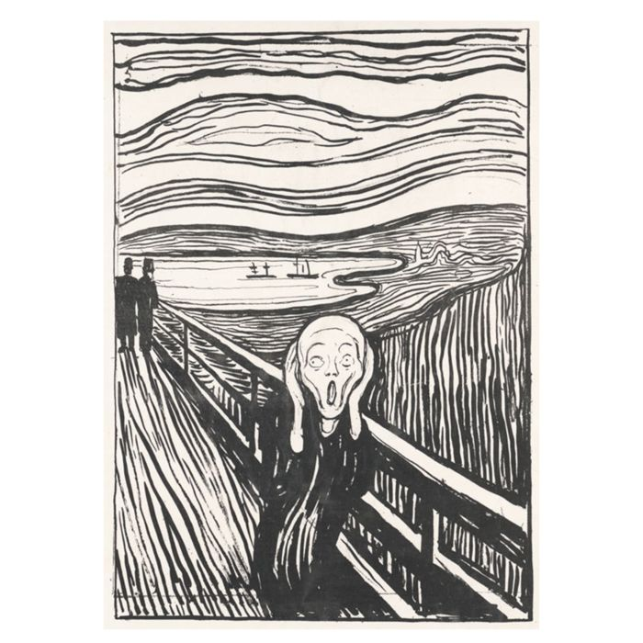
Some Bad News
The number of reported PII breaches in 2017 was up 88% from 2016
  2.5 BILLION records were exposed
  Source: gemalto.com

Slide 13
At Least We Aren’t in “Financial Services” or “Health Care”
Percentage of data breaches by industry
  Healthcare 27%
  Financial Services 12%
  Education 11%
  Government 11%
  Source: gemalto.com

Slide 14


Slide 15
Higher Education is enticing…
We handle LOTS of PII
We tend to promote open access
Our cyber-security tends to be underfunded compared to other industries

Slide 16
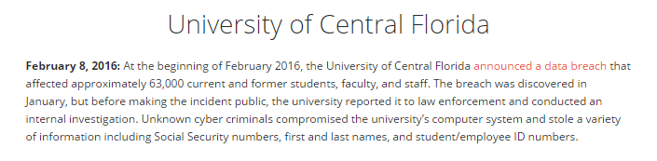
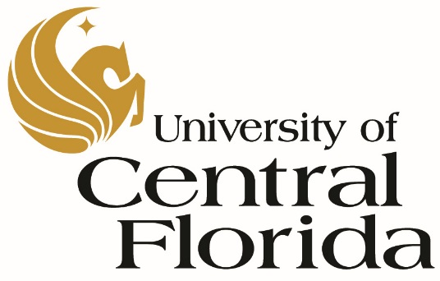
Recent Breaches – Higher Ed

Slide 17
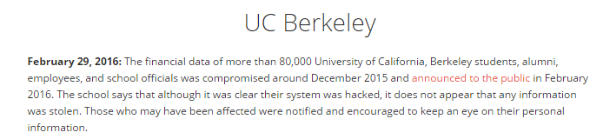

Recent Breaches - Higher Ed

Slide 18
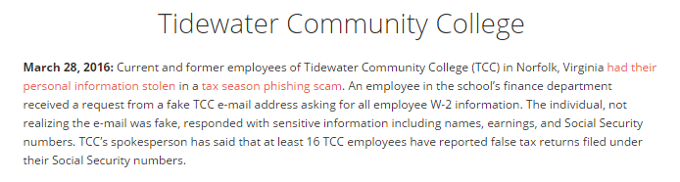

Recent Breaches – Higher Ed

Slide 19
Recent Breaches – Higher Ed
Augusta University
August 16, 2018: The protected health information of 417,000 people has been exposed after a cyberattack on Augusta University. This data breach occurred after several email accounts were compromised in a phishing attack. The individuals affected are primarily patients of Augusta University Health, Augusta University Medical Center, Children’s Hospital of Georgia, and more than 80 outpatient clinics around the state

Slide 20
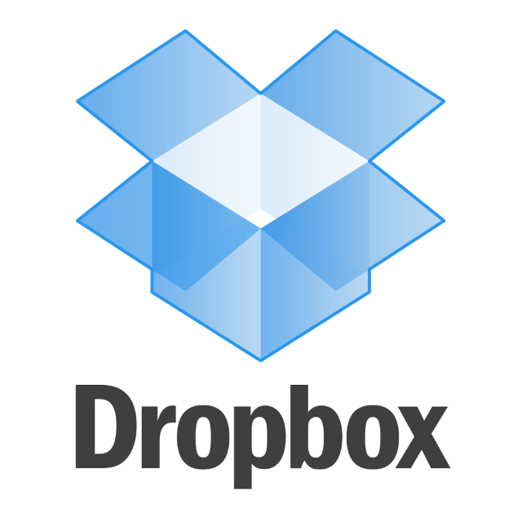
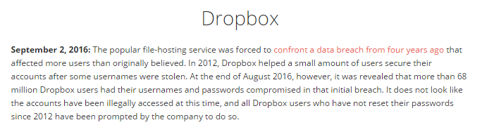
Biggest Breaches – Of Interest

Slide 21

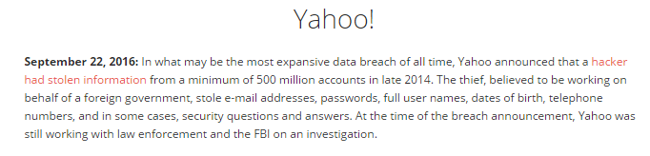
Biggest Breaches – Of Interest

Slide 22

Biggest Breaches – Of Interest
Equifax
In 2017 Cybercriminals penetrated Equifax, one of the largest credit bureaus, in July and stole the personal data of 145 million people. It was considered among the worst breaches of all time because of the amount of sensitive information exposed, including Social Security numbers.
The company only revealed the hack two months later. It could have an impact for years because the stolen data could be used for identity theft.

Slide 23
Biggest Breaches – Of Interest
Apollo
October 2, 2018: A startup sales engagement company Apollo suffered a hack that exposed more than 200 million contact records from its prospect database. Names, email addresses, company names, and other business contact information was included in the data. No financial or Social Security information was compromised.

Slide 24
How are breaches happening?

Slide 25
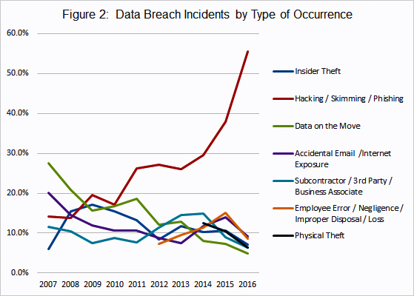
How are breaches happening?

Slide 26
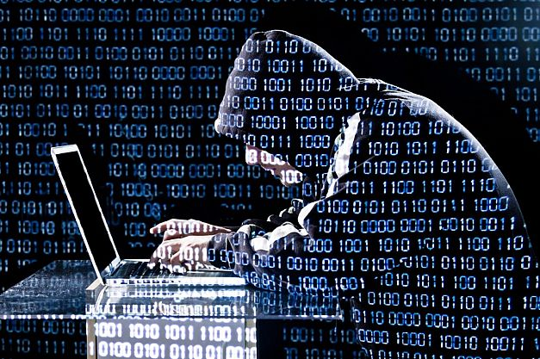
Biggest Threats To Us In Higher Ed
Phishing – Stealing a password via email
Viruses – Malicious software
Ransomware – Encrypt a person’s files and demand payment to get them back
Data Loss – Devices with personal data are lost or stolen (phones, laptops, etc)

Slide 27
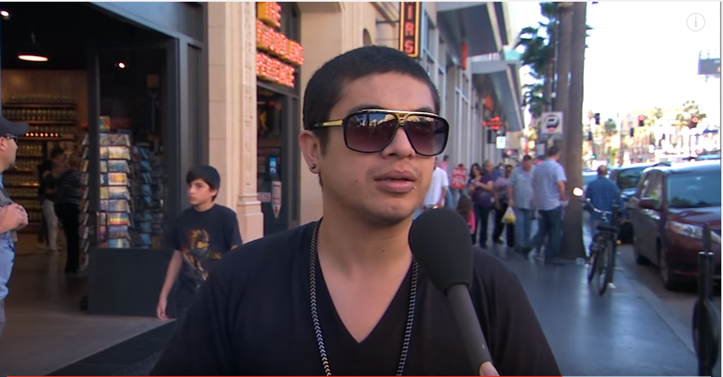
PHISHING
https://www.youtube.com/watch?v=opRMrEfAIiI

Slide 28

Phishing
No Amount of Cyber Security Works
    Firewalls
    Anti-Virus
    Activity Monitoring
  If someone gives away their username and password, or if someone can guess your password, they are YOU on our network.

Slide 29

Phishing
No Amount of Cyber Security Works
  Firewalls
  Anti-Virus
  Activity Monitoring
  If someone gives away their username and password, or if someone can guess your password they are YOU on our network.
YOU ARE THE MOST IMPORTANT PART OF OUR CYBER DEFENSES!

Slide 30

We Interrupt This Broadcast
For An Important Message

Slide 31
Passwords
Change your password regularly, but not too often
Use a long, complex password where possible
  We are working on changing this for Classweb.
Never log someone in under your credentials
And, of course, never give it to anyone via email or over the phone.

Slide 32
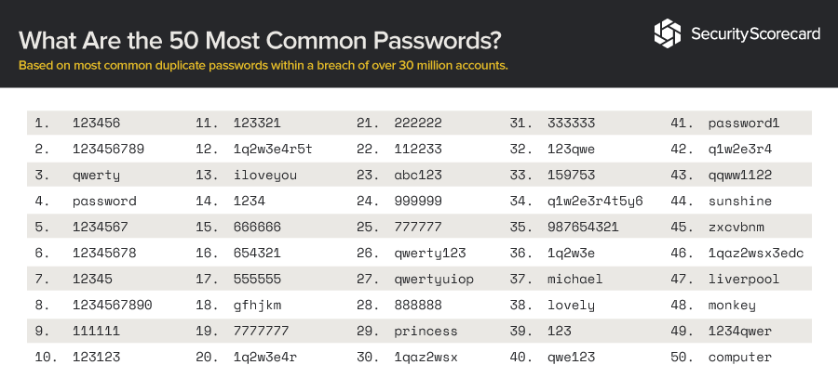
Worst Passwords of 2018
Notes:
According to Osterman Research, Inc. the typical information worker spends 153 minutes per day working in email and 51 minutes in social media – 42.5 percent of a typical eight - hour day – not to mention the various work - related and personal use of the web that takes place on a daily basis.
Consequently, security for all of these tools must be of paramount concern for decision makers because of the substantial opportunity that they represent for ingress of malware and other threats. For example, our research found that during just the last 12 months:
74 percent of organizations have been infiltrated with malware through Websurfing
64 percent have experienced malware infiltration through email.
22 percent have experienced an accidental or malicious leak of sensitive or
confidential data through email
14 percent of organizations have had malware enter the corporate network through
social media or other Web 2.0 apps
http://www2.trustwave.com/rs/trustwave/images/Best_Practices_in_Email_Web_and_Soc ial_Media_Security_Trustwave.pdf

Slide 33
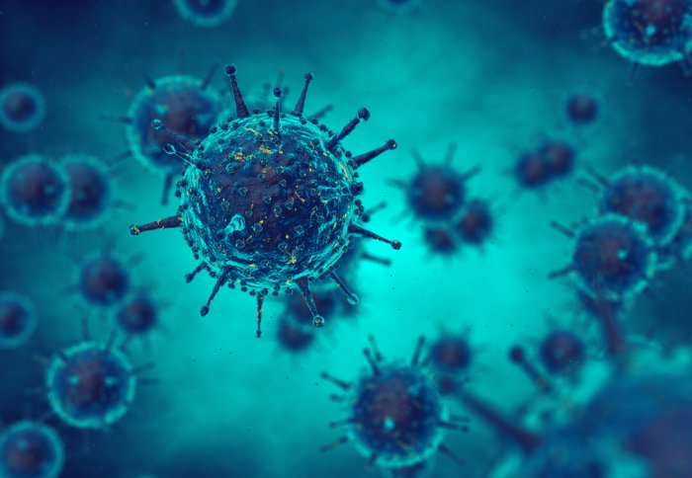
Viruses

Slide 34

Viruses - The Good Ol’ Days
  Hackers wanted to show how smart they were
  Glorified “pranks” with no monetary incentive
  Fueled by “nerd rage” – the Melissa Virus

Slide 35
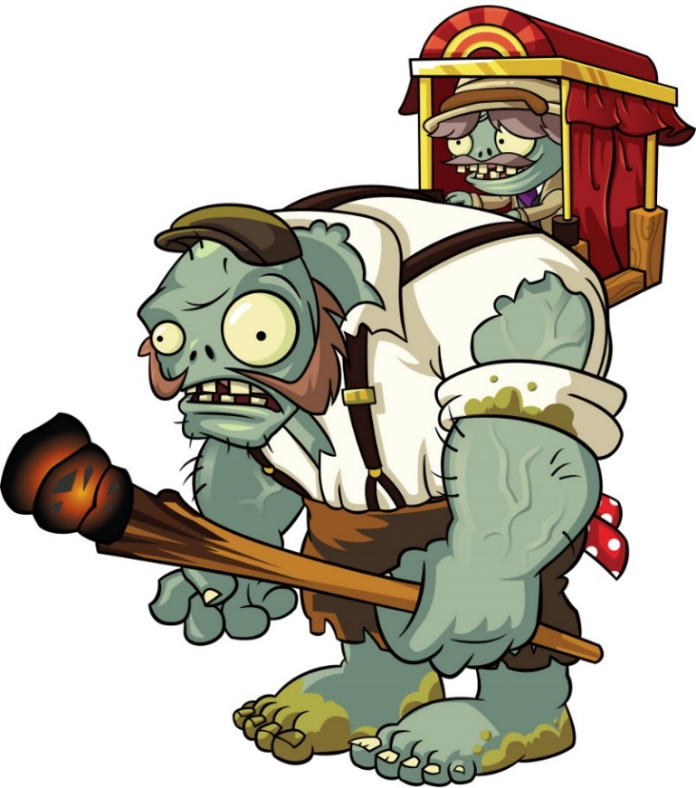
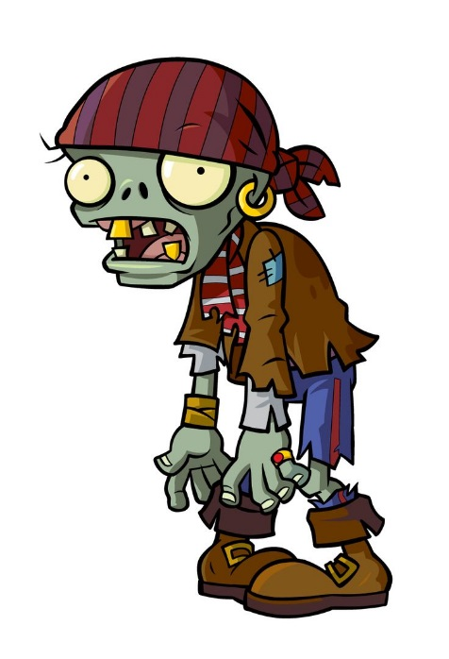
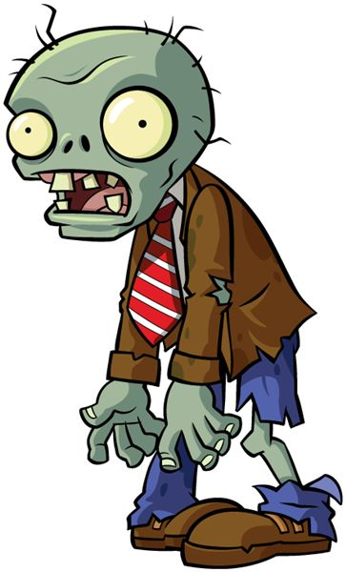
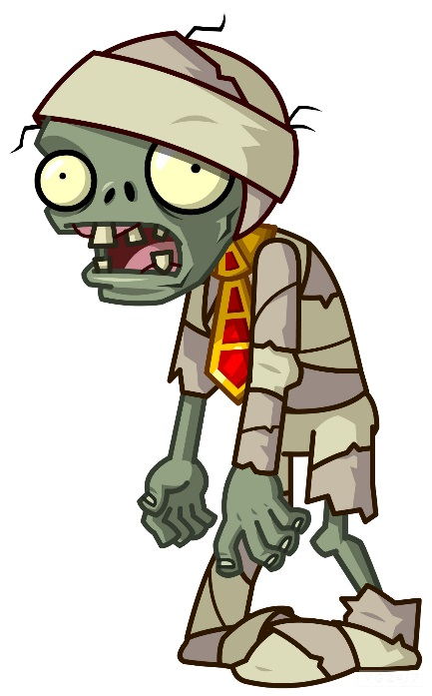

Viruses - Not So Long Ago
  Pop-up and “Adware”
  Hackers wanted to “take over” your computer
  Computer becomes a “Zombie” and is used to generate spam
  Zombies also used for attacks on businesses and government
  Money starting to creep in…

Slide 36

Viruses - Today
Used to steal or gain access to information which can be sold
  Stealing passwords
  Stealing data directly off the computer
Gaining access to other systems
Mining for dollars, and…

Slide 37
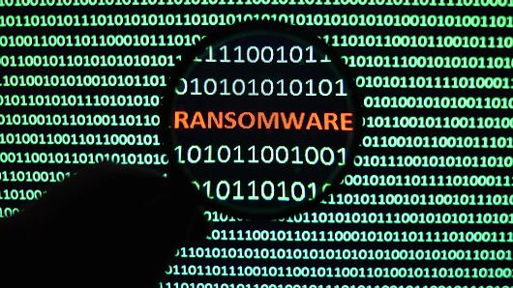

Slide 38
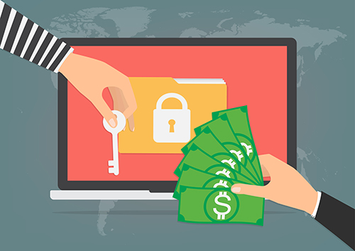
Ransomware
A newer form of Virus - Extortion
Encrypts all or most of the files on a computer or server
Victims are sent messages directing them to pay for access to the files
One Southern California College paid ~$30k to unlock 1700 PCs

Slide 39
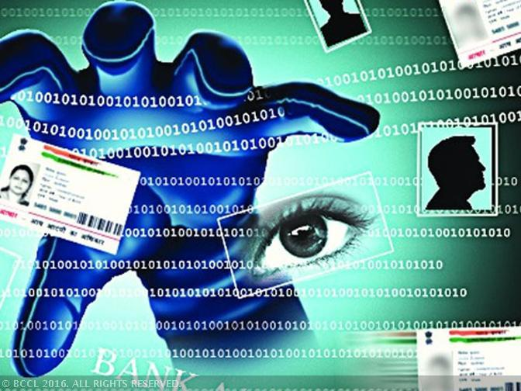
Data Loss & Theft

Slide 40
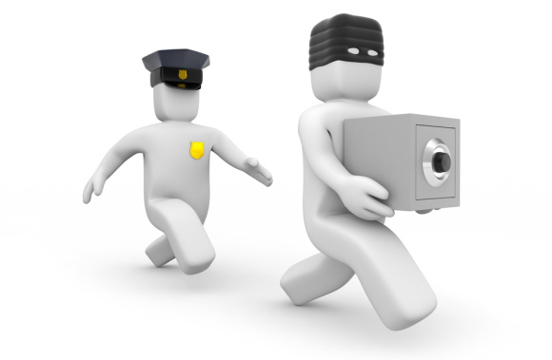
Data Loss / Theft
PII lives in MANY places
  PC’s and Laptops
  Phones and Tablets
  Thumb Drives
  Email
  Hardcopy Files

Slide 41
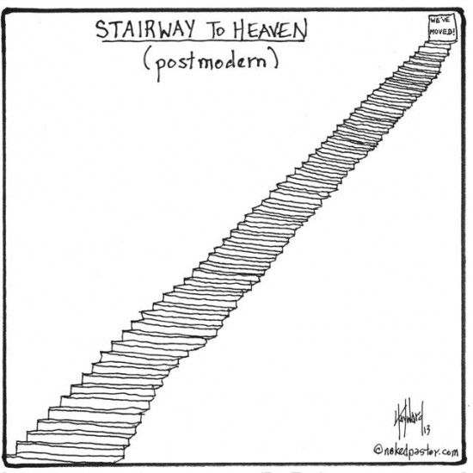
So what are we able to do?
Be vigilant for Phishing attacks
Be “smart” with your passwords
  Password123 needs to be changed.
ITS is implementing a security framework
  CIS 20 Controls

Slide 42
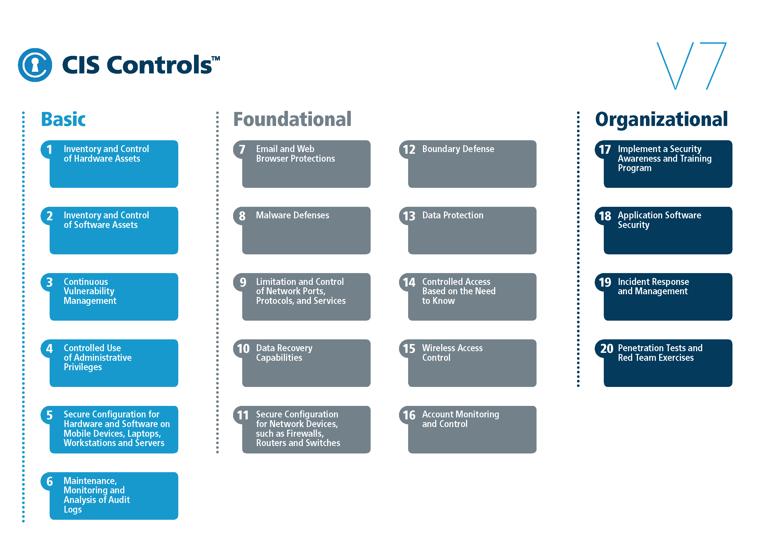

Slide 43
Questions

