Slide 1

Guided Pathways
Voices of LPC
Guided Pathways Steering Committee Members and Workgroup Leads
Flex Day—October 23, 2018
Notes:
Welcome audience; general introduction to panel; delighted that the two student members of the Guided Pathways Steering Committee could join us today—Lylah Schmedel and Garrett Culbertson.
Thank you for attending today. Over the last year +, you’ve probably heard something about Guided Pathways, at a flex day, or division meeting or just overhead someone talking about it. Today, we wanted to provide an opportunity for your voice to be heard, for information to be shared, and to introduce some ideas about how you might become involved.

Slide 2
Pair & Share
What do you know about Guided Pathways?
Notes:
To get us started, we thought it would be good to have a little conversation about what you already know about Guided Pathways. Please take 1 minute to share with the people sitting near what you know about Guided Pathways.

Slide 3
Word Map with Your Pair Share
What single word comes to mind when you think about Guided Pathways?
Notes:
Now, in your small group, take a moment to think about one word that your group would use to describe feelings or thoughts about Guided Pathways. In a moment, you’ll have the opportunity to share your word electronically.

Slide 4


Two ways to Join our Poll!
Text the message: kristywoods950 to the number 37607
Using a Web Browser, go to
PollEv.com/kristywoods950
If you want to change your answer via text, type “clear” and send a new answer.

Slide 5


Four Pillars of Guided Pathways
Clarify their Path
Enter
their Path
Stay on their Path
Ensure Learning
Create Clear
Curricular
Pathways to
Employment
and Further
Education
Help Students
Choose and Enter Their
Pathway
Help Students
Stay on
Their Path
Follow Through, and Ensure that Better Practices are Providing Improved Student Results.
Notes:
As a refresher, the foundation of Guided Pathways involves
Helping student see a path from their first day at LPC until they reach their educational/career goal at LPC.
Assisting student to enter their pathway. For example, providing clear information about how to apply, register, take assessments, get started in a program, etc.
Providing support to help student stay on their path and achieve their educational and career goals
And all the way along, assure learning that supports the students in moving forward.
Often we come to meetings just to listen. But today, we want to listen to you. So we’re going to pose a few questions and we invite to share your responses with us.

Slide 6
Questions to Consider…
Why is Guided Pathways important for our students?
Notes:
Lylah to ask
Joel and Angella to answer + audience

Slide 7
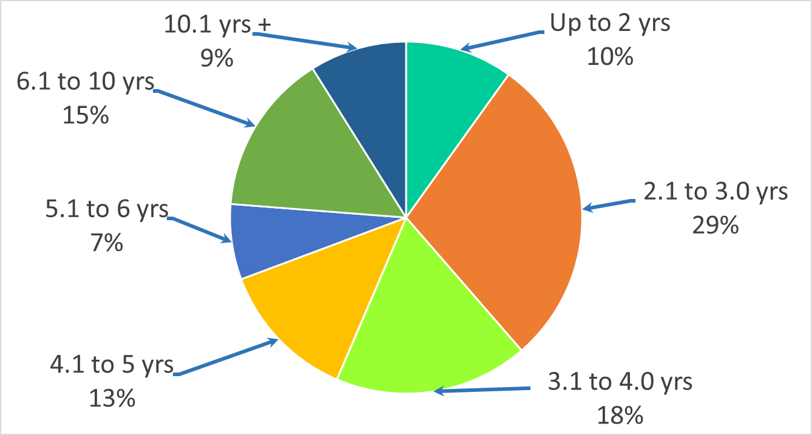
Years to Complete an AA/AS Degree at LPC
2016-2017 First Time Associate Degree Completers
Notes:
Bill to speak to this slide

Slide 8
Number of Units Taken by
First-Time Associate Degree Completers
Average Unit Accumulation
Notes:
Erick to speak to this slide
CA Data is worse:
First time Degree Completers Average Unit Accumulation (2014-2015)
Average Attempted is 102 units

Slide 9
Questions to Consider…
What are the challenges that Guided Pathways work brings to LPC?
Notes:
Jeremiah to ask
LaVaughn to answer + Audience

Slide 10
Questions to Consider…
What are the opportunities Guided Pathways work brings to LPC?
Notes:
Garrett to ask
Kristy and John + Audience

Slide 11
Questions to Consider…
How do you think Guided Pathways will change our campus?
Notes:
Bill to ask
Roanna, Rhiannon and Elizabeth + Audience

Slide 12
Here’s Some Ways to Get Involved
Work on mapping my program
Solicit student feedback & student perspective
Review how we schedule classes
Review our intake processes & procedures
Review our forms & processes
Put Guided Pathways on our meetings agendas
Promote Guided pathways in all media, web pages, etc.
Create a career exploration exercise
….. Your Ideas!!!!!
Notes:
We hope that as you have listened to your colleagues today and have learned about Guided Pathways over the last year, that you are now ready to help us define what Guided Pathways will mean to LPC. We have a unique opportunity to shape Guided Pathways to meet the needs of our students and to honor our campus culture and all the wonderful work that we do now and what we want to do in the future. Often we are told what we must do to comply with an initiative or mandate. With Guided Pathways, we are not being told how it must work only the elements that we need to consider. We have the chance to make it all about our student, our campus, our work. We invite your ideas. We need them.

Slide 13
Guided Pathways Sessions Today
Moving Forward with Guided Pathways—Room 2490, 10:00-11:50
Participate in a Guided Pathways Workgroup
Promotion/Professional Development
  Room 2401—1:00-2:50
Data Collection & Analysis
  Room 2416—1:00-2:50
Program Mapping & Career
  Room 2401—1:00-2:50
Student Experience/Student Voice
  Room 1726—1:00-2:50
Technology/User Interface
  Room 2416—1:00-2:50
Notes:
Ask each of the Workgroup leads to introduce their session
Kristy—Promotion/Professional Development
Rajinder—Data Collection & Analysis
Jeremiah—Program Mapping & Career
Nessa/Elizabeth—Student Voice
Bill—Technology/User Interface

Slide 14
Word Map with Your Pair Share
In one word, how are you feeling about Guided Pathways NOW ?
Notes:
Now that you have heard from your colleagues their thoughts about Guided Pathways, why it is important to our students, the challenges and opportunities presented by Guided Pathways, and how it may change LPC, please take a moment to share with your neighbors your thoughts about Guided Pathways. As a group, what one word would describe your thoughts and feelings now?
Thank you all for coming. We look forward to working with all of you in the future as we move forward with Guided Pathways at LPC.

