Slide 1
Centenarian
cen·te·nar·i·an
sentnˈerēən/
noun
plural noun: centenarians
a person who is one hundred or more years old

Slide 2
Blue Zones
The term first appeared in the November 2005 National Geographic magazine cover story "The Secrets of a Long Life” ^{[1]} by Dan Buettner.
^{[1]} "Longevity, The Secrets of Long Life - National Geographic Magazine”. ngm.nationalgeographic.com. Retrieved 2018-04-03.

Slide 3
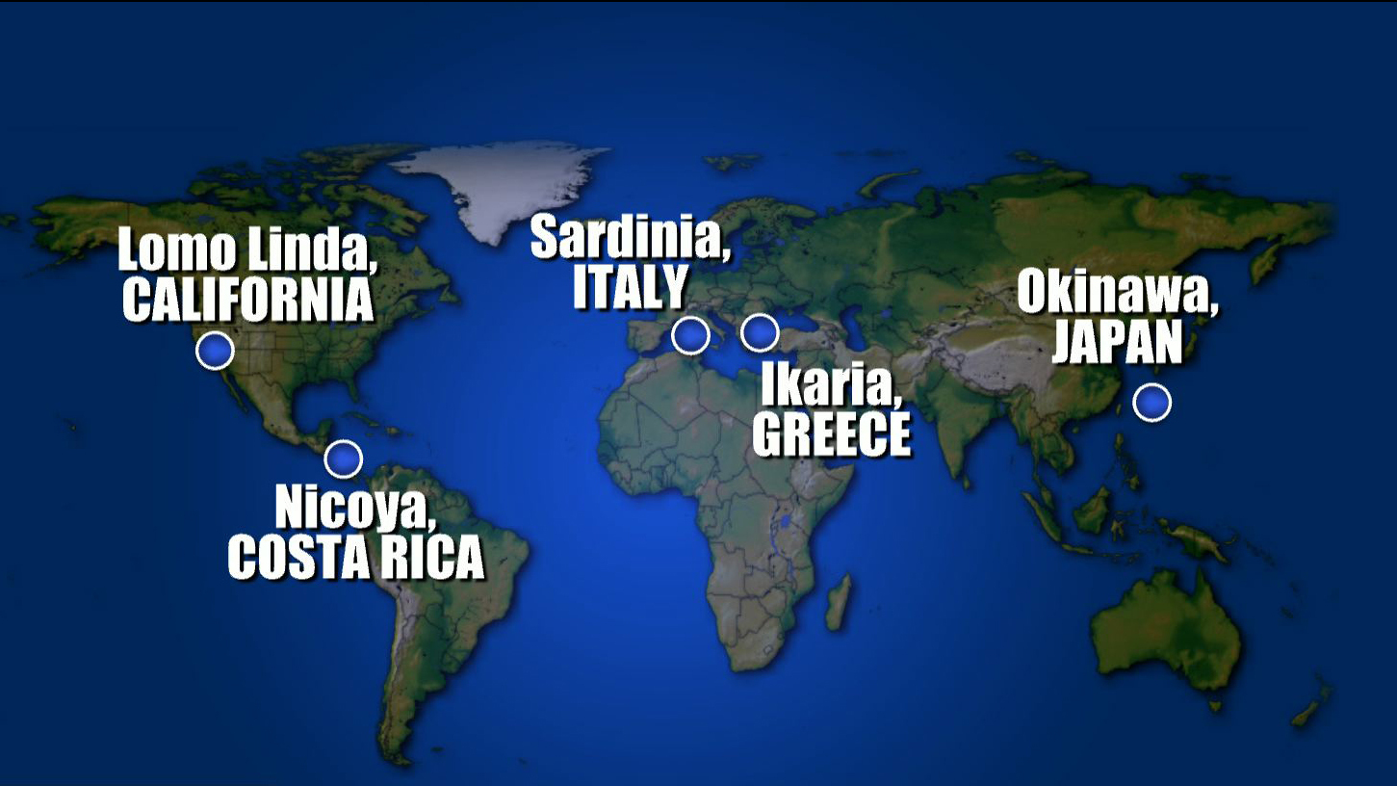

Slide 4
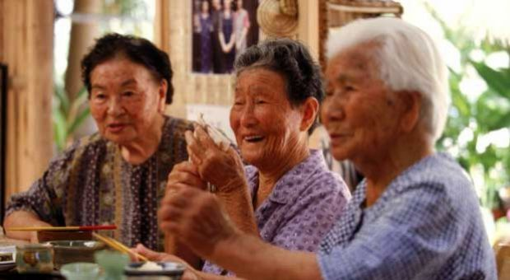
Secrets of the longest-living women
plant-based diet
Lifelong friends called a “moia”

Slide 5
The island where people forget to die.
Move naturally
Mediteranean diet

Slide 6
Home to the longest-living men
laugh and drink wine together

Slide 7
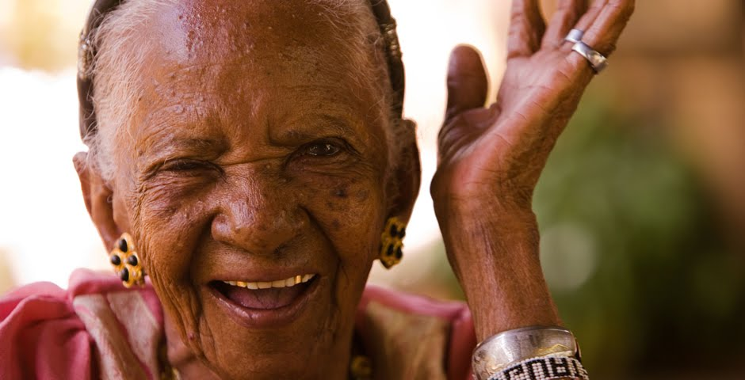
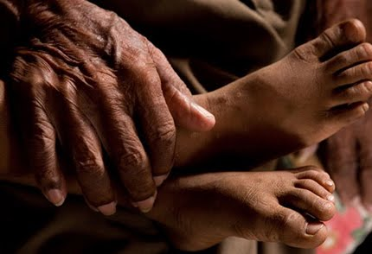
Plan de Vida
“Plan for Life”
sense of daily purpose

Slide 8
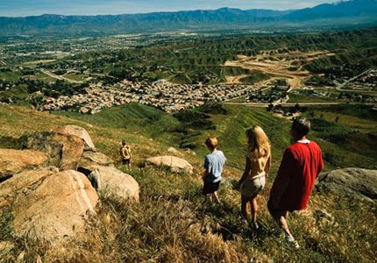
Faith, Friendship, and Fruit
Deep faith
Strong sense of community and family

Slide 9
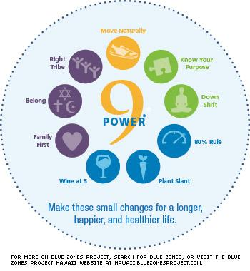
“Power 9”
Move Naturally
Know your Purpose
Down Shift
80% Rule
Plant Slant
Wine at 5
Family First
Spirituality
Right Tribe

Slide 10
Why this topic?
Conclusions from the Baltimore Longevity Study of Aging:
Changes that occur with aging do not inevitably lead to diseases such as diabetes, hypertension, or dementia.
A number of disorders that typically occur in old age are a result of disease processes, not normal aging
Bring the focus on Healthspan rather than Lifespan

Slide 12
Chronic Diseases on the Rise in the U.S.

Slide 13
Collaboration Across Three Disciplines
LPC Honors Project collaboration:
Physiology
Nutrition
Microbiology
Topics:
Global Lifestyles and Longevity in Blue Zones
Healthy Gut Microbiome and Disease Prevention

Slide 14
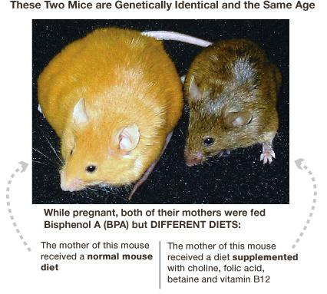
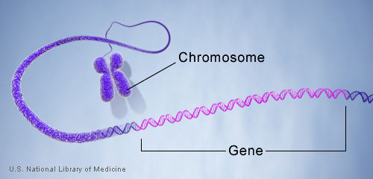
Explore the scientific evidence that supports and explains lifestyle characteristics common in the Blue Zones

Slide 15
Student Reflections
“No doubt that this just one of my favorite topics to reflect on. Since the day of the talk I have talked to three or four people outside of school about what I learned in this presentation, and I will continue to do so.”
“I never knew that 10% of our genes determine longevity whereas our environment determine the rest.”
“Moreover, explaining the Power of 9 in physiological terms made the Blue Zone more interesting and knowledgeable [sic].”

Slide 16
Classroom Discussion
“The power of nine was nothing new for me since I had already seen it myself in real life situations and also had heard it from great people who lived a long time.” – Jesus, who grew up in a small town in Mexico.

Slide 17
Breakout Discussion
Your group will be assigned three areas to consider from the “Power of Nine” lifestyle factors. How could these lifestyle factors be applied to your community, family and/or self?
Behavioral economics is creating a “built-in environment” to influence people to choose healthy behavior. How could we actualize the concept of “Turning LPC Blue”? How could we implement these 9 factors on our own campus?

Slide 18
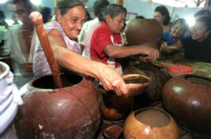
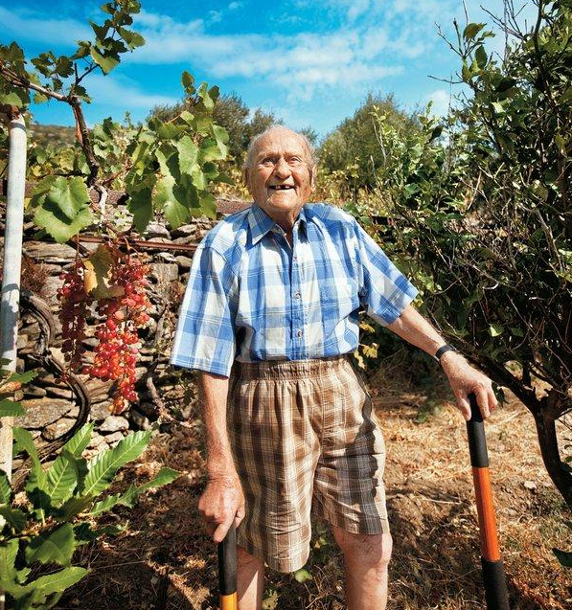
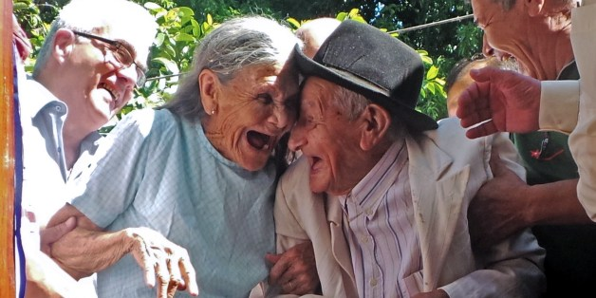
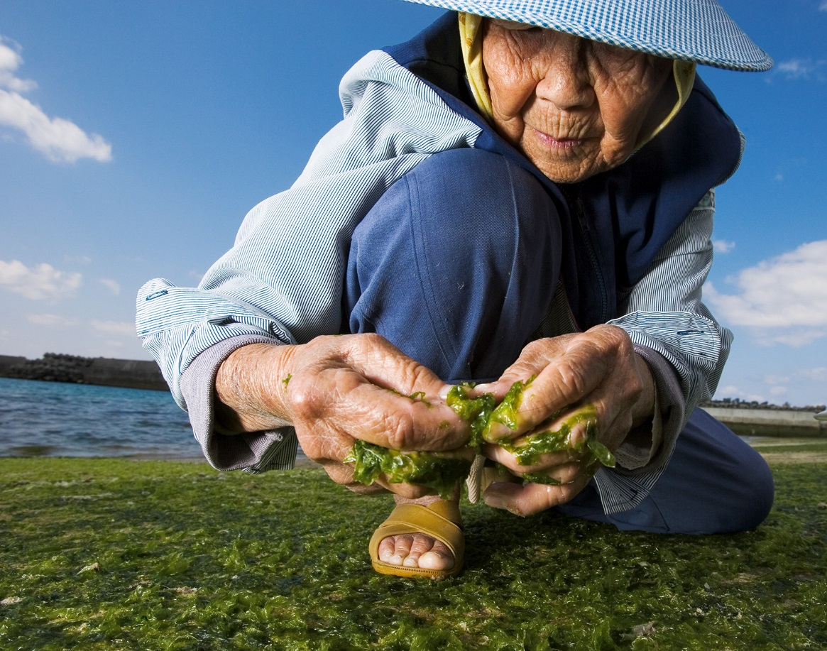
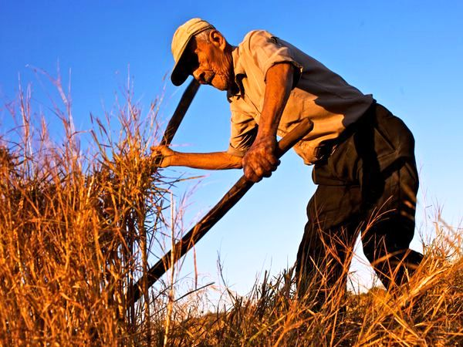

Slide 19
“Power 9”
Move Naturally
Know your Purpose
Down Shift
80% Rule
Plant Slant
Wine at 5
Family First
Spirituality
Right Tribe

Slide 20
Wrapping it up!
Sharing
Where do we go from here??

