Slide 1
October 22, 2019
Community Education Update

Slide 2
History and Mission
Community Education began in earnest at Las Positas in 1998 when Professor Eric Golanty started offering a small range of computer classes for a fee to the Tri-Valley. Karen Halliday, VP Student Services, picked up the program and nurtured it.
Had our 20th Anniversary as a program last year!
Program Mission:
Community Education at Las Positas College is an inclusive, learning-centered program providing educational and personal enrichment opportunities to all Community members. The program supports the life-long learning goals of all students (both for-credit and not-for-credit) to enhance their basic skills, career and technical training, retraining and personal enrichment objectives, and to help all community members meet their personal and professional goals.
2

Slide 3
Las Positas College Values
Las Positas College Values Statement
Las Positas College thrives as a collaborative teaching and learning community committed to integrity and excellence by:
Encouraging and celebrating lifelong learning
Responding to the needs of the ever-changing workplace
Demonstrating civic, social and environmental responsibility
Promoting ethical behavior, tolerance and mutual respect in a diverse community
Fostering a climate of discovery, creativity and personal development
Holding firm to the belief that each of us makes an astonishing difference.
3

Slide 4

Community members meet the college
Incubator for new curriculum
Insight into trends in the Community
Nimble response to Community educational needs
Provide a low-pressure venue for the community to participate in College life as both student and instructor
Small Business Training
Campus Partnerships
Pathway into credit courses
Other pathway opportunities for students
What Community Education Does:

Slide 5
Teaching
Class Ideas Evaluations
Class Proposals Continuous Improvement
Class Scheduling Minimum Enrollment
6

Slide 6
Learning
In-Person classes
Online Classes
Student Evaluations
Special programs and events:
Phlebotomy CPT-1 State Certification
Certificate in Winery Sales and Service
Fencing
HVAC
7

Slide 7
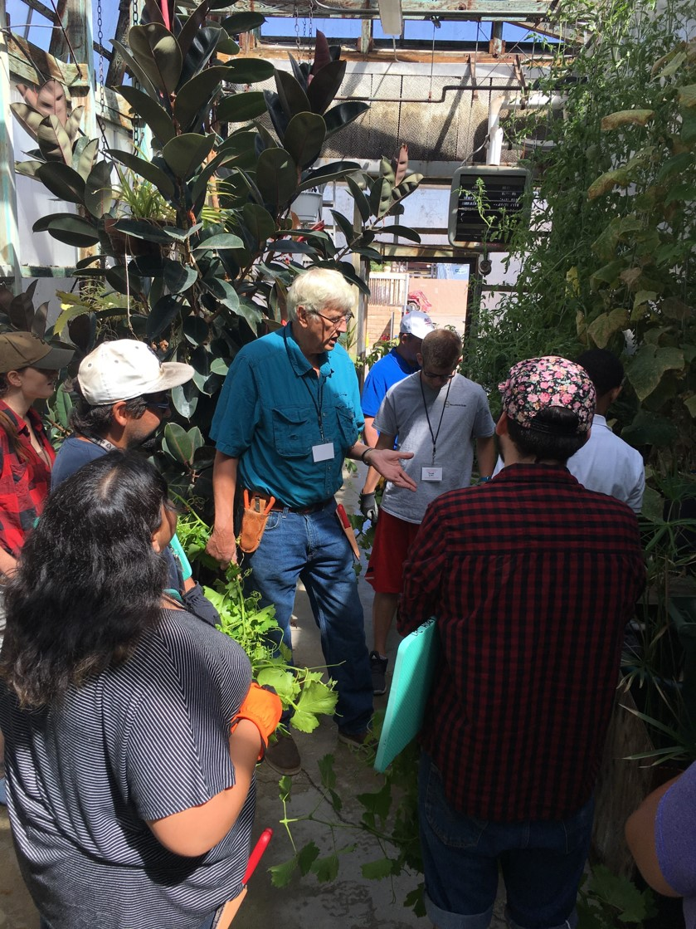
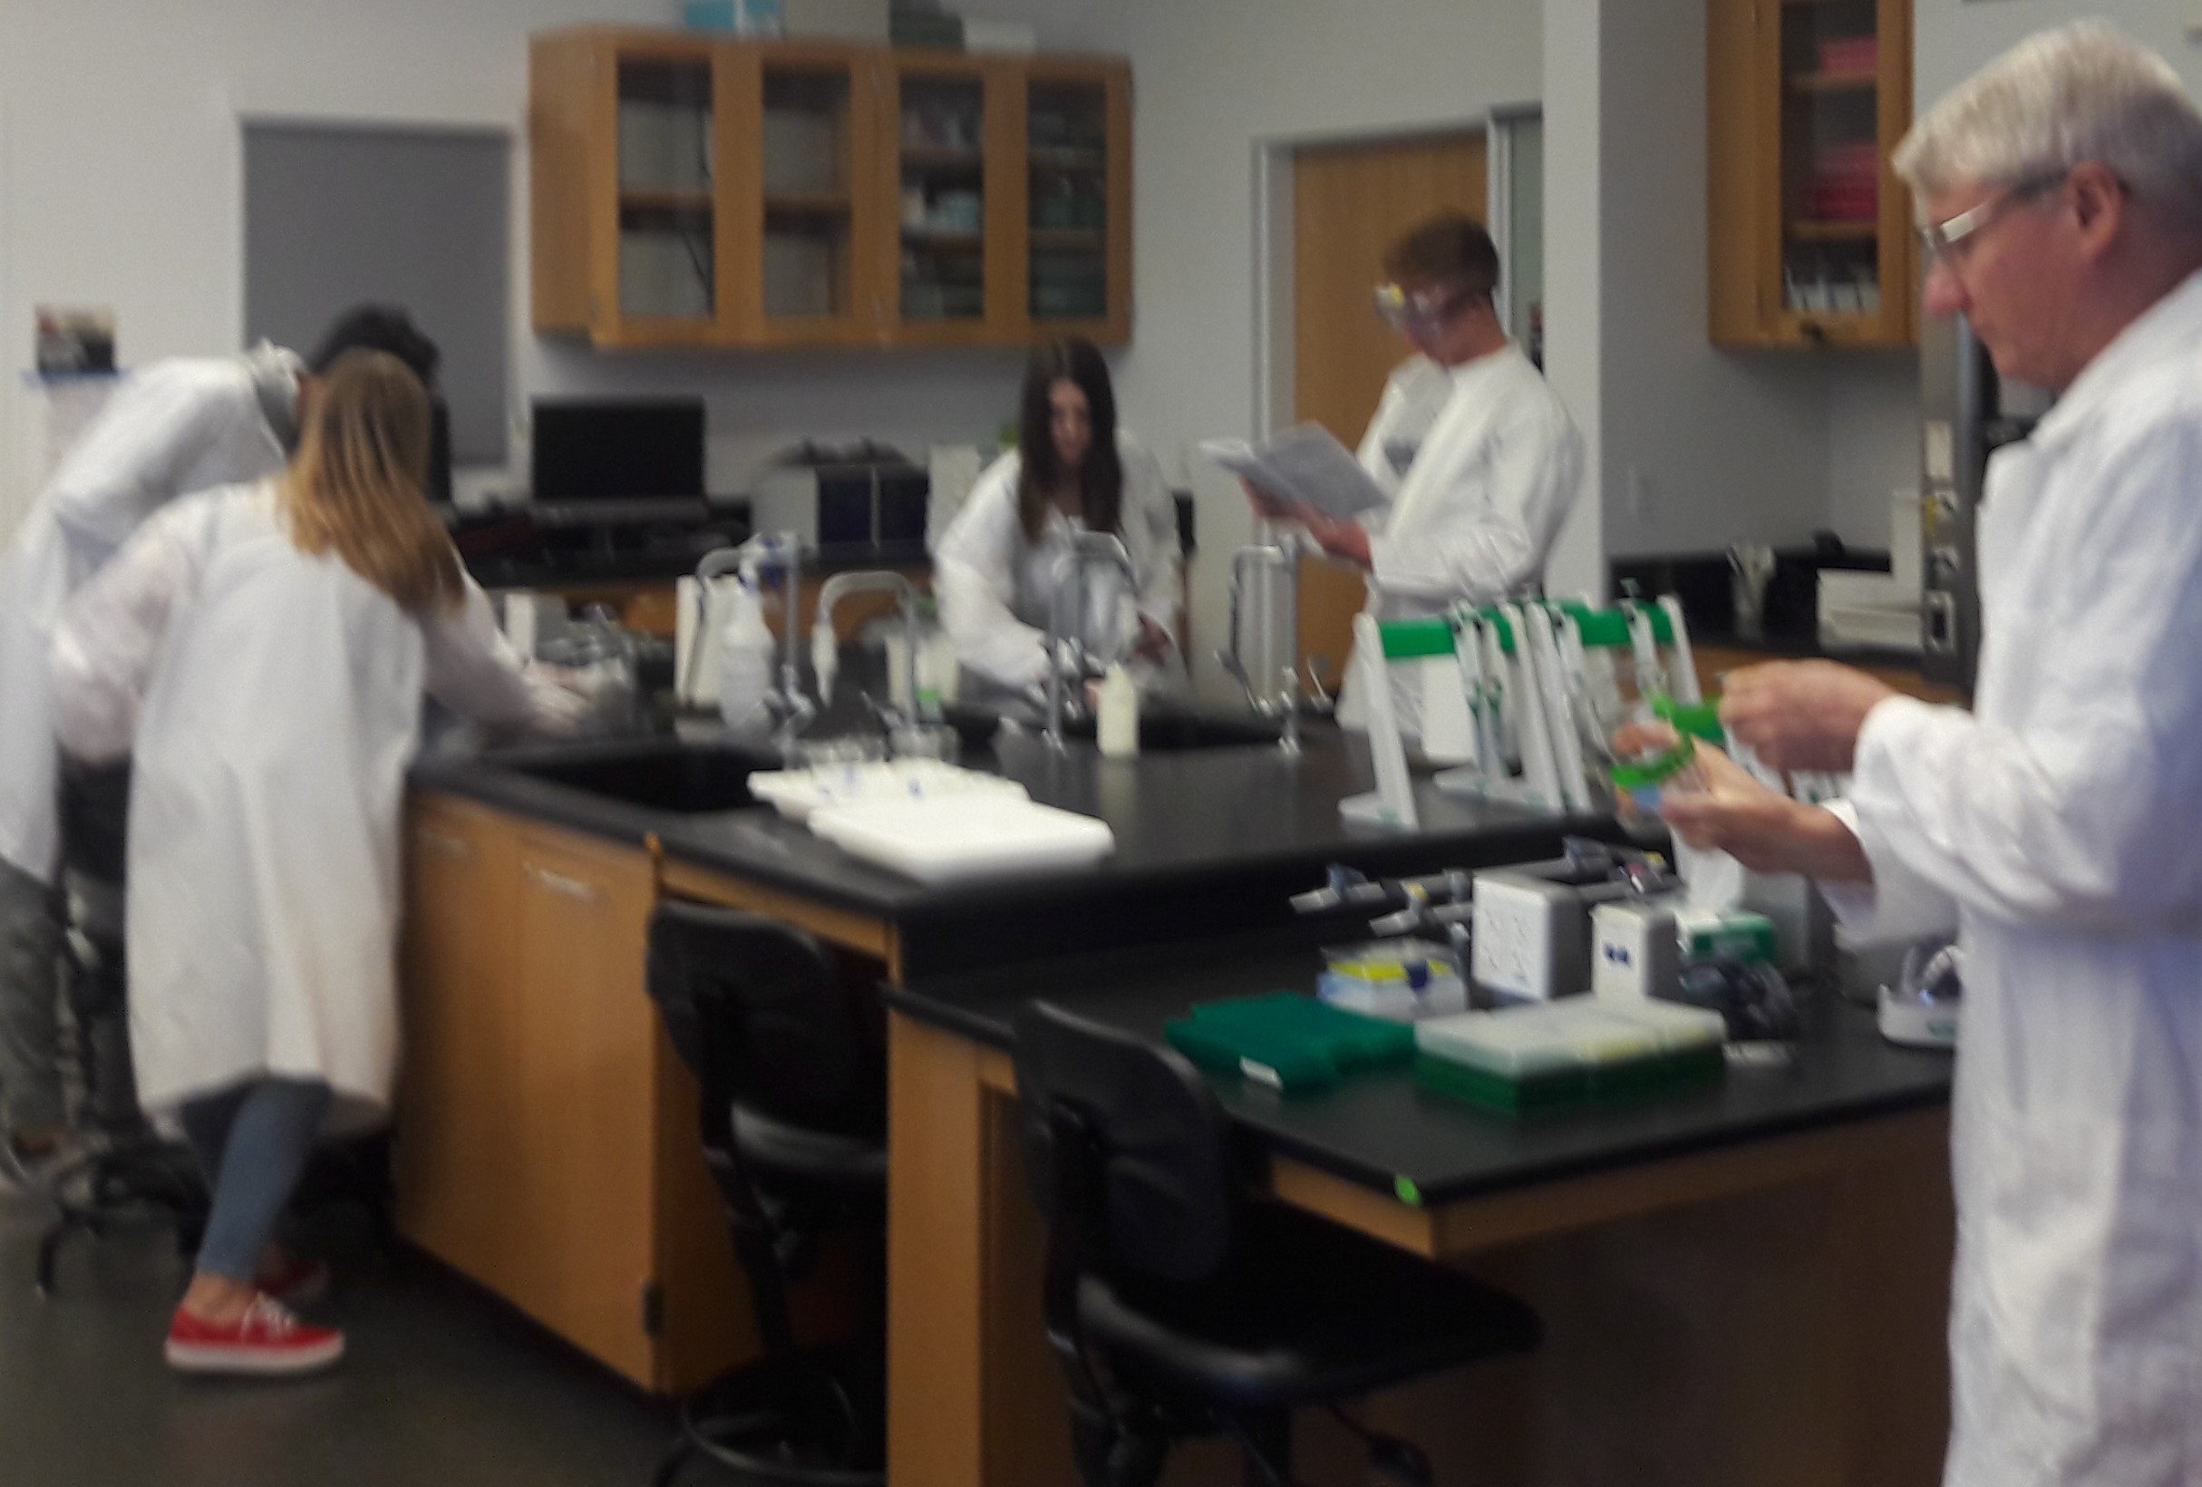
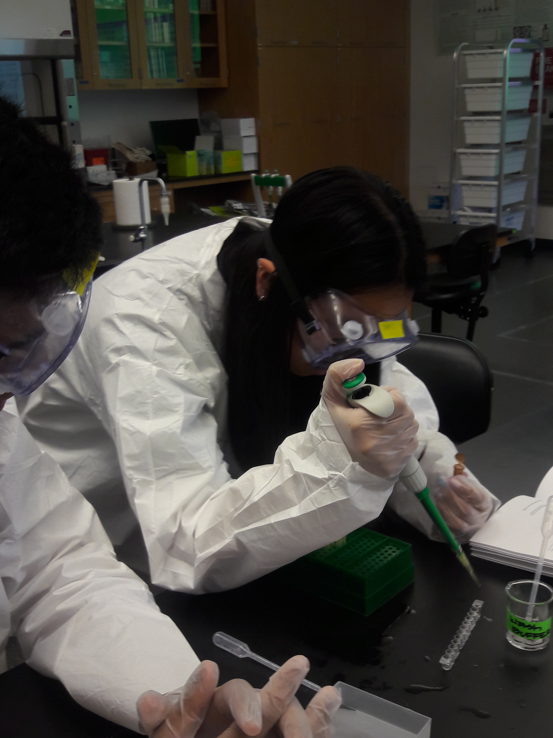
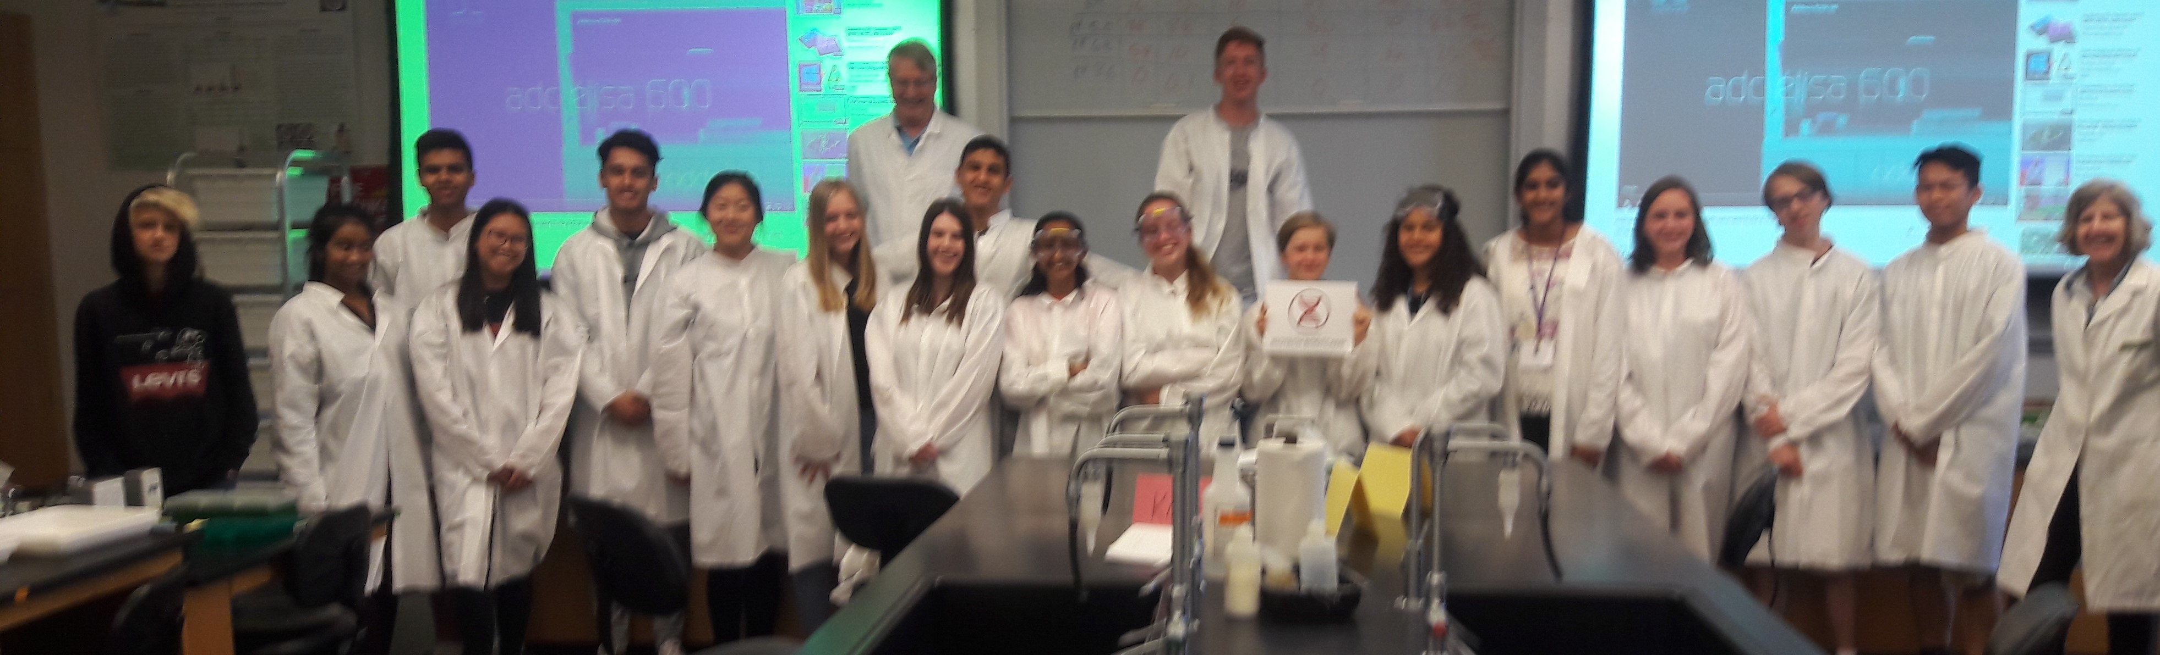
EMS Testing Center
CTE Cooperative Summer camps
Code Jam
Adaptive Horticulture
On Campus Partnerships

Slide 8

Travel
Domestic and International Travel
Who can travel?
How to register your trip with the college
8

Slide 9
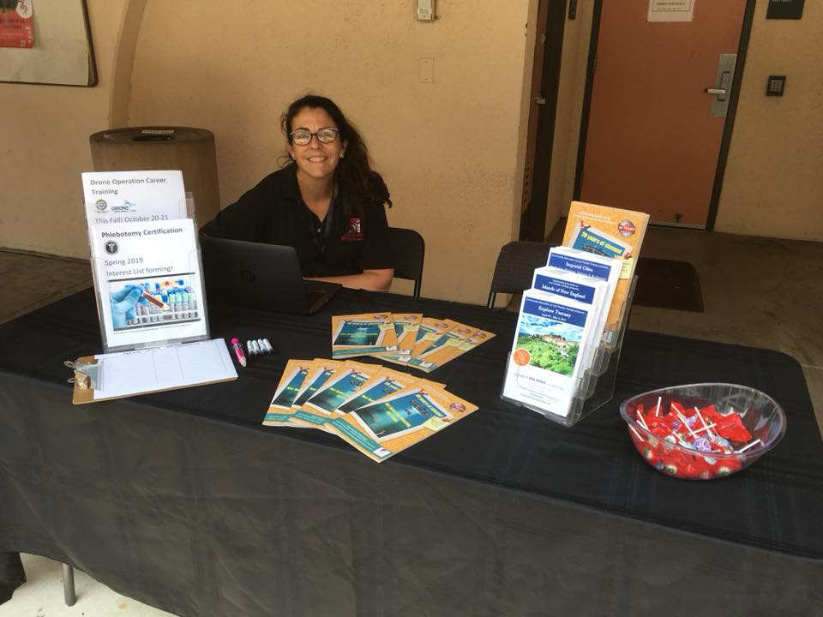
Program Information
Program Review
Guided Pathways
Marketing
Facebook
commed@laspositascollege.edu
Room 1663
Phone 925-424-1467
9

Slide 10

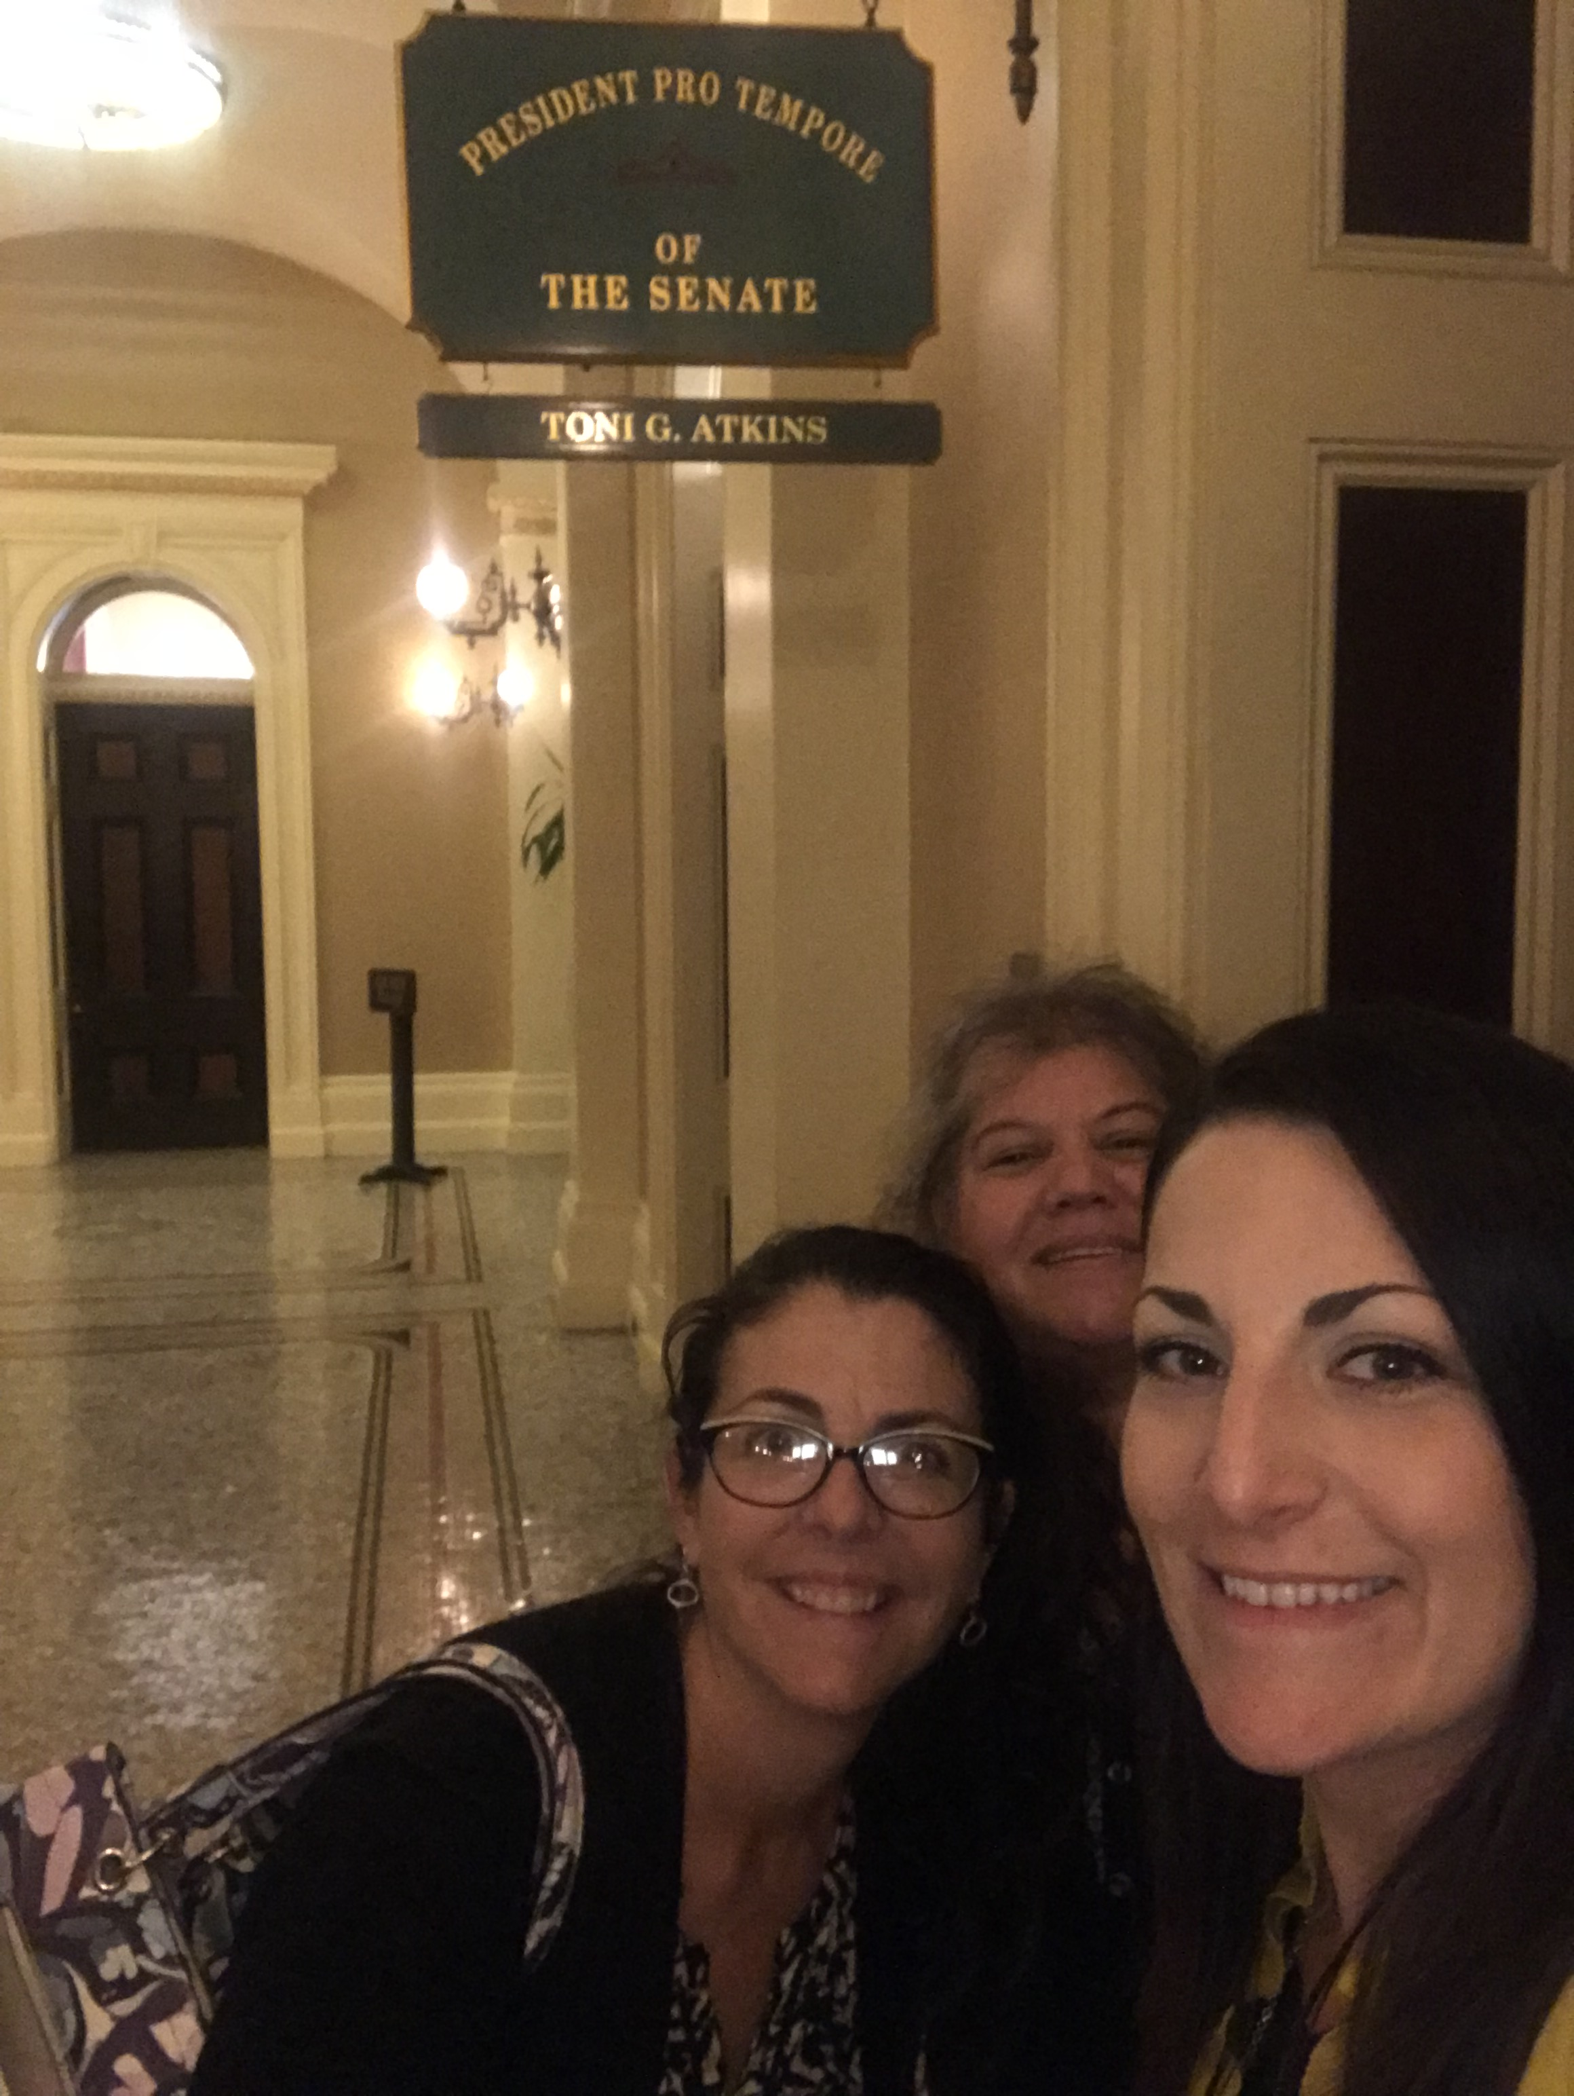
Statewide Information
Association for Community and Continuing Education
Legislation
SB383 passed: Changes verbiage in Ed code from homemaking to family and domestic science, endorsed
AB1727 vetoed: Census accounting for noncredit, sponsored bill
AB5 passed: “Gig Law”
CCC Chancellor’s Office
Guidelines for Community Services revisions await approval
10

