Slide 1

Flight Paths for Student
Career and Academic Pathways

Slide 2
Guided Pathways Help Students Reach Their Educational Goals By
  Creating structured program maps that lead to a career
  Help student choose and enter their pathway
  Help students stay on their path
  Ensure their learning

Slide 3
Students Knew They Should Choose A Major But They Did NOT Know:
How to find information about program options
How career interests related to majors
Degree and transfer requirements
Job opportunities in their field within their community

Slide 4
Students Specifically Wanted To Know:
-Community College Research Center
What are my career options?
What are the educational pathways to these careers?
What will I need to take?
And will the courses transfer to a 4 year university?
How long will it take?
And how much will it cost?

Slide 5
Student Report They Want To Receive
Career Information:
Online and more thorough career information
Earlier & more interactive career information in their college experience
Link between programs of study and career opportunities

Slide 6
Essential Components Of Guided Pathways
Informed Choice: Choices becomes more informed, deliberate and simpler
  Clustering programs into broad “Career & Academic Pathways” (flight paths) makes decisions simpler for students.
  Students match their skills & interests to broad academic paths that lead to careers, e.g.,
    1st year student choose Business Career Pathway;
    2nd year choose specific major- Accounting

Slide 7
Essential Components of Guided Pathways
Whole Programs of Study are Mapped: Students choose coherent programs of study, NOT random, individual courses.
  Students make the “big choice” of academic majors or programs and the courses sequences are laid out for them.
  A clear path to on-time completion is prepared for them semester by semester all the way to graduation.

Slide 8
What Our Students Current See
On our Website
In our Catalog

Slide 9
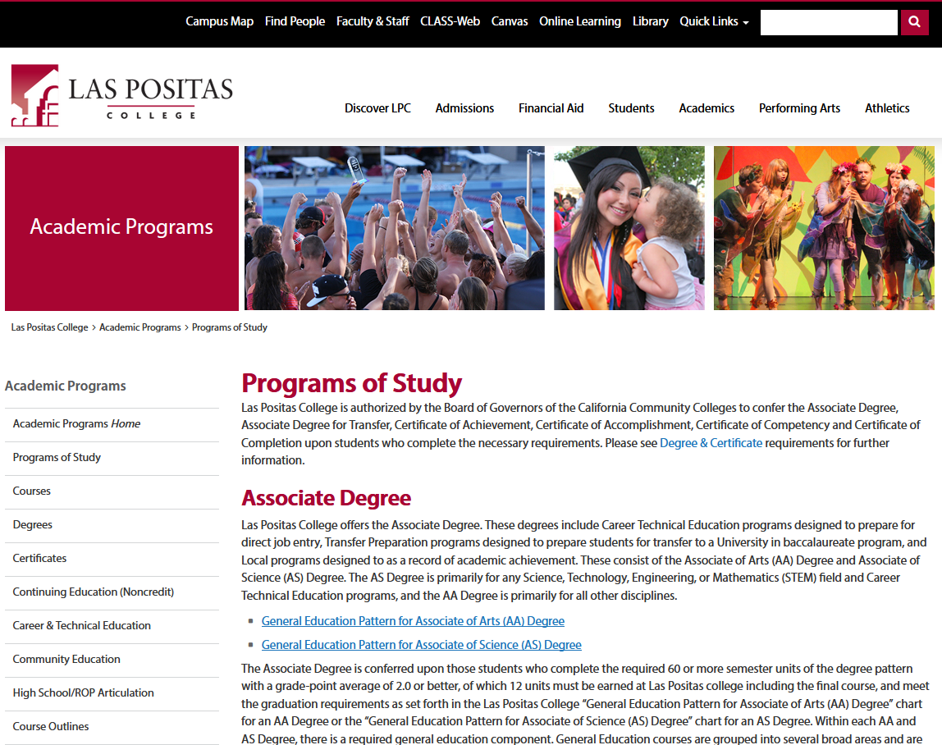

Academics (website)
Maybe I’ll see what programs LPC has
Where do I go from here?
How about this link?

Slide 10
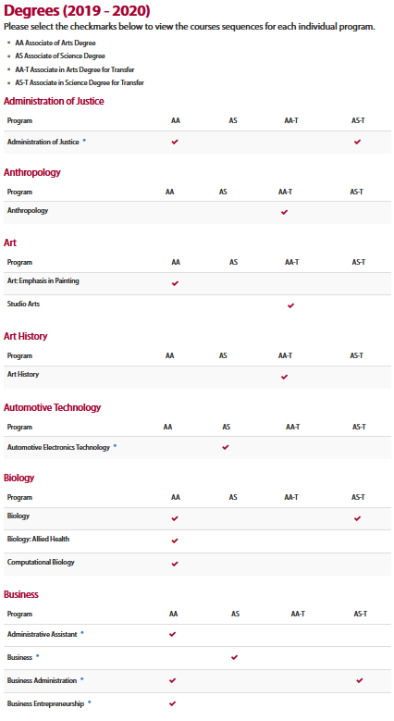
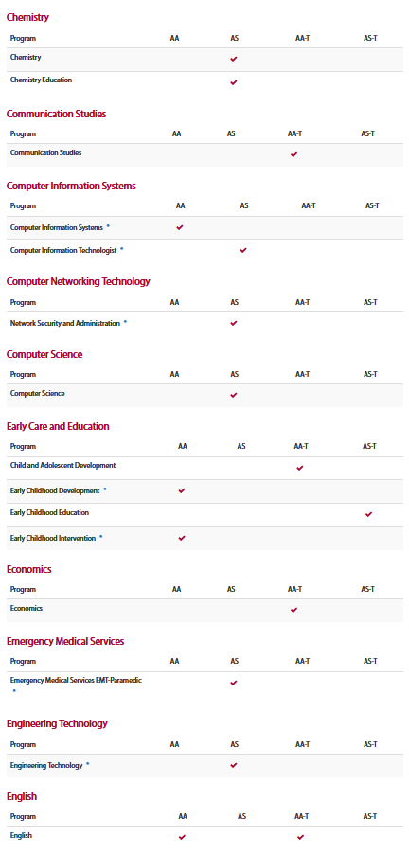
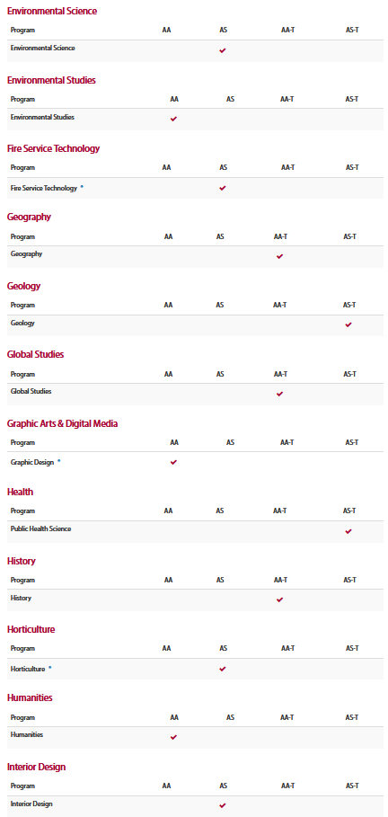
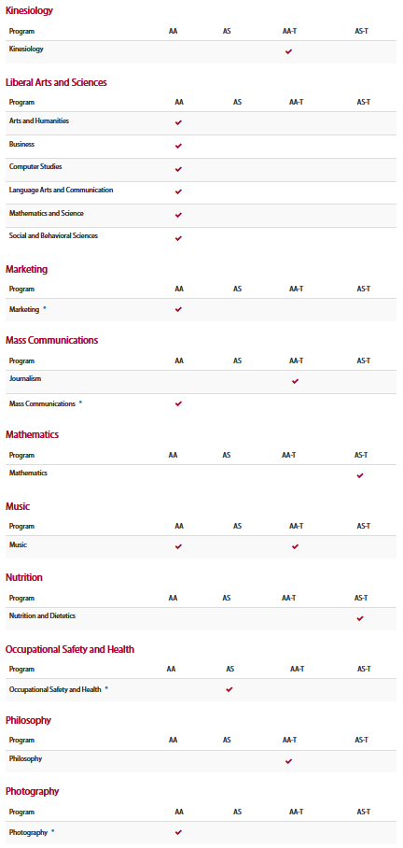

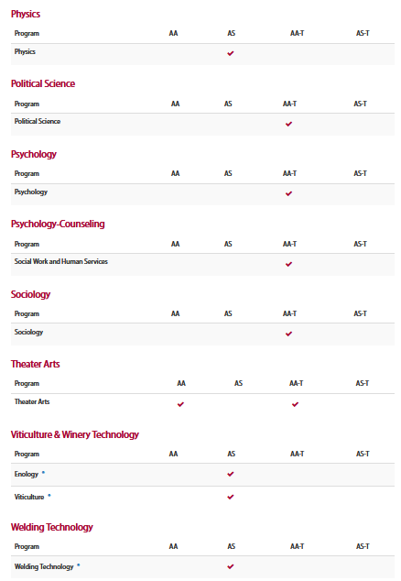
Degrees–AA, AS, AA-T, AS-T
That’s a lot of degrees…what’s an AA-T, and AS-T. How are they different from an AA or AS?

Slide 11
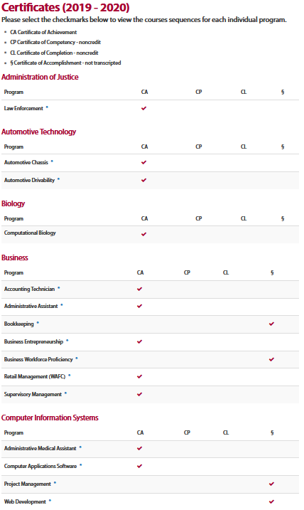
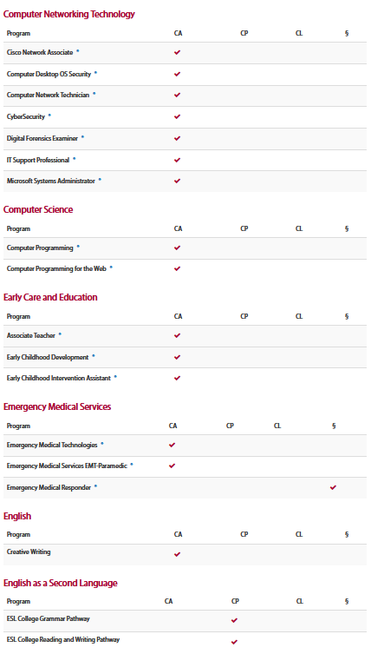
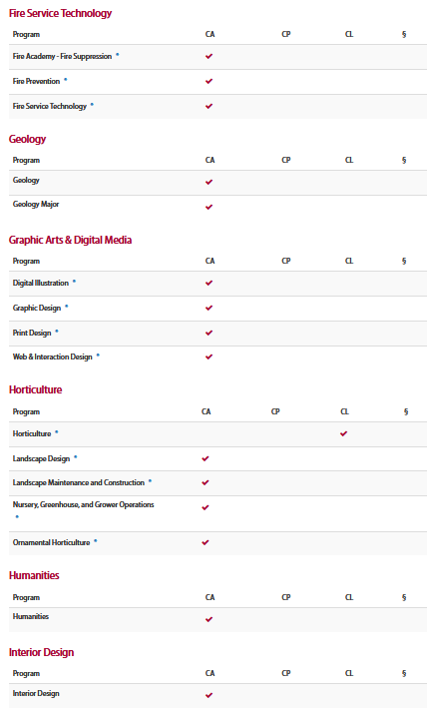
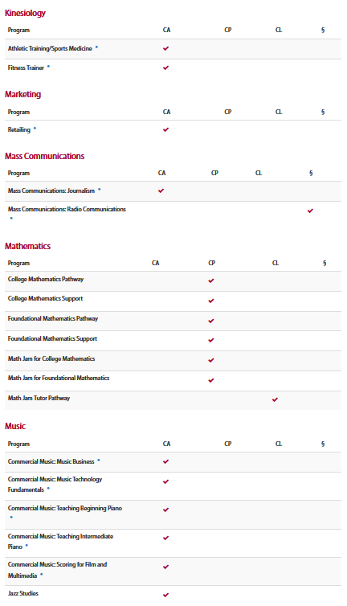
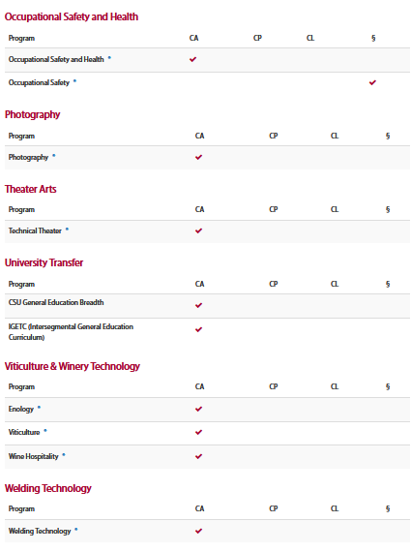
Certificates—CA, CP, CL, §
More???? How are these different from degrees?
Wonder what kind of job I can get with any of these?

Slide 12
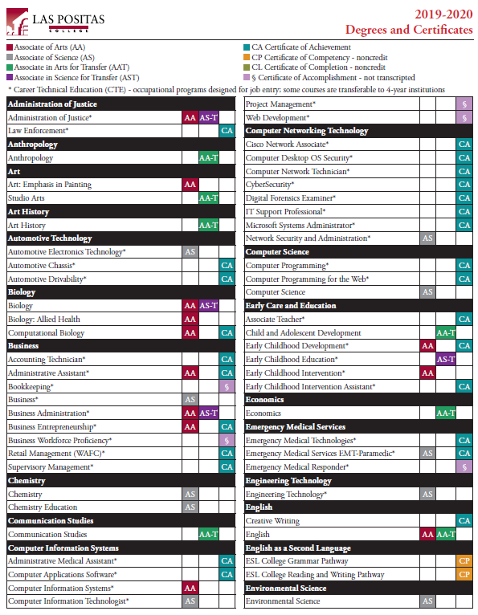
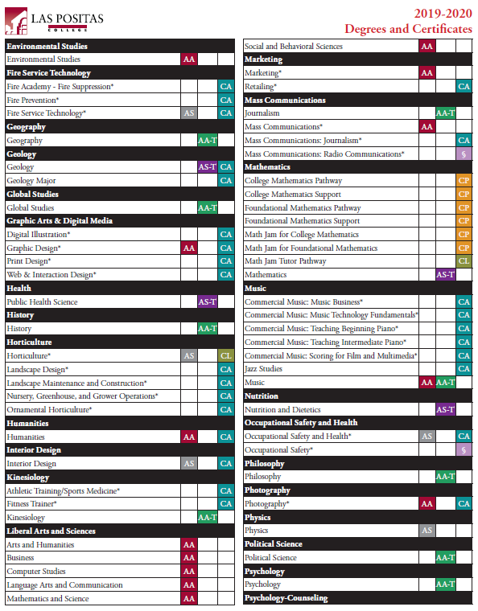
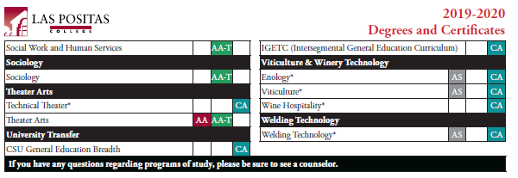
Programs (Catalog)
This isn’t much clearer…and I still don’t see anything about careers

Slide 13
Instructions
Form cross functional teams:
  Classified professionals, instructional faculty, counseling faculty, administrators.
Assign a note taker to capture the discussion.
Assign a presenter to share out your career pathways for Gallery Walk.
Begin clustering LPC degrees & disciplines into career pathways that make sense to your group.

Slide 14
Discussion Questions
Rationale used for clustering the disciplines & degrees into career pathways?
Number & name of career pathways?
What about disciplines that could be in two or more career pathways?
What about disciplines that haven’t identified career pathways?
What about undecided students?

Slide 15
Examples of Career Pathways
Sierra College & Bakersfield
https://academics.sierracollege.edu
https://www.bakersfieldcollege.edu/academics/pathways
https://www.dvc.edu/academics/explore.html

