Slide 1
Model the Way:
Leading Students Toward Equity, Inclusion, and Collaboration
Presented by
Tracey Coleman, Melissa Korber, and Kimberly Burks
Notes:
Model the Way: Leading Students Toward Equity, Inclusion, and Collaboration
Presented by Tracey Coleman, Melissa Korber, and Kimberly Burks
Part 1: Personality Matrix
Introduction by Melissa Korber (5 minutes)
Remember to sign in
Workshop based on leadership institute Personality Matrix.
Goal is to identify personality style based on behaviors. Then to consider how personalities affect leadership, collaboration, and student success.
Safety Rules - Burks (2 minutes)

Slide 2

SAFE Space Agreement
Demonstrate understanding | Be mindful of your biases; avoid stereotyping others | Have a positive attitude
Make room for mistakes and lessons learned | Encourage one another | Be open to new ideas and new perspectives
Be accepting of others | Respect one another | Be attentive and supportive
Share your own thoughts, beliefs and actions | Refrain from judging | Do not put others on the spot
One person speaks at a time; listen to one another | Maintain confidentiality; do not repeat what is shared by your peers | Trust the process
(Adapted from LPC’s Umoja Safe Space agreement, PCN 30 – Fall 2017)
Notes:
Kimberly Burks

Slide 3
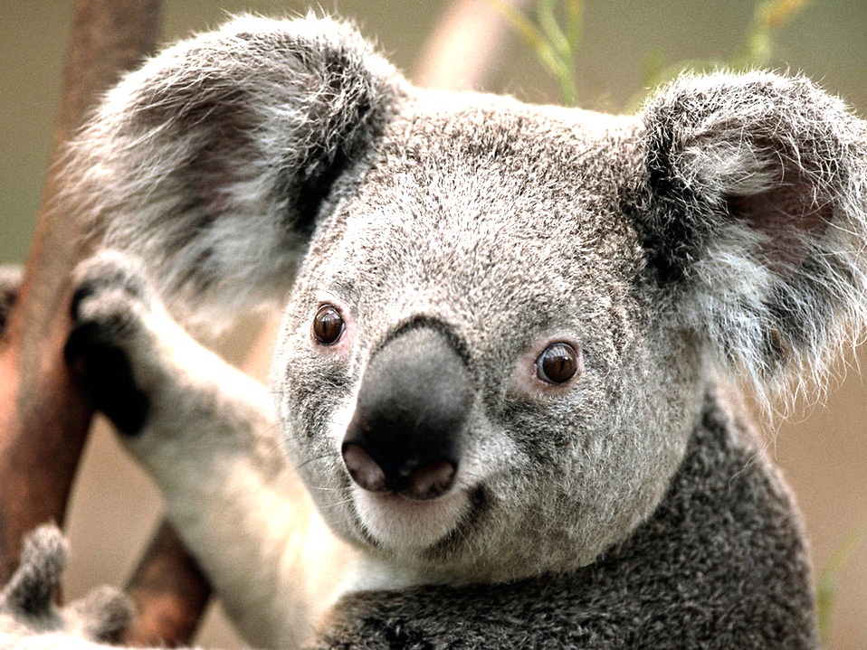
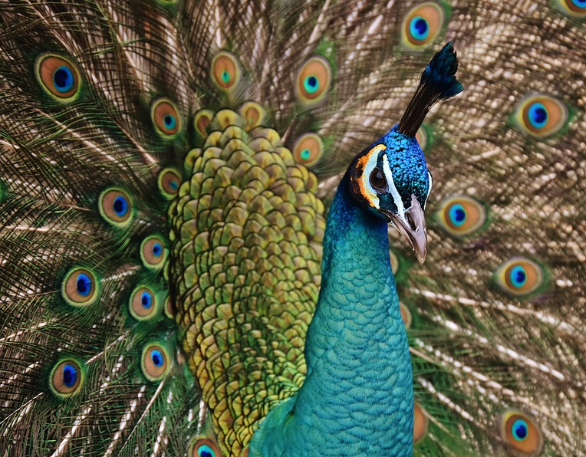
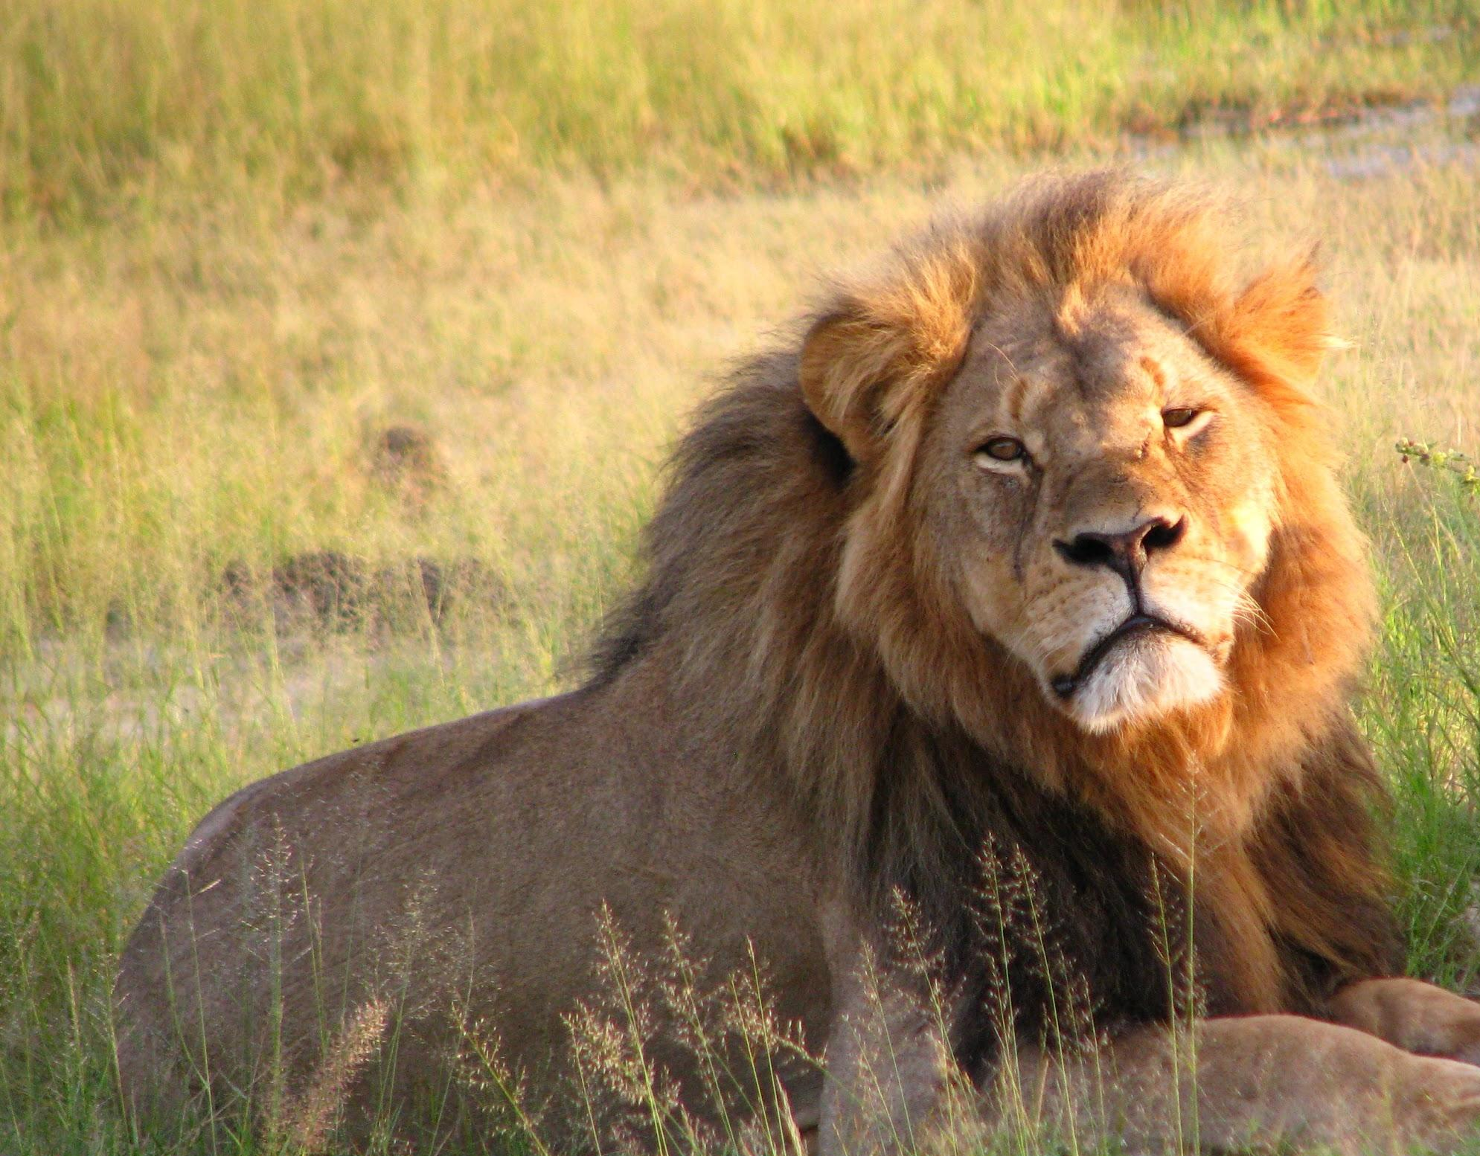
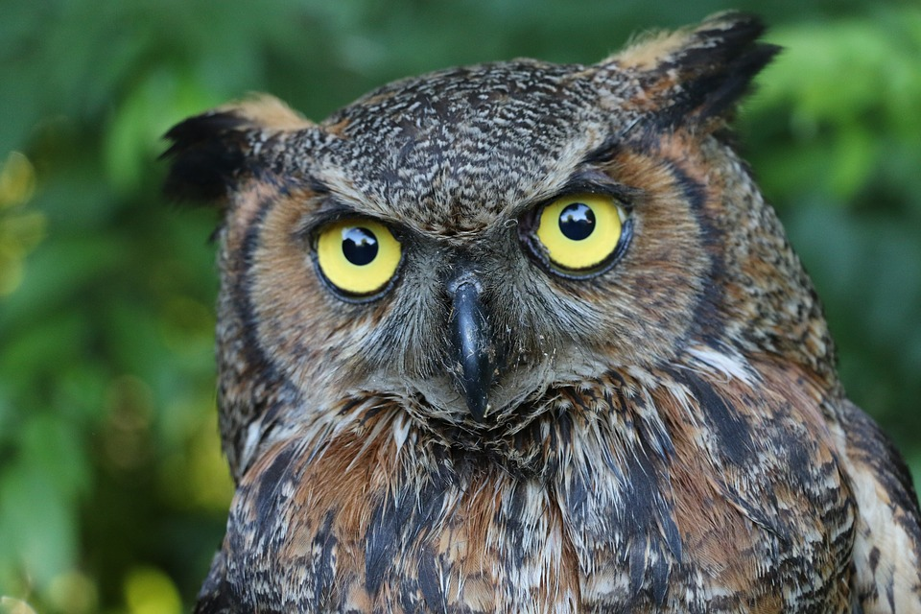
The Personality Matrix
What Is Your Personality style?
How Does Your style Impact Others?
Notes:
The Personality Matrix. (15 minutes)
Take the assessment and discover if you are a Lion, Peacock, Owl, or Koala.
Discussion (30 minutes)
Transition: Prize for the person who can correctly identify all three of our personality styles. Hint: Two of us have the same styles. (Put your guess with the name in envelope; prize to be given at the end of the workshop. Think about that, but don’t submit a guess until after we discuss this.)

Slide 4
Discuss The Personality Matrix
Create a list of strengths and weaknesses for your style
Discuss how your personality style affects:
  How you lead others
  How you collaborate with others
  How you promote student success
  How you engage with students who are facing personal challenges
Notes:
Discussion:
Give each group a description of their personality style for the discussion. In groups create a list of strengths and weaknesses for your style. Use worksheet with brief description. Also discuss how your personality style affects:
How you lead others
How you collaborate with others
How you promote student success
How you engage with students who are facing personal challenges
Report Out: Led by Kimberly Burks, groups will report about their group’s strengths
and weakness and responses to the questions. [Will include a quick reminder that all personality styles are of equal value. Not one style is better than another. Also, all participants will receive a handout of all personality style descriptions before the report out.]
Submit entries for prize.

Slide 5
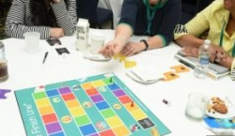
The Finish Line Game
What Barriers Do Students Face?
How Can We Take What We Know About Ourselves To Help Them Achieve Their Goals?
Notes:
Part 2: The Finish Line Game
Transition and Introduction by Tracey Coleman (10 minutes)
Take what you know about yourself and apply it to “The Finish Line” game. The game increases awareness to barriers to graduation faced by students.

Slide 6
Play The Finish Line Game
Form new groups with a variety of personality styles
Set up and play the game
  Roll die to see who goes first
  Have each person choose a marker and take a stack of same-color cards
  Read the Biographical Information on the first card
  Take turns rolling the die, moving your marker, and reading a card each turn
Notes:
Play “The Finish Line” (40 minutes)
In groups, participants will play the game. (Directions above)

Slide 7
Discuss The Finish Line Game
Report Out: Each group will tell about its experiences
Discussion Questions
  What can we do to promote student equity?
  How do our personality styles impact our ability to promote student equity?
Notes:
Report Out and Discussion (10 minutes)
Each group will report out about its experience.
Discussion questions (led by Tracey Coleman):
What can we do to promote student equity?
How do our personalities impact our ability to promote student equity?

Slide 8

Our Finish Line
The Personality Prize
  Who won?
  How did you know? Image from lpcstories.blogspot
2. Final take-aways
  What did you learn?
  What can you use to promote student equity this week?
Notes:
Conclusion (5 minutes)
Reveal winner of the prize
Final takeaways: What can you use on your job this week?
Tracey: Surveys

