Slide 1
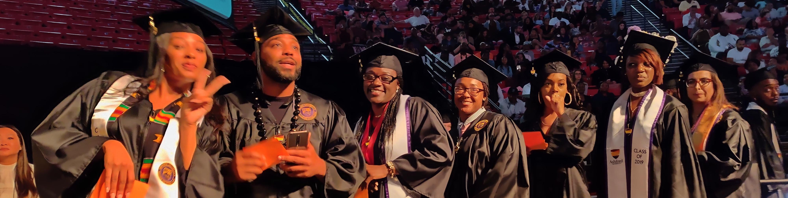



Learning from MOC: Success strategies for at-potential students
Los Positas College
Fall Flex Day
October 22, 2019

Slide 2
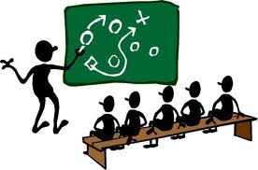
Game Plan
PART I
Conditioning is easy
Mindsets
  3 Pillars
  Survival Mindset
PART II
Setting the stage
  Self-Assessment
  MOC Research
Implications by Pillar
Strategies by Pillar
Ramp-Up Now
Next Steps
  Culture Shift
  PLCs

Slide 3
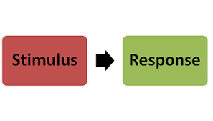
Conditioning is Easy
MacHine
Education either functions as an instrument which is used to facilitate integration of the younger generation into the logic of the present system and bring about conformity or it becomes the practice of freedom, the means by which men and women deal critically and creatively with reality and discover how to participate in the transformation of their world” (Freire, 2000, p.34).
MacHine
Born in and Shaped in
  We are ALL conditioned
  Opposite of Paulo Freire
THEY said it, so it must be true
  Implicit biases are Explicitly speaking
At-Risk is less of a choice than you think
Good News….. Conditioning is Easy
MacHine

Slide 4


Men of
Color

Slide 5

3 Pillars of Mind
Common to successful MOC in Online Higher Education Programming

Slide 6

MOC were more successful when:
They had positive experiences with educators, curriculum interactions, and academic support teams for services.
They use their responsibility to those depending on them to meet their obligations as a source of motivation towards success.
They have an intrinsic commitment to well defined personal goals.
1
2
3

Slide 7

Survival Mindset
Does the WILL to survive beat the SKILL to survive

Slide 8
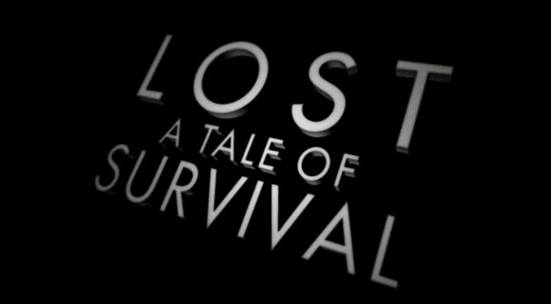
Breaking Down the Survival Mindset
School is a feminine domain (Harper, 2010)
  At-Risk males less likely to participate
Driven and Fed by (Jensen, 2013)
  Economics or Oppression of existence or beliefs
Economic Challenges cause Cognitive shifts (Shah et. Al., 2012)
  Decisions look poor
  Wall of Protection
    Not as vulnerable
    Exercised so it is automatic
    Can be a hiding place/ excuse
Don’t Unconsciously Reinforce Survival
  You “aint” home…
  Growth Mindset is the answer
  Growth Mindset is a personal journey (Dweck, 2017)
Notes:
Seek to Understand BEFORE Being Understood
You aint home… Landsman, J. (2006). White teachers, diverse classrooms a guide to building inclusive schools, promoting high expectations, and eliminating racism
If I’ve never been to your house before, can I come in on my first visit and begin to rearrange your furniture, change to channeling television, go to your cabinets and refrigerator to find what I want to eat, without some type of fight or resistance from you? If you come into a students’ world, and you’ve never dwelled in their situation, you won’t understand the nuances of the culture. Additionally, if you don’t look like the students your serving, then it is initially assumed that you are an outsider and that the area that that school was located is not your home. Therefore, you’re going to meet resistance, if you come into that students’ circle of life and begin to develop rules, policies, and procedures that are not culturally sensitive to the norms of their experience.
Ask Questions without having an answer in mind… Landsman, J. (2006). White teachers, diverse classrooms a guide to building inclusive schools, promoting high expectations, and eliminating racism
If you don’t know the nuances of the cultures of the students that you are serving, ask them. But don’t ask them with the intention of selling them a better way (your way). Ask them because you really want to know. After all, as educators we should be cultured and have intelligent and respectful acceptance of others. We should practice ways to communicate expectations while accounting for the diversity of the learners in our classrooms.
(POLL QUESTION – POWER vs AUTHORITY) Exert authority not power.. (Engaging students with poverty in mind: Practical strategies for raising achievement.)
A speeding car stops for a police officer standing in the middle the street not because that officer has the power to stop the car, but because the officer has the authority to cause tremendous consequences to the driver, if they do not stop. Don’t wrestle with students to show how powerful you are. Share your power so that you can emphasize your authority. Allowing students leeway for life issues, returning an assignment that was done incorrectly so the student can correct it, making yourself available by phone when emails aren’t doing the trick, restating directions to assignments, providing examples to jumpstart and guide thinking are all examples of sharing your power to emphasize your authority. As long as your students are continuing to work on the concepts, and content that you introduced to them and can show mastery of that content, isn’t the inconvenience of sharing your power worth the fact that your students are on track with the objectives which are the reason they are in your classroom in the first place. Sharing your power, builds trust with your students, and with non-traditional students, that is better than gold.

Slide 9

PART
II
Learning from MOC: Success strategies for at-potential students

Slide 10
A Few Questions (T or F)
When a student asks for an extension on a long-standing due date because of a recent unexpected family emergency, it is evidence that they do not fully value the education experience.
I often share stories and pictures from my family vacations and proud moments to connect with my at-risk students and show them what they can aspire to experience in their lives.
I am a realist and have accepted that everyone is not college material.
I have made myself available to my students in every way that I can possibly imagine. It is now my students’ responsibility to contact me if they need help.
Positive Reinforcement (PR) is a HUGE part of my teaching style. However, I believe that PR must be authentic and truly warranted. In order to prevent watering down the value of my PR, I make sure I only PR for things that I deem are significant.
Motivational quotes, videos, and stories are great, but action speaks louder than words.

Slide 11
A Few Questions (Score Sheet)
# of True Responses | Implication
5 | More than likely views things from a vantage point of privilege
4 | Great faith in traditional beliefs… Extremely Culturally UNRESPONSIVE
3 | Unwilling or afraid to ignore societal norms… Culturally UNRESPONSIVE
2 | Empathetic and Aware of others, but unaware of how one's own implicit biases are influencing decisions …. Somewhat Culturally RESPONSIVE
1 | Aware of inequities and implicit biases, makes conscientious decisions around the expectations they have set for others…. Culturally Responsive
0 | Aware of inequities and implicit biases, makes conscientious decisions to create equity for all…. Extremely culturally RESPONSIVE

Slide 12

Strategies of the Successful
Why take all this time to define a specific group and analyze their characteristics and mindsets?
Aren’t we supposed to be talking about strategies to serve our At-Potential students?
What does all of this have to do with anything?
A strategy is only as effective as the educator using it.
The effectiveness of an educator is determined by how they are received.
How an educator is received is depends on how they are PERCEIVED.
Conditioning is EASY
At-Potential is LESS of a choice than we think
Self-Assessment
Survival Mindset
3 Pillars of Mind
Things SUCCESSFUL MOC Did To Thrive in Online Higher Education Programming

Slide 13
Strategies – Things Students Did To Be Successful
Academic
Make Time Available for Studies
Grasp on Require-ments
Communicate with Instructor
Academic
Collaborate with Peers
Aware of Resources
Inner Focus
Advising
Consistency – Patient w/ Changes
Relate w/ Advisor
Support
Academic Resources
Research/ References
Initiate 1st Contact
Technology
Finances

Slide 14
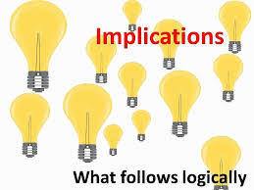
Putting the Pieces Together

Slide 15

Broad Implications for Academics
Counting the Costs (pillars 1, 2, 3)
Matters of the Heart (pillars 1, 2)
Connectivity (pillar 1)

Slide 16

Broad Implications for Advising
Initiate Contact (pillars 1, 2)
Personalize (pillars 1, 2, 3)
Promote Inner Focus (pillars 2, 3)
Connectivity (pillar 1)

Slide 17

Broad Implications for Support Services
Publicize (pillars 1, 2)
Access (pillars 1, 2)
Ease of Use (pillars 1)

Slide 18

5 for the
At-Potential
5

Slide 19
10 High Value Strategies for Serving At-Potential Students
Which of these ten are already in play at your institution?
Course at-a-glance tables (1, 2)
Accommodations: course introductory videos, relaxed deadlines, exemplars, access, “I not F” (1, 2)
Scheduling cohorts (1)
Provide motivational quotes, personal messages, testimonials (2, 3)
Faculty and advisors collaborate to welcome students to class (1, 2)
Groups of advisors who are familiar with same students (1)
PD in communicating online and accommodation strategies for at- potentialsk populations (1, 2)
Clubs with high interest content (1, 2, 3)
Easy access visual aids for common issues and services (1)
Publicize support services resources (1, 2, 3)

Slide 20

Top 5 Strategies for Serving At-Potential Students
Course at-a-glance tables (pillars 1, 2)
Accommodations: course introductory videos, relaxed deadlines, exemplars, access, “I not F” (pillars 1, 2)
Scheduling cohorts (pillars 1, 2)
Provide motivational quotes, personal messages, testimonials (pillars 2, 3)
Faculty and advisors collaborate to welcome students to class (pillars 1, 2)

Slide 21

2 for
Take
Out
Please

Slide 22

2 Ready to Go Ramp-Up Strategies for Serving At-Potential Students
Accommodations: course introductory videos, relaxed deadlines, exemplars, access, “I not F” (pillars 1, 2)
Provide motivational quotes, personal messages, testimonials (pillars 2, 3)

Slide 23
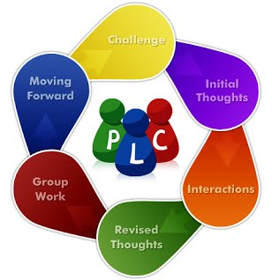
P
L
C s
Professional Learning
Community

Slide 24
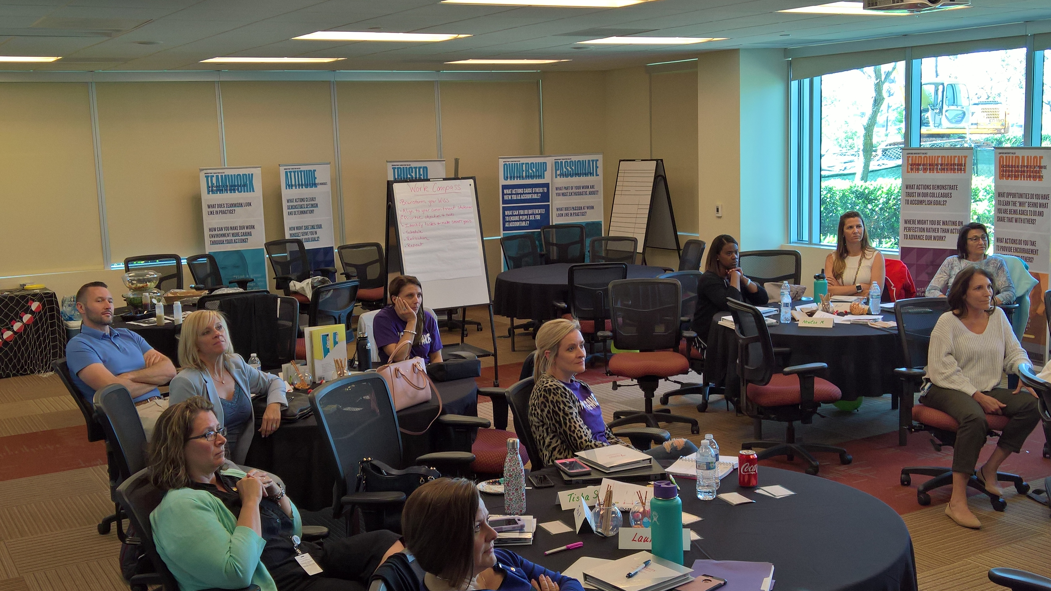
P
L
C s
Professional Learning Communities (PLCs)

Slide 25

Intro to Professional Learning Communities (PLCs)
Build Capacity
Structure/Teamwork
Shared vision
Action Oriented
Shared decision making
Commitment to continuous improvement
Leadership Development
Results oriented

Slide 26
Typical Components of PLCs
Pieces of the PLC
  Shared Mission & Vision
  Collective Commitments
  Trust
  Organizational structures
  Decision-making processes
  Inspect/expect
  Accountability
Scheduling / Frequency
  What works best for all constituents
  Reach consensus
Modality
  Zoom, Skype, Facetime, Face-to-face, etc.
Agenda
  Focus driven

Slide 27
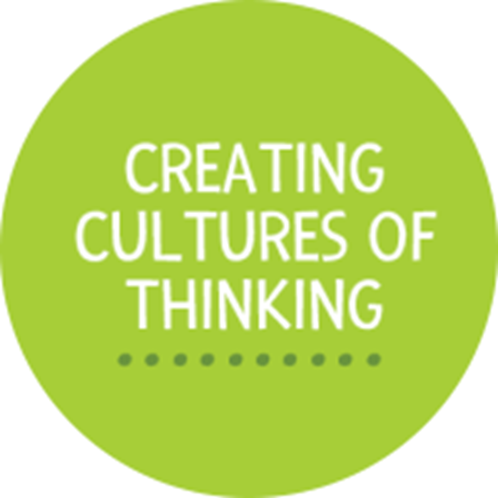
Creating the Rules of the Game
  We’re on a Mission
  What works and why it is working
  What can the team agree to implement
  Define boundaries
MOU
  Set expectations
    Embed new culture into all communication
    Revolve all PD around the new culture
    Set yearly goals around the new culture
Leaders building leaders
  Provide the map and take turns driving
  Share the load
Trust equals positive results
  The ingenuity of the team
  The wisdom of the crowd

Slide 28
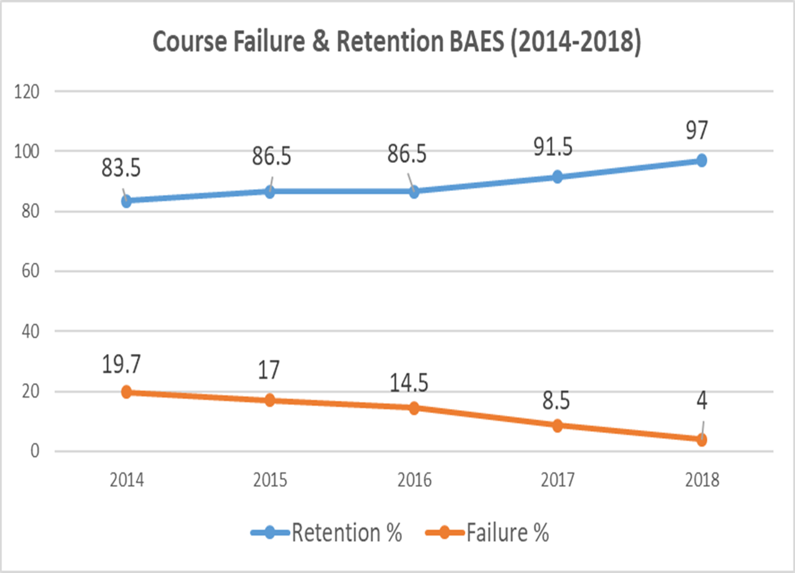
The Proof is in the Pudding

Slide 29
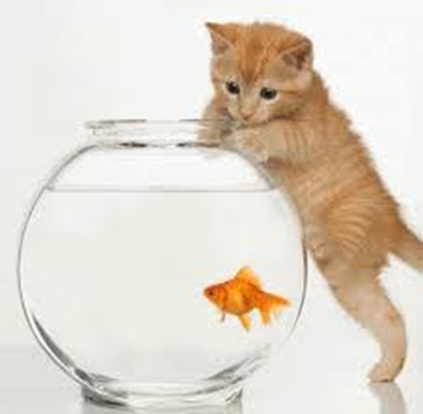
Fish Bowl
Sample mini PLC – Academic Achievement and Student Retention
Process
  Pick two random volunteers.
  What do you do at your institution?
  How do Academic Achievement and Student Retention impact your work?
  What actions are necessary from your department to ensure that Academic Achievement and Student Retention increase?
  Let’s agree upon some actions or strategies.
  Go have a discussion with your team.
  NEXT PLC – HOW to get the whole team onboard with the new culture.

Slide 30

Generate a Plan
Share PLC planning template
Activity – Work together in a group to create a plan – (10 minutes)
  Choose a Facilitator, Recorder, and Topic
  Use the PLC Planning Template to outline your PLC
  Make sure everyone on the team embraces the plan
Report out – One group… (3 minutes)

Slide 31


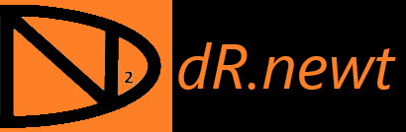
Dr. Newton Miller
newton.miller@ashford.edu
1-866-974-5700 x 21631 nmiller@drnewt2.com
#drnewt
#mm4ym
www.drnewt2.com

Slide 32
References – At-Potential
Asken, M. J., Christensen, L. W., & Grossman, D. (2010). Warrior mindset: mental toughness skills for a nations defenders: performance psychology applied to combat. Millstadt, IL: Human Factor Research Group.
Bender, J.A. & Roberts, M.C. (2009). Exposure to violence, American Journal of Orthopsychiatry, 72, pp. 92–101
Carey, D. C., & Richards, M. H. (2014). Exposure to community violence and social maladjustment among urban African American youth. Journal of Adolescence,37(7), 1161-1170. doi:10.1016/j.adolescence.2014.07.021
Dweck, C. (2017, September 01). Carol Dweck Revisits the 'Growth Mindset'. Retrieved October 25, 2017, from http://www.edweek.org/ew/articles/2015/09/23/carol-dweck-revisits-the-growth-mindset.html
Harper, S. R. (2010). College men and masculinities: theory, research, and implications for practice. San Francisco: Jossey-Bass.
Jensen, E. (2013). Engaging students with poverty in mind: practical strategies for raising achievement. Alexandria, VA: ASCD.
Freire, P., Ramos, M. B., Macedo, D. P., & Shor, I. (2000). Pedagogy of the oppressed. New York: Continuum.
Shah, A. K., Mullainathan, S., & Shafir, E. (2012). Some Consequences of Having Too Little. Science, 338(6107), 682-685. doi:10.1126/science.1222426
The Education Alliance Brown University. (n.d.) Culturally Responsive Teaching. Retrieved from https://www.brown.edu/academics/education-alliance/teaching-diverse-learners/strategies-0/culturally-responsive-teaching-0
Woodley, X. (2017, August 31). Celebrating Difference: Best Practices in Culturally Responsive Teaching Online. Retrieved from https://eric.ed.gov/?id=EJ1152650

Slide 33
References - PLCs
DuFour, R. (2004). What is a professional learning community? Educational Leadership. 61(8). 6-11.
DuFour, R., DuFour, R. Eaker, R., & Many, T. (2006) Learning by doing: A handbook for professional learning communities at work. pp. 2-6.
Easton, L. B. (2017). Strategic accountability is key to making PLCs effective. Phi Delta Kappan. 98(4). 43-48.
Evans, P. (2015). Open online spaces of professional learning: context, personalization and facilitation. TechTrends. 59(1). 31-36.
Hattie, J. (2009). Visible learning: A synthesis of over 800 meta-analysis relating to student achievement. New York: Routledge.

Slide 34
References - PLCs
Hilliard, A. T. (2012). Practices and values of a professional learning community in higher education. Contemporary Issues In Education Research. 5(2). 71-73.
Pirtle, S. S., & Tobia, E. (2014). Implementing effective professional learning communities. SEDL Insights. 2(3). 1-8
Rentfro, E. R. (2007). Professional learning communities impact student success. Leadership Compass. 5(2). 8-11.

