Slide 1


UndocuAlly Training: Best Practices to Support Undocumented Students
DREAMERS
@ LPC
Presented by Alain Olavarrieta & Rafael Valle

Slide 2

October 22, 2019
Agenda
Demographic and Terminology
Laws Affecting Undocumented Students
Testimonials
Best Practices
Resources for UndocuStudents
Closing Remarks

Slide 3
Demographic and Terminology

Slide 4
Definition of undocumented
The term ‘undocumented immigrant’ refers to anyone residing in any given country without legal documentation.
It includes people who entered the U.S. without inspection and proper permission from the government, and those who entered with a legal visa that is no longer valid.
*Source: Immingrants Rising

Slide 5

What does it mean to be undocumented?
For undocumented immigrants living in the United States:
  no permanent social security number,
  cannot work legally,
  may not be able to have a driver’s license,
  may be ineligible for many public benefits,
  can’t vote,
  can’t qualify for federal financial aid,
  limits on travel
For many, it means a life of limited opportunities, invisibility, and fear of deportation
Notes:
Ben

Slide 6
Common Language & Definitions
Common Terms
Undocumented Immigrant: people who enter the United States without immigration clearance.
Mixed Status Families: families with at least one undocumented family member and at least one member who is a U.S. citizen. Over one-third of U.S. households with an undocumented person are mixed families.
Unaccompanied Minors: undocumented children who enter the U.S. without a guardian.
Sanctuary Schools and Campuses: educational institutions that adopt policies to protect students who are undocumented.

Slide 7
Countries of origin
Trend has been undocumented immigrants from Mexico are declining, while immigrants from other countries is on the rise.
  Mexico = 55%
  Guatemala = 7%
  El Salvador = 4%
  Honduras = 3%
  China = 2%

Slide 8
Age of undocumented immigrants
A majority of undocumented immigrants are young people.
  Under 16 = 8%
  16 – 24 = 15%
  25 – 34 = 28%
  --------------------------
  51%

Slide 9
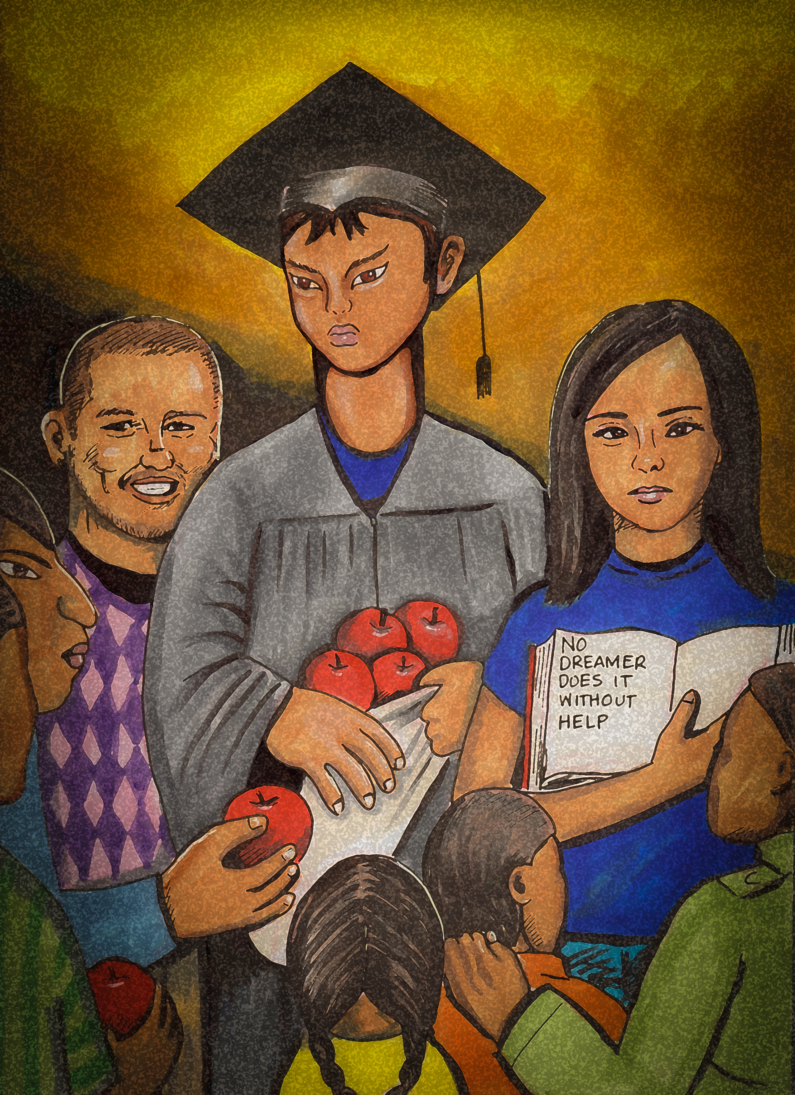
LPC Undocustudents
Data is difficult to collect and rely on.
  About 150+ undocumented students
Statistically speaking, our UndocuStudents:
  Have a wide variety of countries of origin
  Came to the US at a young age
  Speak English fluently
  Have typically completed K-12 in the United States/
  Bay Area region
  Have a diverse school experience & skill level
  Want to go pursue higher education
Notes:
Ben
Highlight the difference between these groups and the challenges the second group often faces when coming to college

Slide 10
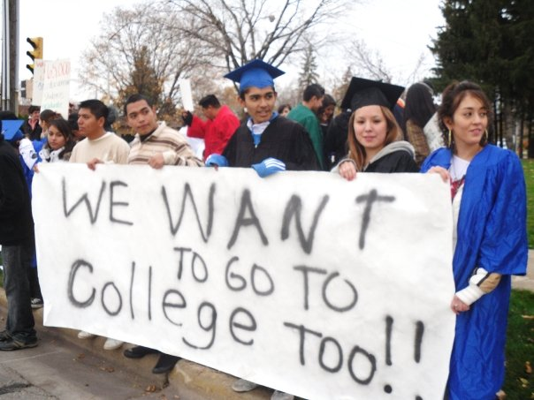
LPC Undocustudents
Our UndocuStudents can have different goals:
  Students who want to pursue degree and transfer goals
  Students/adults who want to learn English/Career Skills
Our UndocuStudents can have different statuses:
  Students who have come to the US recently (often do not meet AB-540 and/or DACA criteria)
  Students who have been here since childhood (often will meet AB-450 and/or DACA criteria)
Notes:
Ben
Highlight the difference between these groups and the challenges the second group often faces when coming to college

Slide 11
Laws affecting undocumented students
DREAMERS
@ LPC

Slide 12
CA State laws: Tuition Reduction Laws
AB 540 (2001), SB 68 (2018) & AB 2000 (2015)
  Exempted students from out-of-state tuition fees
  Students must have attended 3 years of HS in CA or the equivalent for a GED, graduated from a CA HS, obtained a certificate of completion, or a GED, and not have a valid non-immigrant visa
  AB 2000 expanded the definition of who is eligible
  SB 68 expands AB 540 to enable students to count years spent at a California Community College and Adult School towards AB 540 eligibility (paying in-state tuition at CCs, CSUs, UCs).

Slide 13
CA State laws: Financial Support Laws
AB 130 (2012) & AB 131 (2013)
  “California Dream Act”
  Allowed AB 540 students to apply for scholarships administered by public institutions, and for state-funded grants (Cal grants, BOG fee waiver, etc.) and programs (EOPS, EOP)
  AB 595 (2019)
  AB 595 authorizes a student enrolled in a community college class or classes pursuant to an apprenticeship training program or internship training program to use an individual tax identification (ITIN) for purposes of any background check required by the class or program.*

Slide 14
CA State laws: Protection and Support
SB 54, CA Values Act
  Among other protections, prohibits cooperation between ICE and state and local Law Enforcement Agencies in a variety of ways.
  Creates safe spaces by limiting assistance with immigration enforcement in a number of public agencies, including schools, healthcare facilities and courthouses, among others.
SB 1645,
  All public colleges in California must have an undocumented liaison officer on campus.

Slide 15
Executive Action
DACA (2012) “Deferred Action for Childhood Arrivals”
  Allows individuals to receive:
    Employment authorization card with valid social security number
    Temporary relief from deportation
    Advanced parole, in some cases (allowed to leave the country and return)
  Does not provide a path to lawful permanent citizenship or residence
  Does not give eligibility for federal financial aid
  Good for 2 years, option for renewal
  DACA has been recsinded by the Trump Admin and is currently in the courts – future is unknown. Courts ruled that current DACA recipients can continue to renew, but no new applications. The advance parole requests has been suspended.
  About 800,000 DACA recipients in the U.S. - About 240,000 in California.

Slide 16
Federal laws or lack of
The Development, Relief, and Education for Alien Minors (DREAM) Act (Never Approved)
  A proposal in 2001 that would have provided a path to legal status for qualifying high school graduates who attend college or serve in the military.
  Various attempts over the years, but never passed the Congress.

Slide 17

Laws protecting Privacy
The information a student shares with a college or university is protected by federal law and CANNOT be shared with anyone, including immigration officials, without a signed judicial warrant, subpoena or court order, unless authorized by the student or required by law.
Student information is protected by the Federal Family Educational Rights and Privacy Act (FERPA) of 1974. The school legally cannot share this information with third parties including U.S. Immigration and Customs Enforcement (ICE).
Not all AB-540 students are undocumented. Many are legal residents. AB-540 forms are worded in a way so as to protect undocumented students from having to declare their status (they are grouped with US citizens and permanent residents). The affidavit says “IF” they are an “alien without lawful immigration status,” then they will pursue a means to change their immigration status when it becomes available.
LPC is working on a student Privacy Policy & Protocol to protect students and their information (TBD).
Notes:
Katie
Pass out and review privacy protocol policy

Slide 18
Testimonials

Slide 19
Lost and Found
        A testimonial of an undocumented student at UCLA.
        https://www.youtube.com/watch?v=jI7J2b3t4WU

Slide 20

LPC Testimonials
                Our turn to share our immigrant stories

Slide 21
LPC Students
                Please welcome our student panel.

Slide 22
Best Practices
DREAMERS
@ LPC

Slide 23

How to support undocustudents
UndocuStudents may be experiencing:
  Stress
  Anxiety
  Depression
  Substance abuse
Due to a variety of factors:
  Uncertainty and fear about their own legal status
  Experiencing the deportation of a family member
  Sense of isolation
  Financial struggles due to limited job/financial aid opportunities
  Being treated unfairly or negatively by faculty, counselors, other students, financial aid officers, administrators, and security guards/campus police.
  Source: In the Shadows of the Ivory Tower: Undocumented Undergraduates and the Liminal State of Immigration Reform (2015)

Slide 24
How to support undocustudents
Be aware that “one term does not fit all” - Undocumented, AB-540 (“Dreamers’”), DACA
Participate in training opportunities, conferences
Always be mindful of language, do not use words like “illegal” or “Alien” when referring to undocumented individuals
Be sensitive and discrete when talking about documentation status
Be empathetic and supportive – give students a safe space.
Add the following to your syllabus:
“Undocumented Students: If you are an undocumented, DACA, or AB540 student, you can learn more about the supports available at the LPC Dreamers website. http://www.laspositascollege.edu/dreamers/index.php”
Notes:
Katie

Slide 25
How to support undocustudents
Refer students to resources & supports on and off campus (Dreamers @ LPC website)
Be encouraging, but also realistic about possible limitations (i.e. citizenship requirements or background checks for certain programs like Nursing)
Discuss career options after graduation:
  Graduate school
  DACA students can work legally
  Alternate options – participating in LLC or Independent Contracting (see Immigrants Rising for entrepreneurship resources)
  Internships and apprenticeships.
Notes:
Katie

Slide 26
UndocuAlly Pamphlet
                We are working on a pamphlet for our UndocuAlly members so we can better serve our undocumented students.

Slide 27
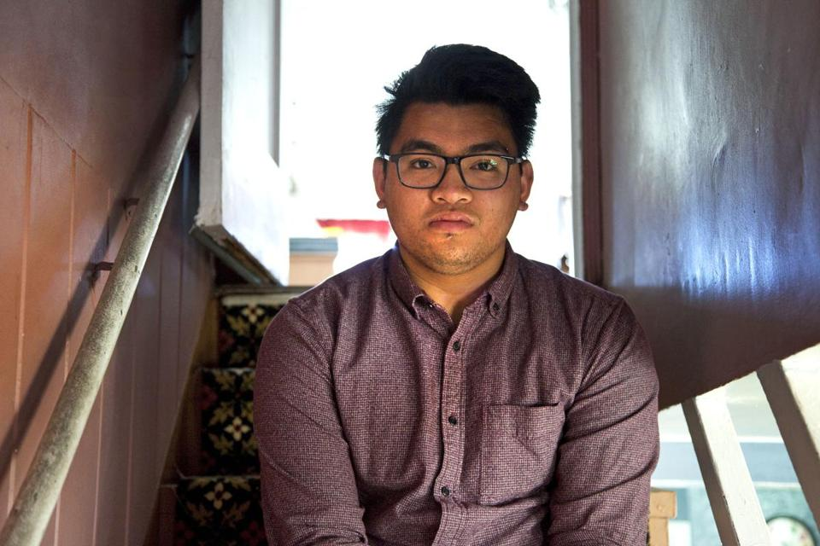
Student Scenario
What would you do?
A student tells you that he is considering applying for financial aid using his older sibling’s SSN, who is not attending college. However, he worries that it may affect his sibling.
How should an Ally handle this situation?

Slide 28
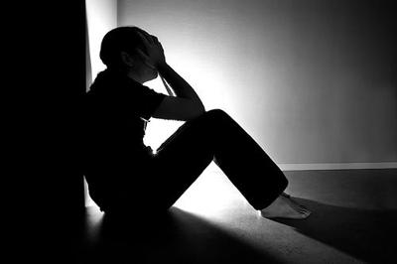
Student Scenario
What would you do?
You observe that one of your student is visibly distraught, depressed. After asking them, they share that they feel like giving up on getting their degrees and exclaim “It’s pointless!”. You then learn one of their family members has been deported.
How could an Ally respond to the students?

Slide 29

Student Scenario
What would you do?
A student of yours is struggling with their courses. They share that they must work to help at home. You learn that they believe they are ineligible for financial aid and cannot afford to buy their textbooks or course materials on time.
How could an Ally respond to the students?

Slide 30
Resources on Campus
DREAMERS
@ LPC

Slide 31
DREAMer Resources @ LPC
Dreamers @ LPC website. Start here!
UndocuAlly Pamphlet (coming soon)
Student Health and Wellness Center, #1701
Counseling Office, 1st Floor, bldg. 1600
EOPS, #1668
Notes:
Katie

Slide 32



DREAMer Resources @ LPC
Additional Support Programs/Learning Communities
  DSPS/Disability Resource Center, #1615
  Veteran’s Resource Center, #1310
  Tutorial Center, # 2401
  Puente
  Umoja
  HSI “Gateway to Success”
Notes:
Katie

Slide 33
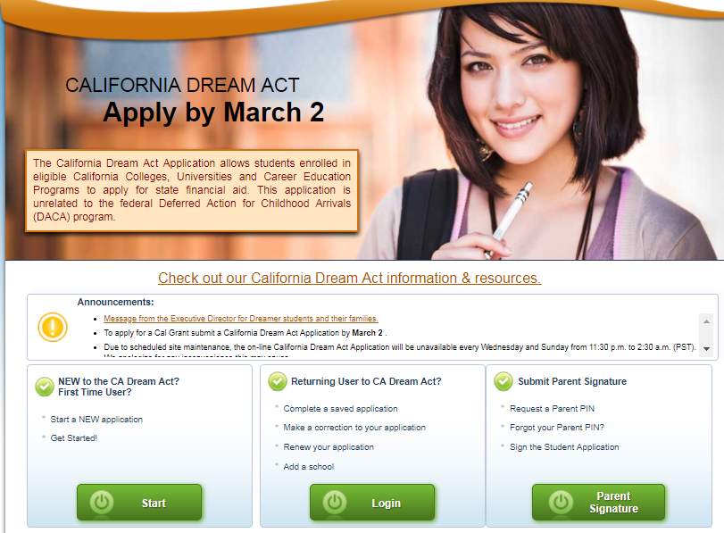
Go to: https://dream.csac.ca.gov

Slide 34
On campus Resources
Food Pantry
Transportation
Textbooks
The Market
In the future we hope to include reduced or free printing, free or reduced calculator rentals, ect.
All of this information will be included on our Pamphlet.

Slide 35
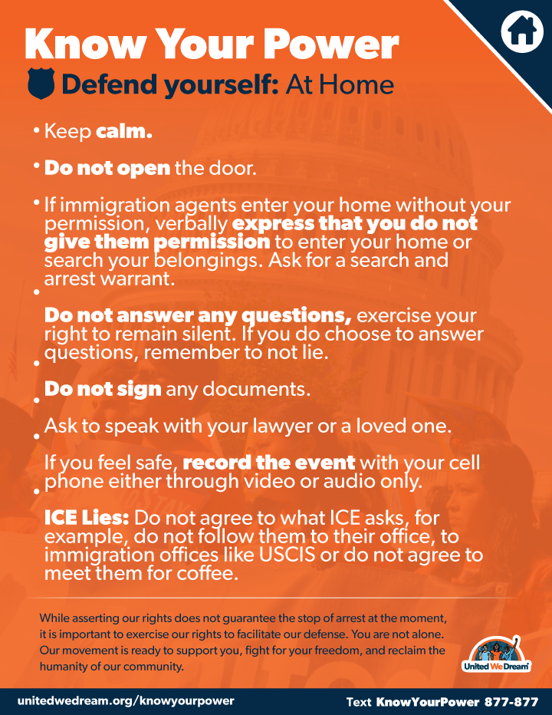
Know your rights
United We Dream – Know Your Power

Slide 36
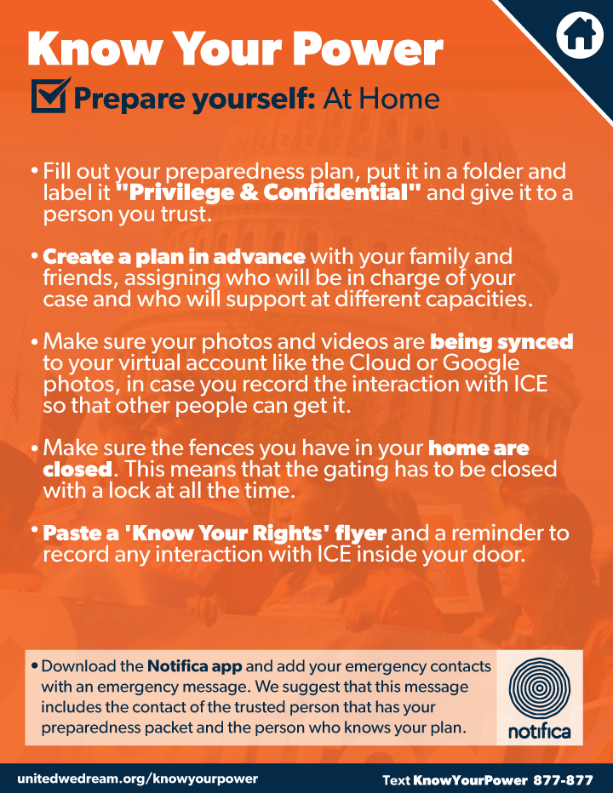
Know Your Rights
United We Dream – Know Your Power

Slide 37
Community Resources
California Community College Chancellor’s Office
  Resources for Undocumented Students
California Department of Social Services
  List of vetted legal aid services
  Immigration services include the following six service categories: (1) Services to Assist Applicants seeking Deferred Action for Childhood Arrivals (DACA); (2) Services to Assist Applicants seeking Naturalization; (3) Services to Assist Applicants seeking Other Immigration Remedies; (4) Legal Training and Technical Assistance Services; (5) Education and Outreach Activities; and (6) Services to Assist Individuals with Removal Defense.

Slide 38



Community resources
Immigrants Rising
United We Dream
National Immigration Law Center

Slide 39
Questions?
Thank you for attending!
UndocuAlly Task Force meetings:
1st Thursday of every month
2:00 – 4:00 pm

