Slide 1
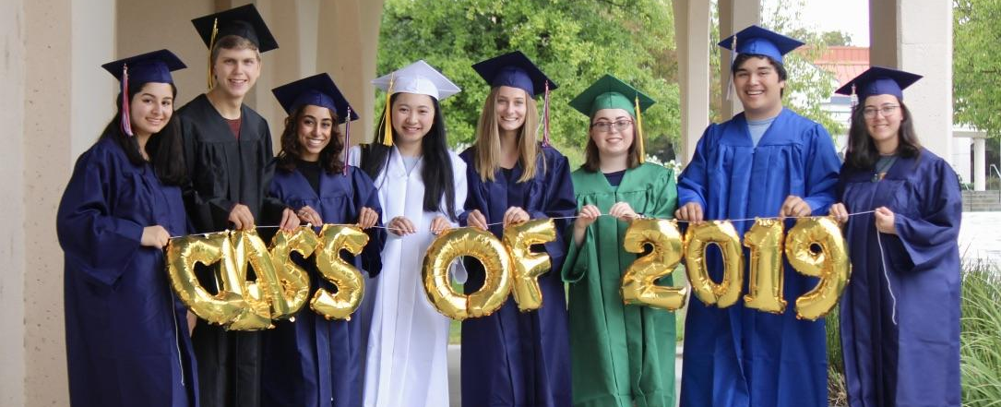

TVROP Middle College High School
at Las Positas College
Paving the Road from High School To College
Amy Brown, Program Coordinator & Kelly Mogilefsky, English & AVID Teacher,

Slide 2
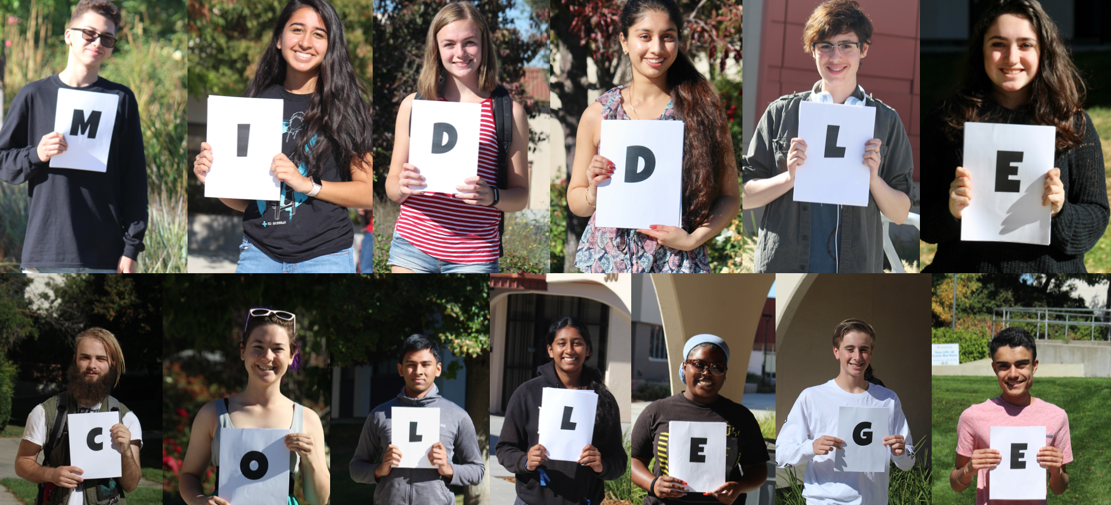
Program Background and Data

Slide 3
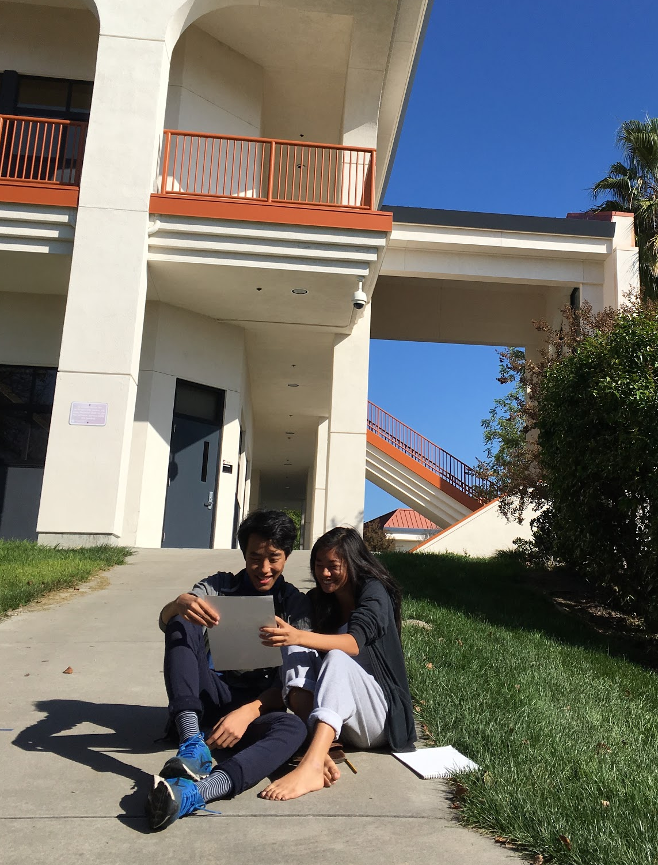
What is Middle College?
The Middle College High School program at Las Positas College is an alternative education program that provides high school students the opportunity to complete their last two years of high school at Las Positas College, earning high school and college credit simultaneously.

Slide 4

TVROP Middle College High School
at Las Positas College is a partnership between...
Notes:
Amy

Slide 5

Bay Area Middle College Programs include
Cañada College - Sequoia Union High School District - Redwood City
Contra Costa College - West Contra Costa Unified School District - San Pablo
De Anza College - Fremont Union High School District - Cupertino
Foothill College - Mountain View Los Altos Union High School District and Palo Alto Union School District - Redwood City
San Joaquin Delta College - Stockton
San Jose City College - San Jose Unified School District - San Jose
Skyline College - South San Francisco Unified School District - San Bruno
College of San Mateo - San Mateo Union High School District - San Mateo
Las Positas College - Tri-Valley ROP • Established 2015-2016
Notes:
Kelly

Slide 6
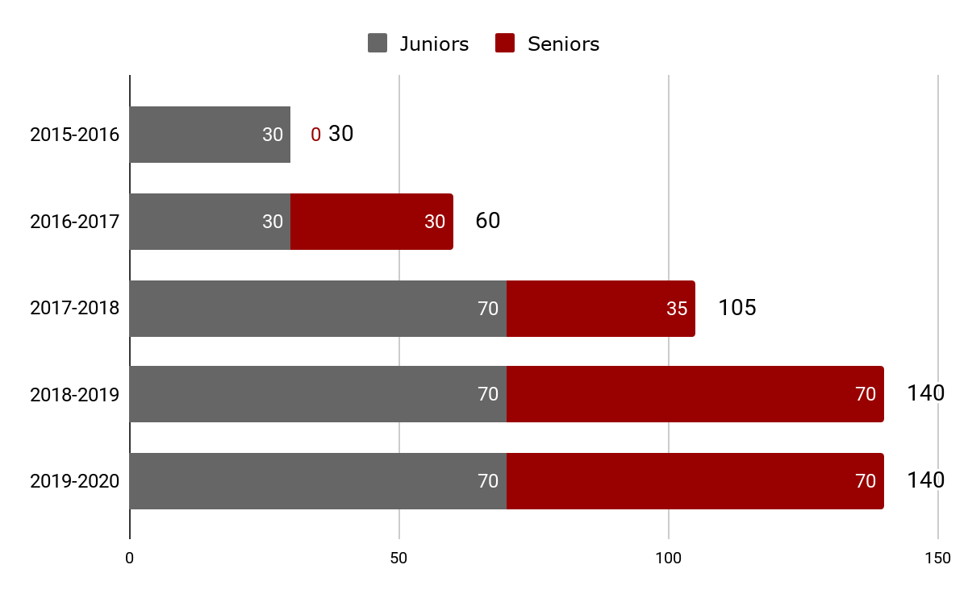
Middle College Enrollment

Slide 7
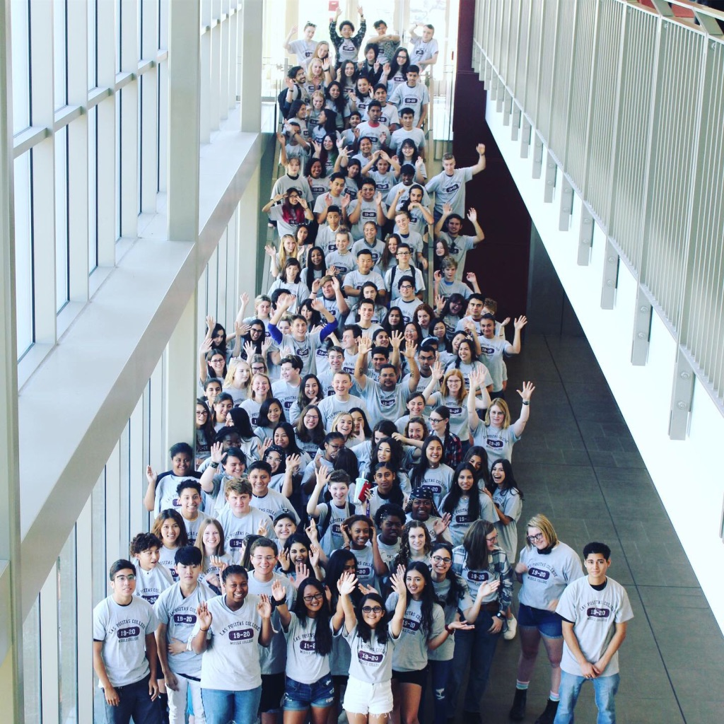
Middle College
Classes of 2020 & 2021
Notes:
Amy

Slide 8
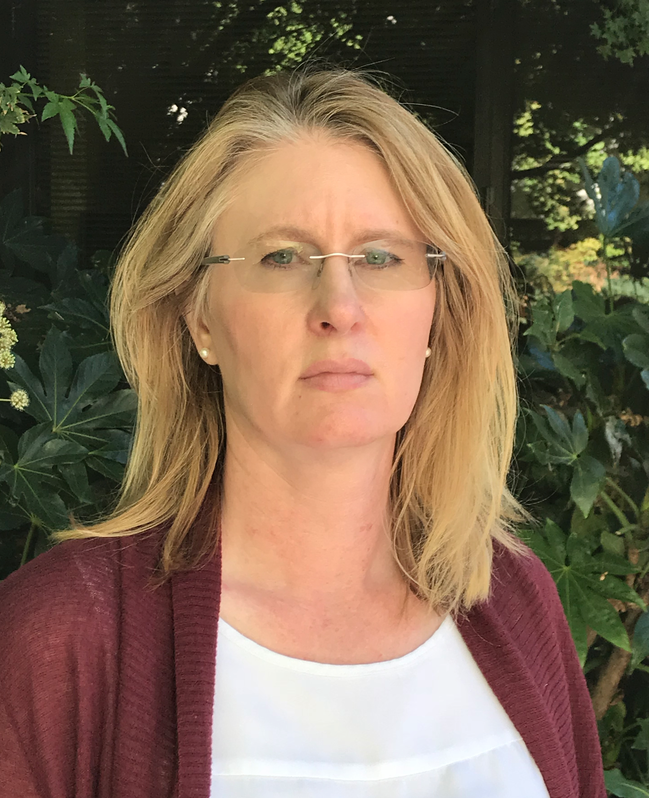
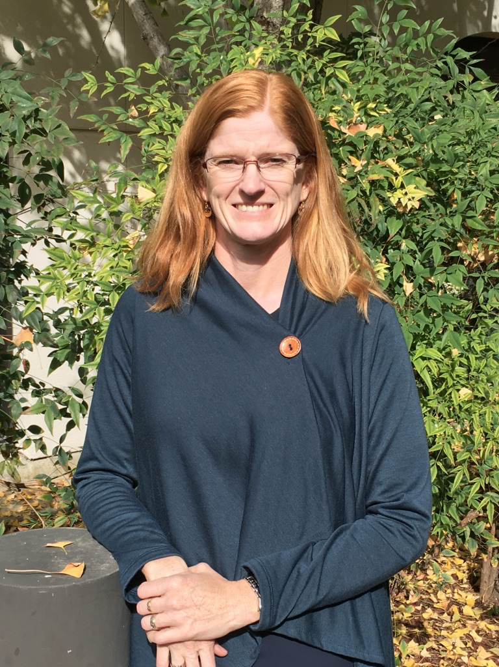
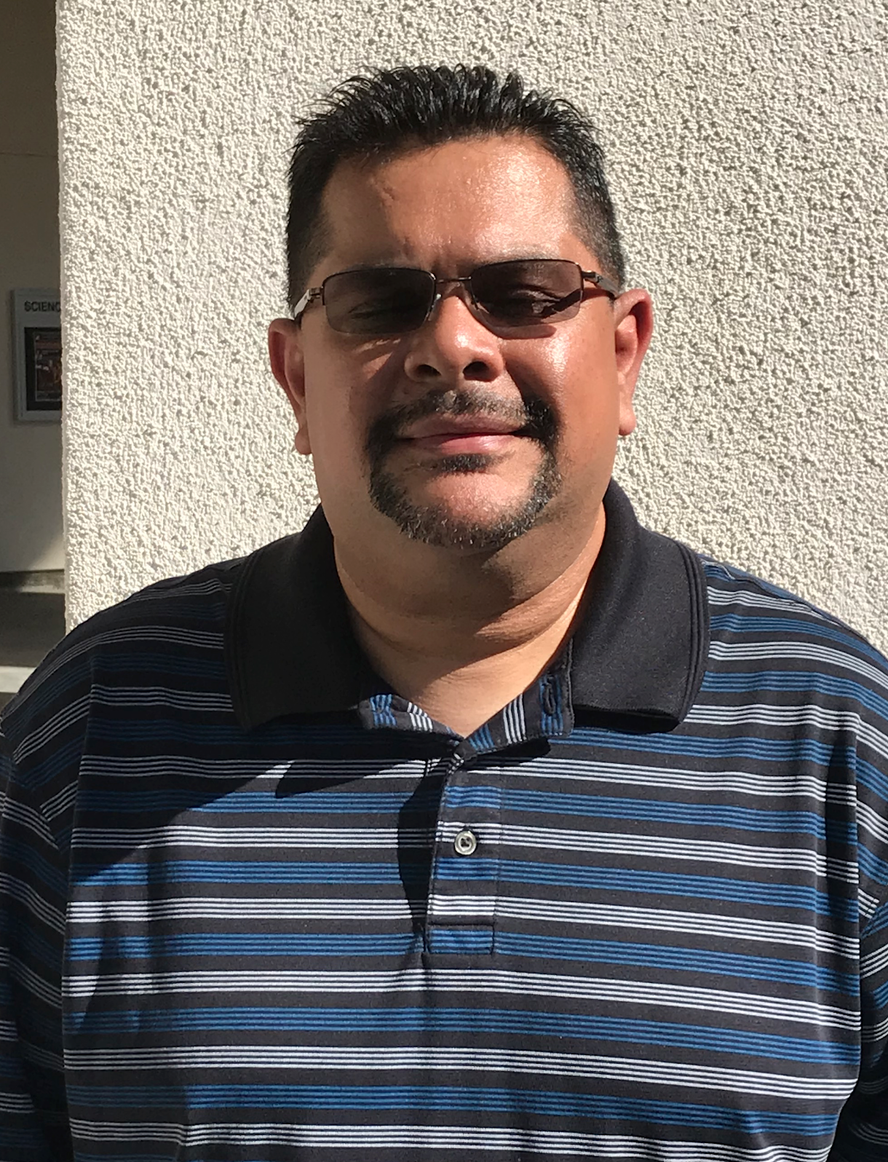

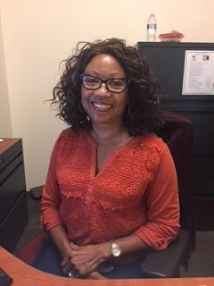
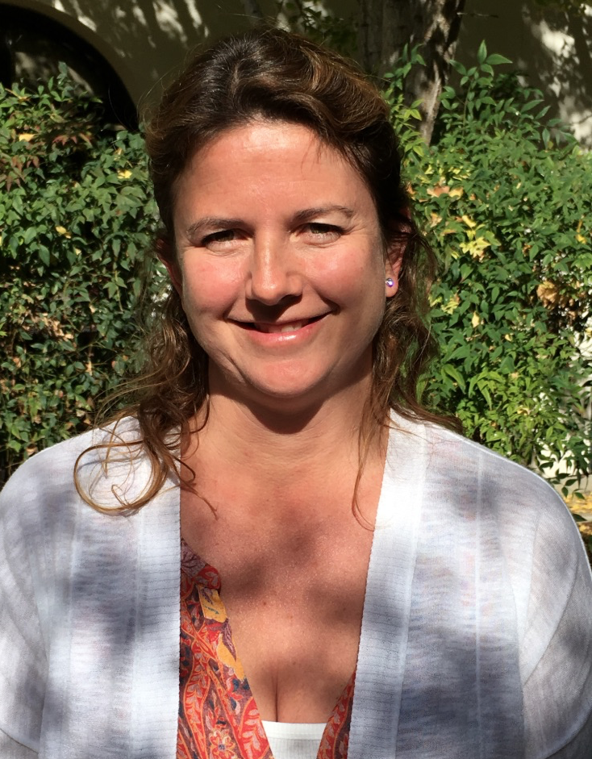
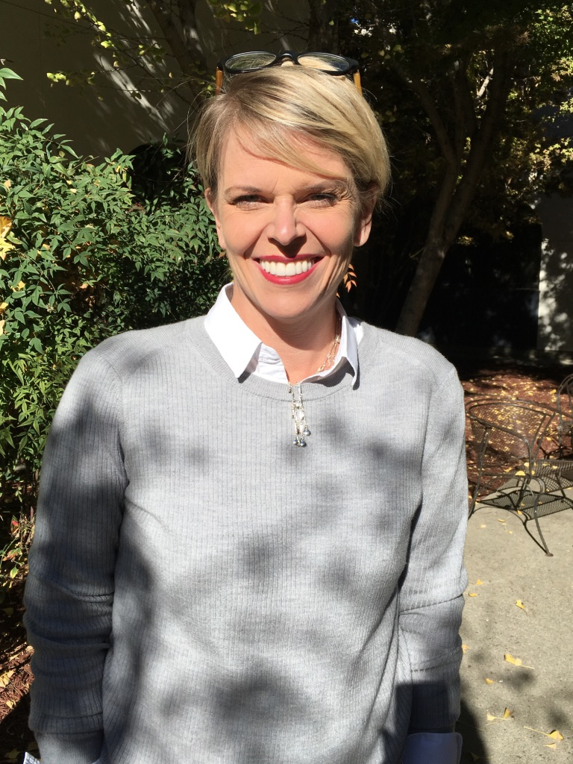

Our Staff
Ms. Denise Gauthier
Teacher
Ms. Kelly Mogilefsky
Teacher
Mr. Sergio Verbis
Teacher
Ms. Sharon Hope
LPC Counselor
Colette Ray
Administration Assistant
Ms. Amy Brown
MCHS Program Coordinator
Notes:
Amy

Slide 9
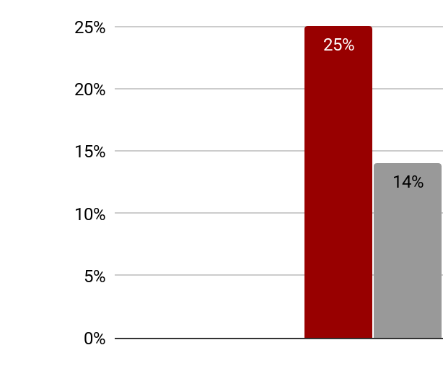
Students Identified as Socioeconomically Disadvantaged

Slide 10
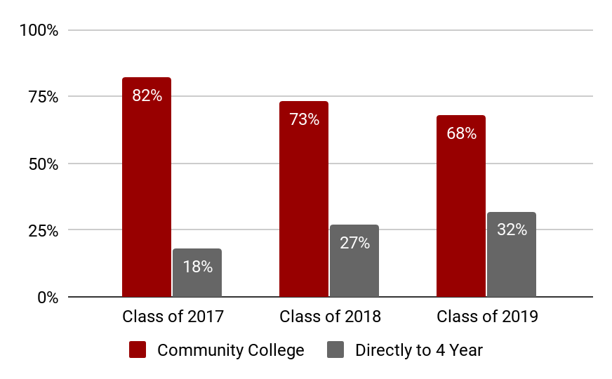
Post Middle College Plans

Slide 11
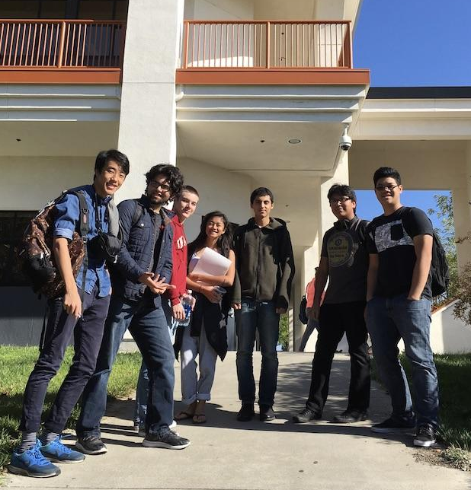
A Day in
Middle College

Slide 12
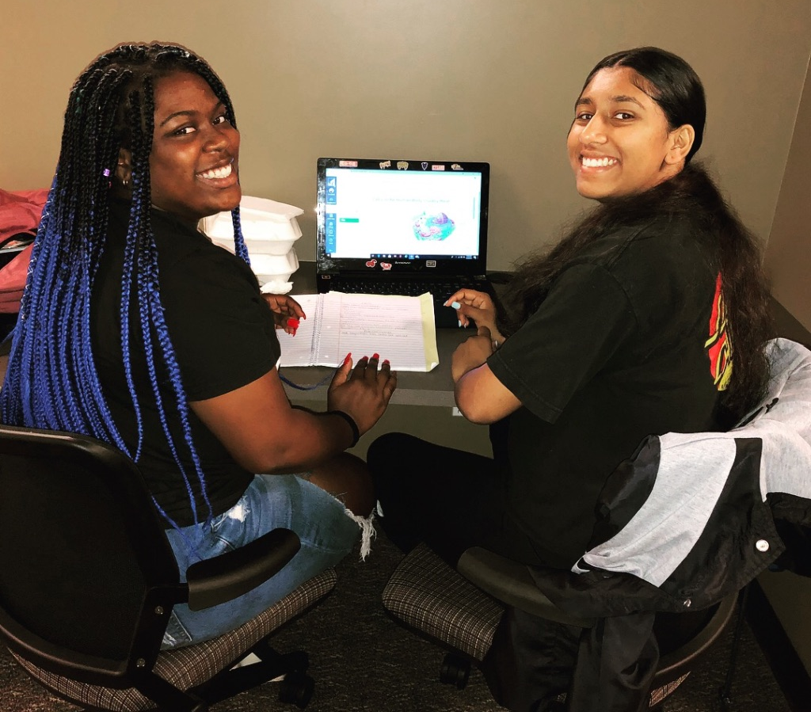
Middle College High School Schedule
Juniors: 8-11AM
Seniors: 11AM-2PM
Monday: All Classes Meet
Tuesday - Friday: Block
AVID meets final hour daily
Block | Juniors | Seniors
8-10AM Periods 1 & 2 Juniors Only | Junior English Junior US History
10-11AM Period 3 Juniors Only | Junior AVID A Junior AVID B
11AM-1PM Periods 4 & 5 Seniors Only |  | Senior ERWC Senior Civics/Econ
1-2PM Period 6 Seniors Only |  | Senior AVID A Senior AVID B

Slide 13
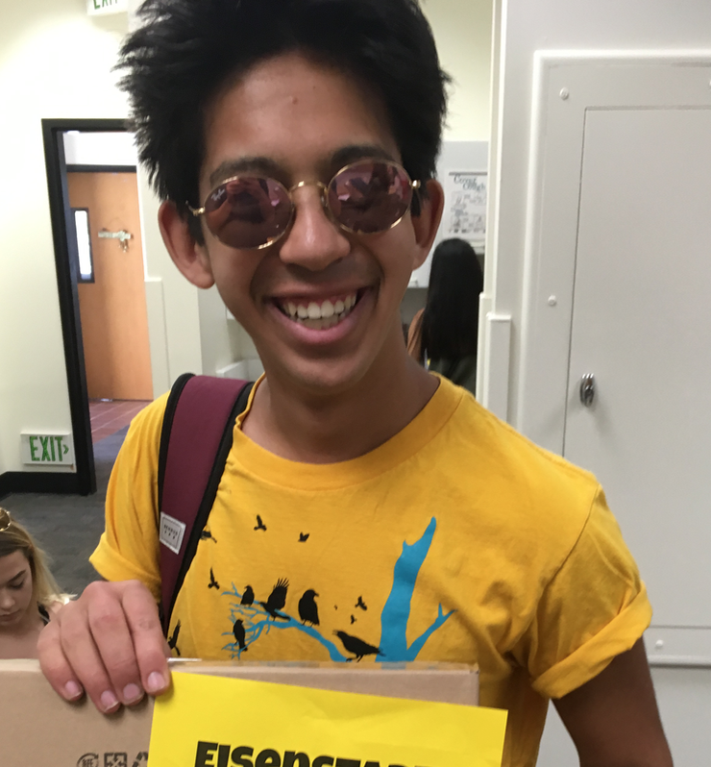
A typical MCHS student
Seeks academic challenge
Enters the program with a 3.44 GPA
Feels ready for a more mature learning environment
Plans to remain at LPC until junior transfer
Students cannot be credit deficient or have major disciplinary issues on their records.
Notes:
Amy

Slide 14
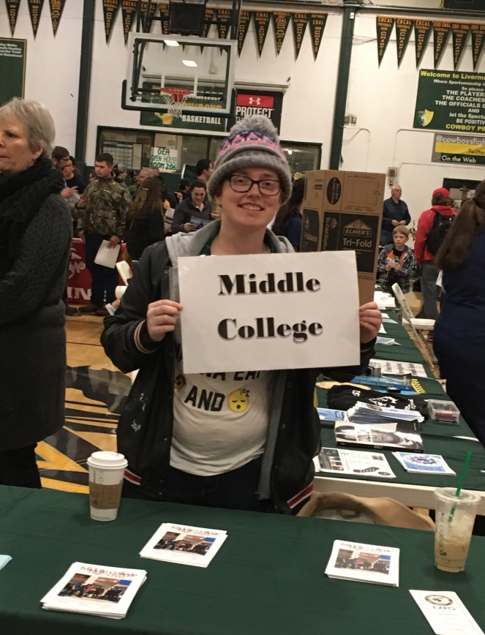
Expectations for
Middle College Students
Students and graduates of Middle College will:
Communicate effectively for a variety of purposes
Make decisions and solve problems in independent and collaborative settings
Employ research and data-gathering skills effectively
Effectively apply knowledge and skills in real world contexts
Meet their civic responsibilities
Value human and cultural diversity
Take personal ownership of their learning and future
Notes:
Kelly

Slide 15
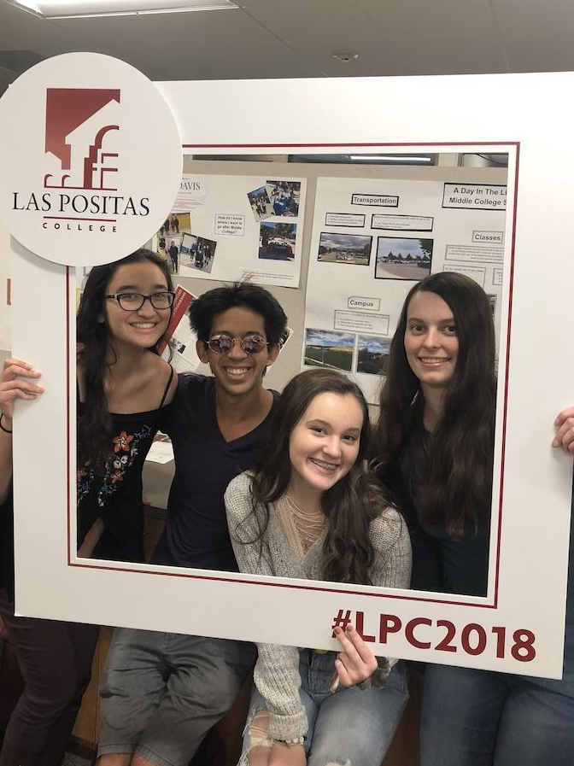
Benefits
Inclusive learning community
Explore individual interests & career paths
Flexible scheduling
Gain a solid college foundation
No cost to student for tuition or textbooks
Earn college units while completing high school requirements
bit.ly/MCinfonight

Slide 16
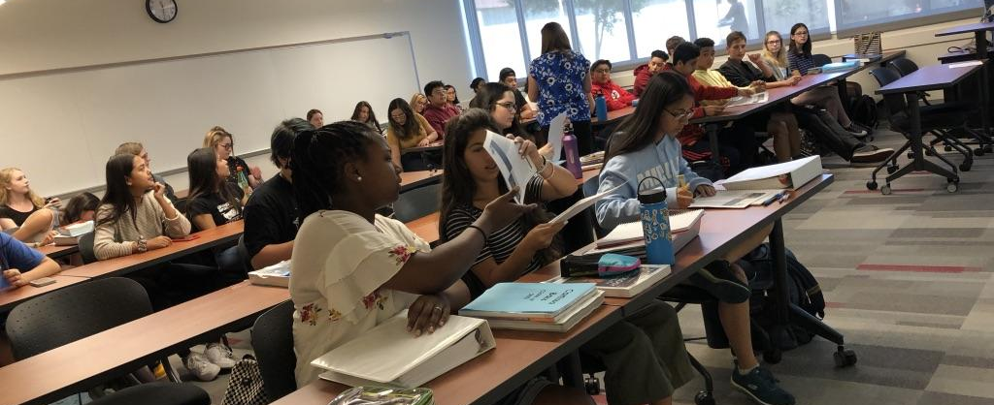

The High School to College Transition

Slide 17
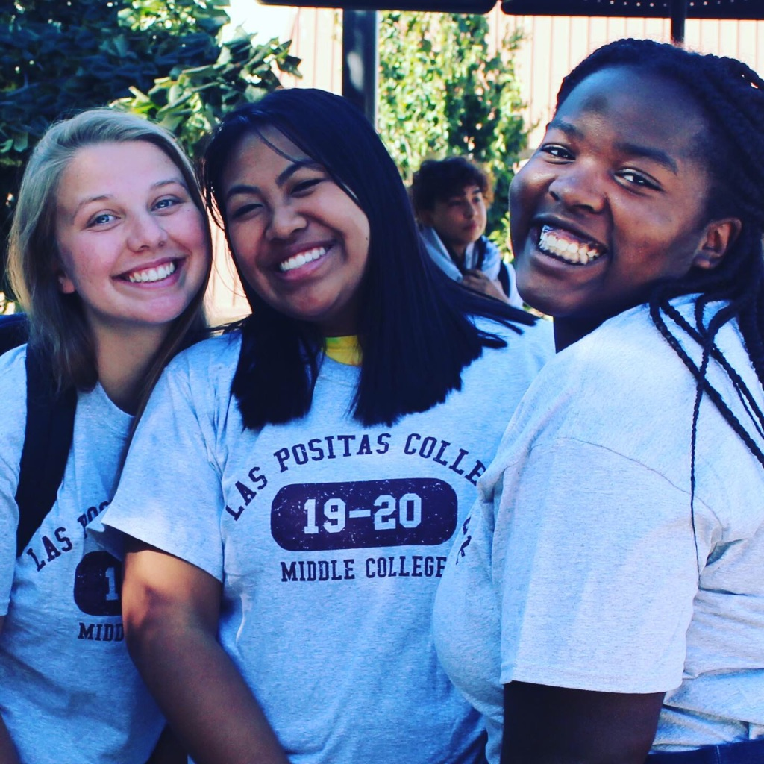
Incoming Class of 2021 Math Placement (70)
Math 55 (Alg 2 - non transfer) - 43
Math 30 (College Algebra) &
Math 39 (Trigonometry) - 11
Math 40 (Statistics) - 4
Math 47 (Liberal Arts Math) - 1
Math 1 (Calculus I) - 7
Math 2 (Calculus II) - 1

Slide 18
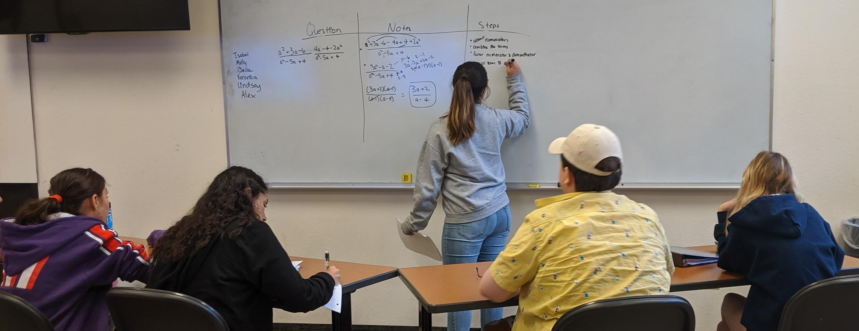
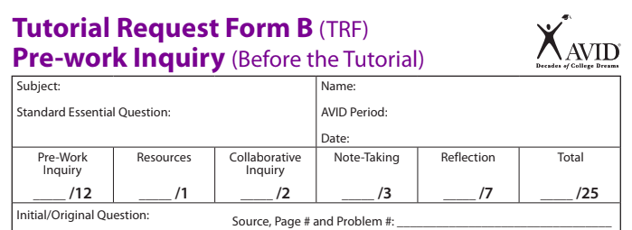
The AVID Tutorial
Notes:
Kelly

Slide 19
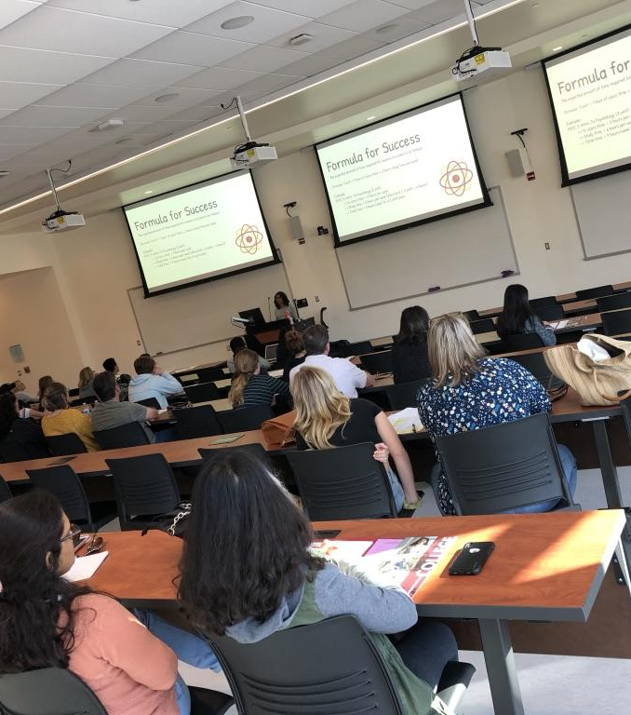
Notetaking Support

Slide 20
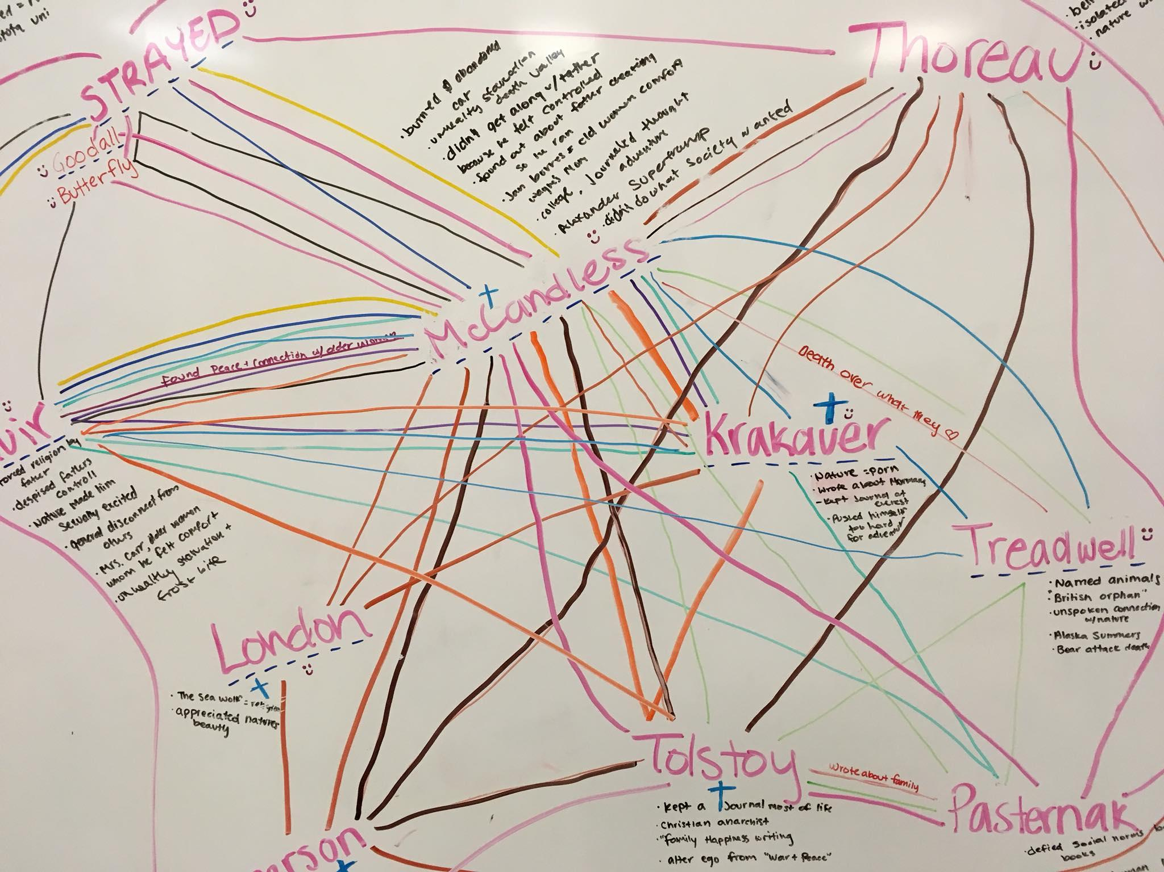
High School & College Reading & Writing Support

Slide 21
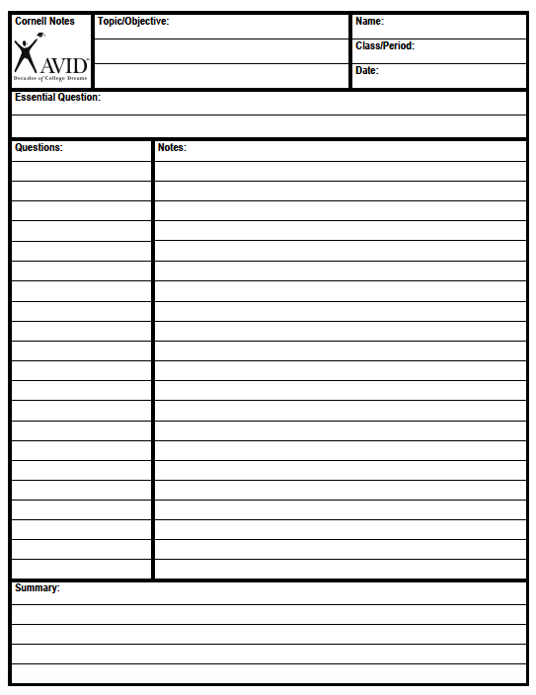
Cornell Notes
Step 1:
Take Notes
Step 2:
Questions
Key Ideas
Step 3: Write Summary

Slide 22
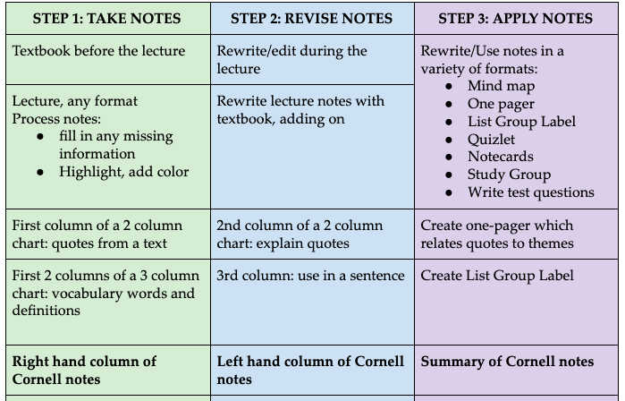
Middle College Notetaking

Slide 23
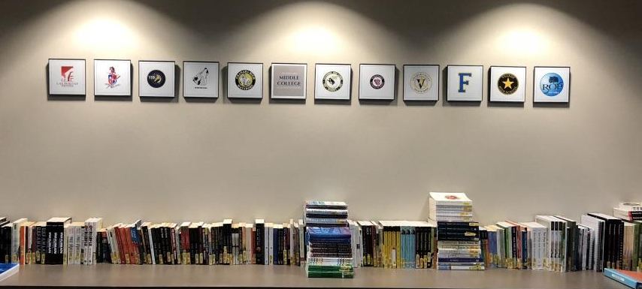
Annotation Skills

Slide 24
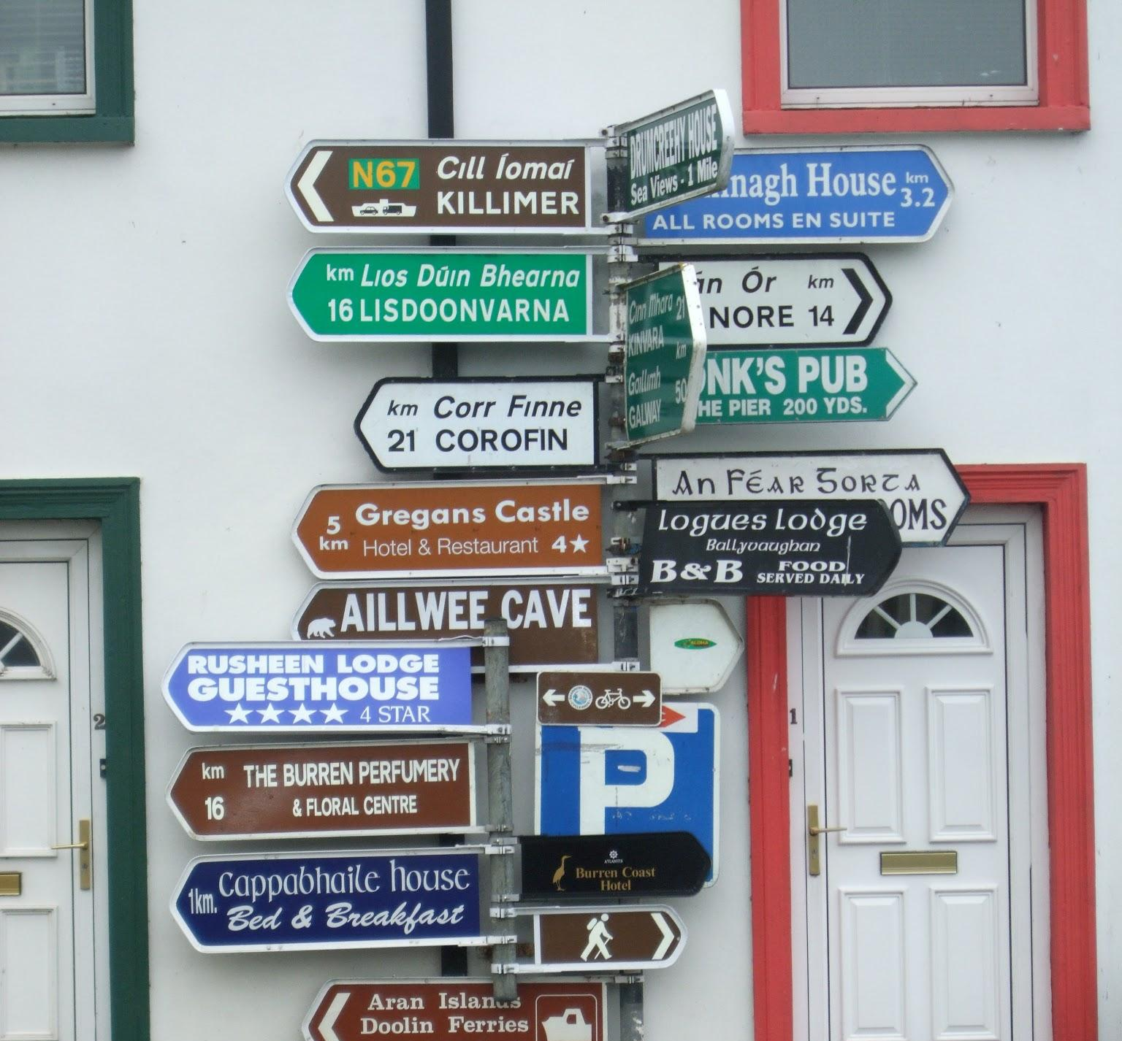

Notice & Note: The 5 Signposts (Mr. Verbis)

Slide 25
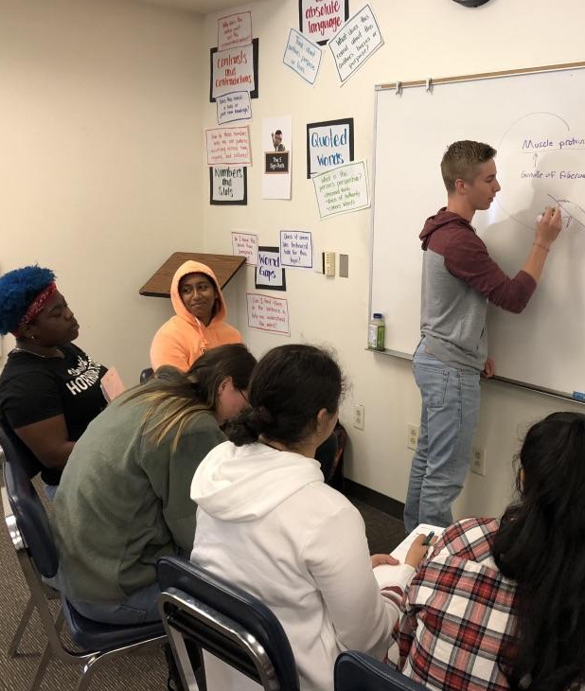
Notice & Note: The 5 Signposts
Notice & Note: The 5 Signposts
These five signposts help students identify concrete clues in the text to help them make those sophisticated moves & think critically about the information.
The five signposts are the following:
Contrasts & Contradictions
Extreme or Absolute Language
Numbers & Stats
Quoted Words
Word Gaps

Slide 26


Page or Paragraph Number | Something I found interesting or surprising? | What did the author think I already know? | What challenged, changed, or confirmed what I already knew?
 |  |  | Chal, chan or con (Circle One)
 |  |  | Chal, chan or con (Circle One)
The Three Questions (Mr. Verbis)

Slide 27
Expository Reading and Writing Course (ERWC)
8 modules ranging from 2-6 weeks
Most are non-fiction topics
Minimum of 2 long works: Into the Wild and 1984
One self-guided research paper
Out-of-class process essays and in-class timed essays
Focus on key grammar development areas: sentence boundaries, sentence combination, integrating other people’s ideas into our texts

Slide 28
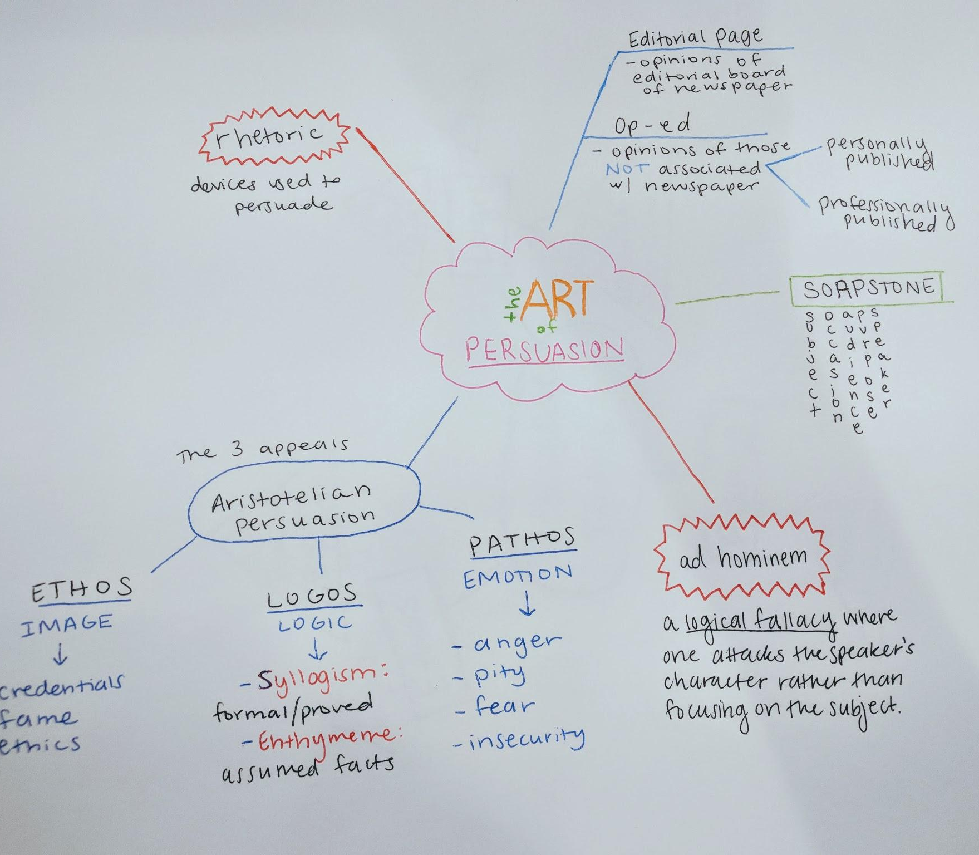
Ethos Logos Pathos
Rhetoric
Ethos: Building Credibility
Logos: Logical Arguments
  Logical Fallacies
  Cognitive Biases
Pathos: Emotional Appeals

Slide 29
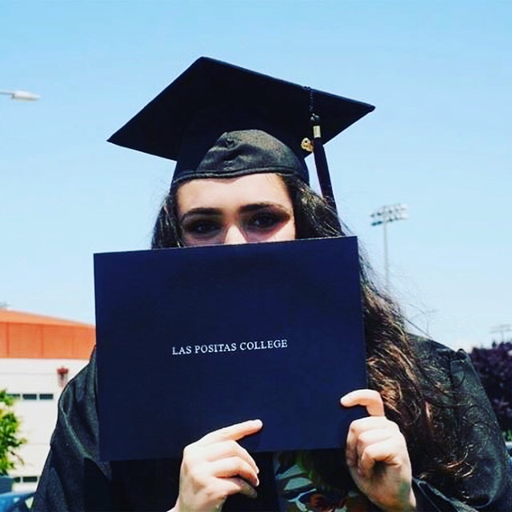
What Professors and Staff Can Do
to Support MCHS Students
Exactly what you do to support all students!
Treat them like LPC students; they may prefer not to be singled out
Keep academic expectations high; question a lack of performance
Provide support when you notice struggle
Help students understand your expectations for specific assignments
Guide students to wrap-around services (LPC Tutoring Center, RAW, MathLab)
Complete Progress Reports
Notes:
Kelly

Slide 30

Student Panel

Slide 31
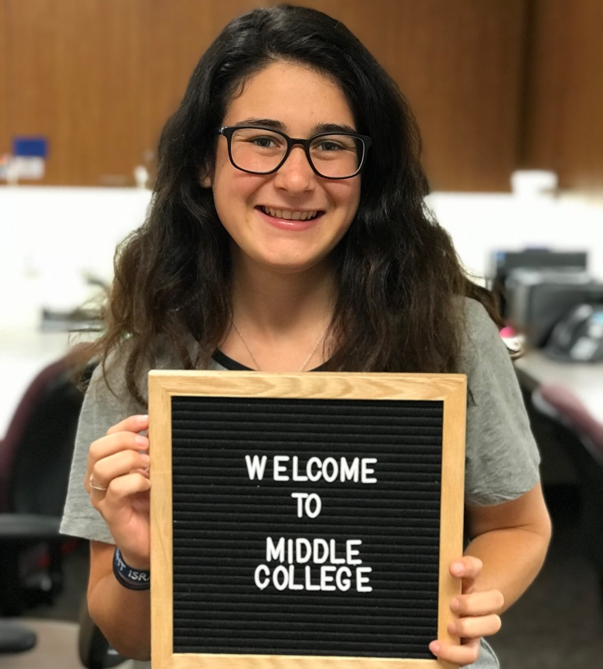
To start, please introduce yourself, include your home district and high school, and what brought you to Middle College.

Slide 32
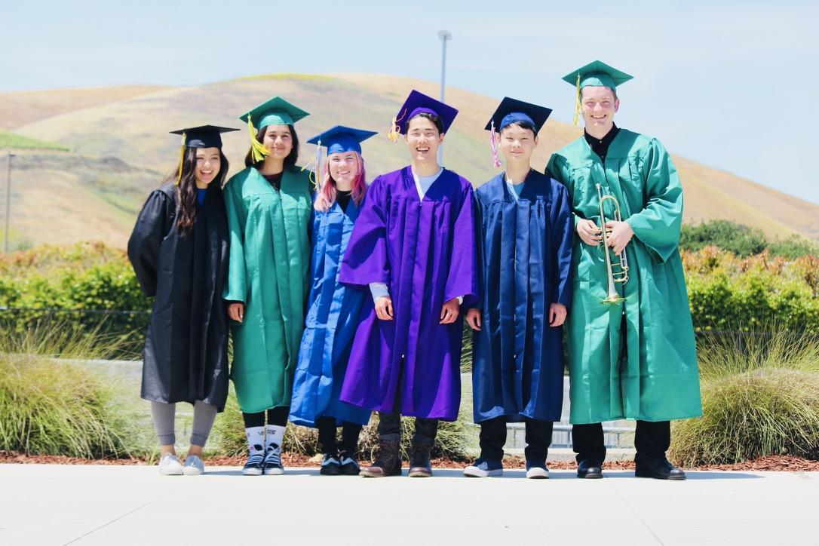
Since students come from three Districts and as many as seven different high schools, share how the high school experience is similar or different for you here at Las Positas College.

Slide 33
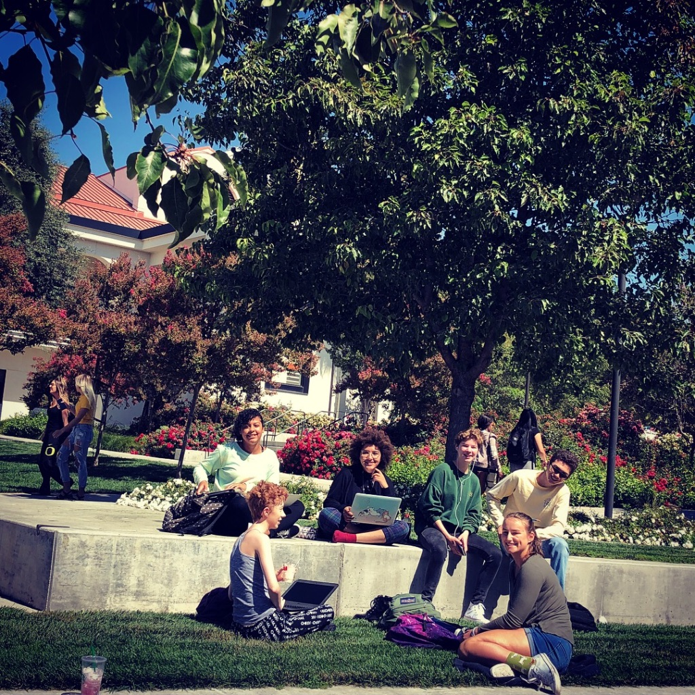
Middle College students take three high school classes every day. In addition to that, students take between 7 and 11 LPC units. What is your current schedule here at Middle College? (Include high school and college courses)

Slide 34
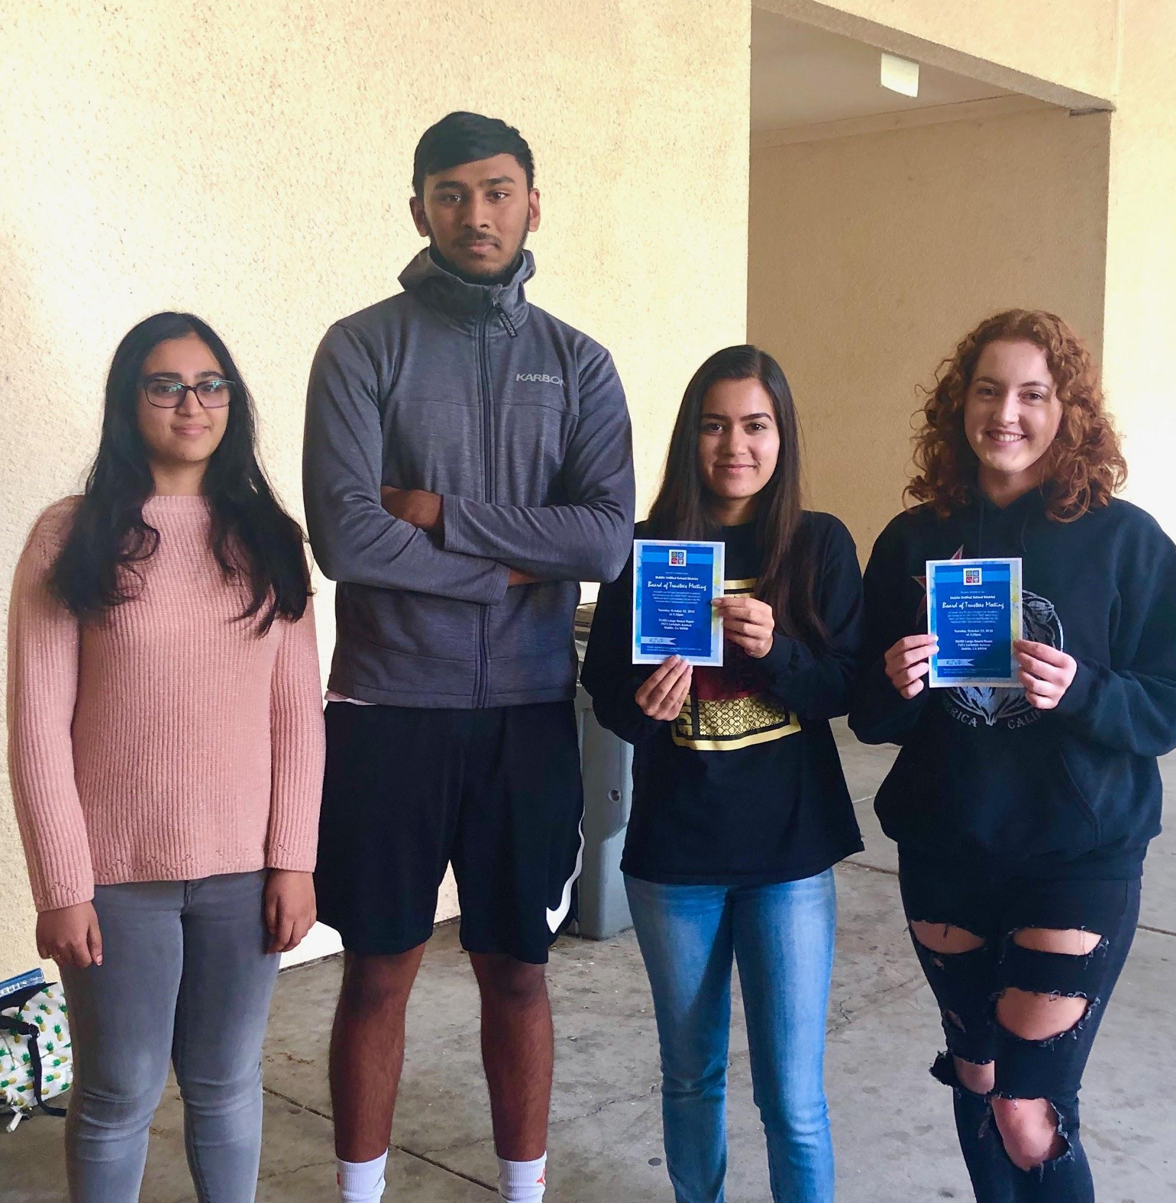
What would you say are some characteristics of a potential Middle College student?

Slide 35
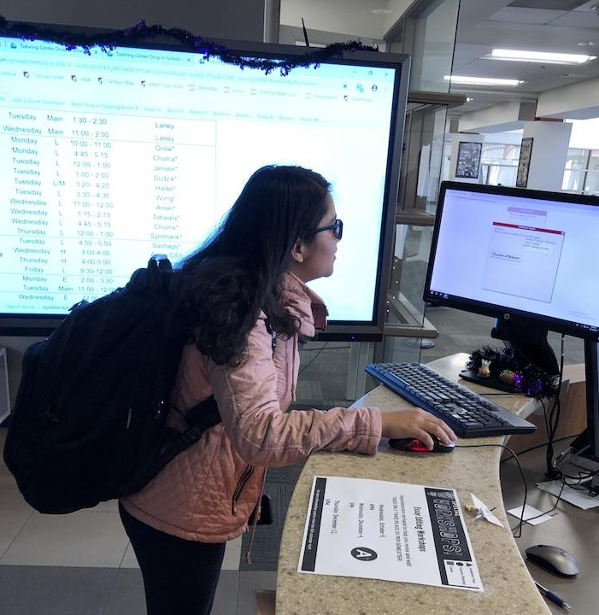
As we know, Las Positas College offers lots of supports such as the Tutorial Center, Counseling, Smartshops, etc. What supports have you accessed and what was your experience using these supports as a high school student?

Slide 36
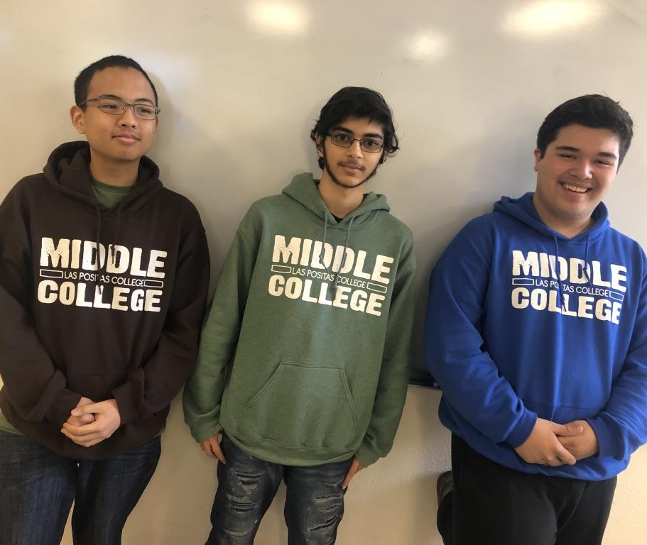
What are your plans after high school?

Slide 37
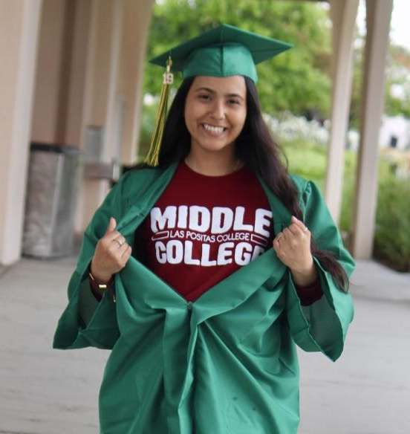
How do you expect your experience here at LPC will help you transition a four year university, either directly after high school or upon transfer.

Slide 38
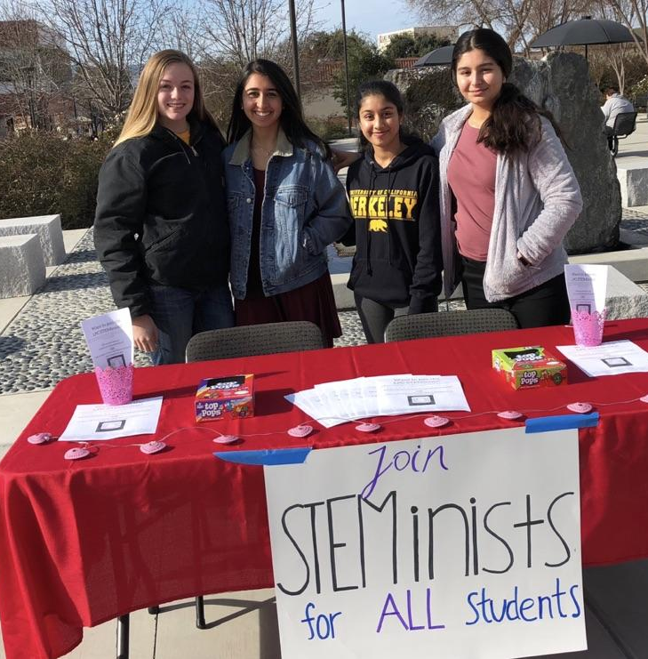
What clubs or activities are you involved in here or at your home high school?

Slide 39
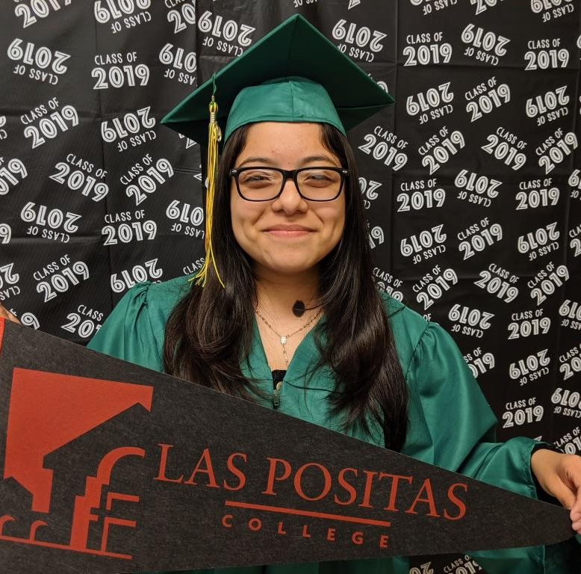
What was the most difficult transition for you from your home high school to Middle College?

Slide 40
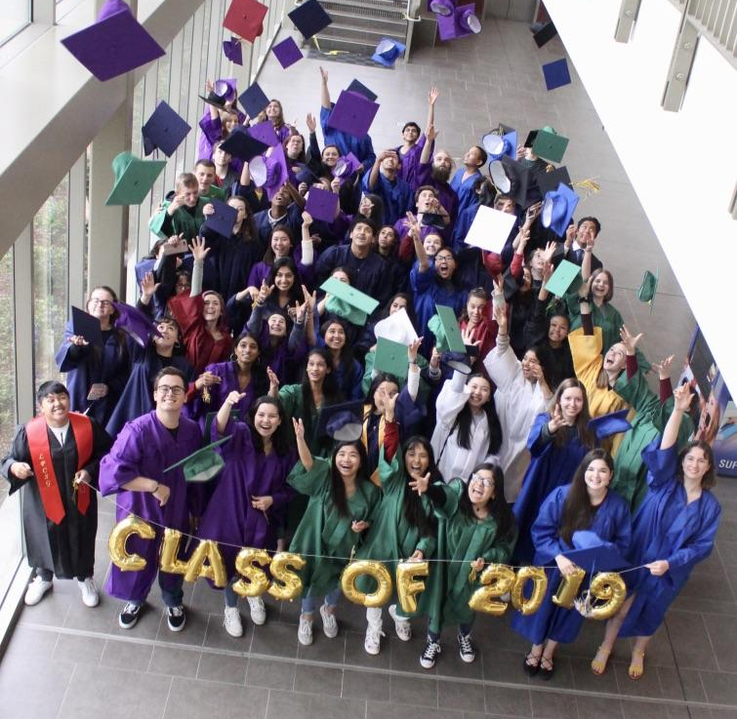
Questions?

Slide 41




Thank you!
Open House Today - 2411 9:30-3:30
Photo Gallery Walk - 2411U & @2400 Hallway through November 8
Amy
Kelly
Sergio
Denise
Colette
Follow Us Facebook @MiddleCollegeLPC Twitter @MCHSatLPC Instagram middlecollegeLPC

