Slide 1
Guided Pathways
FLEX DAY
October 20, 2020
Career and Academic Pathways

Slide 2
Norms for our work together
Start and end on time
Be present
Clear agenda
Allow flexibility
Honor all voices
Assume good intentions
Safe space
Collaborative decision-making

Slide 3
Fall FLEX Day
Career & Academic Communities
Why Communities?
Students who apply to LPC choose an area of study based on their interests.
Students early on explore related fields, careers, pathways, programs, courses.
Instructional and counseling faculty, classified professionals, and peers work together to support students.
Students receive targeted interventions along their journey, to help them meet academic and career preparedness milestones.
Last year we collaboratively started working on defining our Career and Academic Communities. Thank you for joining us today as we finalize this work.
Notes:
Kristy
A key piece to being able to provide all students with clear curricular pathways to employment and future education, supporting all students in entering their pathway from application to registration, support students staying on their pathway with comprehensive academic and student services, and finally to complete their educational journey in a timely manner is to have Academic and Career Communities established for our programs. Some colleges have meta-majors or clusters, but through our conversations we as a college have favored Communities.

Slide 4
Las Positas College Students Need More Clarity
It is clear to me what I am expected to learn, know, and be able to do in order to successfully complete:
My courses 83%
My major/program 64%
My degree/certificate 62%
My transfer education 57%
About 40% of our students are not clear about what they need to do to complete their program of study
Las Positas College 2016 Student Satisfaction Survey
Notes:
Las Positas College 2016 Student Satisfaction Survey
Our students indicate they want more structure and guidance
Many find choosing a major a difficult task
(Career Ladders Project (2017): Bringing Student Voice to Guided Pathways Inquiry and Design)
>50% concerned about making a mistake when choosing classes (Moore & Shulock, 2014)
Many are surprised to find that courses taken do not count towards credentials
(Nodine et al 2012)

Slide 5
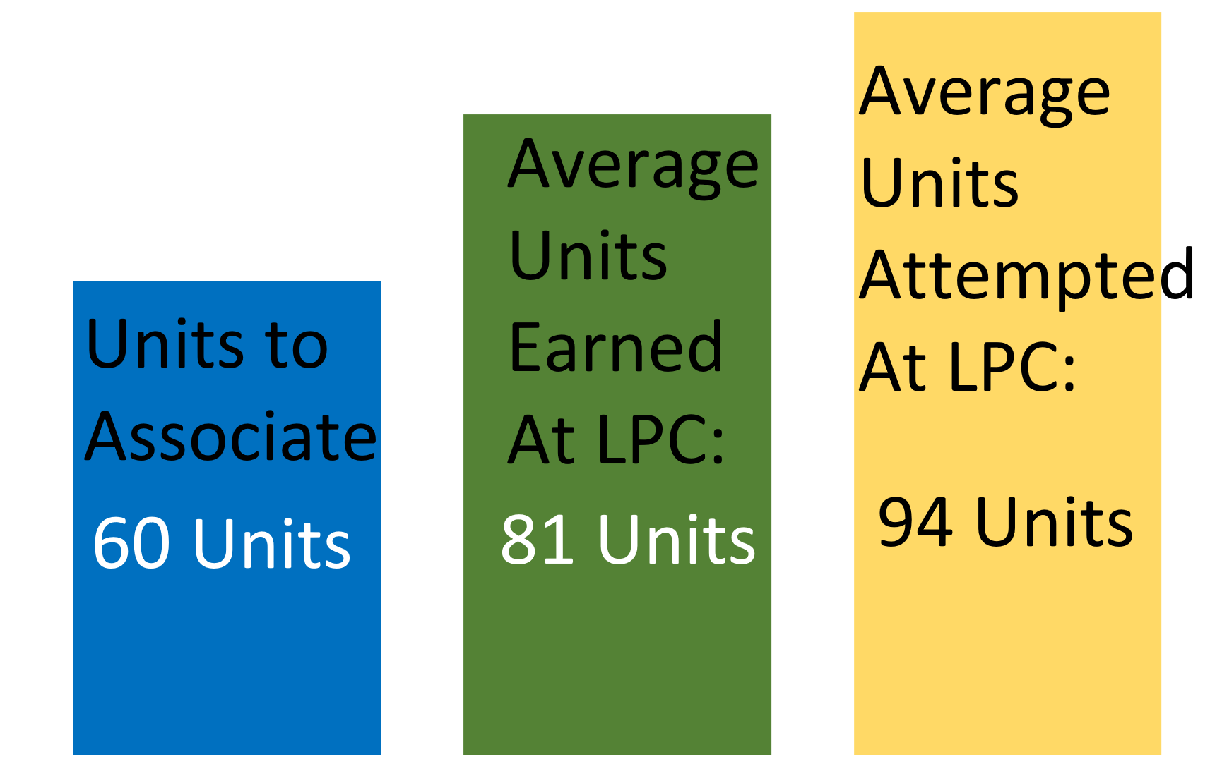
Las Positas College 2016-17 First-Time Associate Degree Completers
Average Unit Accumulation
Notes:
LPC Data:
x% of our students are undecided.
x% programs are CTE vs AD-T

Slide 6
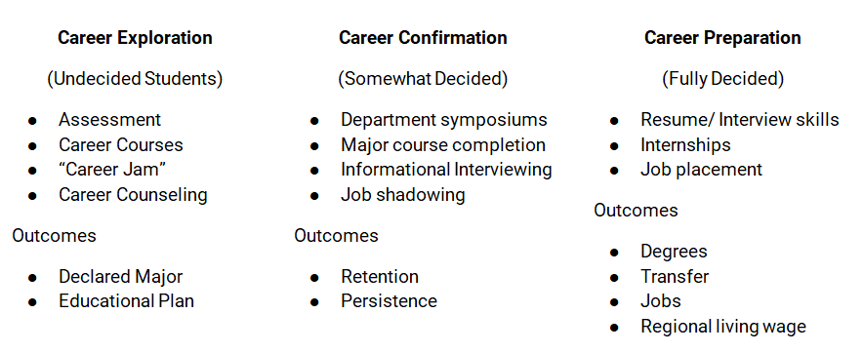
LPC students tend to fall into three categories...
with ~20% of new students undecided and ~65% of our Programs are CTE

Slide 7
Career and Academic Communities
Putting students first when defining communities:
Transfer may be the end of a pathway, but for many students, employment is the target.
Organizations of communities can provide opportunities for exploration of careers, maximize transfer and employment connections, targeted marketing & inreach
Communities can foster the use of data, inquiry, and evidence to encourage students in their area to thrive
Notes:
Kristy
A key piece to being able to provide all students with clear curricular pathways to employment and future education, supporting all students in entering their pathway from application to registration, support students staying on their pathway with comprehensive academic and student services, and finally to complete their educational journey in a timely manner is to have Academic and Career Communities established for our programs. Some colleges have meta-majors or clusters, but through our conversations we as a college have favored Communities.

Slide 8
Overview of Session
Why this work matters
Diverse clustering examples from around the State.
What did they call their groups? What did they group together? How many did they have?
What did you like? Did not like?
Reflect on the work that has been done at LPC
Reflect on our groupings
Polishing our Communities
Next Steps
Student user groups
October 30 Workgroup 1 - 3pm
Notes:
Why this work matters (5 min)
Diverse clustering examples from around the State. (15 min)
What did they call their groups? What did they group together? How many did they have?
What did you like? Did not like? (Together 10 min)
Reflect on the work that has been done at LPC (15 min)
Reflect on our groupings
RP Group’s findings on our LPC natural curriculum communities
Polishing our Communities
Next Steps
Student user groups
October 30 Workgroup 1 - 3pm

Slide 9
Learning from diverse clustering examples from around the State.
Directions:
Breakout into groups for 15 minutes
Each group will look at two different colleges’ groupings.
Notice:
What did they call their groups?
What did they group together?
How many did they have?
Time permitting: What did you like? Did not like?
Write your notices on your Breakout Group’s Jamboard.
Notes:
Group 1
https://jamboard.google.com/d/1WRhJMxGlzXaA7Xr7e2QhfTkObavWFzzV2gY-ySTzZbI/edit?usp=sharing
Group 2
https://jamboard.google.com/d/1xpfG2G2iqwx8dIhveIYZpyeoF0VSMKzy_dtrc04zEiI/edit?usp=sharing
Group 3
https://jamboard.google.com/d/1h5p2rOV4sx1My1wVL9ie3Oy98r1VMZmgKuuTIyAFVqw/edit?usp=sharing
Group 4
https://jamboard.google.com/d/18p1c90U2suAJQGGrjt6yGydiSR5lySUE-tzDe6T5b0U/edit?usp=sharing
Group 5
https://jamboard.google.com/d/13p0oUunppQbUw3CLtWpEOEmVx5v23zdyuG-xNKRHfis/edit?usp=sharing
Group 6
https://jamboard.google.com/d/1FIJLMUSTEKnqb6OmeZSy8OQQxUH1g516aprrenrbAfo/edit?usp=sharing

Slide 10
Breakout: Diverse clustering examples
Breakout Group A:
Sierra College and Diablo Valley College
Capture your thinking on Group A Jamboard
Breakout Group B:
Bakersfield College and Chaffey College
Capture your thinking on Group B Jamboard
15 minutes!

Slide 11
Sierra College
Jamboard Question (links to external site)
What stood out to you?
https://academics.sierracollege.edu

Slide 12
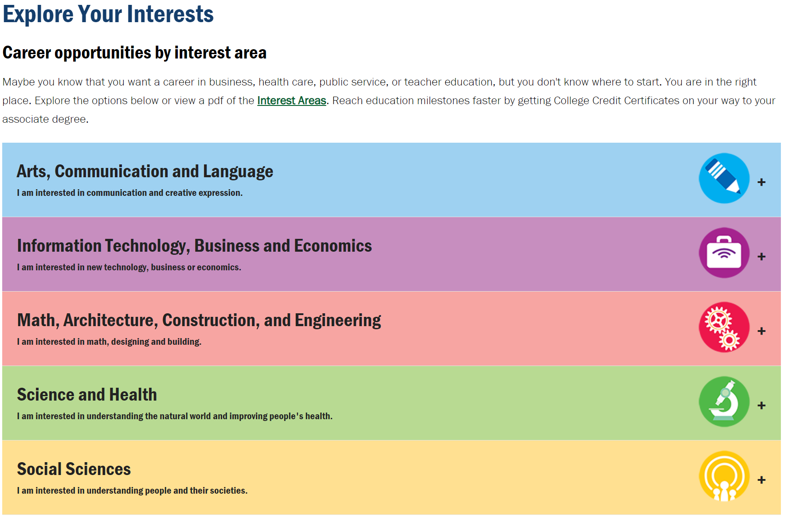
Diablo Valley College
Jamboard Question (links to external site)
What stood out to you?
https://www.dvc.edu/academics/explore.html

Slide 13
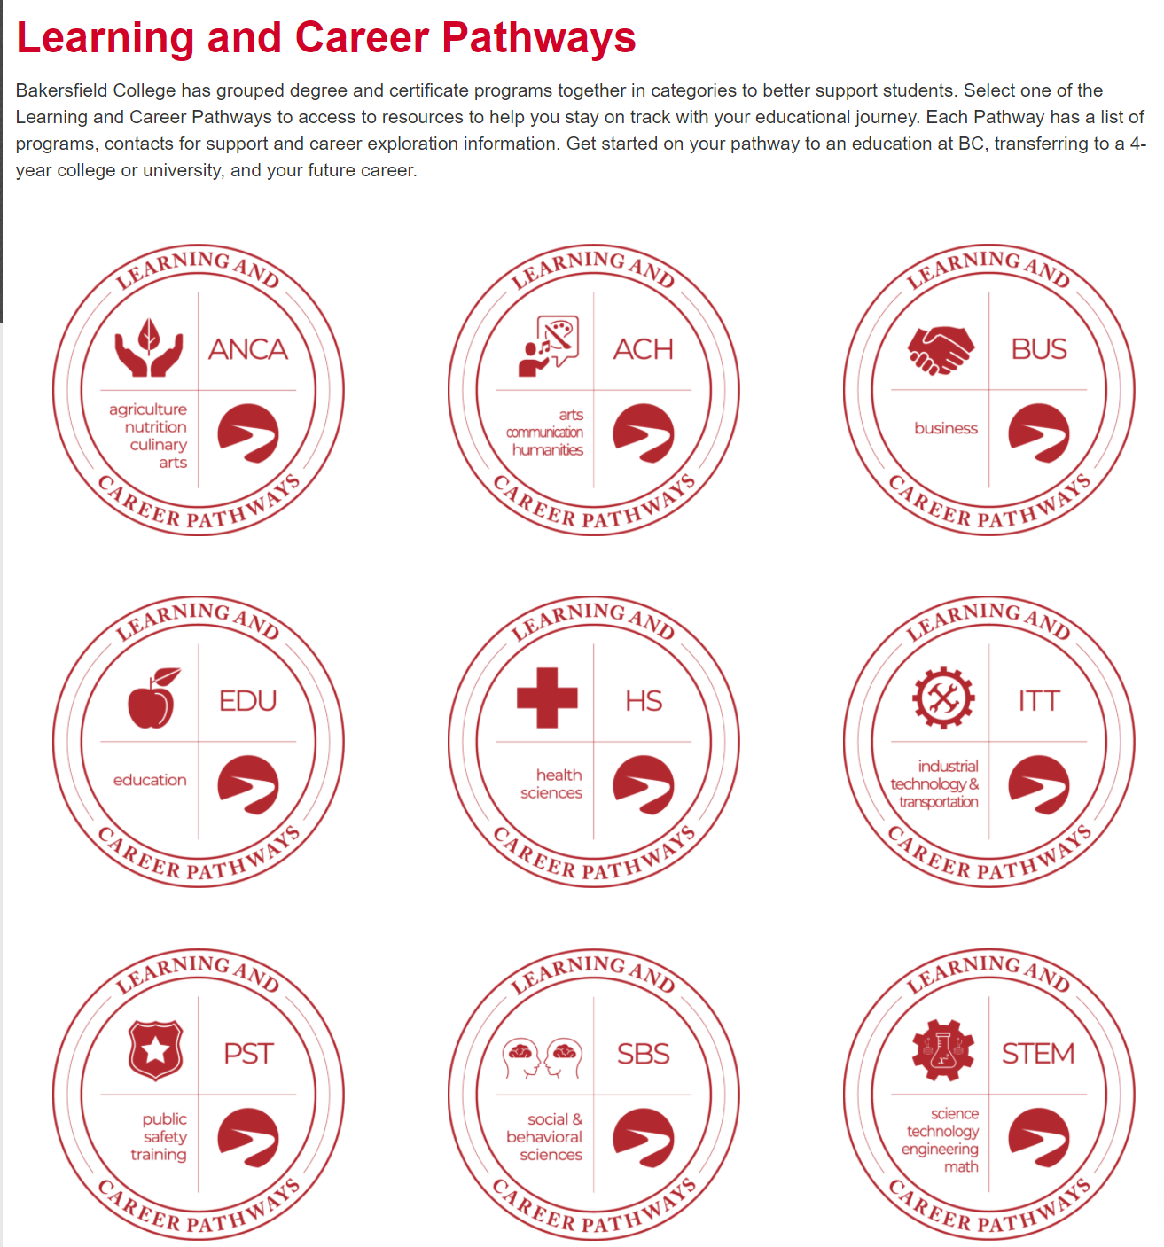
Bakersfield
College
Jamboard Question (links to external site)
What stood out to you?
https://www.bakersfieldcollege.edu/academics/pathways

Slide 14
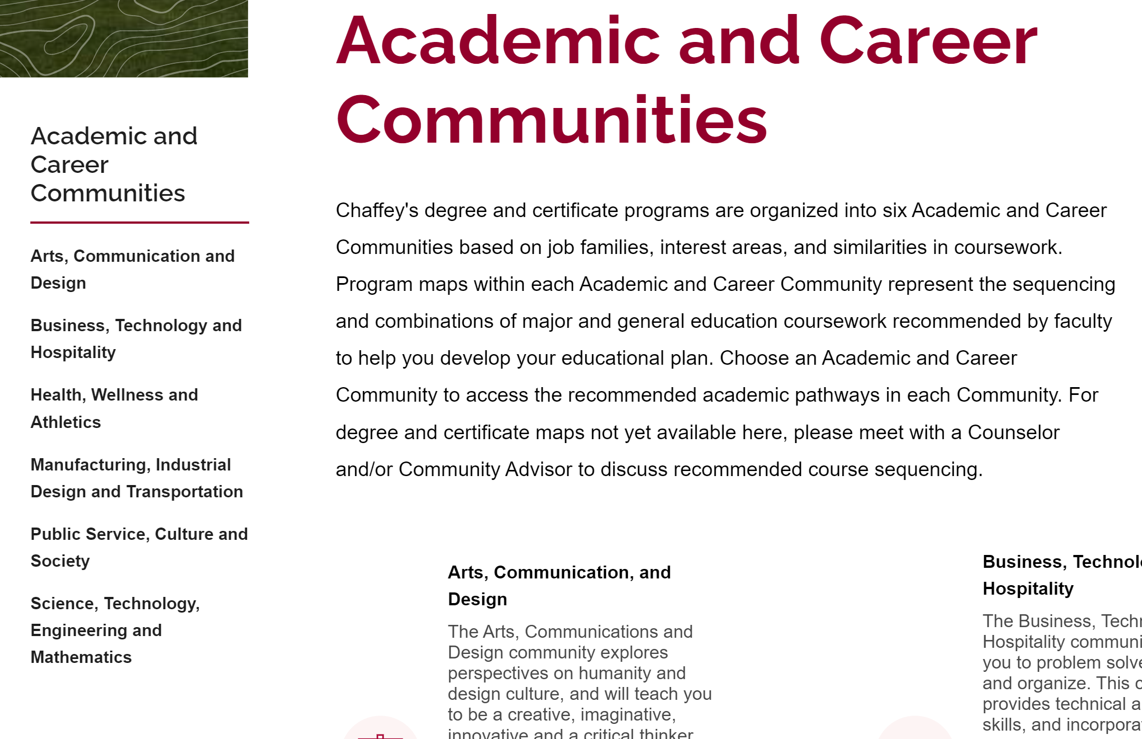
Chaffey College
Jamboard Question (links to external site)
What stood out to you?
https://www.chaffey.edu/acc/index.php

Slide 15
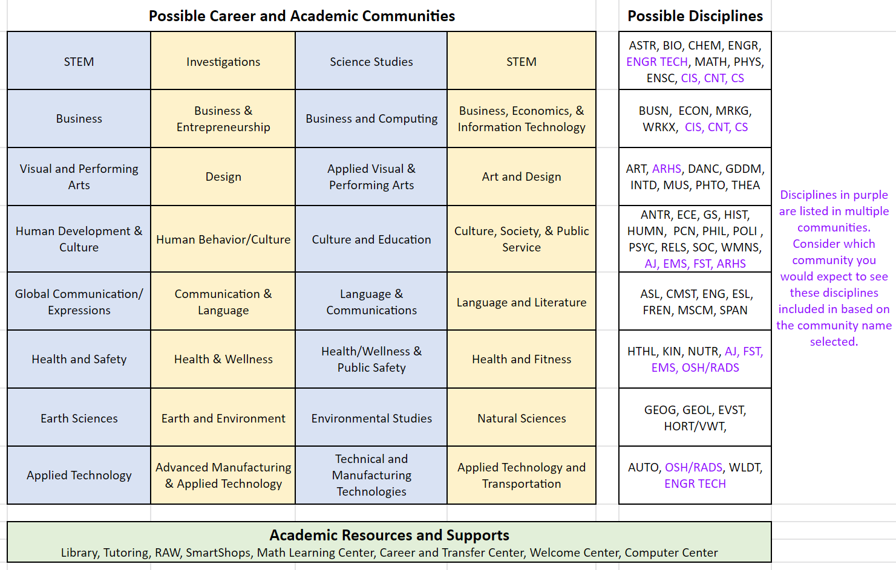
Possible Career and Academic Communities
Link to this information

Slide 16
Career and Academic Communities
Revisiting all of the things we have noticed today, let’s work on finalizing our own groupings.
Ideally we have two different versions:
Academic-Focused Named Communities
Career-Focused Named Communities
We will get student input in October on these!
Notes:
GROUP 1:
https://drive.google.com/file/d/1bKXsyg82VzushzTWfaSlMFhfdVNfIIXJ/view?usp=sharing
GROUP 2:
https://drive.google.com/file/d/1B3Vce5mwDjR_zJEEgwzkasy9gnUJduEi/view?usp=sharing
GROUP 3:
https://drive.google.com/file/d/1pKLu_nM8huhpR94wQSoyVBXF5lA9l35C/view?usp=sharing
GROUP 4:
https://drive.google.com/file/d/1V7hwP0LocaRhjK59MhwoJHGhEfRqfpXc/view?usp=sharing
GROUP 5:
https://drive.google.com/file/d/1p_ZMx0oMlNLSLcNQ9i7EOeMgnYIkn0tA/view?usp=sharing
GROUP 6:
https://drive.google.com/file/d/1GkxtLSJ2Dtz4wcQ8o_GZa04J6dxfETUx/view?usp=sharing

Slide 17
Next steps that still need to happen….
These communities need to be vetted by…
STUDENTS
Academic, Classified and Student Senates and College Council
Academic Divisions
Determination of how communities will be used to organize our Program Maps
Development of Career Exploration resources for independent exploration, onboarding activities, and further exploration of careers, maximize transfer and employment connections
Consideration for how these communities will collaborate, collect data and provide intentional targeted marketing & inreach
Work on these next steps will be supported by the CA Demonstration Project.
Notes:
Anyone?

Slide 18
Guided Pathways is an “US” thing!
Join us Friday, October 30th 1 - 3pm to finalize this work!
We are all involved in ensuring all of our students are successful in achieving their academic and career goals. Our students are counting on us to reduce the equity gap.
Do you have a SUGGESTION for us about something that can make a real difference for our students? Please share using our digital suggestion box!
Visit www.laspositascollege.edu/gp and Projects 2020/2021
Notes:
Anyone?

Slide 19
Guided Pathways
FLEX DAY
October 20, 2020
THANK YOU for being here as we work to improve our student experience!
Please fill out this FLEX Survey: https://forms.gle/XBCD6uo3QEDu3GQ48

Slide 20
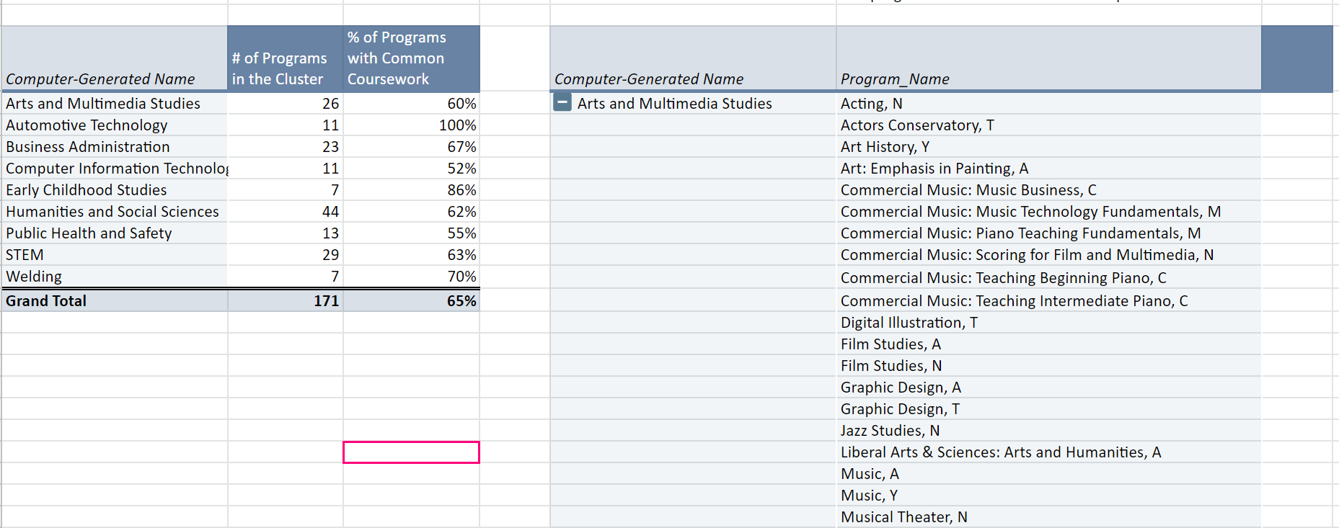
RP Group’s LPC meta-major report
This is groups our programs based on curriculum overlaps, not common career goals. Here is a link to the Report Summary.

