Slide 1
Accessible PowerPoints
By Wanda Butterly
Las Positas College

Slide 2
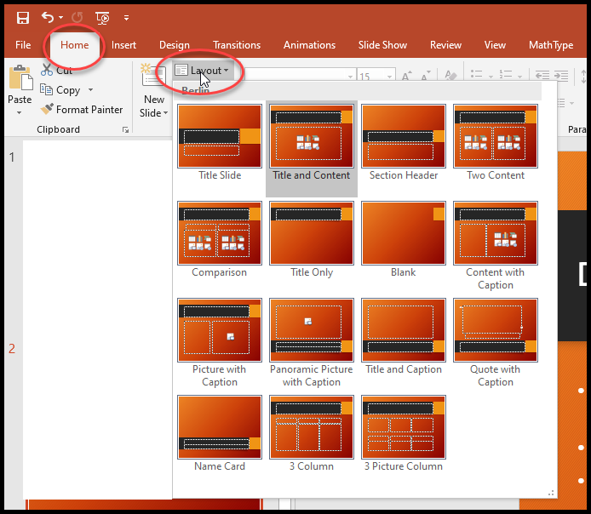
Design Basics
If you have no “feel” for design, use PowerPoint’s pre-made templates and slide layouts
Slide Layouts
Using slide layouts provided within PowerPoint will ensure that files have correctly structured headings and lists, and proper reading order.

Slide 3
Text
Always use the tools for formatting
*Keep your text short (chunck)
*Best font size 16-point or larger
*One of the most accessible and most widely available fonts is Arial; others include Calibri, Century Gothic, Helvetica, Tahoma and Verdana. All these *fonts are “sans serif” fonts.
*Use no more than two font styles
*DON’T UPPERCASE EVERYTHING
*Don’t underline text for emphasis

Slide 4
Hyperlinks
PowerPoint automatically creates a hyperlink when a user pastes a full URL onto a slide and presses Enter or Space. These may not make sense to screen reader users or others, so make the link text descriptive.
Select a hyperlink, right click, and select Edit Hyperlink or hit Ctrl + k.
Change the text in the Text to Display field to a more meaningful description.
http://ncdae.org/resources/cheatsheets/#msword

Slide 5
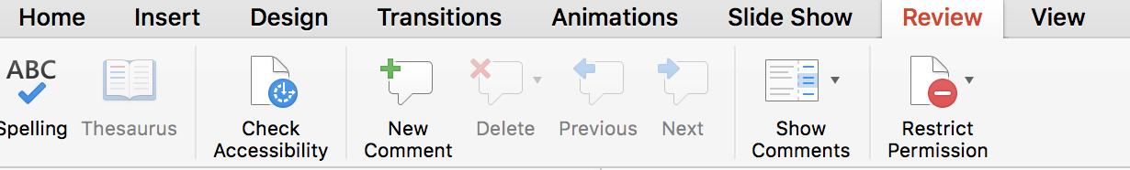
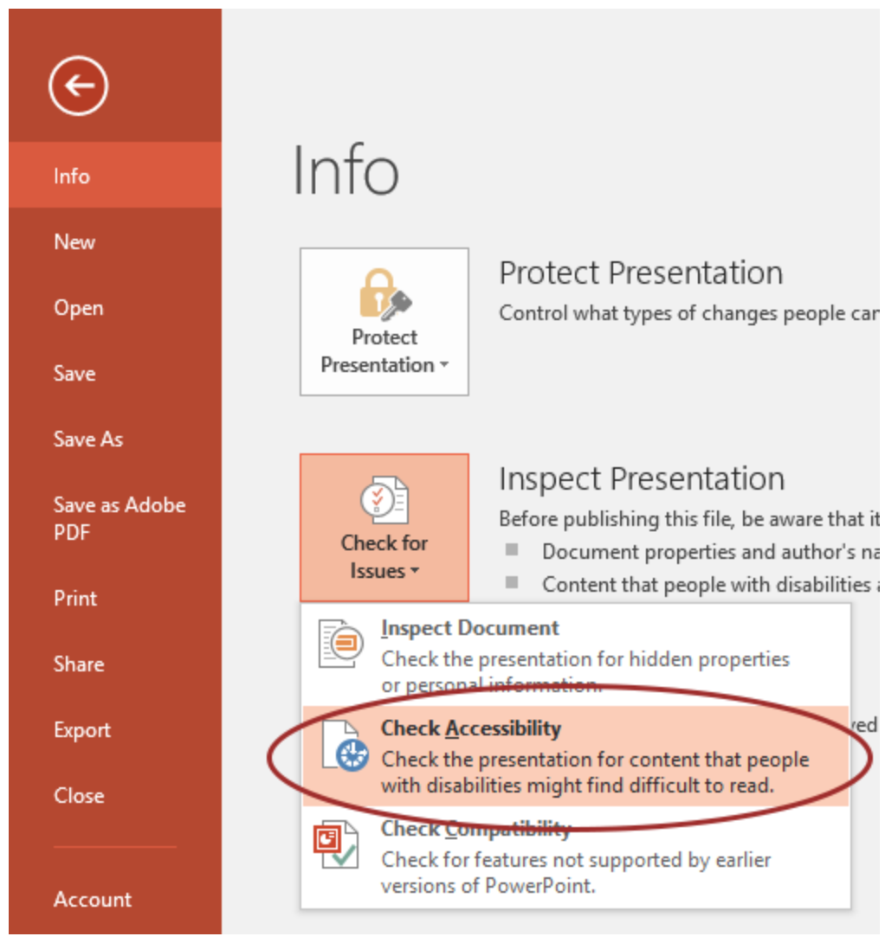
Accessibility Checker
Instructions for different versions of PPT
Office 365 (2017)
Office 2016

Slide 6


Images
Stick to 1 style with backgrounds, graphics, color schemes, and avoid animations
Choose art carefully (ie. Use clip art for lightheartedness)
Apply Alt Text to all images – Right click on the image
More info on Image Description Guidelines
This Photo by Unknown Author is licensed under CC BY-NC-ND

Slide 7
Tables
Keep tables simple
For Data only, not for layout
No nesting
No spacing
No merging
Easiest to Save as Picture, import picture, and add alt text
More info on Image Description Guidelines
 | 1975 | 1995 | 2015
Dow | 1.6% | 2.9% | 3.3%
S&P 500 | 0.4% | 1.5% | 4.7%
NASDAQ | 2.7% | 8.3% | 6.9%
Data Tables (Note from the National Center on Disability and Access to Education)
PowerPoint can style rows and columns so they appear as data tables, but there is no way to add content in a way that will be identified by a screen reader.
If your presentation contains more than the simplest tables, and if you have Adobe Acrobat, consider saving your presentation to PDF and adding the additional accessibility information in Acrobat Pro.

Slide 8
Charts
Convey data graphically when possible
Accompany charts and tables with bullet-point text that explains numbers
Easiest to Save as Picture, import picture, and add alt text
More info on Image Description Guidelines

Slide 9
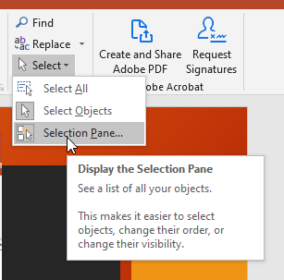
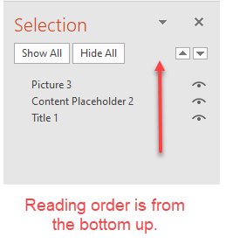
Reading Order
Reviewing this panel can help ensure the content on the slides is:
Logically sequenced
The reading order is appropriate for any user.

Slide 10
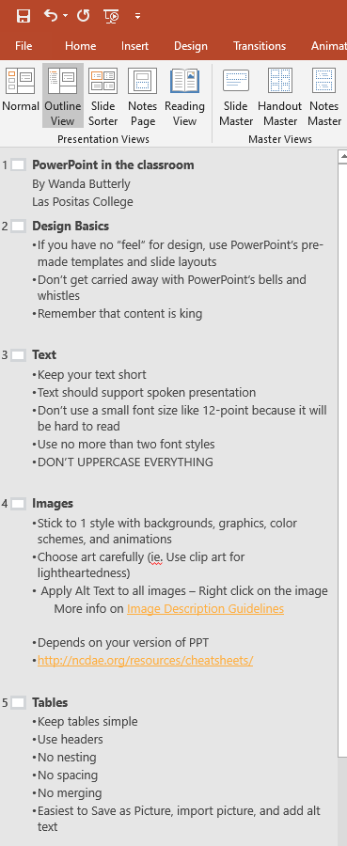
Outline View
Reviewing this panel can help ensure the content on the slides is:
Logically sequenced
The reading order is appropriate for any user.

