Slide 1
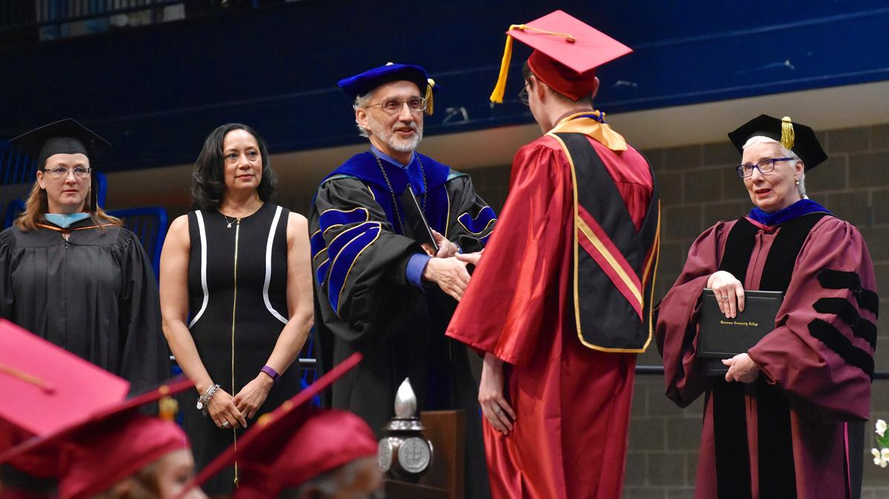
Embracing the Change(s) of Distanced Education:
EDUCATORS POSITIONED TO EXCEL
Todd Steffan
Evelyn Andews
Dr. Miatta R. Snetter, Psy.D.
OCTOBER 19, 2020

Slide 2
OBJECTIVES:
Student Veterans and Distanced Learning
What’s Working: Asking the “Tough Questions” with a Unique Population
Tools for Retention and Academic Empowerment and Success during a Pandemic

Slide 3

EXCELLING…
HOW DO I BEST HELP MY STUDENTS?

Slide 4

I NEVER WANTED TO TEACH LIKE THIS
ARE MY STUDENTS REALLY LEARNING
Keeping students engaged
Technology Interference(s)
Simultaneous Family &
Work Life
VIRTUAL FATIGUE…

Slide 5
I KEEP REACHING OUT AND I DON’T GET ANY RESPONSE…
WHAT DO I DO?

Slide 6
DO I LET MY STUDENTS “SLIDE” BECAUSE IT’S A DIFFICULT TIME OR DO I MAINTAIN THE STANDARD?
WHAT’S THE BALANCE?

Slide 7
RETENTION
ACADEMIC EMPOWERMENT
ACADEMIC SUCCESS

Slide 8

“VETERANS FIRST”???
What does this mean?
Going above and beyond
Balancing the Standard
  Observing my own assumptions
  Not “excusing” behaviors, but empathizing
  How to identify “Exceptions to the RULES…”
  (“I’m not looking for a hand-out, but a hand-up)
Acknowledging the veteran “cultural mindset”
Everyone loves to hear their “name”

Slide 9

(1)
(2)
Ideas for Veteran RETENTION, EMPOWERMENT, and SUCCESS
(3)
(4)
(5)

Slide 10

QUESTIONS
COMMENTS
FINAL THOUGHTS
THANK YOU!

Slide 11

CONGRADULATIONS!
BY ATTENDING TODAY, YOU ARE ELIGIBLE FOR A 50% OFF DISCOUNT TO THE 3rd ANNUAL 2.2 (VIRTUAL) CHALLENGE WALK FOR 22 VETS
REGISTER ONLINE:
https://runsignup.com/Race/CA/Livermore/22for22WalkforVets
Or go to LasPositasCollege.edu/Veterans
Discount Code: studentvet22
QUESTIONS: LPCVeteransFirst@laspositascollege.edu

