Slide 1
Effective Design and Implementation of SAOs
Approaching SAO work as a research process
Michael Schwarz & Robin Rehagen
FLEX Day Fall 2021

Slide 2
Defining Acronyms
Used to assess courses in all disciplines:
SLO: Student Learning Outcome
CSLO: Course SLO (each course has these)
PSLO: Program SLO (each degree and certificate has these)
Used to assess Student Service Areas (such as Counseling, Library, Veteran’s Center, etc.)
SAO: Student Area Outcome

Slide 3
Why do we assess learning outcomes?
LPC Mission
Las Positas College provides an inclusive, learning-centered, equity-focused environment that offers educational opportunities and support for completion of students’ transfer, degree, and career-technical goals while promoting lifelong learning.
We report out to ACCJC in our accreditation cycle how we are accomplishing our Mission. The accreditation team then evaluates how well we are doing this.
The central mission of Las Positas College is its commitment to student learning. To further that mission, the college recognizes the importance of evaluating progress towards that goal.
We do this at the course, program, and institutional level.
We do this with the student services, which are vital in supporting our students.

Slide 4
Why do we assess SAOs?
Measuring quantitative SAO data facilitates objective analysis of student service areas, and moves us away from “gut feelings” based on anecdotal information and subjective perceptions.
Results from SAO assessment can be used to modify or improve the Student Service Area to better accomplish the desired outcomes.

Slide 5
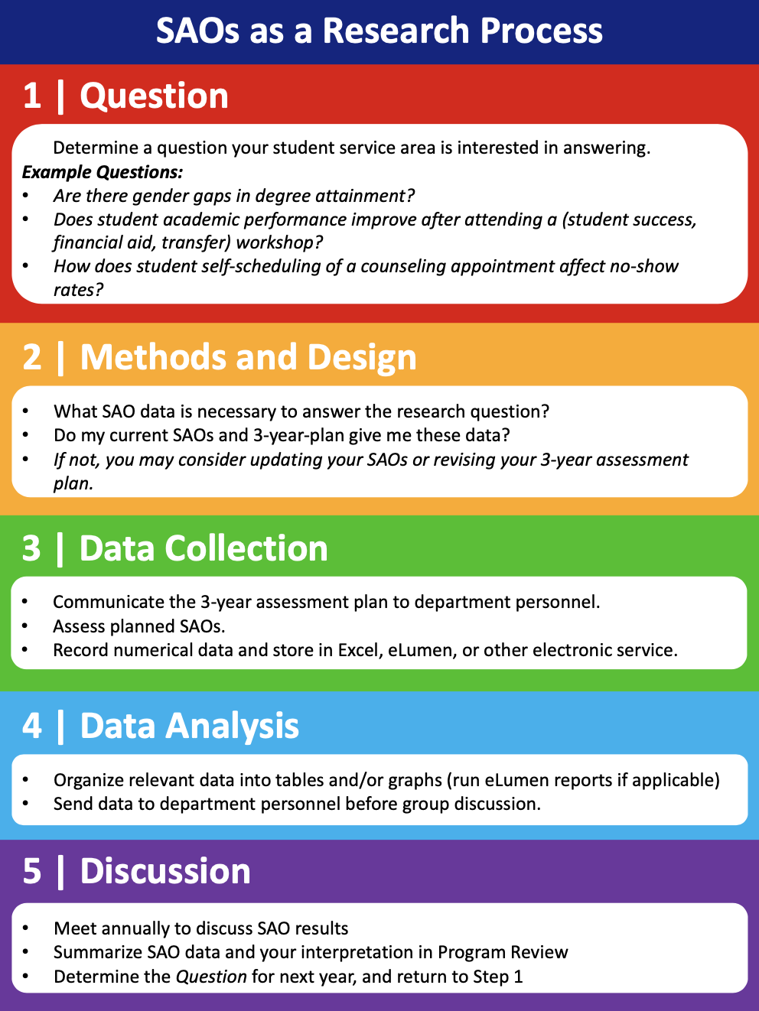
The Big Picture
The process of collecting useful SAO data is like running a research experiment.
As SAO coordinators, we help frame the question, design the experiment, facilitate data collection and analysis, and lead the discussion of the results.
Each step of the process has its own unique challenges. Today we will cover all steps of the process and try to address common challenges.

Slide 6
The Big Picture
All of the details of this process (including how to use eLumen) are available in the SLO Coordinator Handbook, which can be found on the LPC SLO Website.

Slide 7
1 | Developing a Question
The first step in collecting useful data is to determine a question your student service area is interested in answering.
Here are some example questions:
Is there a different in student experiences with counselors between online and face-to-face?
Are there gender gaps in degree attainment?
Does student academic performance improve after attending a (student success, financial aid, transfer) workshop?
How does student self-scheduling of a counseling appointment affect no-show rates?

Slide 8
1 | Developing a Question
Activity: Consider the student services offered by your department. Brainstorm a list of possible questions you might be interested in getting data for.
Ideas to consider when developing questions:
Which areas of the student support that you provide are not working as well as desired? What factors might affect their efficacy?
Are there any places in your student service area where there may be equity issues?
Has the transition to increased use of online resources affected student interaction with your service area?
Notes:
Break into breakout rooms by discipline, or perhaps have people work silently for 5 minutes?
Or you can start with silent work, and then say we will break out into rooms to share ideas for questions.
Then have people propose questions they particularly liked to the Main Session

Slide 9
1 | Developing a Question
Ideally, SAO coordinators would discuss possible questions with department personnel and come to a consensus.
At the very least, the question should be communicated to the relevant personnel in your service area prior to assessing the SAO.

Slide 10
2 | Methods and Design
Once you have decided on your question, the next step is to determine what SAO data is necessary to answer the question.
What data is necessary to answer my question?
What method should I use to obtain the necessary data? (IR data, survey, interviews, etc.)
How often should I assess the SAOs to get a large enough sample of students?
Does my current 3-year-plan give me the data I need?
  If not, you may consider updating your SAOs or revising your 3-year assessment plan.

Slide 11
3 | Data Collection
The SAO Coordinator should:
Collect the relevant data during the appropriate time frame
Work with department personnel to facilitate data collection (when necessary)
Record SAO data and store electronically using Excel, eLumen, or other digital service of choice
Notes:
Describe my emails at the beginning/end of the semester.
I usually send an email at the beginning of the semester saying which SLOs we are focusing on, why, and provide links to the 3 year plan, and I give them a document I wrote up with possible assessment options for each type of SLO for each course.

Slide 12
4 | Data Analysis
Before the student service area can meet together to discuss SAO results, the SAO coordinator should:
Organize the relevant data into relevant tables and/or graphs, using Excel, eLumen, or other digital software
  Sometimes it is helpful to convey your results in a few plots on Powerpoint Slides
  The more easily readable your visuals, the more likely your colleagues will look at them, and the more powerful the results will be
Send the data to department personnel before the group discussion

Slide 13
5 | Discussion
Annually (or once per semester) each student service area should meet to discuss the SAO results. During the meeting:
The SAO coordinator presents the data and moderates the discussion.
  End goal of discussion: How can faculty use the results to improve the student service area?
All department personnel should attend (if possible)
The group should determine how they wish to proceed with SAOs in the future
  Will we change to a new research question?
  Will we stick with our current 3-year plan or change it?

Slide 14
5 | Discussion
The purpose of SAOs is to provide data to answer your research question.
When you meet as a group to discuss SAO results, it is important to frame your discussion around the data itself. (i.e., don’t ignore the graphs and jump to a department discussion based on anecdotes or personal experience.)
Notes:
Note: framing the discussion around the numerical data does not have to mean running a statistical analysis of the data,
Rather, if can be discussing the qualitative trends in the data, which can be further supported by your experiences in the classroom

Slide 15
5 | Discussion
If you find that the graphs of numerical SAO data are not useful for answering your research question, then you should figure out how to improve the design or implementation of your research process, or change your research question. Some possibilities to consider:
Can the SAO wording be improved or clarified?
Is the assessment we designed giving us the information we want from it?
Are there outside factors influencing the data in such a way that we can’t tease out the information we want?

Slide 16
5 | Discussion
After the department discussion, the SAO Coordinator should summarize SAO data, findings, and resultant changes annually in Program Review. This serves as documentation for the college’s accreditation process.

Slide 17
Questions?

Slide 18
FLEX Day Feedback Survey
Please fill out this survey after the session ends:
https://docs.google.com/forms/d/e/1FAIpQLSd4CXo6RK0NQ1-17H7j6Y7XNpNf-oBRi7E8scS_evts6qHI-Q/viewform

