Slide 1
Mission: Lower Textbook Costs
OER at LPC
Notes:
Optional Survey as we begin: https://laspositascollege.libwizard.com/f/LPCOERsurvey2021

Slide 2
Agenda
Questions + Outro
Katie Eagan
Welcome
Katie Eagan
Nadiyah Taylor
Kali Rippel
OER + ECE
Nadiyah Taylor
OER + English
Maureen O’Herin
OER + Math
Jennie Graham
OER Basics
Kali Rippel
OER + Other CCCs
Kat King

Slide 3
OER Basics
Kali Rippel, New OER Liaison
**Huge Shoutout to previous OER Liaison, Lyndale Garner**

Slide 4
OER
Vocabulary
OER = Oen Educational Resources
Teaching, learning, and research materials that are either (a) in the public domain or (b) licensed in a manner that provides everyone with free and perpetual permission to engage.
ZTC = Zero Textbook Cost
Courses with no textbook-related costs, including access fees for online materials. Exact definition at LPC is TBD.
LTC = Low Textbook Cost
Courses with “low” textbook-related costs, including access fees for online materials. Exact definition at LPC is TBD.

Slide 5
Why OER?
Textbook costs can be a barrier ”with a disproportionately negative effect among racial/ethnic minorities, low-income students, and first-generation college students” (Equity & OER).
OER encourages student success ”decrease non-tuition costs, while simultaneously increasing student access, academic performance, and time-to-graduation rates (Jenkins, et al., 2020, 9).

Slide 6
Updates
More and more courses with ZTC + LTC options
Bookstore Help: will list OER books as course textbooks (60+ courses listed F21), bookstore can provide optional low-cost printed copies, option to search for OER using Follett Discover.
Library Resources: eBooks/items with unlimited user access can be used as a ZTC option.

Slide 7
Goals
More courses with ZTC/LTC through OER or other resources Interested? Reach out!.
ZTC + LTC Designations in the Course Schedule (SB 1359): Resolutions coming. Thoughts on what low cost should mean?
ZTC + LTC Degrees/Certificates
Incentives ($$) for creating OER Textbooks

Slide 8
Biggest Barriers to OER Adoption= Access & Time, but times are changing...
Notes:
Previous LPC Survey results from a survey sent out by Lyndale and I. ...as evidenced by the next presenters! Optional Survey for teaching faculty: https://laspositascollege.libwizard.com/f/LPCOERsurvey2021

Slide 9
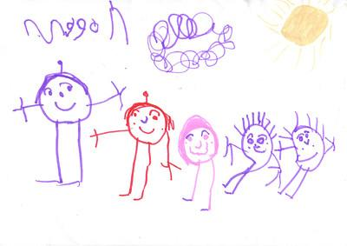
OER + ECE
Nadiyah Taylor
Image: Flickr
Years of collective work
LibreText - a resource across fields
Social Science - Early Childhood Education
Students can print OER texts for a low-cost if that meets their learning styles - - www.lulu.com
Notes:
Several years of work among OER workgroup - led by the college of the canyons; provided information to faculty on different licensing types, what the codes mean, how to find open-source material such as images, videos, etc. Shared work with ECE people in other states (florida, colorado). Can be updated to better fit your content.

Slide 10





OER + Math
Jennie Graham

Slide 11
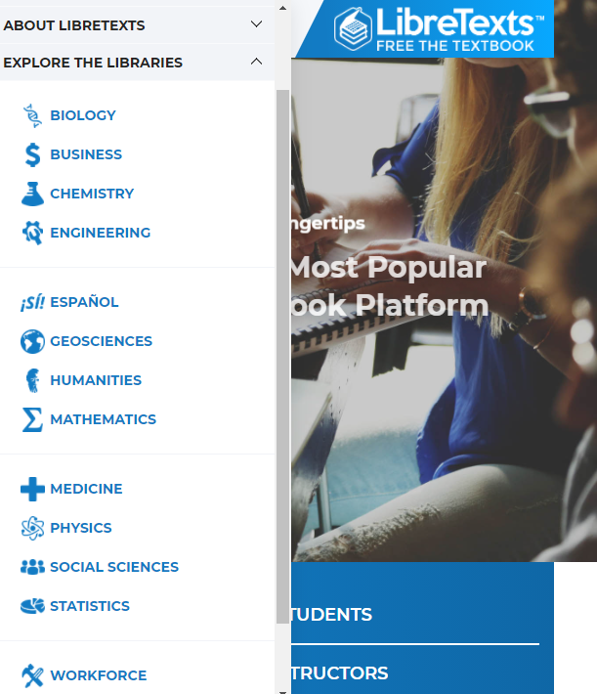
“The LibreTexts mission is to unite students, faculty and scholars in a cooperative effort to develop an easy-to-use online platform for the construction, customization, and dissemination of open educational resources (OER) to reduce the burdens of unreasonable textbook costs to our students and society.”
LibreText, Mission and Values Statement

Slide 12
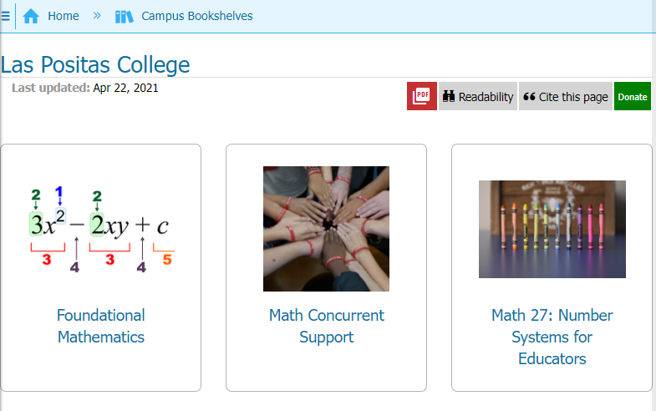
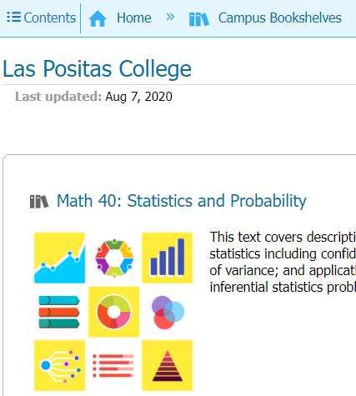
LPC: Campus Bookshelves
Ability to adjust existing OER textbook through
  Editing pages
  Adding pages
  Mixing content from different books (same/different subjects).
Free = 10 books per campus across all library campus hubs.
Central campus hub is possible with unlimits textbooks if part of the LibreText Consortium (payment of $500/year).

Slide 13
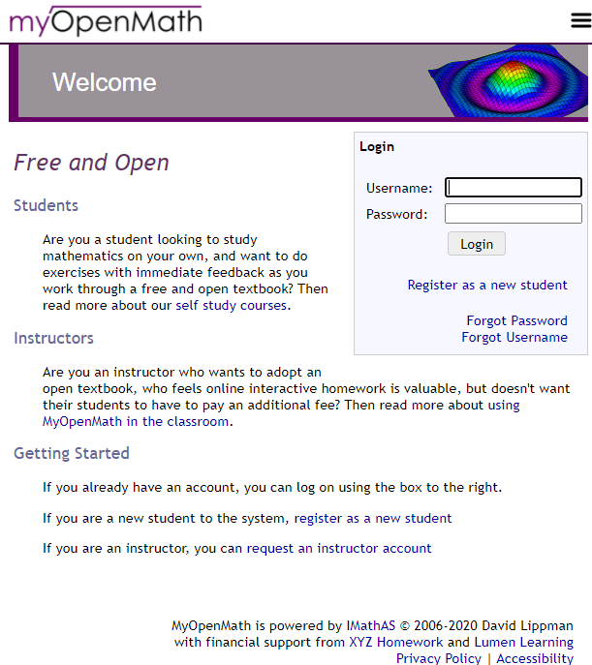
“MyOpenMath is an online course management and assessment system for mathematics and other quantitative fields. MyOpenMath’s focus is providing rich algorithmically generated assessment to support the use of free, open textbooks like the ones listed on OpenTextBookStore.com.
MyOpenMath is a collaborative community of users. MyOpenMath.com provides managed hosting of the open source IMathAS online assessment software. Questions and pre-built courses are all created by faculty in the user community and shared with others in the spirit of openness. Experienced users provide peer-to-peer support through discussion forums.
MyOpenMath.com is operated by the non-profit organization MyOpenMath.”
- MyOpenMath, About Us

Slide 14
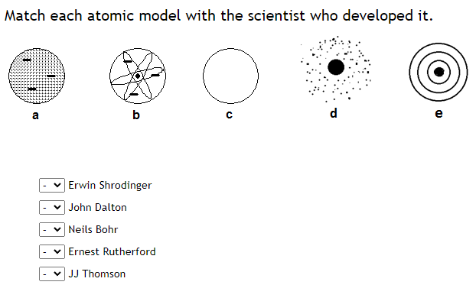
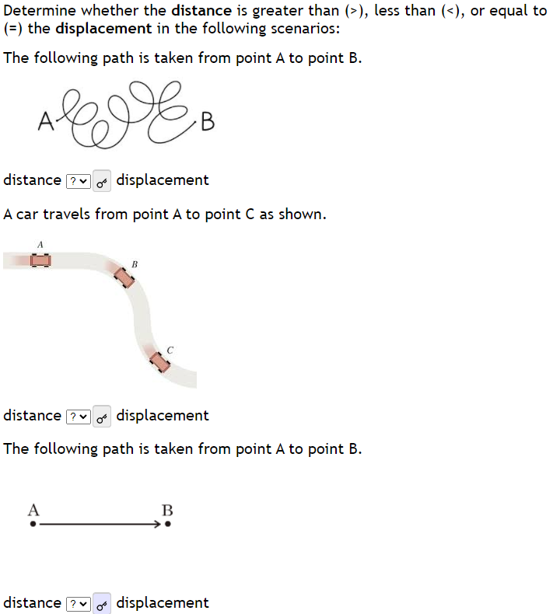
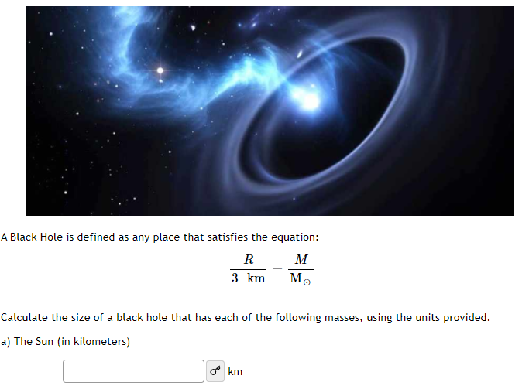
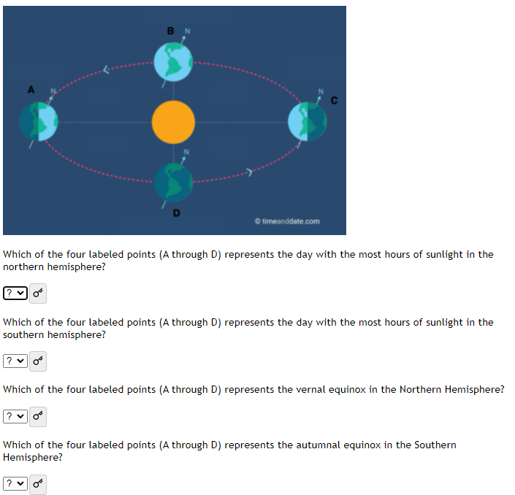
My Open Math
Publishers charge $$$ for these types of platforms.
The caliber of questions/student supports in MyOpenMath have nearly reached publisher level.
Questions are easily created or edited to meet your needs.
Easy integration into Canvas.
Not just for math:
  Chemistry
  Physics
  Astronomy
  ...

Slide 15
Easy access to texts in the public domain with Project Gutenberg
Maureen O’Herin

Slide 16

Choose among free epub and Kindle eBooks, download them or read them online. The majority of the collection are older works for which U.S. copyright has expired.
Homepage:
  Project Gutenberg: Free eBooks
Frequently Asked Questions about Project Gutenberg
  https://www.gutenberg.org/help/faq.html

Slide 17



Easy Search
Project Gutenberg Search
Title: Jane Eyre
Subject: The Peloponnesian War
Author: Jacob A. Riis
Subject: Slave narratives
Theme: feminism

Slide 18
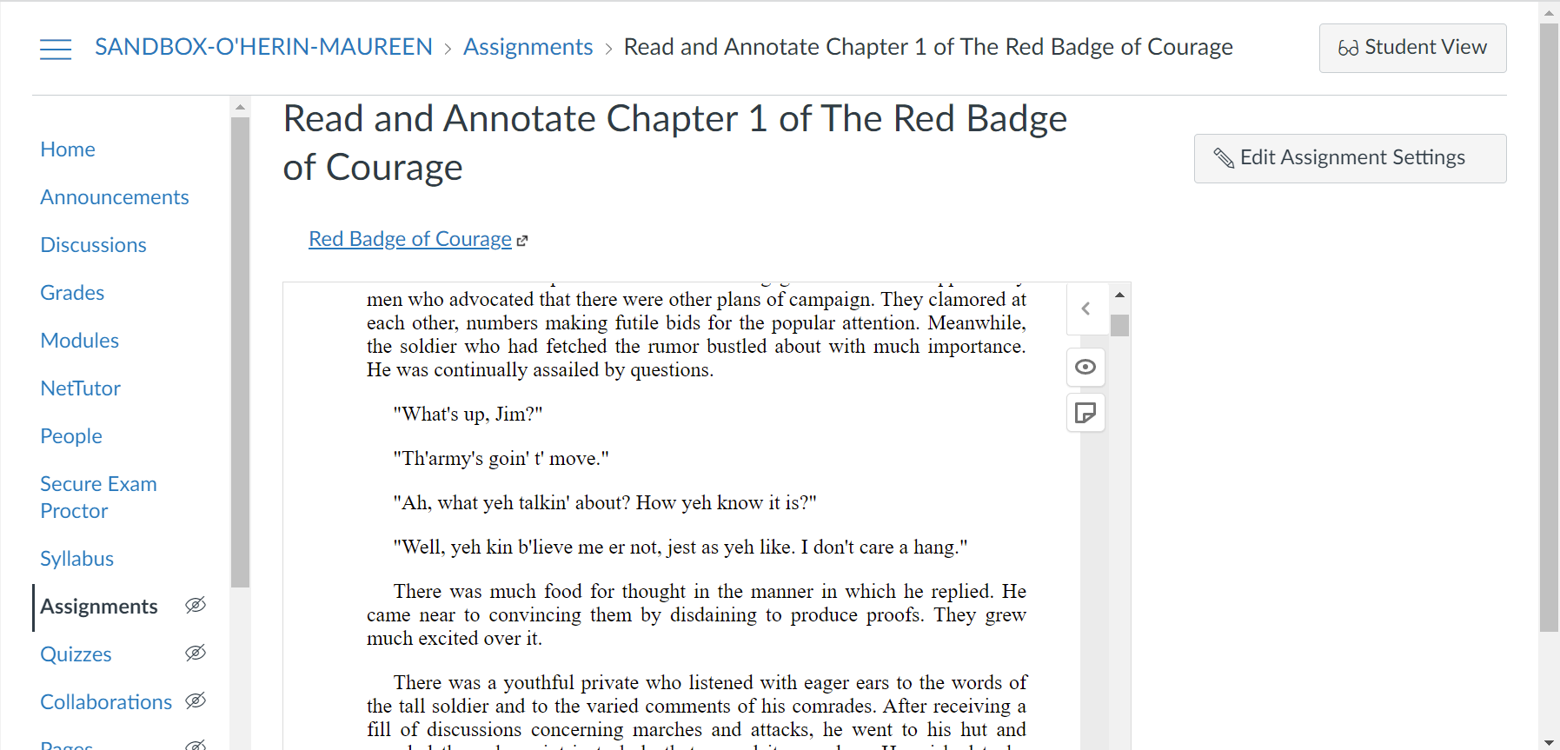
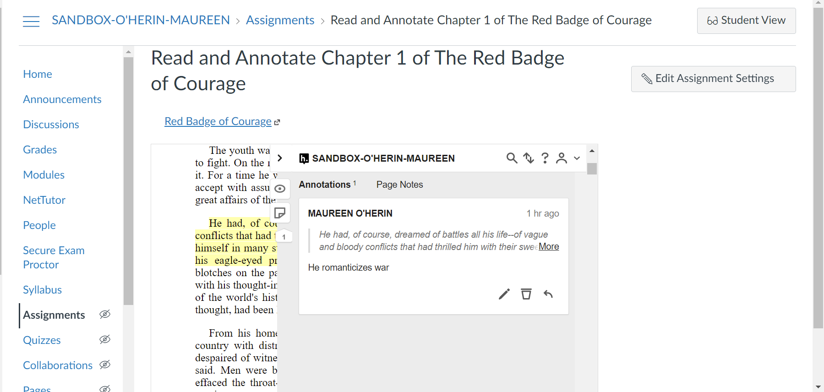
Add the link to your Canvas assignment page or use Hypothesis for annotations
Canvas Assignment Page

Slide 19
OER + Other CCCs
Kat King

Slide 20
Contra Costa Community College District
LibreText Grant 2019-21
  Districtwide grant funding funding OER conversions through LibreText
OER@DVC Grant 2021-22
  Using Higher Education Emergency Relief Funding (HEERF) and overseen by OER Committee
  38 faculty converting 93 sections to ZTC
  Projected to reach over 2,900 students and save $290,000 per semester
OER Symposium
  Next up: February 11, 2022 - online (will send invite out!)

Slide 21
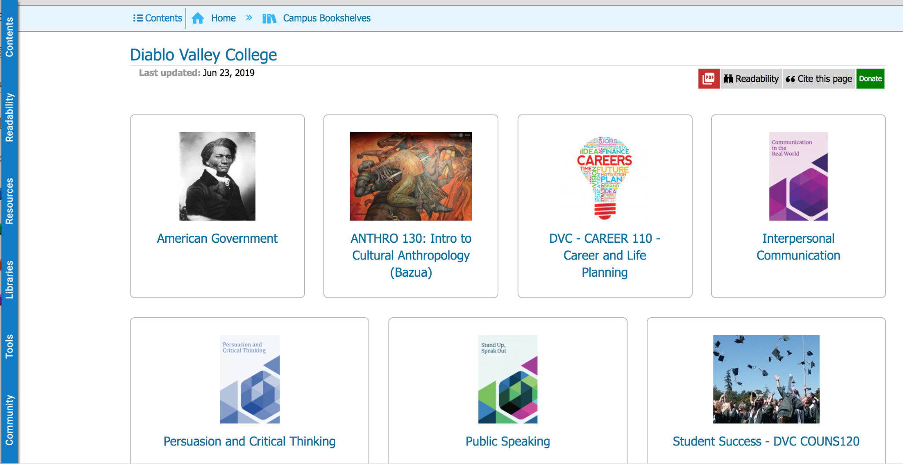
Sample Projects: LibreText

Slide 22

California Virtual College
https://cvc.edu/open-educational-resources/

Slide 23
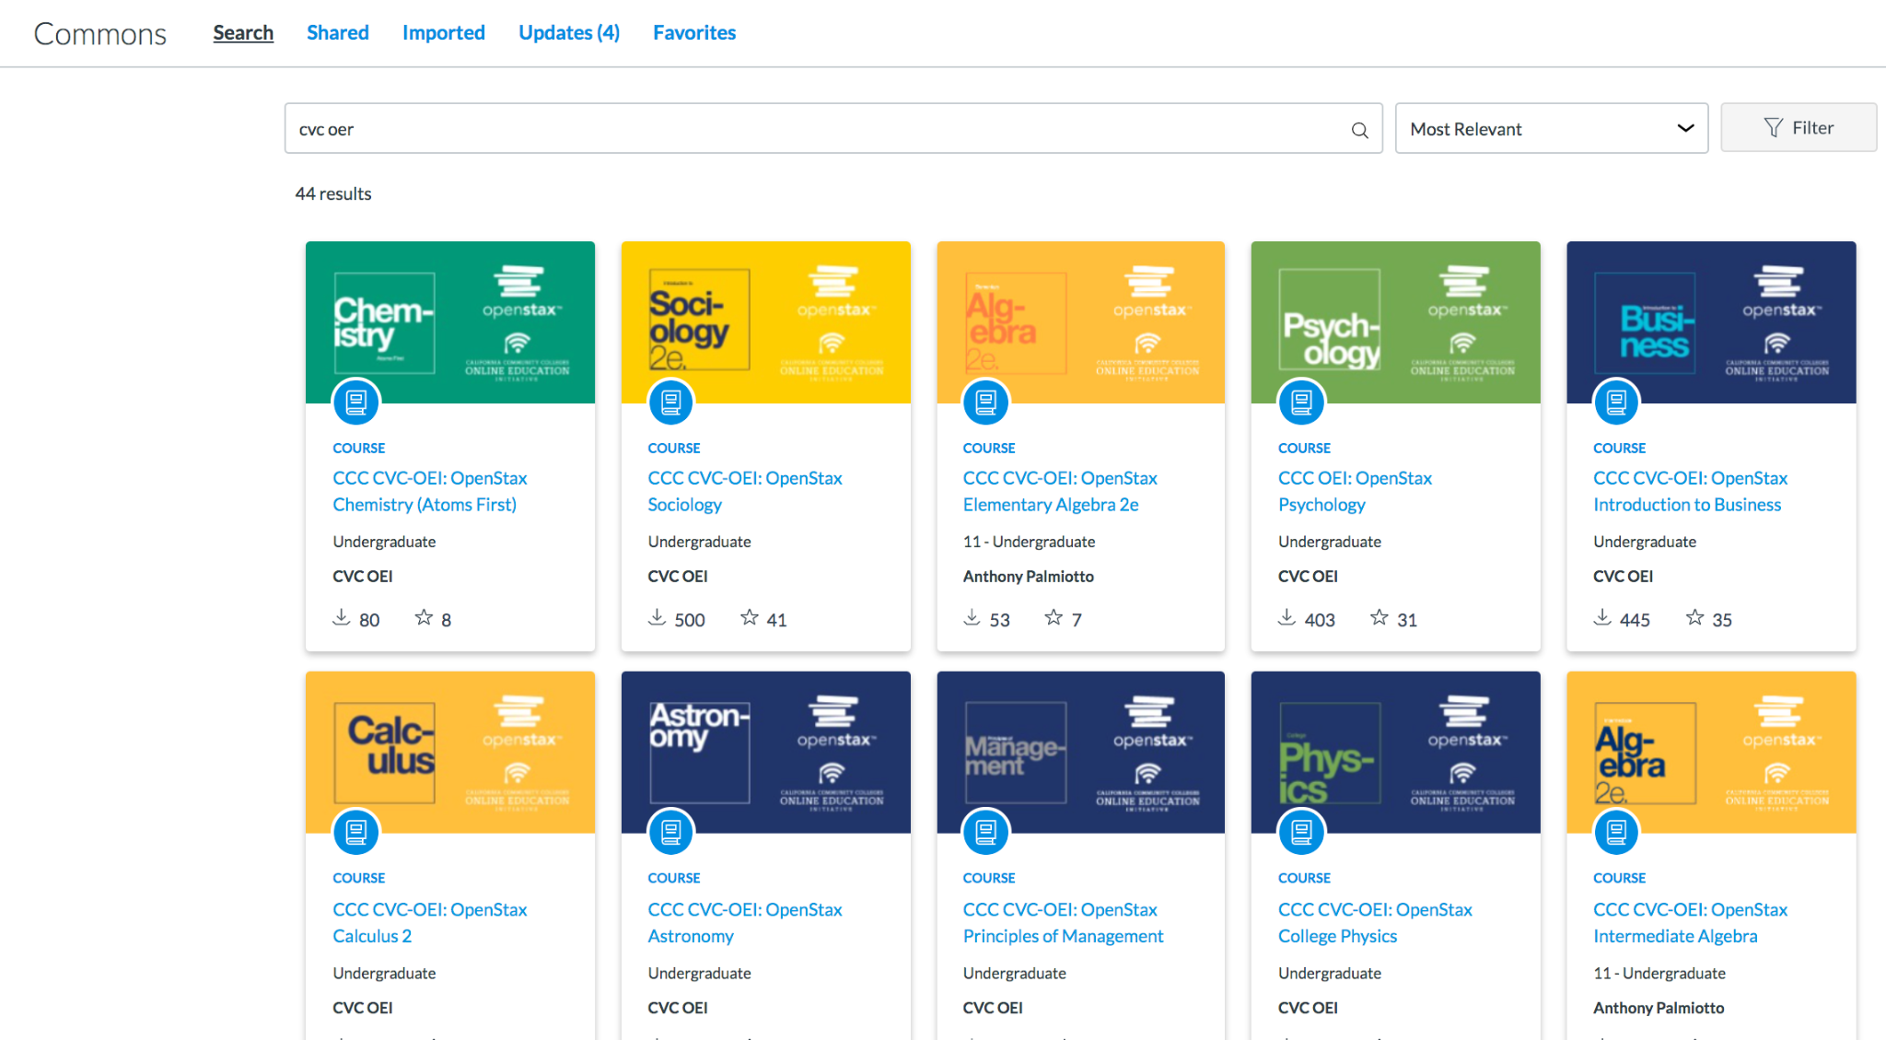
CVC OER Courses in Commons
Click Commons from global nav in Canvas
Search CVC OER
View over 40 adaptable OER courses!

Slide 24
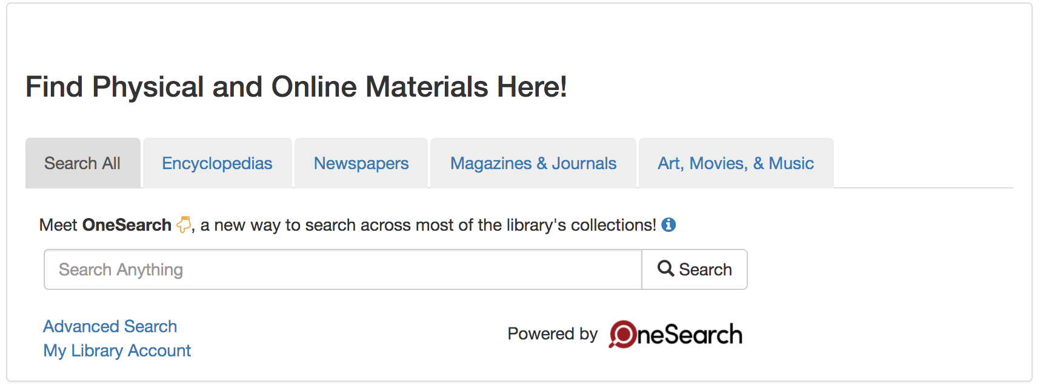
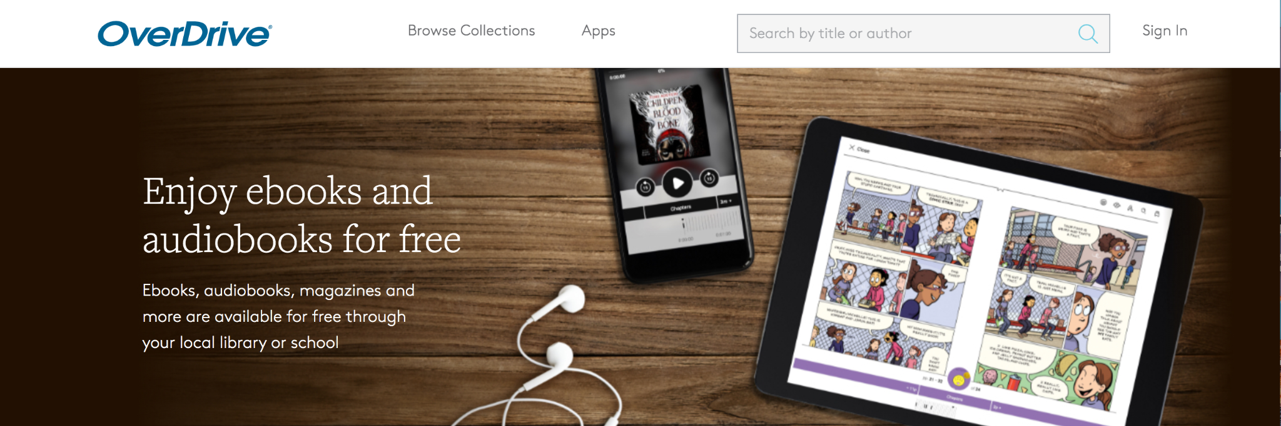
Don’t forget LPC Library Resources!

Slide 25
Questions + Outro
Katie Eagan

Slide 26
Thank you & Please Complete the Survey!
https://docs.google.com/forms/d/e/1FAIpQLSd4CXo6RK0NQ1-17H7j6Y7XNpNf-oBRi7E8scS_evts6qHI-Q/viewform

