Slide 1
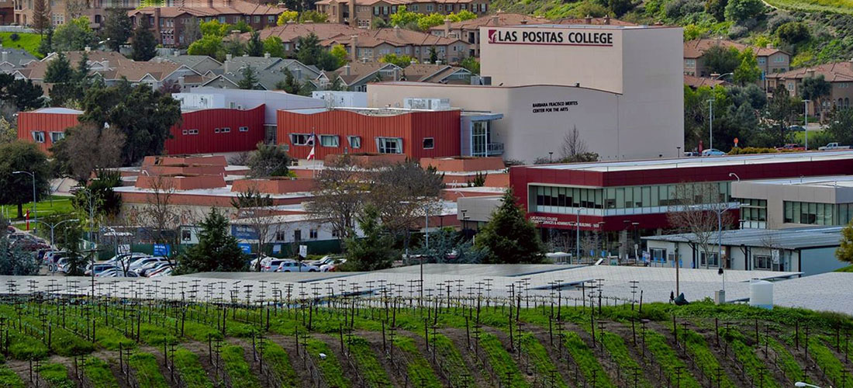
Creating a Welcoming Directory Message
to our Community
FLEX DAY, FALL 2022

Slide 2
"Decades of research supports that students who feel connected to their college are more likely to complete and succeed in their courses, persist from semester to semester, and achieve their educational goals."
- Caring Campus

Slide 3
Agenda
Welcome!
What is a welcoming directory message?
What things could include in my message?
Create a welcoming directory
Next steps
  Post your message! We can or you can attend one of Tim’s Omni trainings and do it yourself!
  Update your profile photo!
Outcomes
Create a welcoming directory message.

Slide 4

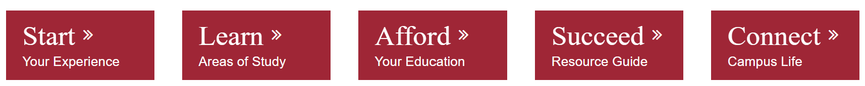

Notes:
Please post in the chat this link: http://www.laspositascollege.edu/gp/phaseoneactivities.php

Slide 5
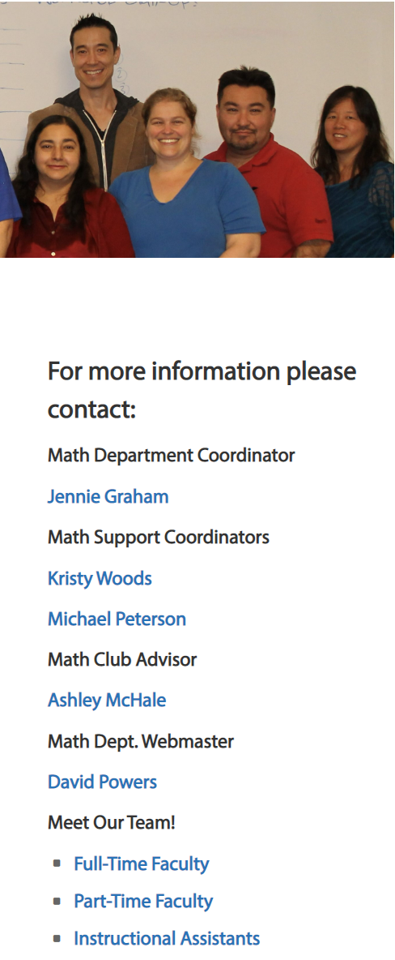
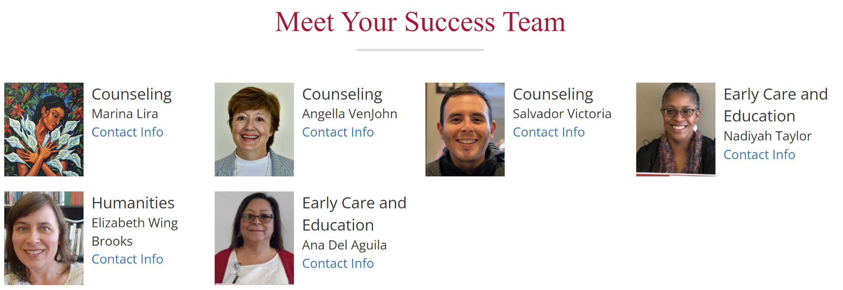

Our LPC websites frequently will link
to our Directory Page!

Slide 6
What is a welcoming Directory message?
A welcoming message is one that…
Notes:
Ideas (not limited to:)
provides information how to get in touch with you
invites the reader to communicate with you
includes a statement of best wishes or support
is personable and relatable

Slide 7
What can I include in my message?
Notes:
Ideas (not limited to:)
Academic & Career Pathway (if applicable)
Contact times and locations with links if HyFlex or online
About yourself!
Preferred name, pronouns
What do you do at the college, what you enjoy about it.
Interests, previous experiences, or work experience
Belonging statement

Slide 8
Belonging Statement
We know students who feel connected to their college are more likely to complete and succeed. Including a diversity or inclusion statement in your welcome shows students that you value and respect differences and are aware of inequities and challenges that different students face.
“Is your statement inclusive of different types of diversity, including, but not limited to: race, gender, ethnicity, sexual orientation, age, socioeconomic status, religion, and disability? Which campus resources would you like to direct your students to for further support?” - Brown University

Slide 9
Belonging Statement
Example: “I want to stress that ALL students are welcome in my class, regardless of national origin, religious affiliation, ethnicity, gender, sexual orientation, age, physical or mental challenges, socioeconomic status, race, or cultural background. Together we can work together to create an environment that supports growth, enjoyment for learning, embraces mistakes and fosters kindness and mutual respect. Our differences afford us the greatest opportunities for learning and collaboration.”

Slide 10
Create a welcoming message
Please join https://tinyurl.com/FLEXWDM and place your name next to the page you want to use to create your welcoming message.
Make sure to indicate if you have completed your message and want us to update it for you or if you intend to complete an Omni training with Tim Druely.
Counseling Faculty - Optional breakout session to collaborate on a welcoming message template and communication plan for how students should contact and make a counseling appointment!
Notes:
Google Doc link: https://tinyurl.com/FLEXWDM

Slide 11

Directory Profile Picture
Do you have a profile picture?
Do you want or need a new one?
Get a fabulous Headshot with one of our photography students!
Schedule (tentative) Studio #709
Th. 10/20, 12-4PM Fri. 10/21, 12-3PM
Mon. 10/24, 12-3PM Tue. 10/25, 10-1PM
Wed. 10/26, 12-3PM Th. 10/27, 10-d1PM
Fri. 10/28, 12-3PM

Slide 12


THANK YOU for coming!
Please take a moment to provide feedback on the Session.
Notes:
Fall FLEX Survey Link
https://docs.google.com/forms/d/e/1FAIpQLSd4CXo6RK0NQ1-17H7j6Y7XNpNf-oBRi7E8scS_evts6qHI-Q/viewform

Slide 13
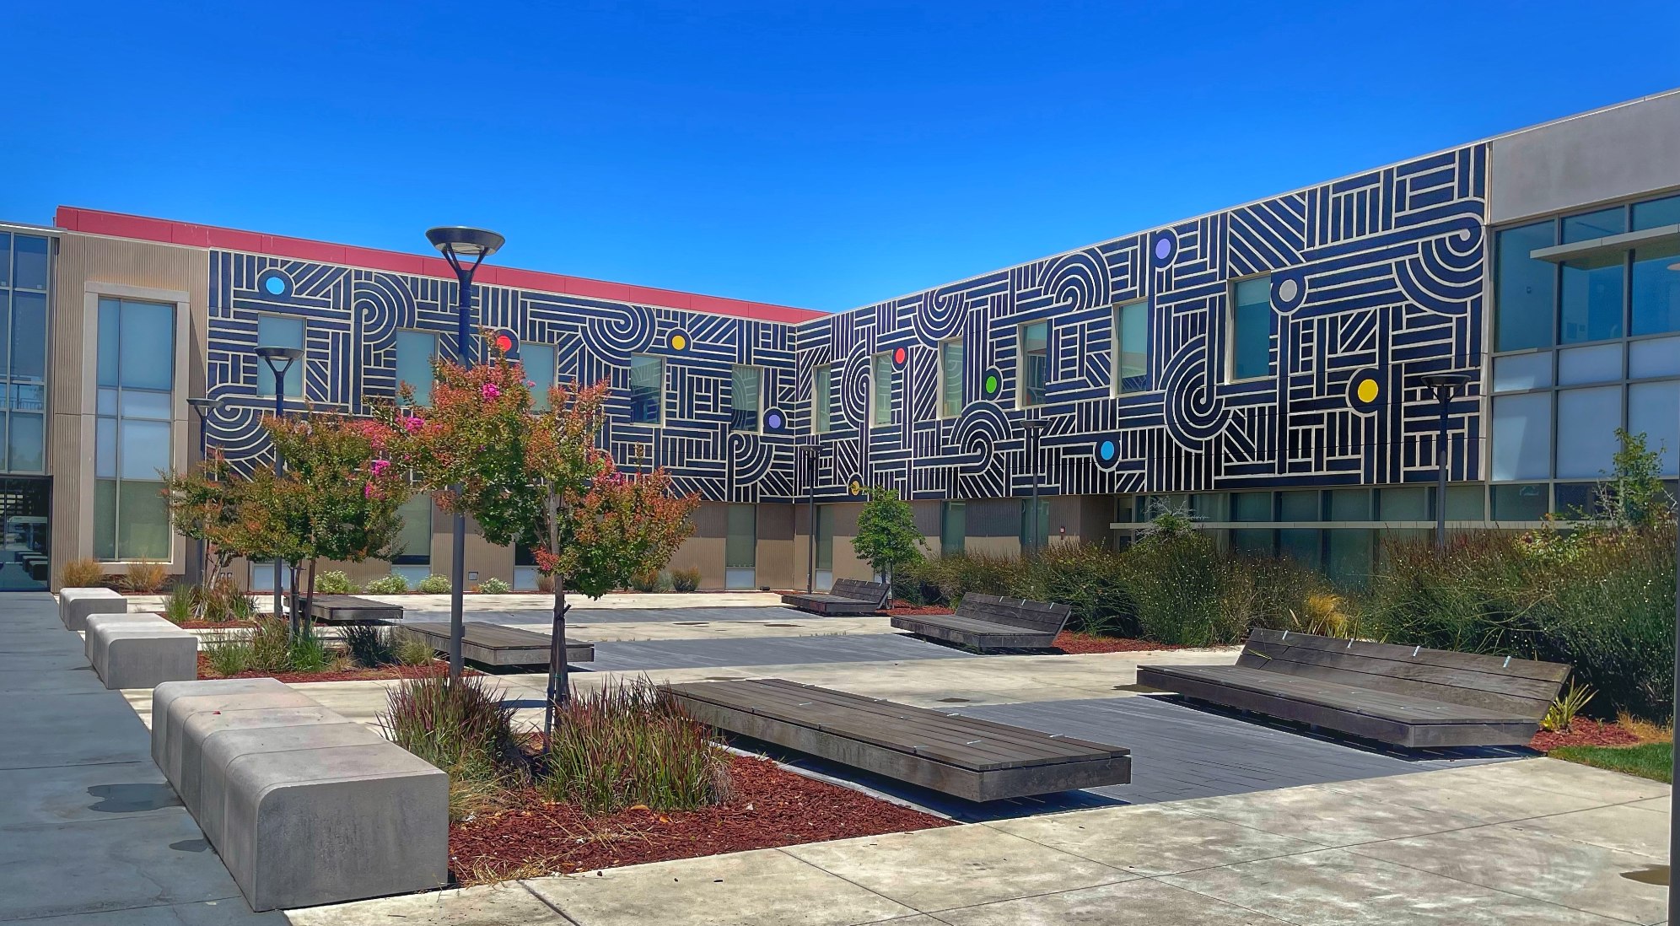
Supporting Students at LPC
IT IS AN “US” THING

