Slide 1
Hypothesis with JSTOR
Increasing students’ interaction while building their reading skills
LPC Fall 2022 Flex Day
Katie Eagan, with the help of the folks at

Slide 2
Do you expect your students to read articles on JSTOR or other databases?
If so, how do you know they are reading them?
What help do you typically provide?
What help do they seek out?
Do they have trouble understanding these articles?
Do they accidentally plagiarize their ideas?
Do they give up and purchase or otherwise find an essay that cites articles like these?

Slide 3
Breaking down the challenge
Journal articles are written for other academics and not for undergraduates. This leads to student struggles:
Challenging vocabulary and sentence structure
Lack of schema, or background knowledge
Lack of prior initiation into the typical “academic moves” that authors make, for example reviewing the literature in the field and detailing the methodology before they even get to the argument and evidence!
Lack of a note-taking strategy
Inconvenience and cost of printing and annotating articles
Lack of practice with reading with a guiding question

Slide 4
Promoting Student Engagement While Reading
Hypothesis allows students to build the reading skills needed for these texts with their professors and fellow students in a supportive, collaborative learning environment.
Before students start individual research, consider selecting a journal article that relates to the course material or the specific research project and model how to read and annotate it.
Armed with this schema and information about the academic moves that academics make, students can read this article together.
Provide points and feedback in the SpeedGrader. You can choose whether to make it private or “public” to the class.

Slide 5
Annotation Ideas
You can leave background information, word definitions, paraphrases of complex ideas, links to other sites, and images in annotations that the students can review prior to or while reading
You can flag the various sections of the article and comment on what the author is doing in that section
Students can be assigned to identify and paraphrase main ideas, make connections, post their own links and images and definitions
Students can learn from their fellow students’ annotations
Students can be encouraged to support and extend each other’s learning in responses.
Students can ask questions that other students or you can answer

Slide 6
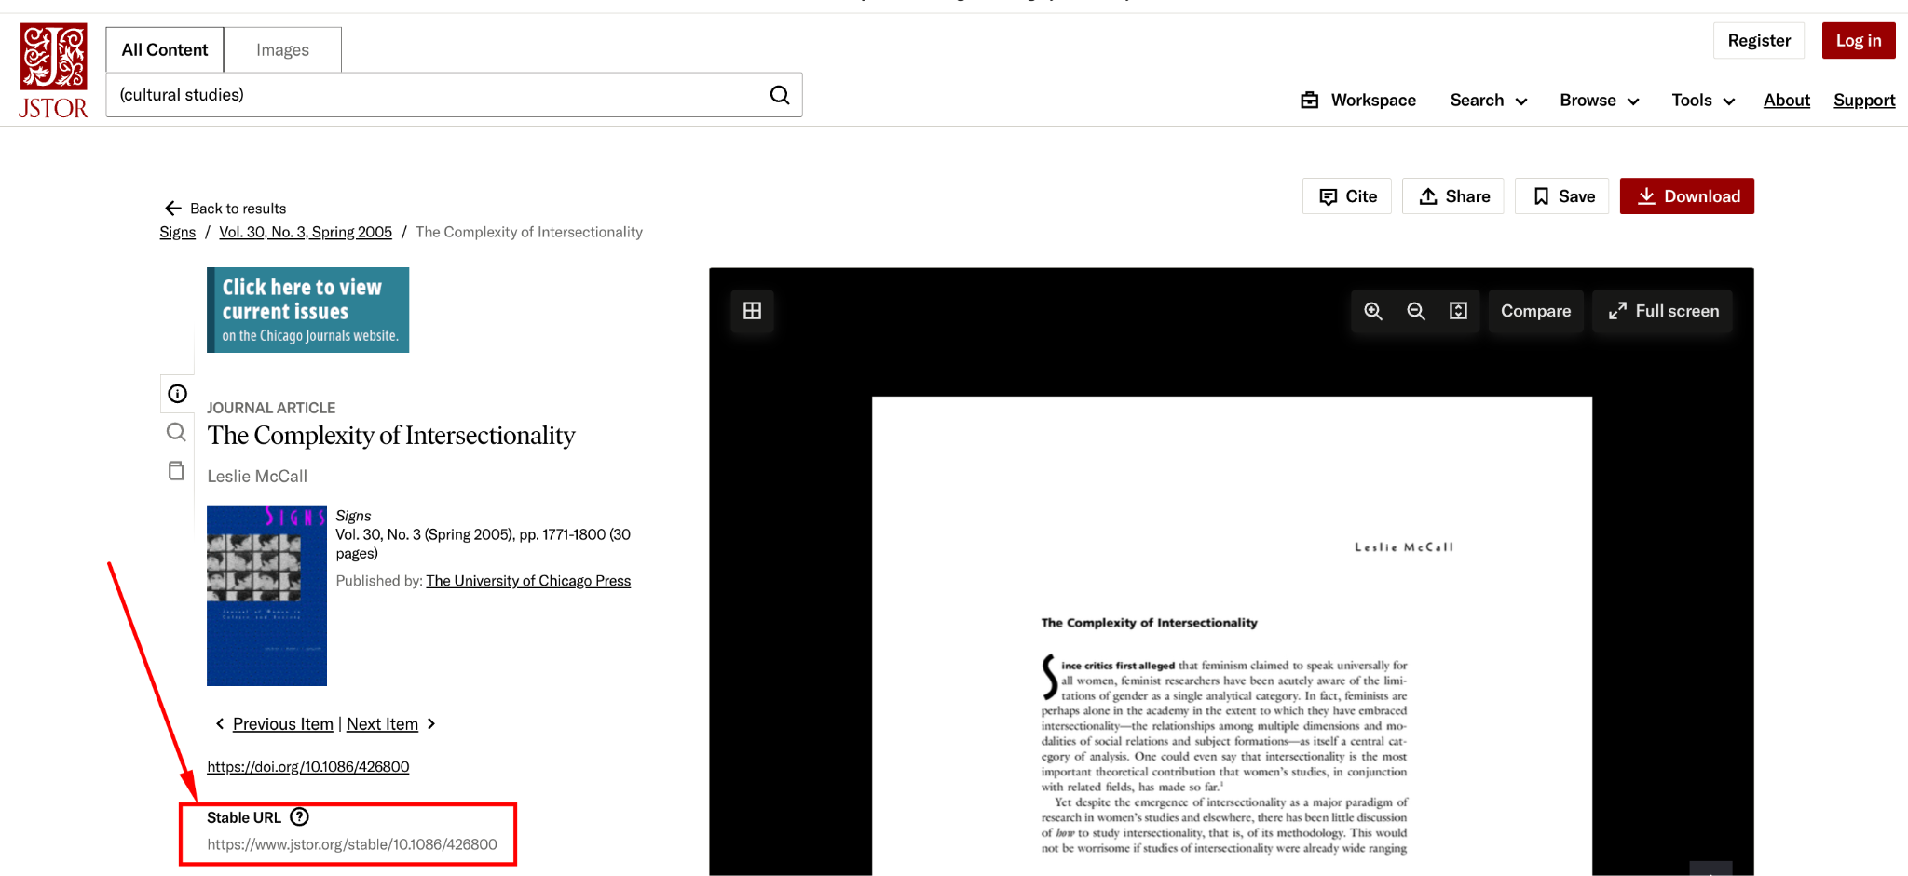
Find and copy the Stable URL of the article you will be assigning at JSTOR.org

Slide 7
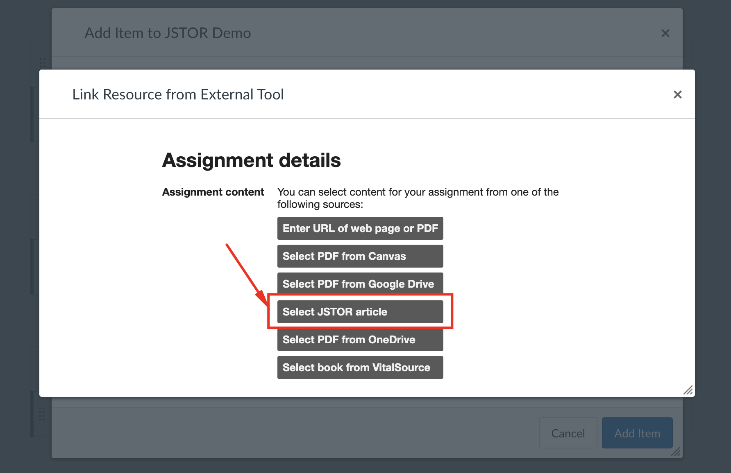
2) Select the JSTOR article option in the Hypothesis picker during assignment creation

Slide 8
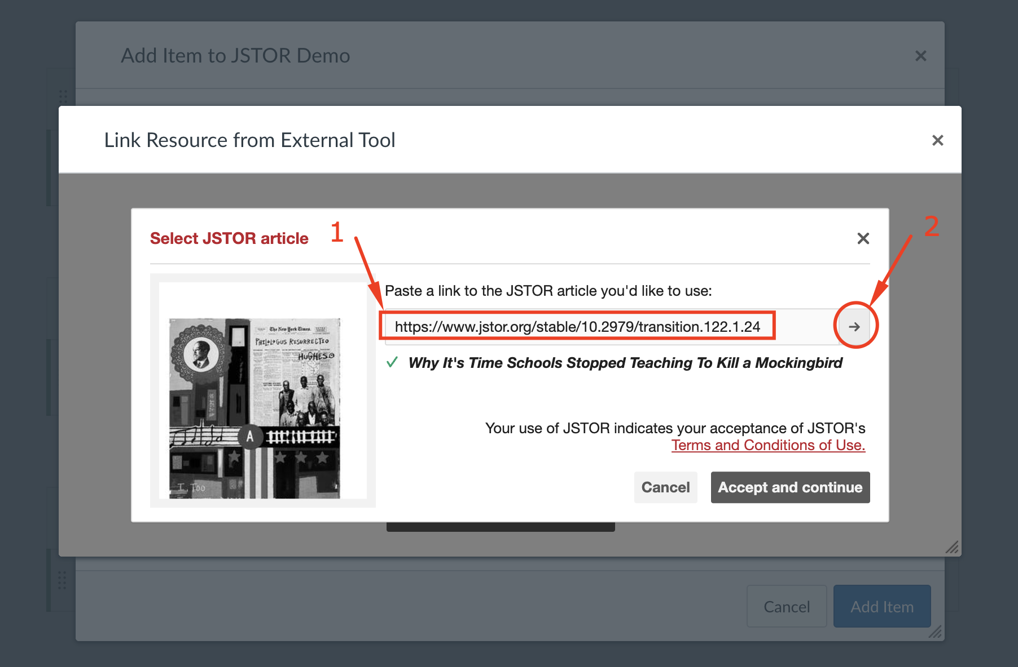
3) Paste the Stable URL when prompted 4) Click the arrow

Slide 9
Providing Context for Article Titles

Slide 10
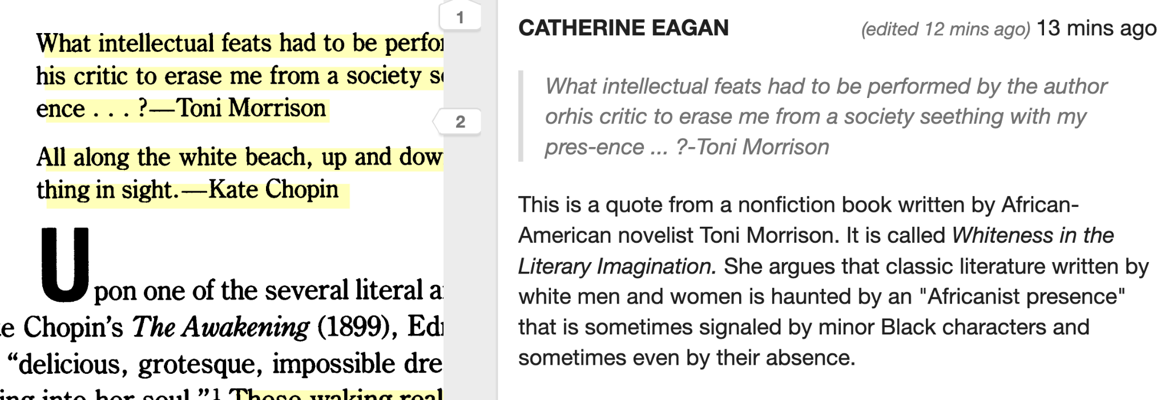
Providing Context for Epigraphs

Slide 11
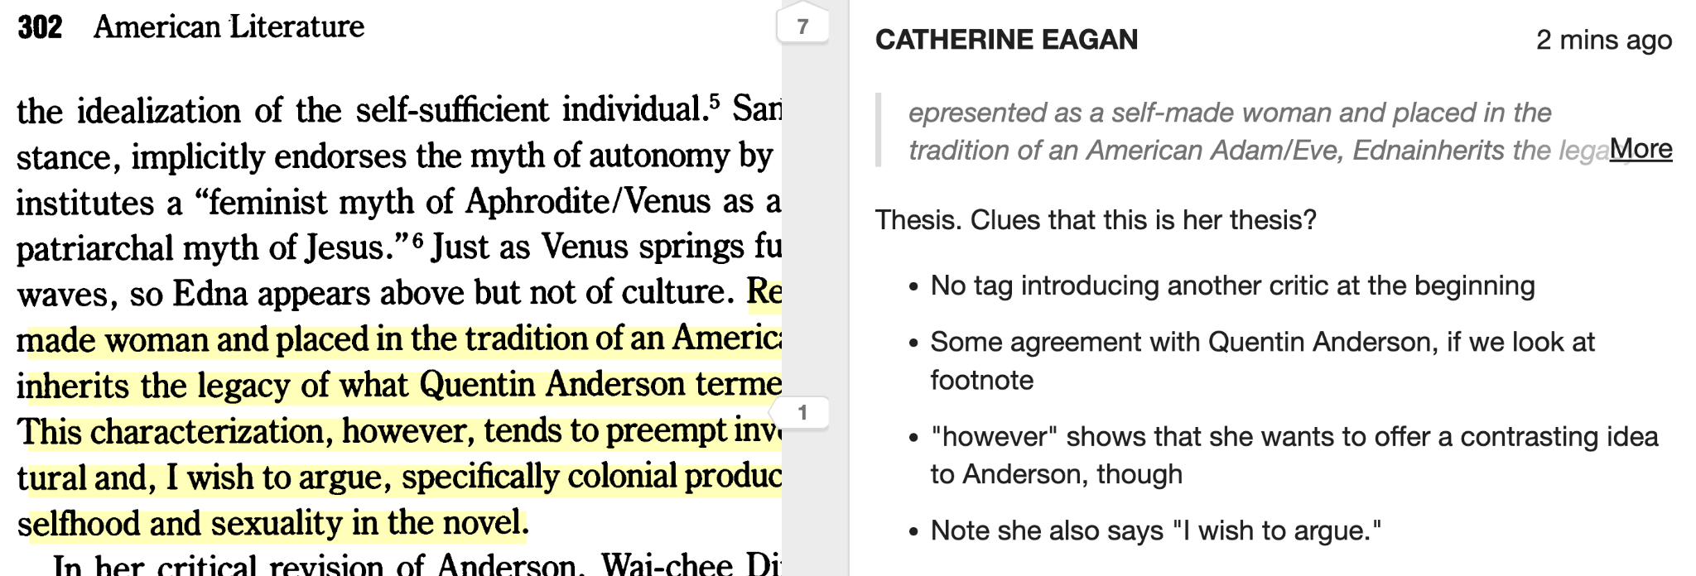
Providing Advice on Locating the Thesis

Slide 12
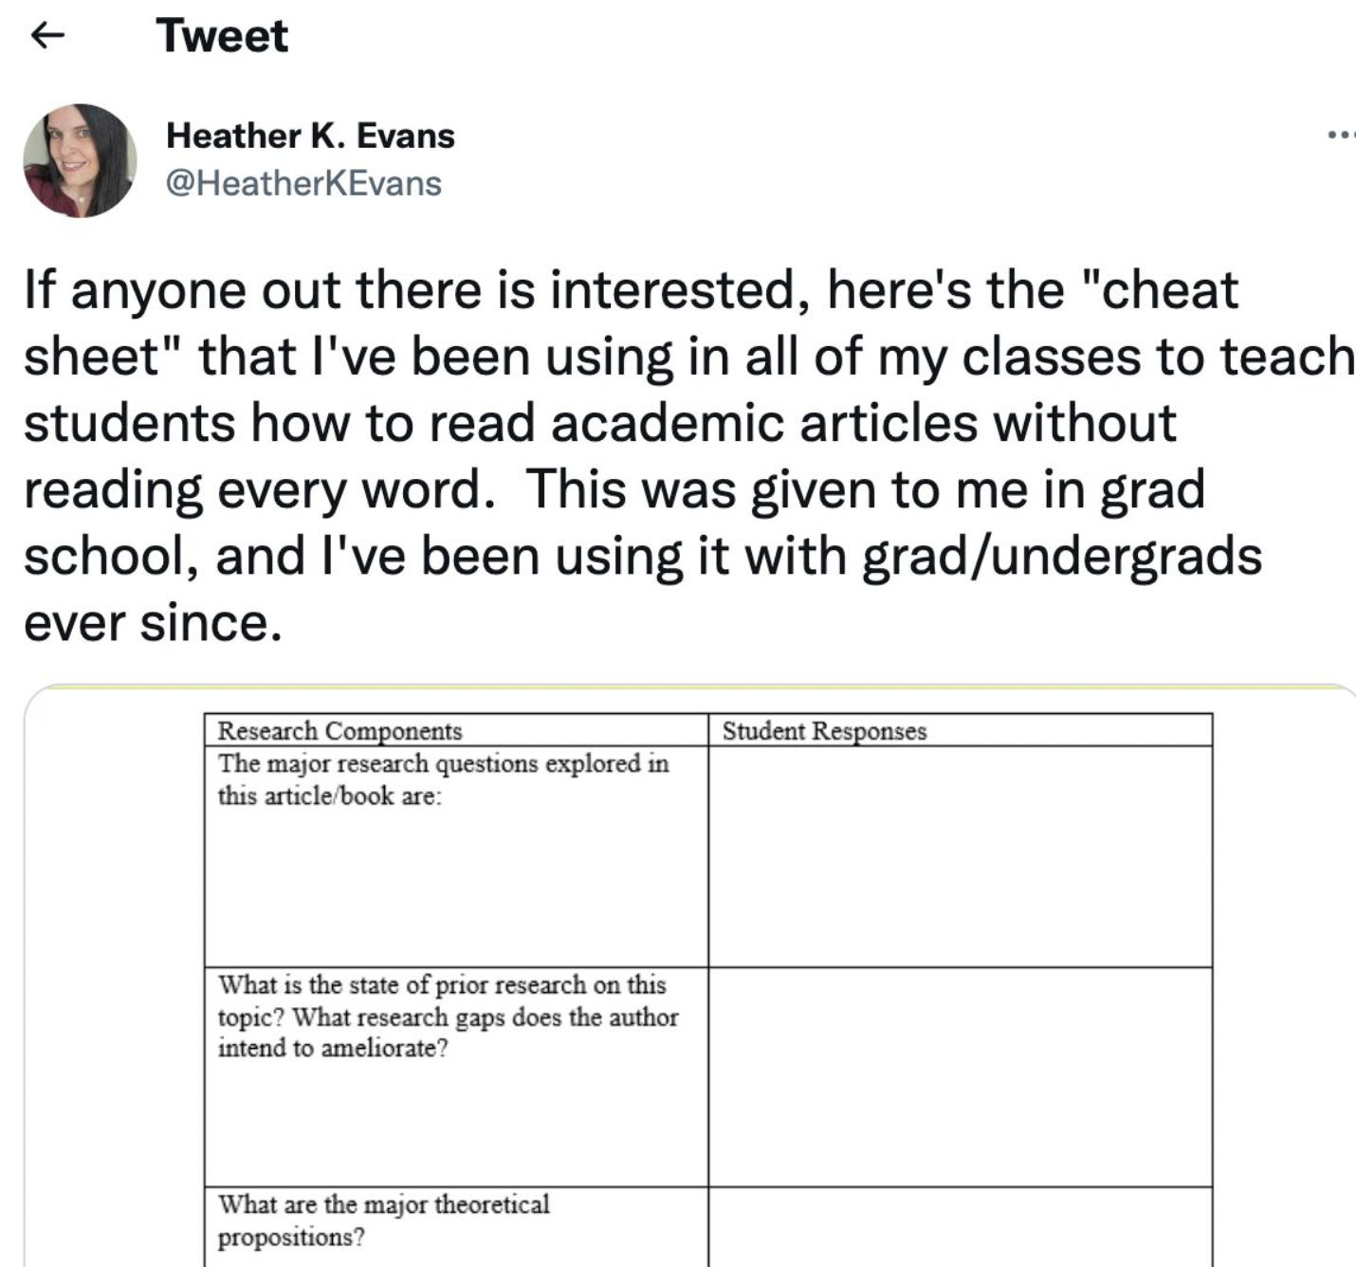
Helping Students Read Articles Strategically
Provide students with things to look for in the article, and they can help each other.

Slide 13
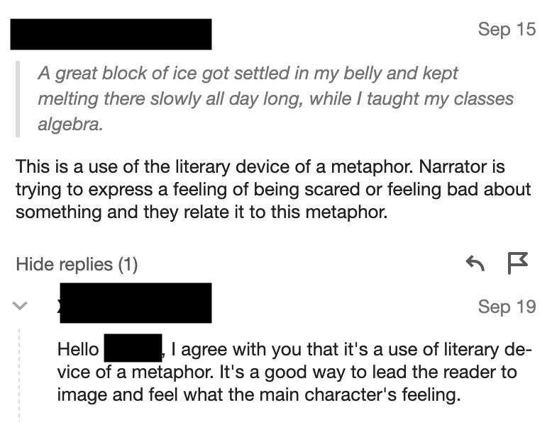
Example of Student-to-Student Contact
First student identifies what they believe the author is doing.
Second student agrees and adds additional insight.
Students are also encour- aged to politely disagree and suggest alternate paraphrase or interpretation This is a James Baldwin story, but it’s the same idea!

Slide 14
Thank you, and let me know if you try it!

