Slide 1
Solar Power, Energy Storage, Saving the World, and You
Or - how to save a buck and feel good about yourself in the process
1. Reasons for going solar
2. Cost of solar
3. Disadvantages of solar (and their remedies)
4. Calculate the cost of solar for you
5. Question and Answer period

Slide 2
1. Reasons for going solar
A. The Good of Humanity and all Species
Greenhouse Gases (ex. CO2) absorb heat
CO2 is a byproduct of all fossil fuel combustion
Atmospheric CO2 concentration 420 ppm in 2022
up from 390 ppm 2010 (~ 2.5ppm/year)
Average global temperature up ~2⁰F since 1880
Extreme weather
Heat waves
Drought

Slide 3
B. Petro-dictatorship
Masha Amini

Slide 4
1. Reasons for going solar
C. To save $
$220/month X 12 months X 10 years = $26,400
Every 4 years PG&E “reassess” (read increases) what they charge customers for energy
12 PV panel, 4.8kW system (25 year warranty)
and a 13kWh battery (10 year warranty) less government tax credits and rebates = $19500
Solar is by far the cheapest source of energy. By far!

Slide 5
Solar Power, Energy Storage, Saving the World, and You
Or - how to save a buck and feel good about yourself in the process
1. Reasons for going solar
2. Cost of solar
3. Disadvantages of solar (and their remedies)
4. Calculate the cost of solar for you
5. Question and Answer period

Slide 6
2. Cost of solar
Average cost per kWh in California = $0.2143 or ~ $214/month or ~$2600/year
- Increases every 4 years (up 7% from 2020)
- Never ends (you will pay every month, forever)
2. Average cost per watt for Solar = $2.68/watt or ~$1000 for a 400w panel
- 1 time investment (or you could invest and not change your budget)
- Panels last >25 years
- Government Incentives (tax credits, rebates) decrease price
- Quantity of Incentives is income and location dependent (think equity)
3. Upshot
- Solar will ultimately decrease your energy cost

Slide 7
Solar Power, Energy Storage, Saving the World, and You
Or - how to save a buck and feel good about yourself in the process
1. Reasons for going solar
2. Cost of solar
3. Disadvantages of solar (and their remedies)
4. Calculate the cost of solar for you
5. Question and Answer period

Slide 8
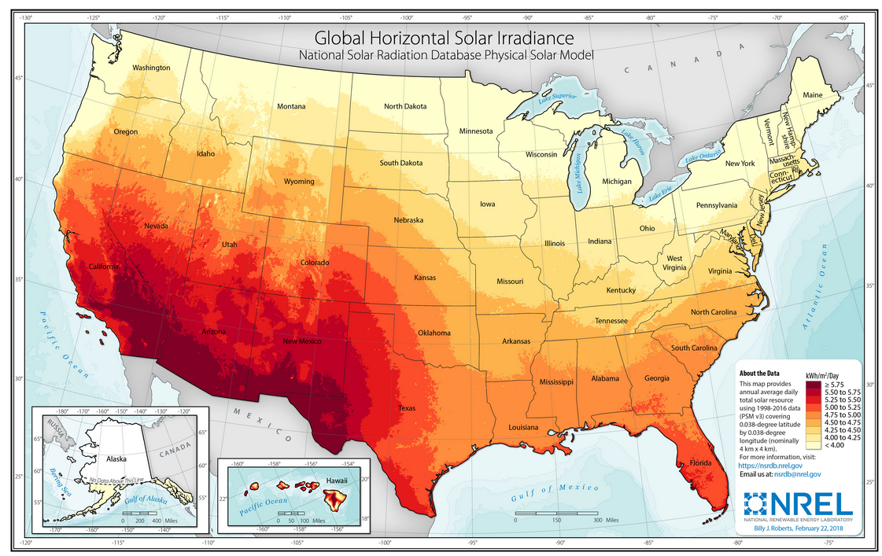
3. Disadvantages of solar (and their remedies)

Slide 9
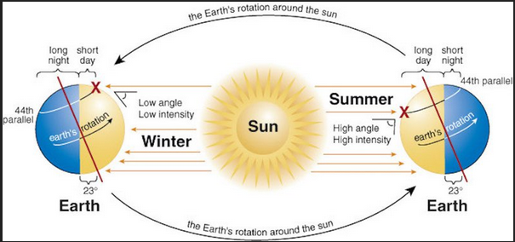
3. Disadvantages of solar (and their remedies)

Slide 10
3. Disadvantages of solar (and their remedies)
Batteries!

Slide 11
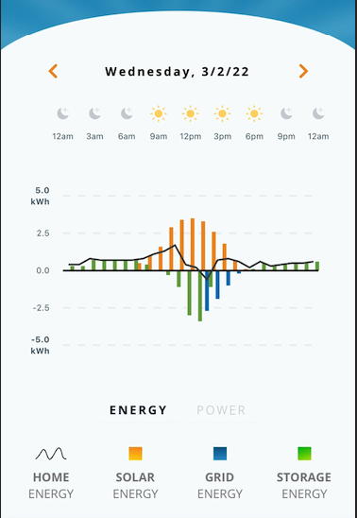
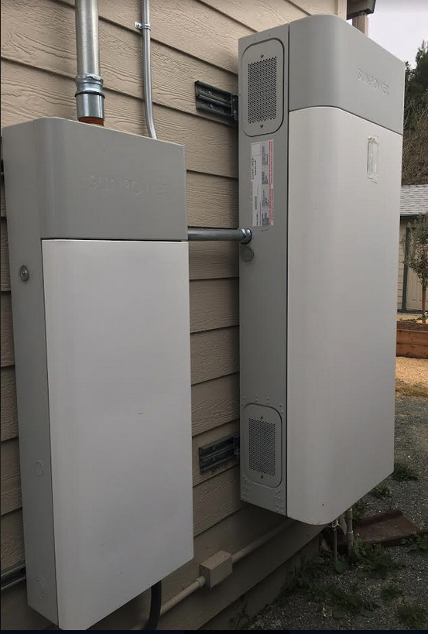
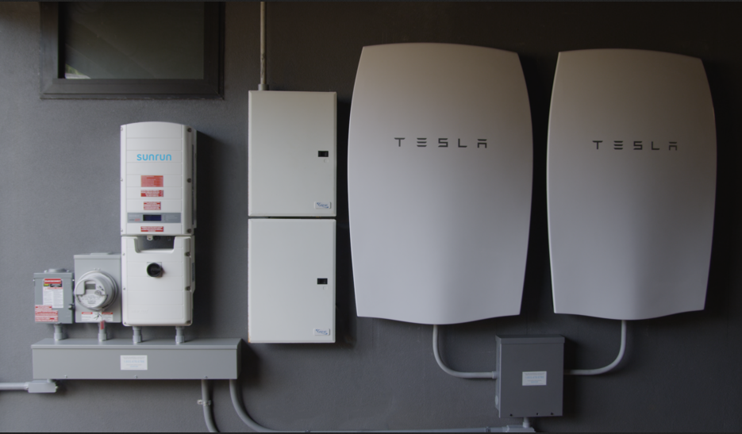
Solar Energy Storage - Batteries
Average battery cost ~$15000

Slide 12
Solar Power, Energy Storage, Saving the World, and You
Or - how to save a buck and feel good about yourself in the process
1. Reasons for going solar
2. Cost of solar
3. Disadvantages of solar (and their remedies)
4. Calculate the cost of solar for you
5. Question and Answer period

Slide 13
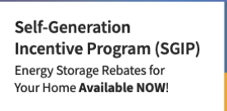
Tax Credits! Rebates! Payments for Excess Energy!
Purchasing Solar Panels, Energy Storage Systems:
Tax Credits - Reduce the amount of federal or state tax you owe. Currently all PV, and, separately, all energy storage systems are eligible for 30% credit from the federal government.
Rebates - Money direct to you. Usually with the idea that you will immediately give it to the company you purchased the system from.
Payments for excess energy generated - Some energy providers will pay you for the excess energy you generate and export to the grid. PG&E, SCE, SDG&E will pay you between 2-3 cents per kWh through CA - Net Energy Metering.

Slide 14
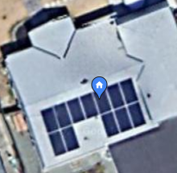
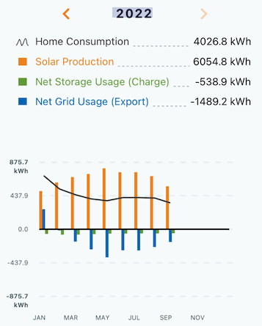
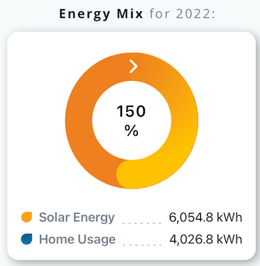
Testimonial Time!
Made $103!

Slide 15
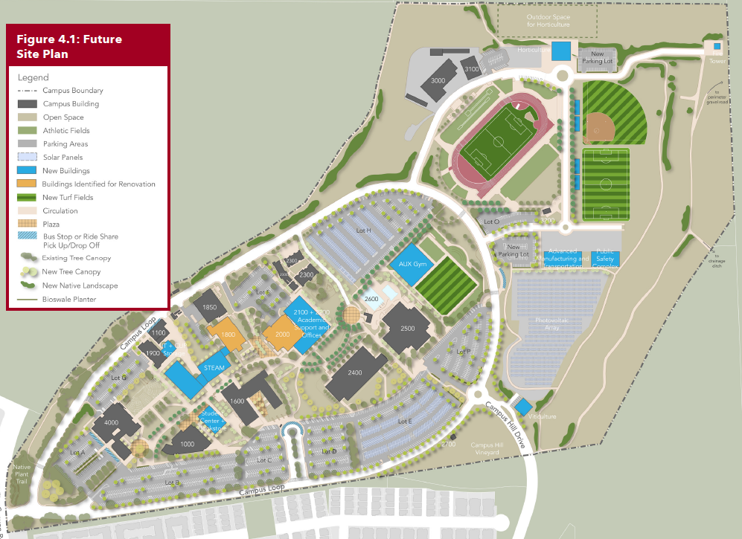
Solar and Batteries for New STEAM building?
Makes building energy self-sufficient
Excess energy can be stored or transferred to the community via PG&E
Energy made and stored can be used to offset operational costs in lean years freeing up funds to assist other programs.
PG&E pays electricity generators, further offsetting costs

Slide 16
Steps to calculating the cost of your solar energy system
Calculate your average energy requirement per month over 3 months.
Divide the monthly average by 30 days, then divide by 24 hours to get energy used per hour (kWh/hour)
Ex. Average home use = 900kWh/month x 1month/30days x 1day/24hours = 1.25kWh/hour. Multiply your hourly energy need by 1000 to get watt hours per hour: 1.25kWh/hour x 1000W/1kW = 1250Wh/hour
Assume 5 hours peak sunlight (more or less depending where you live and season)
Ex. 5 hr x 1250Wh/hour = 6250W (size of system needed)
Size of system needed x $2.68/watt = cost for system

Slide 17
Steps to calculating the cost of your solar energy system
Subtract 30% tax credit = net cost of system
Solar panels last >25 years. Take your average monthly energy cost from your bills used above.
Multiply that cost by 12 months and then by 25 years. Compare it to the solar cost. Be pleased that you are investing your money wisely by going solar.
Bonus: Assume $15000 for 13kWh storage battery (between $10000 - $20000)
Less 30% Fed. tax credit and 13kWh x $250/kWh rebate from PG&E ~$7250 net battery cost.
12. Rest assured you will never be caught in a blackout again :-)

Slide 18
Steps to calculating the cost of your solar energy system
Worried about the up front costs?
Of course! This is close to the cost of a small new car.
However, these companies know that. And they want your business.
I went with SunPower. I had to put $1000 up front and then didn’t pay a dime until the system was working.
My payments for the system were less than my monthly PG&E payments without the solar panels!
In other words, I actually decreased the amount of money I was spending every month!

