Slide 1




Slide 2

https://bit.ly/MCflexday
Notes:
Amy

Slide 3

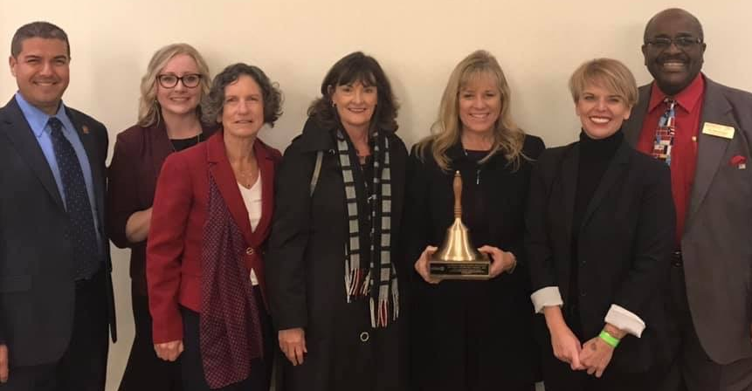
https://bit.ly/MCflexday
Notes:
TVROP Middle College is proud to have been recognized as an Outstanding Program in the State of California for its vision, partnerships and resounding success by receiving the CSBA Golden Bell Award from the California Association of School Boards in January 2018.

Slide 4
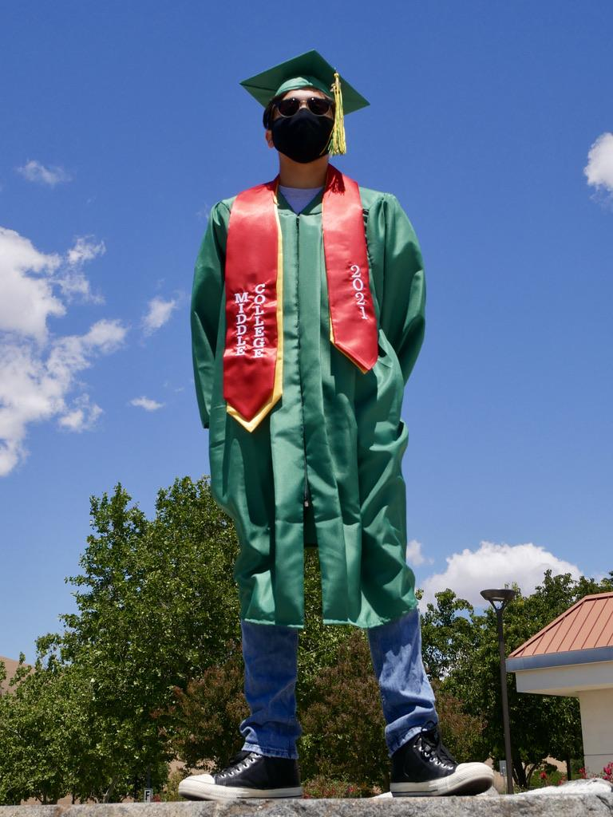

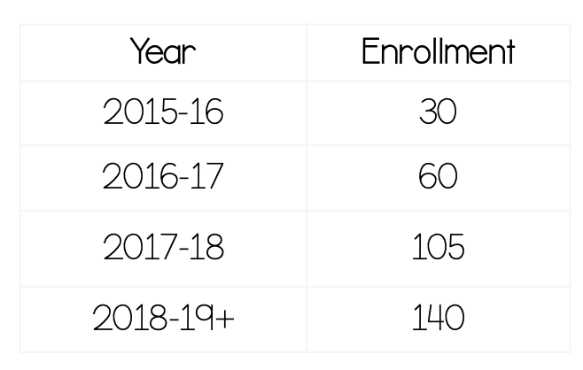
https://bit.ly/MCflexday
Notes:
2022 6th graduating class…

Slide 5


https://bit.ly/MCflexday

Slide 6
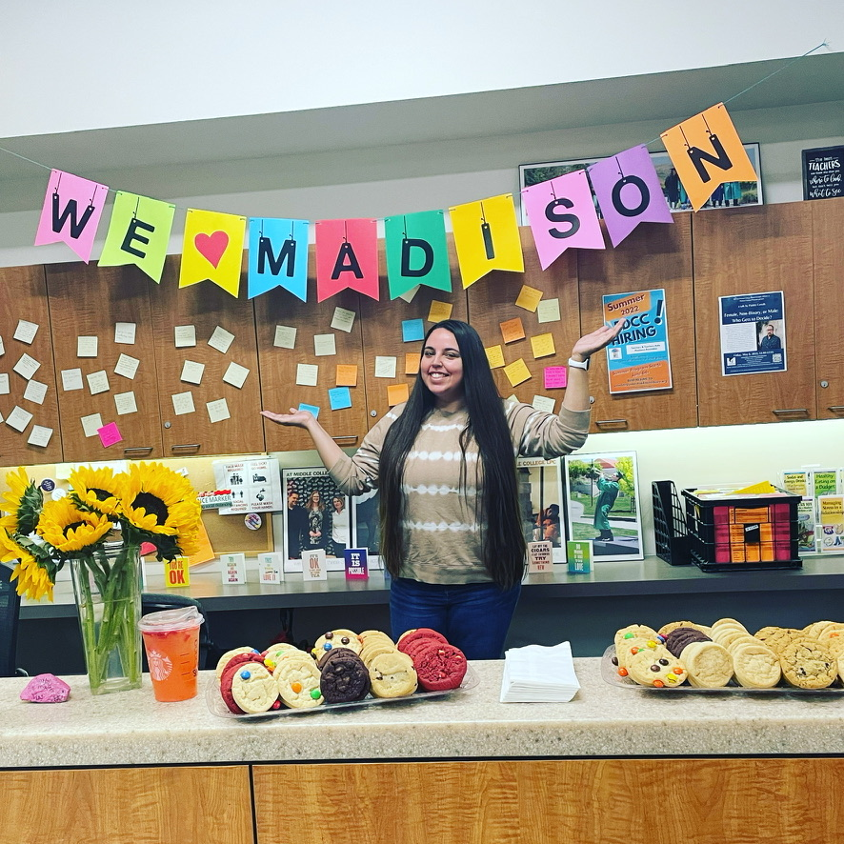

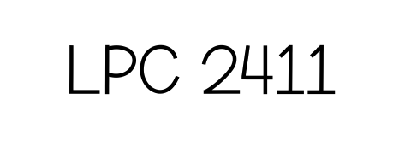
https://bit.ly/MCflexday

Slide 7
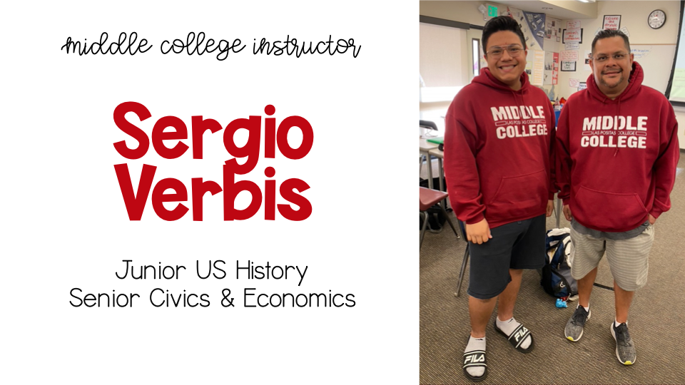

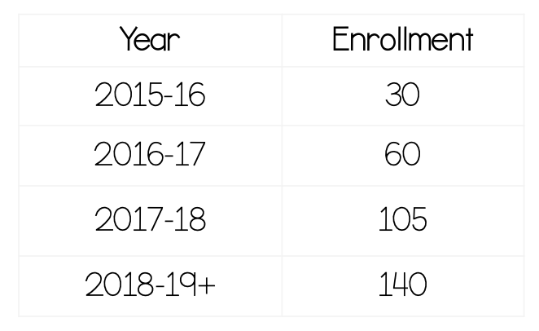
https://bit.ly/MCflexday

Slide 8
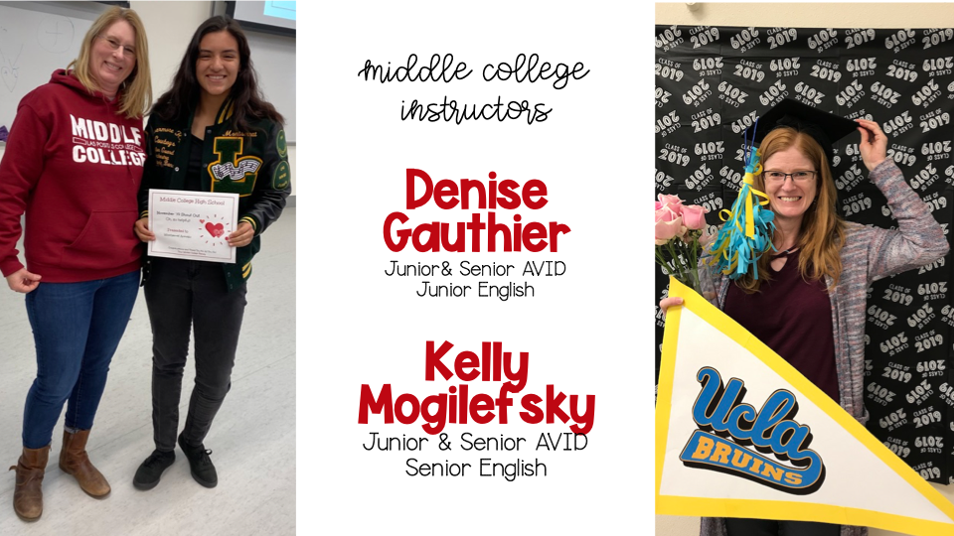
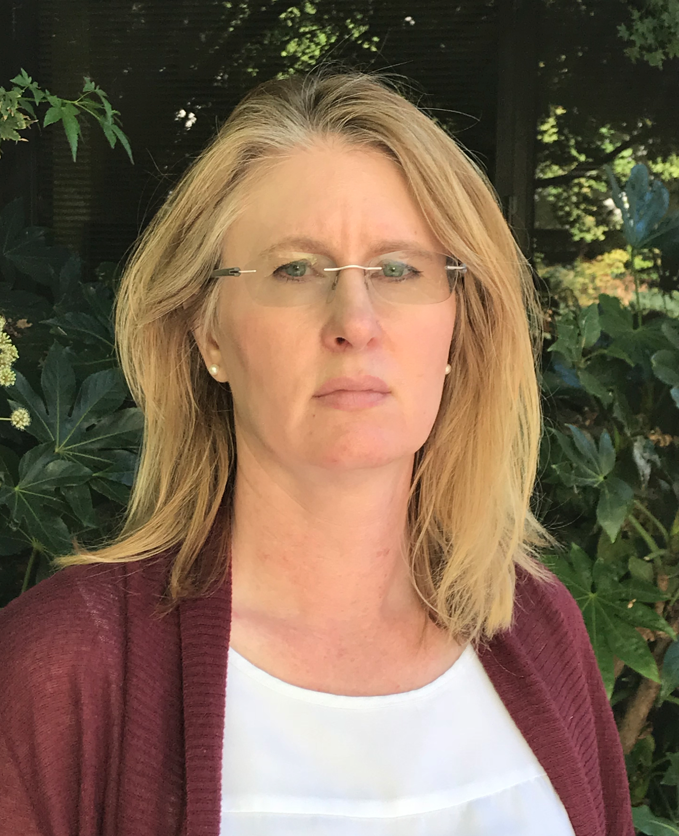
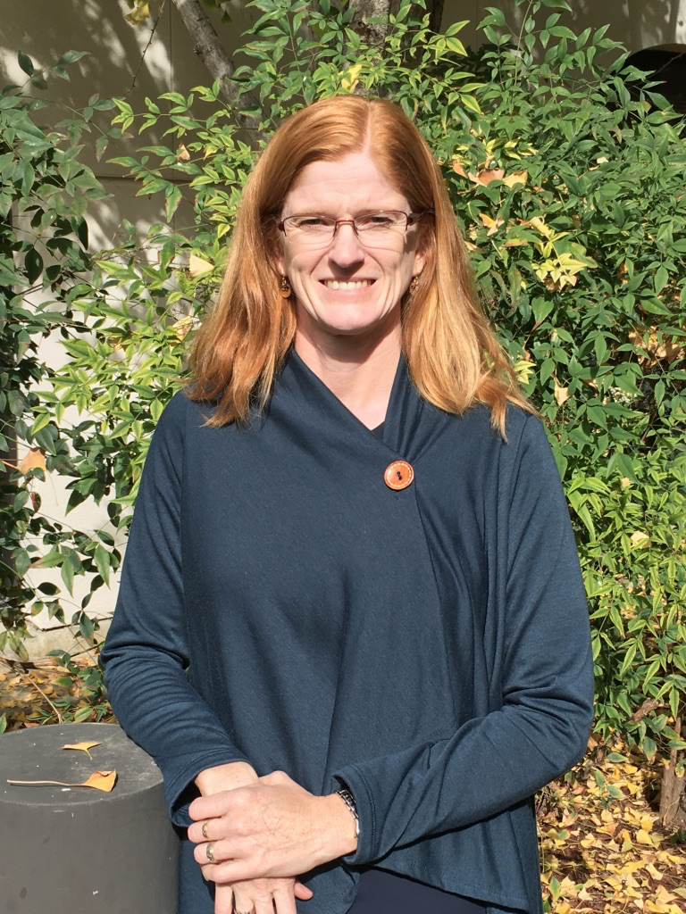
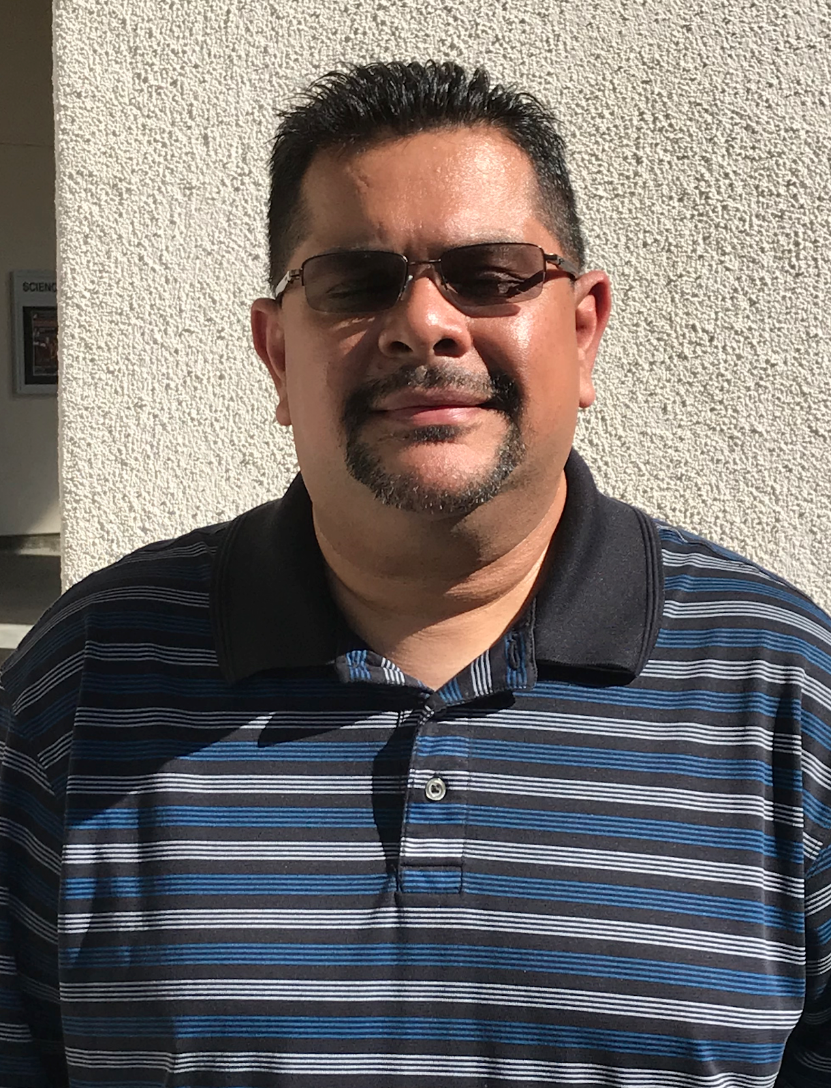

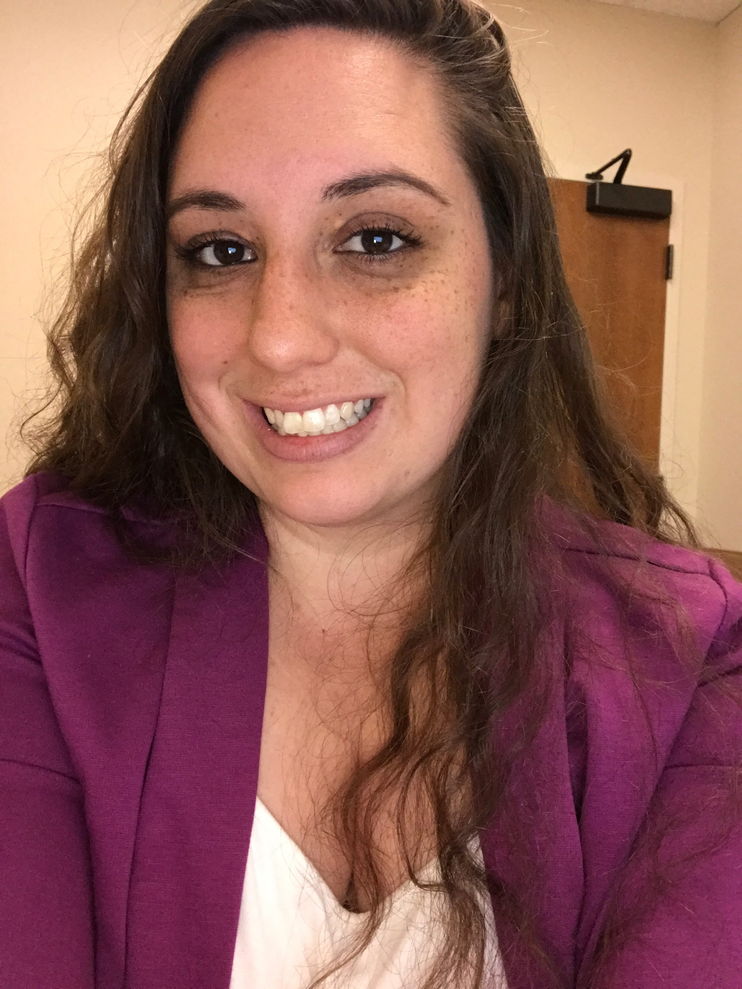
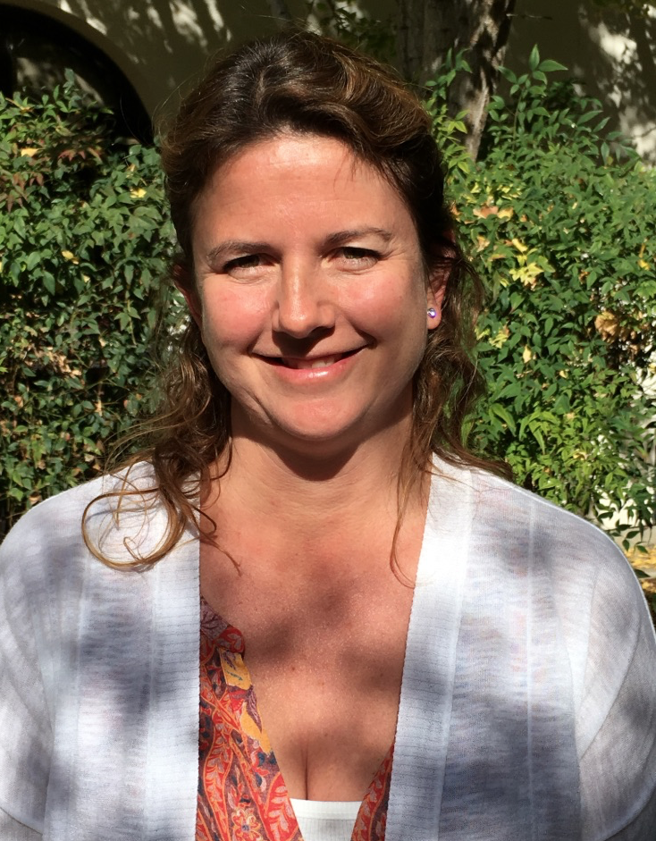
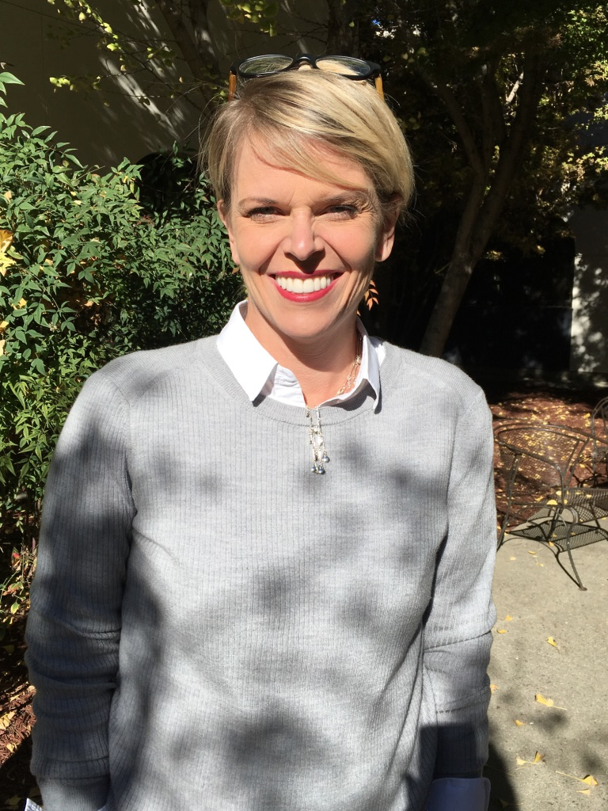

Our Staff
Ms. Denise Gauthier
Teacher
Ms. Kelly Mogilefsky
Teacher
Mr. Sergio Verbis
Teacher
Ms. Sara Alturk
LPC Counselor
Ms. Colette Ray
Administration Assistant
Ms. Amy Brown
MCHS Program Coordinator
Notes:
Amy

Slide 9

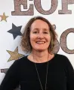
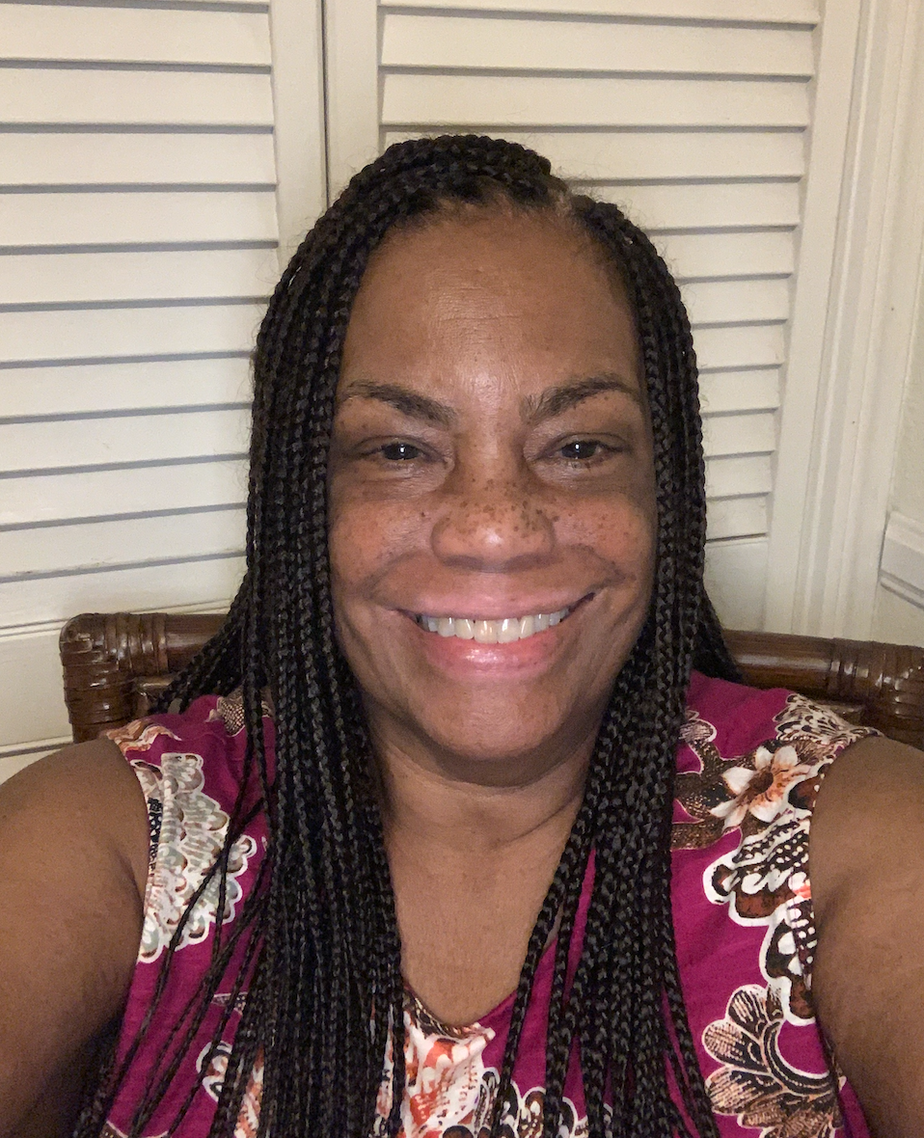



Notes:
Amy

Slide 10
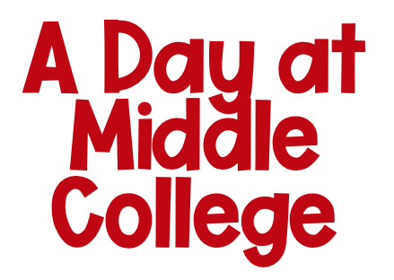
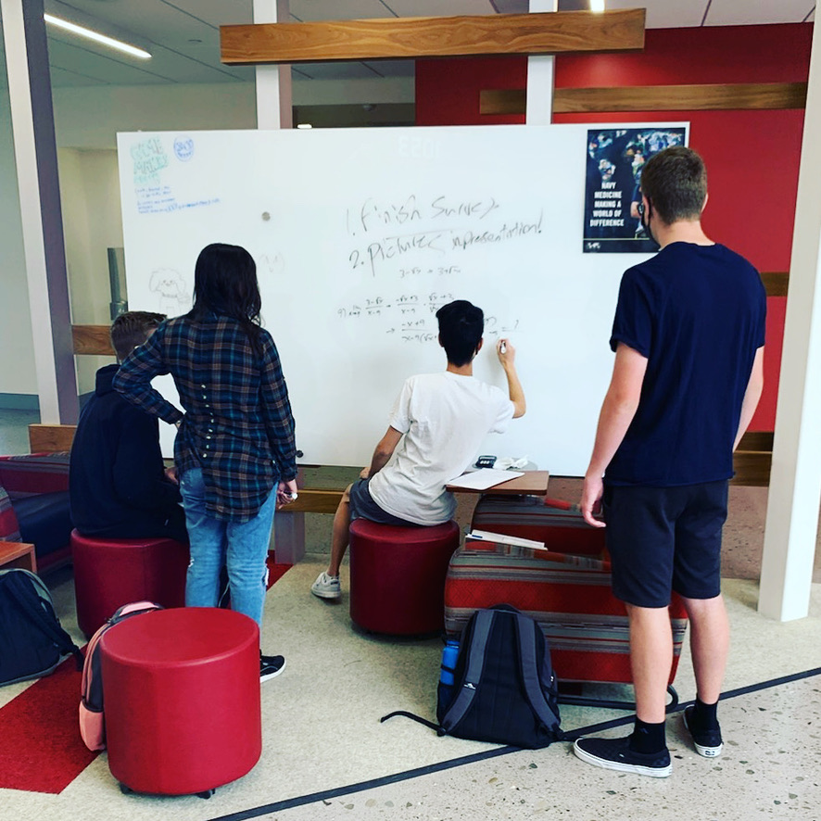

LPC Rooms 802 & 505
https://bit.ly/MCflexday

Slide 11

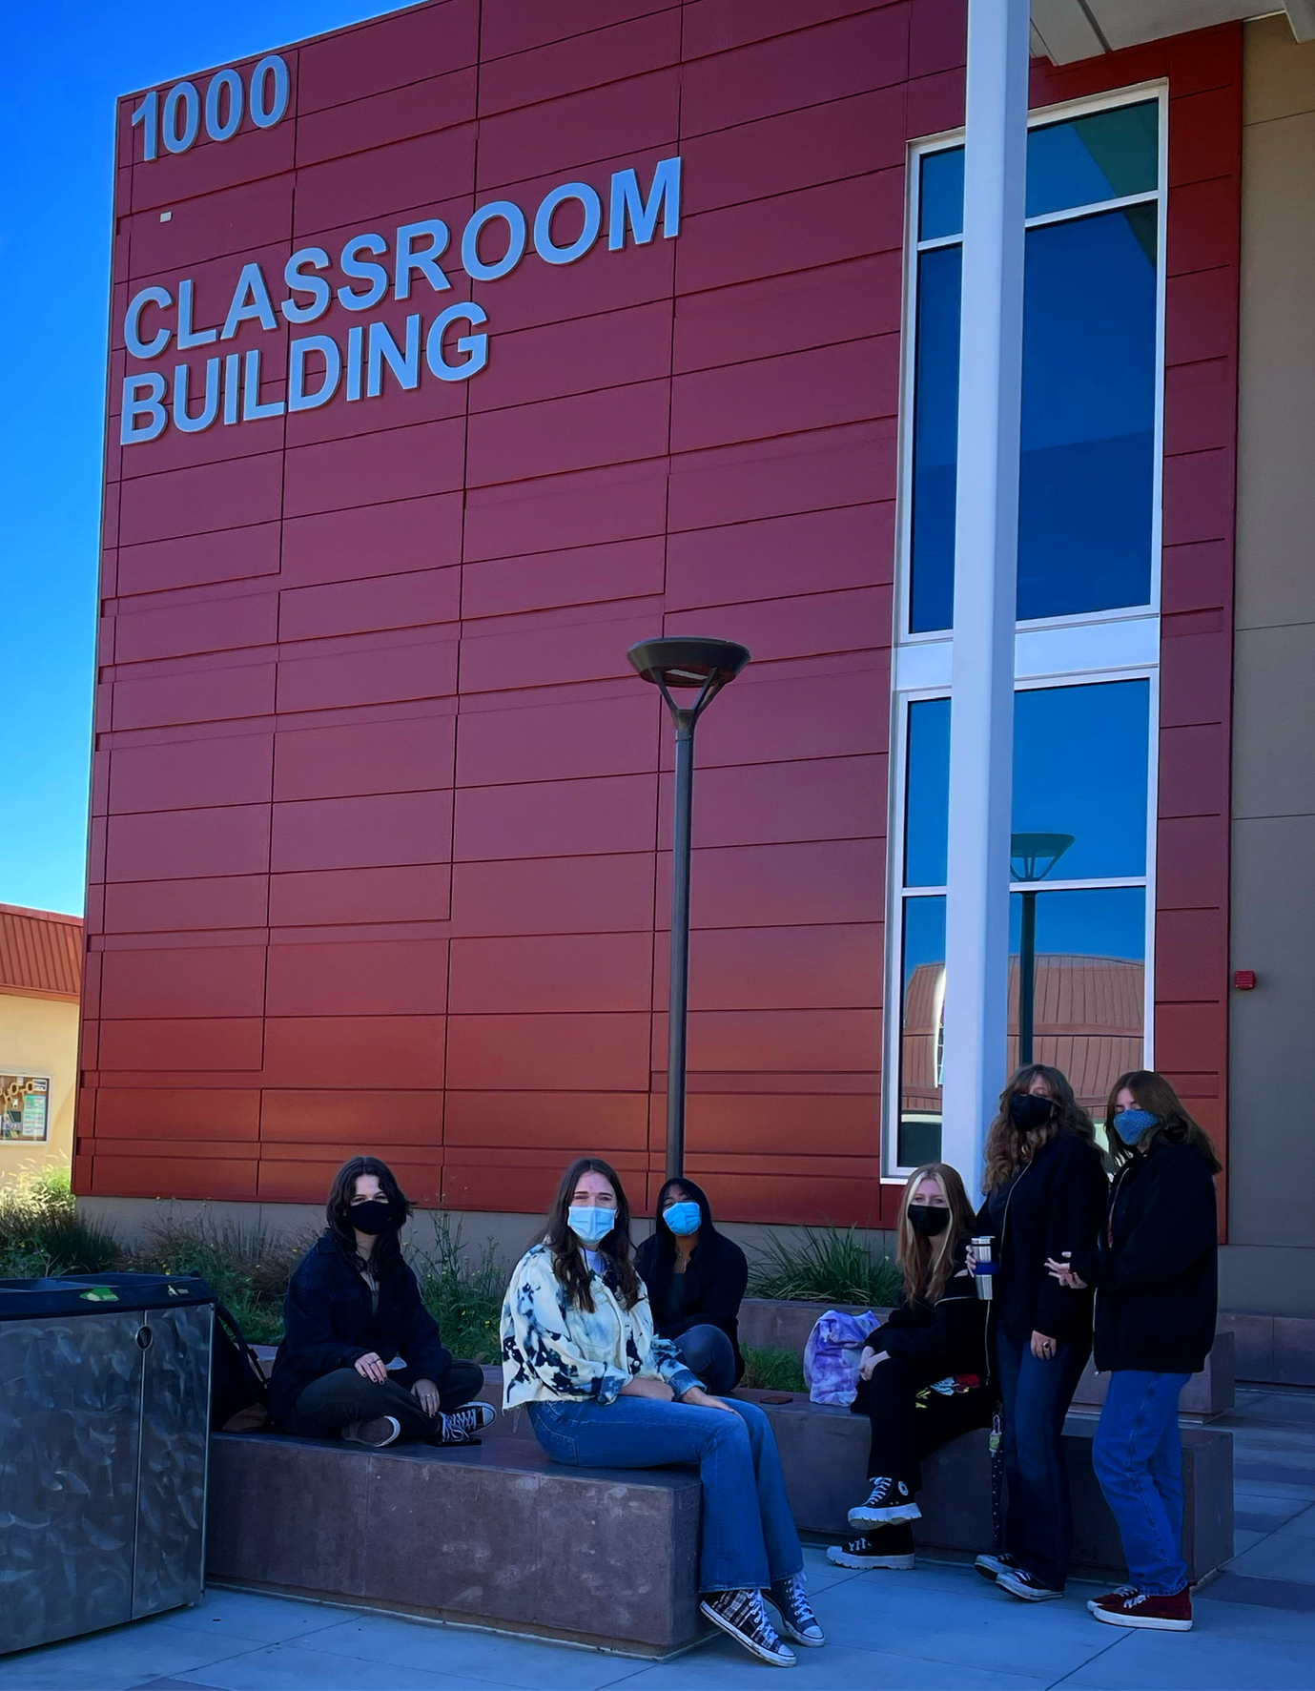
Help students adequately prepare themselves for college and career
Expose students to courses and career opportunities not available to typical high school students
Provide students the support services needed to be successful in high school and college courses
Develop a solid foundation for “life as a college student”
Emphasize that college can be “for all students”
Increase underrepresented student enrollment in higher education
https://bit.ly/MCflexday
Notes:
Kelly

Slide 12

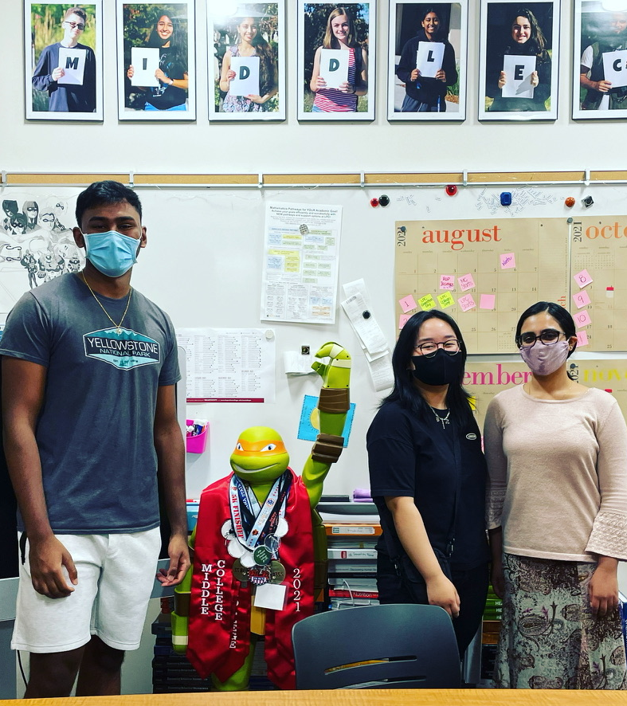
Earn a C or better in all high school and college courses
Maintain an enrollment of at least 6 and no more than 11 college units per semester
Behave with academic integrity
Be an active participant in the Middle College community
https://bit.ly/MCflexday
Notes:
Amy

Slide 13
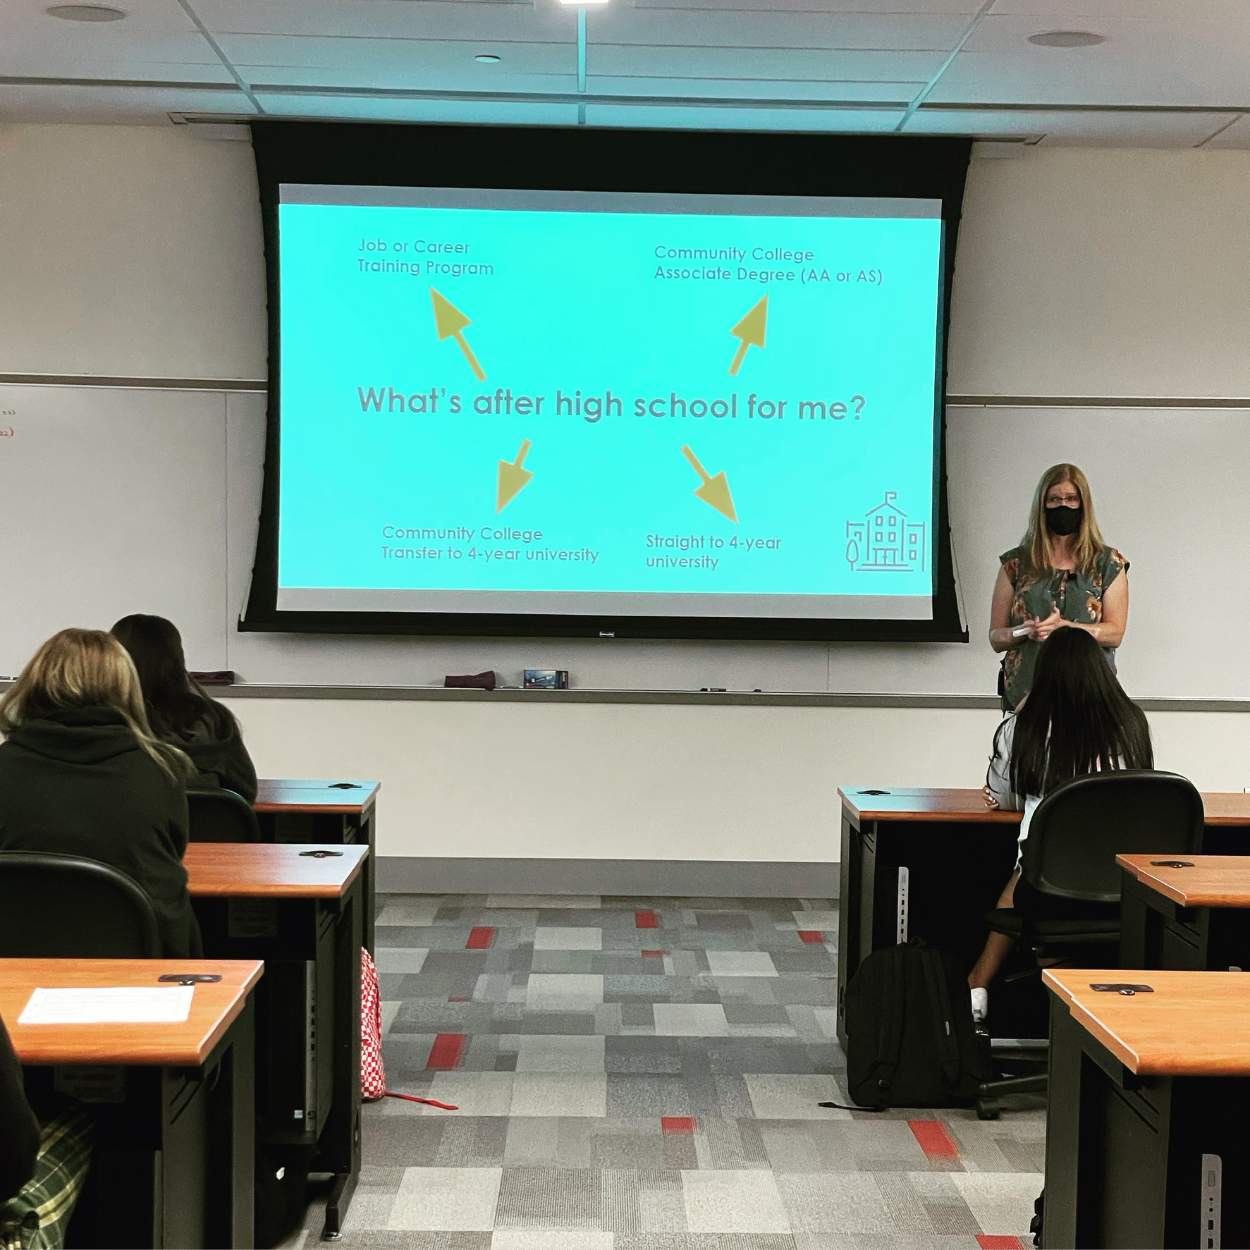

Community Based, Inclusive Environment
AVID
”Advancement Via Individual Determination”
Notetaking Skills
College & Career Research
Reading and Writing Support
Annotation Skills
Financial Literacy
Navigating A College System
LPC resources and more…
https://bit.ly/MCflexday
Notes:
Explicitly teach the ins and out of navigating college. Discussion boards seminar, using canvas, What are Office Hours, Let’s Get Digital, not to mention walking them through registration…

Slide 14
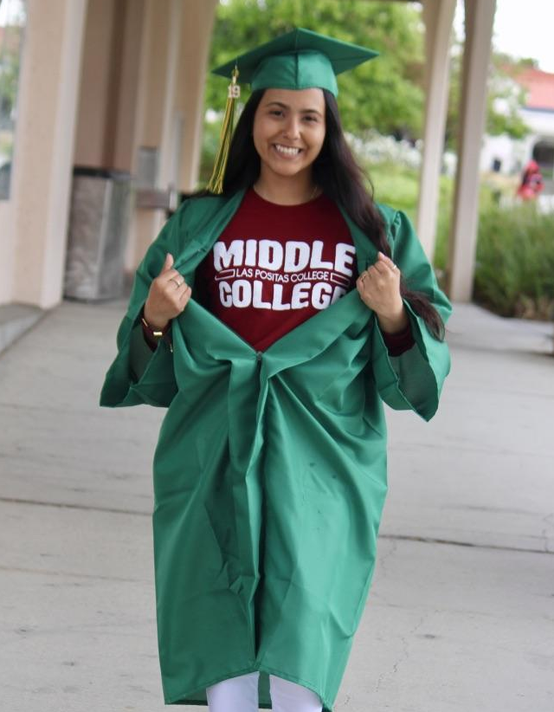

340 Middle College students have graduated since 2017
Completed 12,000 college units
Fall 2021 Average Completed
LPC Units: 9.7 with a 3.4 GPA
Program Average Completed
LPC Units: 8.6 with a 3.2 GPA
100% Graduation Rate
~75% of each cohort continues at LPC after high school graduation

Slide 15

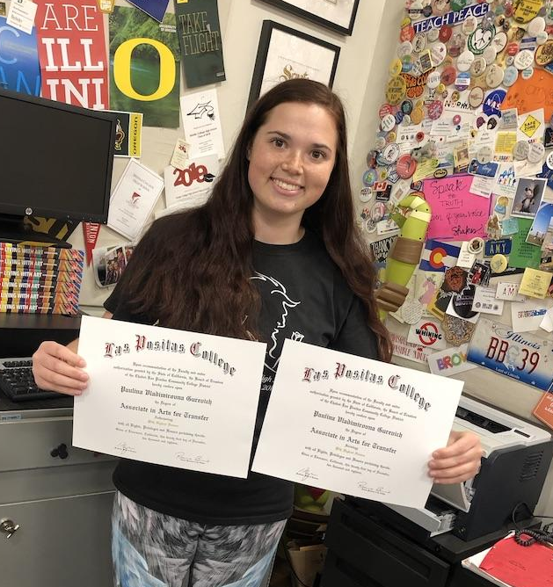
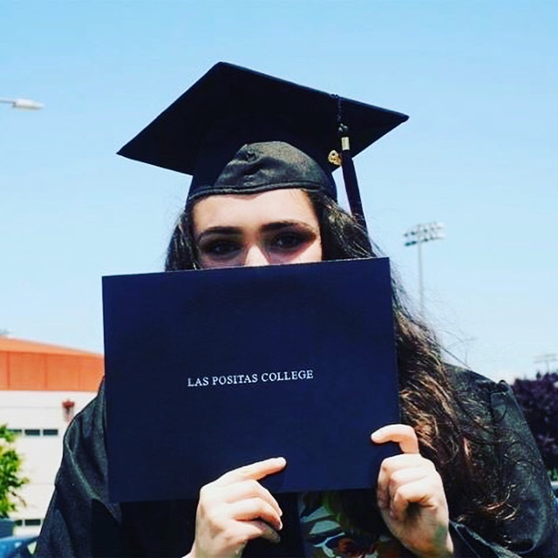
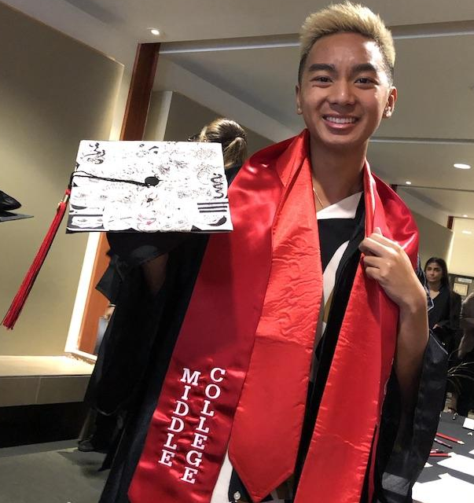
https://bit.ly/MCflexday

Slide 16
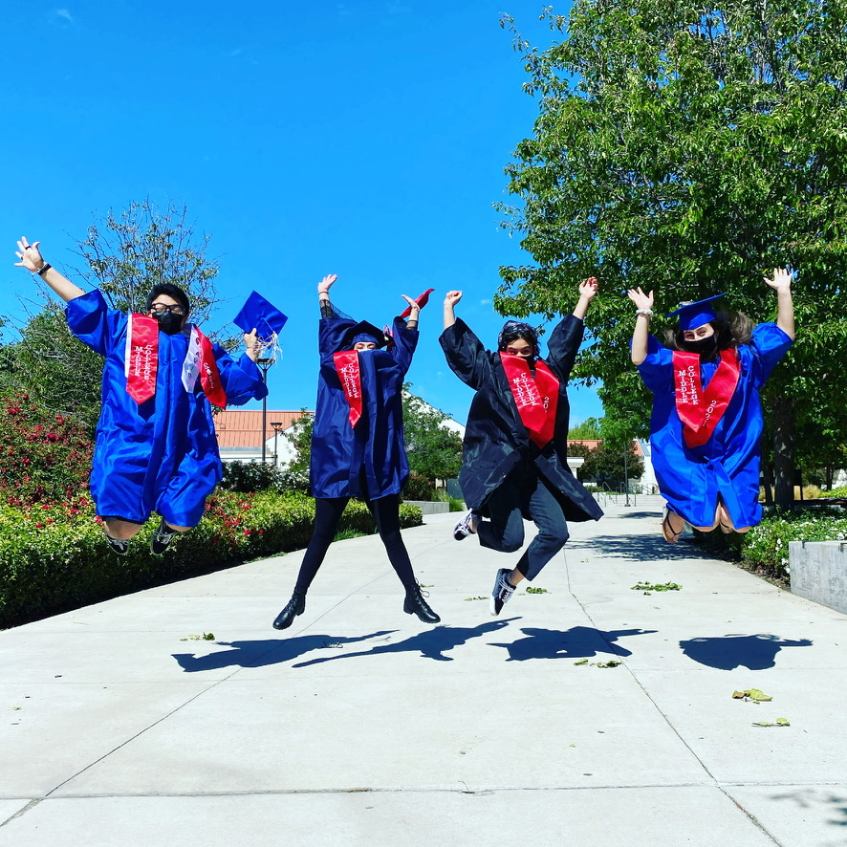


Slide 17

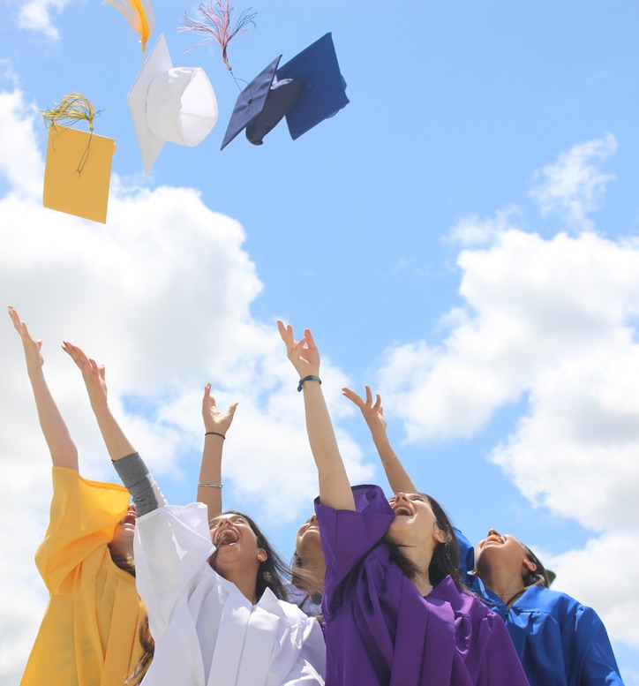
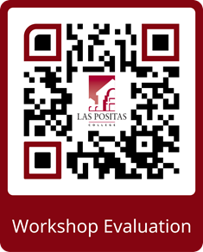



https://tinyurl.com/bdcvucrp
Facebook MiddleCollegeatLPC | Instagram MiddleCollegeLPC | Twitter MCHSatLPC

