Slide 1


Should CLPCCD adopt a
Compressed Academic Calendar?
Alternative Academic Calendar Committee
Chabot College Las Positas College
District Office

Slide 2

Alternative Academic Calendar Committee
The AACC was formed in Fall 2022 with members carefully selected to represent key stakeholder groups, contribute expertise, and ensure consistent and committed participation.
Co-chairs are Vice Chancellor Theresa Fleischer Rowland and Chabot Communications Studies Instructor Jason Ames.
AACC members include students, faculty, classified professionals and administrators from Chabot, Las Positas and the District Office.
Support is provided by District-contracted professional expert John Mullen.
Notes:
Notes to presenter:
Description of what you learned in your own words on one side.
Include information about the topic
Details about the topic will also be helpful here.
Tell the story of your learning experience. Just like a story there should always be a beginning, middle and an end.
On the other side, you can add a graphic that provides evidence of what you learned.
Feel free to use more than one slide to reflect upon your process. It also helps to add some video of your process.

Slide 3
Alternative Academic Calendar Committee
The committee is charged with “examining in detail the benefits and liabilities involved with any modification to the standard 17.5-week semester primary term.” (FA Contract Article 8D)
In consultation with students, faculty, classified professionals, and administrators across the District, the AACC is studying the pros and cons of adopting a compressed academic calendar.
By 2022-23, 68 California Community Colleges had converted to a compressed academic calendar.
Notes:
Notes to presenter:
Description of what you learned in your own words on one side.
Include information about the topic
Details about the topic will also be helpful here.
Tell the story of your learning experience. Just like a story there should always be a beginning, middle and an end.
On the other side, you can add a graphic that provides evidence of what you learned.
Feel free to use more than one slide to reflect upon your process. It also helps to add some video of your process.

Slide 4
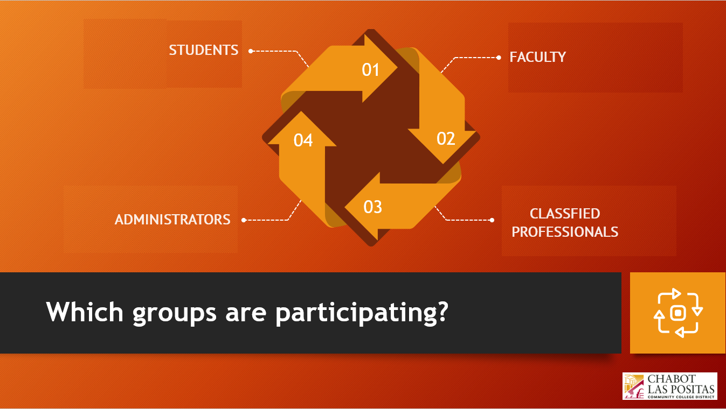

Slide 5

What are the next steps?
Information Gathering and Discussions
4
1
December
Districtwide Forums
3
2
November
2
3
Impact Survey
October
1
September
Recommendation
4
Notes:
Notes to presenter:
What steps will you be taking as a result of this learning experience?
Did you learn from any failed experiences? How will you do things differently?
What advice will you give to others so they can learn from your experiences?
How can you share what you learned with a real-world audience?
Some examples of next steps might be:
After delivering my first persuasive presentation, I am thinking about joining the debate team.
After making my first film, I’m considering entering it in our school film festival or local film festival.
After connecting with this career expert, I’d like to do some research on that career field because it sounds interesting to me.
This SmartArt allows you add images and text to help outline your process. If a picture is worth a thousand words, then pictures and words should help you communicate this reflection on learning perfectly! You can always click on Insert>SmartArt to change this graphic or select the graphic and click on the Design contextual menu to change the colors.
Feel free to use more than one slide to share your next steps. It also helps to add some video content to explain your message.

Slide 6

Information Gathering and Discussions
Districtwide Forums
Impact Survey
Effects of calendar compression on students’ daily time schedules, learning and well-being.
Experience at colleges that have adopted a compressed calendar
Anticipated fiscal and facility utilization changes
Changes in staffing and workload patterns
In-person and virtual presentation and discussion forums
Participation by students, faculty, classified professionals and administrators
Attendees learn details and discuss the pros and cons of adopting a compressed academic calendar
A comprehensive online survey will enable members of all stakeholder groups to express their opinions and preferences.
Detailed analysis of survey results will inform the AACC as well as the District community.
Notes:
Notes to presenter:
What was important about this learning experience?
How is it relevant to your course, yourself, or your society or community?
Why is this significant?
This SmartArt allows you add images and text to help outline your process. If a picture is worth a thousand words, then pictures and words should help you communicate this reflection on learning perfectly! You can always click on Insert>SmartArt to change this graphic or select the graphic and click on the Design contextual menu to change the colors.

Slide 7
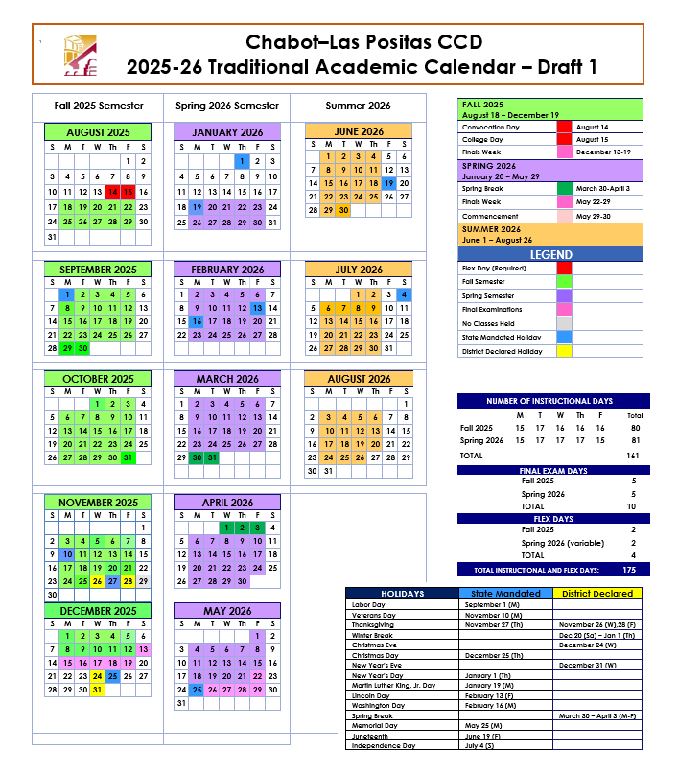
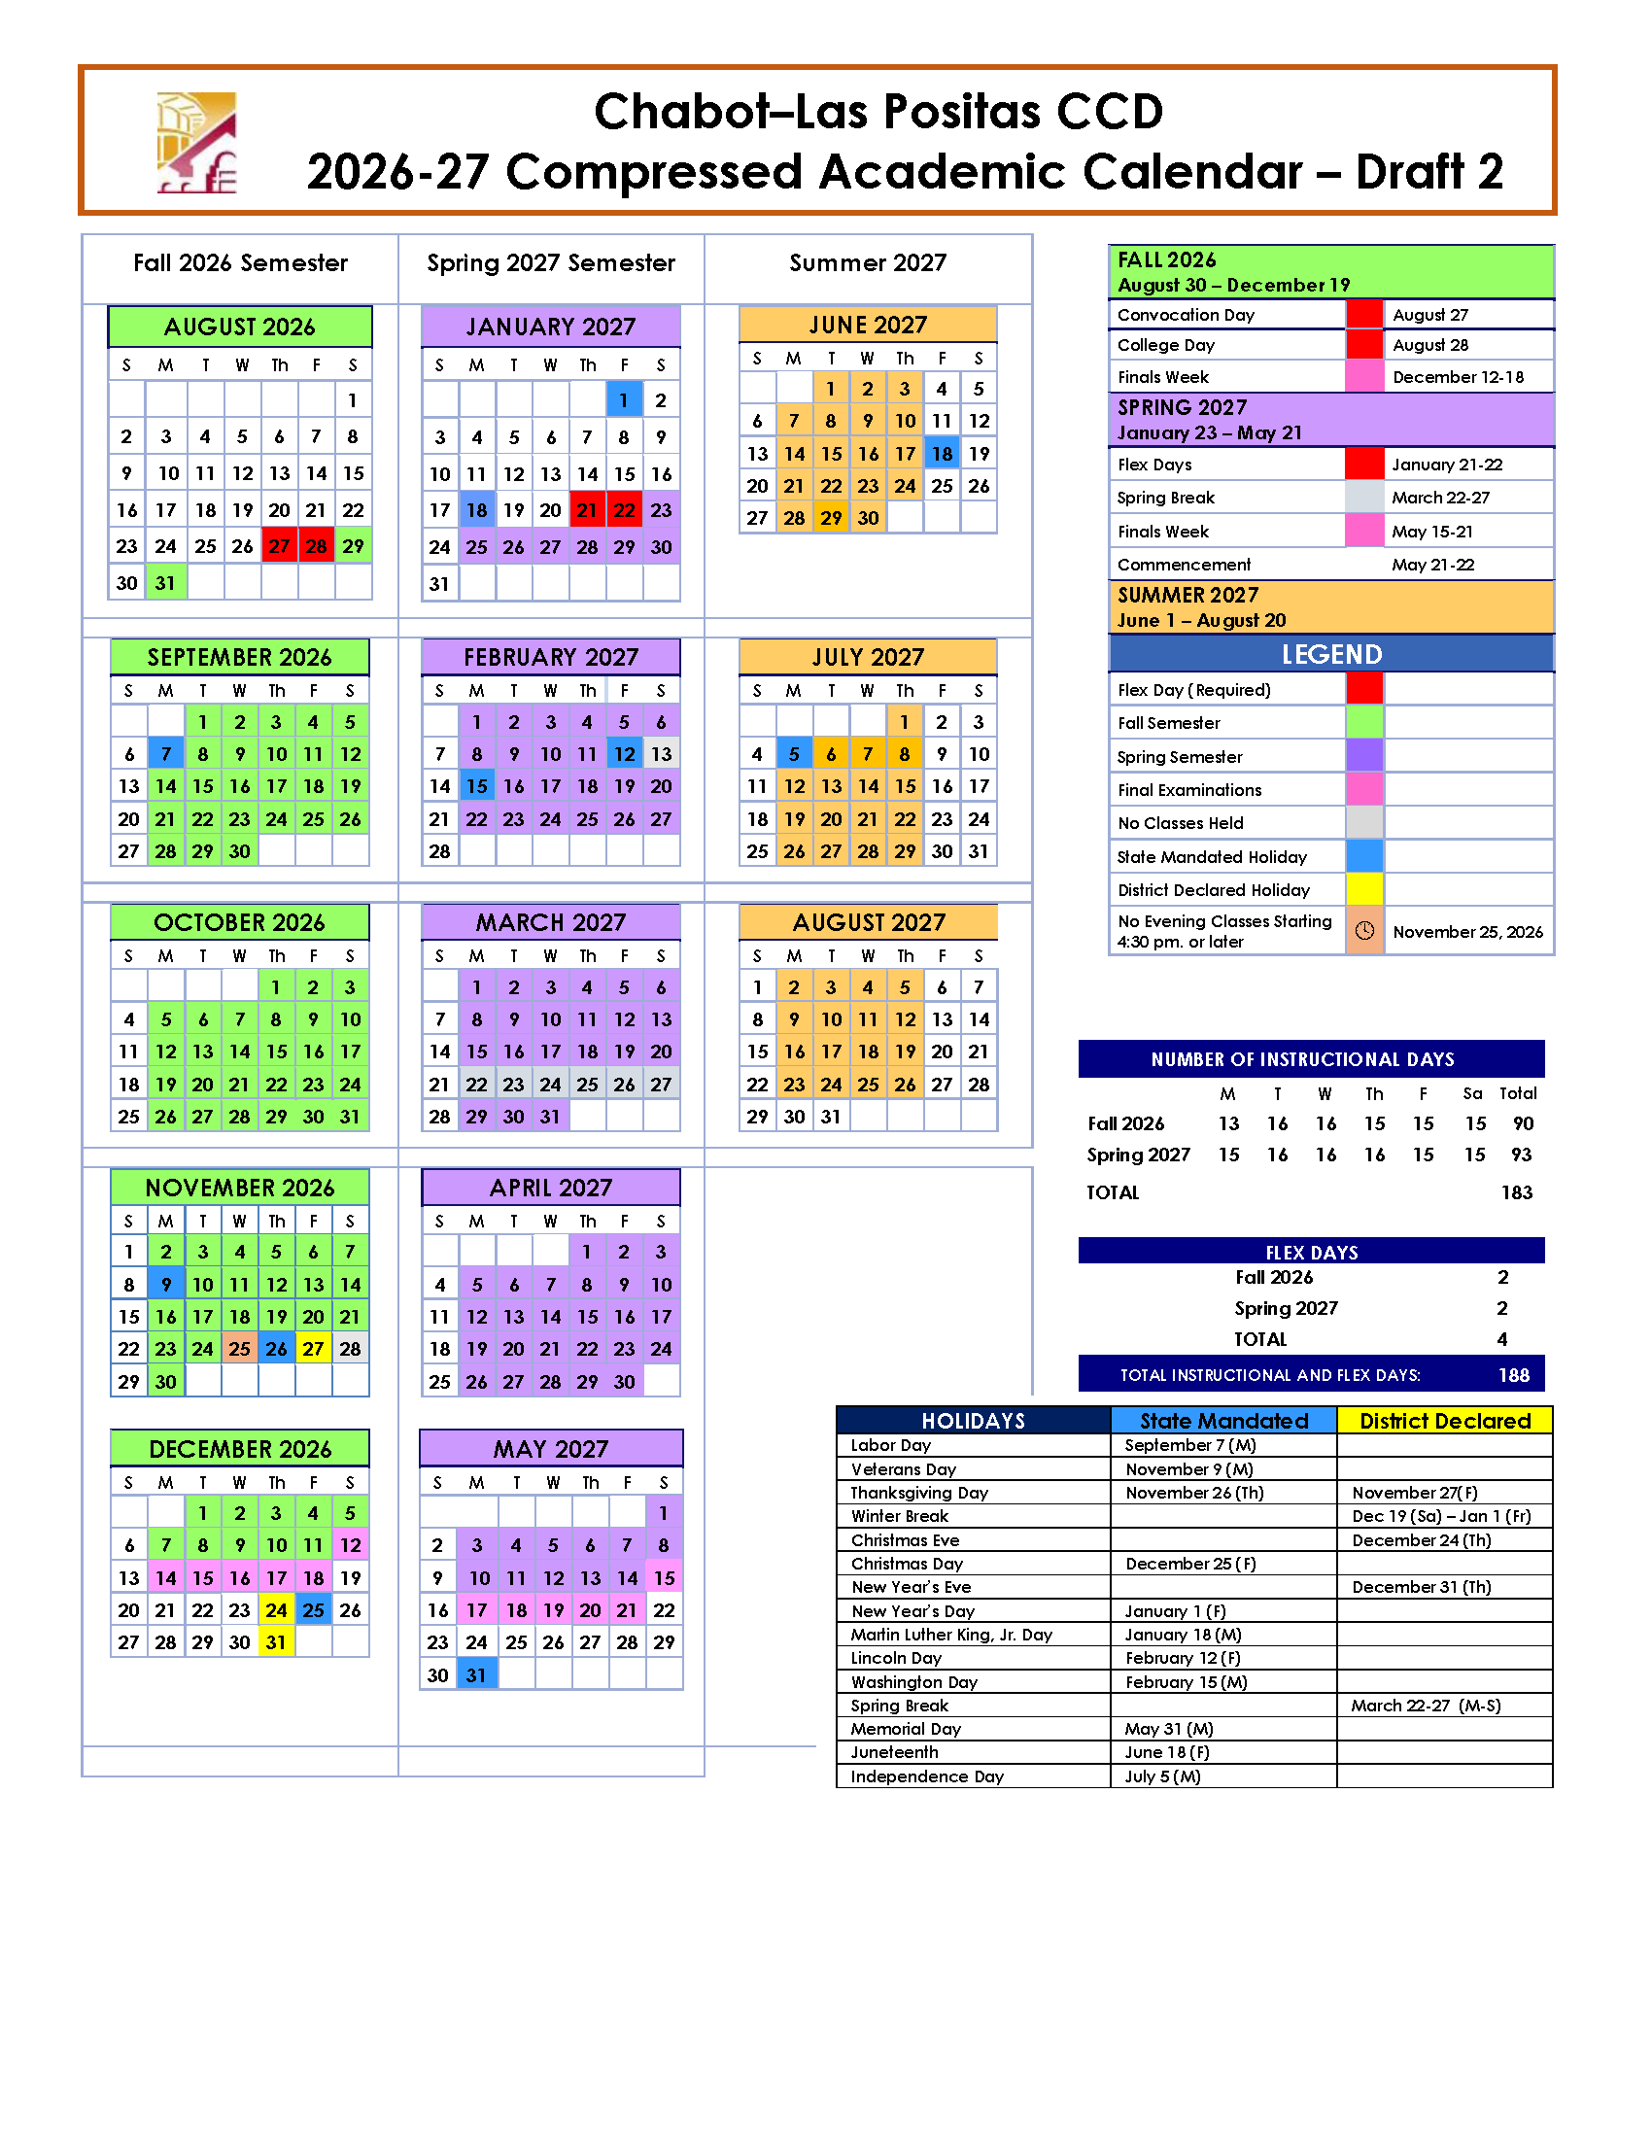
Notes:
Notes to presenter:
Description of what you learned in your own words on one side.
Include information about the topic
Details about the topic will also be helpful here.
Tell the story of your learning experience. Just like a story there should always be a beginning, middle and an end.
On the other side, you can add a graphic that provides evidence of what you learned.
Feel free to use more than one slide to reflect upon your process. It also helps to add some video of your process.

Slide 8
University Academic Calendars
The Fall 2023 semester at UC Berkeley has 14 weeks of classroom instruction and 1 week of final examinations.
At Cal State East Bay, San Francisco State, and San José State, the Fall 2023 semester has 15 weeks of classroom instruction and 1 week of final examinations.
The compressed academic calendar being discussed as a possibility for Chabot and Las Positas has 15 weeks of classroom instruction and 1 week of final examinations.
Notes:
Notes to presenter:
Description of what you learned in your own words on one side.
Include information about the topic
Details about the topic will also be helpful here.
Tell the story of your learning experience. Just like a story there should always be a beginning, middle and an end.
On the other side, you can add a graphic that provides evidence of what you learned.
Feel free to use more than one slide to reflect upon your process. It also helps to add some video of your process.

Slide 9
Recommendation
Informed by the information gathered from all sources, including forum discussions and analysis of the impact survey responses, and following consultation with the leaders of the major stakeholder groups, the AACC will formulate a recommendation to the District Chancellor as to whether or not, and when, an alternative academic calendar for Chabot and Las Positas Colleges should be adopted.
This recommendation, targeted to be submitted in December 2023, will complete the work of the Alternative Academic Calendar Committee.
Notes:
Notes to presenter:
Description of what you learned in your own words on one side.
Include information about the topic
Details about the topic will also be helpful here.
Tell the story of your learning experience. Just like a story there should always be a beginning, middle and an end.
On the other side, you can add a graphic that provides evidence of what you learned.
Feel free to use more than one slide to reflect upon your process. It also helps to add some video of your process.

Slide 10

FLEX DAY Feedback
Please spend a moment to provide feedback to the Professional Development Committee on this session.
This helps us improve and offer quality professional development sessions in the future.
Notes:
Notes to presenter:
Description of what you learned in your own words on one side.
Include information about the topic
Details about the topic will also be helpful here.
Tell the story of your learning experience. Just like a story there should always be a beginning, middle and an end.
On the other side, you can add a graphic that provides evidence of what you learned.
Feel free to use more than one slide to reflect upon your process. It also helps to add some video of your process.

Slide 11
Should CLPCCD adopt a
Compressed Academic Calendar?
Alternative Academic Calendar Committee
Chabot College Las Positas College
District Office

