Slide 1
Equitable Grading
Presenters:
Jennie Graham
David Powers
LPC - FLEX Day
Fall 2023

Slide 2
Session Goals
Define Equitable Grading
Importance of Equitable Grading
Explore Examples of Equitable Grading
Explore Strategies for Your Discipline
Discuss Classroom Policies

Slide 3
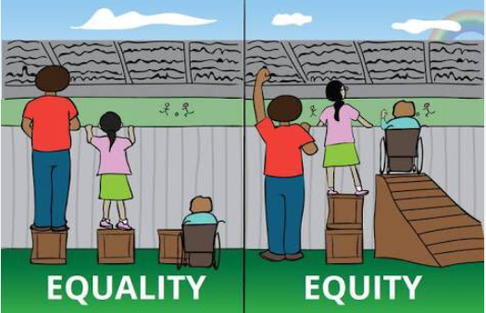
What does equitable grading mean?
Acknowledge students’ diverse backgrounds, abilities, and challenges.
Assignments accurately assess students’ academic performance.
Remove bias from grading.
Focus students on learning the content, not the points they earn.

Slide 4
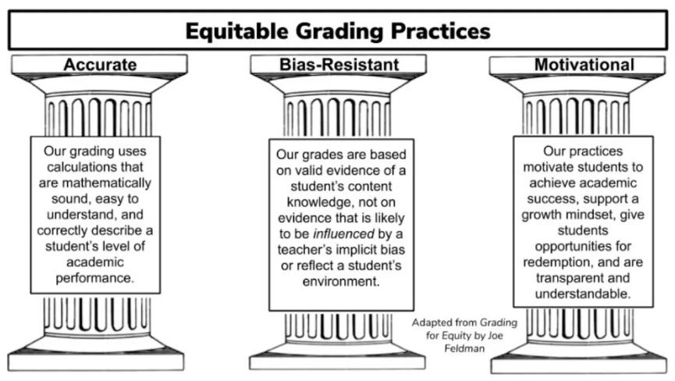
PUSD Image

Slide 5


Slide 6
Why switch to an equitable grading system?
Possible Benefits for Faculty:
No haggling over points (students primarily control their fate)
Flexible deadlines (not the gatekeeper of judging legitimacy of crisis)
Reduced social anxiety
Reduced educational trauma (not in a position of judgement, mistrust or being inflexible)
Possible Benefits for students:
No haggling over points. Flexible deadlines (schedules and compounding responsibilities are validated and accommodated)
Increased autonomy
Increased motivation
Fosters student retention and performance
Adapted from Equitable Grading Strategies for Online Teaching

Slide 7
Equitable Grading Strategies
Ungrading
  an assessment method that focuses on the learning process and de-emphasizing letter or numerical grades.
  designed to create a more student-centered, and reflective assessment experience their course.
Contract Grading
  an assessment method that emphasizes student autonomy and accountability in their course.
  students and instructors collaboratively set expectations and criteria for success in assignments and the course as a whole.
Standards or Competency Based Grading
  an assessment approach that focuses on measuring a student's mastery of specific learning standards or objectives.
  a valuable tool to provide more accurate feedback on a student's knowledge and skills.

Slide 8
Ungrading
It empowers students to take ownership of their learning, encourages deeper engagement, and reduces stress associated with letter or numerical grades.
It focuses on the learning process rather than the end result, fostering a more learner-centered and reflective educational experience.
OTC- Equity and Grading Work Group

Slide 9
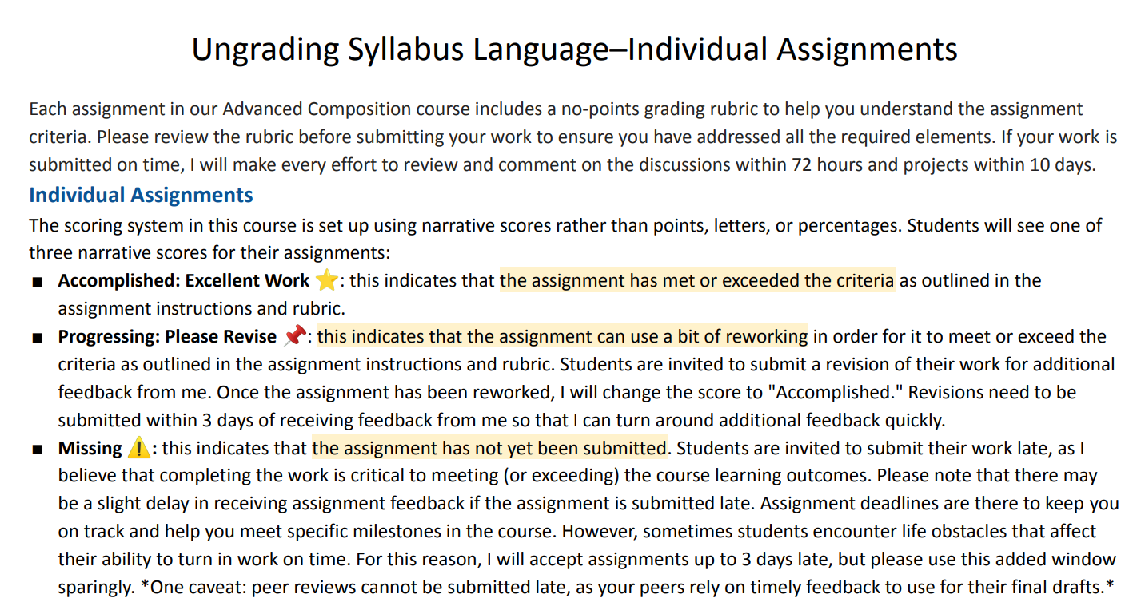

Slide 10
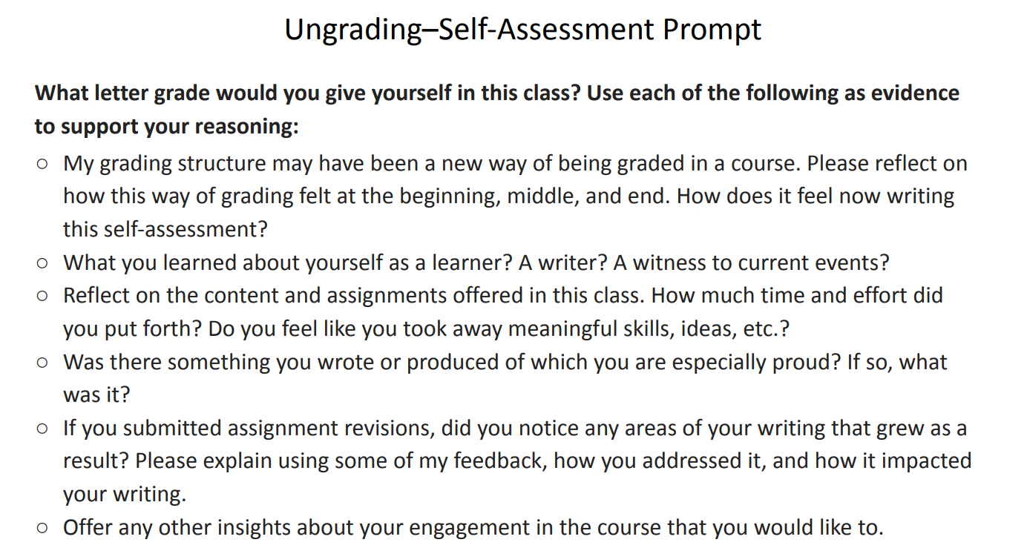

Slide 11
Contract Grading
It promotes student agency and a sense of ownership over their education.
It allows for individualized pathways to success and is especially effective in courses where self-directed learning and personal goals are paramount.

Slide 12
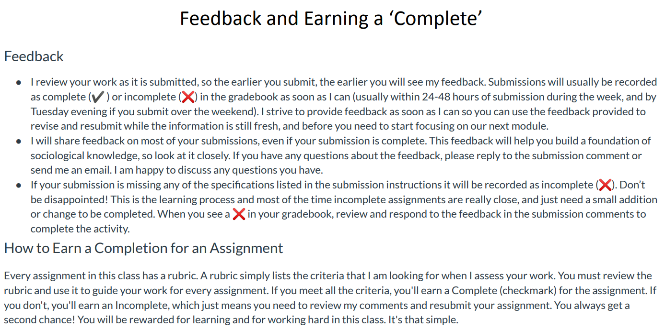
Sociology

Slide 13
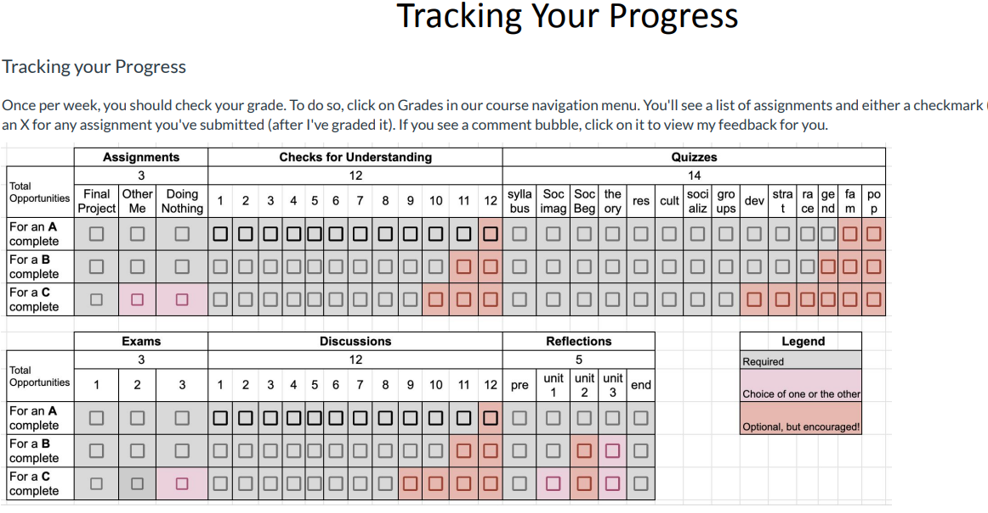

Slide 14
Standards Based Grading
It offers a more detailed and informative assessment of a student's proficiency in the specific skills and knowledge areas of the course.
It allows students to focus on areas where they need improvement and provides a more accurate representation of their abilities.

Slide 15
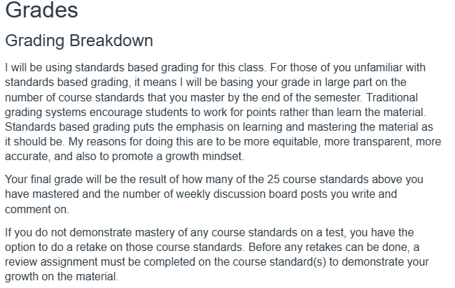
Math

Slide 16
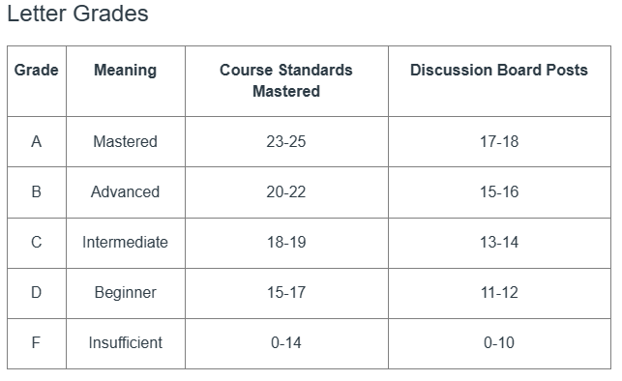

Slide 17
Math’s Journey
Skills based classes, landed on Standards Based Grading
Shared idea with the department
Reviewed measurable objectives from course outline of record
Reviewed C-ID
Collaboratively explored the material
First pass
Refine
Implementation?

Slide 18
What strategies might work best in your discipline/class?
Consider how you grade now
Don’t be afraid to Mix ‘n Match
Explore options within your comfort zone
What are some course policies that make sense for you for your chosen grading scheme?
What are some challenges that you would have to overcome?
Are you already using equitable strategies?
Share your ideas: https://tinyurl.com/LPC-FlexEquity

Slide 19
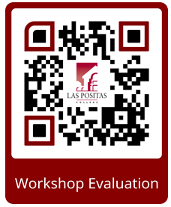
Thank you for coming!
Please fill out the session survey.
https://forms.gle/2WVyUE5yNiNBTEyj9

