Slide 1
Equity - Environmental Justice Style
First, a few facts:
Burning fossil fuels produces air pollution. (USEPA)
Air pollution from burning fossil fuels increases cases of asthma, heart disease, stroke, and lung cancer. (WHO)
Exposure to air pollution from burning fossil fuels shortens the Global life expectancy by 2.2 years. (WHO)
Unsurprisingly, those most affected by these certainties are in poor communities and the communities of people of color. (USEPA)
In the United States, the difference in the average life expectancy of the poorest and the richest among us is approximately 15 years. (National Library of Medicine)
This sounds bad, but how big could this problem be, really?

Slide 2
Equity - Environmental Justice Style
Pretty big.
As a species:
We burn approximately 100 million barrels of oil,
1.4 million tons of coal,
and 384 billion cubic feet of natural gas…
each day.
But wait! Aren’t we in California? Hasn’t the governor pledged to make us 100% clean energy by 2045?

Slide 3
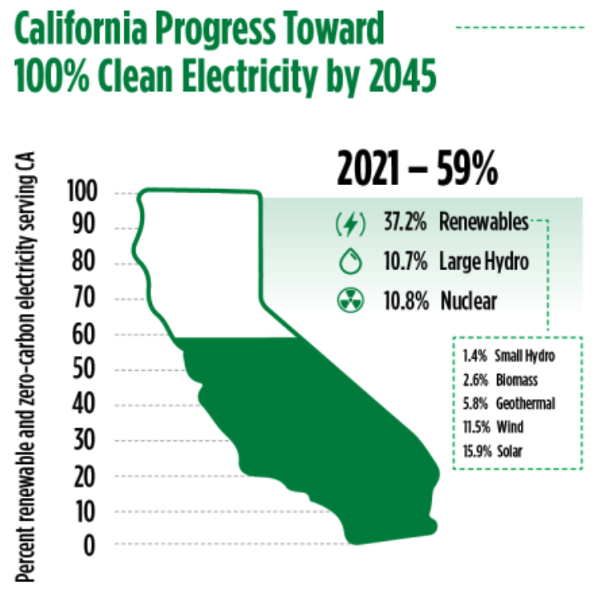
Yes! But…with a catch
Source: California Energy Commission

Slide 4
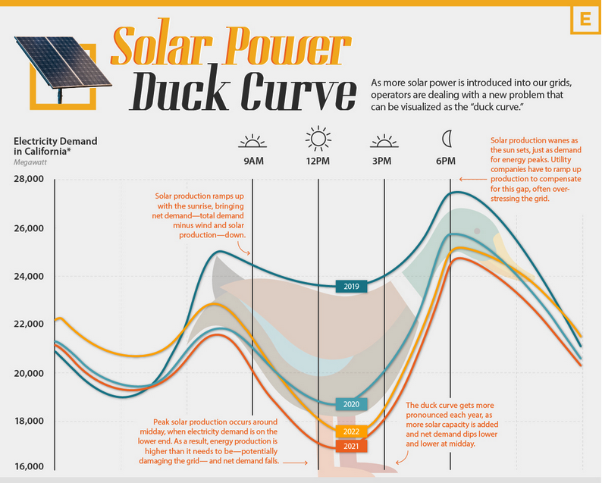
The Duck
Watch this video about understanding the Duck Curve:
https://www.energy.gov/eere/articles/confronting-duck-curve-how-address-over-generation-solar-energy

Slide 5
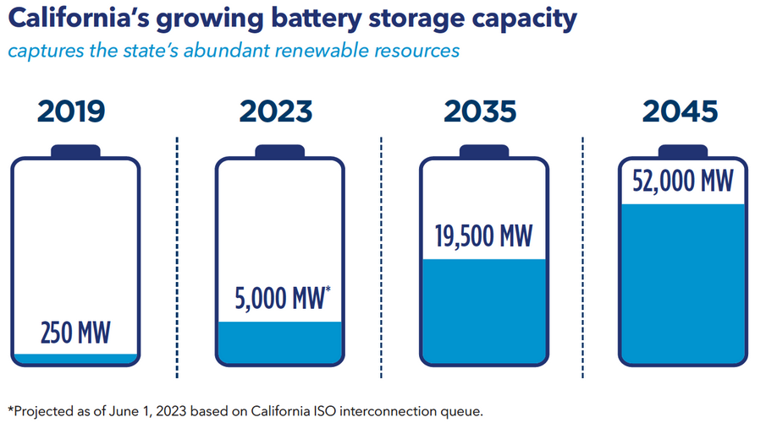
The Solution - Energy Storage
Source: California Energy Commission

Slide 6
PG&E Self Generation Incentive Program (SGIP)
Benefits for battery storage
Customers can make their home more resilient during a power outage or a Public Safety Power Shutoff (PSPS) event.
Pairing your battery with solar can enable you to recharge during the day – as long there is sufficient sunshine – to extend your home’s backup power for potentially multiple days. How long your system will provide backup power depends on your battery size, critical energy needs and, if paired with rooftop solar, weather conditions. Talk to a battery storage provider to learn more about your specific needs and options.
If you’re on a Time-of Use-rate or Home Charging rate, your battery can charge when; electricity is cheaper and discharge electricity for home use when electricity from PG&E’s grid is more expensive. When paired with solar, a battery can help you get the most bill savings under Net Energy Metering and optimize the carbon-reduction impacts from your solar system. PG&E recommends you review the expected financial return on adopting batteries prior to investing in a system.

Slide 7
Please click this code to evaluate this workshop. Your feedback is valuable!

