Slide 1
InformedK12
Tips and best practices
Lpc administrative services

Slide 2
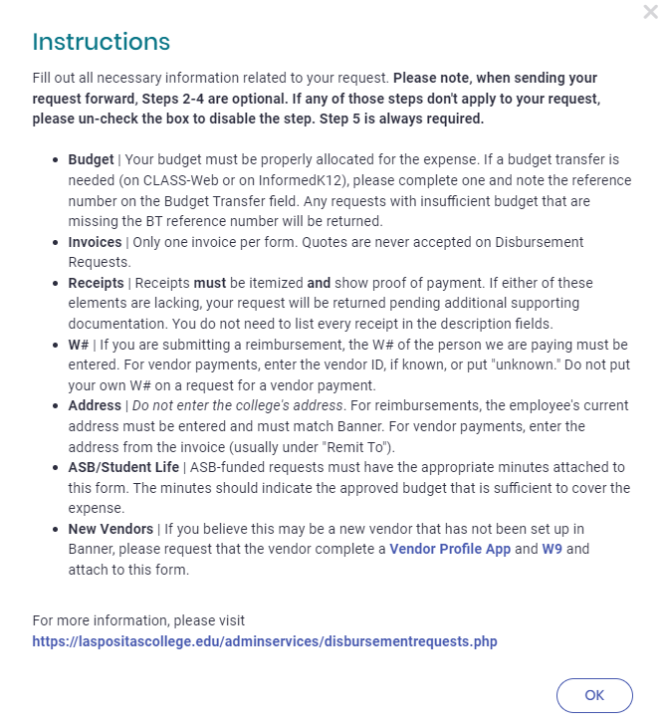

Instructions
Instructions pop up on most forms when you initiate a document
This pop up can be viewed again any time you press the Save button

Slide 3
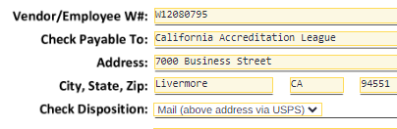
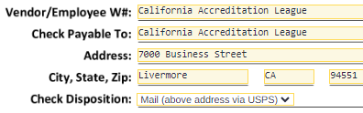
W#/Vendor ID (Banner ID)
Jane Doe’s W#
The W#/Vendor ID field is for the ID of the person/entity we are paying, not who is filling out the form.
Do not put your W# unless we are reimbursing you.
Do not duplicate the vendor name in this field. If you don’t know the W#, enter “unknown” or email Admin Services.

Slide 4
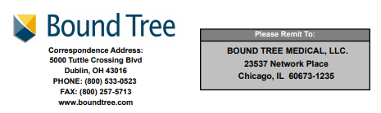
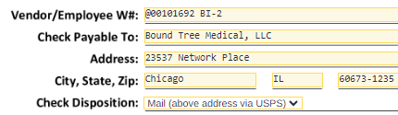
Address
The address on the form must match Banner.
Change to your address?
  Employees must update their address with HR.
  Students must update their address with Admissions & Records.
For invoices, the address on the invoice must match with the form.

Slide 5
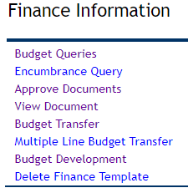
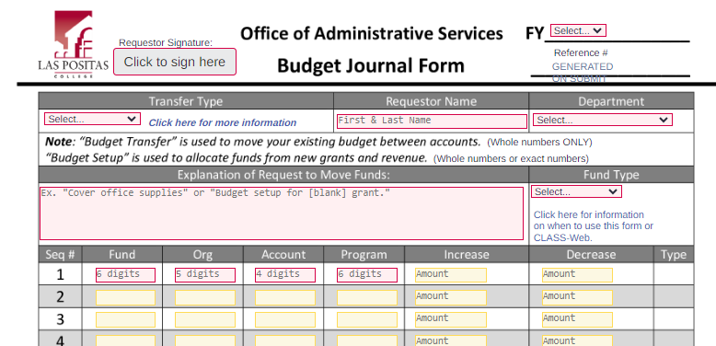
Budget
Please check your budget before submitting a form.
Complete a budget transfer in CLASS-Web or InformedK12 and reference the journal number on the related Disbursement Request or Requisition, etc.
If the Business Office receives a form with no budget and no reference number, it will be returned for correction.

Slide 6





Attachments
Must be clear and contain necessary/required information (name of business, date, itemized charges, total cost, etc.)
PDF attachments only. Other file types (Word, Excel, etc.) do not load/save correctly and will be returned for correction.
Please attach receipts/backup in a single PDF.

Slide 7
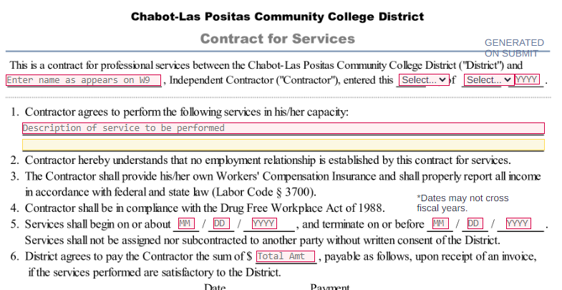
Contracts
The Contract (page 1) can ONLY be edited by the initiator. Triple-check details before sending it to the contractor. Errors on page 1 can’t be fixed by anyone else, it must be returned to Step 1 for correction and then resubmitted to the Contractor.
This is to ensure that important details like duties, cost, and duration are agreed upon/approved by the Initiator and the Contractor.
Note: Catering orders no longer require a Contract for Services

Slide 8
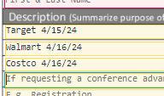


Description
On Disbursement Requests, the description does not need to be detailed. Keep it simple. Do not itemize charges. Include the purpose of the expense or group similar charges.
Examples:
  “Membership Dues 24-25”
  “Food for Club Day”

Slide 9
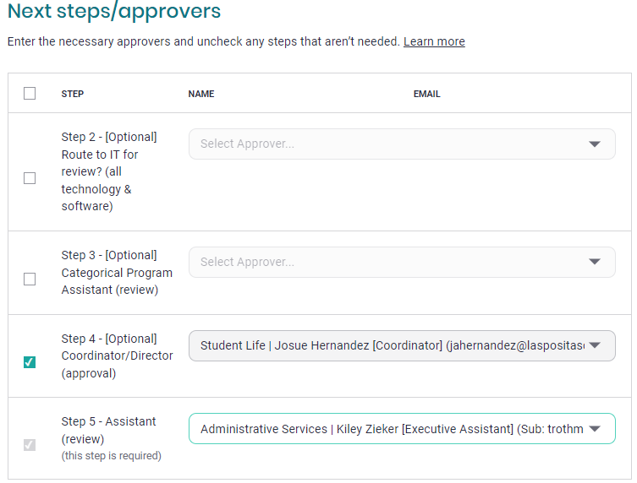
Coordinators
Some submissions require Coordinator approval before an Administrator.
These steps will appear as optional. If applicable, please select the appropriate Coordinator that manages the budget for your submission.

Slide 10
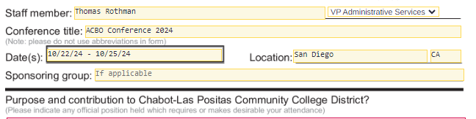
Conferences
Include the first and last date of travel. The District will only reimburse you for expenses that incurred within the dates on your Conference Leave Request.
  E.g. if the conference is on Oct. 23rd -25th, but you are traveling the night before, put Oct. 22nd - 25th.
Agendas must be attached to the Conference Expense Claim

Slide 11
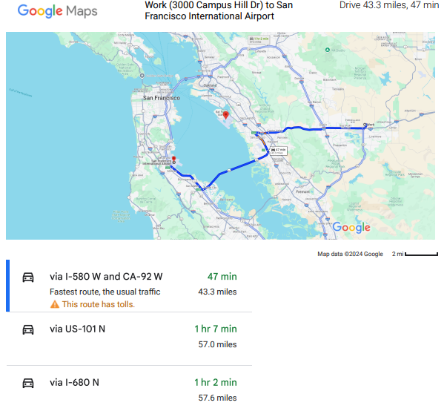
Maps
For conference travel or local travel, please only use Google Maps.
Print the overall view with multiple route options. Do not print turn-by-turn directions.
You are only reimbursed for the shortest distance, not the shortest travel time.

Slide 12
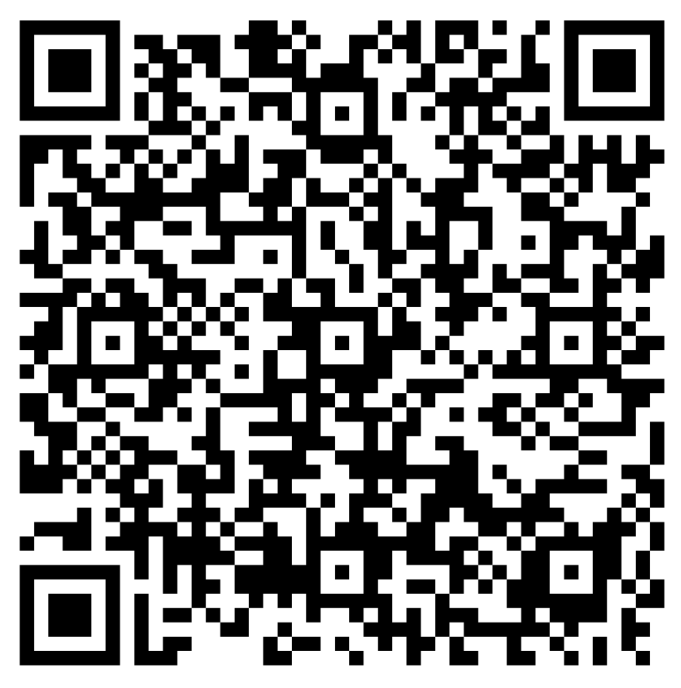
Feedback?
Feel free to submit anonymous feedback on the survey below
https://forms.office.com/r/km0vEsYzbC

