Slide 1
ePortfolios

Slide 2
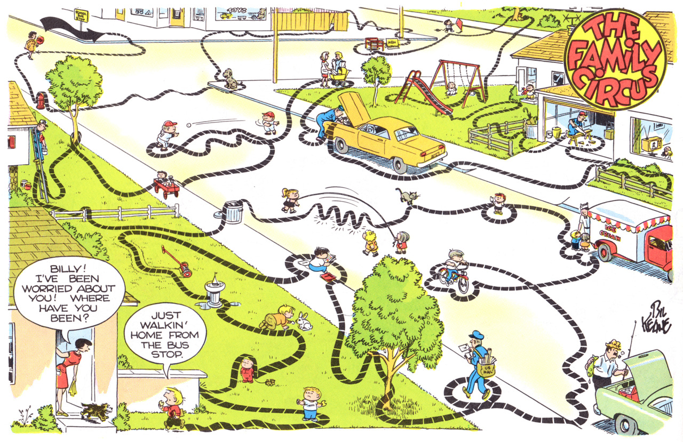

Slide 3
What is an Eportfolio?
“An e-portfolio is a digitized collection of artifacts including demonstrations, resources and accomplishments that represent an individual, group or institution.”
Lorenzo and Ittelson, Educause, 2005

Slide 4
What Can ePortfolios do?
Showcase student work
Connect post-secondary education to the workplace
Merge faculty instruction with faculty research
Join co-curricular activities to curricular activities
Relate classroom assessment to institutional assessment
Couple faculty development with faculty practices
Span across high impact practices

Slide 5
Mission
Provide opportunities for individuals to access,
integrate and utilize information that will
expand their capacity for meaningful work,
engaged citizenry and creative expression, each
being crucial to the economic, democratic and
cultural advancement of a nation.
Notes:
We provide access not success. Success is what students make of the opportunities the college provides.

Slide 6
Conflation Nation
This mission and education in general, seems to be subject to the current conflation of fiscal, political, legislative and public policy that poses as pedagogical imperatives.

Slide 7

Mandates
Notes:
This mission however, seems to be subject to the current conflation of fiscal, political and pedagogical dynamics that passes for public policy. Initiatives such as No Child Left Behind, Race to the Top, Common Core and the California Student Success Initiative are born of this conflation.
These policies are intended to spur innovative measures to address deficiencies in public education but tend to create data driven paradigms

Slide 8
Data Driven Paradigms
Initiatives such as:
No Child Left Behind
Race to the Top
Common Core
California Student Success Initiative
are born of this conflation. These policies, intended to
spur innovative measures to address deficiencies in
public education, tend to produce data-driven paradigms
Accountability tends to become synonymous with accounting
Notes:
Instead, have produced data-driven paradigms that equate testing with learning, productivity with competency and efficiency with efficacy.
These are not inherently false equivalencies but neither are they synonymous

Slide 9
Mutually Assured Construction
We’re not so different from our students
Student success lies in the student’s innate capacity to access, process, organize and apply information while utilizing available resources that enhance strengths and compensates for deficits.
We too operate as a function of the dynamic interplay of our strengths and deficits. We establish institutional outcomes that orient our efforts but struggle mightily to align our programs and services with these outcomes

Slide 10
Setting the Context: Authenticity
  Association for Authentic, Experiential, and Evidence-Based Learning AAEEBL
    https://aaeebl.org

Slide 11
LEARNING
Assessment
COMPETENCY
PRODUCTIVITY
EFFICACY
EFFICIENCY
Notes:
Data driven paradigms equate learning with testing; competency with productivity; efficacy with efficiency. The are not inherently false equivalencies but neither are they synonymous

Slide 12
Authenticity
Learning
Assessment
Competency
Productivity
Efficacy
Efficiency
Notes:
The more these concepts overlap the more authentic the student experience.
For that to happen certain conditions must exist, beginning with institutional culture. From an organizational standpoint it matters. We don’t operate in a vacuum. We bring to out work a set of values that inform what we do. If processes stifle or overide those values it impacts the dynamic.

Slide 13
Why is Authenticity Important?
Student success is often measured by indices such as persistence, completion and remediation rates, however, the college culture, the fuel that runs the institution, dictates that success is not only measured by these indices but also by the quality, values and character of it’s community and its ability to infuse those intangible elements into its programs and therefore its students.

Slide 14

An organization cannot be effective if its goals and processes do not reflect its culture
Notes:
We don’t operate in a vacuum. We bring to our work a set of values that inform what we do. If processes stifle or override those values it impacts the dynamic.

Slide 15
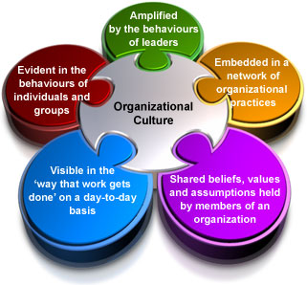
Notes:
Organizational culture is central to institutional functioning at every level.

Slide 16

Toward a Student Development Paradigm

Slide 17

Come What May
Notes:
Success depends on the use of executive functions i.e. the ability to set goals, gather information, evaluate options, distill the essence of complex demands, strategize, enact plans, adapt and persist. All this at a time when, neurologically speaking, the infrastructure simply isn’t in place to handle the demand effectively. Neurological development varies from student to student.

Slide 18
“The world is not ready for some people when they show up, but that shouldn't stop anyone “

Slide 19
We SHOULD be ready when students show up

Slide 20
The Dynamic Student
Cognitive, psychological, cultural and socioeconomic factors combine in dynamic configurations as each factor alters the other in unique, idiosyncratic and often surprising ways.
For many students these elements coalesce with relative ease and stability. For others it is a fragile alliance teetering on collapse should any one element overwhelm the others.
Notes:
This reality should form the basis for student centered practices

Slide 21
Notes:
Imagine these are all first year college students. Each organized in unique patterns. The third figure might be considered the most favorable OR…

Slide 22

Better yet……

Slide 23
Developmental Diversity
The greatest challenge for colleges is a developmental one, not in the basic skills sense
Students come to us, not only from diverse backgrounds and abilities, but also varying levels of neuro-cognitive and psychosocial development

Slide 24
Given the developmental diversity of our student population it is clear that one size does not fit all.

Slide 25

Notes:
Yet, as an institution we are attempting to provide resources for what amounts to a moving target.

Slide 26
Student Recognition
Most importantly a student development paradigm should allow us to recognize students at any given point in their development.
The idea of a one–size-fits-all delivery system ignores the reality of a developmentally diverse student population.

Slide 27

Notes:
One size clearly does not fit all, yet we are unable to recognize those outside the target area. Adopting a developmental paradigm will create a more inclusive environment

Slide 28
What does this have to do withLearning?
Learning does not happen unless there is engagement
Engagement does not happen unless purpose is clear
Purpose is not clear unless internal sense of meaning is established
ePortfolios promote the establishment of purpose

Slide 29
Examples of Student Development Paradigms
Student development is certainly not a new field of study and, as is the case for any field of study, conceptual frameworks vary based on focus, orientation, taxonomy and application.
King & Howard- Hamilton (2002) provide an overview of some of the major student development theories along with instruments used to measure them. They fall into three major categories:

Slide 30
Psychosocial Theories
Cognitive-Structural Theories
Typological Theories

Slide 31
Psychosocial Theories
Seven aspects (vectors) of identity development | Chickering & Reisser (1993) | Student Development Task and Lifestyle Assessment
African American Identity Development | Cross (1991) | Racial Identity Attitudes Scale-B
White racial identity development | Helms & Cook (1999) | White Racial Identity Scale
White identity development (based on Helm’s model of racial identity) | Claney & Parker (1989) | The White Racial Consciousness Development Scale
Beliefs, attitudes and behaviors affirming of one’s African American life and cultural heritage | Baldwin & Bell (1982) | African Self-Consciousness Scale
Ethnic identity development of adolescents | Phinney (1992) | Multigroup Ethnic Identity Measure
Sexual identity development for gays, lesbians & bisexuals | Cass (1983-84) | The Homosexual Identity Questionnaire

Slide 32
Cognitive-Structural Theories
Intellectual Development | Baxter Magolda (1992) | Measure of Epistemological Reflection
Intellectual Development | King & Kitchner (1994) | Reflective Judgment Interview Reasoning about current issues
Moral Development | Rest, Thoma, Edwards (1997) | Defining Issues Test
Moral Orientation (care and justice) | Liddell & Davis (1996) | Measure of Moral Orientation
Identity Development (cognitive, interpersonal, intrapersonal) | Kegan (1982) | Subject/Object Scale

Slide 33
Typological Theories
Learning Styles | Kolb (1984) | Learning Style Inventory
Personality Types | Meyers (1980) | Meyers-Briggs Type Indicator
While not exhaustive, this list demonstrates that student development paradigms can be as specific or wide-ranging as the students themselves. These paradigms can provide a theoretical basis for student support as a whole and be tailored to meet the specific mandates of each service area.

Slide 34
Barber, King, Baxter Magolda (2013)
Self-Authorship
( Kegan 1992)
A phase of development whereby individuals
begin to increasingly rely on an internal sense of
self to guide their actions.
Seen as a major developmental task for young
adults, this evolving sense of identity is
characterized by a shift from reliance on authority
for knowledge to awareness of one’s own values,
needs and identity
Notes:
King et al conducted an impressive study that used Kegan’s concept of “Self-Authorship” to determine what kinds of student experiences had the most impact on student development.

Slide 35
Self-Authorship (cont.)
In order for this shift to occur, individuals engage
is a process of “meaning-making” as a way
understanding who they are at any given point
in their lives. Meaning-making involves:
Consideration of multiple perspectives
Reflection on one’s own values and motivations
Pursuit of goals that are internally grounded

Slide 36
First…The bad news
Their review of the literature revealed:
many students make very small shifts in critical thinking and reasoning skills during college
personal development (including cognitive, intrapersonal and interpersonal meaning-making capacities) in early adulthood unfolds slowly and in small increments.

Slide 37
Bad news (cont.)
Students do not evidence self-authorship by the time they graduate
Essentially, colleges have a limited amount of time to impact this developmental trajectory, a task complicated by wide-ranging diversity in developmental readiness.

Slide 38
Now…The good news
Confirmed the significance of high impact experiences – “ developmentally effective experiences” on identity development
These experiences were effective to the degree they demanded an internal voice
Marginalized students demonstrate self-authorship earlier than non-marginalized

Slide 39
ePortfolios: High Impact Practice
HIPs are strategies, programs, and activities that contribute to student success and persistence to graduation.
ePortfolios require students to:
  practice higher-order thinking skills
  produce a product that showcases not only their learning, but their thinking about their learning
  integrate knowledge from other high-impact practices

Slide 40
Digital Identity
The various presentations, personas and constructions of an individual in the online space.
Digital identities are co-constructed with others who are interacting with or consuming the content

Slide 41
Context Collapse
Information posted online is intended for one audience is consumed and interpreted by a different audience
Digital identity are not solely under the control of the individual

Slide 42
Digital Reputation Management
Individuals can curate (be selective) about the content in a way that maximizes the impression they want to leave

Slide 43
Electronic Portfolio
Encourages a sense of self through the organizing, collecting and classifying “artifact” (LOOK IT UP)
Encourages thinking about ways of presenting yourself
Encourages use of images convey a sense of self or to illustrate points

Slide 44
The Practice of Reflection
We are being pummeled by a deluge of data and unless we create time and spaces in which to reflect, we will be left with only our reactions --
Rebecca Blood

Slide 45
Reflection
Reflection is what makes us learners; we need to practice, assess and perfect it.

Slide 46
Three Elements of Reflection
Meaning making process
Systematic, rigorous and disciplined
requires attitudes that value personal and intellectual growth

Slide 47
Reflection Process
What did I do?
What was important about it?
Where could I use this again?
Do I see patterns in what I did?
How well did I do?
What should I do next?

Slide 48
LINKS
  Association for Authentic, Experiential, and Evidence-Based Learning AAEEBL
    https://aaeebl.org
    https://aaeebl.org/2018/02/05/field-guide-to-eportfolio/
    Galleries
    IUPUI : https://eportfolio.iupui.edu/Gallery
    Salt Lake Community College: http://eportresource.weebly.com/examples.html
    Digication: https://www.digication.com
    Journals
    International Journal of ePortfolio: http://www.theijep.com/index.html

Slide 49
Links…Continued
San Jose State: http://ischool.sjsu.edu/current-students/courses/289-e-portfolio-handbook

