Slide 1

The Teaching and Learning Center:
A Different Kind of Animal
Notes:
Time limit: 50 minutes.
Slide 1: Activity prompt (picking a card, sitting next to a different group, an shares)
Slide 2: Introductions, our story, The TLC then and now (types of activities: FIG, APPLE & POP Gabe; DIY, DART, and LESSON STUDY, Dylan)
Slide 3: Activity prompt (create a commitment to a FIG and POP through Socrative)
Slide 4: Reflection (random sample of three people from different groups)
Slide 5: Activity prompt (creating a pedagogy of reflection and trust rather than a pedagogy of reluctance and compliance)
**
Working with others; not knowing what the outcome might be
exactly like student learning: meaningful, collaborative, context-based
2012: SS Task Force
GOALS:
faculty-driven, structured and supported to create ongoing efforts (rather than one-shot workshops)
bottom-up, top down,
structured, cohesive vision
time-consuming
project can’t be too overwhelming without limits
honoring
**
respecting the expertise of each other; exposing our vulnerability
***
magic wand: wish students do; What do you animal is staff development?
Trade ideas;
Why doesn’t staff development work?
Humor, opposites, one-shot
one-shot, isolated
solution
connect outside world to local envi

Slide 2
Make a group (2 minutes)
Turn to the person next to you and share your role at the school.
Find another pair in front of or behind your row to make a group of four.

Slide 3
Problem (5 minutes)
If traditional staff development were an animal, what would it be and why?
Please draw a sketch of the animal.
Notes:
Dylan: One person from each group stand with the picture of your animal hidden (don’t reveal yet) and wait for me to point to you when you will say what your animal was and the picture of it. (Gesture to those individuals standing one by one.)

Slide 4
A Different Kind of Animal
Teacher-driven
Collaborative
Structured and sustained
Paid

Slide 5
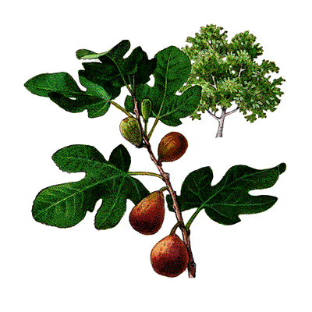

TLC Activities
FIG: Focused Inquiry Group
APPLE: Action Plan Project for Learning Excellence
Notes:
Gabe will explain the story of the TLC, how it emerged from FIGs, and then other projects to create teacher-driven projects that honors the expertise of faculty and staff.
Provides a central space for collaboration
Organizes small groups of faculty and staff within and across disciplines, to learn, share, and solve problems together
NOTE: Sample FIG questions and projects in handout.
Sample FIGs:
BIO/GEOG: What kinds of active learning activities best help students learn scientific concepts?
COUN: How can we improve students' experiences at their first orientation at BCC?
ENG: How do we help students to improve their skills conducting research and writing research papers?
MMART: Would shorter certificates result in more retention and persistence in MMArts?
MATH: How can using narratives in math reduce anxiety and increase retention/completion?
ESOL: How can we best incorporate technology to meet our language learners’ needs?

Slide 6
Sample FIG Questions (2009-2016)
BIOL/GEOG: What kinds of active learning activities best help students learn scientific concepts?
COUN: How can we improve students' experiences at their first orientation at BCC?
ENGL: How do we help students to improve their skills conducting research and writing research papers?
MMART: Would shorter certificates result in more retention and persistence in Multimedia Arts?
MATH: How can using narratives in math reduce anxiety and increase retention/completion?
ESOL: How can we best incorporate technology to meet our language learners’ needs?

Slide 7

TLC Activities
POP: Peer Observation Pool
Notes:
Gabe will explain how POPs worked and gave faculty and staff a means to witness and honor the teacher expertise and vulnerability without being focused mainly on judgement and evaluation.

Slide 8
A Different Kind of Animal
Design Lab
Experimental
Trust and vulnerability
Paid
Notes:
Pause before “Paid.”

Slide 9
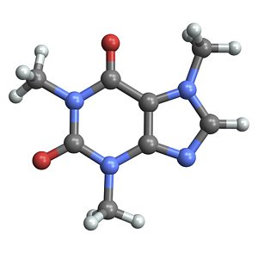
TLC Activities
LESSON STUDY: Instructional Design
Notes:
Dylan will pick up the thread of the TLC story, why he chose to get involved, and shaping the TLC to become an experimental lab for creating trust and a sense of community across the college.
Sample TLC projects: Resilience (Building a Trauma-Informed College), Out of Site Tours, Parody the Teacher

Slide 10
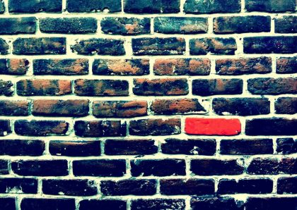
TLC Activities
DIY: Do-It-Yourself Experiments
Notes:
Dylan will pick up the thread of the TLC story, why he chose to get involved, and shaping the TLC to become an experimental lab for creating trust and a sense of community across the college.
TLC PROJECTS 2017-2018
TLC PROJECT 1 (Faculty Inquiry Group):
Faculty Lead Organizer: Loretta Kane
Research Question: Why are some basic skills students not applying the instruction they receive in class to their essays even though they have ample opportunity to practice developing their skills in the lab section of the course, held in the computer lab and equipped with their instructor as well as embedded writing coaches?
Please contact Dylan Eret (deret@peralta.edu) or the faculty lead organizer if you're interested in joining or learning more about this project.
TLC PROJECT 2 (Faculty Inquiry Group):
Faculty Lead Organizers: Heather Dodge (hdodge@peralta.edu), Scott Hoshida (shoshida@peralta.edu), Janine Greer (jgreer@peralta.edu)
Research Questions: How do we become a trauma-informed college through an awareness of our co-workers and our students' ACEs (Adverse Childhood Experiences)? What are the practices and policies we can implement so we are not re-traumatizing our students, faculty and staff?
Please contact Dylan Eret (deret@peralta.edu) or the faculty lead organizer if you're interested in joining or learning more about this project.
TLC PROJECT 3 (Discuss-Apply-Research-Tool):
Faculty Lead Organizers: Laura Ruberto and Dylan Eret
Tool: We used cloud-based video-editing software to help students produce a short film on immigrant stories for our respective courses (Humanities 5: Storytelling in American Culture and Humanities 55: Immigration in Cinema and TV). This is a brief reflection on the process of using this digital technology for student projects, and some of the surprises and challenges we faced along the way.
Please contact Dylan Eret (deret@peralta.edu) if you're interested in joining or learning more about the project.
TLC PROJECT 4 (APPLE: Action Plan Project for Learning Excellence):
Faculty Lead Organizer: Jayne Matthews
Our FIG (Faculty Inquiry Group) last year identified several areas where students could get coaching to improve their success (examples: Study Skills, Time Management; Stress Management, Tutoring, etc.). At my Flex Day presentation approximately fifteen people attended and many showed interest in working to develop short workshops for College Hour with some of these topics. The workshops would be possibly scheduled in March or April.
If you want to create a specific study skills workshop, and report back to the TLC about your results within the APPLE, please contact Dylan Eret (deret@peralta.edu) or the faculty lead organizer if you're interested in joining or learning more about this project.
TLC PROJECT 5 (DIY Role-Playing History and Performance, Intersectional Instructional Design, Lesson Study, APPLE):
Faculty Lead Organizers: Dylan Eret (deret@peralta.edu) and Seth Eisen
QUEER HISTORY TOURS AND PERFORMANCE EVENTS: This large-scale project will be a series of performance events and walking tours that will bring to life San Francisco’s rich queer history on the streets where it all began. I will collaborate with Seth Eisen (Art) to design cross-disciplinary curriculum modules and field-based activities (Art, Humanities, History, English, Social Sciences, etc.) that will integrate over two hundred years of queer history through short lectures, walking tours in San Francisco, and a series of role-playing, historical performances at Berkeley City College (with students and local performers working in collaborative theater spaces on and off campus).
Sample TLC projects: Resilience (Building a Trauma-Informed College), Out of Site Tours, Parody the Teacher

Slide 11
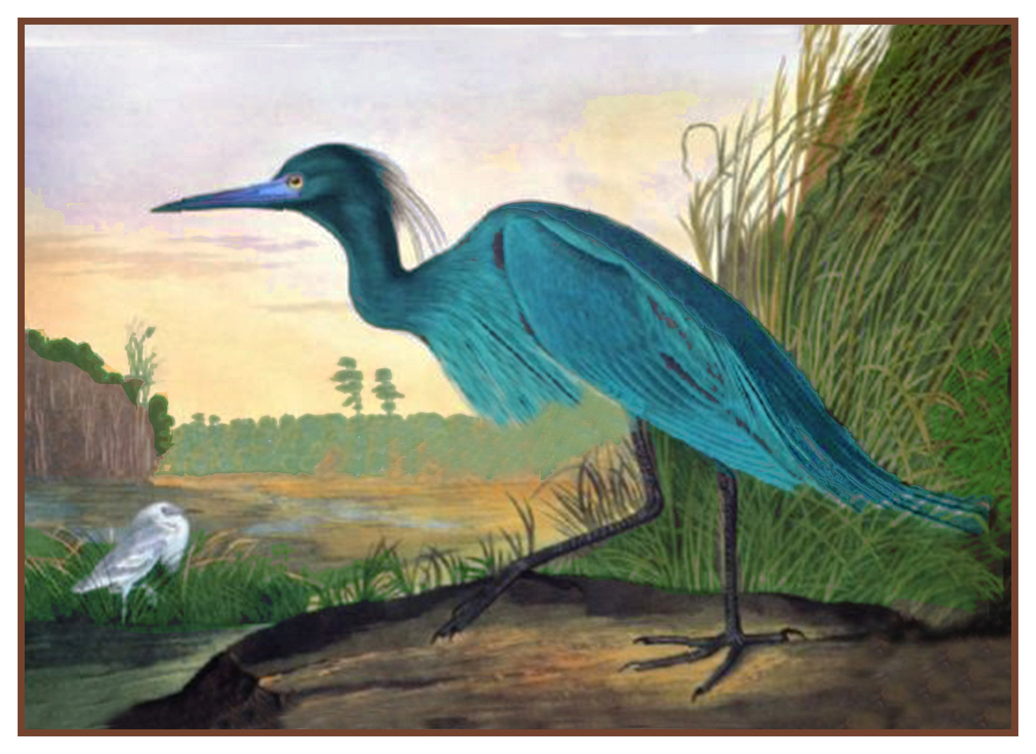
Sample TLC Projects (2017-2018): An Administrator’s Point of View
TLC PROJECT 1 (Faculty Inquiry Group):
Faculty Lead Organizer: English Basic Skills Faculty
Research Question: Why are some basic skills students not applying the instruction they receive in class to their essays even though they have ample opportunity to practice developing their skills in the lab section of the course, held in the computer lab and equipped with their instructor as well as embedded writing coaches?
TLC PROJECT 2 (Faculty Inquiry Group):
Faculty Lead Organizers: English, Library, and Counseling Faculty
Research Questions: How do we become a trauma-informed college through an awareness of our co-workers and our students' ACEs (Adverse Childhood Experiences)? What are the practices and policies we can implement so we are not re-traumatizing our students, faculty and staff?
TLC PROJECT 3 (DIY Role-Playing History and Performance)
Faculty Lead Organizers: Art and Humanities faculty
QUEER HISTORY TOURS AND STREET PERFORMANCES: This large-scale project offers a series of performance events, curriculum re-design, and walking tours for two Humanities courses (Popular Culture and Introduction to the Humanities) and across several disciplines that brings to life San Francisco’s rich queer history on the streets where it all began.
Notes:
Dylan will pick up the thread of the TLC story, why he chose to get involved, and shaping the TLC to become an experimental lab for creating trust and a sense of community across the college.
TLC PROJECTS 2017-2018
TLC PROJECT 1 (Faculty Inquiry Group):
Faculty Lead Organizer: Loretta Kane
Research Question: Why are some basic skills students not applying the instruction they receive in class to their essays even though they have ample opportunity to practice developing their skills in the lab section of the course, held in the computer lab and equipped with their instructor as well as embedded writing coaches?
Please contact Dylan Eret (deret@peralta.edu) or the faculty lead organizer if you're interested in joining or learning more about this project.
TLC PROJECT 2 (Faculty Inquiry Group):
Faculty Lead Organizers: Heather Dodge (hdodge@peralta.edu), Scott Hoshida (shoshida@peralta.edu), Janine Greer (jgreer@peralta.edu)
Research Questions: How do we become a trauma-informed college through an awareness of our co-workers and our students' ACEs (Adverse Childhood Experiences)? What are the practices and policies we can implement so we are not re-traumatizing our students, faculty and staff?
Please contact Dylan Eret (deret@peralta.edu) or the faculty lead organizer if you're interested in joining or learning more about this project.
TLC PROJECT 3 (Discuss-Apply-Research-Tool):
Faculty Lead Organizers: Laura Ruberto and Dylan Eret
Tool: We used cloud-based video-editing software to help students produce a short film on immigrant stories for our respective courses (Humanities 5: Storytelling in American Culture and Humanities 55: Immigration in Cinema and TV). This is a brief reflection on the process of using this digital technology for student projects, and some of the surprises and challenges we faced along the way.
Please contact Dylan Eret (deret@peralta.edu) if you're interested in joining or learning more about the project.
TLC PROJECT 4 (APPLE: Action Plan Project for Learning Excellence):
Faculty Lead Organizer: Jayne Matthews
Our FIG (Faculty Inquiry Group) last year identified several areas where students could get coaching to improve their success (examples: Study Skills, Time Management; Stress Management, Tutoring, etc.). At my Flex Day presentation approximately fifteen people attended and many showed interest in working to develop short workshops for College Hour with some of these topics. The workshops would be possibly scheduled in March or April.
If you want to create a specific study skills workshop, and report back to the TLC about your results within the APPLE, please contact Dylan Eret (deret@peralta.edu) or the faculty lead organizer if you're interested in joining or learning more about this project.
TLC PROJECT 5 (DIY Role-Playing History and Performance, Intersectional Instructional Design, Lesson Study, APPLE):
Faculty Lead Organizers: Dylan Eret (deret@peralta.edu) and Seth Eisen
QUEER HISTORY TOURS AND PERFORMANCE EVENTS: This large-scale project will be a series of performance events and walking tours that will bring to life San Francisco’s rich queer history on the streets where it all began. I will collaborate with Seth Eisen (Art) to design cross-disciplinary curriculum modules and field-based activities (Art, Humanities, History, English, Social Sciences, etc.) that will integrate over two hundred years of queer history through short lectures, walking tours in San Francisco, and a series of role-playing, historical performances at Berkeley City College (with students and local performers working in collaborative theater spaces on and off campus).
Sample TLC projects: Resilience (Building a Trauma-Informed College), Out of Site Tours, Parody the Teacher

Slide 12
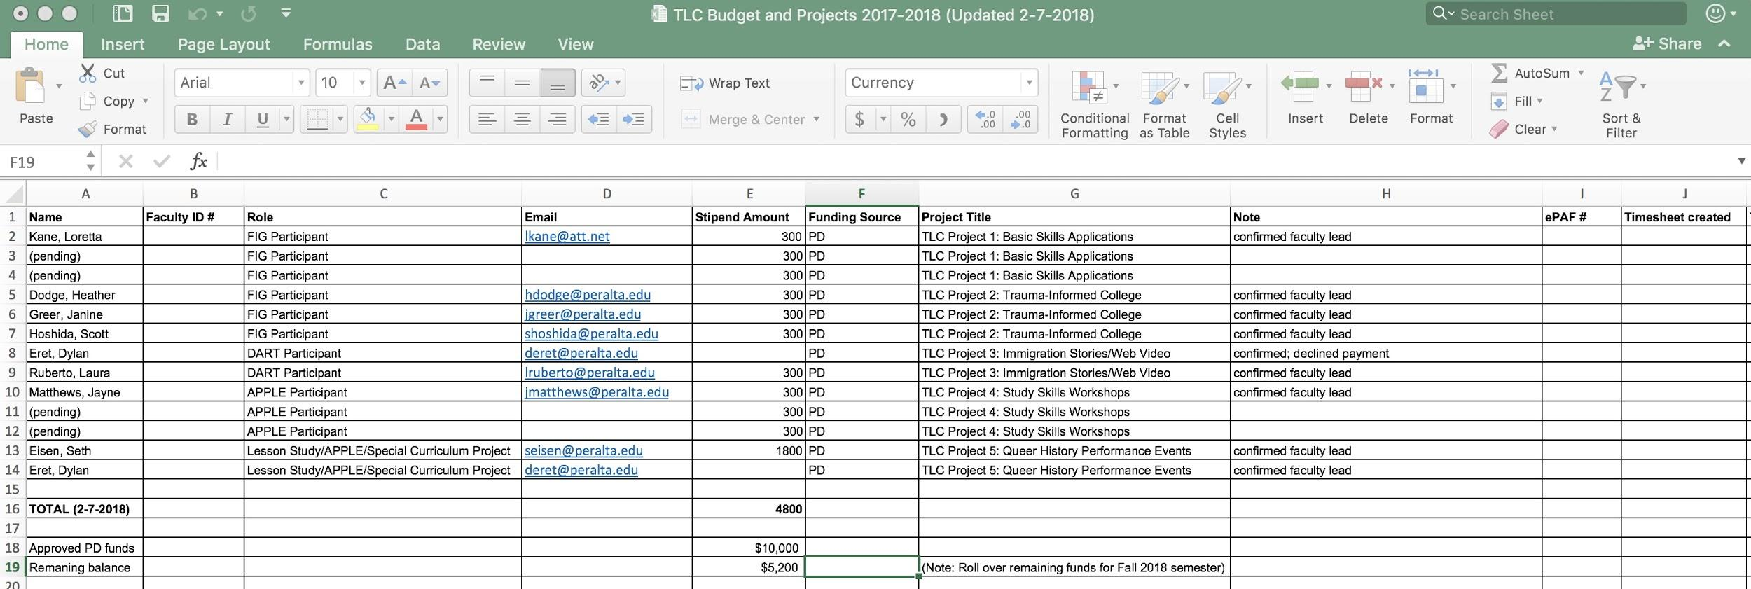
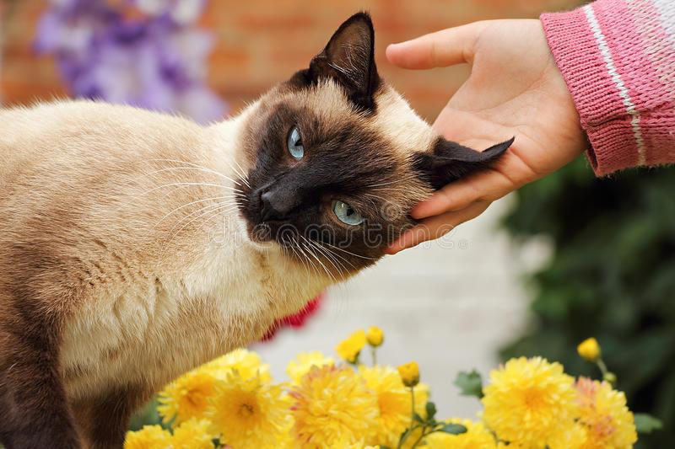
Sample TLC Projects (2017-2018): An Administrator’s Point of View
Notes:
Dylan will pick up the thread of the TLC story, why he chose to get involved, and shaping the TLC to become an experimental lab for creating trust and a sense of community across the college.
TLC PROJECTS 2017-2018
TLC PROJECT 1 (Faculty Inquiry Group):
Faculty Lead Organizer: Loretta Kane
Research Question: Why are some basic skills students not applying the instruction they receive in class to their essays even though they have ample opportunity to practice developing their skills in the lab section of the course, held in the computer lab and equipped with their instructor as well as embedded writing coaches?
Please contact Dylan Eret (deret@peralta.edu) or the faculty lead organizer if you're interested in joining or learning more about this project.
TLC PROJECT 2 (Faculty Inquiry Group):
Faculty Lead Organizers: Heather Dodge (hdodge@peralta.edu), Scott Hoshida (shoshida@peralta.edu), Janine Greer (jgreer@peralta.edu)
Research Questions: How do we become a trauma-informed college through an awareness of our co-workers and our students' ACEs (Adverse Childhood Experiences)? What are the practices and policies we can implement so we are not re-traumatizing our students, faculty and staff?
Please contact Dylan Eret (deret@peralta.edu) or the faculty lead organizer if you're interested in joining or learning more about this project.
TLC PROJECT 3 (Discuss-Apply-Research-Tool):
Faculty Lead Organizers: Laura Ruberto and Dylan Eret
Tool: We used cloud-based video-editing software to help students produce a short film on immigrant stories for our respective courses (Humanities 5: Storytelling in American Culture and Humanities 55: Immigration in Cinema and TV). This is a brief reflection on the process of using this digital technology for student projects, and some of the surprises and challenges we faced along the way.
Please contact Dylan Eret (deret@peralta.edu) if you're interested in joining or learning more about the project.
TLC PROJECT 4 (APPLE: Action Plan Project for Learning Excellence):
Faculty Lead Organizer: Jayne Matthews
Our FIG (Faculty Inquiry Group) last year identified several areas where students could get coaching to improve their success (examples: Study Skills, Time Management; Stress Management, Tutoring, etc.). At my Flex Day presentation approximately fifteen people attended and many showed interest in working to develop short workshops for College Hour with some of these topics. The workshops would be possibly scheduled in March or April.
If you want to create a specific study skills workshop, and report back to the TLC about your results within the APPLE, please contact Dylan Eret (deret@peralta.edu) or the faculty lead organizer if you're interested in joining or learning more about this project.
TLC PROJECT 5 (DIY Role-Playing History and Performance, Intersectional Instructional Design, Lesson Study, APPLE):
Faculty Lead Organizers: Dylan Eret (deret@peralta.edu) and Seth Eisen
QUEER HISTORY TOURS AND PERFORMANCE EVENTS: This large-scale project will be a series of performance events and walking tours that will bring to life San Francisco’s rich queer history on the streets where it all began. I will collaborate with Seth Eisen (Art) to design cross-disciplinary curriculum modules and field-based activities (Art, Humanities, History, English, Social Sciences, etc.) that will integrate over two hundred years of queer history through short lectures, walking tours in San Francisco, and a series of role-playing, historical performances at Berkeley City College (with students and local performers working in collaborative theater spaces on and off campus).
Sample TLC projects: Resilience (Building a Trauma-Informed College), Out of Site Tours, Parody the Teacher

Slide 13
Sample TLC Projects (2017-2018)
Faculty Inquiry Group (FIG): English, Counseling, and Library faculty
Research Questions: How do we become a trauma-informed college through an awareness of our co-workers and our students' ACEs (Adverse Childhood Experiences)?
What are the practices and policies we can implement so we are not re-traumatizing our students, faculty and staff?
Notes:
Dylan will pick up the thread of the TLC story, why he chose to get involved, and shaping the TLC to become an experimental lab for creating trust and a sense of community across the college.
TLC PROJECTS 2017-2018
TLC PROJECT 1 (Faculty Inquiry Group):
Faculty Lead Organizer: Loretta Kane
Research Question: Why are some basic skills students not applying the instruction they receive in class to their essays even though they have ample opportunity to practice developing their skills in the lab section of the course, held in the computer lab and equipped with their instructor as well as embedded writing coaches?
Please contact Dylan Eret (deret@peralta.edu) or the faculty lead organizer if you're interested in joining or learning more about this project.
TLC PROJECT 2 (Faculty Inquiry Group):
Faculty Lead Organizers: Heather Dodge (hdodge@peralta.edu), Scott Hoshida (shoshida@peralta.edu), Janine Greer (jgreer@peralta.edu)
Research Questions: How do we become a trauma-informed college through an awareness of our co-workers and our students' ACEs (Adverse Childhood Experiences)? What are the practices and policies we can implement so we are not re-traumatizing our students, faculty and staff?
Please contact Dylan Eret (deret@peralta.edu) or the faculty lead organizer if you're interested in joining or learning more about this project.
TLC PROJECT 3 (Discuss-Apply-Research-Tool):
Faculty Lead Organizers: Laura Ruberto and Dylan Eret
Tool: We used cloud-based video-editing software to help students produce a short film on immigrant stories for our respective courses (Humanities 5: Storytelling in American Culture and Humanities 55: Immigration in Cinema and TV). This is a brief reflection on the process of using this digital technology for student projects, and some of the surprises and challenges we faced along the way.
Please contact Dylan Eret (deret@peralta.edu) if you're interested in joining or learning more about the project.
TLC PROJECT 4 (APPLE: Action Plan Project for Learning Excellence):
Faculty Lead Organizer: Jayne Matthews
Our FIG (Faculty Inquiry Group) last year identified several areas where students could get coaching to improve their success (examples: Study Skills, Time Management; Stress Management, Tutoring, etc.). At my Flex Day presentation approximately fifteen people attended and many showed interest in working to develop short workshops for College Hour with some of these topics. The workshops would be possibly scheduled in March or April.
If you want to create a specific study skills workshop, and report back to the TLC about your results within the APPLE, please contact Dylan Eret (deret@peralta.edu) or the faculty lead organizer if you're interested in joining or learning more about this project.
TLC PROJECT 5 (DIY Role-Playing History and Performance, Intersectional Instructional Design, Lesson Study, APPLE):
Faculty Lead Organizers: Dylan Eret (deret@peralta.edu) and Seth Eisen
QUEER HISTORY TOURS AND PERFORMANCE EVENTS: This large-scale project will be a series of performance events and walking tours that will bring to life San Francisco’s rich queer history on the streets where it all began. I will collaborate with Seth Eisen (Art) to design cross-disciplinary curriculum modules and field-based activities (Art, Humanities, History, English, Social Sciences, etc.) that will integrate over two hundred years of queer history through short lectures, walking tours in San Francisco, and a series of role-playing, historical performances at Berkeley City College (with students and local performers working in collaborative theater spaces on and off campus).
Sample TLC projects: Resilience (Building a Trauma-Informed College), Out of Site Tours, Parody the Teacher

Slide 14
Sample TLC Projects (2017-2018)
Faculty Inquiry Group (FIG): English faculty
Research Question:
Why are some basic skills students not applying the instruction they receive in class to their essays…
...even though they have ample opportunity to practice developing their skills in the lab section of the course, held in the computer lab and equipped with their instructor as well as embedded writing coaches?
Notes:
Dylan will pick up the thread of the TLC story, why he chose to get involved, and shaping the TLC to become an experimental lab for creating trust and a sense of community across the college.
TLC PROJECTS 2017-2018
TLC PROJECT 1 (Faculty Inquiry Group):
Faculty Lead Organizer: Loretta Kane
Research Question: Why are some basic skills students not applying the instruction they receive in class to their essays even though they have ample opportunity to practice developing their skills in the lab section of the course, held in the computer lab and equipped with their instructor as well as embedded writing coaches?
Please contact Dylan Eret (deret@peralta.edu) or the faculty lead organizer if you're interested in joining or learning more about this project.
TLC PROJECT 2 (Faculty Inquiry Group):
Faculty Lead Organizers: Heather Dodge (hdodge@peralta.edu), Scott Hoshida (shoshida@peralta.edu), Janine Greer (jgreer@peralta.edu)
Research Questions: How do we become a trauma-informed college through an awareness of our co-workers and our students' ACEs (Adverse Childhood Experiences)? What are the practices and policies we can implement so we are not re-traumatizing our students, faculty and staff?
Please contact Dylan Eret (deret@peralta.edu) or the faculty lead organizer if you're interested in joining or learning more about this project.
TLC PROJECT 3 (Discuss-Apply-Research-Tool):
Faculty Lead Organizers: Laura Ruberto and Dylan Eret
Tool: We used cloud-based video-editing software to help students produce a short film on immigrant stories for our respective courses (Humanities 5: Storytelling in American Culture and Humanities 55: Immigration in Cinema and TV). This is a brief reflection on the process of using this digital technology for student projects, and some of the surprises and challenges we faced along the way.
Please contact Dylan Eret (deret@peralta.edu) if you're interested in joining or learning more about the project.
TLC PROJECT 4 (APPLE: Action Plan Project for Learning Excellence):
Faculty Lead Organizer: Jayne Matthews
Our FIG (Faculty Inquiry Group) last year identified several areas where students could get coaching to improve their success (examples: Study Skills, Time Management; Stress Management, Tutoring, etc.). At my Flex Day presentation approximately fifteen people attended and many showed interest in working to develop short workshops for College Hour with some of these topics. The workshops would be possibly scheduled in March or April.
If you want to create a specific study skills workshop, and report back to the TLC about your results within the APPLE, please contact Dylan Eret (deret@peralta.edu) or the faculty lead organizer if you're interested in joining or learning more about this project.
TLC PROJECT 5 (DIY Role-Playing History and Performance, Intersectional Instructional Design, Lesson Study, APPLE):
Faculty Lead Organizers: Dylan Eret (deret@peralta.edu) and Seth Eisen
QUEER HISTORY TOURS AND PERFORMANCE EVENTS: This large-scale project will be a series of performance events and walking tours that will bring to life San Francisco’s rich queer history on the streets where it all began. I will collaborate with Seth Eisen (Art) to design cross-disciplinary curriculum modules and field-based activities (Art, Humanities, History, English, Social Sciences, etc.) that will integrate over two hundred years of queer history through short lectures, walking tours in San Francisco, and a series of role-playing, historical performances at Berkeley City College (with students and local performers working in collaborative theater spaces on and off campus).
Sample TLC projects: Resilience (Building a Trauma-Informed College), Out of Site Tours, Parody the Teacher

Slide 15
Sample TLC Projects (2017-2018)
DIY/LESSON STUDY: Art (Seth Eisen) and Humanities faculty (Dylan Eret)
QUEER HISTORY TOURS AND STREET PERFORMANCES:
This large-scale project offers a series of performance events, curriculum re-design, and walking tours for two Humanities courses (Popular Culture and Introduction to the Humanities) and across several disciplines that brings to life San Francisco’s rich queer history on the streets where it all began.
Notes:
Dylan will pick up the thread of the TLC story, why he chose to get involved, and shaping the TLC to become an experimental lab for creating trust and a sense of community across the college.
TLC PROJECTS 2017-2018
TLC PROJECT 1 (Faculty Inquiry Group):
Faculty Lead Organizer: Loretta Kane
Research Question: Why are some basic skills students not applying the instruction they receive in class to their essays even though they have ample opportunity to practice developing their skills in the lab section of the course, held in the computer lab and equipped with their instructor as well as embedded writing coaches?
Please contact Dylan Eret (deret@peralta.edu) or the faculty lead organizer if you're interested in joining or learning more about this project.
TLC PROJECT 2 (Faculty Inquiry Group):
Faculty Lead Organizers: Heather Dodge (hdodge@peralta.edu), Scott Hoshida (shoshida@peralta.edu), Janine Greer (jgreer@peralta.edu)
Research Questions: How do we become a trauma-informed college through an awareness of our co-workers and our students' ACEs (Adverse Childhood Experiences)? What are the practices and policies we can implement so we are not re-traumatizing our students, faculty and staff?
Please contact Dylan Eret (deret@peralta.edu) or the faculty lead organizer if you're interested in joining or learning more about this project.
TLC PROJECT 3 (Discuss-Apply-Research-Tool):
Faculty Lead Organizers: Laura Ruberto and Dylan Eret
Tool: We used cloud-based video-editing software to help students produce a short film on immigrant stories for our respective courses (Humanities 5: Storytelling in American Culture and Humanities 55: Immigration in Cinema and TV). This is a brief reflection on the process of using this digital technology for student projects, and some of the surprises and challenges we faced along the way.
Please contact Dylan Eret (deret@peralta.edu) if you're interested in joining or learning more about the project.
TLC PROJECT 4 (APPLE: Action Plan Project for Learning Excellence):
Faculty Lead Organizer: Jayne Matthews
Our FIG (Faculty Inquiry Group) last year identified several areas where students could get coaching to improve their success (examples: Study Skills, Time Management; Stress Management, Tutoring, etc.). At my Flex Day presentation approximately fifteen people attended and many showed interest in working to develop short workshops for College Hour with some of these topics. The workshops would be possibly scheduled in March or April.
If you want to create a specific study skills workshop, and report back to the TLC about your results within the APPLE, please contact Dylan Eret (deret@peralta.edu) or the faculty lead organizer if you're interested in joining or learning more about this project.
TLC PROJECT 5 (DIY Role-Playing History and Performance, Intersectional Instructional Design, Lesson Study, APPLE):
Faculty Lead Organizers: Dylan Eret (deret@peralta.edu) and Seth Eisen
QUEER HISTORY TOURS AND PERFORMANCE EVENTS: This large-scale project will be a series of performance events and walking tours that will bring to life San Francisco’s rich queer history on the streets where it all began. I will collaborate with Seth Eisen (Art) to design cross-disciplinary curriculum modules and field-based activities (Art, Humanities, History, English, Social Sciences, etc.) that will integrate over two hundred years of queer history through short lectures, walking tours in San Francisco, and a series of role-playing, historical performances at Berkeley City College (with students and local performers working in collaborative theater spaces on and off campus).
Sample TLC projects: Resilience (Building a Trauma-Informed College), Out of Site Tours, Parody the Teacher

Slide 16
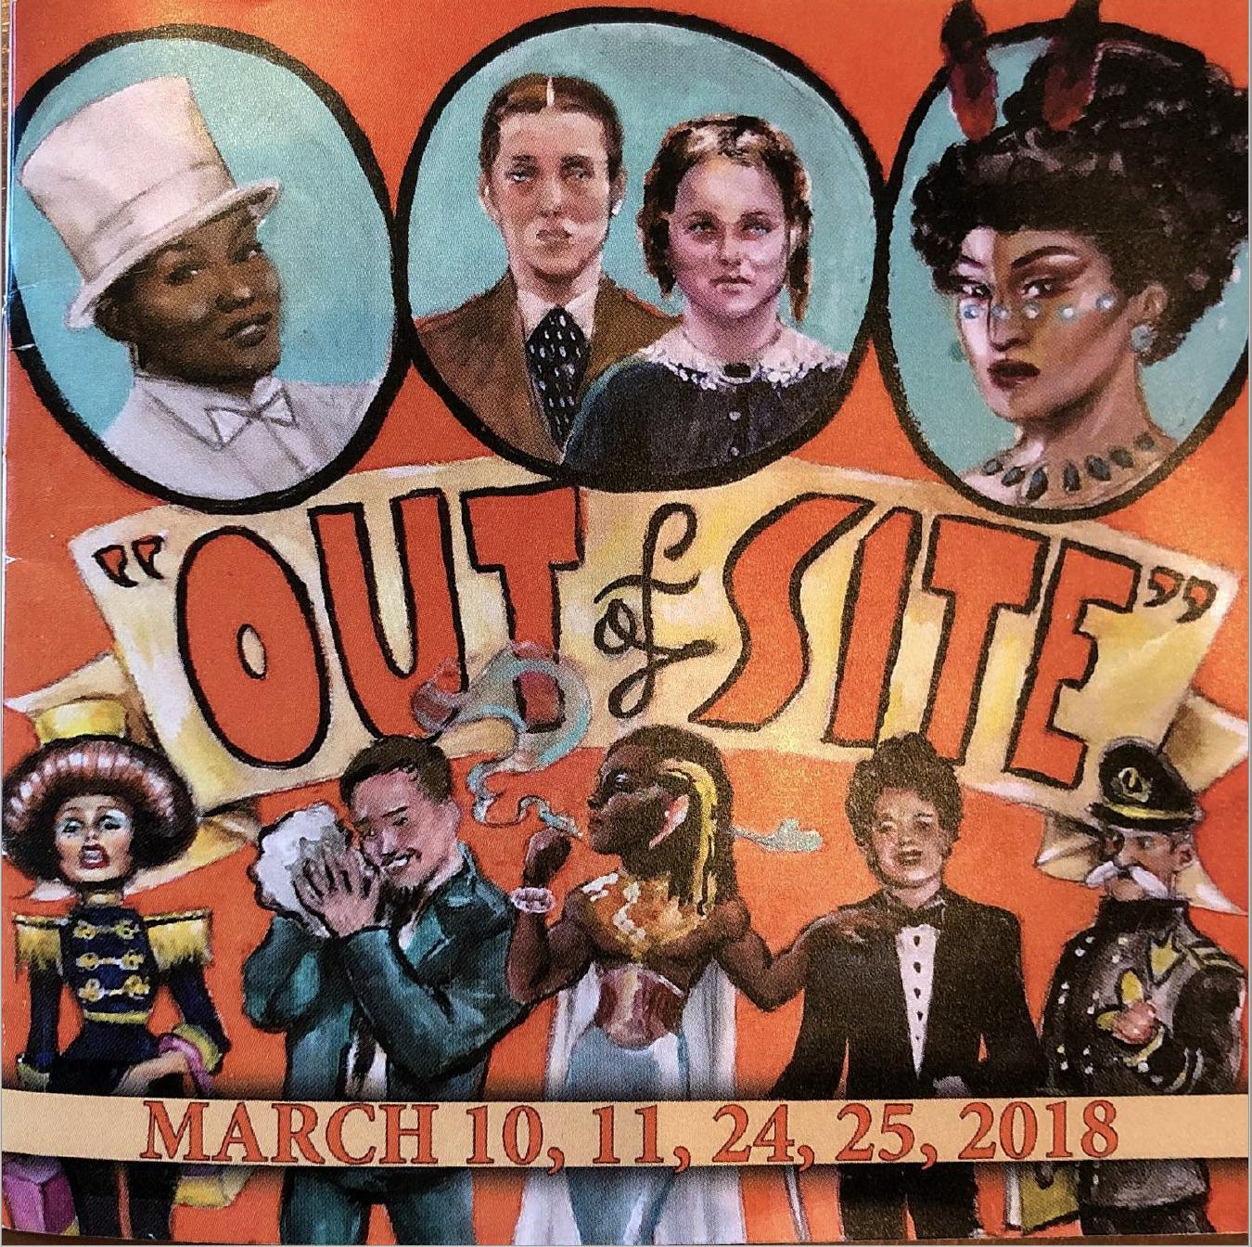
Notes:
Dylan will pick up the thread of the TLC story, why he chose to get involved, and shaping the TLC to become an experimental lab for creating trust and a sense of community across the college.
TLC PROJECTS 2017-2018
TLC PROJECT 1 (Faculty Inquiry Group):
Faculty Lead Organizer: Loretta Kane
Research Question: Why are some basic skills students not applying the instruction they receive in class to their essays even though they have ample opportunity to practice developing their skills in the lab section of the course, held in the computer lab and equipped with their instructor as well as embedded writing coaches?
Please contact Dylan Eret (deret@peralta.edu) or the faculty lead organizer if you're interested in joining or learning more about this project.
TLC PROJECT 2 (Faculty Inquiry Group):
Faculty Lead Organizers: Heather Dodge (hdodge@peralta.edu), Scott Hoshida (shoshida@peralta.edu), Janine Greer (jgreer@peralta.edu)
Research Questions: How do we become a trauma-informed college through an awareness of our co-workers and our students' ACEs (Adverse Childhood Experiences)? What are the practices and policies we can implement so we are not re-traumatizing our students, faculty and staff?
Please contact Dylan Eret (deret@peralta.edu) or the faculty lead organizer if you're interested in joining or learning more about this project.
TLC PROJECT 3 (Discuss-Apply-Research-Tool):
Faculty Lead Organizers: Laura Ruberto and Dylan Eret
Tool: We used cloud-based video-editing software to help students produce a short film on immigrant stories for our respective courses (Humanities 5: Storytelling in American Culture and Humanities 55: Immigration in Cinema and TV). This is a brief reflection on the process of using this digital technology for student projects, and some of the surprises and challenges we faced along the way.
Please contact Dylan Eret (deret@peralta.edu) if you're interested in joining or learning more about the project.
TLC PROJECT 4 (APPLE: Action Plan Project for Learning Excellence):
Faculty Lead Organizer: Jayne Matthews
Our FIG (Faculty Inquiry Group) last year identified several areas where students could get coaching to improve their success (examples: Study Skills, Time Management; Stress Management, Tutoring, etc.). At my Flex Day presentation approximately fifteen people attended and many showed interest in working to develop short workshops for College Hour with some of these topics. The workshops would be possibly scheduled in March or April.
If you want to create a specific study skills workshop, and report back to the TLC about your results within the APPLE, please contact Dylan Eret (deret@peralta.edu) or the faculty lead organizer if you're interested in joining or learning more about this project.
TLC PROJECT 5 (DIY Role-Playing History and Performance, Intersectional Instructional Design, Lesson Study, APPLE):
Faculty Lead Organizers: Dylan Eret (deret@peralta.edu) and Seth Eisen
QUEER HISTORY TOURS AND PERFORMANCE EVENTS: This large-scale project will be a series of performance events and walking tours that will bring to life San Francisco’s rich queer history on the streets where it all began. I will collaborate with Seth Eisen (Art) to design cross-disciplinary curriculum modules and field-based activities (Art, Humanities, History, English, Social Sciences, etc.) that will integrate over two hundred years of queer history through short lectures, walking tours in San Francisco, and a series of role-playing, historical performances at Berkeley City College (with students and local performers working in collaborative theater spaces on and off campus).
Sample TLC projects: Resilience (Building a Trauma-Informed College), Out of Site Tours, Parody the Teacher

Slide 17
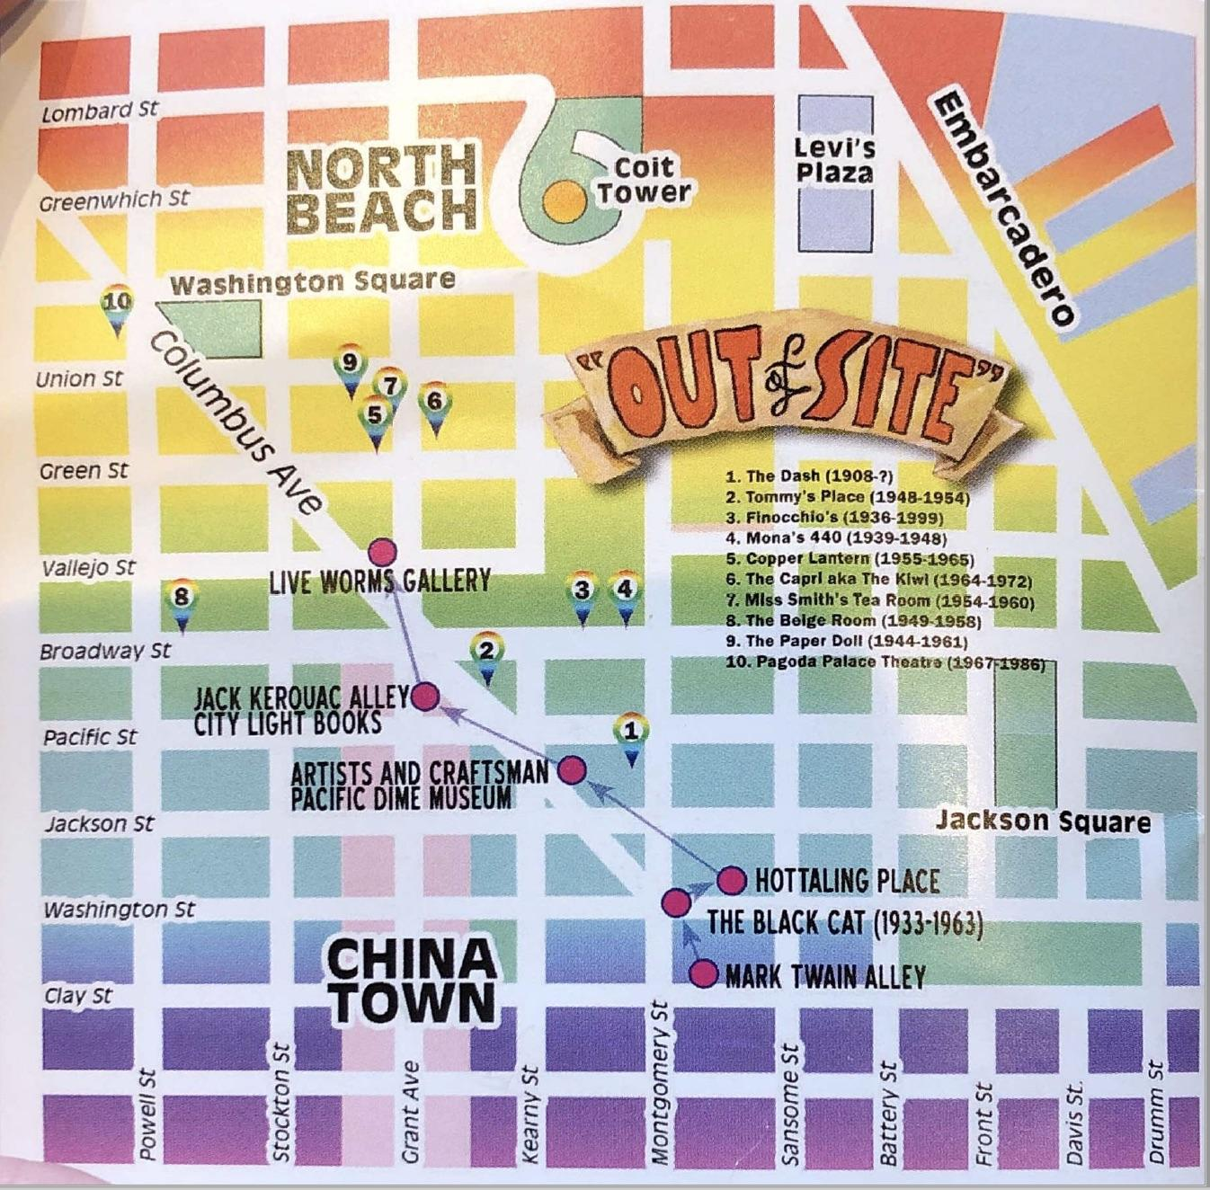
Notes:
Dylan will pick up the thread of the TLC story, why he chose to get involved, and shaping the TLC to become an experimental lab for creating trust and a sense of community across the college.
TLC PROJECTS 2017-2018
TLC PROJECT 1 (Faculty Inquiry Group):
Faculty Lead Organizer: Loretta Kane
Research Question: Why are some basic skills students not applying the instruction they receive in class to their essays even though they have ample opportunity to practice developing their skills in the lab section of the course, held in the computer lab and equipped with their instructor as well as embedded writing coaches?
Please contact Dylan Eret (deret@peralta.edu) or the faculty lead organizer if you're interested in joining or learning more about this project.
TLC PROJECT 2 (Faculty Inquiry Group):
Faculty Lead Organizers: Heather Dodge (hdodge@peralta.edu), Scott Hoshida (shoshida@peralta.edu), Janine Greer (jgreer@peralta.edu)
Research Questions: How do we become a trauma-informed college through an awareness of our co-workers and our students' ACEs (Adverse Childhood Experiences)? What are the practices and policies we can implement so we are not re-traumatizing our students, faculty and staff?
Please contact Dylan Eret (deret@peralta.edu) or the faculty lead organizer if you're interested in joining or learning more about this project.
TLC PROJECT 3 (Discuss-Apply-Research-Tool):
Faculty Lead Organizers: Laura Ruberto and Dylan Eret
Tool: We used cloud-based video-editing software to help students produce a short film on immigrant stories for our respective courses (Humanities 5: Storytelling in American Culture and Humanities 55: Immigration in Cinema and TV). This is a brief reflection on the process of using this digital technology for student projects, and some of the surprises and challenges we faced along the way.
Please contact Dylan Eret (deret@peralta.edu) if you're interested in joining or learning more about the project.
TLC PROJECT 4 (APPLE: Action Plan Project for Learning Excellence):
Faculty Lead Organizer: Jayne Matthews
Our FIG (Faculty Inquiry Group) last year identified several areas where students could get coaching to improve their success (examples: Study Skills, Time Management; Stress Management, Tutoring, etc.). At my Flex Day presentation approximately fifteen people attended and many showed interest in working to develop short workshops for College Hour with some of these topics. The workshops would be possibly scheduled in March or April.
If you want to create a specific study skills workshop, and report back to the TLC about your results within the APPLE, please contact Dylan Eret (deret@peralta.edu) or the faculty lead organizer if you're interested in joining or learning more about this project.
TLC PROJECT 5 (DIY Role-Playing History and Performance, Intersectional Instructional Design, Lesson Study, APPLE):
Faculty Lead Organizers: Dylan Eret (deret@peralta.edu) and Seth Eisen
QUEER HISTORY TOURS AND PERFORMANCE EVENTS: This large-scale project will be a series of performance events and walking tours that will bring to life San Francisco’s rich queer history on the streets where it all began. I will collaborate with Seth Eisen (Art) to design cross-disciplinary curriculum modules and field-based activities (Art, Humanities, History, English, Social Sciences, etc.) that will integrate over two hundred years of queer history through short lectures, walking tours in San Francisco, and a series of role-playing, historical performances at Berkeley City College (with students and local performers working in collaborative theater spaces on and off campus).
Sample TLC projects: Resilience (Building a Trauma-Informed College), Out of Site Tours, Parody the Teacher

Slide 18
Solution
In the same group, commit to a FIG, POP, or DIY activity.
For this activity, how would you take a risk, honor the expertise of your group, or share something vulnerable about your professional role or life with a colleague in a safe and creative way?
How could you structure and sustain this conversation over time?

