Slide 1
Student Mental Health Resources on Campus
Dr. Sheena Turner-August, Dayna Cerruti-Barbero, Heike Gecox

Slide 2
Workshop Overview
Introduction to the Team and Behavioral Health Services overview
Review of BIRT
Review of online resources & kognitos training
Signs of Psychological Distress
Case Scenarios and appropriate Interventions
Q&A

Slide 3
Meet the Team
Dr. Sheena August-Turner: Las Positas College Psychology professor, Behavioral Health Outreach Program Coordinator.
Dayna Cerruti-Barbero: Health Service Association of California Community College Mental Health and Wellness Association liaison, the Northern California regional representative, Integrative mental health advocate for medical programs, Director of Student Health and Wellness Services
Heike Gecox: General Counselor, International Student’s Counselor, Marriage Family Intern Supervisor
MFT Associates:
  Cheryl Dickinson: MFT associate provider, Chill and Chat facilitator, “13 reasons why not smart shop series lecturer”
  Peter Hartman: MFT associate provider, adjunct psychology professor

Slide 4
Behavioral Intervention Resource website
Resources & guidelines for recognizing a student in need
Reporting a student of concern
Campus emergency contact for crisis
Community behavioral health crisis resources
Behavioral health resources
http://www.laspositascollege.edu/birt/index.php
Notes:
How can we all work together to help address these growing concerns?

Slide 5
Kognitos Training
Online training simulation designed to educate our faculty, staff, and students about best practices in supporting
Each training takes 30-60 minutes to complete and is structured as a virtual practice environment where users learn by engaging in interactive role-play conversations with emotionally responsive student avatars.
Trainings are available at no-cost to all California community college faculty, staff, and students.
https://www.kognitocampus.com/faculty/ccc

Slide 6
Recognizing a Student in Need
You may be the first one to recognize when a student needs help, and can guide him or her to professional resources. The following examples of student’s appearance, behavior, and expressions of distress are cause for concern.
Unusual Appearance:
Swollen or red eyes
A change in personal hygiene or dress
Dramatic weight loss or gain
Marked Behavior Changes:
Poor performance and preparation
Excessive absences or tardiness
Repeated requests for special consideration, especially when accompanied by a change in attitude
Unusual or changed pattern of interaction
Avoids participation
Dominates discussions
Excessive anxiety when called upon
Disruptive behavior
Problems with roommates or family
Exaggerated emotional responses that are inappropriate to the situation
Depressed, lethargic mood
Hyperactivity or very rapid speech
Strange or bizarre behavior indicating a loss of contact with reality

Slide 7
Vignette # 1
Ronald Smith is an adjunct instructor at the local community college, teaching an evening History class for the first time. The class only meets Monday evenings from 7:00 PM to 9:50 PM. Although the class meets in the evenings and many of his students report coming straight form work, most of his students are very engaged and greatly participate during class discussions.
One of his students, Bob, however, makes it at point to continually interrupt him or other students during class. Professor Smith has asked him several times not to interrupt, to no avail.
Tonight seems no different. Professor Smith has to ask Bob once again to not interrupt him, but this time the response is different. Bob jumps out of his chair and starts yelling at Professor Smith, telling him in expletives that he most certainly will not do that. Bob is making verbal threats toward his instructor.
The other students in the class are visibly shaken by Bob’s outburst.

Slide 8
Questions?
How should Professor Smith manage the situation in the class room?
What resources are available to him?
Are there specific institutional procedures in place that he should follow?

Slide 9
Vignette #2
Dr. Lindsey Powell is an English instructor at Las Positas Community College. She is a popular and highly respected instructor, by both students and her colleagues alike.
Dr. Powell has noticed that the grade one of her students, Michelle, is slipping. Michelle had a great start to the semester and was always one of the top students in class, but has turned in remedial work for the last two assignments.
Dr. Powell informs Michelle that they need to talk about her slipping grade and that she is concerned. Michelle does approach Dr. Powell right after the next class and asks to speak to her, which she is more than happy to do so.
Michelle starts to tell Dr. Powell that her personal life is in turmoil, her parents are getting a divorce and she will no longer receive any financial support from them. The news is devastating to her, because now she can no longer afford to transfer to San Jose State University to pursue her dream, a degree in journalism. Michelle informs Dr. Powell she has been depressed about the situation for a while now and feels there is no alternative. Michelle tells her that she just wants to die. The situation is hopeless and she no longer sees a future for herself.

Slide 10
Questions?
How should Professor Smith manage the situation in the class room?
What resources are available to him?
Are there specific institutional procedures in place that he should follow?

Slide 11
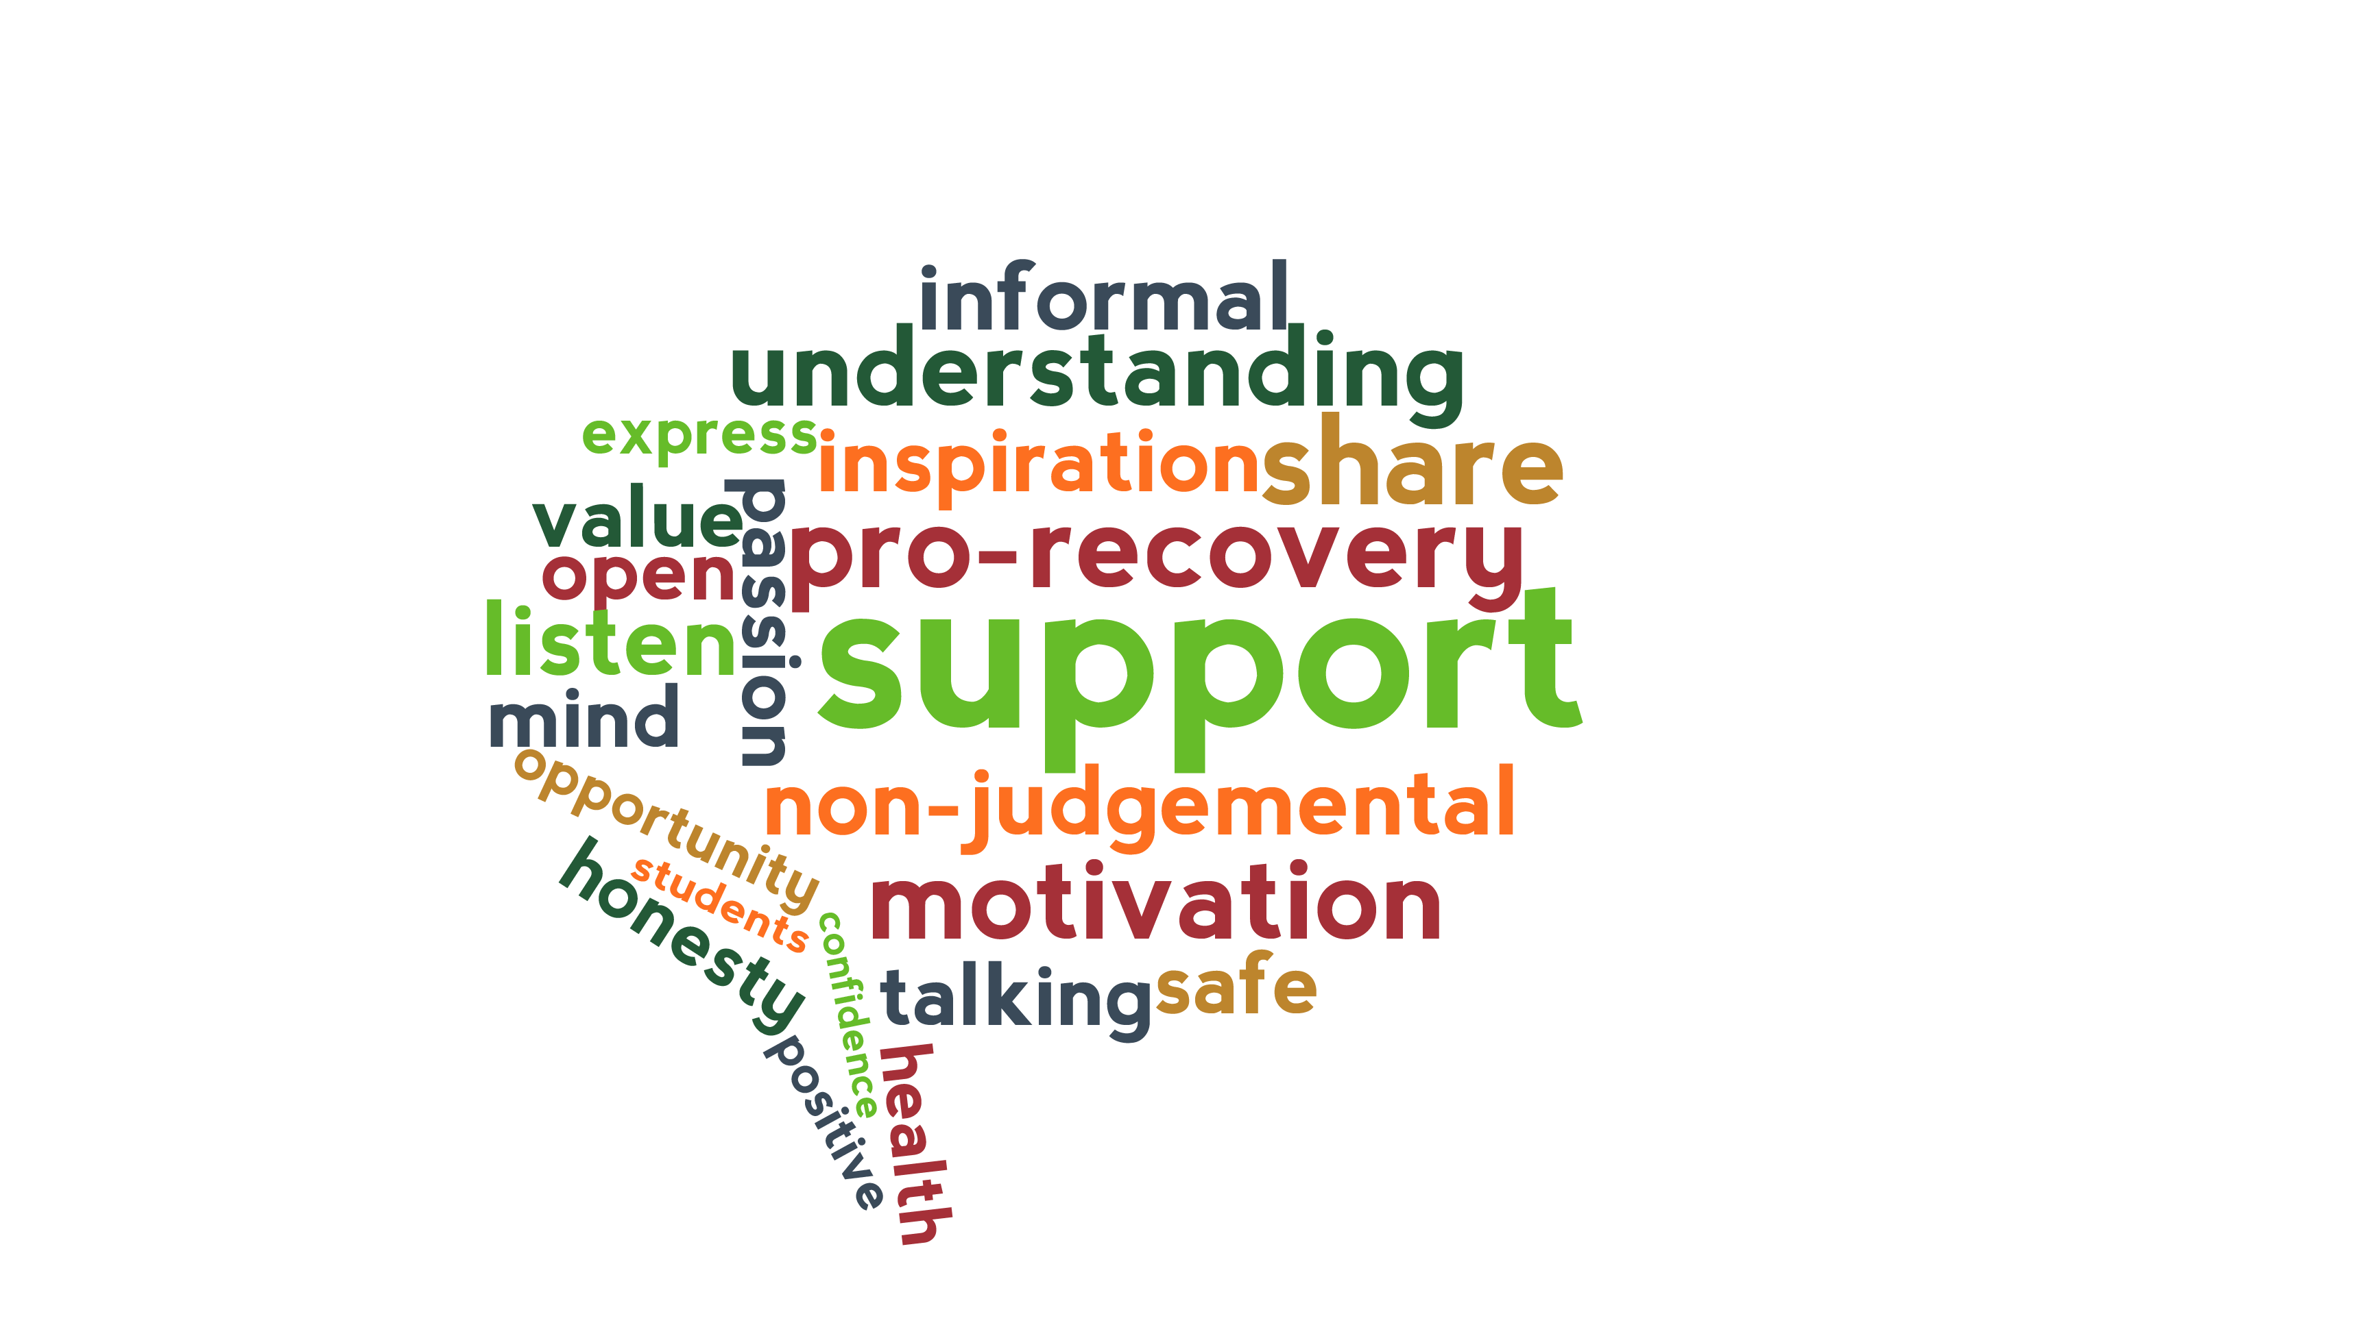
Q&A

