Slide 1
Successes and Benefits
Of Being a Student-Athlete
Flex Day April 4, 2018
Robert Arroyo, MBA
LPC Adjunct Business
LPC Head Coach
Diablo Alliance CEO

Slide 2
Reminders
LPC Athletics Mission Statement
“Las Positas College Athletics meets are student athletes where they are and empowers them to achieve their academic and athletic goals, by providing equitable athletic opportunities, leadership skills, team work, hard work, accountability and symmetry.
The mission of the Athletic Department is to provide exceptional opportunities to students interested in competing in intercollegiate athletics, and to promote success both on and off the field through intercollegiate participation. The Athletic Department will assist student- athletes in developing the knowledge and skills to help them pursue their educational, career, athletic and personal goals.”

Slide 3
Reminders
LPC Athletics Mission Statement
Valentina

Slide 4
Reminders
College Education
A college degree has a direct impact on a person’s quality of life
The median lifetime earnings of bachelor’s degree recipients are 65 percent higher than those of high school graduates
Access to a college education
15 percent of D-I student-athletes are first-generation college students

Slide 5
Reminders
Academic Success
82 percent of D-I student-athletes are earning degrees
College student-athletes graduate at rates higher than the general student body
More than 11,500 student-athletes have returned to campus and completed their degrees since 2005

Slide 6
Reminders
Scholarships
The average college student graduates with $35,200 in debt
150,000 student-athletes receive $2.4 billion in athletic scholarships each year from NCAA member colleges and universities
USA Today determined that a full scholarship can be worth at least $120,000 per year, when factoring in goods, services and future earnings.
Athletes who do not receive athletic scholarships have a variety of other financial aid available to them, including academic scholarships and federal Pell Grants. Student-athletes’ earnings from part-time employment also are exempt from financial aid limits
In the last decade NCAA schools have awarded more than $17 billion in athletics scholarships

Slide 7
Reminders
Student Assistance Fund
Division I student-athletes have access through their campus and conference offices to more than $75 million from the NCAA’s Student Assistance Fund
These resources can be used in a variety of ways, from helping student-athletes fly home in the event of a family tragedy to purchasing a winter coat or other needed clothing that they might not be able to afford.

Slide 8
Reminders
Academic and Support Services
Student-athletes receive academic support, such as state-of-the-art technology and tutoring, and have access to athlete-focused academic advisors in addition to traditional academic advisors
The NCAA also provides resources each year to schools as part of the Academic Enhancement Fund (24.6 Million 2011-2012)

Slide 9
Reminders
Academic and Support Services
Last Chance U
6:30

Slide 10
Reminders
Academic and Support Services

Slide 11
Reminders
Medical Care
Safety guidelines
Protective playing rules and standards
Access to multiple healthcare professionals
Preventive care

Slide 12
Reminders
Medical Care
Oregon Treatment Center

Slide 13
Reminders
Elite Training Opportunities
Top-notch coaching, facilities and equipment
These resources typically cost Olympic athletes thousands of dollars per year

Slide 14
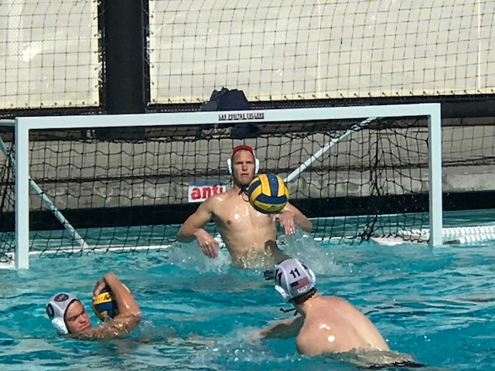
Reminders
Elite Training Opportunities

Slide 15
Reminders
Healthy Living
Student-athletes have access to cafeteria “training tables” on campus
Some schools hire nutritionists and dieticians to work with each individual student-athlete

Slide 16
Reminders
Healthy Living
The “SHOT”
39:00

Slide 17
Reminders
Exposure and Experiences
Student-athletes have the opportunity to travel across the country and around the world for competition, including regular-season, championships and foreign tours
Some student-athletes receive national and international exposure during competition
These experiences can open doors for the few who will compete professionally and for the majority who will go pro in something other than sports

Slide 18
Reminders
Preparation for Life
Increasingly, the business world is focusing on creating a team environment with employees, as evidenced by constant discussion of teamwork in publications like the Harvard Business Review. By competing in college sports, student-athletes learn important skills, like leadership, time management and how to effectively work with others toward a common goal. Companies have specifically said that they seek to hire former student-athletes, and the majority of student-athletes say that participating in college sports prepares them for life after graduation.

Slide 19
Reminders
Questions?
Questions?

Slide 20
Reminders
Evaluation Forms & Sign in Sheet
Please Fill Out an Evaluation Form and Remember to Sign-In.

