Slide 1

AB705:STEM
Andrea D. Thorson, Dean of Instruction
March 19, 2019

Slide 2

Activity
Brainstorm and discuss concepts and/or topics that your students seem to consistently struggle understanding in a common transfer level class.
Write the name of your top choice on your white board and place on the board.(If your word is on the board, write a different one!)
On the note card, write one way students could use this in real life. Clip it to the magnet and place under the word.

Slide 3
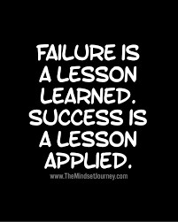

Slide 4


Who is impacted?

Slide 5
Nearly Everyone is Impacted
Students
Transferable units
Financial Aid
Ed Plans
Placement changes
New norms
Communication gaps
English, ESL, and Math departments
All departments with prerequisites
All programs that require Math or English
changes to support
curriculum
placement decisions
Pedagogy shifts
Data tracking
less prepared students
may require a pedagogy shift
consider tutoring norms
shift in ed plans
impacts on transfer
impacts on graduation

Slide 6
Preview
Recommendations
Active Learning

Slide 7
What we know
Tests stink
GPA's are helpful
Throughput must increase
Standards must remain
High schools say students are ready
We say they are not
Still gotta get'em through

Slide 8

Recommendations
Communicate
High Schools
Task Force
Institution
Students
Track
Support success
Throughput vs. success rates
Strategize
Strategically communicate
Thoughtfully plan and support impacted groups
Consult
Consult active-learning experts
Invest in
Professional development
Mandatory support or proven support

Slide 9
Caution
Be careful not to:
Create financial burdens
Endanger you ADT’s
Forget throughput analysis
Under support students
Create unnecessary obstacles
  Lab v. Lecture
  2 vs 3…6..9… hours
  Impact access to other classes
  Impact on ed plans

Slide 10

Active Learning

Slide 11
Active Learning
“Active learning strategies …promote the multiple modes of engagement to reach all students- including historically underrepresented groups”
(Edd & Hogan, 2014 as qutd. In The Harriet W. Sheridan Center for Teaching and Learning, 2019, p.2).

Slide 12
“More extensive use of active learning is associated with higher learning gains”
(Connel, Donovan, & Chambers, 2015 as qutd. In The Harriet W. Sheridan Center for Teaching and Learning, 2019, p.2).

Slide 13
Lab Perks
In class activities
Fresh approach
Financially conservative
No additional outside work

Slide 14
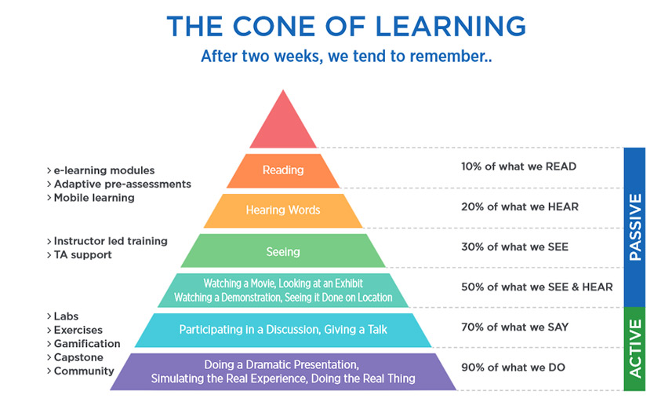

Slide 15
Active Learning Requires:
Openness
Meaningful activities
Making sense of ideas
Students physically participating
Cognitive engagement

Slide 16

Mitigate resistance
(DeMonbrun et. al., 2017; Wiggins et. al., 2017)
Values
Explain purpose and value of activity
Challenges
Preview challenging parts
Clarity
Clearly explain and describe process
Available
Be available and fully engaged

Slide 17
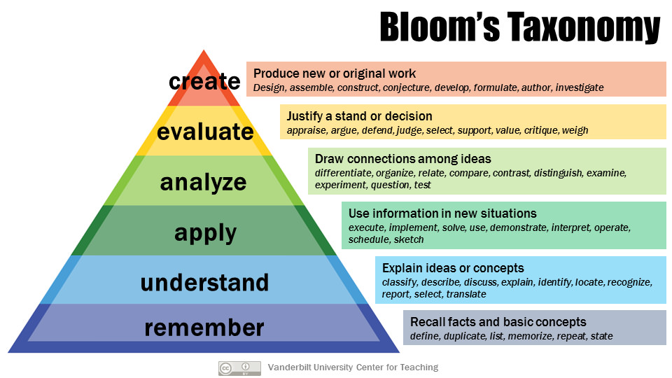

Slide 18
Activity
Grab a word and its corresponding card.
Discuss and create a workshop, presentation, or in-class activity that would help students understand this concept.
Try to link it to a real world application if possible.

Slide 19
Assignment- Pick a topic and card
Create an in class active learning assignment! GO!

Slide 20
Thank you
Howard
STEM

