Slide 1
Demystifying Data Science
Paul Hrycewicz
Computer Science
March 19, 2019

Slide 2
Agenda
Why do we care about data science? The business case.
Terms you hear about in the news
Two kinds of predictive modeling
Image recognition demo (how-old.net)
Neural Networks
Controversies
ML Demo

Slide 3
The Business Case
Large trucking company has 2,000 trucks and 1,600 drivers.
The driver churn rate is 70% - 7 out of 10 drivers leave the company each year.
Training a new driver takes 3 months and costs the company $14,000.
This represents a $15.7M annual expense for the company.
Can we use a predictive model to predict which drivers are most likely to churn, so that the company can take proactive steps to prevent?
If we can reduce the churn rate by 10%, that represents a $1.5M annual savings for the company.

Slide 4
The Business Case – Our View as Faculty
If businesses are successful using data science to save expense / increase revenue
They will demand people that can perform those analyses, and
Colleges and universities can help meet the demand by preparing students for careers in data science.
Analysis has expanded beyond the traditional data scientist
Universities aren’t producing enough to meet demand
Software has been developed to bridge the gap
But the principles are still the same whether it’s a programmer doing the science, or a domain expert with a package

Slide 5
Terms We Read in the News

Slide 6
Big Data – Big Compute
Facebook is generating >5TB of new data per day
New storage methodologies have been developed to store and make use of all this data
A standard datacenter server costs the same as it did 15 years ago, but has 32x the capacity

Slide 7
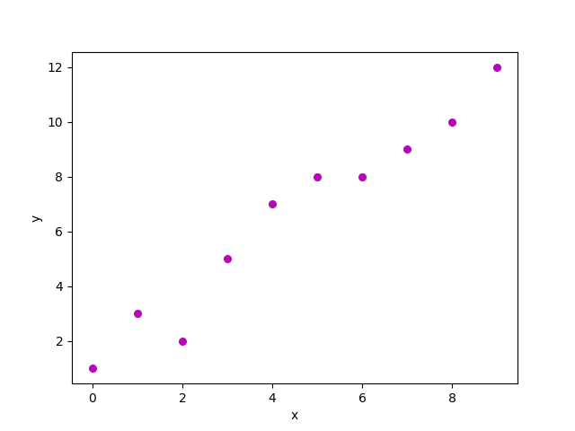
Making Predictions
Let’s assume that a company wants to increase its revenue.
Should it increase its advertising spend to achieve this goal?
Let’s look at the company’s history of advertising spend and revenue.
Revenue
Advertising Spend

Slide 8
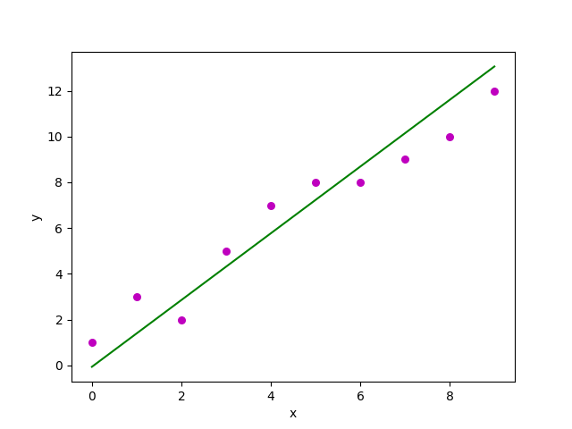
Linear Regression
We create a linear model.
We draw a line that fits the data like this:
The line is a function of the form
y = mx + b
where
x is the advertising spend
m is the slope of the line
b is the y-intercept

Slide 9
How Do We Calculate the Line’s Function?
We use a “best fit” approach. It won’t be perfect for each data point, but it represents the overall best fit for all data points
A good best fit approach is “least square regression” which means
use this formula to determine the slope:
and this to get b:
y = mx + b

Slide 10
Doing the Arithmetic
Assume we have data points (2,2), (3,5), (4,7), and (5,8)
Then X bar = (2 + 3 + 4 + 5) ÷ 4 = 3.5
Y bar = (2 + 5 + 7 + 8) ÷ 4 = 5.5
(2-3.5)x(2-5.5) + (3-3.5)x(5-5.5) + (4-3.5)x(7-5.5) + (5-3.5)x(8-5.5)
m = ---------------------------------------------------------------------------------
(2-3.5)x(2-3.5) + (3-3.5)x(3-3.5) + (4-3.5)x(4-3.5) + (5-3.5)x(5-3.5)
m = 10 / 5 = 2
b = 2 – (2*2) = - 2
So the equation of the line is:
y = 2x – 2
R-square value: 95.2

Slide 11
How Do We Then Estimate Revenue?
y = 2x – 2
We plug in an amount for advertising spend, say $100, and calculate expected revenue
198 = 2 (100) -2
We expect to generate $198 in revenue if we spend $100 on advertising
This is called scoring the data

Slide 12
Now Let’s Predict an Event
Scientists are trying to use the size of the sand grains on beaches to predict the presence of spiders.
We have data that looks like this:
Spider? | Grain size
spider | .45
no spider | .51
spider | .48
spider | .51
no spider | .50

Slide 13
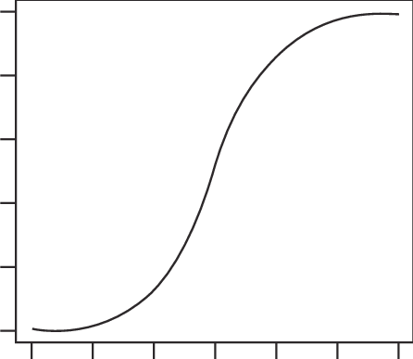
Logistic Regression
Returns the probability of an event happening – a number between 0 (low probability) and 1 (high probability)
Expressed as a probability curve, which is closely related to the bell curve
1
Probability of finding
a spider
0
Grain size

Slide 14
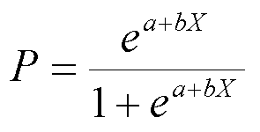
How is the Curve Determined?
Use this formula:
where a and b are parameters of the model, and x is the data point
But how to get the parameters?

Slide 15
We Build a Logistic Regression Model…
… using an algorithm called Maximum Likelihood Estimation and a technique called supervised learning.
Supervised learning requires a training set.
A training set is a statistically representative subset of all the data.
The model learns from the training set.
The training set contains outcomes, along with the data associated with each individual outcome.
The learning algorithm examines the data and calculates how that data relates to the outcome.
The output of the learning process is a trained model.

Slide 16
Maximum Likelihood Estimation
MLE is commonly used to build logistic regression models.
MLE is “analytically intractable”
MLE is only a combination of math and iterations.
There are numerous MLE algorithms that are already developed.
No need for us to code our own algorithms. We can simply use what’s already available.
For example,
model = linearRegression (data, options)
model = logisticRegression (data, options)

Slide 17
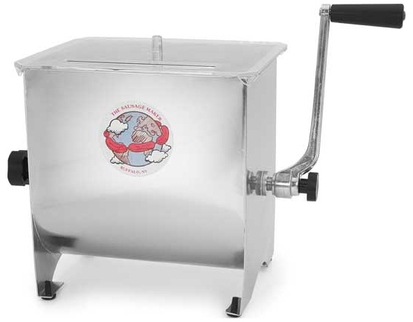
Summary of Supervised Learning
We create a training set.
We invoke a training function.
The output of training is a model.
An example of a model is a logistic regression.
Data is then fed into the model in a process called scoring.
Spider? | Grain size
?? | .49
Spider? | Grain size
spider | .45
no spider | .51
spider | .48
Model
Spider? | Grain size
.897354 | .49

Slide 18
Back to the Trucking Company
It has more data that could be used to train the model
Length of time with the company
Driving record
Home location
Family size, dependents, ages
Route preferences
Number of breakdowns
Amount of loading bay wait time
Disciplinary record
Age
Number of years driving
Hair Color
Favorite brand of blue jeans

Slide 19
An Improved Model
More attributes give a (possibly) more accurate model
Now we switch to multivariate logistic regression, along with a commensurate increase in CPU resource needed to train and score
… a + b₁ x₁ + b₂ x₂ + b₃ x₃ + b₄ x₄ + b₅ x_{5 …}

Slide 20
Diving Into the Data
Which of these attributes have an effect on driver churn?
Beware of bias.
Data Gathering: Where is all this data stored? How is it stored? Is it all in the same format?
Data Preparation: How do we adjust the data prior to analysis?
Missing data
Outliers
Inaccurate data
Data requiring normalization
70% of the time involved in data science is devoted to data gathering and preparation.
Only 20% is spent on model development. 10% is spent on model evaluation and refinement.

Slide 21
Evolution of Data Science
1960s – Buy a machine, write all your own code
1970s – Buy a machine, write your own code, but use commercial algorithms
availability of statistical packages like SAS and SPSS
1980s – Buy a smaller machine, but continue to write your own code and to use commercial algorithms
Minicomputers, microcomputers, and Unix systems. SuperCalc, VisiCalc, Lotus 1-2-3.
1990s – incorporation of Business Intelligence solutions and statistics into Business Analytics
Focus on solving business problems. Excel, Hyperion, Cognos. Analytic add-ins. Oracle DB, DB2.
2000s – improvement in diversity of analytic methods. Availability in open source and in a variety of programming languages.
R, Python. Numpy, CRAN. Git.
early-to-mid 2010s – marked increase in compute and storage capacity coupled with decrease in cost. Advent of Big Data. Incorporation of analytics into popular software packages for HR, scheduling, CRM, patient management, manufacturing, etc.
x86 proliferation, large capacity drives, increase in web traffic and data collection. Hadoop, NoSQL.
late 2010’s – move to cloud computing, availability of algorithms via AaaS. Availablity of cognitive algorithms. Availability of Citizen tools.
AWS, Azure. Rekognition, CNTK, TensorFlow. MLaaS model. Tableau, AML, Alteryx.
2020s – widespread use of NNs for voice and image processing.

Slide 22
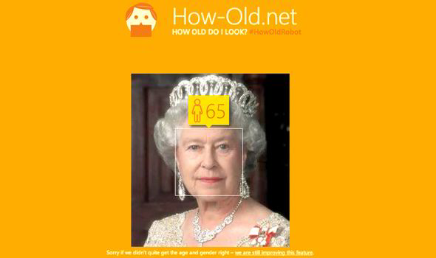
Image Recognition

Slide 23
Image Recognition
Model
1 | 1 | 5 | 4 | 3
7 | 5 | 3 | 5 | 3
5 | 5 | 9 | 0 | 6
3 | 5 | 2 | 0 | 0
2
Training Set

Slide 24
Artificial Neural Networks (ANNs)

Slide 25
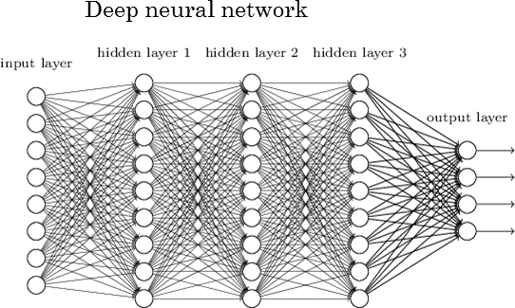
Neural Networks

Slide 26
Image Recognition
A picture is a set of pixels, each with a numeric value.

Slide 27
Complexities in Image Recognition
A single 30x30 pixel image is actually 30x30x3, and in a three-layer ANN, it requires calculating 22 million weights and biases.
Practically speaking, a standard 200x200x3 image is too large to work with.
A special type of ANN, called a Convolutional NN, can be configured to recognize features in a picture.
The theory behind a CNN is that pixels that are close together are more likely to be related than pixels far away from each other.
In a CNN, features are combined into larger and larger groups until the model is able to identify what it’s looking at.
Image recognition using commercial CNNs is readily available, reasonably accurate, cheap, and getting better all the time.

Slide 28
How Is the Bell Curve Determined?
One way: Base the probability curve on the bell curve for the data
The shape of the bell curve is determined by the mean of the data points and their standard deviation (μ and σ)
For example, this equation shows the relationship between μ and σ and three data points 9, 9.5, and 11:
You can solve for μ and σ and thus get the bell curve. It’s more complicated than
figuring a linear regression, but it’s not magic.

Slide 29
How Is the Curve Determined?
Another way: Use Expectation Maximization
EM is a supervised learning algorithm. We train the model using a subset of the data called the training set.
We feed the training data into an EM function.
The EM function returns a (simplified) equation looking like:
y = bx
where y is the outcome (0 – 1), x is a data point, and b is a coefficient
Assume that the equation produced by EM is
y = .6235x
We then score the data - A grain size of .49 yiends a probability finding a spider of .3055

Slide 30
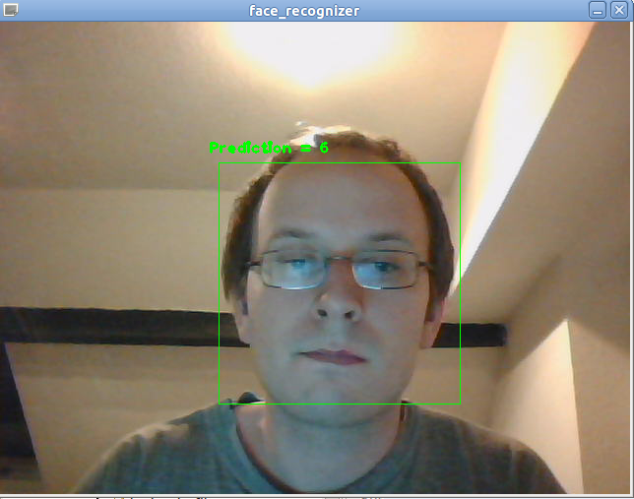
How Does How-Old.Net Work?
A CNN is used to determine where faces exist in the picture.
The CNN returns the size and location of the face rectangle.

Slide 31
How Does How-Old.Net Work?
The CNN also returns a feature set for the face.
"faceId": "5af35e84-ec20-4897-9795-8b3d4512a1f9",
"faceRectangle": {"width": 60, "height": 60, "left": 276, "top": 43},
"faceLandmarks":
{"pupilLeft": {"x": "295.1","y": "56.8"},
"pupilRight": {"x": "317.9","y": "59.6"},
"noseTip": {"x": "311.6","y": "74.7"},
"mouthLeft": {"x": "291.0","y": "86.3"},
"mouthRight": {"x": "311.6","y": "88.6"},
"eyebrowLeftOuter": {"x": "281.6","y": "50.1"}

Slide 32
And it’s Logistic Regression Time
A set of known faces are used to train a CNN model.
The CNN returns facial features for each face.
Train a regression model using the features.
Then, given a face:
The CNN returns the face rectangle and features
The features are scored by the regression model, giving us age and gender
The original picture is augmented with the face rectangle, age, and gender.
The commercial version of this can:
list emotions present in the face
provide a group of similar faces
determine if two faces match
determine if this face matches others

Slide 33
Controversies Surrounding Data Science
We all know that Facebook and other web products use data on us to target ads and information.
Currently, there are few limitations on what data companies can gather and store.
An example of a data seller is Experian:

Slide 34
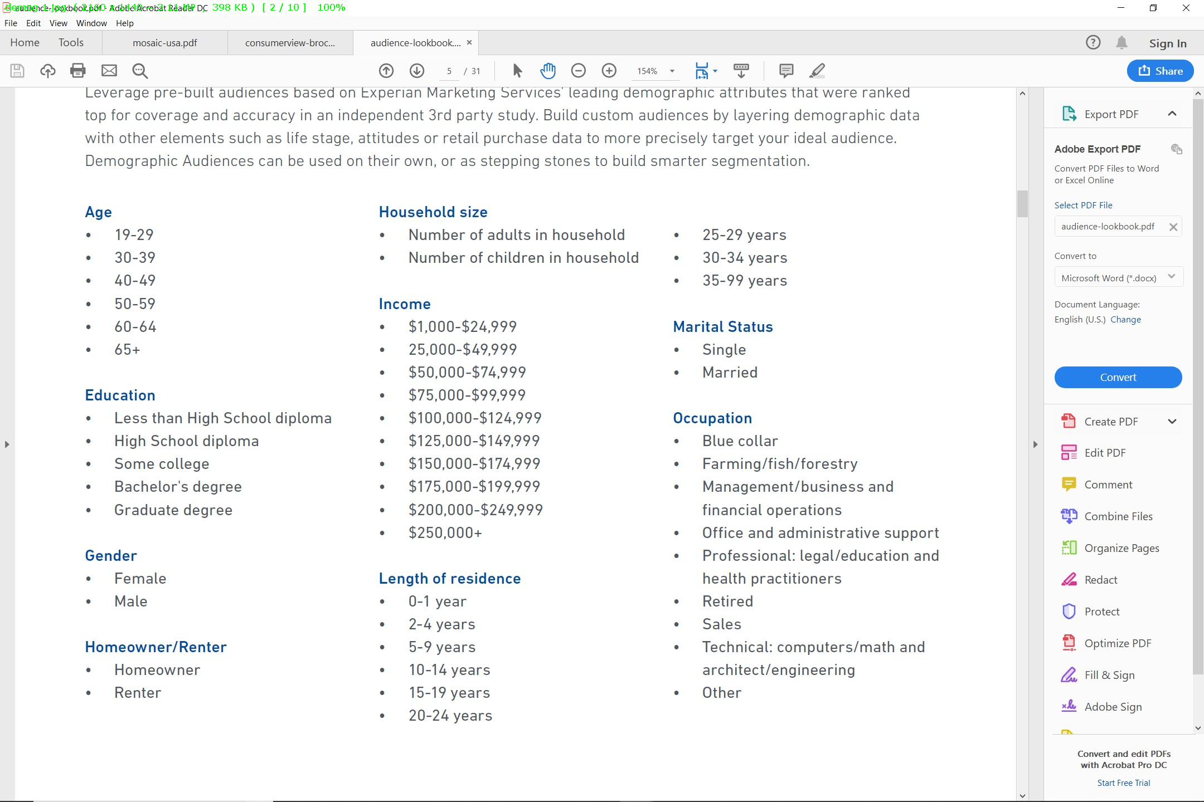

Slide 35
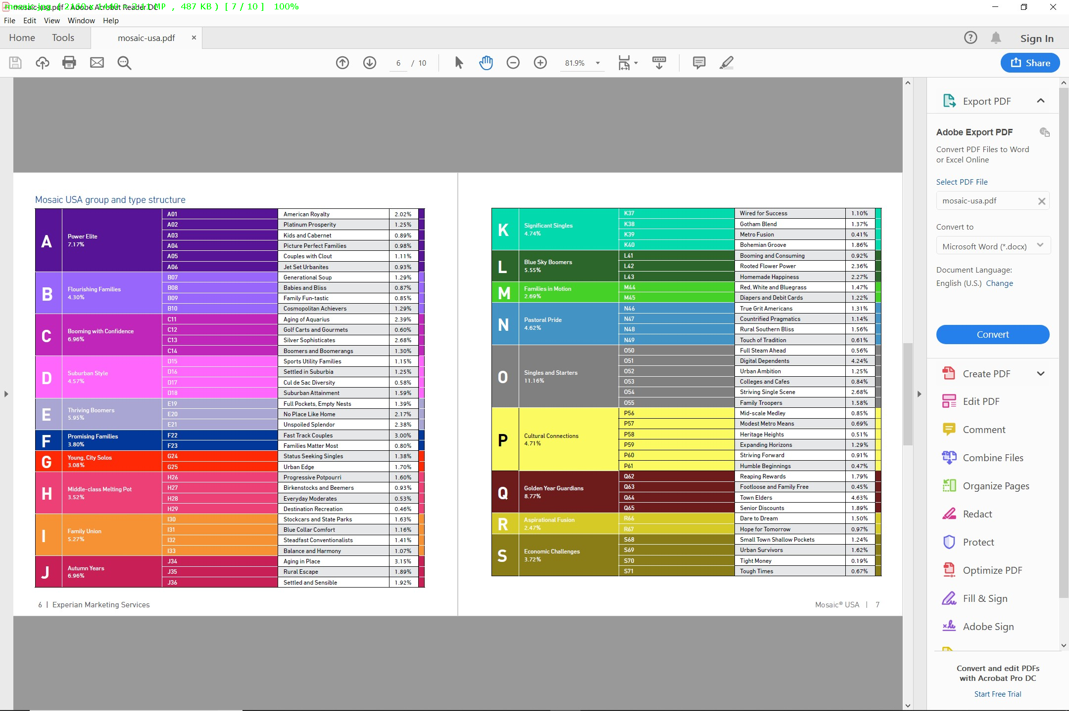

Slide 36
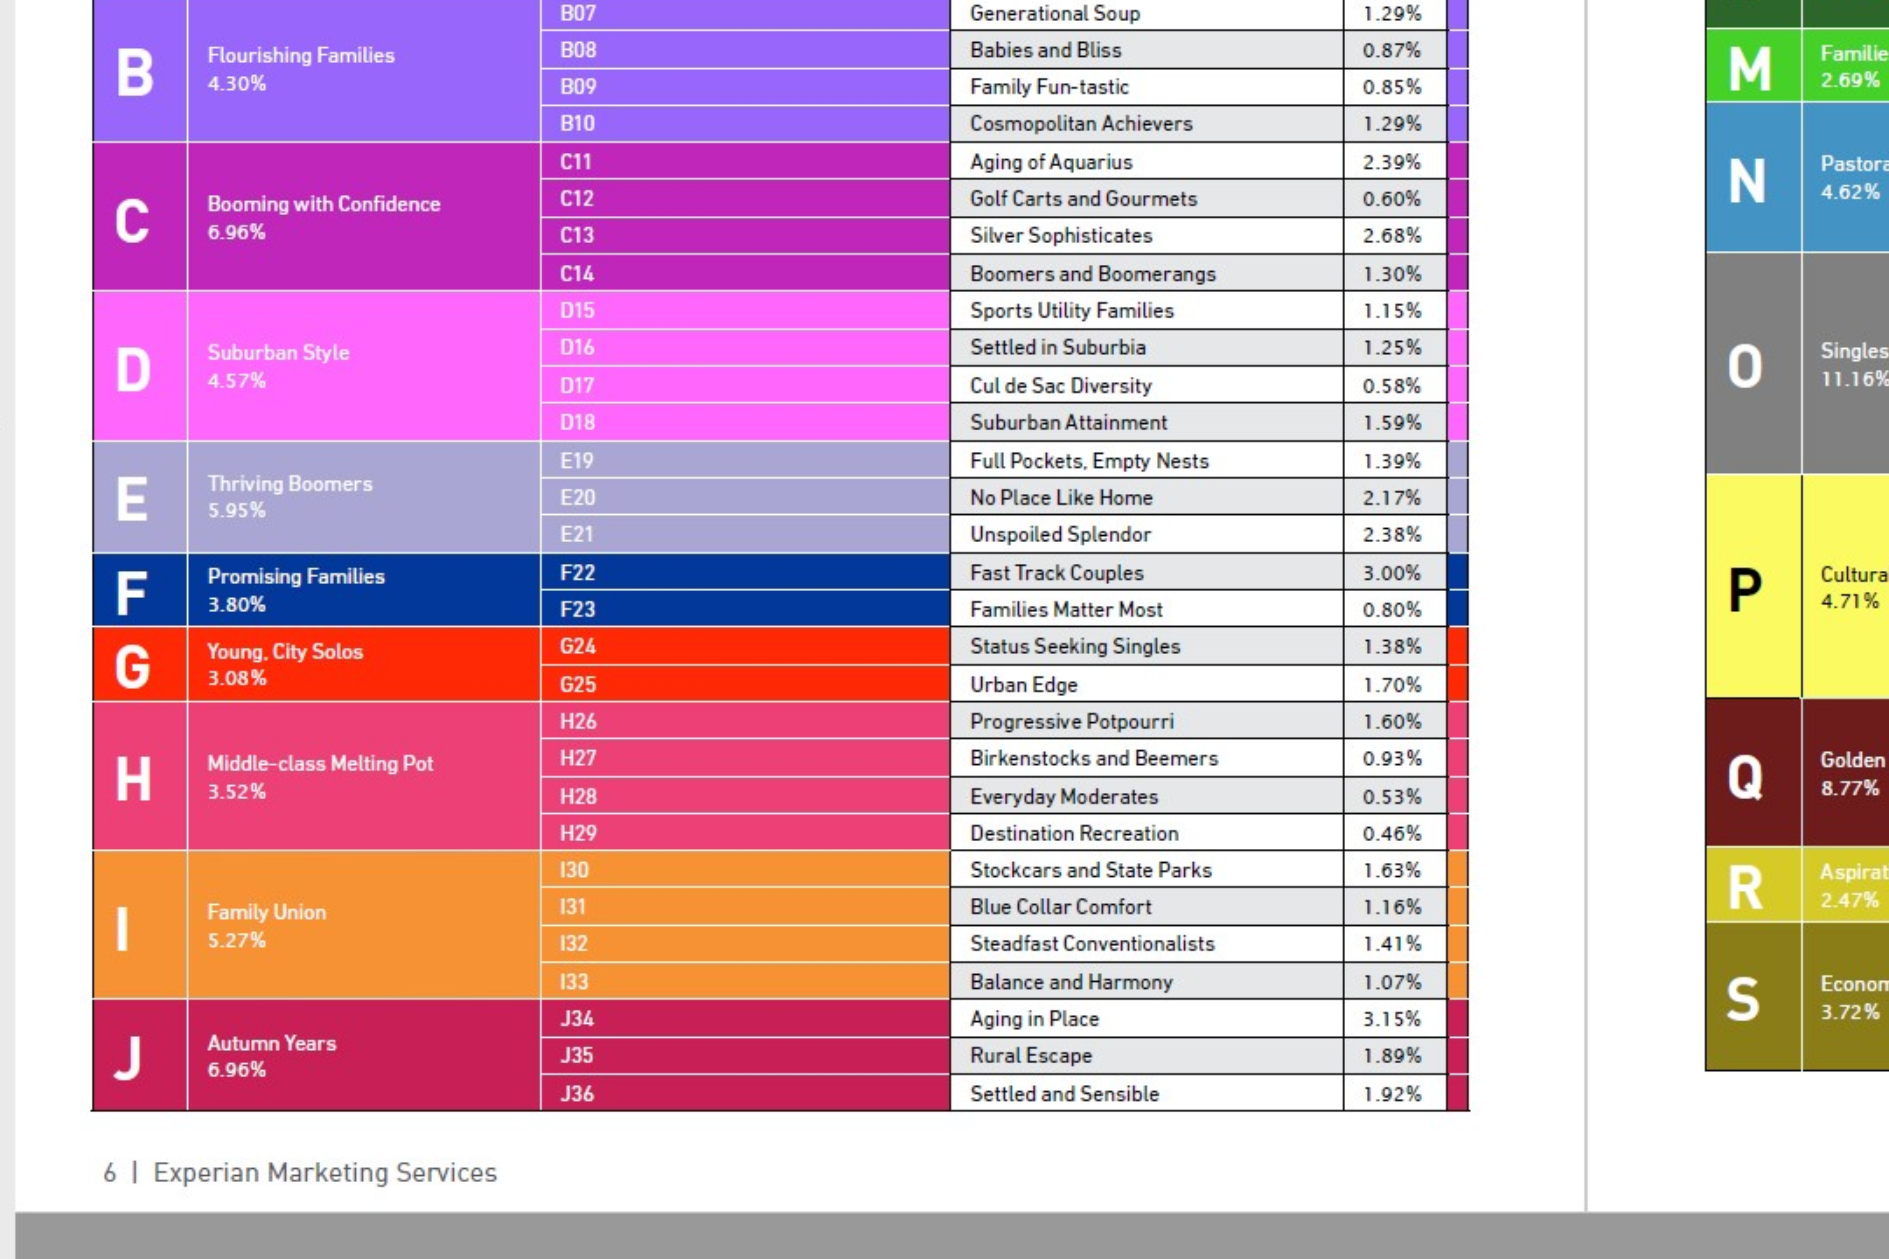

Slide 37
Controversies, Continued
Facial Recognition
Facial recognition services are available now from Microsoft, Amazon, and Google.
What will this to do privacy?
Can algorithms be trusted? Do they have bias?
COMPAS from Equivant predicts recidivism rates, and is used by prosecutors and judges when determining plea arrangements and sentences.
If the algorithm itself is unbiased, then its accuracy must depend on the data used to train it.
Training data is potentially skewed due to prior policing practices. Therefore COMPAS might just be reinforcing existing patterns of discrimination.

Slide 38
Data Science for the Citizen
Packages and cloud-based solutions available from companies like
Trifacta
Talend
Alteryx
RapidMiner
Tableau
Microsoft

Slide 39
Microsoft’s Azure Machine Learning

Slide 40
Thank You!

