Slide 1
The Computer Science Behind Bitcoin
Paul Hrycewicz
Computer science
March 10, 2020

Slide 2
What is Money?
A medium of exchange
Something which has actual or perceived value
Something which is scarce
Scarce by its nature, or
Scarcity by fiat
What is Bitcoin?
One of several “digital currencies”
A mainstream medium of exchange, accepted and used by many individuals and businesses. So it has perceived value.
It has built-in scarcity

Slide 3
Using Bitcoin
A user sends and receives BTC to other users.
That transfer is represented by a transaction.
Transactions reside in blocks.
Blocks are linked together in chronological sequence and form the blockchain.
The blockchain is the system of record, open to everybody.
Users rely on digital signatures to make sure that BTC goes only to the intended recipient.
Transaction granularity is 1 satoshi, .00000001 BTC (one one-hundred-millionth BTC, today $0.00001)
My “wallet” can scan the blockchain and tell me how much bitcoin I have.
It does this by summing the value of all the transactions that gave me BTC and subtracting the BTC I sent to somebody else.
To spend money, I create a transaction sending some of my accumulated BTC to somebody else.
Everybody can detect if I try to spend more money than I have, and reject my attempt.

Slide 4
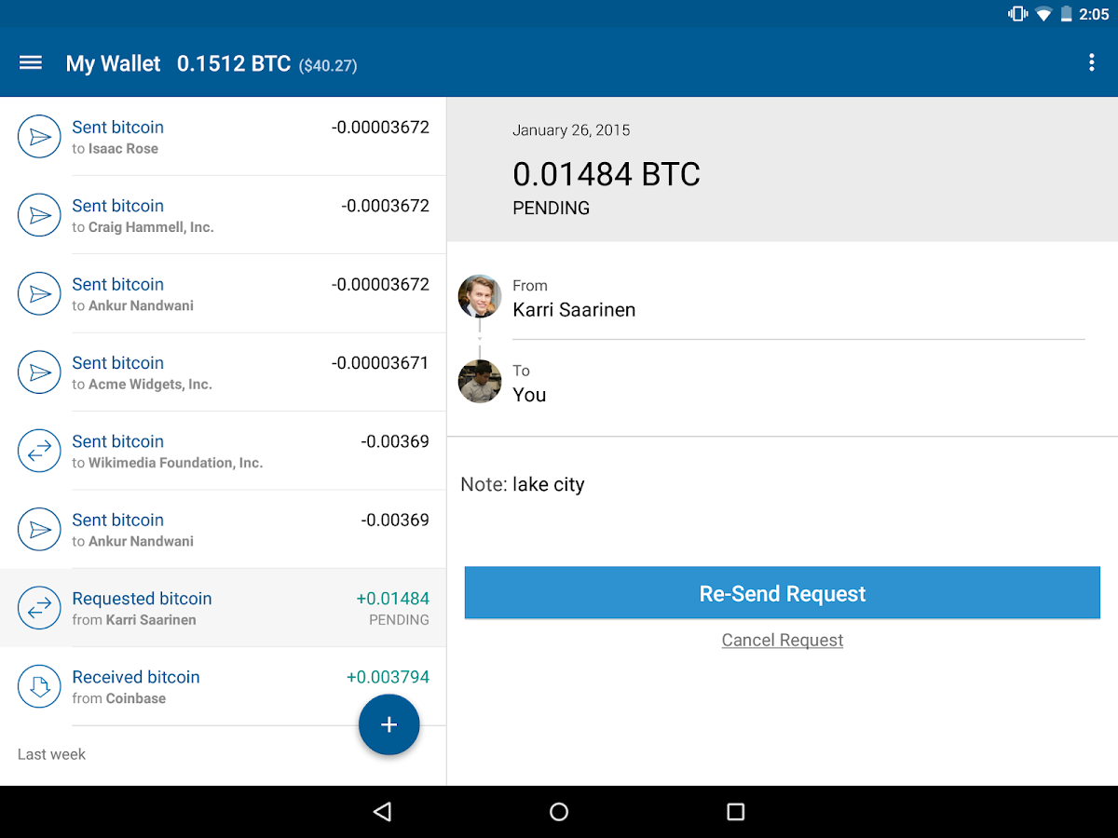
Bitcoin wallet
Users generally use a “wallet” as the interface into the BTC environment.
Each BTC user has a unique anonymous address, for example 1BvBMSEYstWetqTFn5Au4m4GFg7xJaNVN2
This is an example of a “pay-to-public-key hash” address (P2PHK)

Slide 5
Bitcoin’s use of Technologies
Problems that need to be handled by a digital currency:
How do we ensure that transactions are secure?
1a. Ensure money goes only to its intended recipient
1b. Ensure money is coming from whom we think it is
How do we maintain the scarcity of the currency?
How do we maintain a system of record?
How do we maintain the integrity of the currency?
Technologies used to solve these problems:
Cryptographic hashing
Public key encryption
Mining (proof-of-work)
Blockchain – public distributed ledger
Network (lest we forget)

Slide 6
Problem # 1: Transaction Security
Problem 1A. How do we make sure that when we transfer BTC, it goes only to the intended recipient?

Slide 7
Background: Cryptographic Hashing Public-Key Cryptography

Slide 8
Cryptographic Hashing
The origin of cryptographic hashing can be traced back to the work in 1961 by W. Wesley Peterson, then at IBM, regarding data transmission error protocols.
Peterson’s problem: You’re sending data over an imperfect transmission line. How can you determine if the data you sent was received correctly?
Peterson developed something called a “checksum” which was transmitted along with the data. The received data must match its checksum; else an error occurred.
Today: Cryptographic hashing creates a unique “signature” for a piece of data.
Current state-of-the-art: the SHA-256 algorithm
Data
SHA-256
hash

Slide 9
Cryptographic Hashing
Generating the SHA-256 hash of a given piece of data is relatively quick and easy.
Anybody that hashes the same data gets the same hash.
Even a small change in the data results in a large change in the resulting hash.
See https://xorbin.com/tools/sha256-hash-calculator
Using SHA-256, there are 2**256 different possible hashes. This is a HUGE number.
It is not (practically) possible to determine the original data from its hash.
Common usages of cryptographic hashing are verifying file integrity and for the storing of passwords.

Slide 10
Public Key (Asymmetric) Cryptography
Developed in 1975 by Whitfield Diffie and Martin E. Hellman (Stanford).
Problem: How to send a secure message over an insecure transmission line?
(insecure = somebody may be listening)
(secure = only the intended recipient can decode and read the message)
This can be solved if both parties have the same shared key.
But how do you share a key securely?
Solution: Use a pair of keys. This is known as Diffie-Hellman cryptography.
Released as PGP (Pretty Good Privacy) in 1991 by Phil Zimmerman.

Slide 11
Public Key Cryptography
A user creates two keys:
a private key, kept secret
a public key, seen by everybody
The public key is mathematically derived from the private key, using some additional numbers which are also kept private.
Two well-known methods of key generation are RSA (Rivest – Shamir – Adelman) and ECC (elliptic-curve cryptography)
The linkage between keys is one-way:
a public key can easily be generated from a private key, but
a private key cannot be determined from its public key
Generating a public/private key pair is reasonably straightforward.
See:
https://qsandbox.com/tools/private-public-keygen

Slide 12
Public Key Cryptography
Data that has been encrypted using one key can be decrypted with the other.
The longer the key, the harder it is to break.
There is currently no known method of breaking the commonly-used public/private key functionality.

Slide 13
Public Key Cryptography
B wants to be able to receive secure messages.
B publishes its public key.
A wants to send a secure message to B
A
B
message
encryption
encrypted message
encrypted message
decryption
decrypted message
B’s public key
B’s private key
As long as B’s private key stays private, nobody can decrypt the message. The message is secure.
B can send a secure message to A by reversing the process.

Slide 14
Problem 1A. How do we make sure that when we transfer BTC, it goes only to the intended recipient? Solution – use public key cryptography. Only the recipient can decipher the transfer.

Slide 15
Problem # 1B: Transaction Security
Problem 1B. How do we make sure that a transaction is coming from the person we think it is, and not an impostor?

Slide 16
Authentication (Digital Signature)
Can be accomplished using a combination of cryptographic hashing and public key encryption
A wants to send B a message, and B wants to ensure that it was sent from A
A
message path
(can be encrypted)
message
send message
and signature
to B
signature path
hash
function
hash
encrypt
A’s
signature
A’s
private
key

Slide 17
Authentication (Digital Signature)
B
Yes, the message
came from A,
and,
the message
has not been
tampered with
message
hash
function
hash
Are the
hashes
equal?
A’s
signature
decrypt
hash
No, the message
is counterfeit
A’s
public
key

Slide 18
Problem 1B. How do we make sure that a transaction is coming from the person we think it is, and not an impostor? Solution: Use a digital signature.

Slide 19
Problem # 2 How do we maintain BTC scarcity?

Slide 20
Mining (Proof-of-Work)
Roots in email spam detection system Cynthia Dwork (Harvard), Moni Naor (UCB) – 1991.
Question: How to detect if an incoming email is spam?
Have the sender expend some “proof of work” which is insignificant if sending one email, but burdensome if sending to many recipients.
Sender:
To:
From:
Date:
Subject:
Body:
Does the resulting hash start with 20 zero bits?
hash function
Yes - send
nonce
add 1 to nonce and try again
No

Slide 21
Mining (Proof-of-Work)
Receiver:
To:
From:
Date:
Subject:
Body:
Does the hash start with 20 zero bits?
hash function
Yes, it’s a valid
email
nonce
No, it’s spam
Assume on a typical sender machine, it takes 0.25 second of CPU time to develop the nonce.
For one email, that’s insignificant.
For 1,000,000 spam emails, each with a different “to:,” that’s 69 hours of compute time.

Slide 22
Bitcoin Mining
hash until you get approx. 46 zero bits
yes, get reward (currently 12.5 BTC)
Block of
transactions
were you the first?
nonce
No, try again with next block

Slide 23
Mining hardware
My Surface Pro 3 with an Intel i5-4300 can do about 6.5 megahashes/second (MH/s)
Recent estimates shows 5.92653E+22 hashes (9 billion trillion) needed before a reward can be claimed
That would take my laptop 31 billion years to compute
This device – the Innosilicon T3+ - does 67 TH/s ($2,000 retail)
You can expect to mine .41 BTC/year with a power cost of $2,312 (US – Bay Area) or $867 (China)
1 BTC = about $8,619 (Jan 19)

Slide 24
Problem # 2 How do we maintain BTC scarcity? Solution: Require bitcoins to be mined.

Slide 25
Problem # 3 How do we maintain a system of record?

Slide 26
Transferring Money
How do banks do this today?
Each bank maintains a system of record for their accounts (centralized ledger database)
Problem: A wants to transfer $10 from their bank account, to B’s account in a different bank
Similar to the Two Generals Problem
Solution: Need a trusted third party to act as the coordinator.
could be one of the banks
could be a Paypal or a Venmo
If we have a trusted third party, then we can use the Two-Phase Commit protocol

Slide 27
Two-Phase Commit
The instructions for transfer are sent to both banks
Both banks’ databases log the upcoming change but do not change the actual databases
The trusted third party tells each bank “prepare to commit” (Phase 1)
Each bank logs the upcoming transaction, and tells the coordinator “OK”
The trusted third party waits for a response from each bank
If the trusted third party receives positive responses from each bank, meaning that the logging was successful, it tells each bank to “commit” (Phase 2)
Each bank writes the change to its database

Slide 28
Two-Phase Commit
If the coordinator fails during processing, the commit is never issued, so integrity of both databases is maintained
If a bank fails before it receives the prepare, it never responds, so the commit is never issued
If a bank fails after it sends a positive response but before it executes the commit, that bank’s log contains the record, so the database can be adjusted
Bank databases exhibit the ACID property

Slide 29
But Bitcoin does not operate like a bank
By design,
There is no centralized ledger in a Bitcoin network
There is no Bitcoin database
There is no trusted third party in a Bitcoin network
There can be no two-phase commit

Slide 30
Bitcoin Data Structure: Transaction
Every user of BTC is represented by a unique address
Any BTC user can send BTC to any other user via a transaction
Each transaction contains
the identifier of the sender
a reference to BTC owned by the sender
could be from a single previous transaction
could be from multiple previous transactions
the identifier of the recipient
authentication instructions for the recipient (typically via signature)
Transactions are not encrypted

Slide 31
Bitcoin Data Structure: Block
Transactions are grouped into blocks
By design, one new block is created every 10 minutes
When a transaction is placed into a block, and the block is added to the blockchain, the transaction is said to be authenticated, and the recipient can use those BTC
So, it takes an average of 5 minutes for a transaction to complete
The 2019 BTC transaction rate was roughly 5 transactions/second

Slide 32
Blockchain
Based on initial work by Ralph Merkle (Stanford, UCB) 1979, Stuart Haber and W. Scott Stornetta (1991) (Columbia), (Stanford, Bellcore), then by Satoshi Nakamoto (2008)
In a distributed network like Bitcoin,
there are no banks
there are no bank accounts
there is no trusted third party
there is no centralized database with ACID properties containing account balances
there is the possibility of bogus transactions
it has only an insecure network
Bitcoin uses a distributed public ledger
the ledger can be used to show balances
everybody can have a copy
the content of the ledger is agreed upon by consensus of the users

Slide 33
Bitcoin Blockchain
previous
block’s hash
previous
block’s hash
previous
block’s hash
. . .
transactions
transactions
transactions
this block’s
hash
this block’s
hash
this block’s
hash
this block’s
hash
Genesis
Block
Transaction
Blocks
One new block enters the chain every 10 minutes
Each block contains the transactions from that time interval
Each transaction contains a sender, a receiver, and the number of BTC being transferred

Slide 34
Bitcoin Blockchain
Transactions go into a pool
Miners grab the transactions, place them into a working block, and try to develop the nonce for that block
When a miner is successful, it broadcasts its success to the network
Anybody on the network can verify the nonce, and everybody that’s interested can grab the new blockchain
It’s possible that two or more miners generate a successful hash at the same time
This causes a “fork” in the blockchain
. . .
. . .

Slide 35
Bitcoin Blockchain
The next block’s miner will choose one fork or the other for the new block
That fork is now longer than the other, and since everybody can see the blockchain, everybody sees that it’s longer
New blocks are always added to the longer fork
Transactions from the shorter block go back into the pool, where they are picked up by miners
The integrity of the blockchain is therefore maintained

Slide 36
Problem # 3 How do we maintain a system of record (in a widely-distributed system)? Solution: Use a blockchain.

Slide 37
Problem # 4: How do we maintain the integrity of the currency?

Slide 38
Transaction integrity
The pointer from one block to the previous is the SHA-256 hash of that block.
Everybody can verify that the new block contains the correct hash of the previous block,
And everybody can verify that the hash of the current block is correct.
So we conclude that the block is legitimate.
Everybody can see the transactions in the new block.
Everybody can see all the previous transactions that form the inputs for each new transaction.
Everybody can verify that those transactions add up to enough BTC for the new transaction’s transfer amount.
So we conclude that the transactions are legitimate.
If a block and its transactions are legitimate, users add it to their copy of the blockchain.
If it’s not legitimate, users don’t add it to their copies. As long as 50%+1 users accept a block as legitimate, it is.

Slide 39
Transaction integrity
Let’s say somebody tries to change a transaction in a previous block.
The hash of that block changes.
Everybody can see that the hash contained in that block is incorrect, and therefore the change is bogus. So the change is rejected.
Let’s now say somebody changes a transaction in a block and the hash contained in the block.
They would have to re-mine the nonce for that block.
If they did that, the block, by itself, looks correct.
But the next block in the chain (the more recent block) would no longer point to (no longer contains the hash of) the changed block, so
Everybody can see that the chain is broken, and can reject the change.
In theory, somebody could change a block, and change all the pointers from that block to the newest.

Slide 40
Problem # 4: How do we maintain the integrity of the currency? Solution: Even though many of the details of a transaction are hidden, everybody can see the high points, so everybody can validate.

Slide 41
Bitcoin Statistics
As of Jan 19 2020, the number of BTC in circulation is 18.1M
(there is a design cap of 21M)
www.blockchain.com
There are approximately 614,000 blocks
Average transaction rate: 3.28 / second
Average transaction size is 500 bytes
Average size of each block is 1MB
The average transaction value is $19,000

Slide 42
Thank You! And have a great semester!

