Slide 1
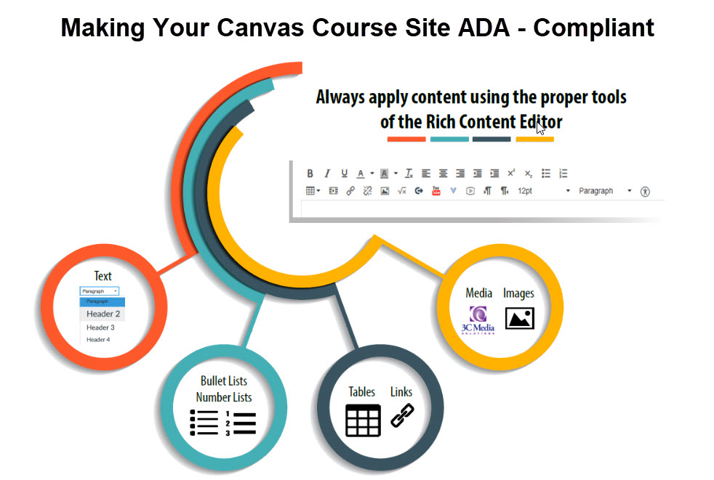
Making your Canvas Course Site
ADA-Compliant

Slide 2
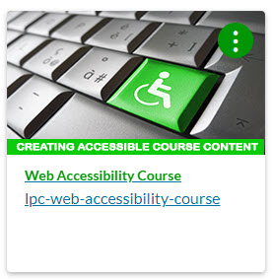
Web Accessibility – Basics
Whether or not you have students with disabilities in your class is irrelevant;
All materials must be made accessible.
This is Federal Law and a Title 5 requirement.
Accreditors also check for accessibility.
Everything you need to know is in the Web Accessibility course in Canvas.
The Web Accessibility site on the LPC Online Learning site is also helpful.
Attend our Workshops listed on the LPC Professional Development site.

Slide 3

Web Accessibility – Canvas
Accessibility in Canvas is all about using the tools to properly format the page content and using the accessibility checker.
  Text Styles
  Lists
  Links
  Tables
  Color
  Alt text for images
  Video/Audio
  Formatting content outside of Canvas
  External Files: WORD, PDF and PPTs

Slide 4
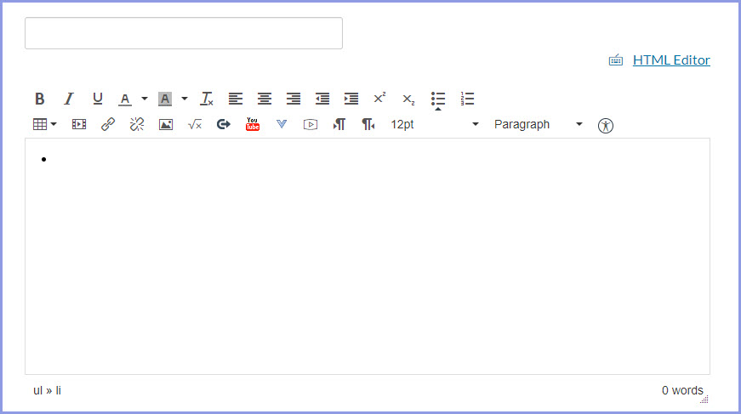
Web Accessibility – Canvas
RCE – Rich Content Editor (using the tools to properly )
  Syllabus
  Pages
  Assignments
  Discussions
  Quizzes
  Use the
  Accessibility Checker

Slide 5
Web Accessibility – Canvas
  Web Accessibility Course
  On your Canvas Dashboard

Slide 6
Web Accessibility – Captioning
Best option: Use the 3C Media Solutions app in Canvas.
When first setting up your 3C Media Account:
Use your “ ….@laspositascollege.edu” only
Use the same password used when logging onto Canvas
You can also use the 3C Media Solutions web site.
You can use YouTube’s automatic captioner, but it is flawed and will need correcting. Learn how to edit YouTube captions information on the LPC Web Accessibility site.
You can caption videos yourself, with AMARA.org . This site also has a repository of captioned YouTube videos already captioned.

Slide 7
Web Accessibility – Word, PowerPoint
The easiest way to ensure accessibility is to type or paste directly into Canvas' Rich Content Editor and NOT use Word or PowerPoint at all.
Use PowerPoint templates; give each slide a unique title.
Clean up reading order in PPT: Home tab, click Select in the Editing group, and choose Selection Pane.
Use tabs, not spaces, to move around words.
Convert to accessible PDFs as an alternate format, best for mobile devices. To PDF or Not to PDF – Its intention is the Question
Include a link to the free Acrobat Reader in your course.
Converting a Word document to an accessible PDF
Converting a PowerPoint presentation to an accessible PDF

Slide 8
Common Barriers
Commonly used items that will create barriers for students with disabilities include:
  Tables used for formatting purposes
  Color (poor choice of text and background colors)
  Images missing alternative text description
  Multimedia that lacks captioning and/or text description
  Underlined text that are not links

Slide 9
Web Accessibility – Misc.
ConferZoom: Can request a captioner 5 days ahead of time if you have a deaf student.
If copy and paste from documents, use the Clear Formatting tool in RCE
Don’t set multimedia to auto-play.
Don’t use flashing content.
All apps and external web sites have to be accessible.
Be careful using publisher content. (Request for accessible PPT’s)
Use the CCC’s Accessibility Center Help Desk.

Slide 10
Web Accessibility – Canvas
Styles
  text styles – paragraph and header (H2-H4)
  numbered and bullet lists
Explanatory links
  Don’t use click here
  Don’t use web addresses as links (e.g.http://bit.ly/1YixxlB)
  Don’t underline text if it’s not a link
  Tables
  Use the accessibility checker
  Must have a header row, column, or both, and need a caption.
Alt text for images
  Can be a phrase or even 2-3 sentences
  If your image contains text, make sure to include those same words as alt text
  Don't copy text that students are reading and paste it in as alt text
  Don't begin your alt text with "Image of ..." Screen reader will already say that
  Don't use the filename of the image, shouldn’t include file extensions (.jpg, .gif, .png)
  Decorative Image checkbox for image that have no pedagogical value.

