Slide 1
AB 705 and Its Impact on English and Math
March 2022 Flex Day
Michael Peterson, Mike Sato, Katie Eagan

Slide 2
Our Previous Linear Model
In response to a perceived lack of preparation for English and math, colleges added multiple levels of remedial, pre-transfer coursework to prepare students for transfer-level work.
Some English programs had four levels below transfer. (LPC had two.)
In English, many programs added reading courses and whole programs as well.
Some math programs had four levels below transfer (LPC had three)

Slide 3
However, the Throughput was Horrible
With so many levels, many students would “leak” out of the pipeline and never get to transfer-level work.
Often, this was hard for us to see–in English at LPC for example, success rates in English 104 were strong, and students who passed 104 often did well in 1A, but this ignored the effect of having an additional level of English on throughput.
In Math, different courses used varying levels of prerequisite material. Elementary statistics, for example, did not use very much content out of intermediate algebra, even though it was a prerequisite course. Students frequently had a more challenging time passing algebra than statistics, which negatively affected throughput.

Slide 4
Notes:
John Hetts, “AB 705 Adjustments, Ethnicity, Gender and Special Populations” with RP Group

Slide 5
The Paradigm Shift
The Multiple Measures Assessment Project (MMAP), the California Acceleration Project (CAP) and others began to promote high school GPA as a better predictor of college success than an assessment test.
CAP focused on providing contextualized learning and just-in-time remediation for the necessary grammar or basic math concepts, which would allow students to succeed in college-level English and math at higher rates.
Their knowledge of English and math might not be as deep or vast, but they were passing, and this would mean that they would transfer at higher rates, an important goal given the poor retention rates in community college.

Slide 6
Assembly Bill 705
“This bill would require a community college district or college to maximize the probability that the student will enter and complete transfer-level coursework in English and mathematics within a one-year timeframe, and use, in the placement of students into English and mathematics courses in order to achieve this goal, one or more of the following: high school coursework, high school grades, and high school grade point average.”

Slide 9
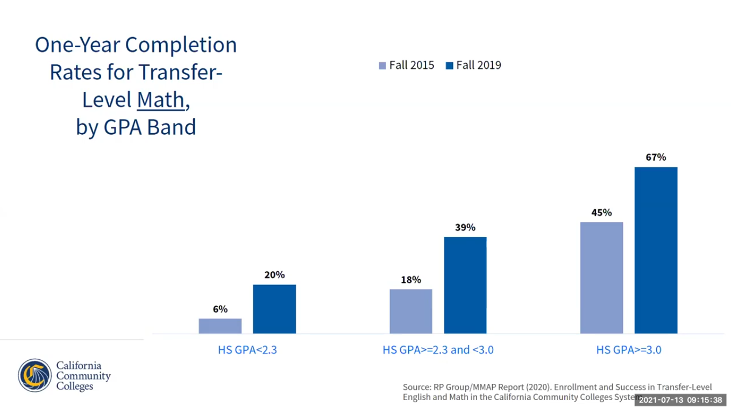

Slide 11
Notes:
At a July 2021 Systems Office webinar, the CCC community was told that despite these great numbers, our most vulnerable students were not being served and were still enrolling in BTL courses at higher rates, putting their transfer dreams at risk.

Slide 12
The Chancellor’s Response and Our Response
The Chancellor’s Office response was to insist that we do more to “fully implement” AB705, which had promised to maximize the potential of students to complete transfer-level English and math in one year and ESL in three years.
We were told that unless we could identify a group of students who started in below-transfer-level classes and had a throughput that was equal to or greater than that of students who started in transfer-level, we could not justify keeping that class.
Accordingly, we will no longer be offering English 104 or any pre-transfer math classes besides Math 55, which will only be offered at Middle College.

Slide 13
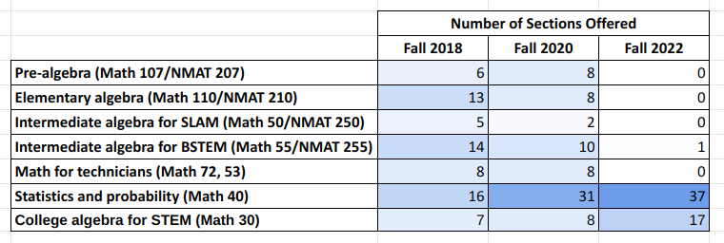

Slide 14
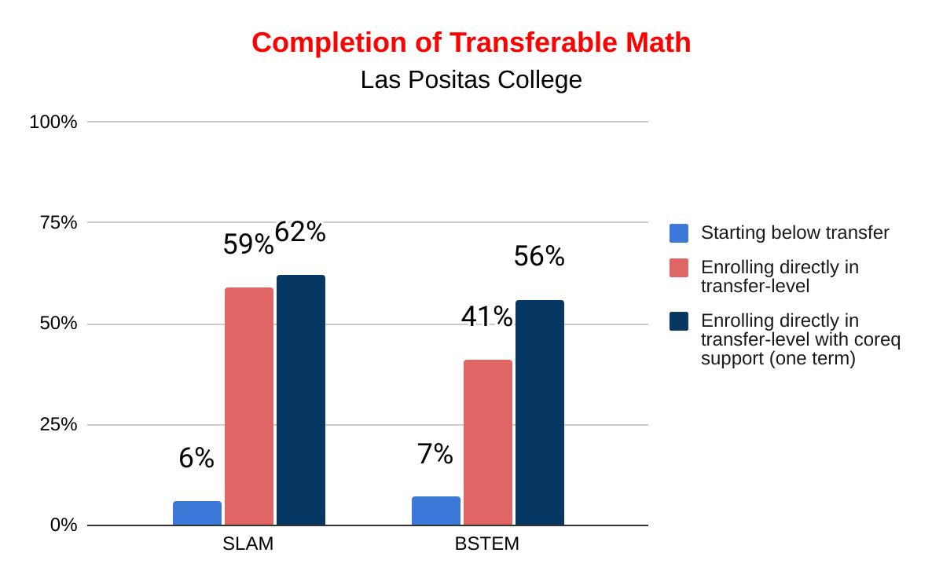
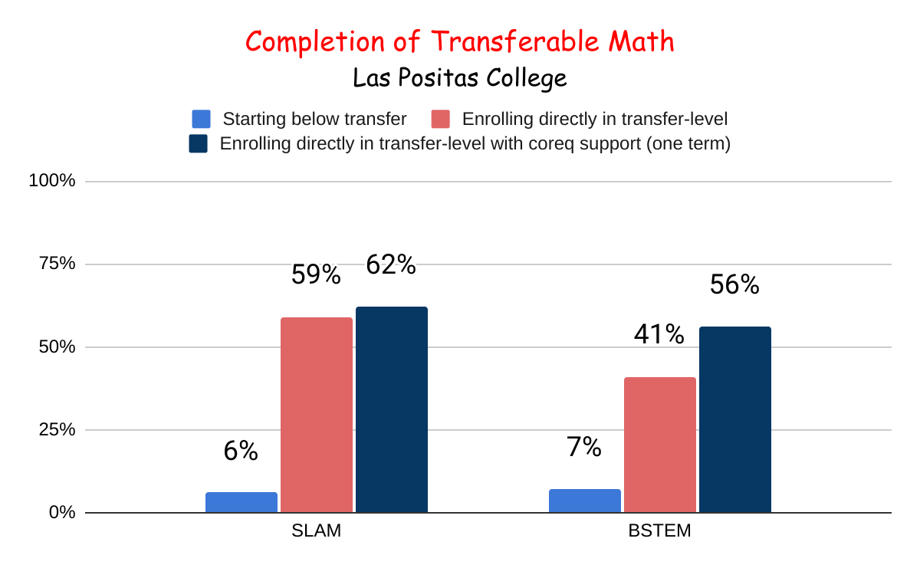
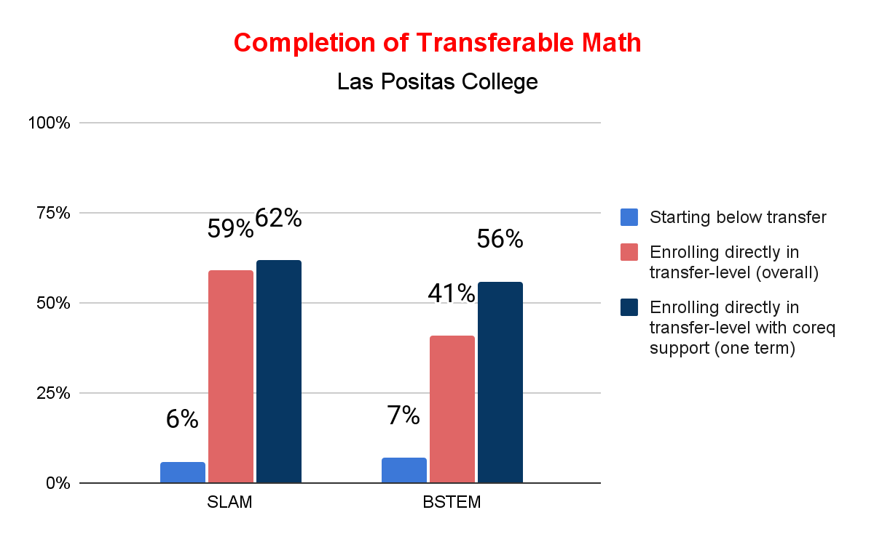

Slide 16
Summer 2022
Concurrent support or Math Jam will be required for students based on high school background
For BSTEM, support required for students with:
Highest class successfully completed below Algebra 2
Highest class successfully completed was Algebra 2 AND cumulative GPA under 2.6
For SLAM, support required for students with:
Highest class successfully completed below Algebra 2 AND cumulative GPA under 2.6
Highest lass successfully completed was Algebra 2 AND cumulative GPA under 2.3
Concurrent Support will also be highly recommended for other students, including some Calculus students

Slide 17
English Placement at LPC
New first-time LPC students who assessed and enrolled in fall 2006:
729 students = 64% placed in pretransfer*
New first-time LPC students who assessed and enrolled in spring 2022:
No students enrolled in pretransfer
*Chabot College Office of Institutional Research

Slide 18
English Pretransfer to Transfer Success in Two Years
Enrolled in English 100A in 2001 = 29%
Enrolled in English 104 in 2001 = 66%

Slide 19
English 104 (Pretransfer) Measurable Objectives
Upon completion of this course, the student should be able to:
A. Use strategies to assess a text’s difficulty, purpose, and main idea prior to the act of reading
B. Annotate a text during the act of reading
C. Employ strategies that enable a critical evaluation of a text
D. Respond critically to a text through class discussions and writing
E. Use concepts of paragraph and essay structure and development to analyze his/her own and others’ essays
F. Write effective summaries of texts that avoid wording and sentence structure of the original
G. Respond to texts drawing on personal experience and other texts
H. Organize coherent essays around a central idea or a position
I. Apply structural elements in writing that are appropriate to the audience and purpose
J. Provide appropriate and accurate evidence to support positions and conclusions
K.Produce written work that reflects academic integrity and responsibility, particularly when integrating the exact language and ideas of an outside text into one’s own writing
L. Utilize effective grammar recall to check sentences for correct grammar and mechanics M. Proofread his/her own and others’ prose

Slide 20
Do changes in English affect other disciplines?
Success in Math 30s and 40s by highest successful English course, fall 2002 - spring 2005:
No English = 65%
English 100A = 70%
English 104 = 71%
English 1A = 72%
Do courses have English prerequisites or advisories?
What assumptions are made about students’ reading, writing, and research skills?
Are students informed about academic support services?

Slide 21
Questions and Suggestions!

