Slide 1
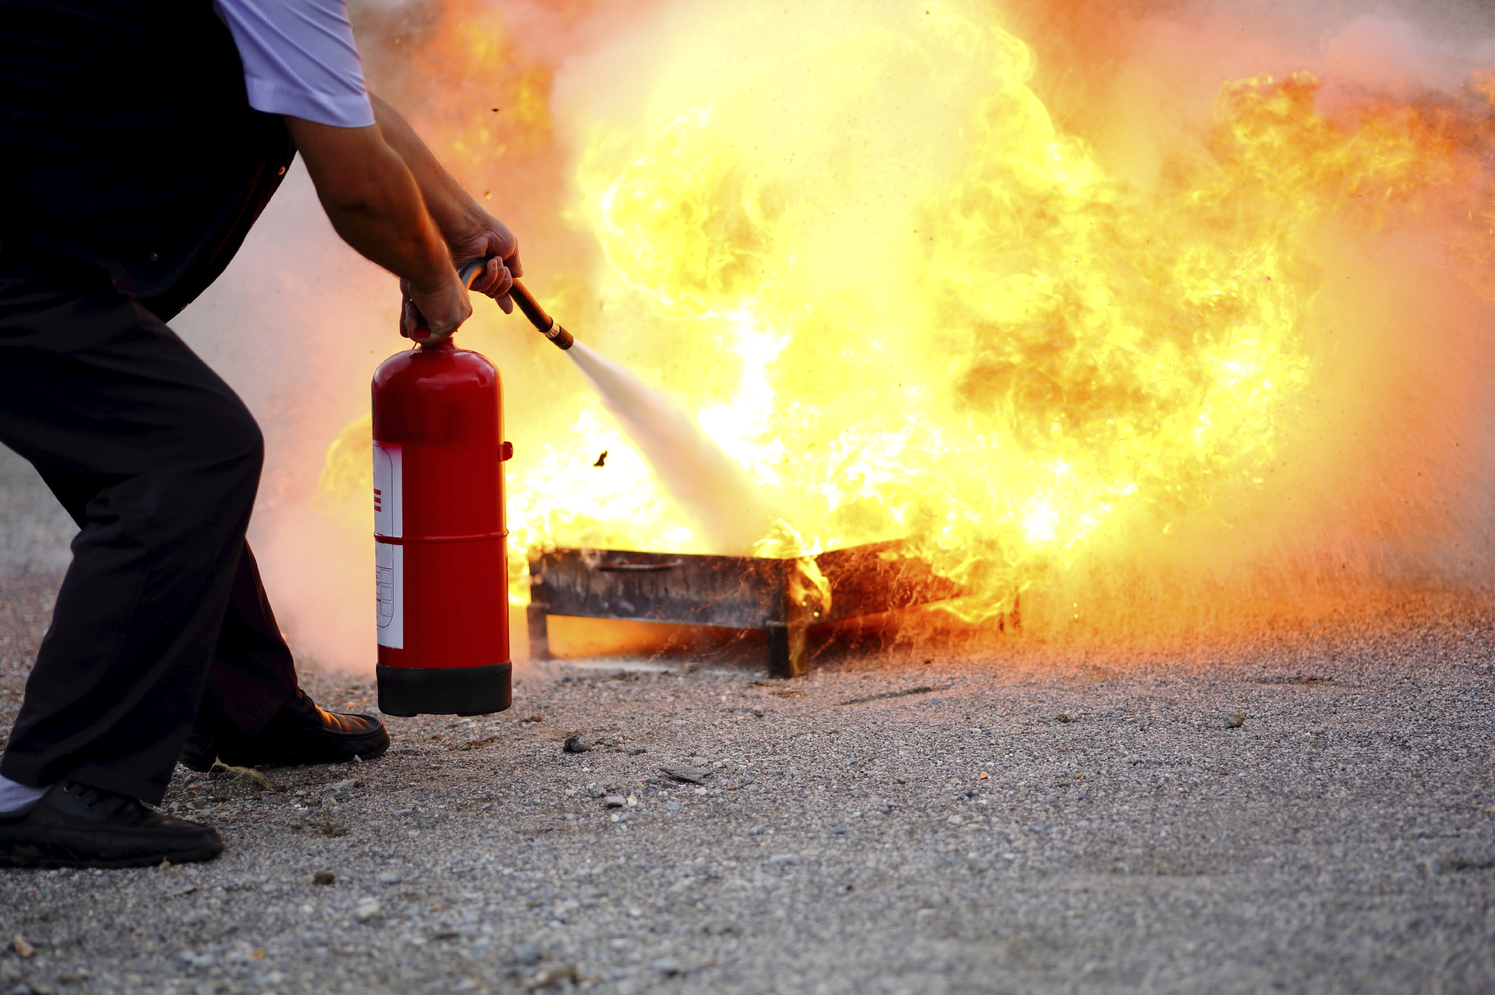
Portable Fire Extinguishers
Flex day March 8th, 2022
Matthew Jewett
Fire Service Technology Instructor/Coordinator
Notes:
1

Slide 2
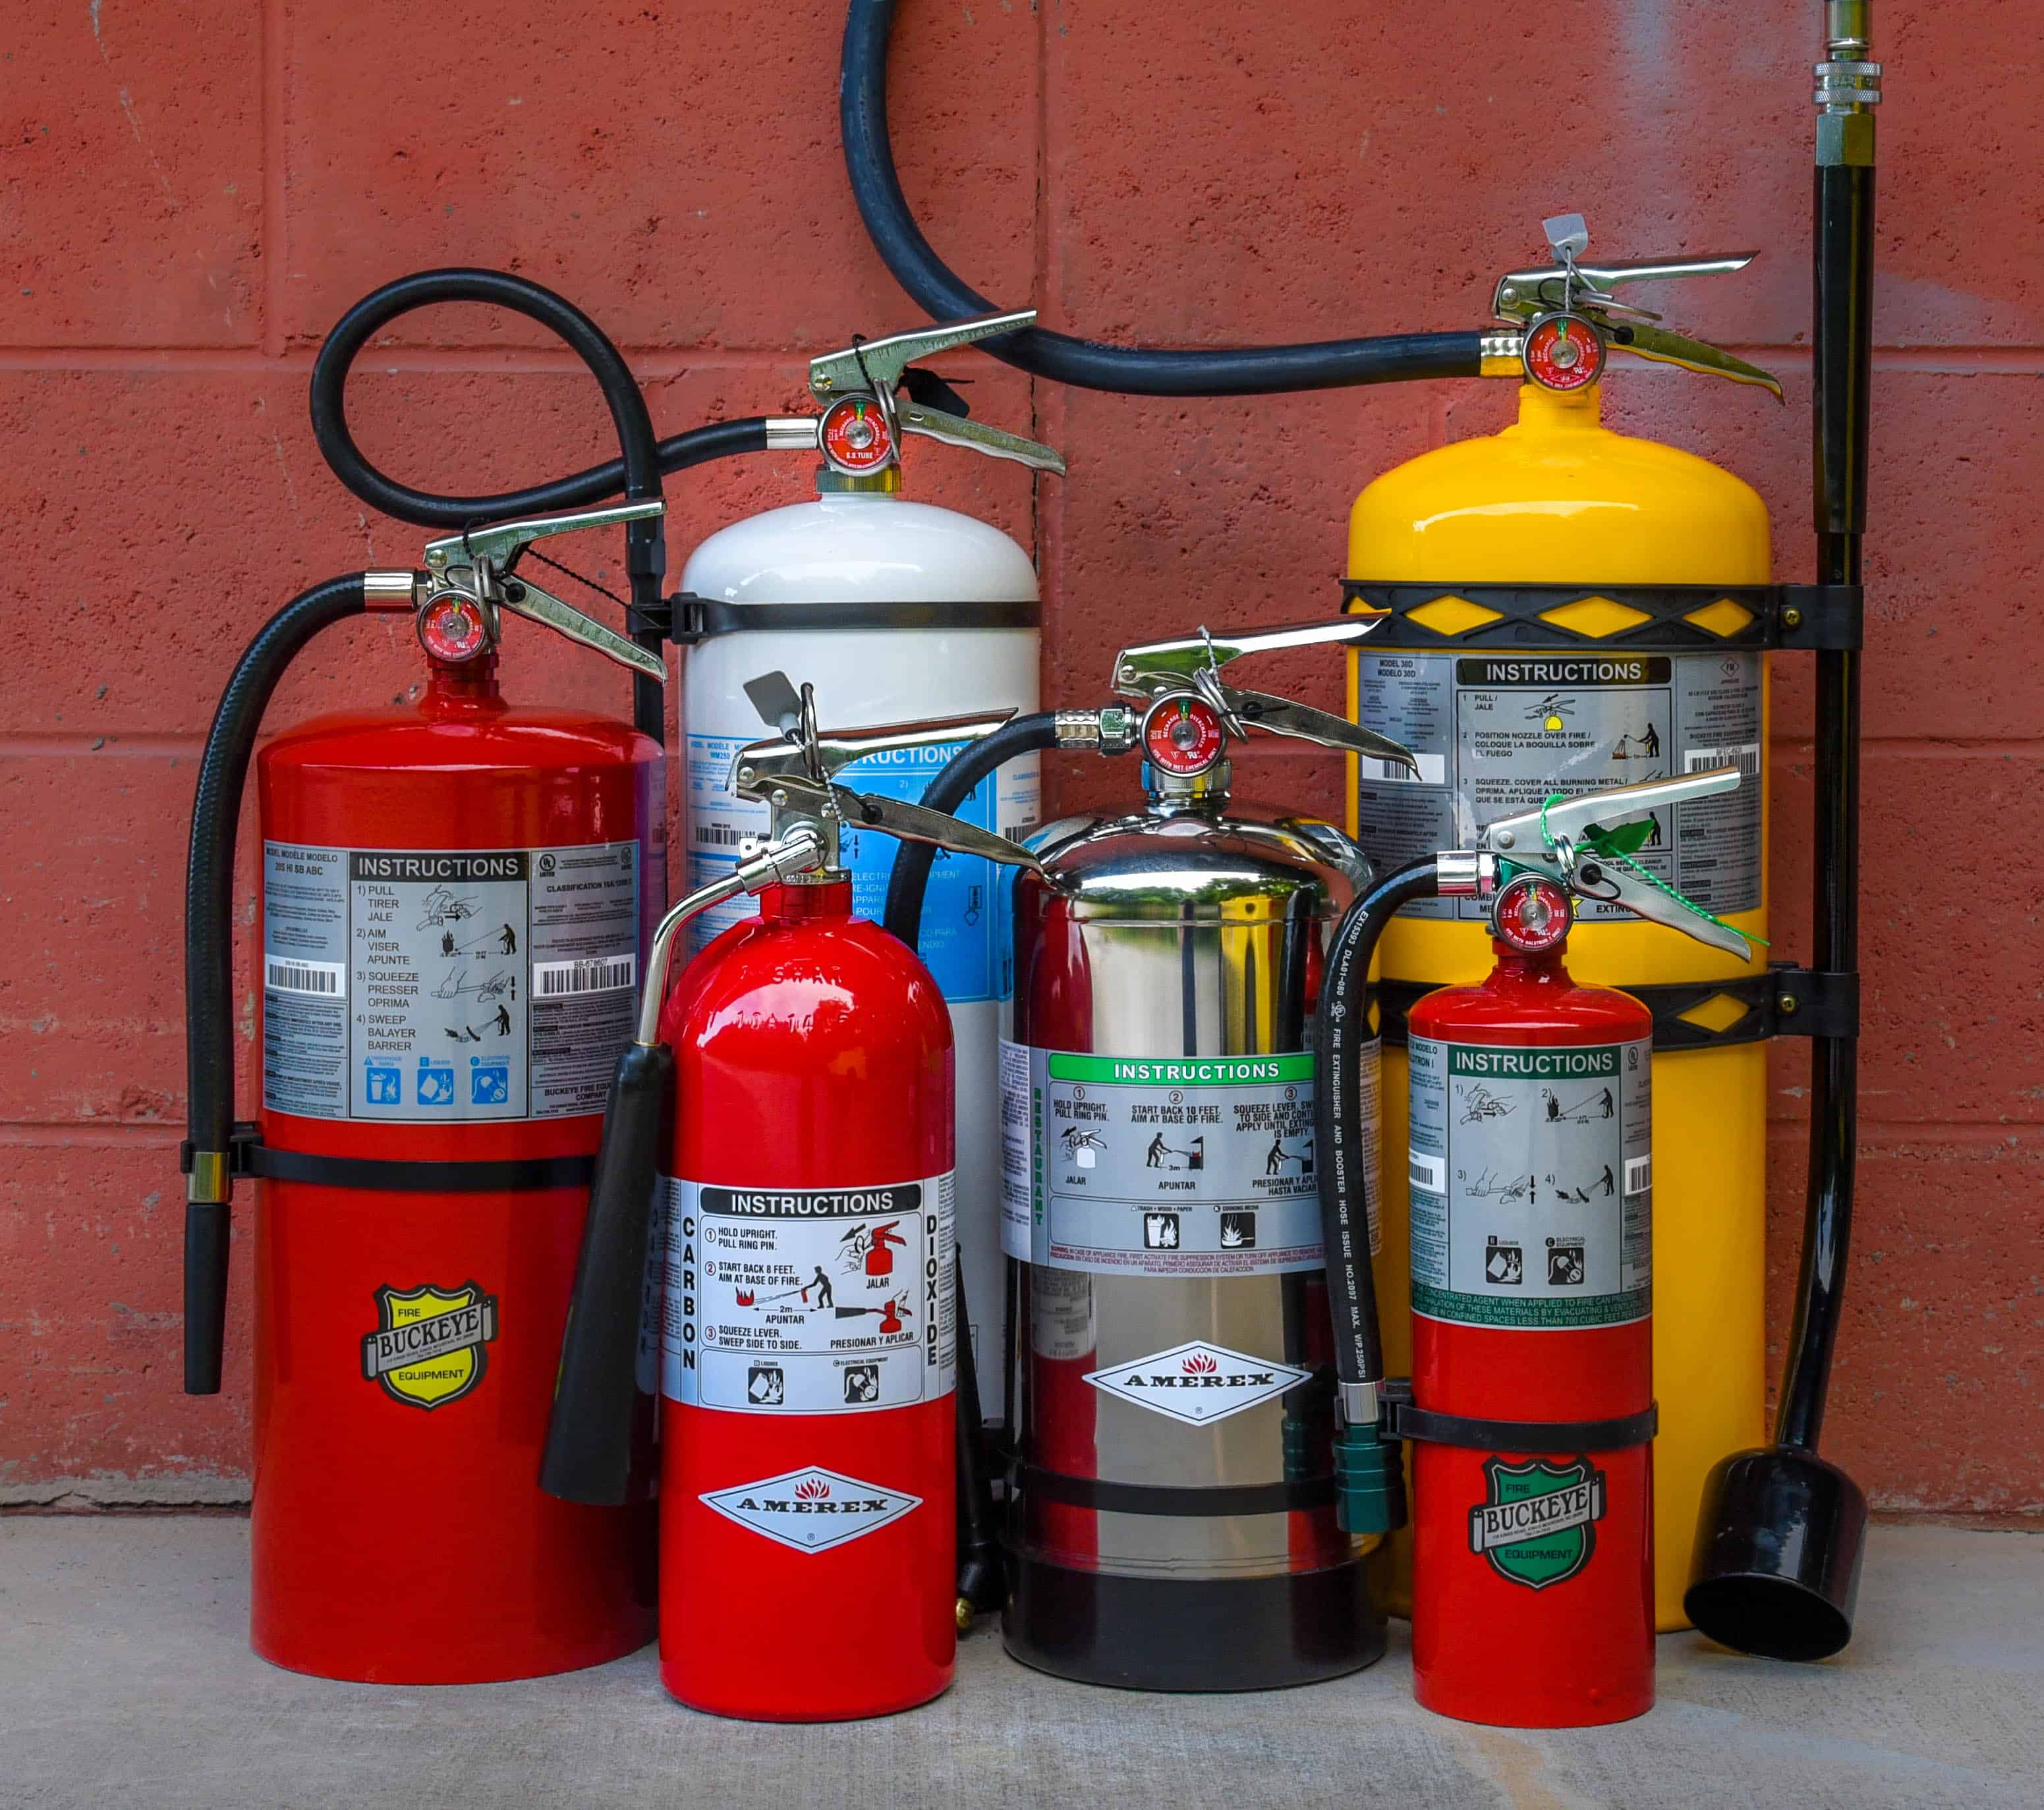
Knowledge Objectives
State the primary purposes of fire extinguishers
Define Class A fires
Define Class B fires
Define Class C fires
Define Class D fires
Define Class K fires
Explain the classification and rating system for fire extinguishers
Explain the labeling system for fire extinguishers
Select the proper class of fire extinguisher
Define the P.A.S.S method
Apply the P.A.S.S method
Notes:
2

Slide 3
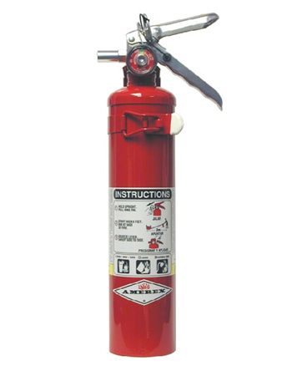
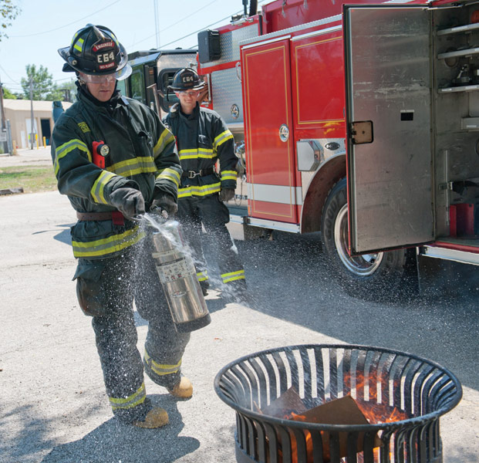
Purposes of Fire Extinguishers
Extinguish incipient fires
Control fires where traditional methods are not recommended
Available for immediate use on small, incipient fires
Notes:
3

Slide 4
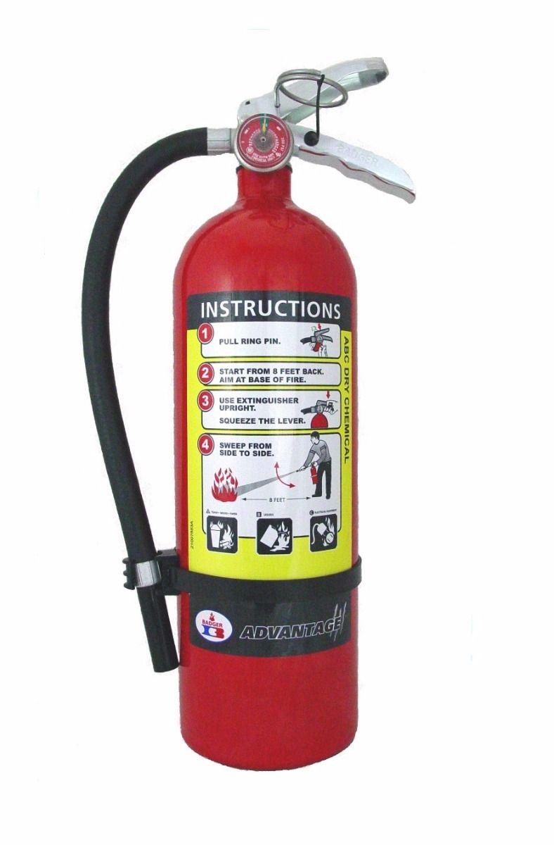
Extinguishing Incipient Stage Fires
One advantage of fire extinguishers is their portability.
The primary disadvantage of fire extinguishers is that they are “one-shot” devices.
If the device does not control the fire, some other device or method is needed.
Call 911 / FD regardless of successful extinguishment or not
Notes:
4

Slide 5
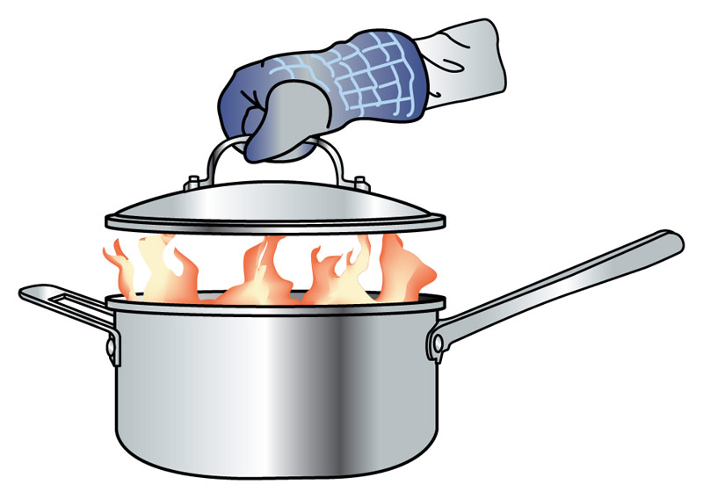
Methods of Fire Extinguishment
Extinguishers stop burning by:
Cooling the fuel
Cutting off the supply of oxygen
Interrupting the chain reactions
Notes:
5

Slide 6
Classes of Fires
Essential to match extinguisher and fire
Some agents are more efficient on certain fires.
Some agents will not control certain fires.
Some agents are dangerous when applied to certain fires.
Before selecting a fire extinguisher, ask yourself, “Which class of fire am I fighting?”
Notes:
6

Slide 7
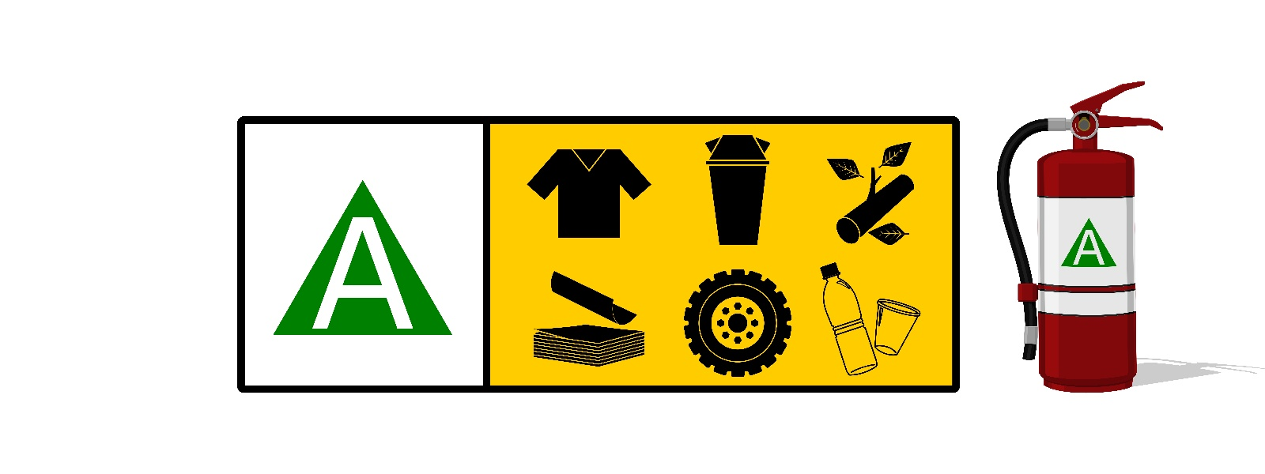
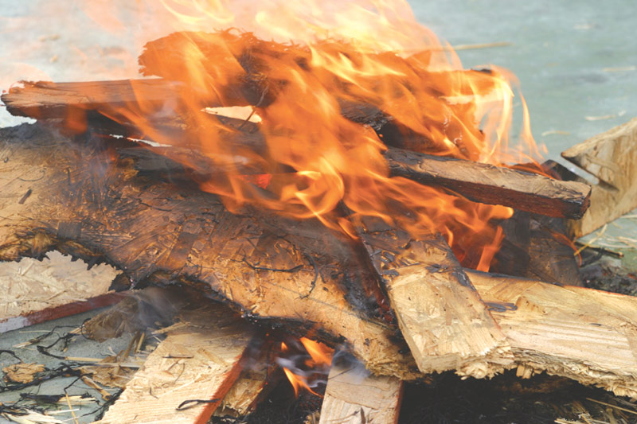
Class A Fires
Involve ordinary combustibles and natural vegetation
Water is the most common extinguishing agent.
Notes:
7

Slide 8
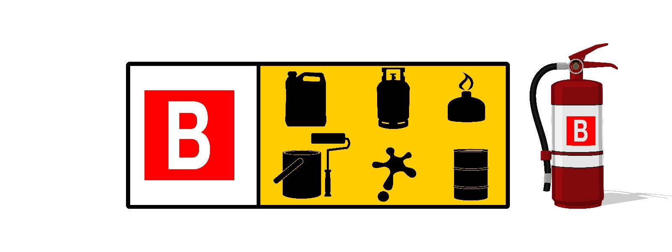
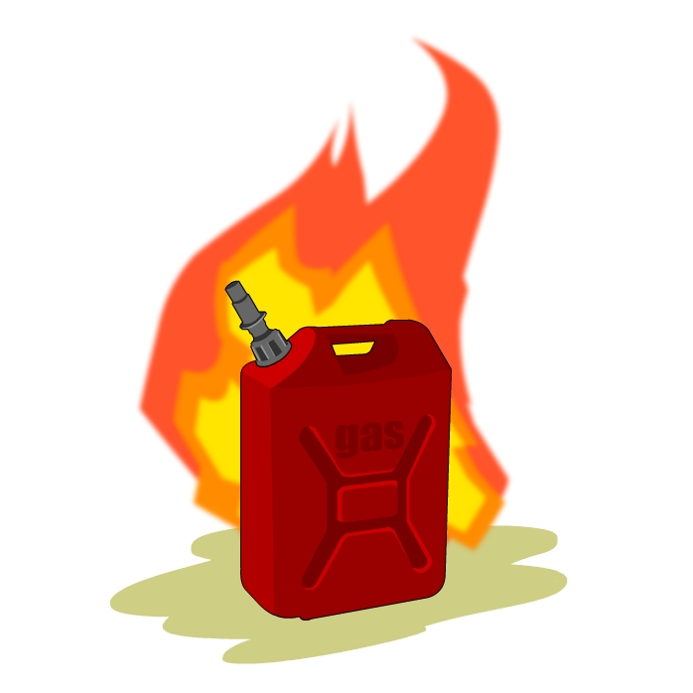
Class B Fires
Involve flammable or combustible liquids and flammable gases
Several different types of extinguishing agents are approved.
Notes:
8

Slide 9
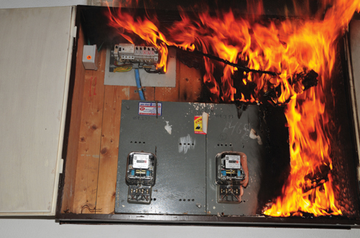
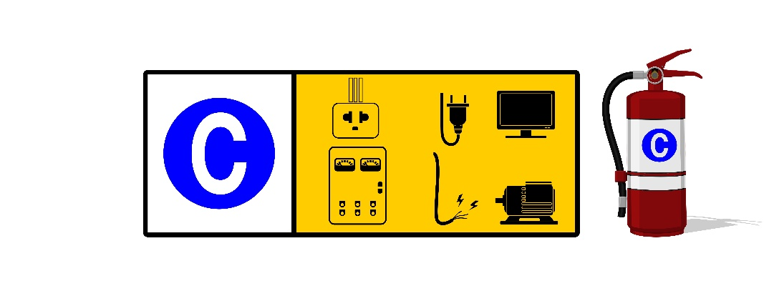
Class C Fires
Involve energized electrical equipment
Can generate tremendous heat that ignites nearby Class A or B materials
Agents that will not conduct electricity must be used.
Notes:
9

Slide 10
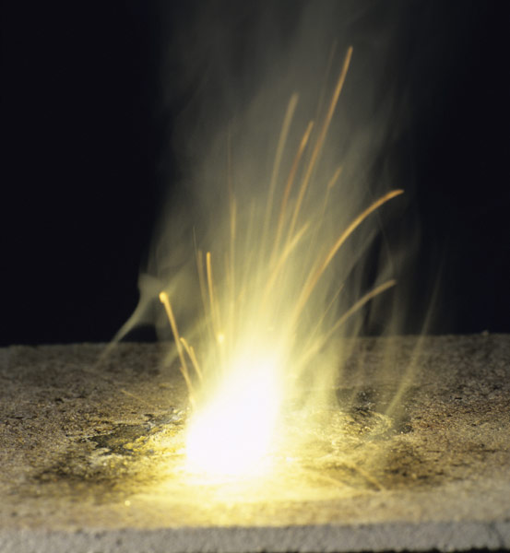
Class D Fires
Involve combustible metals
Special techniques and agents are required.
Normal agents can react violently.
Notes:
10

Slide 11
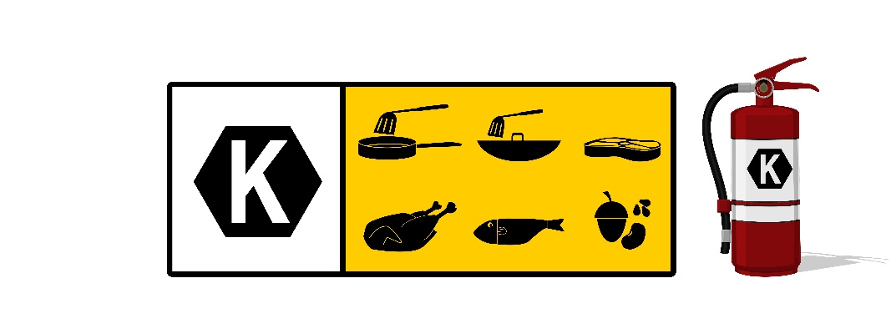
Class K Fires
Involve combustible cooking oils and fats
Required the development of a new class of agents
Notes:
11

Slide 12
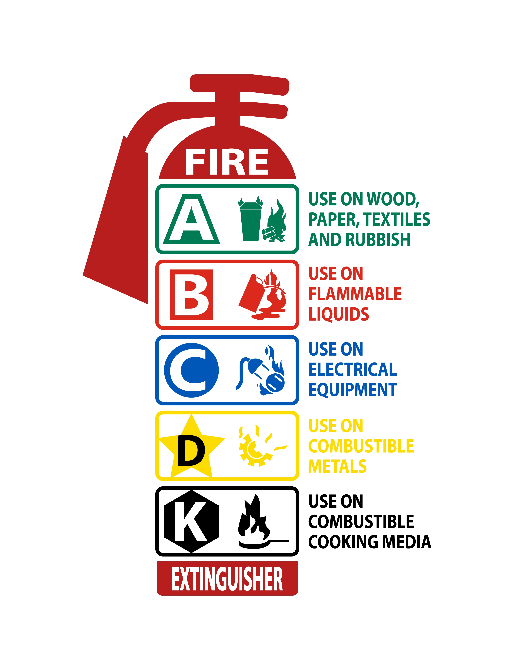
Classification of Fire Extinguishers
Standard test fires are used to rate the effectiveness of fire extinguishers.
Testing may involve different agents, amounts, application rates, and methods.
Fire extinguishers are rated for their ability to control a specific type of fire and prevent rekindling.
A rating is only given if the extinguisher completely extinguishes the standard test fire and prevents rekindling.
Notes:
12

Slide 13
Traditional Lettering System
Notes:
13

Slide 14
Universal Pictograph System
Notes:
14

Slide 15
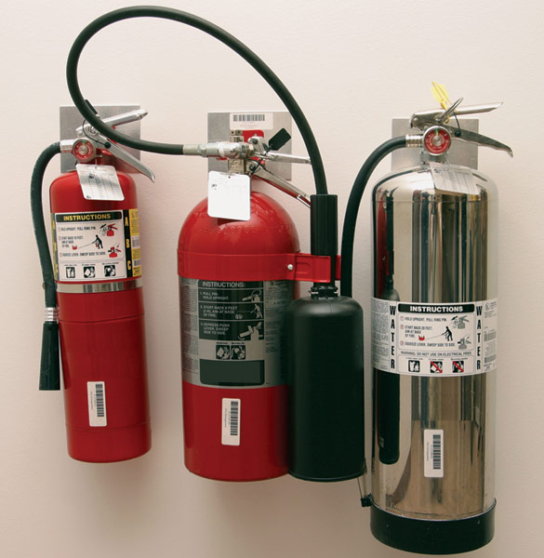
Fire Extinguisher Placement
Extinguishers should be mounted so they are readily visible and easily accessed.
Notes:
15

Slide 16
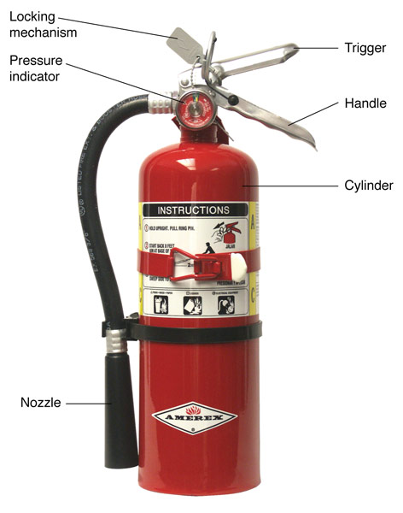
Portable Fire Extinguisher Components
6 basic parts:
Cylinder
Carrying handle
Nozzle or horn
Trigger
Locking mechanism
Pressure indicator
Notes:
16

Slide 17
Stored-Pressure Water-Type Fire Extinguishers
2.5 gal (9.5 L) 2-A rating
Used on incipient Class A fires
Solid stream, range 35-40 feet (9-12 m), through a nozzle on a short hose
Discharges for 55 seconds
Contents can freeze
Notes:
17

Slide 18
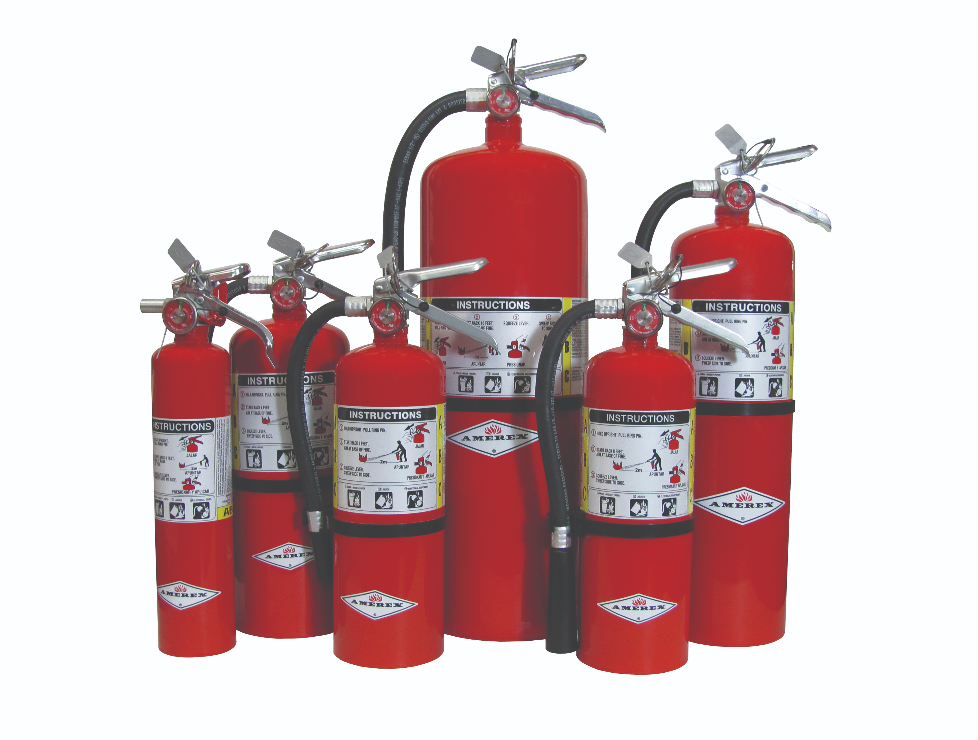
Dry Chemical Extinguishers
Deliver a stream of very finely ground particles onto a fire.
Varying capabilities and characteristics
First, the finer particles of the chemical vaporize when they reach the flame and release a vapor that interrupts flame chemistry.
Particles shield the fuel surface from the flame radiation, thereby reducing the rate at which the burning fuel is being pyrolysised or vaporized.
It can smother the fire by forming an insulating blanket.
Notes:
18

Slide 19
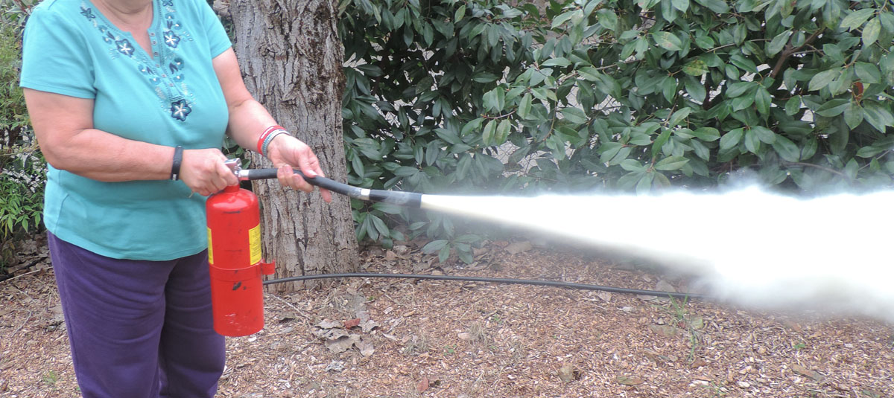
Dry Chemical Extinguishers
Ammonium phosphate
Rated for Class A, B, and C fires
They are effective on Class B (flammable liquids and gases) fires.
They can be used on Class C (energized electrical equipment) fires because the chemicals are nonconductive.
They are not subject to freezing.
Notes:
19

Slide 20
Dry Chemical Extinguishers: Disadvantages
The chemicals, particularly the multipurpose dry chemicals, are corrosive and can damage electronic equipment.
The fine particles are carried by the air and settle like a fine dust inside the equipment.
During a period of months, the residue can corrode metal parts, causing damage.
Chemicals may make breathing more difficult when discharged in an enclosed environment.
Notes:
20

Slide 21
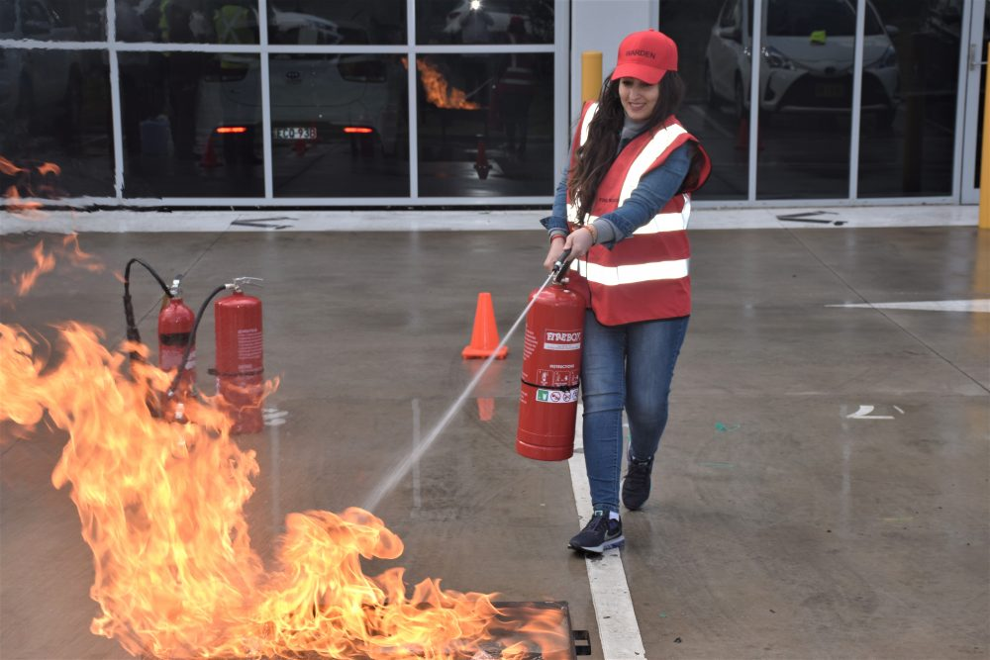
Ensure Your Personal Safety
Approach fire with an exit behind you.
Have a planned escape route.
Never let fire get between you and exit.
Never turn your back on the fire.
Watch fire for rekindle.
Keep the wind at your back.
Notes:
21

Slide 22
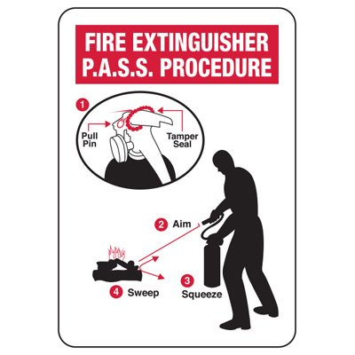
Basic Steps of Fire Extinguisher Operation
PASS acronym:
Pull the safety pin.
Aim the nozzle at the base of the flames.
Squeeze the trigger to discharge agent.
Sweep the nozzle across the base of the flames.
Notes:
22

Slide 29
Let’s go practice!

