Slide 1
Disabilities do not discriminate!
Everyone is confronted with stigma, stereotypes, labels
People with disabilities are not excluded…
WE ALL HAVE STRENGTHS
WE ALL HAVE WEAKNESSES
WE ALL HAVE BLIND SPOTS

Slide 2
Understanding Care Compassion Self-Advocacy Inclusion Awareness
Disabilities are another aspect of human diversity.
.. but does NOT DEFINE WHO YOU ARE!
Recognize your disabilities. Recognize your abilities.
Celebrate your accomplishments!

Slide 3
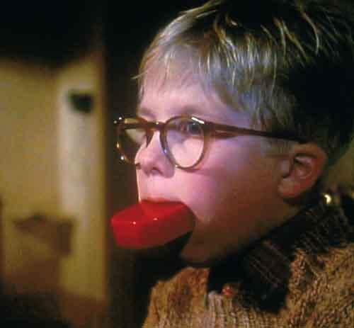
Words Matter
Assembly Concurrent Resolution No. 60 [ Filed with Secretary of State July 21, 2015. ]ACR 60, Santiago. Education: students with disabilities. This measure would recognize the necessity of a more respectful and humanistic view of students with disabilities, and would affirm that state policies and procedures should use People First Language to the greatest extent possible.
Disabled Student Programs and Services (DSPS) (Education Code, Section 84850 and Title 5, California Code of Regulations (5 CCR) Sections 56000-56076) were enacted in 1976 through the passage of Assembly Bill 77 (Lanterman), which funds support services and instructional programs for students with disabilities in the California Community Colleges.
Should “Disability” or “Disabled” be considered “bad words”?
If so, then what?

Slide 4
New Name Ideas???
Given the Assembly Concurrent Resolution No. 60 (2015)…
(People First Language → i.e. “Students With Disabilities”)
And
Understanding the law as written in 1976 →
“Disabled Student Programs and Services” -DSPS

Slide 5
Open For Suggestions!
“Disabled Student Programs and Services” -DSPS
e.g. PSSSWD (pronounced “password”☺)
Programs and Services to Support Students With Disabilities
e.g. Ohlone –SAS (Student Accessibility Services)
Chabot – ACE (Accessibility Center for Education)

Slide 6
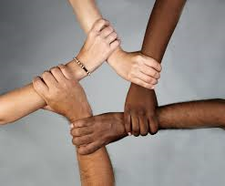
LPC – Where everyone who comes here,
belongs here!!
We The People!
Be the change that you want to see in the world..

