Slide 1

HyFlex @ LPC
Flex Day, March 8, 2022

Slide 2
Agenda
HyFlex overview & training (so far)
Faculty experience (so far)
Classroom technology (so far)
Questions

Slide 3
LPC’s Definition of HyFlex
A HyFlex (Hybrid Flexible) course allows students the choice of attending class on campus or online. Online modalities may include synchronous online, and/or asynchronous online instruction.
  Definition by LPC Distance Education Committee, January 28, 2022

Slide 4
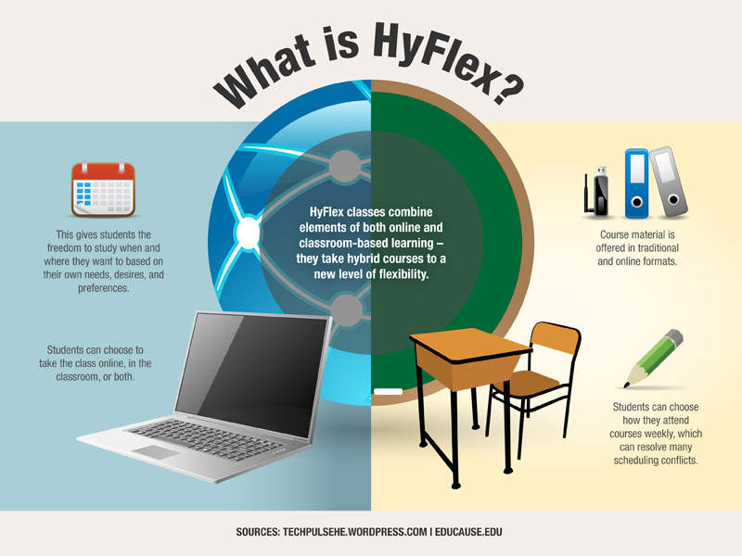

Slide 5
Instructor Choices
LPC instructors have three choices to teach in these modalities:
  Face-to-face (f2f) and synchronous online using ConferZoom
  Face-to-face (f2f) and asynchronous online
  Face-to-face (f2f) and synchronous online AND asynchronous online
Students should be able to choose modalities on a session-by-session basis.
Students need to know the modalities prior to registering for classes.

Slide 6
Key Points
Possibility of increased workload
  Draw upon your experience; reuse content
  If trained to teach asynchronously online, you have a head start
No matter your content & activities with students in different modalities, all students should be able to achieve the SLOs of the course
Aim for interaction among all students
More flexibility might equal higher enrollments

Slide 7
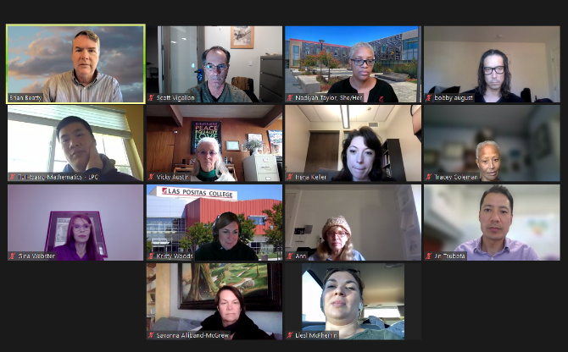

LPC HyFlex Training
20 faculty last fall
Spring 2022 training
  Delivered in 3 modalities
  Will cover HyFlex design, engagement, implementation, and classroom technology
Summer 2022 training
Dates, compensation, template

