Slide 1
Using Pronto, RAW, Smart Shops to Increase Student Success
Michelle Gonzales
Las Positas College

Slide 2

Our most at risk students, students who enter with GPAs 2.5 or below demonstrates higher rates of success in their English classes than any other group when they use the RAW Center.

Slide 3
Adult students have HS reading and writing training
May lack student skills, schema for college reading and writing
May simply need coaching, guidance, refreshers
Experienced English and ESL instructor can diagnose reading and writing issues quickly
Offer further training, practice, reminders, handouts, proofreading, support
Experienced English and ESL instructors

Slide 4
Open 7 days a week via Canvas LPC Tutoring/RAW
22 hours per week
Drop-in on campus/6 hours
Drop-in online 16 hours
Paper drop-off service
RAW resources site

Slide 5
Smart Shop Workshop Series
Campus IR data correlates increased student success and workshop attendance.
Have an idea for a workshop?
Attend coordinator meeting, create workshops and set dates
The workshop series will put your workshop on the calendar and do the marketing

Slide 6


Slide 7
Teacher-to-Student Contact
Post reminders about upcoming office hours
Post Zoom links to office hours at the start of those hours
Send quick messages to tell students to check email for info sent via email
DM individual students as needed

Slide 8
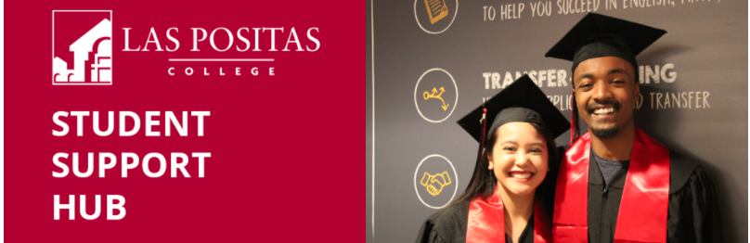
Post Smart Shop Weeklies
Post reminders to use the RAW Center
Send links to other oft-needed campus resources:
computer center, the library, the student resource guide, mental health services

Slide 9
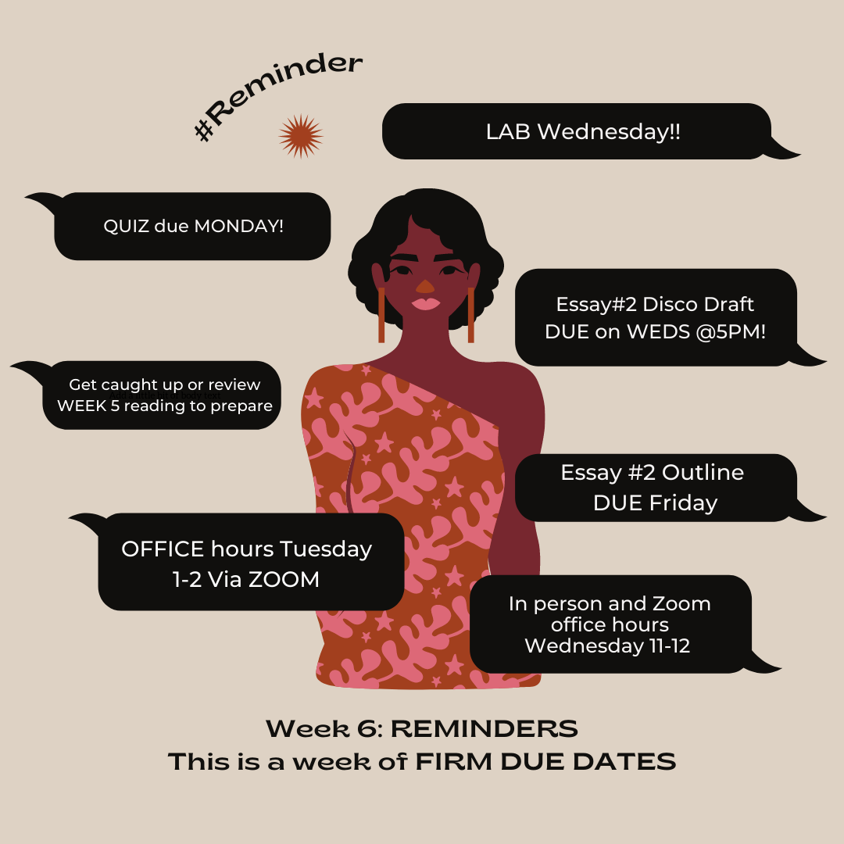
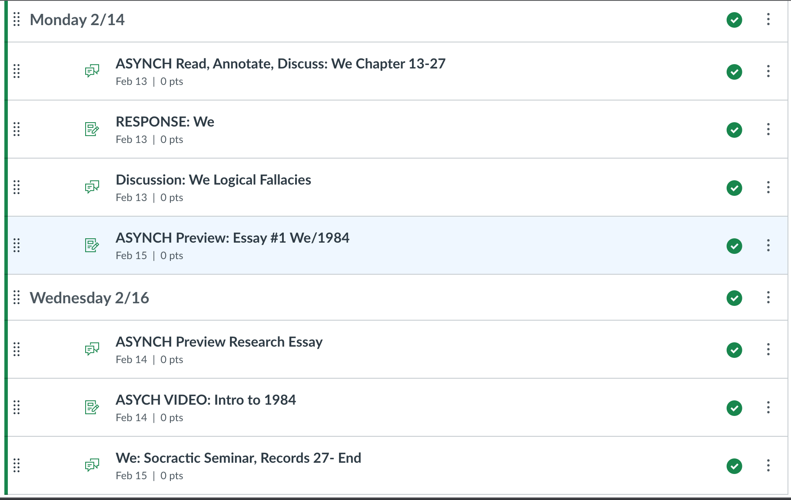
Create and post infographic of weekly module assignments

Slide 10

Curriculum Extension
Send links to relevant articles re. related current events, research, etc
Related images and videos
Group work materials
Send reminders, links, flyers regarding related campus events

Slide 11
Student-to-Teacher Contact
Students can quickly message class/teacher when there are issues with
assignments or google docs permissions
quizzes
when a link is broken
when they have quick questions
Students can DM instructors when in crisis

Slide 12
Emergency Contact
Send info via Pronto when Canvas or other learning interfaces go down
Send info about due date extensions when above happens (minimize stress)
Resend Zoom links
Contact students when you need to be absent or are running late

Slide 13
Contact students when they are MIA and/or before dropping them from the course
Contact students regarding due date extensions during
1) power outages 💡
2) fire season evacuations (don’t assume bc where you live
is fine that your students aren’t facing evacuations) 📛
3) campus emergencies 🔫
4) global pandemics 🦠

Slide 14
Student-to-Student Communication
Encourage students to use Pronto to contact one another
to contact one another to discuss assignment instructions
to contact peers in need of support or encouragement
to share links, documents, etc
to form study groups
to organize group assignments

Slide 15
Creating Groups in Pronto
Aside from the synced groups in Pronto that are created when attached to a course, teachers and students can also manually create groups in Pronto when needed.
Some examples could include:
  Study groups
  Group projects
  Special topics/themes
  Student government/clubs
Use group creation to further network and engage!

