Slide 1




01
Create, Organize & Let it Go!
Facilitated by: Aubrie Ross
FLEX DAY
Date: March 16, 2023

Slide 2



02
Mind Clearing Activity

Slide 3


03
MIND CLEARNING ACTIVITY
TAKE A BLANK PIECE OF PAPER
WHEN YOU ARE DONE.......
  Make a list of current worries & thoughts.
  Ball it up/tear it up - GET RID OF IT!

Slide 4


04
LET'S GET STARTED

Slide 5

05
WHY ARE YOU HERE?
  You're probably here because you have a lot on your mind, and you need help sorting it out.
  You might be stressed, anxious, depressed, or overwhelmed with what's going on in you life.
  You're a creative individual who love's learning new ideas to enhance your creativity.

Slide 6


06
WHAT CAN YOU DO?
DOING A BRAIN DUMP CAN HELP YOU WITH ALL OF THAT!
WHAT EXACTLY IS A BRAIN DUMP AND HOW DO YOU DO ONE?

Slide 7

07
WHAT IS IT?
An exercise to help get your thoughts & feelings out so that you can make sense of them.
Something weighing you down?
A brain dump can be an effective way to organize them & let it go!

Slide 8



08
WHY & HOW IT WORKS
Writing down all of your thoughts & feelings may seem a bit silly at first
You may even think
What is writing down my thoughts going to do?

Slide 9

09
LET'S ANSWER THAT
A group of researcher found that "offloading your worries into free-form writing frees up mental resources so that you are able to complete tasks more easily."
It literally changes the way that your brain works!
Fascinating right?!
BUT WHAT DOES IT MEAN IN LAYMAN'S TERMS?

Slide 10


10
A brain dump works because it makes your thought & feelings real.
When something feels real and tangible, it allows you to find solutions and connections that you might not have seen before.

Slide 11

11
Writing down your thoughts (especially your worries) assist in becoming:
  More focused
  Less worried
  More productive

Slide 12

12
WHEN SHOULD YOU DO A BRAIN DUMP?
Anytime, whenever you are feeling stressed, overwhelmed or just need to get something out into the universe.

Slide 13
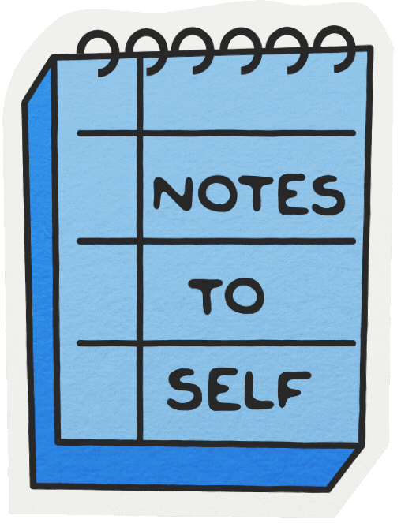
13
THERE MAY BE TIMES WHERE A BRAIN DUMP IS, ESPECIALLY BENEFICIAL. FOR EXAMPLE:
  When you're trying to make a big decision
  When you have competing thoughts
  At night when you have a lot on your mind
  In the morning - help structure & organize your day
  On a weekly basis - clear out last week & organize your thoughts for the week ahead

Slide 14

14
HOW TO DO A BRAIN DUMP
Two different styles to do a brain dump:
  Stream of consciousness - List style
  Mind mapping - organized by category

Slide 15

15
STREAM OF CONSCIOUSNESS LIST-STYLE
In a stream of consciousness style, you write whatever comes to mind.
Your start by creating a list of everything that's on your mind.
  I really need to think about what to cook for dinner.
  I can't believe my boss blamed me for a mistake.
  My kid is sick and I have no sick time left, what do I do?
  My co-worker is really annoying.
  I totally forgot to pay the electric bill.

Slide 16
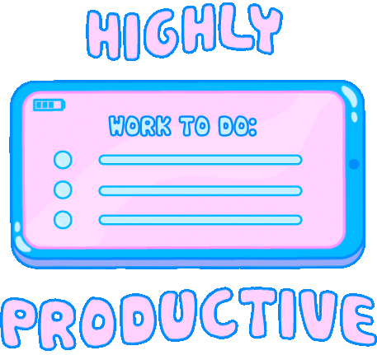
16
MIND MAPPING - CATEGORY STYLE
  This type of brain dump is more organized.
  Instead of writing down you thoughts as they come to you, you categorize your thoughts based on their relationships with each other

Slide 17

MIND MAPPING CAN GET SUPER INTRICATE.
Think of it as a tree with branches, twigs, and leaves all coming out at different points.
Some categories to try are:
  Family
  Procrastinations
  Incomplete goals
  Household tasks
  Money/Finances
  Relationships
  Unresolved feelings (anger, sorrow, etc...)
17

Slide 18

18
ORGANIZING YOUR BRAIN DUMP
Do you have to organize your brain dump?
Different ways to get organized:
  Rewrite your thoughts in an organized manner
  Color coding
Experiment to see what works for you!

Slide 19

19
ORGANIZING YOUR BRAIN DUMP WITH LISTS
Rewriting your brain dump into organized list helps you visualize areas of your life and how to find solutions.

Slide 20

20
TYPES OF LISTS
  To-do lists
    Based on urgency: RIGHT NOW, SOON, or LATER
  Things to plan
    Bigger tasks and goals that you'll want to break down into smaller chunks before tackling them
  Things to delegate
    Things you can ask someone else to do
  Things to eliminate
    Is there anything that you're ready to release?

Slide 21

21
COLOR-CODING
If you are a visual person, color-coding may be helpful.
Color- coding suggestions:
  Green = MONEY
  Red = ROMANTIC RELATIONSHIPS
  Yellow = PROFESSIONAL or EDUCATIONAL
  Purple = CREATIVE IDEAS
  Gold = GOAL SETTING
You can use markers, pens, highlighters and event stickers for
color-coding!

Slide 22

22
WHY SHOULD I START DOING THIS?!
The truth is, if we want to avoid burnout, we each have to find time to step back; cultivate our curiosities, interests, and passions; and remember who we are apart from our jobs and our family roles. No matter what is affecting your life, creative self-expression like these examples are essential to your physical and mental well-being. In fact, it has been found to be a form of “transformative coping” that allows individuals to deal with transitions and stressful events.

Slide 23

23
BRAIN DUMP TIPS
So now that you understand what a brain dump is, when to do it, and how to do it.
Here are some tips for brain dumping:
  Set a routine
  Set a reminder -
    try to do a brain dump at least once a week
  Set a time limit
    so you don't get lost in your thoughts.

Slide 24


24
BRAIN DUMP TIPS
  Walk away from your brain dump
    Instead of feeling like you have to do it all at once, know that you can always come back later
  Use sticky notes
    Instead of having to reorganize or rewrite your thoughts, you simply move to a sticky note

Slide 25
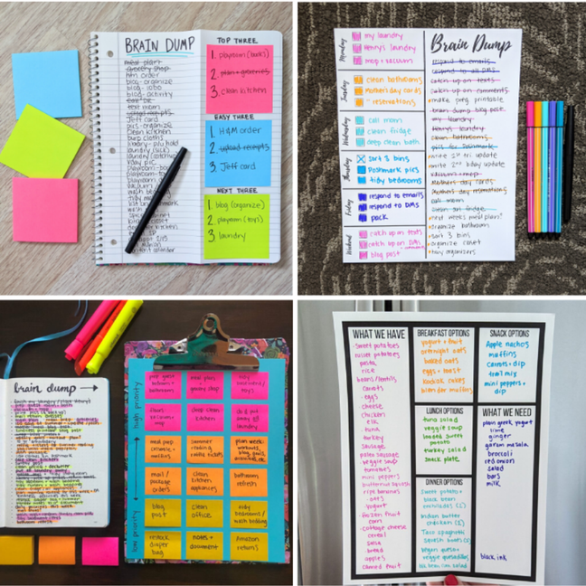

25
SAMPLE LAYOUTS

Slide 26

26
ONLINE TEMPLATES
  You can find a variety of online templates to help you get started:
    Lemons & Lattes
    The Savvy Sparrow
    Teachers Pay Teachers
    Healthy Happy Impactful
  Subscription Boxes
    Journal Junk Box

Slide 27

27
QUESTIONS?

Slide 28

28

Slide 29


